Slide 1
Cancer Central Clinical Participant Registry (C3PR) v2.8
Silver Level Compatibility Review
Kickoff
January 28, 2010
Pankaj Agarwal1 - Project Manager
Wes Wiggins2 - Business Analyst
Kruttik Aggarwal2 - Technical Lead
1Duke Comprehensive Cancer Center
bob.annechiarico@duke.edu
2SemanticBits, LLC
patrick.mcconnell@semanticbits.com

Slide 2
Agenda
Overview (10 min)
C3PR Architecture Issues (10 min)
C3PR VCDE Issues (10 min)
Q/A (20 min)
Review Plan and Timelines (10 min)

Slide 3
Who is involved in C3PR?
Duke Bioinformatics
  Jamie Cuticchia (PI)
Duke Information Systems
  Bob Annechiarico (co-PI)
  Pankaj Agarwal (PM)
  William Banks (domain expert)
  Arati Nemani (DBA, tester)
  Jeff Allred (IT manager)
Duke Clinical Trials
  Vijaya Chadaram (domain expert)
CALGB
  Kim Johnson (domain expert)
  Bill Martin (domain expert)
Westat
  Steve Riordan (domain expert)
Georgetown
  Jieping Li (domain expert)
North Carolina State
  Patty Spears (patient advocate)
Wake Forest
  Bob Morrell (domain expert)
  Don Babcock (Technical Expert)
  Lisa Dixon (SME)
  Claire Kimbrough (SME)
Mayo
  Sharon Elcombe (domain expert)
SemanticBits
  Patrick McConnell (architect)
  Ram Chilukuri (architect)
  Wes Wiggis (business analyst)
  Kruttik Aggarwal (lead developer)
  Ramakrishna Gundala (developer)
  Vinay Gangoli (developer)
  Kartikh Iyer (QA tester)
  David Coffey (UI designer)
  Himanshu Gupta (developer)
NCI
  Christo Andonyadis
  John Speakman
SAIC
  Nancy Roche
  Peter Yan

Slide 4
Timeline Perspective
C3PR Release 2
  Developed by Duke Comprehensive Cancer Center
  Extends the Release 1 functionality
  Project began in November 2006, slated for 14+2 months
C3PR v1
Released
C3PR v2
Construction
Start
C3PR v3
Start
C3PR v2.1
Release
C3PR v2.8
Release
Mar
Mar
Sep
Dec
2004
2005
2006
2007
2008
2009
Nov
Jan
May
C3PR v1
Testing
Start
C3PR v2
Start
C3PR v2
Transition
Start
C3PR v3
Construction
Start

Slide 5
Overview
Where does a participant registry fit in?
Cancer Central Clinical
Participant Registry (C3PR v2.8)
Patient Study Calendar (PSC)
Eligibility is verified
and patient is registered
to a study
Tracks the patient
throughout the study
Clinical Trial Data
Management Systems (C3D)
Cancer Adverse Event
Reporting System (caAERS)
Patient visits the
Physician
Lab Viewer
Clinical data is captured
Identifies adverse events
and any associated
schedule changes
Identifies labs, loads
them into the CDMS
and AE system

Slide 6
Overview
What does a participant registry do?
Tracks subject registrations to clinical trials
  Screening, registration, re-randomization, protocol amendments,
  re-consent, companion studies etc.
Ensures that all registration criteria are met
  Trial is still open to accrual
  Consent has been obtained
  Eligibility criteria are met
Stratifies the subject into a stratum group
Randomizes the subject to the trial
Registers the subject on the trial
Handles reporting
  Meets federal regulatory reporting
  Supports local reporting needs

Slide 7
Overview
Project goals
Integrate with other clinical system
  Cancer Clinical Database (C3D)
  Patient Study Calendar (PSC)
  Cancer Adverse Events Reporting System (caAERS)
  Clinical Trials Object Model (CTOM)
  caXchange
  LabViewer
  NCI Enterprise Services (COPPA)
Provide support for multi-site studies
  C3PR-to-C3PR integration
Extend registration, including storing randomization information
  Phone call and internal book lookup
Enhance protocol management, including web-based management
Improve the user interface from the perspective of the registrar
Augment reporting to meet regulatory needs

Slide 8
Overview
Use cases and features
Manage Subjects
  Create Subject
  Search for a Subject
  View a Subject
  Update Subject Details
Manage Study
  High Level Study Diagram
  Data Capture Diagram
  Create Study Definition Manually
  Search for Studies
  View Study
  Update Study
  Associate Study Personnel Study
  Add Notifications to Study
  Add Stratification
  Disable a Stratum Group
  Add Eligibility Criteria
  Add Diseases
  Change Status from Pending to Open
  Change Status from Amendment Pending to Open
  Update Study Definition
  Update Study Protocol Version
  Multiple Consents
Manage Registration
  Register a New Subject
  Register Subject to Multi-site Study
  Enroll Subject to a Study Site
  Transfer Epoch to Study Site of Multi-site Study
  Assign Subject to New Epoch in Study Site
  Register Existing Subject to a Study
  Assign Kit Number for Blinded Study
  Save a Registration in Incomplete Status
  Register Subject to Reservation Study
  Search for Registrations
  View Subject Registration History
  Update Eligibility Status for Registration
  Randomize Subject
  Take Subject Off Study
  Register subject on study version
  Support for ICD-9 disease sites
Reporting
  Advanced Registration Search
  Study Search and Export
  Summary 3 Reporting

Slide 9
Overview
Use cases and features
Administration
  Create Investigator
  Add Investigator Group
  Add Investigator To A Group
  Create Research Staff
  Create Organization
  Associate Investigator to Study Organization
  Associate Investigator Group to Study Organization
  Search for a Study Personnel
  View and Update Research Staff Details
  Search for an Investigator
  List Investigators In A Group
  View or Update Investigator Details
  Disassociate Study Person from Study Site
  Change the Study Site Investigator status
  Export Study Definition to a File
  Export Registration Definition to a File
  Import Study Definition from a File
  Get Study Definition via Study Message from External Source
Security
  Role-based
  Scoped (study versus system)
  CSM for local security
  Grid-based security
caBIG Principles
  Open access (APIs and DB)
  Open source
  Federated development
User interface
  Intuitive look-and-feel
  Google-like search boxes
  Support for multiple workflows
  Show summary information when possible
  Dynamic interface controls
Integration
  C3D, PSC, caAERS, LabViewer

Slide 10
Overview
Architecture
User Interface
Database
IndexService
Java APIs
Business Logic
Grid Services
GME
caGrid Security Components
Enterprise
Service Bus
(ESB)
SSO
Webapp
Authentication
Service
Dorian
GTS
Delegation
Service
CSM

Slide 11
Model
Overview
Diseases
Study
Personnel
Site
Subject
Study
Registration

Slide 12
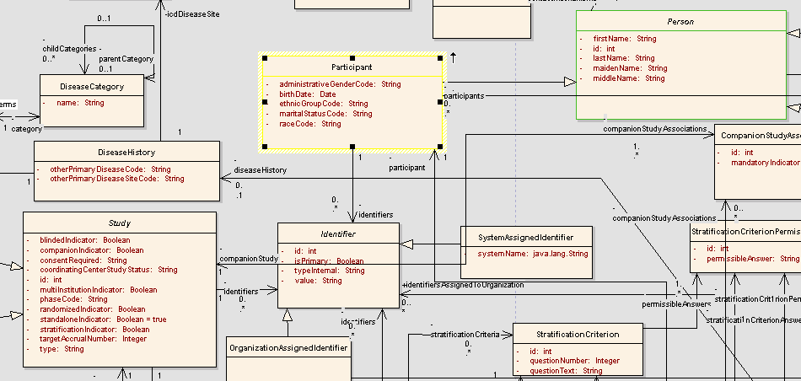
Model
Subject

Slide 13
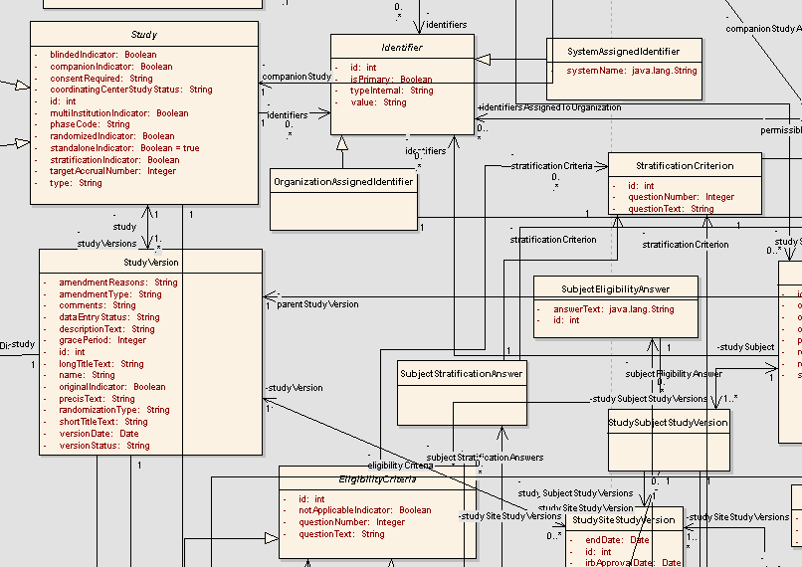
Model
Study: details, eligibility, stratification

Slide 14
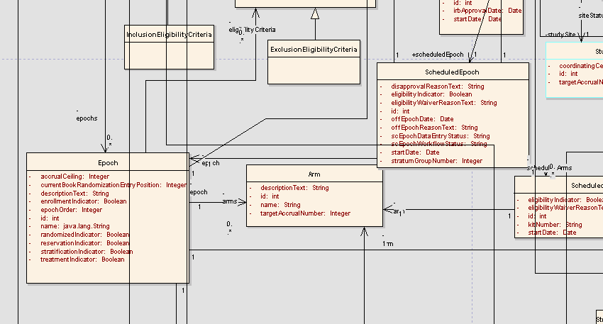
Model
Study: structure (epochs and arms)

Slide 15
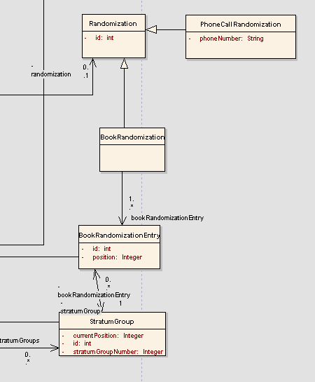
Model
Study: randomization

Slide 16
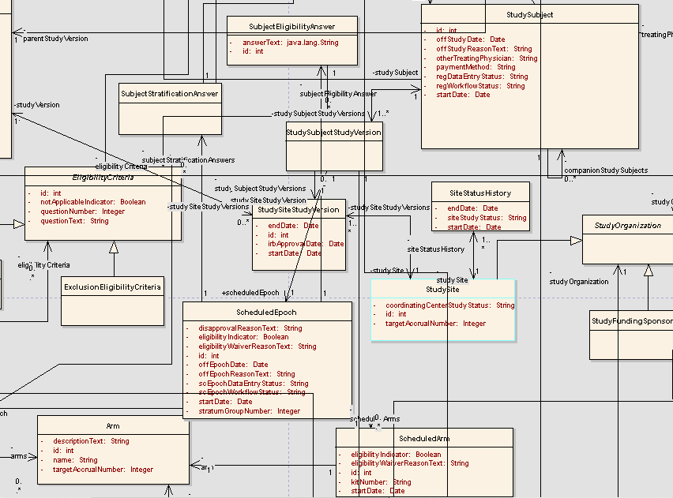
Model
Registration: general approach

Slide 17
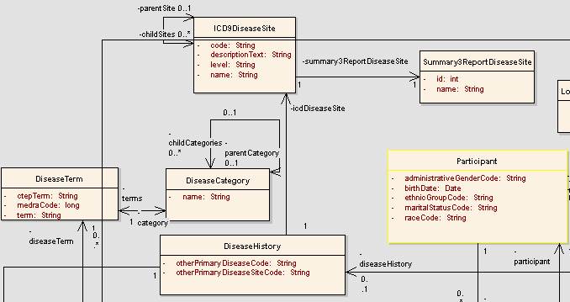
Model
Disease

Slide 18
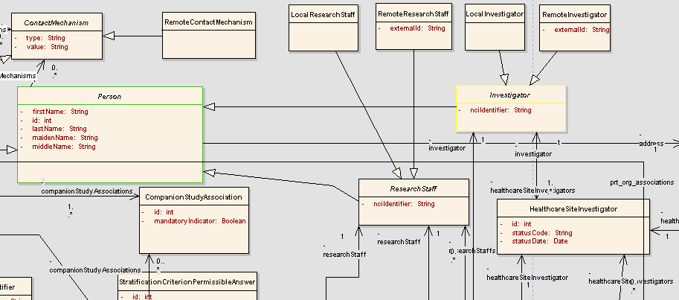
Model
Study Personnel

Slide 19
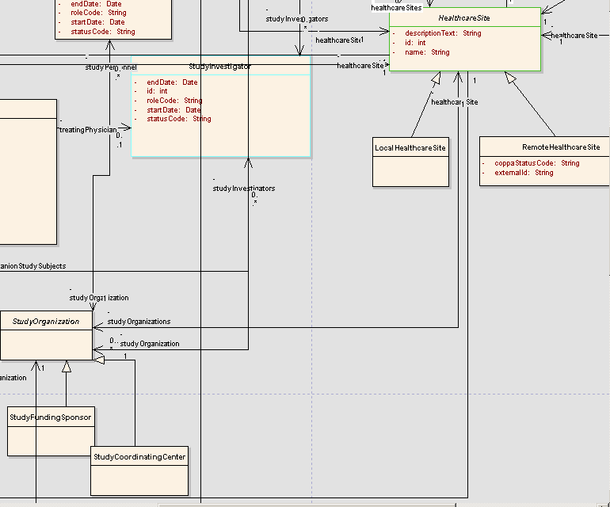
Model
Organization

Slide 20
Model
Standards
No vocabulary standards
CDE standards: C3PR v2.8 model has been loaded in caDSR production server

Slide 21
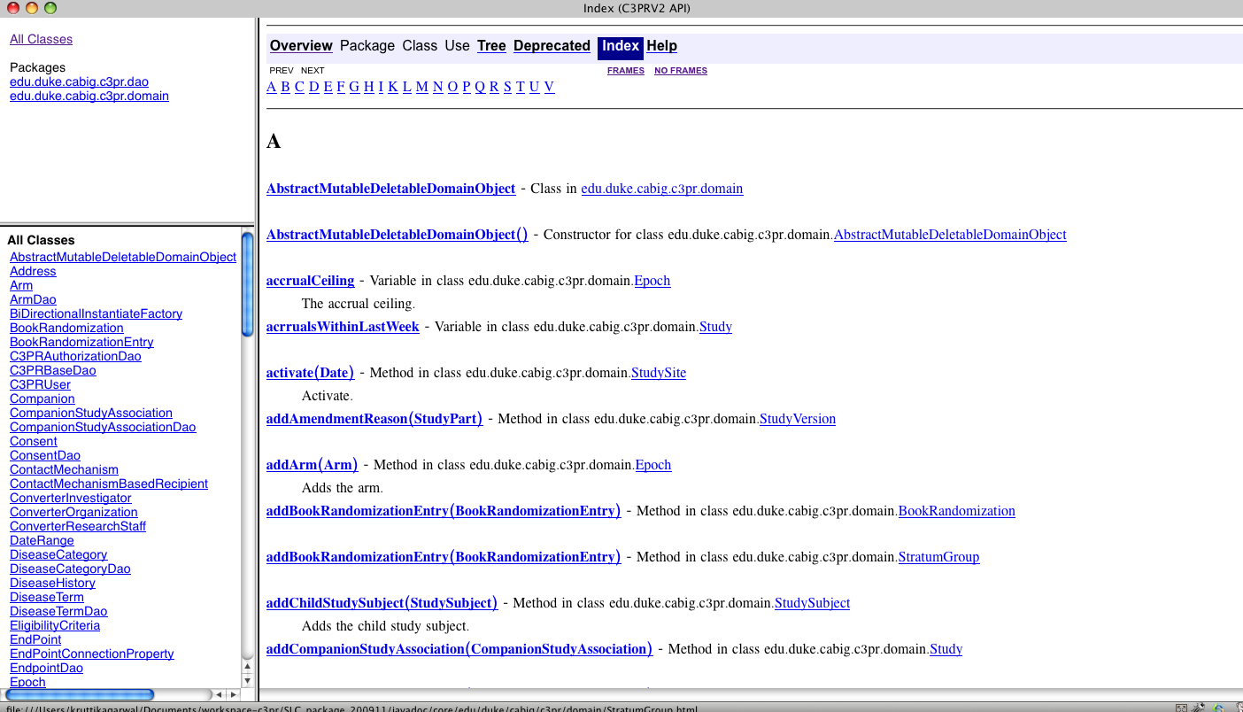
API
Overview
Standard caCORE SDK-like Hibernate Query
  Data Objects
  Hibernate query API
We generally use DAOs (data access objects) in our development
We request review of the Hibernate query API

Slide 22
API
Existence
Test scripts
  Java program
  Runs queries through DAOs
  Writes results to files
Test logs
  XML serialization of results into files
  HTML web pages
Test coverage
  Cobertura HTML reports

Slide 23
Submission package

