Slide 1
caAdapter
Data Transformation Service
caAdapter Team
11/18/2010

Slide 2
Outline
Product Overview
Major Components
Demo (on formula service only)

Slide 3
Product Overview
Background
  Users need an easy-to-use tool to define data derivation formulae and domain value mappings for data transformation
Objectives
  Develop an open source tool for users to create data derivation formulae and domain value mappings
  Support integration with other caBIG tools and applications
Scope
  Develop a service for creating and updating data transformation formulae
  Develop a service for mapping domain data values
  Support integration with caDSR

Slide 4
Major Components
- Features
The tool provides
  Graphic user interface for users to create, update, delete, review data transformation formulae
  Representation of the math formulae in XML
  Representation of the math formulae in Java
  Import of commonly used formulae
  Formula execution for testing
  Graphic user interface for users to map domain data values (will be available soon)
  Support for remote and local data repositories
  Java APIs and web services for integration
  Integration with caDSR (to be implemented)
The tool can be deployed as Windows application or web application. The tool can also be deployed on caGrid as a common service

Slide 5
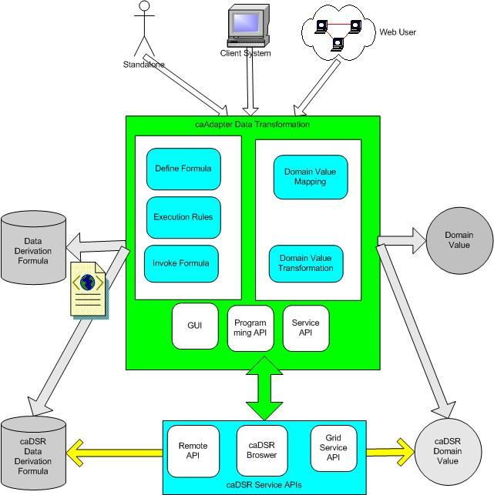
Major Components
- High-level architecture

Slide 6
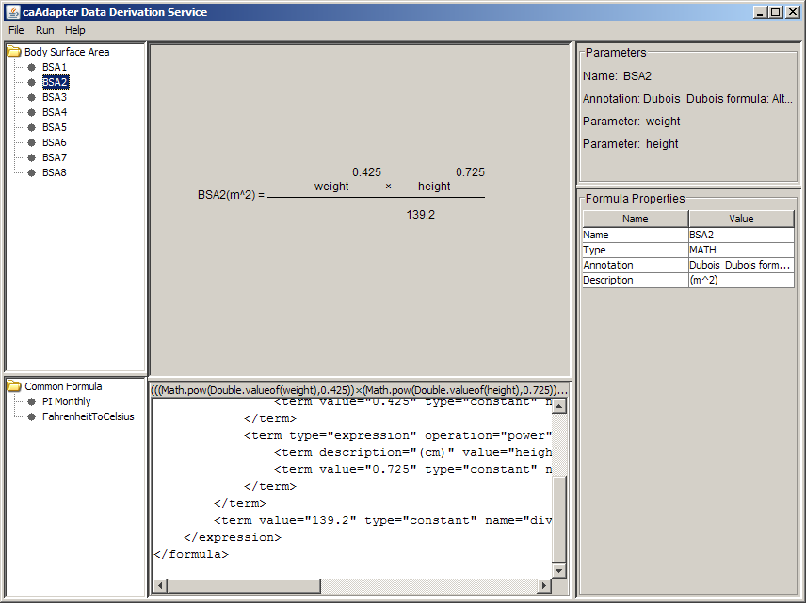
Major Components
- Graphic user interface
User-defined formula list
User-defined parameters
User working area – create, update, delete formula
Properties or attributes of the highlighted object
Some pre-defined formula list
JAVA representation
XML representation

Slide 7
Major Components
- Representation of a math formula in XML
<formula type="math" name=“FtoC">
<annotation>Convert Fahrenheit Degree to Celsius Degree</annotation>
<expression type="expression" name="FtoC" description="(C)" operation="multiplication">
<term type="expression" name="factor" operation="subtraction">
<term type="variable" name="minuend" description="(F)" value="F"/>
<term type="constant" name="subtrahend" value="32"/>
</term>
<term type="expression" name="factor" operation="division">
<term type="constant" name="dividend" value="5"/>
<term type="constant" name="divisor" value="9"/>
</term>
</expression>
</formula>

Slide 8
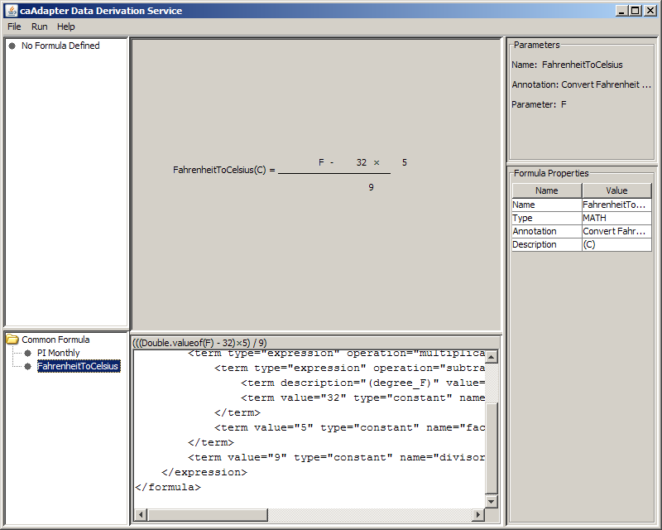
Demo – formula service
- Common formula (read-only)

Slide 9
Demo – formula service
- User defined formula (create/update/delete)

Slide 10
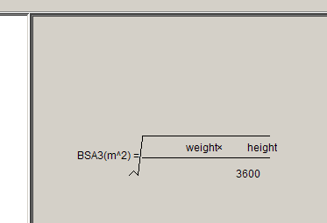
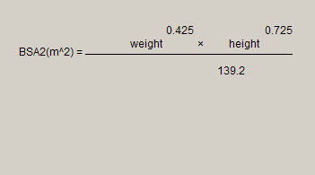
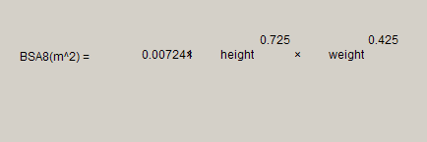
Demo
- User defined formula examples

Slide 11
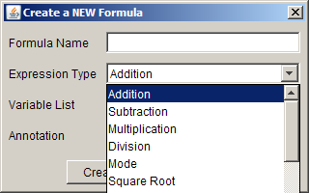
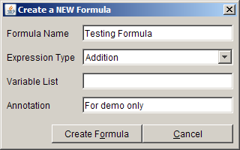
Demo – formula service
- Create a new formula
  Create or modify formula

Slide 12
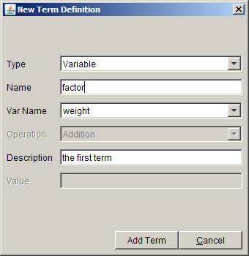
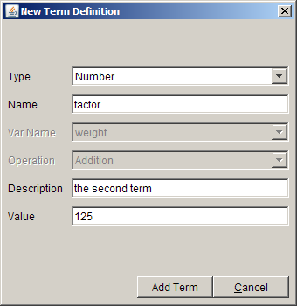
Demo – formula service
- Create a new formula
  Create or modify expression term

Slide 13
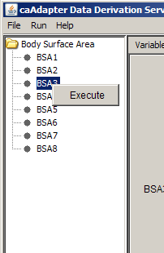
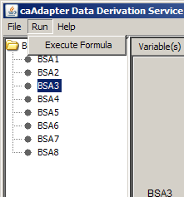
Demo – formula service
- Execute a formula

Slide 14
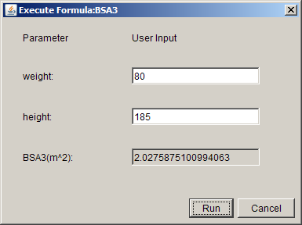
Demo
- Test a formula

Slide 15
ESST feedback (KNM)
  1. This service capabilities are not identified as part of NESI currently.
  2. What was the motive of developing such service ?
  3&7. Domain value mapping: Vocabulary Service: LexEVS.
  4&5. Standard to represent the formulae such as MathML?
  6. Will there be such formulae at enterprise-level?
  7.&3 Need to sync Domain value mapping with the LexEVS
  8. Deployment mode-- retrieve the transformation formulae from central service or rely on local store?

Slide 16
MathML represents math formula (KNM 4&5)
  Design Goal of MathML
  http://www.w3.org/TR/MathML3/
Encode mathematical material suitable for all educational and scientific communication.
Encode both mathematical notation and mathematical meaning.
Facilitate conversion to and from other mathematical formats, both presentational and semantic.
It is recognized that conversion to and from other notational systems or media may entail loss of information in the process.
Allow the passing of information intended for specific renderers and applications.
Support efficient browsing of lengthy expressions.
Provide for extensibility.
Be well suited to templates and other common techniques for editing formulas.
Be legible to humans, and simple for software to generate and process.

Slide 17
MathML represents math formula (KNM 4&5)
  Overview of MathML
  MathML uses XML markup for describing mathematics:
    presentation markup– display mathematics
    content markup-- convey mathematical meaning using Content Dictionaries
  MathML specification
    Default CSS style sheet
    Document Type Definition (DTD)
  Use MathML
    W3C defines specification without implementation
    Variouse tools or software support MathML from every aspects: http://www.w3.org/Math/Software/mathml_software.html
  Observations
    MathML provides a complete markup specification for mathematics
    The complexity is a drawback to adopt: 38 tags specifying structure and 170 tags defining meaning of expression

Slide 18
caAdatper represents math formula
  Requirement highlights of caAdapter Data Transformation Service:
    Develop an open source tool for users to create data derivation formulae and domain value mappings
    Support integration with other caBIG tools and applications
    Flexible deployment: standalone, web server, caGrid servie
  MathML
    Pros:
      Completeness in describing mathematical notation (208 + tags)
      Promised compatibility of W3C conformed tools/software
    cons:
      Limitation of developing resource to implement in-house MathML tool
      depends on other MathML tool.
  caAdapter Meta Model
    Pros:
      Simple model defined with XSD ( 3 data types with 6 associated attributes)
      Conformed to W3C XSD specification but independent of any third party tools
    cons:
      Compatibility with application beyond caBIG
Notes:
MathML
Pros:
Completeness in describing mathematical notation (208 + tags)
Promised compatibility of W3C conformed tools/softwares
cons:
Limitation of developing resource to implement in-house MathML tool
depends on other MathML tool.

Slide 19
MathML Tool: MathEdit
A Browser-Based Visual Editor for Mathematical Expressions
  http://wme.lzu.edu.cn/mathedit/index.html
  MathEdit is an interactive visual mathematical expression editor
  MathEdit is implemented in standard JavaScript and DOM
  MathEdit runs within any standard Web browser that supports JavaScript and DOM
  Manipulate MathXML –new, edit, format, export, import, local, remote, retrieve mathXL from other application
  Return the result mathematical encoding
  MathEdit API– embed MathEdit in CKEditor, niceEdit, webpage, pop-up window
  Web Service provides the translating services of different mathematical formula encoding and the generation services of picture, pdf, ps and dvi document
Notes:
MathML
Pros:
Completeness in describing mathematical notation (208 + tags)
Promised compatibility of W3C conformed tools/softwares
cons:
Limitation of developing resource to implement in-house MathML tool
depends on other MathML tool.

Slide 20
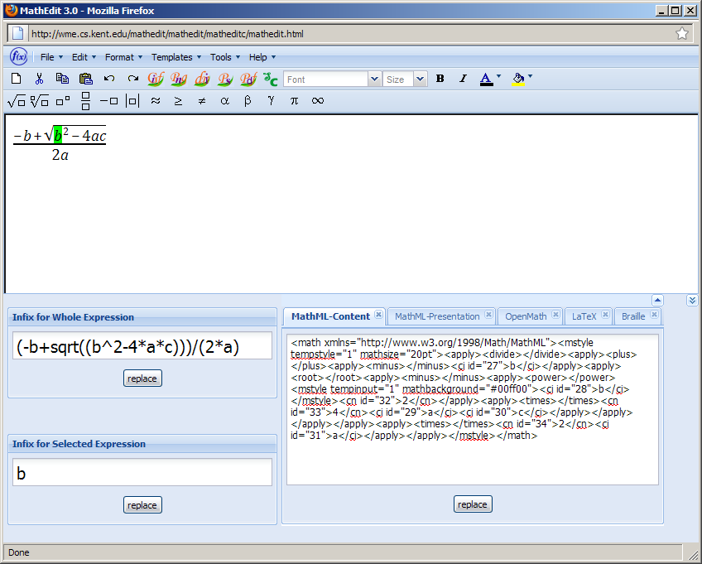
MathML Tool: MathEdit
Notes:
MathML
Pros:
Completeness in describing mathematical notation (208 + tags)
Promised compatibility of W3C conformed tools/softwares
cons:
Limitation of developing resource to implement in-house MathML tool
depends on other MathML tool.

Slide 21
MathML Tool: MathEdit
<math xmlns="http://www.w3.org/1998/Math/MathML">
<mstyle mathsize="20pt" tempstyle="1">
<mfrac>
<mrow>
<mrow>
<mo>-</mo>
<mrow>
<mi id="5">b</mi>
</mrow>
</mrow>
<mo>+</mo>
<msqrt>
<mrow>
<msup>
<mrow>
<mi id="8">b</mi>
</mrow>
<mn id="9">2</mn>
</msup>
<mo>-</mo>
Notes:
MathML
Pros:
Completeness in describing mathematical notation (208 + tags)
Promised compatibility of W3C conformed tools/softwares
cons:
Limitation of developing resource to implement in-house MathML tool
depends on other MathML tool.

Slide 22
MathML Tool: MathEdit
<mrow>
<mn id="11">4</mn>
<mo>?</mo>
<mrow>
<mi id="13">a</mi>
</mrow>
<mo>?</mo>
<mstyle mathbackground="#00ff00" tempinput="1">
<mrow>
<mi id="15">c</mi>
</mrow>
</mstyle>
</mrow>
</mrow>
</msqrt>
</mrow>
<mrow>
<mn id="16">2</mn>
<mo>?</mo>
<mrow>
<mi id="18">a</mi>
</mrow>
</mrow>
</mfrac>
</mstyle>
</math>
Notes:
MathML
Pros:
Completeness in describing mathematical notation (208 + tags)
Promised compatibility of W3C conformed tools/softwares
cons:
Limitation of developing resource to implement in-house MathML tool
depends on other MathML tool.

Slide 23
MathML Tool: XSLT MathML Library
MathML Library, is a set of XSLT stylesheets to transform MathML 2.0 to LaTeX
  http://xsltml.sourceforge.net/
  implemented purely in XSLT, that is they do not use any extensions
  xsltml is a SourceForge project.
  The XSLT MathML Library is available for download
Notes:
MathML
Pros:
Completeness in describing mathematical notation (208 + tags)
Promised compatibility of W3C conformed tools/softwares
cons:
Limitation of developing resource to implement in-house MathML tool
depends on other MathML tool.

Slide 24
MathML Tool: Word2MathML
Word2MathML is a tool which converts existing Word 2007 documents into XHTML+MathML
http://word2mathml.blogspot.com
Notes:
MathML
Pros:
Completeness in describing mathematical notation (208 + tags)
Promised compatibility of W3C conformed tools/softwares
cons:
Limitation of developing resource to implement in-house MathML tool
depends on other MathML tool.

Slide 25
MathML Tool: webMathematica
webMathematica adds interactive calculations and visualization to websites by integrating Mathematica with the latest web server technology
http://word2mathml.blogspot.com
webMathematica and Mathematica have the same underlying engine, but they provide fundamentally different user interfaces and are aimed at different types of users
webMathematica offers access to specific Mathematica applications through a web browser or other web clients
Implemented with Applet, javaScript, and customized JSP tags.
Mathematica is implemented with C and 1.0 was released on (June 23 , 1988, http://en.wikipedia.org/wiki/Mathematica
Mathematica is a development environment for webMathematica sites
Notes:
MathML
Pros:
Completeness in describing mathematical notation (208 + tags)
Promised compatibility of W3C conformed tools/softwares
cons:
Limitation of developing resource to implement in-house MathML tool
depends on other MathML tool.

Slide 26
Domain Value Mapping and Transformation Service vs. LexEVS
Domain Value Mapping and Transformation Overview
  caBIG community -- LexEVS and EVS APIs, https://cabig.nci.nih.gov/tools/LexEVS_API
  Commercial product -- Oracle Enterprise Bus provide Maps view of Oracle ESB Control
  Overview Process
Source Domain has a list of values: {1, 2, 3, 4, 5, 6, 7, 8…}
Target Domain has a list of values: {copy, print, email, …}
Mapping from source to target--One or more than one source values are mapped to one target values: {1, 2—copy; 3 – print;4, 5,6 – email …}
Transformation process returns one target value as meets one source value: {return “email” as meets 4, 5, or 6 ;..}
Notes:
MathML
Pros:
Completeness in describing mathematical notation (208 + tags)
Promised compatibility of W3C conformed tools/softwares
cons:
Limitation of developing resource to implement in-house MathML tool
depends on other MathML tool.

Slide 27
Domain Value Mapping and Transformation Service vs. LexEVS
LexEVS provides mapping and searching of concept code
Concept Code -- A concept unique identifier within the NCI Enterprise Vocabulary Service's NCI Thesaurus, http://nciterms.nci.nih.gov/ncitbrowser/ConceptReport.jsp?dictionary=NCI%20Thesaurus&code=C43516
Source domain model has a list of concept code
Target domain model has a list of concept code
Predefined mapping setup one-to-one link between the concept code in source domain and the concept code in target domain
EVS searching service return the linked concept code if one concept code is provided. i.e. if the source concept code is provided, it returns target concept code; if the target concept code is provided, it returns the source concept code.
LexEVS implemented programming API for mapping and searching of concept code (5.1)
LexEVS (6.0 ?) proposed SOA service for mapping and searching
Notes:
MathML
Pros:
Completeness in describing mathematical notation (208 + tags)
Promised compatibility of W3C conformed tools/softwares
cons:
Limitation of developing resource to implement in-house MathML tool
depends on other MathML tool.

Slide 28
Domain Value Mapping and Transformation Service vs. LexEVS
caAdapter (requirements)
Domain value mapping
One-to-one; One-to-many; many-to-one
Bi-directional mapping
User maintained/flexible mapping data
Programming API
SOA service
LexEVS (product/proposal)
NCI domain concept code mapping
One-to-one
Bi-directional mapping
Repository maintained/static mapping data
Programming API in production release 5.1
SOA service in proposal of 6.0
Notes:
MathML
Pros:
Completeness in describing mathematical notation (208 + tags)
Promised compatibility of W3C conformed tools/softwares
cons:
Limitation of developing resource to implement in-house MathML tool
depends on other MathML tool.

