Slide 1
CMTS Mapping and Transforming via DVTS

Slide 2
Transforming

Slide 3
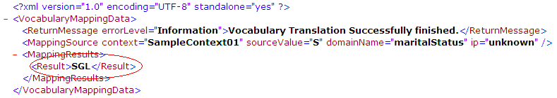
Principle
Domain value translation with Xquery or XSLT
DVTS request is a URL form (web and restful)
  Web : http://dvts.org/caadapter-dvts/ContextVOMTranslation?context=CTEP&domain=gender&value=M
  Restful : http://dvts.org/caadapter-dvts/restful/context/CTEP/domain/gender/value/M
DVTS return value is an XML document.
Return value can be read by XQuery as an XML doc.

Slide 4
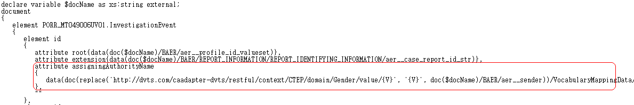
Generating XQuery statement
XQurey grammar
Sample usage
  Data
  (
  doc
  (
  replace({DVTS_PHYSICAL_URL}, {REPLACE_PATTERN}, {SOURCE_DATA})
  )/VocabularyMappingData/MappingResults/Result
  )

Slide 5

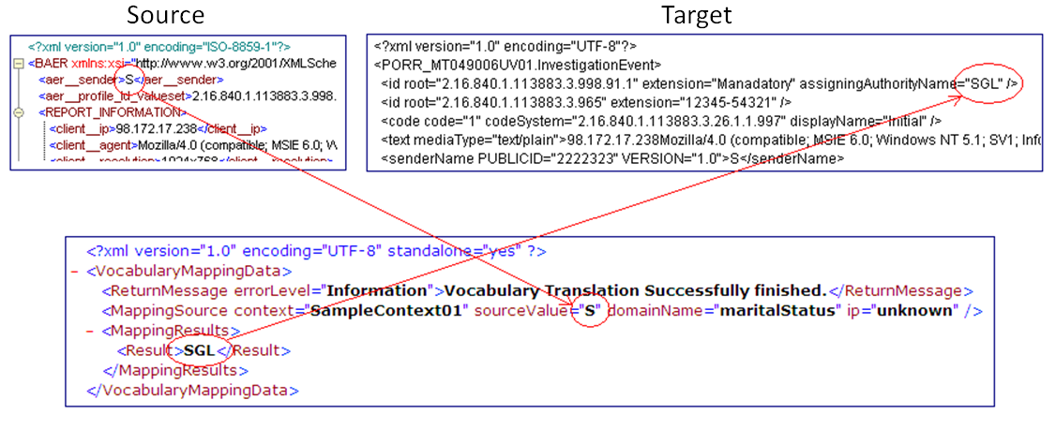
Test and the Result
Test Instances
  The location of Instances : workingspace/deepLoading/
  Test XSLT file : DVTS_translation_sample.xq
  Input XML file : data_xml2.xml
Result: Successfully transformed

Slide 6
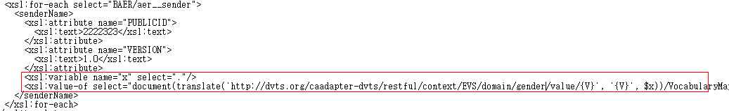
Generating XSLT statement
XSLT grammar
Sample usage
<xsl:variable name="x" select="."/> <!-- store the current node value to variable ‘x’. -->
<xsl:value-of select=“
document(
translate(
'http://dvts.org/caadapter-dvts/restful/context/EVS/domain/gender/value/{V}',
'{V}', <!– This is a replace pattern -->
$x <!– fetch the value of the variable ‘x’ -->
)
)/VocabularyMappingData/MappingResults/Result"
/>

Slide 7
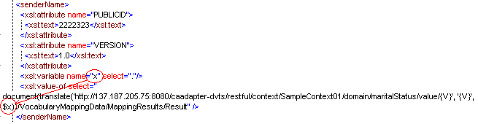
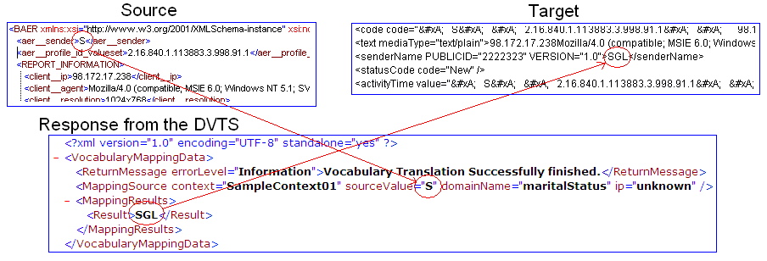
Test and the Result
Test Instances
  The location of Instances : workingspace/deepLoading/
  Test XSLT file : DVTS_translation_sample.xslt
  Input XML file : data_xml2.xml
Result: Successfully transformed

Slide 8
Mapping
(Design Suggestion)

Slide 9
GUI Mapping Concepts
Mapping Panel
  Mapping with a function box
    Added by drag-and-drop from the function Pane as usual
    DVM Function tree is built based on ‘contextLinkAddress.properties’ file
  Mock-up screen
●Source_head
●Target_head
● Functions
Node1
Node2
Node3
Domain Value Mapping
Node1
Node2
Node3
● Constant
● Math
● String
●DomainValueMapping
● Context: CTEP
domain: Gender
domain: signalType
● Context: EVS
domain: MaritalStatus
●
in
C:CTEP
D:Gender
out
●

Slide 10
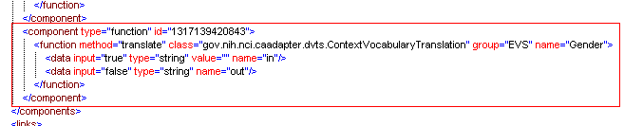
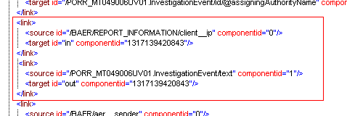
Mapping Data
Component
Link data

