Slide 1
caAERS:
Cancer Adverse Event Reporting System
Demo of caAERS v1.0
February 19, 2008
Presented by:
Edmond Mulaire and Ram Chilukuri, SemanticBits

Slide 2
Release Schedule
Version 1.0 -- March 2008
Version 1.5 -- September 2008
Version 2.0 -- February 2008
^{caAERS v1.5}
^{Projected Release}
^{caAERS v1}
^{Kickoff}
^{caAERS v1}
^{Released}
^{caAERS v2.0}
^{Projected Release}
^{caAERS v1}
^{Construction Starts}
²⁰⁰⁶
²⁰⁰⁷
²⁰⁰⁸
²⁰⁰⁹
^{Dec}
^{Mar}
^{Mar}
^{Sep}
^{Feb}
Upcoming Releases

Slide 3
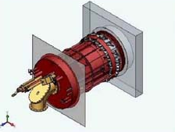
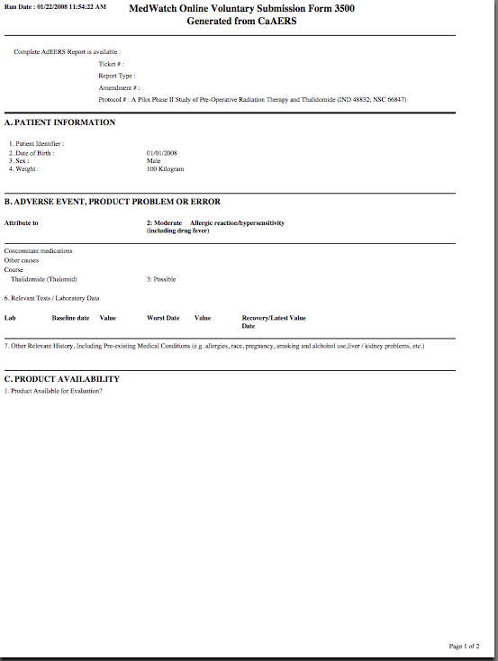
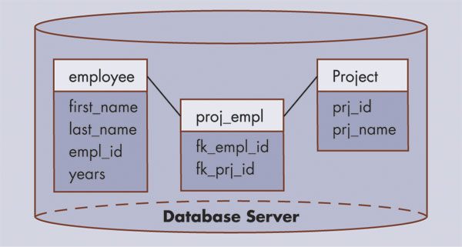
caAERS: A web-based tool for …
Collecting AE’s and SAE’s
Submitting Expedited Reports
Rules Engine …
has determine that a 10-Day Expedited AE Report is REQUIRED
subject
ae
study
FDA
AdEERS
DCP
Pharma

Slide 4
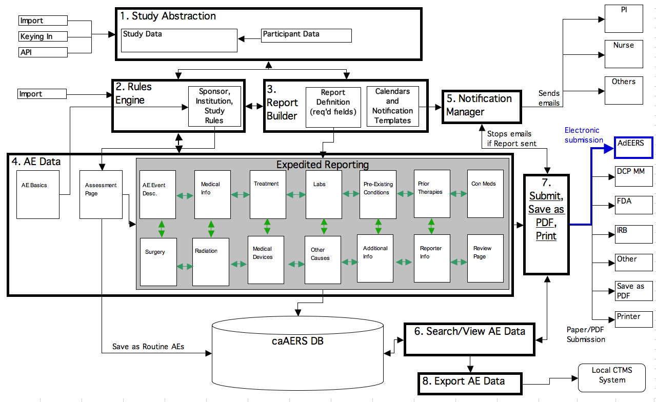
System Diagram

Slide 5
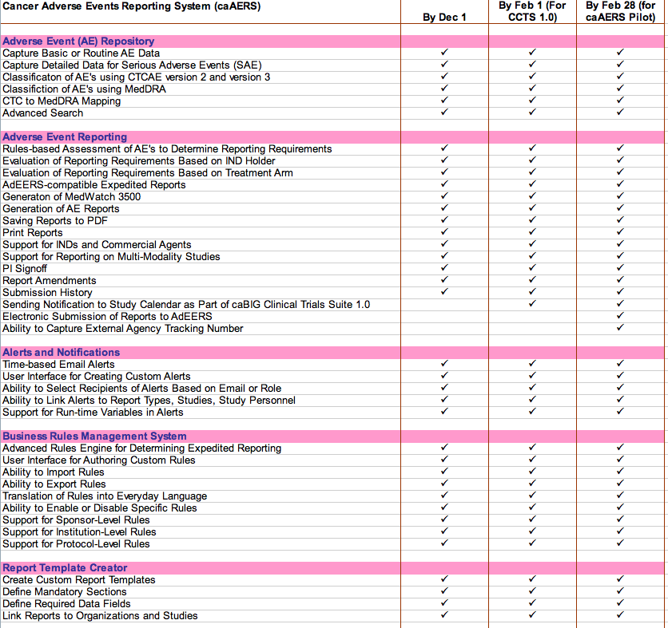
Feature List
AE Capture & Repository
AE Expedited Reporting
Alerts
Business Rules
Report Template Generator

Slide 6
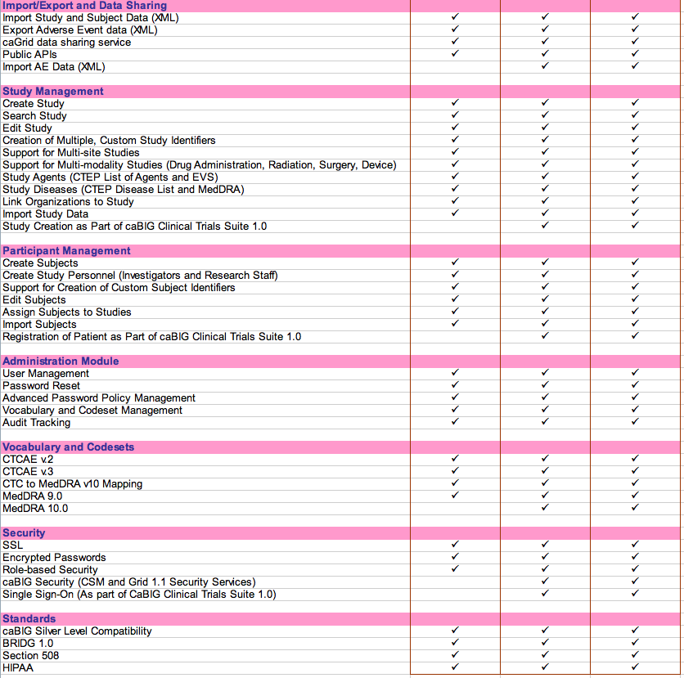
Feature List (Page 2)
Import/Export
Study Management
Participant Management
Administration
Vocabularies & Code Sets
Security
Standards

Slide 7
AE Coding Terminologies
capture
classify
CTC v2
CTCAE v3
MedDRA v9
MedDRA v10
  and
Verbatim
Routine AEs
Coding Systems
Supported in
caAERS v.1
Expedited AEs

Slide 8
Generate Standard Reports
Included in Version 1:
CTEP AdEERS
  24-Hour/5-Day Report
  10-Day Report
DCP
  24-Hour/48-Hour SAE Form
Other Safety Reports
  FDA MedWatch 3500A
  CIOMS

Slide 9
caAERS is Flexible and Configurable
  Customizable Report Templates
  Customizable Email Alerts
You can …
Specify report name
Designate recipients
Set time allowed till report due
Choose required fields
You can …
Decide when email is sent
Pick recipients
Edit message content
Use variables
Set up multiple alerts per day

Slide 10
caAERS is Smart …
Choose from a library of Rules from:
  CTEP
  DCP
  Other Sponsors
  And
Plug existing rules into caAERS
  Or
Create new rules using the built-in Rules creation screen.

Slide 11
Rules for Assessing Expedited Reporting
Select triggers using:
  AE Attributes
    Grade, Category, Term
    Hospitalization, Relationship to Study, Expectedness
    FDA Outcome Indicators (Life-Threatening, Death, Hospitalization, Congenital, Serious, Other)
  Phase
  Treatment Arm
  Agent Type: Commercial or Investigational
  IND Holder
  Study Therapy or Modality
Set up rules at the following levels:
  Sponsor
  Institution
  Study

Slide 12
Rules for Mandatory Sections
Specify mandatory sections in report using:
  Study Intervention Modalities
    Agent
    Radiation
    Surgery
    Medical Device
    or combination
  IND Holder
  Report Name/Type
Set up rules at the following levels:
  Sponsor
  Institution
  Study

Slide 13
A New Approach …
An AE repository and reporting tool powered by a rules engine to provide clinical researchers with automated, rules-based assessment of expedited AE reporting requirements
Standardizing the representation of study-specific conditions and exceptions found in Protocol Documents using a tabular format to permit translation into programmable rules
Establishing a library of rule sets for plugging into caAERS

Slide 14
Creating a Custom Report Definition
Name of Report
Amount of Time Until Report is Due
Is report amendable
Where to send/submit report
Required and optional fields on the report
Email notifications associated with report

Slide 15
Email Notifications
The following items are fully customizable:
  Recipients of emails
    specific email addresses
    or roles (e.g., Reporter, PI)
  When emails get sent
    When report created
    Before report due date
    After report due date -- if report not submitted yet
  Text for Subject Line of email
  Text for body of email message
  Number of email notifications associated with report.

Slide 16
Additional Email Features
Send different emails to different recipients.
    E.g., when report created, send one email to the reporter as reminder/confirmation and send another email with different text to the PI as notification.
Use variables that get populated with real data when email sent out
    E.g., StudyID, SubjectID, Study Title

Slide 17
caAERS is Open
Import Data from Existing or Legacy Systems
  Studies
  Subjects
  AEs
Export Data for Use in Other Applications
  AE Reports → Download as PDFs and XML files
  Search Results
Share Data for Better Research
  caGrid-enabled
  caBIG Silver-Level Compatibility
  BRIDG Harmonized

Slide 18
caAERS is Secure, Compliant …
HIPAA Compliant
21 CFR Part 11 Compliant
Section 508 Compliant

Slide 19
caAERS is (relatively) easy to install …
Application Support Difficulty Level: Intermediate
H/W and S/W Requirements
Standard server machine
Server OS (Linux, Windows or Mac)
Open source database (PostgreSQL)
Open source application server (Apache Tomcat)
Personnel Requirements
Mid-level technical skills required for initial installation and setup
Mid-level technical skills for ongoing systems administration

Slide 20
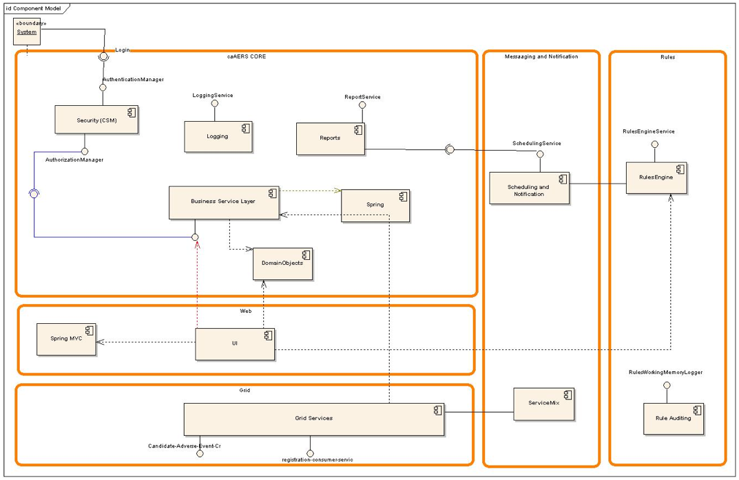
caAERS Component Diagram

Slide 21
High Level Architecture of Rules Engine

Slide 22
High Level View of Layered Architecture of Reporting and Scheduling Module

Slide 23
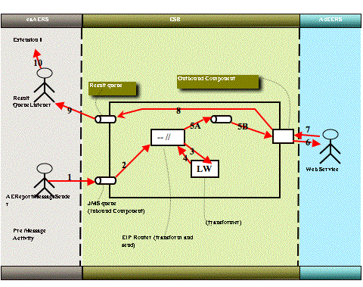
caAERS - AdEERS Integration

Slide 24
Enterprise Service Bus

Slide 25
Accessing the Demo
There is a development release on the Public Demo Site right now. The build here gets updated approximately every 3-4 weeks.
  URL:
  https://sbdev1000.semanticbits.com:8031/caaers/public/login
  Log in as:
  Username: SYSTEM_ADMIN
  Password: system_admin
  Sample Studies:
  A good study to use for testing/exploring is:
  Short Title: E3200 Phase III Trial
  Study ID: E3200
  You can use the following sample patient:
  Patient ID: MRN0013579

Slide 26
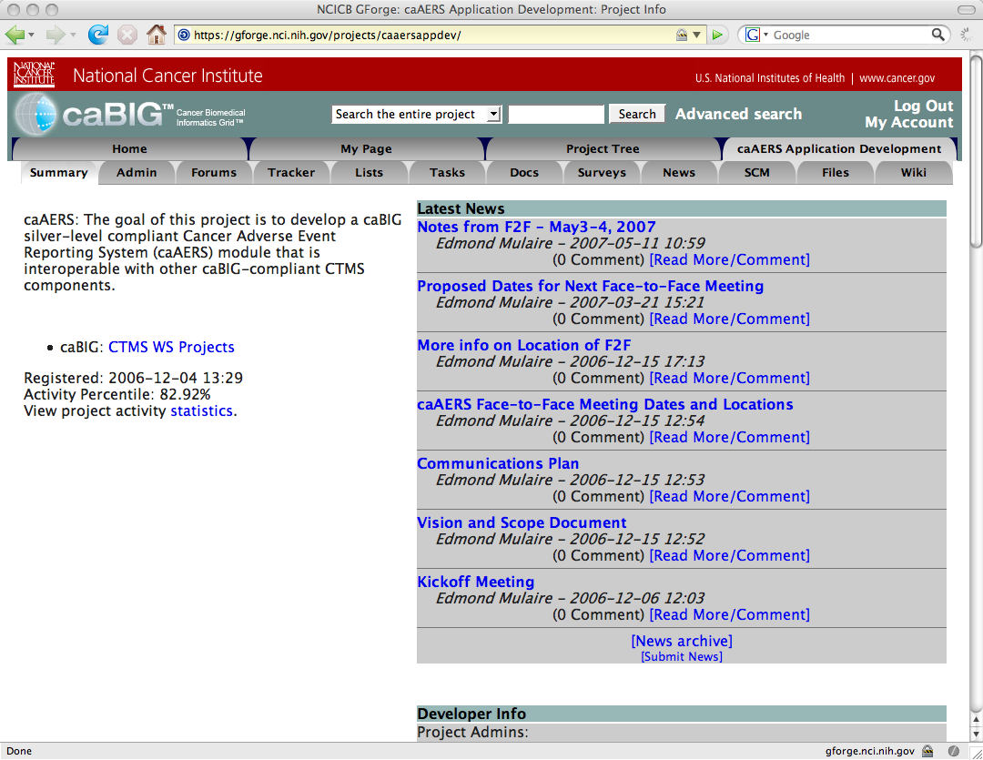
caAERS Project Site
What’s Here:
Latest news on project
List of team members
Access to source files
CaAERS End Users Guide:
http://gforge.nci.nih.gov/docman/index.php?group_id=249&selected_doc_group_id=2838&language_id=1
https://gforge.nci.nih.gov/projects/caaersappdev/

Slide 27
New Features for Next Phase
List Still Being Formulated
Likely Candidates:
  Advanced Workflow Features to allow distribution, review, revision of reports prior to submission
  Enhanced Support for Hosted Version to support Cooperative Groups
  Improved Data Analysis Tools and Reports
  Further Development of APIs for Live-Linking/Integration with other CTMS Systems
  Automation of Determination of Expectedness of AE
  Improved Usability in Creating Expedited Report

Slide 28
The caAERS Team
Development Team
SemanticBits
Northwestern University
Akaza Research
CTIS
Key Contributors
CTEP
DCP
AE SIG
(AdEERS Integration)
caBIG Adopters
Mayo Clinic
Wake Forest University
Sponsors
NCI
BAH

Slide 29
Credits
Technical
Functional
Lead Architects
Ram Chilukuri¹
Vinay Kumar¹
Sponsors
NCI: Christo Andonyadis
BAH: Derek Walker, Lisa Schick Julie Holtzolpe, Karen Ryan⁸
Domain Experts
Warren Kibbe, Ph.D.²
Renee Webb, RN²
David Patton²
Brenda Martone, MD²
Cal Collins³
Lead Developers:
Srini Akkala¹
Rhett Sutphin²
Developers:
Biju Joseph¹
Krikor Krumlian³
Karthik Iyer¹
AdEERS Integration:
Kumar Chandran⁹
Vijay Britto⁹
Project Manager
Edmond Mulaire¹
Adopters
Mayo Clinic: Sharon Elcombe, Sonja Hamilton, Jean Hanson, Jennifer Frank⁴
Wake Forest: Bob Morrell, Kim Livengood, Steven Cheng⁵
Analyst
Sean Whitaker²
Writer
Jennifer Reed¹
Architecture WS
Michael Keller⁸
Pankaj Agarwal¹²
VCDE WS
Brian Davis
Lynne Wilkens¹³
Brenda Maeske⁹
Key Contributors
CTEP: Ann Setser⁶
DCP: Anne Tompkins⁷, Linda Doody,Troy Budd
Susan Pannoni¹⁰ and AE SIG members
1. SemanticBits 2. Northwestern U. 3. Akaza Research 4. Mayo Clinic 5. Wake Forest 6. CTEP 7. DCP 8. BAH 9. CTIS 10. COH 11. SAIC 12. Duke University 13. Univ. of Hawaii

