Slide 1
caAERS v2.0 Overview
11/18/2009
Paul Baumgartner

Slide 2
Release Schedule
Version 1.0 -- March 2008
Version 1.5 -- September 2008
Version 2.0 -- December 2009
^{caAERS v1.5}
^{Release}
^{caAERS v1}
^{Kickoff}
^{caAERS v1}
^{Released}
^{caAERS v2.0}
^{Projected Release}
^{caAERS v1}
^{Construction Starts}
²⁰⁰⁶
²⁰⁰⁷
²⁰⁰⁸
²⁰⁰⁹
^{Dec}
^{Mar}
^{Mar}
^{Sep}
^{Dec}

Slide 3
caAERS Basics
Major Objective
A system that can serve as the single source of truth for ALL adverse events
Facilitate & simplify adverse event reporting
Facilitate & simplify adverse event entry

Slide 4
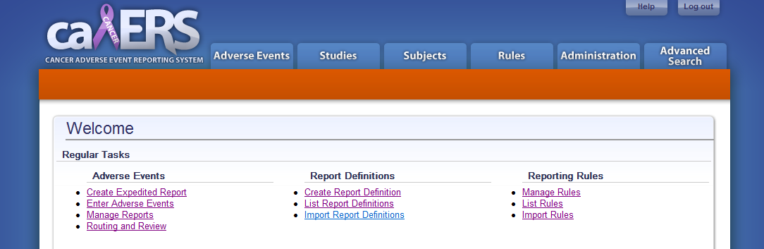
caAERS Basics
Major Components
Adverse event entry
Rules Manager
Adverse event reporting
Programmatic interfaces
Supporting Components
Study Module
Subject Module
Administration Module
Search Module

Slide 5
caAERS Basics
The Team
Development Team
  SemanticBits
Subject Matter Experts
  Wake Forest Comprehensive Cancer Center
  The Mayo Clinic
  The Cancer and Leukemia Group B
Compliance Team
  Lynne Wilkens (VCDE Mentor)
  Pankaj Agarwal (Architecture Mentor)
  Michele Elhman (BAM Analyst)
NCI
Adopters
Knowledge Center

Slide 6
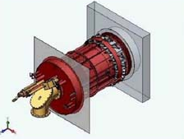
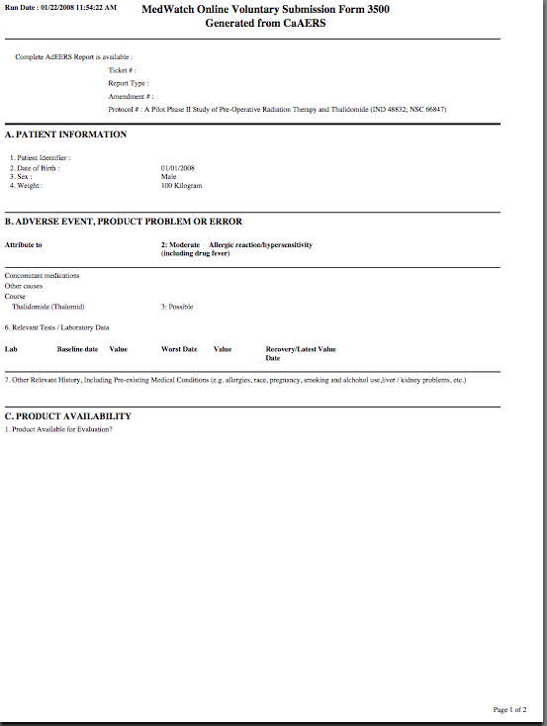
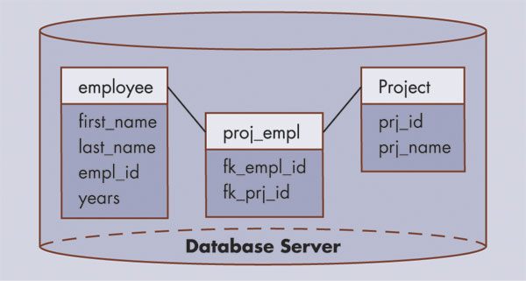
caAERS: A web-based tool for …
Collecting AE’s and SAE’s
Submitting Expedited Reports
Rules Engine …
has determine that a 10-Day Expedited AE Report is REQUIRED
subject
ae
study
FDA
AdEERS
DCP
Pharma

Slide 7
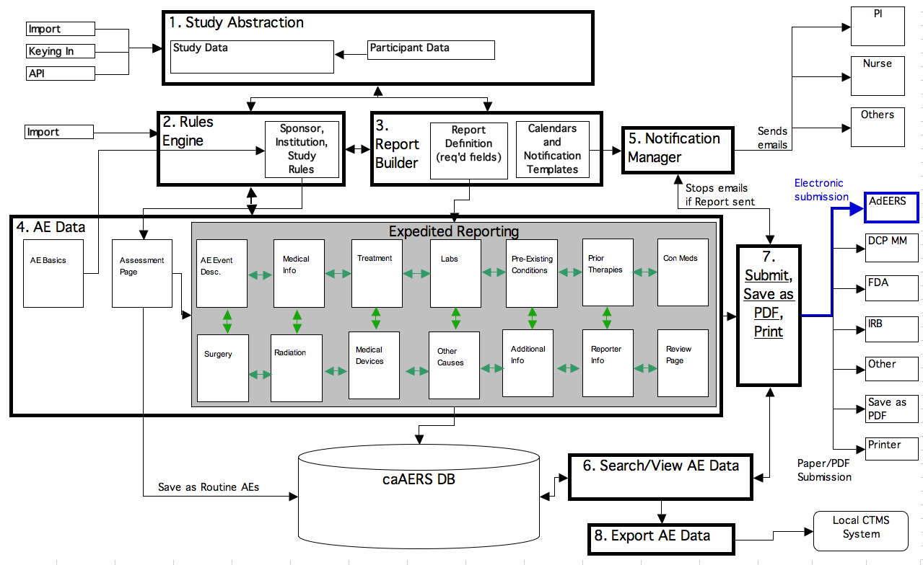
System Diagram

Slide 8
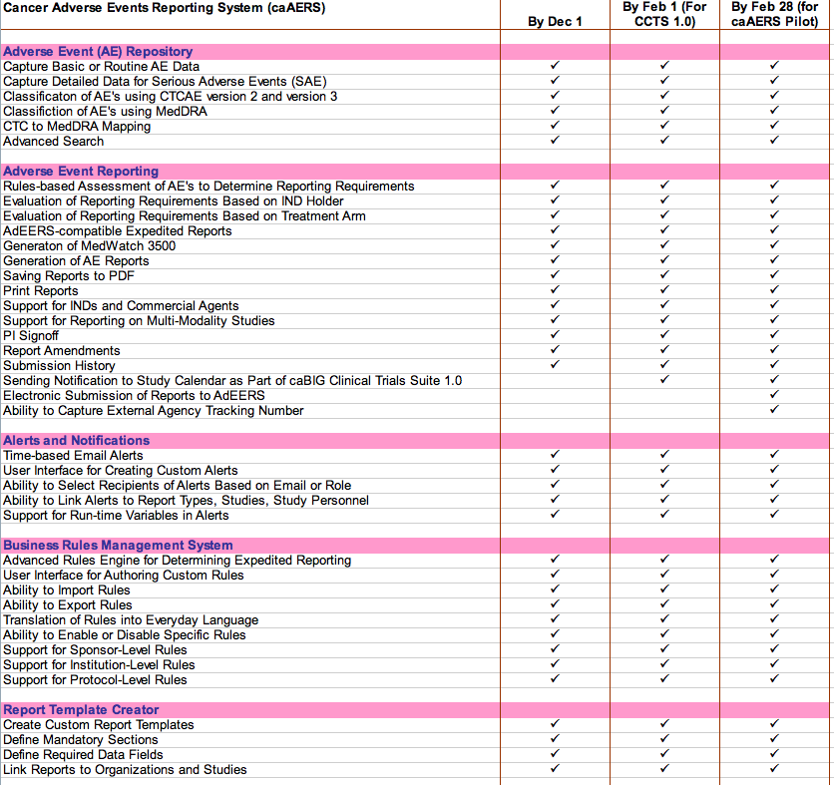
Feature List
AE Capture & Repository
AE Expedited Reporting
Alerts
Business Rules
Report Template Generator

Slide 9
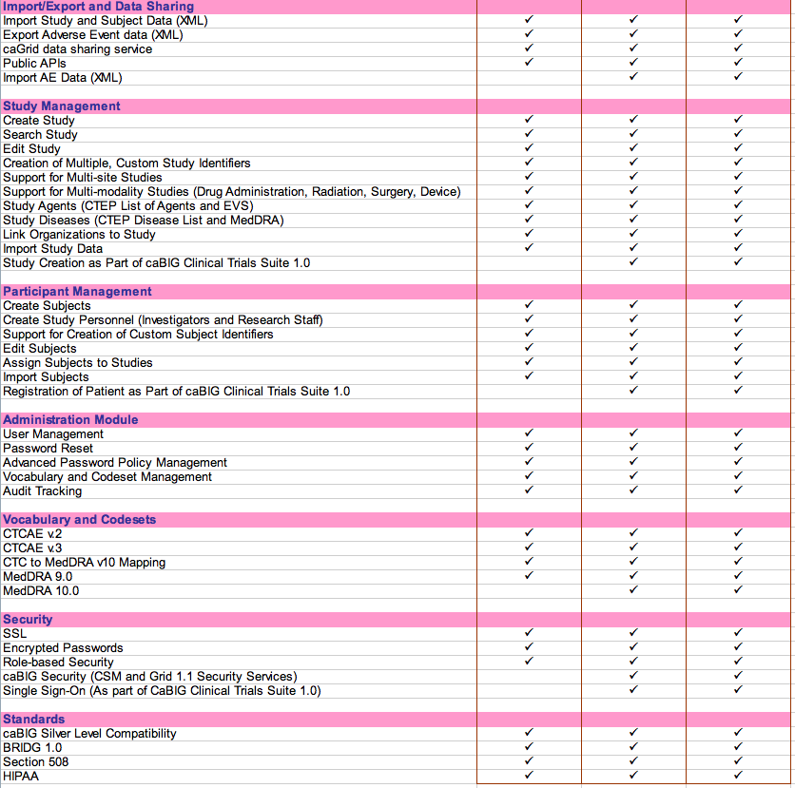
Feature List (Page 2)
Import/Export
Study Management
Participant Management
Administration
Vocabularies & Code Sets
Security
Standards

Slide 10
AE Coding Terminologies
capture
classify
CTC v2
CTCAE v3
CTCAE v4
MedDRA (any version)
Verbatim
Routine AEs
Coding Systems
Supported in
caAERS v.1
Expedited AEs

Slide 11
Generate Standard Reports
Included in Version 2:
CTEP AdEERS
  24-Hour/5-Day Report
  10-Day Report
  Commercial and Non-CTEP IND
DCP
  24-Hour/48-Hour SAE Form
Other Safety Reports
  FDA MedWatch 3500A
  CIOMS

Slide 12


caAERS is Flexible and Configurable
  Customizable Report Templates
  Customizable Email Alerts
You can …
Specify report name
Designate recipients
Set time allowed till report due
Choose required fields
You can …
Decide when email is sent
Pick recipients
Edit message content
Use variables
Set up multiple alerts per day

Slide 13
caAERS is Smart …
Choose from a library of Rules from:
  CTEP
  DCP
  Other Sponsors
  And
Plug existing rules into caAERS
  Or
Create new rules using the built-in Rules creation screen.

Slide 14
Rules for Assessing Expedited Reporting
Select triggers using:
  AE Attributes
    Grade, Category, Term
    Hospitalization, Relationship to Study, Expectedness
    FDA Outcome Indicators (Life-Threatening, Death, Hospitalization, Congenital, Serious, Other)
  Phase
  Treatment Arm
  Agent Type: Commercial or Investigational
  IND Holder
  Study Therapy or Modality
Set up rules at the following levels:
  Sponsor
  Institution
  Study

Slide 15
Rules for Mandatory Sections
Specify mandatory sections in report using:
  Study Intervention Modalities
    Agent
    Radiation
    Surgery
    Medical Device
    or combination
  IND Holder
  Report Name/Type
Set up rules at the following levels:
  Sponsor
  Institution
  Study

Slide 16
A New Approach …
An AE repository and reporting tool powered by a rules engine to provide clinical researchers with automated, rules-based assessment of expedited AE reporting requirements
Standardizing the representation of study-specific conditions and exceptions found in Protocol Documents using a tabular format to permit translation into programmable rules
Establishing a library of rule sets for plugging into caAERS

Slide 17
Creating a Custom Report Definition
Name of Report
Amount of Time Until Report is Due
Is report amendable
Where to send/submit report
Required and optional fields on the report
Email notifications associated with report

Slide 18
Email Notifications
The following items are fully customizable:
  Recipients of emails
    specific email addresses
    or roles (e.g., Reporter, PI)
  When emails get sent
    When report created
    Before report due date
    After report due date -- if report not submitted yet
  Text for Subject Line of email
  Text for body of email message
  Number of email notifications associated with report.

Slide 19
Additional Email Features
Send different emails to different recipients.
    E.g., when report created, send one email to the reporter as reminder/confirmation and send another email with different text to the PI as notification.
Use variables that get populated with real data when email sent out
    E.g., StudyID, SubjectID, Study Title

Slide 20
caAERS is Open
Import Data from Existing or Legacy Systems
  Studies
  Subjects
  AEs
Export Data for Use in Other Applications
  AE Reports → Download as PDFs and XML files
  Search Results
Share Data for Better Research
  caGrid-enabled
  caBIG Silver-Level Compatibility
  BRIDG Harmonized

Slide 21
caAERS is (relatively) easy to install …
Application Support Difficulty Level: Intermediate
H/W and S/W Requirements
Standard server machine
Server OS (Linux, Windows or Mac)
Open source database (PostgreSQL)
Open source application server (Apache Tomcat)
Personnel Requirements
Mid-level technical skills required for initial installation and setup
Mid-level technical skills for ongoing systems administration

Slide 22
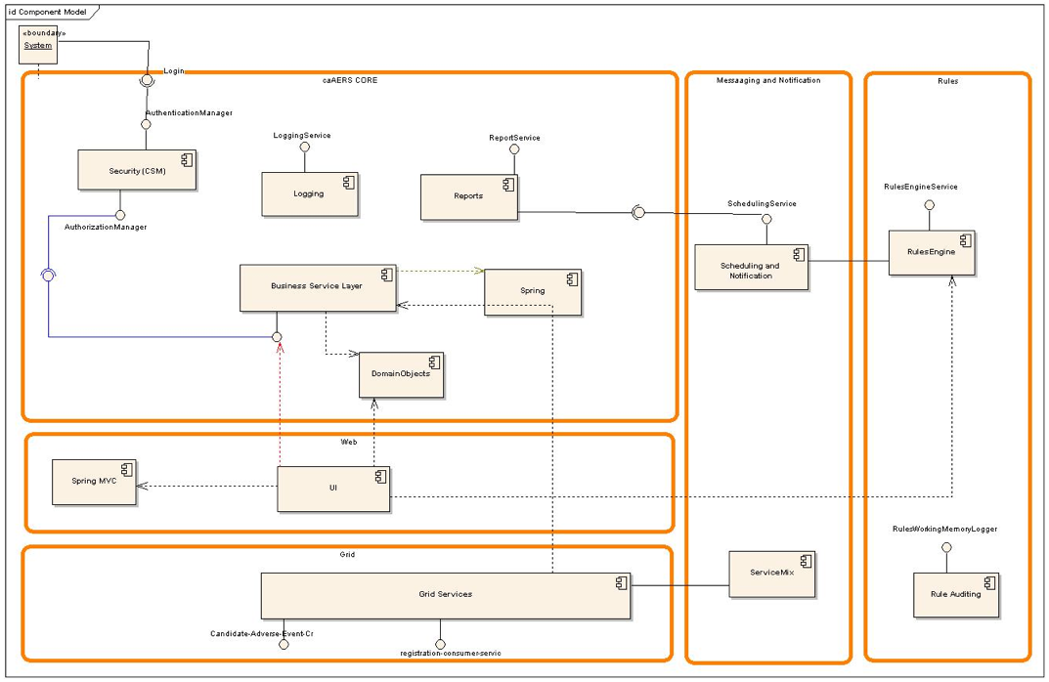
caAERS Component Diagram

Slide 23
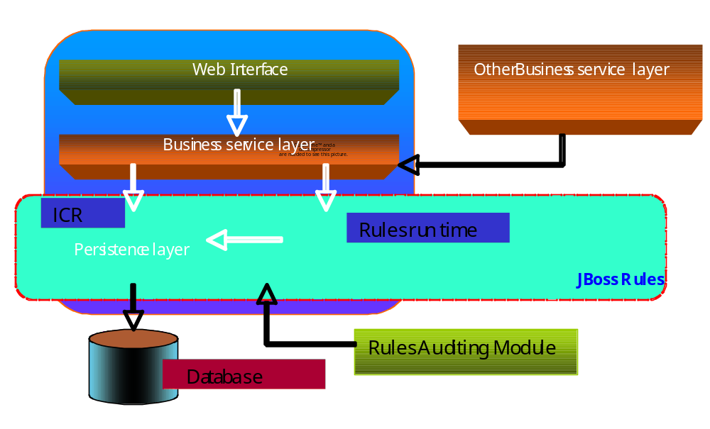
High Level Architecture of Rules Engine

Slide 24
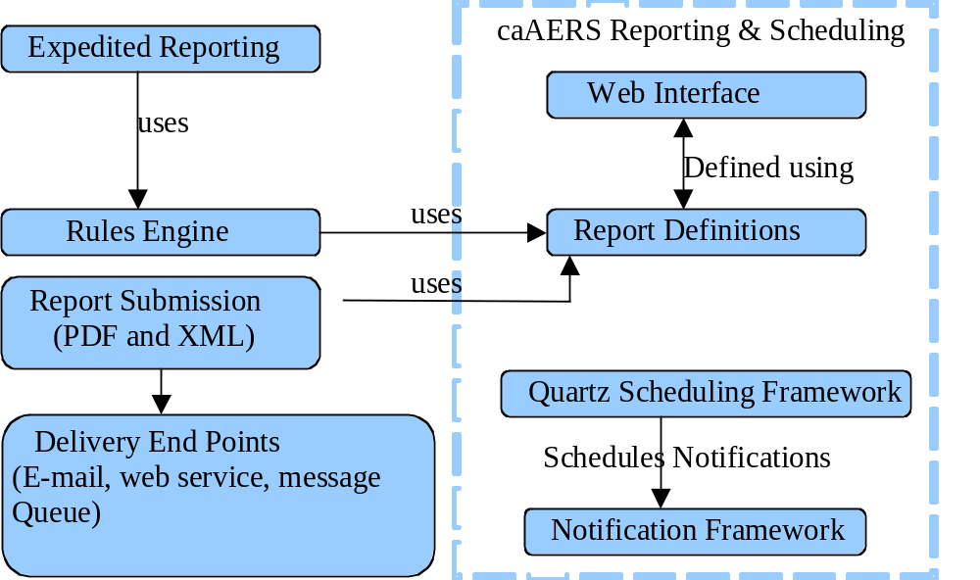
High Level View of Layered Architecture of Reporting and Scheduling Module

Slide 25
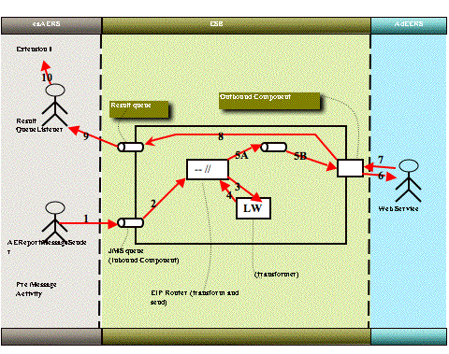
caAERS - AdEERS Integration

Slide 26
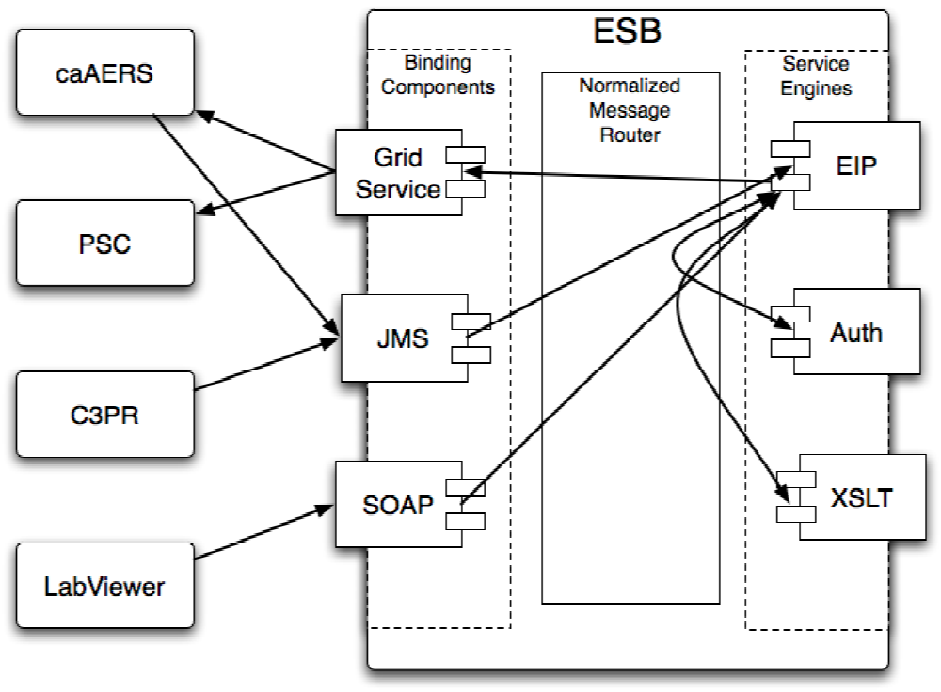
Enterprise Service Bus

Slide 27
Accessing the Demo
There is a development release on the Public Demo Site right now. The build here gets updated approximately every 3-4 weeks.
  URL:
  https://demo.semanticbits.com/caaers/
  Log in as:
  Username: SYSTEM_ADMIN
  Password: system_admin
  Sample Studies:
  A good study to use for testing/exploring is:
  Study ID: 5876
  You can use the following sample patient:
  Patient: Nelly Stevens
  NOTE: All data on this system is test data.

Slide 28
caAERS Basics
Project Wiki
    https://wiki.nci.nih.gov/x/6IF8
  Project materials
Knowledge Center Wiki
    https://cabig-kc.nci.nih.gov/CTMS/KC/index.php/CaAERS
  Product materials

Slide 29
Upcoming caAERS Deliverables
caAERS-AdEERS production pilot begins at Mayo
Integration with the NCI Enterprise Services
Release of caAERS v2.0
Release of the caBIG Suite v2.0
Support for BDA
Silver Compatibility review of v2.0
Harden current functionality – robust and bug free
Support for CTCAE v4.0
Product demonstrations
Adoption support
  Adoption for I-SPY 2 trial
  Adoption at Immunovative Therapies Ltd
  Adoption at Roswell Park Cancer Institute
  Analysis of requirements for Industry adoption

Slide 30
caAERS - Next 6 Months
caAERS-AdEERS production pilot begins at CALGB
Support NCI Enterprise Service improvements
Support for the caBIG Suite
Expand adverse event service
Release caAERS v2.1 and v2.2
Adoption support
Development to support electronic submission to FDA.
Development to support Industry adoption
Development to support international reporting
Continued adoption support

Slide 31
caAERS - Next 1 Year
caAERS-AdEERS production pilot ends at Mayo and CALGB
caAERS-AdEERS production usage is approved
Support a CTEP hosted caAERS
Expand integration with the NCI Enterprise Services
Support for the caBIG Suite
Support for electronic submissions to FDA
Support for broad Industry adoption
Support for international adoption
Support for non-cancer adoption
Support for CDMS integration?
Release of caAERS v2.3, v2.4, v2.5
Silver Compatibility review of v2.5
Continued adoption support

Slide 32
New Features for Next Phase
List Still Being Formulated
Likely Candidates:
  Advanced Workflow Features to allow distribution, review, revision of reports prior to submission
  Enhanced Support for Hosted Version to support Cooperative Groups
  Improved Data Analysis Tools and Reports
  Further Development of APIs for Live-Linking/Integration with other CTMS Systems
  Automation of Determination of Expectedness of AE
  Improved Usability in Creating Expedited Report

Slide 33


13921 Park Center Road ▪ Suite 420 ▪ Herndon, VA 20171
tel 703.787.9656 ▪ fax 703.787.9657
www.semanticbits.com
Copyright 2008 SemanticBits LLC. All Rights Reserved.

