Slide 1


caArray User Community Meeting
ICR-WS Meeting
2.2.0 Feature Overview and Review of MAGE-TAB Update and Export Specification
caArray 2.4.0 and 2.5.0
Call in: 877-416-5524
Participant Passcode: 2627056
Centra: http://ncicb.centra.com
Meeting ID: ICR_meeting
November 5, 2008
Call in: 800-593-0616
Participant Passcode: 2927756
Centra: http://ncicb.centra.com
Meeting ID: ICR_WS
August 11, 2010

Slide 2
Outline
Overview of caArray
caArray 2.4.0 – upcoming release
  New data parsers
caArray 2.5.0 – next major release
  Importing large volumes of data from next gen sequencing experiments
Avenues for Feedback

Slide 3
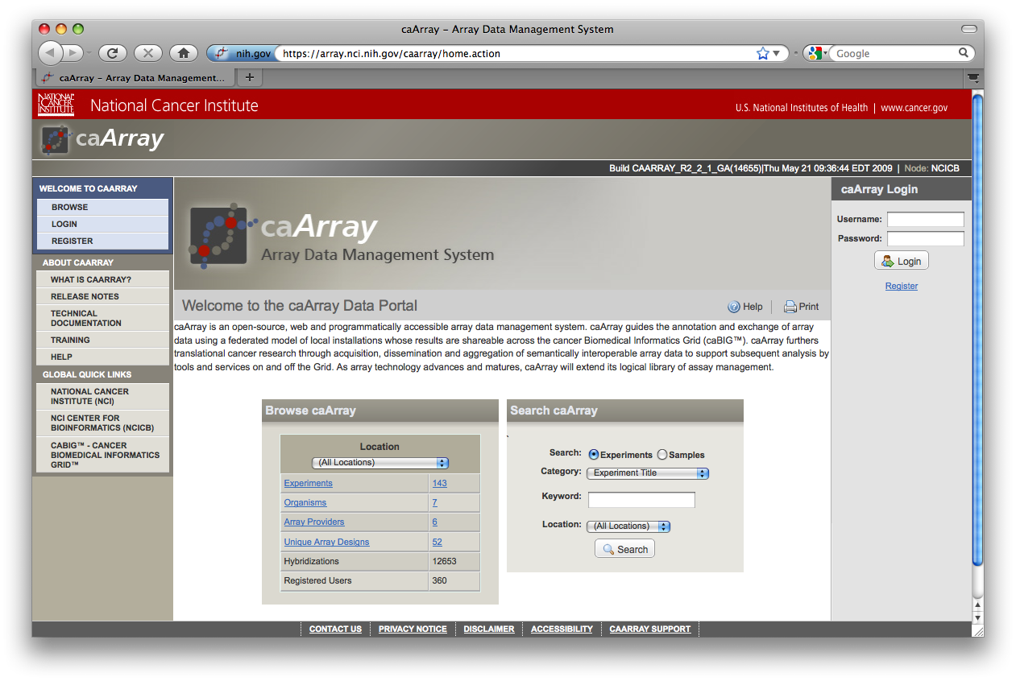
caArray Overview
Manage data/annotations through the life of an experiment
Collaborate & share pre-publication data with partners
Control access at experiment or sample level.
Install locally or use the central NCI instance

Slide 4
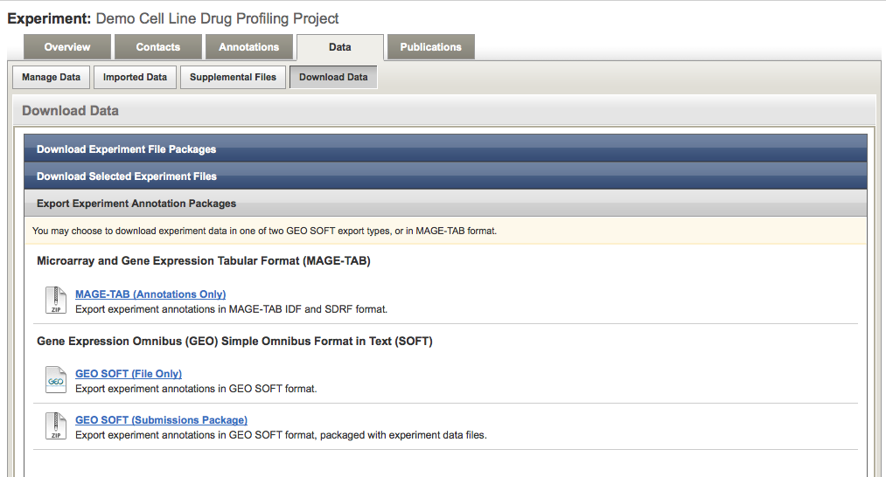
Import and Export in caArray
Import data and annotations using MAGE-TAB
  Associate data files to samples
  Annotate the experiment and samples using controlled vocabularies
  Specify protocols used to process samples and data
Export data and annotations
  Export into MAGE-TAB
  Export into SOFT format for subsequent GEO submission

Slide 5
Data in caArray
Native data
  Native files from various platforms and providers can be stored and associated to samples. E.g., Affymetrix, Agilent, Illumina, Nimblegen, Genepix, ImaGene
Parsed data
  In addition, caArray parses a subset of file types so that the data can be pulled by analytical clients using programmatic APIs. E.g., retrieve signal values from Affymetrix CHP file.

Slide 6
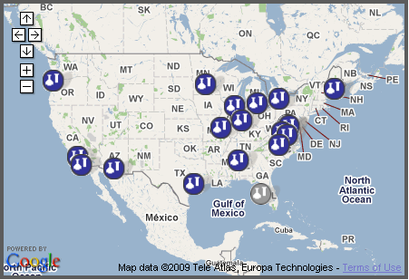
Programmatic APIs and the Grid
Programmatic APIs allow…
  search and retrieval of annotations and native data files
  retrieval of parsed data that can be passed on to analysis applications
Grid API and Java-only API
  Grid API: Retrieve public data across caArray installations on caGrid
  Java API: Retrieve public or private data

Slide 7
Clients of caArray
  Clients consuming caArray data via APIs include…
    GenePattern
    geWorkbench
    caIntegrator2
    caB2B
    Taverna workflows

Slide 8
caArray 2.4.0 – upcoming release
Timeline: expected release this month (August)
Scope: New Data Parsers
  Agilent:
    GEML/xml array designs (aCGH, gene expression and miRNA)
    Raw TXT data files (aCGH, gene expression and miRNA)
  Nimblegen – Community Code Contribution:
    NDF array designs
    Pair Report (raw and normalized) data files
  Illumina:
    BGX/TXT array designs
    Gene expression: Sample Probe Profile TXT files with unique Probe_Id
    Genotyping: Processed matrix TXT files with unique IlmnID values
  Affymetrix:
    AGCC/Command Console formats for CDF, CEL and CHP files.
    CNCHP files with copy number and LOH data.
  Copy number data in MAGE-TAB Data Matrix format

Slide 9
caArray 2.5.0
Plan for caArray 2.5.0
  Focus on upload/import/download of large data sets
    Support large data set imports without the need for chunking
    Support import of next gen sequencing files like SAM/BAM
    Add queue management to ease the import process
    Support resumable downloads and transparent compression
  Plan for Grid security
  Fix collaborator view of uploaded files
  Curate organisms, material types and protocol types
  Support search for experiments by publication
  Find & download samples within an experiment
  Upgrade Java (6), Jboss (5.1) and MySQL (5.1)

Slide 10
Avenues for Feedback
Molecular Analysis Tools Knowledge Center Forum:
  https://cabig-kc.nci.nih.gov/Molecular/forums/
Gforge Community Change Request tracker
  http://gforge.nci.nih.gov/tracker/?atid=1339&group_id=305&func=browse
This meeting. The next caArray session on the ICR-WS will be on:
  Wednesday, October 13, 2:00 PM ET

