Slide 1


caArray User Community Meeting
caArray: A Microarray Data Management System
2.2.0 Feature Overview and Review of MAGE-TAB Update and Export Specification
Call in: 877-416-5524
Participant Passcode: 2627056
Centra: http://ncicb.centra.com
Meeting ID: ICR_meeting
November 5, 2008
caBIG Meeting
NCI-Frederick
November 3, 2009

Slide 2
Agenda
Overview of caArray
Workflow and Collaboration
Data Submission and Standards
Data Analysis
Roadmap for the Future
Get Started

Slide 3
caArray Overview
More than a simple repository for microarray data.
Supports data management throughout life of experiment.
Allows collaborative sharing of pre-publication data with a set of partners.
Combine caArray with other components of the caBIG® Life Science Distribution Bundle to form a comprehensive solution for biospecimen management, array data management, search and analysis.

Slide 4
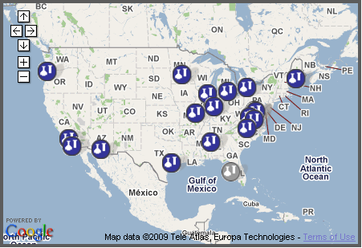
caArray Overview
  Federated model allows researchers to search data across laboratories which host their own installations of caArray.
  Rich programmatic APIs that allow analytical tools (on and off the Grid) to pull data from caArray and visualize/analyze it.

Slide 5
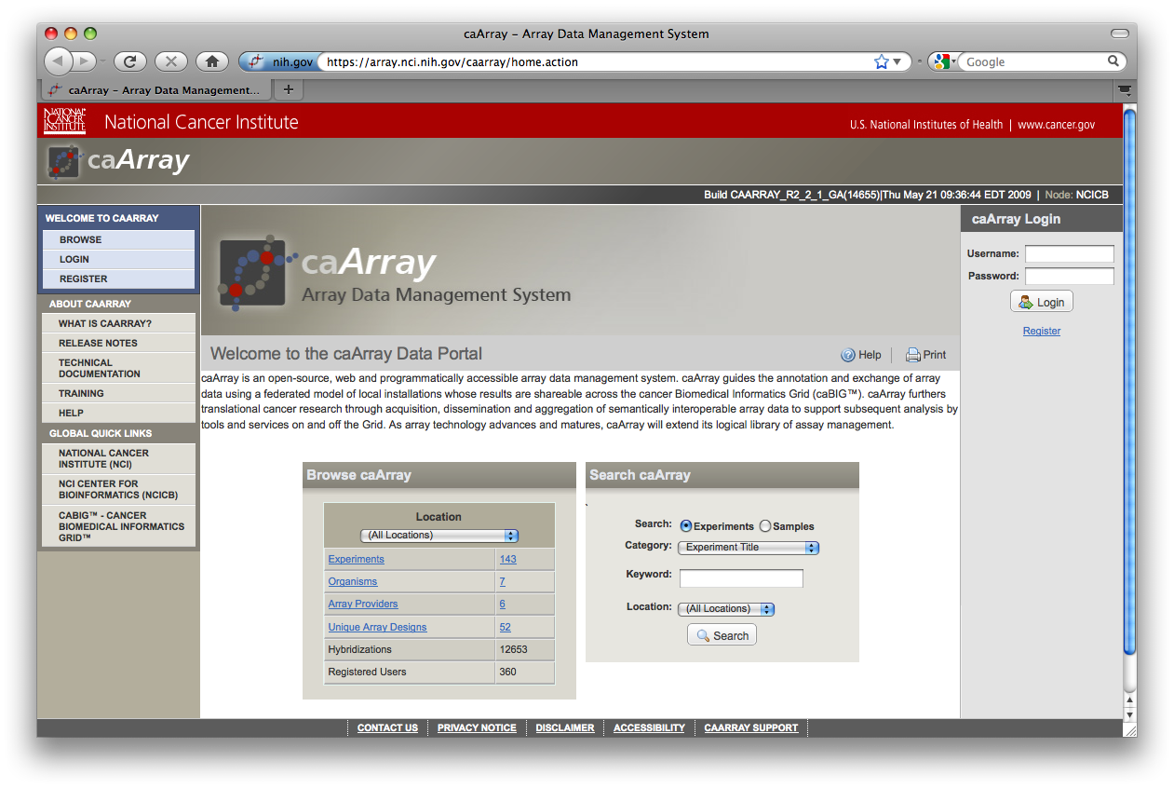
caArray Overview
User-friendly web interface for browse and search.
Native data files from various platforms and providers can be stored and associated to samples.
Parses data from Affymetrix, Illumina and Genepix formatted data files for use in data analysis.

Slide 6
Workflow
Bench scientists can securely store data and annotations as they become available during the experiment.

Slide 7
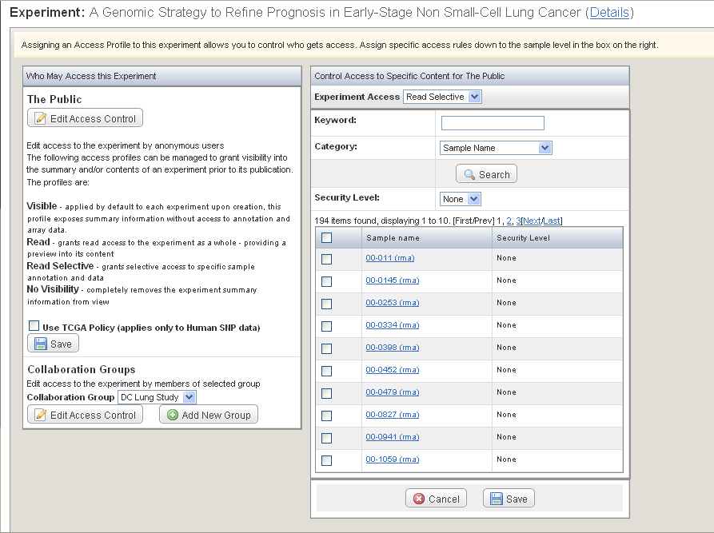
Collaboration
Investigators can define collaboration groups for sharing of pre-publication data with a set of partners.
Sophisticated access control at the experiment level or at the level of individual samples.
Data is private until made public by the Data Owner.

Slide 8
Data Submission and Standards
A bench scientist can use MAGE-TAB to bulk-import data and annotations in a familiar spreadsheet format.
Can easily include annotations referencing controlled vocabularies like MGED Ontology and NCI Thesaurus.
Easy to bulk-update annotations as experiment progresses (using MAGE-TAB).
  Old and new annotations are merged in an intuitive manner.
The NCI CBIIT instance of caArray is supported by a team of curators who load data from key NCI initiatives including TCGA and TARGET.

Slide 9
Data Submission and Standards
MAGE-TAB, a spreadsheet-based format for annotating and exchanging microarray data in a MIAME-compliant fashion - http://www.mged.org/mage-tab.
MAGE-TAB components:
  Investigation Description Format (IDF): General information about the investigation including its name, a brief description, the investigator’s contact details, bibliographic references, etc.
  Sample and Data Relationship Format (SDRF): Describes the relationships between the samples, arrays, data, and other objects used or produced in the investigation

Slide 10




Data Analysis
  geWorkbench
    Pull parsed gene expression data from caArray and visualize.
  GenePattern
    Pull native data files from caArray and do gene expression or SNP analysis.
  caB2B
    Discover and search data from multiple caArray sites across caGrid.
    Query across caTissue, caArray and NBIA.
  caIntegrator2
    Pull parsed gene expression data and native copy number data from caArray.
    Integrate with clinical data and analyze.

Slide 11
Data Analysis
caArray Programmatic APIs
  Java API
  Grid API
Search for experiments
Search for biomaterials
Search for files, hybridizations, quantitation types
Download file content
Download parsed data sets
Download sample annotations
Look up disease states, array designs, PIs, etc.

Slide 12
Roadmap: Next Release
caArray 2.3.1
Release targeted for early January.
Primary feature: Export to GEO
  Problem:
    Users store their data + annotations in caArray. When ready to publish, they have to repackage the same data in order to publish it in GEO.
  Solution:
    caArray will allow the user to export an experiment into GEO SOFT format. This SOFT package can then be submitted to GEO.
    The initial release will support single-channel experiments that have Affymetrix CHP data files, and that are based on array designs (platforms) already in GEO.
    Focussing on CHP files allows us to package the native data files in the SOFT package as opposed to having to derive data tables to include in the SOFT submission.

Slide 13
Roadmap: Priority Features
Integrate caArray with biospecimen systems (caTissue).
  Problems:
    Various ad hoc systems (like email/paper) are used during the lab workflow in order to transfer specimen information from the biospecimen system to the assay system (caArray).
    Users need a way to look up data associated with a specimen they found in the biospecimen system.
    Users need a way to look up the specimens associated with data they found in caArray.
  Possible Solution:
    Use an "external ID" biomaterial characteristic in caArray to store the identifier for the specimen as defined by the biospecimen system.
    Provide a mechanism for transfer of specimens (with selected annotations) between caArray and the biospecimen system. This could be through a MAGE-TAB spreadsheet, and/or via programmatic services.
    Provide APIs that allow a Data Integration system (like caB2B) to search for biomaterials by external ID.

Slide 14
Roadmap: Priority Features
Add parsers for the latest Illumina data formats.
Enable development and distribution of plug-in parsers.
Support Grid API access to protected data.
Provide a writable API to allow programmatic loading of data into caArray as part of existing pipelines.
Controlled vocabulary:
  Suggest alternative terms already available.
  Allow curator to merge duplicate terms.

Slide 15
Get Started
Browse the caArray instance at NCI CBIIT
  http://array.nci.nih.gov/
  Public data sets from TCGA, Rembrandt, TARGET and GSK
Upload your data to caArray
  Test with guest account (username=caarrayGuest, password=caarrayGuest)
  Register for an account to upload and store real data
Install your own caArray instance
  Easy-to-use GUI installer at https://gforge.nci.nih.gov/frs/?group_id=305
  Release 2.3.0 will be available in early November.
Get the Life Sciences Distribution bundle
  Includes caArray, caTissue, caB2B, caIntegrator2, NBIA, geWorkbench
  New release will be available in November.

Slide 16
Support
Molecular Analysis Tools Knowledge Center
  https://cabig-kc.nci.nih.gov/Molecular/KC/index.php/CaArray#About_caArray
  Forums
  Demos and Instructional videos
    How to share pre-published data in caArray: https://cabig-kc.nci.nih.gov/Molecular/uploaded_files/6/67/Sharing_Prepublished_data.ppt
    How to retrieve Affymetrix data from caArray into geWorkbench: https://cabig-kc.nci.nih.gov/Molecular/uploaded_files/5/58/GeWorkbench_Remote_Access.ppt
    Open-source development: https://cabig-kc.nci.nih.gov/Molecular/KC/index.php/Caarray020
Monthly caArray User Community web conference
  First Wednesday of every month

