Slide 1
caArray 2.0
Inception Post-Mortem
Tuesday, May 22, 2007
Notes:
Post mortem title

Slide 2
Before we begin
In Case Anyone Feels Intimidated…
  The caArray Development team uses Iteration Postmortems and Reviews as a means to improve – Our Process, Our Delivery, and Ourselves
  “Regardless of what we discover, we must understand and truly believe that everyone did the best job he or she could, given what was known at the time, his or her skills and abilities, and the situation at hand.”
    Norman Kerth, from Project Retrospectives, a Handbook for Team Reviews

Slide 3
Agenda
Goals of the Meeting
  What are post mortems for
  Who’s the team
  High level characteristics
  Iteration Goals
What Happened and What is Scheduled to Happen
  Product Manager’s View
  Project Manager’s View
  Architect’s View

Slide 4
Goals of Any Postmortem
Reveal and Share the Gold:
  What worked well that we don’t want to forget
  What we learned
  What we should do differently next time
  What still puzzles us
  What we need to discuss in greater detail
Notes:
Note: Kerth recommends tracking each of these on a flipchart/whiteboard as the postmortem progresses.

Slide 5
Iteration Characteristics
Project Name | caArray 2.0
Customer | NCICB
Iteration Name | Inception 1
Started | 04/02/2007
Finished | 05/18/2007
Binary Result | Complete
Development Team Size | 4

Slide 6
Initially Articulated Project Risks
Identified
  caArray perception in the community and internally is laced with failure to meet expectations
  Procedural and organizational change
  Lack of detailed awareness of who and what is using caArray as a data source
  Balance current user needs and requests for 1.x against the desire to release a new version
  Timing of the 2.0 release and pressure to get it
  Working with updated technologies (EJB 3, Hibernate 3.2, Java Server Faces)
  Integrating with EVS, Analysis Services, caBIO
Process for managing Risk items and resolution strategy to come

Slide 7
Players
Development Team – Brent, Eric, John, Rashmi
Product Management – Juli,
Community Relations - Mervi
Engineering Management – Anand
External Stakeholders – see Vision Section Stakeholders
Internal Stakeholders to be involved more going forward
  Independent Quality Assurance, Systems, Application Support, Documentation

Slide 8
Goals of Inception Iteration 1
Establish the Vision of the Product
Elicit and Prioritize the Requirements
Establish a representative and maintainable Use Case Model
Research Architectural Constraints and Approaches
  Against the current application
  Supporting caBIG-wide elements and tools
Build out an initial prototype of the “to be” architecture
  Demonstrate functionality employing all layers of candidate architecture
  Integrate with EVS
  Determine and implement caCORE code-generation approach
  Design and implement MAGE-OM API
  Design and implement authorization logic
Coordinate with QA a use case oriented approach for traceability and testing
Create a maintainable environment

Slide 9
Success Criteria
Clearly articulated requirements that have been prioritized by the user community and the Product Manager that can be validated by independent QA for testability
Documented Candidate Architecture that represents the layering of the system and the technologies to be employed
A running prototype that demonstrates the candidate architecture
A stable development environment that can support the automation of deployment requests and testing
A reasonable plan for Elaboration Iteration 1 and version 2.0 as a whole
Notes:
Author: Put success criteria from Iteration Plan here.

Slide 10
Product Manager’s View
We obtained a good sampling of input from external stakeholders and several internal stakeholders
  F2F and phone interviews drove much of the content of the Vision document – over 20 hrs of interviews
  Feedback on resulting Vision document – still to be analyzed
Internal communication needs to improve
  Challenge of running the 1.5 release in parallel with the 2.0 Inception
Timelines are proposed
  If the Test Plan to come doesn’t fit into the current proposed schedule, the features will be re-evaluated

Slide 11
Revisit Overall Phase Goals
Inception (What are we doing)
  Where the project is scoped and stakeholder buy-in is sought. Long-range planning is done, environments are established, detail is provided on what is to be built.
Elaboration (How will we do it)
  Where the envisioned architecture of the finished system is implemented sufficiently that it can be executed and objectively measured.
Construction (Do it)
  The most labor-intensive phase, with the largest staff size and the most code being churned out. A successful construction phase will result in a complete product that is ready to be deployed to the user community.
Transition (Deliver it)
  Where the user community will progressively be exposed to and use the system being developed. Includes testing the product in preparation for release, and making minor, fine-tuning adjustments based on user feedback.

Slide 12
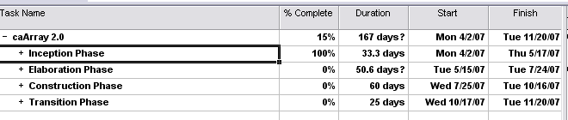
Project Manager’s View of the Iteration
Majority of Goals Met
  The overall plan is established though subject to review, negotiation and finalization
  The requirements are established – negotiation on what’s in and out will occur in E1
  Architectural concepts were crafted, threads proven and major investigation into key elements planned
  Test Environment and Tools established
  Development Environment created
  Configuration and Change management procedures drafted
Notes:
Author: Put Project Manager’s Assessment here.
Feel free to use multiple slides.
Bear in mind our overall goals of the postmortem. Focus on project management issues and:
What worked well that we don’t want to forget
What we learned
What we should do differently next time
What still puzzles us
What we need to discuss in greater detail
This will conclude the manager’s portion of the presentation.
They should hand off to the Lead Architect.

Slide 13
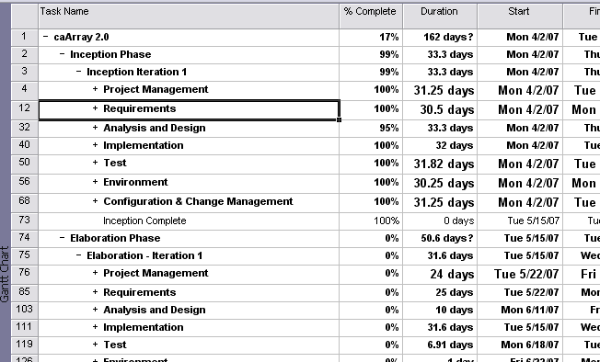
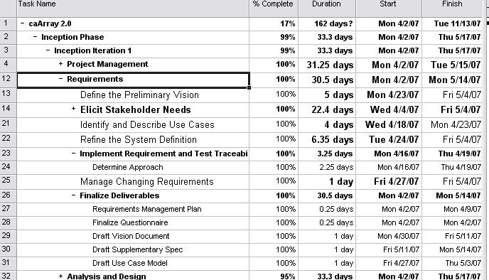
How we organized the Dev Project Plan
At the highest level: Generation, Phase, Iteration
Tasks are broken out by Discipline
Each Discipline has distinct Deliverables
  See Development Case for what is must, should, optional according to Phase
  Use Case Oriented
Plan is officially updated weekly

Slide 14
Parallel caArray Paths
May June July August September Oct.
1.5
1.6
RC
2.0
I1
E1
E2
C1
C2
C3
1.5+ support

Slide 15
What we did well
Interaction with External User Community
Established Draft Process and Plan Proposals
Produced Supporting Documentation
Built what we said we we’d build

Slide 16
Targets for Improvement
Clarity of Success Criteria upfront
  Need to be certain (e.g., documented) of what “complete” means for each iteration
Coordination between Development, IQA, Systems, Application Support
Cross Team Process Mentoring

Slide 17
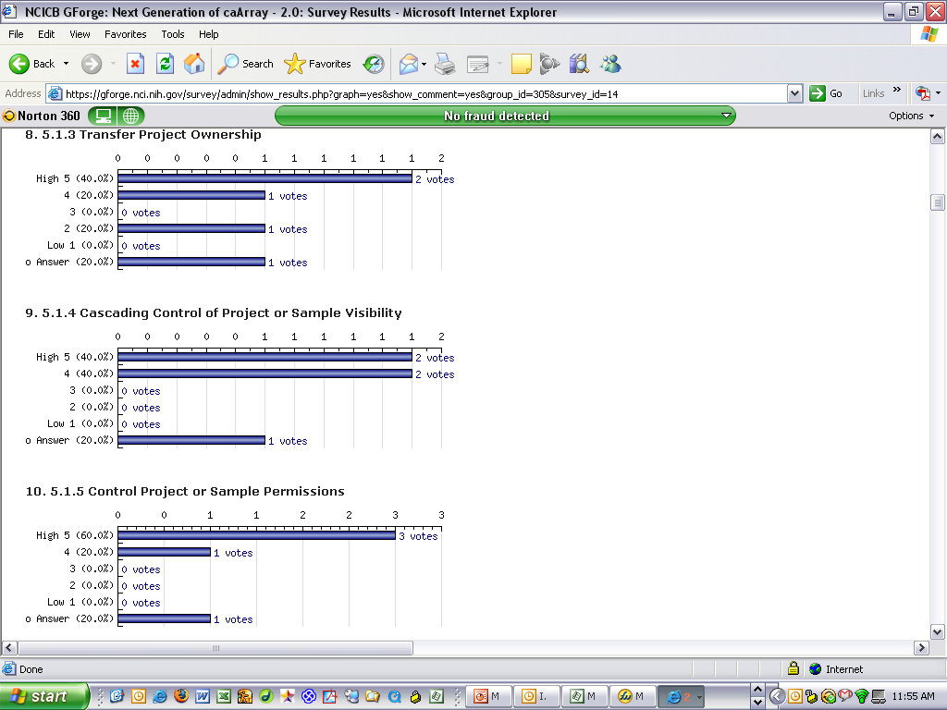
Requirements
Elicitation went well – needs and features acquired, written and documented
GForge Implementation of how we represent requirements is a work in progress
  Traceability remains a problem
Use Case Model Organized and Prioritized for E1
  Prioritization for 2.0 to be done in E1
Requirements Management Plan established

Slide 18
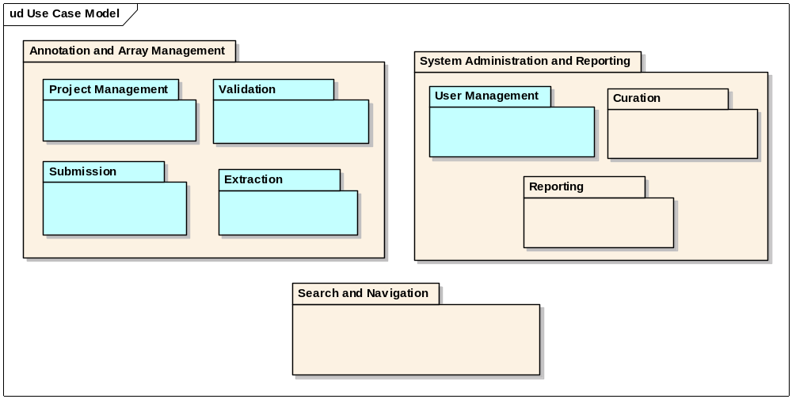
Requirements: Use-Case Organization
Notes:
Author: Put a use-case diagram (hopefully in iteration plan as well) that is color coded or fill patterned to show use-cases that were:
Previously implemented
Implemented Partially during this iteration
Implemented Fully during this iteration
Leave all TBD and Wish List use-cases in their subtle form

Slide 19
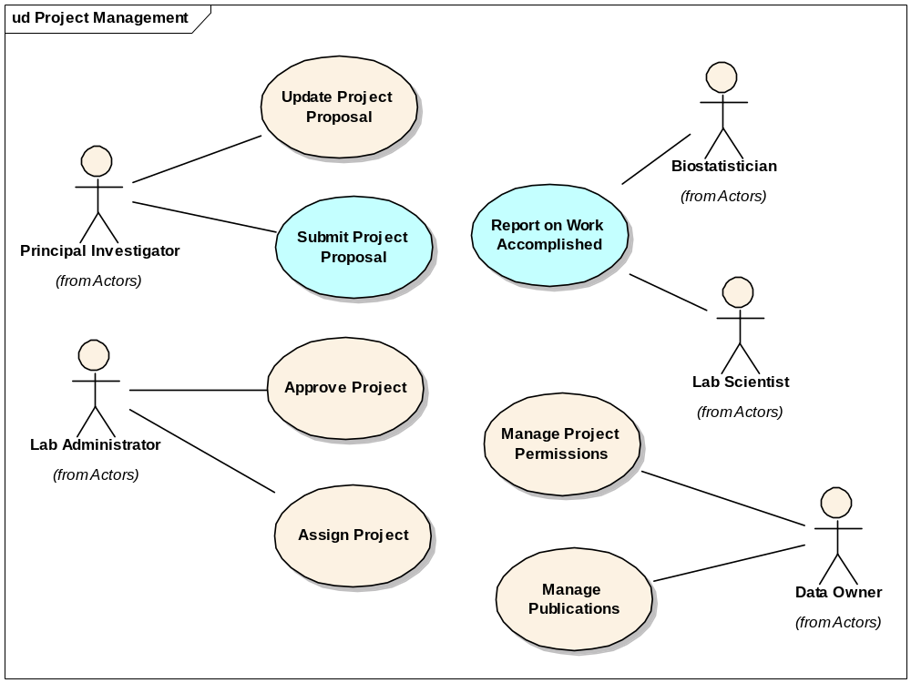
Targeted Use Cases for E1

Slide 20
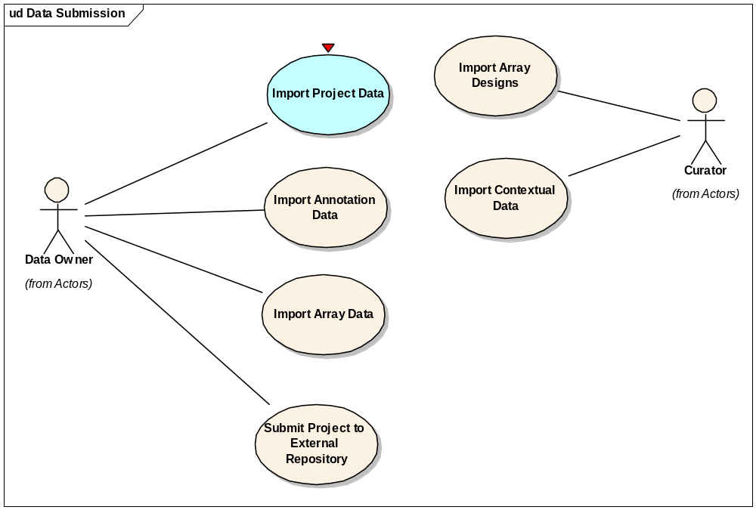
Targeted Use Cases for E1

Slide 21

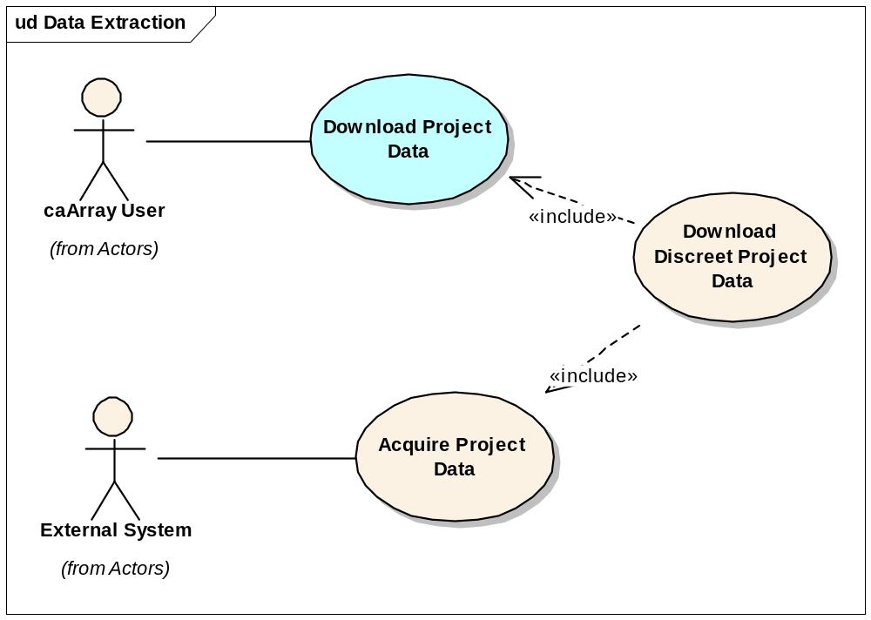
Targeted Use Cases for E1

Slide 22
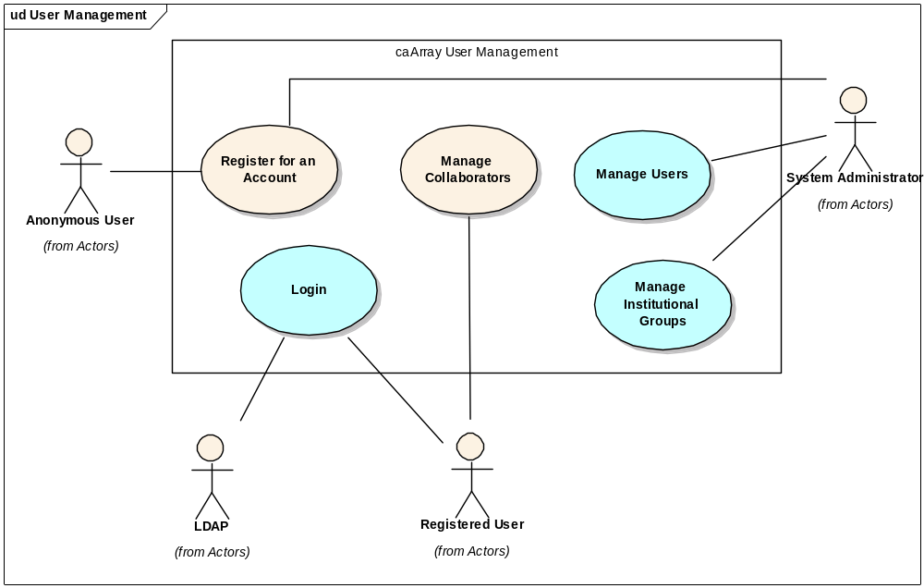
Targeted Use Cases for E1

Slide 23
Architect’s View of the Iteration
Technical Accomplishments
  Designed and implemented the candidate architecture
  Designed initial draft of the underlying domain object model
  Investigated and designed approach to MAGE-OM API
Environmental Accomplishments
  Documented and implemented software development process
  Defined coding standards and automated quality checks
  Implemented development and continuous integration environments

Slide 24
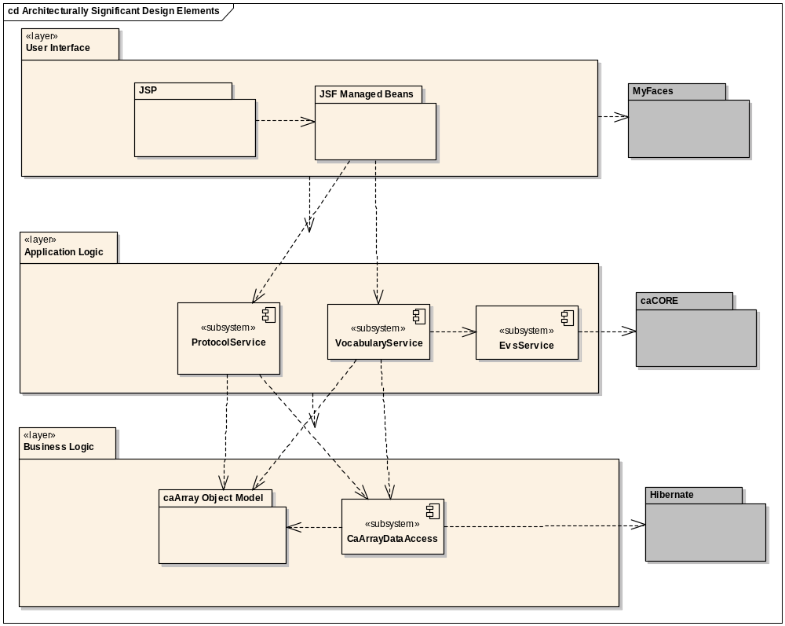
Candidate Architecture Implemented
J2EE 1.4
EJB 3.0
JSF 1.1
  MyFaces 1.1.5
Hibernate 3.2
EVS integration
For complete details:
  Software Architecture Document
  UML model

Slide 25
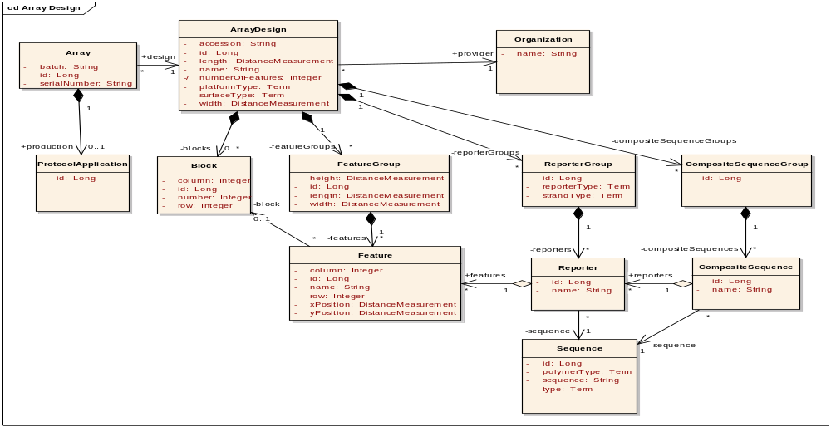
Domain Object Model
Drafted initial cut of simplified microarray domain model
  MAGE-OM overly complex, difficult for implementers and clients alike

Slide 26
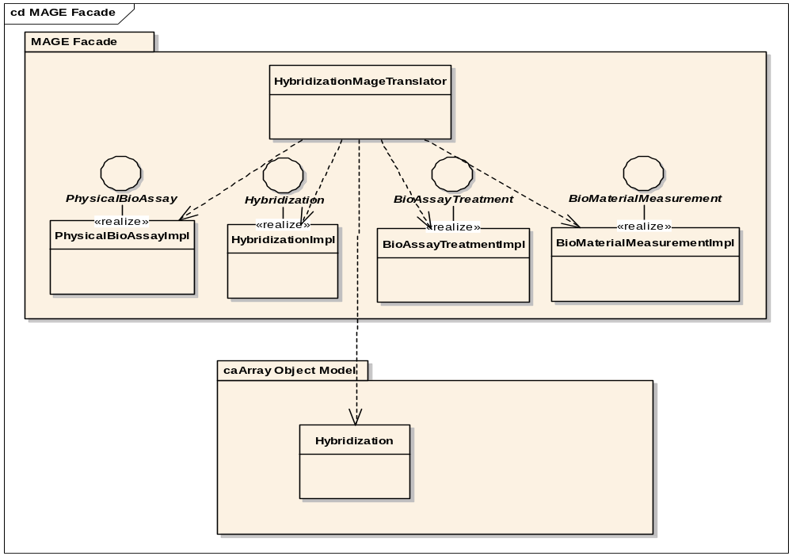
MAGE-OM API Approach
Explored various alternatives to support legacy MAGE-OM API
Settled on translation based approach
Determining whether MAGE-OM API support is required at all

Slide 27
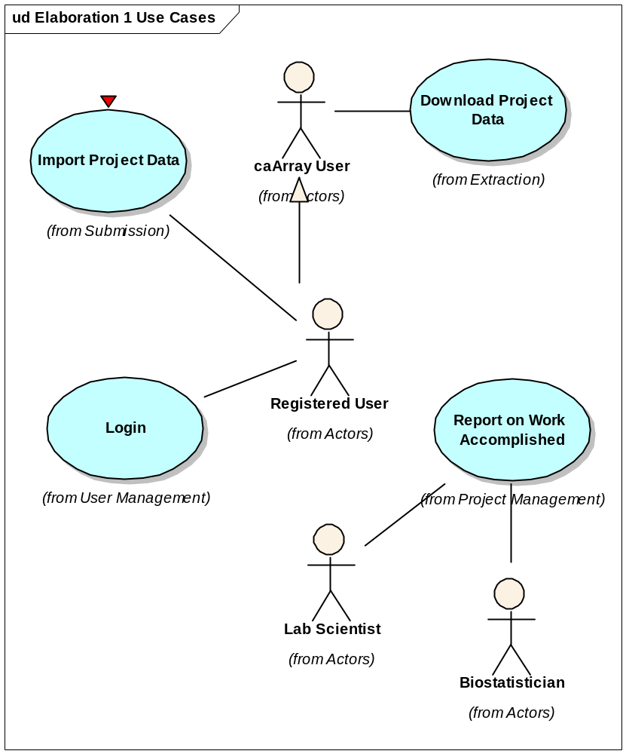
Use Cases Scheduled for Initial Implementation in E1

Slide 28
Closing Topics
Unexpected Topics and Questions
Review what needs to be discussed in more detail
Any issues/questions resolved today
What’s next
Notes:
This one goes back to the project manager to put it all together.

