Slide 1
caArray 2.0 Scope

Slide 2
caArray 2.0
Timeline
Data types supported
Data input
Data retrieval
Permission and Security
Searches
1.x >> 2.0 transition
Future releases

Slide 3
Timeline
caArray 2.0 will be part of the Life Science Distribution
  Alpha release scheduled for October 19
  Beta releases scheduled for November 16 and November 30
  General Availability release scheduled for December 14

Slide 4
Supported file formats
Supported file formats
  Affymetrix Expression
  Affymetrix SNP
  Illumina Expression
  Illumina SNP
Custom Spotted Arrays
  Genepix
Determining the number of pre-bundled Array Designs within supported formats
  Otherwise, the ability to import array designs to supportable manufacturers is available

Slide 5
Data input and export
Data input
  Web portal
    Use of MGED Ontologies for annotation
  MAGE-TAB
    Native hyb data associated as Data External
Data export
  Query via the web portal; download native files
    Download selected files for an experiment or the whole experiment
    Download files for selected samples in an experiment
  APIs – both perform the same read-only functions
    Remote Java API
      Provides an alternative remote API to the grid service. Users that are not grid enabled, or otherwise prefer features available in Java (e.g., streaming of data files)
    Grid Service
      Compliant with Grid 1.1
      Standard Data Method (CQL)
      And an Analytic Service

Slide 6
API
Support for MAGE-TAB level of annotation
Harmonized with caTissue and caBIO
Convenience methods will be provided for retrieval of hyb data
  The Data Service: The data available via the data service is any information stored in caArray 2.0 that does not require inspecting the contents of individual data files. Examples of this type of data are:
    Experiment information such as name and collaborators
    Hybridization information
    File name or type (but not contents)
  The Analytic Service: The analytic service provides access to information stored within files. Examples of this data include:
    Full file contents

Slide 7
Permissions and Security
Role-based permissions for each Installation
  Anonymous user
  PI
  Research scientist
  Lab Manager
  Lab Scientist
  Biostatistican
  System Administrator
Most Data is Private until made Public
  Ticklers of information are searchable (title, PI, number of samples) but deep experiment content is not available to the anonymous user
Collaboration groups can be managed by the PI to give pre-public insight
CSM 4.0
  Field level security available but not definable on the UI

Slide 8
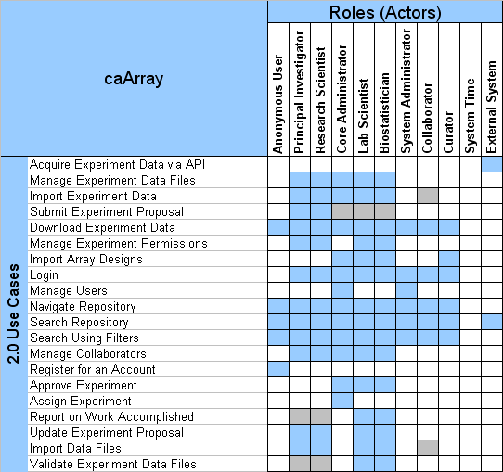
caArray 2.0 Roles to Capabilities Matrix
Notes:
all data owners can manage experiment files
if given permission to do so on a particular experiment or samples within an experiment
lab personnel may want to create their own experiments but would be treated as a PI
public data = everyone, private data is restricted based on experiment/sample permission
ext. system uses the API, not the UI
dependent on experiment type - (full, partial, analysis), PI/RS may need to execute this

Slide 9
Browse and search
Browse by
  Experiments
  Species
  Platform
  Array design
Search by specifying a(n)
  Experiment Name
  Experiment ID
  Platform type
  Principle Investigator
  Species
  Disease
Results are returned organized by Experiment, with the associated Samples

Slide 10
1.x >> 2.0 transition
The CBIIT production instance 1.x will be converted to read-only upon release of 2.0
  To avoid two instances where data could be loaded
Read-only 1.x will be kept up for at least 6 months – longer if needed by the community
Data from 1.x will be migrated to 2.0
  Migration utility will be provided for local installers of caArray
  1.x Experiments URLs will be supported in 2.0 so that external references are maintained

Slide 11
Future releases
User Management
  Managing Institutional Groups
  Consortium Management
Assay and Data Formats
  Chip-CHIP, RNAi
Workflow Enhancements
  Submission to specific groups within an institution
  Lab Workflow – particularly quality control data and sophistication of the interface
  Managing Publications
  Assignment of Experiments to Lab Personnel
Data Curation
Reporting

