Slide 1
caArray 2.0
Development to QA Handoff Preparation
Friday August 10, 2007

Slide 2
Agenda
Paradigm Shift – Iterative Development (5 min)
Current 2.0 Scope (10 min)
Current 2.0 Schedule (15 min)
Process and Content of Development Deliveries (20 min)
Overview of Build and Deploy Automation (15 min)
Questions on Documents and Open Discussion (25 min)

Slide 3
Paradigm Shift – Iterative Development
We are moving to an iterative development process at CBIIT
The goal of the process change is to:
  Increase Repeatability
  Increase Predictability
  Reduce Risk
  Provide Visibility to Progress
  Provide an improved product to our customers and to be more responsive to their requests and needs
caArray 2.0 is the reference implementation for the Center
Iterative Development is a global shift for all teams
  Want to move to an interdependent model
  We are a step 0 – moving to step 1

Slide 4
The process is evolutionary
Controlled
  Based on a plan with verifiable progress
Incremental
  The system is built, segment-by-segment, across the iterations
Iterative
  A set of tasks are repeated to improve system quality
How will we achieve this for caArray 2.0? Some key points:
  Controlled:
    Clearly documented use cases, requirements, and test cases that support Traceability
  Incremental
    Biweekly delivery of code from Dev to QA
  Iterative
    Automated testing by both Dev and QA
    Automated build and deploy process to support iterations

Slide 5
Agenda
Paradigm Shift – Iterative Development (5 min)
Current 2.0 Scope (10 min)
Current 2.0 Schedule (15 min)
Process and Content of Development Deliveries (20 min)
Overview of Build and Deploy Automation (15 min)
Questions on Documents and Open Discussion (25 min)

Slide 6
Current 2.0 Scope
The focus will be on making the same functionality available in the 1.x product line available in the 2.0 release with improved performance, usability and a subset of additional features in one application (vs. 4)
Super High Level Features | 1.X | 2.0
Upload, Validation, Importing, Downloading of Data | Applet and caAMEL (MAGE-ML) | Native GUI for native files and MAGE-TAB
Project Annotation | caArray Portal – one page submission | caArray – with basic workflow
Grid API Access acquring biodatacubes | MAGE-OM API and caArray Grid Service | caArray with revised model
Search for annotation and data | caArray Portal | caArray with ability to act on results

Slide 7
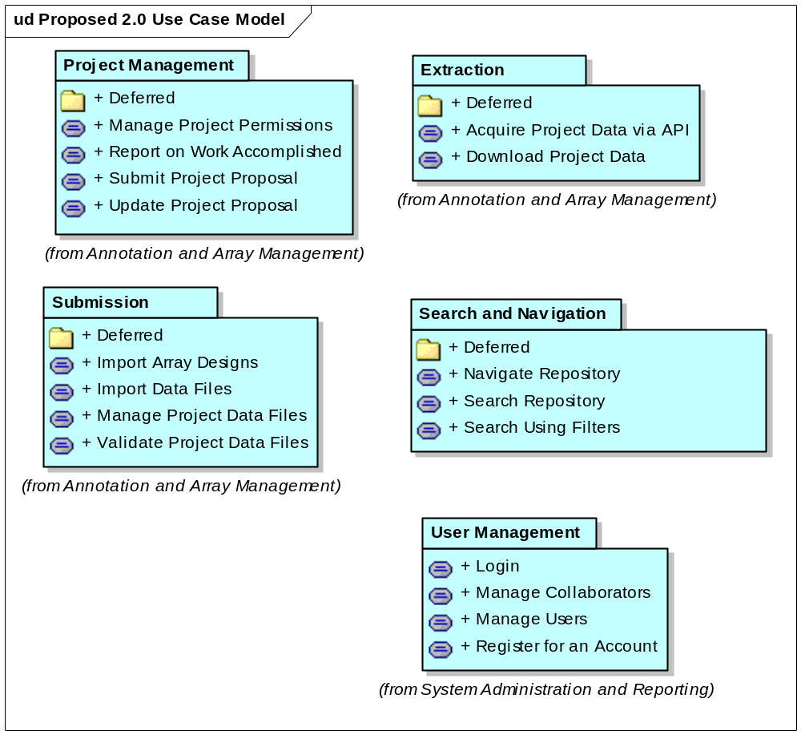
Scope Described with Use Cases

Slide 8
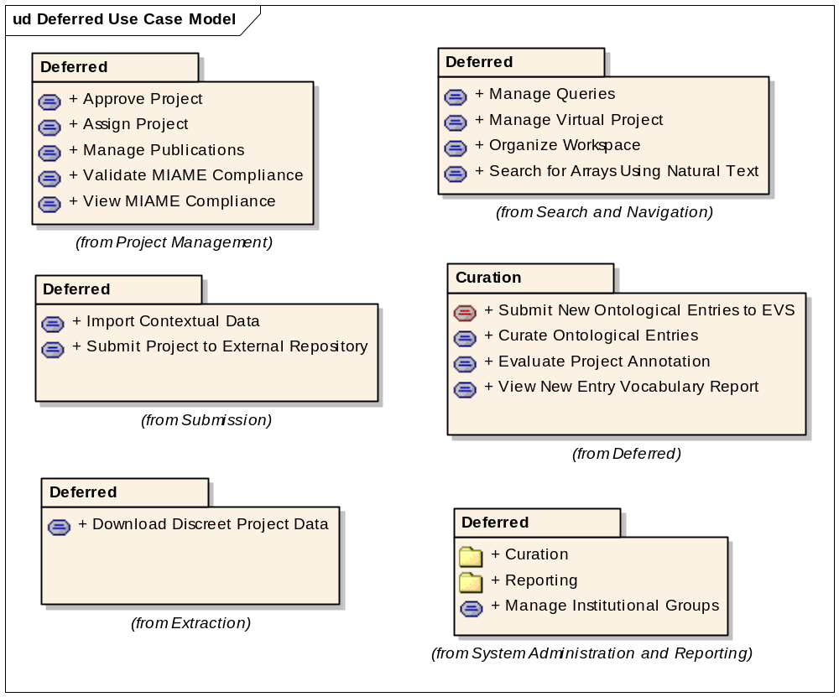
What Got Scoped Out

Slide 9
Not all requirements fit into Use Cases
The Supplemental Requirements document covers:
  System Requirements and Design Constraints
  Usability
  Performance
  Reliability
  Documentation

Slide 10
Agenda
Paradigm Shift – Iterative Development (5 min)
Current 2.0 Scope (10 min)
Current 2.0 Schedule (15 min)
Process and Content of Development Deliveries (20 min)
Overview of Build and Deploy Automation (15 min)
Questions on Documents and Open Discussion (25 min)

Slide 11
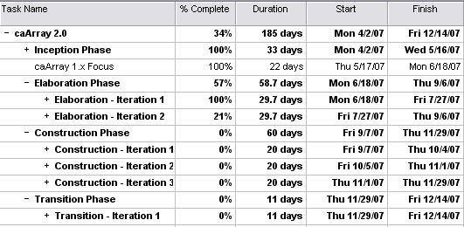
Current 2.0 Iteration Schedule
We are here
Release date is critical
and non-negotiable

Slide 12
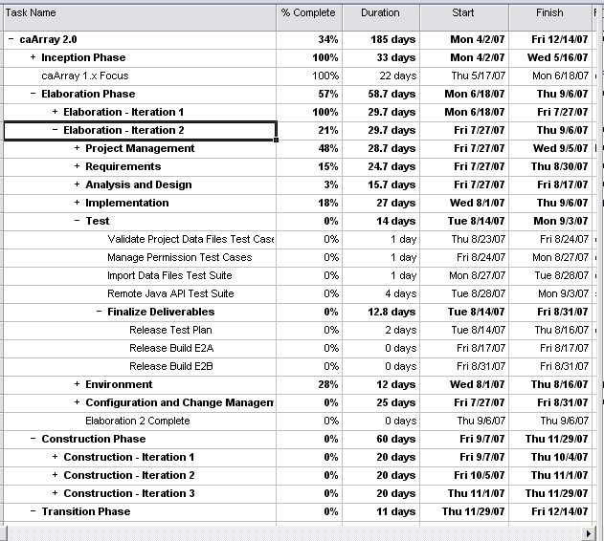
E2 Schedule – with Test Highlighted
Builds
Highlighted
Here

Slide 13
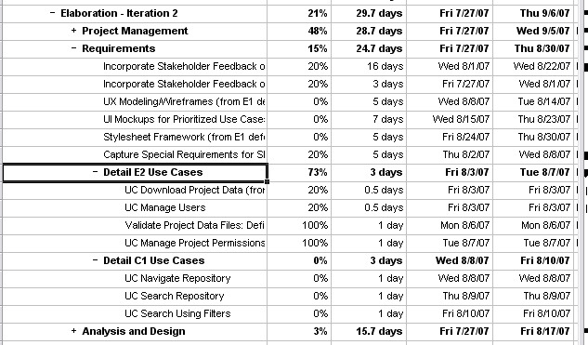
E2 Schedule with Requirements Highlighted
E2
C1

Slide 14
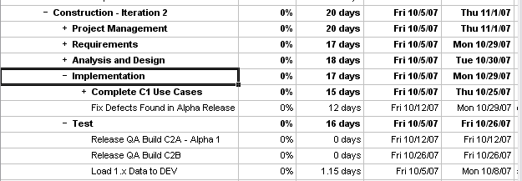
Initial Alpha Release
Alpha release *may* be provided to a limited number of customers

Slide 15
Agenda
Paradigm Shift – Iterative Development (5 min)
Current 2.0 Scope (10 min)
Current 2.0 Schedule (15 min)
Process and Content of Development Deliveries (20 min)
Overview of Build and Deploy Automation (15 min)
Questions on Documents and Open Discussion (25 min)

Slide 16
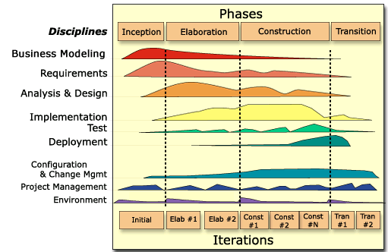
Delivery Process to QA – Every 2 weeks
Risks
  Significant change across all teams will require greater coordination
  Three prongs – new development, extensions to existing functionality, rolling bug fixes
Pros
  Software is delivered through all tiers faster
  Response time to issues and customer needs vastly improved
Notes:
Phase Boundaries are – Objectives, Architecture, Operational, Release

Slide 17
What’s In the 2.0 Tags – The Artifacts Delivered
With Every Tag (and later to be done at any time)
  The complete set of documents at the time
    Organized by disciple
  The complete set of code at the time
  The GForge Representation of the Use Cases, Supplemental Specs, and Development Test Cases related to the delivery
  GUI visibility into Dev’s automated unit tests and functional tests available through the integration machine via CruiseControl
    http://6116-caarray-int.nci.nih.gov:9191/buildresults/caarray2

Slide 18
Discussion Point – Helping Each Other
As part of the recently adopted weekly tag, we will continue to support QA’s request of:
  What is being worked on
  What the tag name is
  What is in the tag (bug tracker items)
However, additional information will be necessary as we handle scope, slivers of functionality, rolling bugs, and fixed bugs
  Discussion will need to center around what should we write versus what we can display in GForge and what might need to be in both places – e.g., a written email as we currently do and the corresponding updates in GForge
  Granularity is also a point for discussion
    A single use case may not be implemented fully – for example the basic flow might be the only part of the use case done
    Should each flow be documented in GForge
    Suggestion – we indicate when the use case or use case flow was first introduced into the delivery, not update it for every delivery

Slide 19
Use of GForge
We are going to try to use GForge as the defacto mechanism for communication to all stakeholders
  Decrease reliance on email as the primary method of communication
  Increase visibility and clarity of GForge (it’s a tool not a job)
  Use Cases are currently available
  Granularity of Test Case Representation being evaluated (may be at the use case level or highlight specific flows – basic, alternate, exception)
We are increasing the use of code quality, testing and build automation tools
  Will directly lead to greater confidence in what’s delivered
  Want to reduce environment variability

Slide 20
Agenda
Paradigm Shift – Iterative Development (5 min)
Current 2.0 Scope (10 min)
Current 2.0 Schedule (15 min)
Process and Content of Development Deliveries (20 min)
Overview of Build and Deploy Automation (15 min)
Questions on Documents and Open Discussion (25 min)

Slide 21
Build and Deploy Automation Pilot
Make Deployment the “click of a button”
What: Speed up delivery time by decreasing manual processes
  Integrate configuration into the build process rather than requiring manual intervention
How: Convert attributes (currently maintained in Word documents) into files that are machine-readable (an automated system)
Why: Enable caArray 2 to adapt to changes and deliver software faster with fewer deployment errors

Slide 22
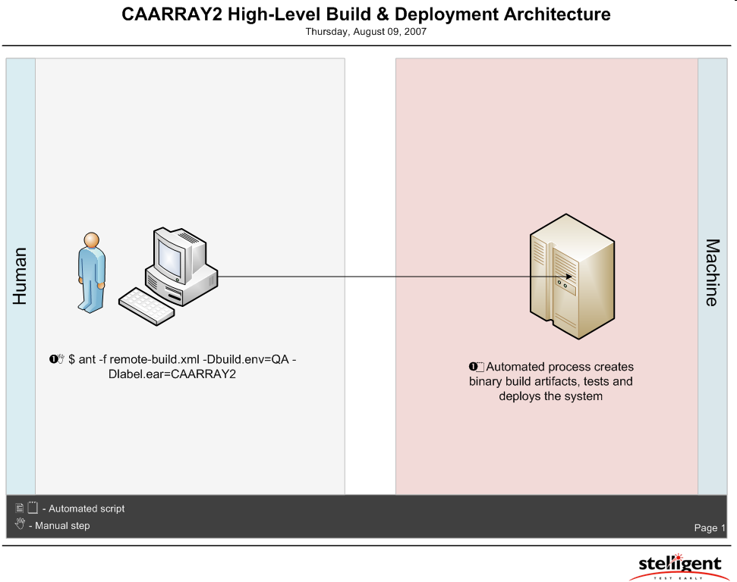
User Actions

Slide 23
Benefits
More time testing. Less time troubleshooting error-prone deployment steps
  Redeploy in minutes (from a baseline configuration)
  Development can remotely deploy to DEV environment in a single command
  QA can remotely deploy to QA environment in a single command
  MySQL database is updated remotely
  JBoss is completely configured remotely
Single Source Repository
  All source code and application configuration is maintained in SVN
Maintain Security
  caarray2-key.properties file is publicly accessible, while the dev.properties, qa.properties and staging.properties can be restricted to authorized users or machines
Reduce wild-goose chases (i.e. Build system is king)
  All application/deployment configuration is managed through the build scripts
    Not hard-coded values in the source code
    Not vendor-specific XML files
    This includes JBoss and MySQL
No duplication of resources
  Reuse of caArray’s existing build scripts
  Extensions written for remote deployment without changing existing build scripts

Slide 24
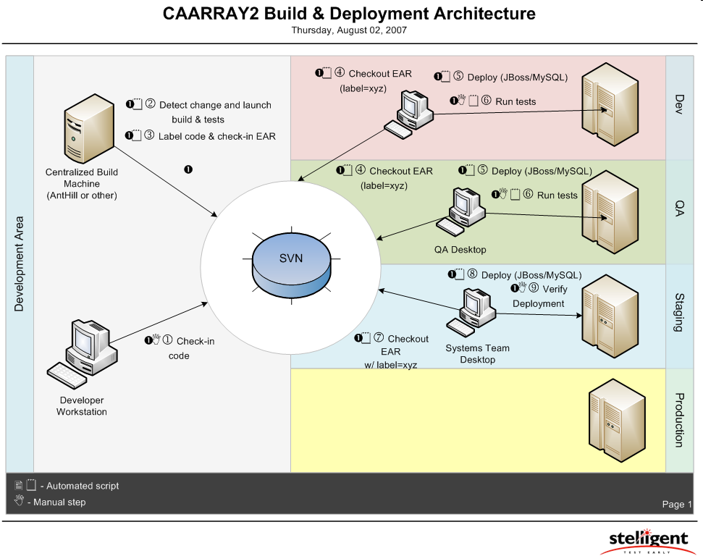
Build and Deployment Architecture for caArray 2 Pilot

Slide 25
caArray 2 – High-Level Build and Deployment Steps
Developer checks-in code to SVN
From a centralized integration build machine, (similar to target environments) a developer runs a build and deployment in the DEV environment
  ant -f remote-build.xml -Dbuild.env=DEV
  If the build is successful, the Ant script on the build server checks the EAR (or moves to managed directory) into SVN and labels the EAR
QA runs an Ant script from the centralized build machine. This script checks out the packaged EAR file from SVN
  ant -f remote-build.xml -Dbuild.env=QA -Dlabel.ear=CAARRAY2
  This Ant script configures the QA environment’s JBoss and MySQL servers, runs the database integration scripts and deploys the EAR file to the JEE container (JBoss) and runs a suite of automated tests
QA performs a suite of manual tests as necessary in the QA environment

Slide 26
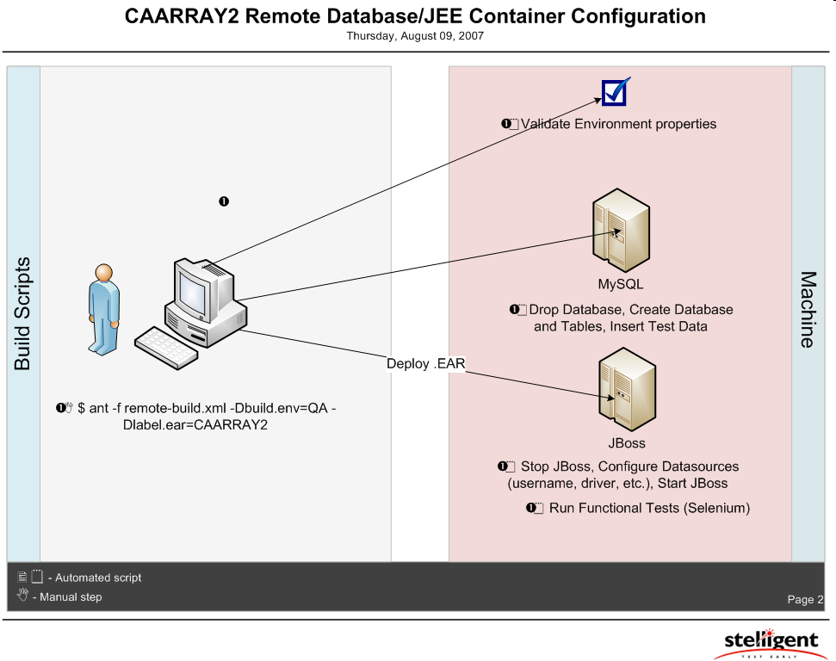
Remote Deployment Configuration

Slide 27
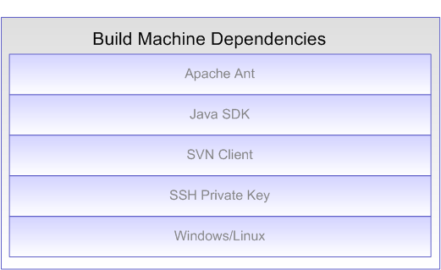
Build Machine Dependencies

Slide 28
Developer Scenario for caArray 2
Developer commits code to SVN (ideally, at least once a day)
As necessary, a developer can run a remote build and deploy to the “DEV” environment
  ant -f remote-build.xml -Dbuild.env=DEV
When ready to test, a developer will notify QA to run a deployment by giving QA the Subversion label
  For example, CAARRAY_2_0_QA_20070817

Slide 29
QA Scenario for caArray 2
QA manages the qa.properties file for the caArray 2 project
  This may be managed via SVN, file system or other. However, this file and these values should not be made available to public (or even development team?)
QA runs an Ant script from the centralized build machine. This script effectively checks-out the packaged EAR file from SVN
  ant -f remote-build.xml -Dbuild.env=QA -Dlabel.ear=CAARRAY2
After successful deployment to the QA environment, QA may run their suite of automated and manual tests

Slide 30
Additional Information
This process places more responsibility with the development teams
  Attributes must be extracted into simple .properties files
  Build process is responsible for much of the application configuration (JBoss, MySQL, etc.)
Eliminates the manual copying and pasting that occurs from Word documents to AntHill/JBoss/MySQL, etc.
  This will reduce errors and lessen the time to get software into production
  Allow for more time to think and spend on testing that can’t be automated

Slide 31
Agenda
Paradigm Shift – Iterative Development (5 min)
Current 2.0 Scope (10 min)
Current 2.0 Schedule (15 min)
Process and Content of Development Deliveries (20 min)
Overview of Build and Deploy Automation (15 min)
Questions on Documents and Open Discussion (25 min)

Slide 32
Feedback on documents
Extraction
  Acquire project data via API
Submission
  Report on work accomplished
  Submit project proposal
Project Management
  Import data files
  Manage data files
  Validate data files
Supplementary requirements specification

Slide 33
Open Q & A
Unexpected Topics and Questions
Review what needs to be discussed in more detail
Any issues/questions resolved today

