Slide 1

5AM NCICB Development Process
An Overview
Notes:
Post mortem title

Slide 2

Introduction
Overview of the development process we use at NCICB
Very closely based on Unified Process at 5AM (UP@5) with some NCICB specific twists
This overview should give the essential information necessary to get stuff done.
  For the gory details, see the project artifacts (under construction)

Slide 3
Outline
RUP Refresher/Overview
Process description categorized by RUP Discipline
Phase-based considerations

Slide 4
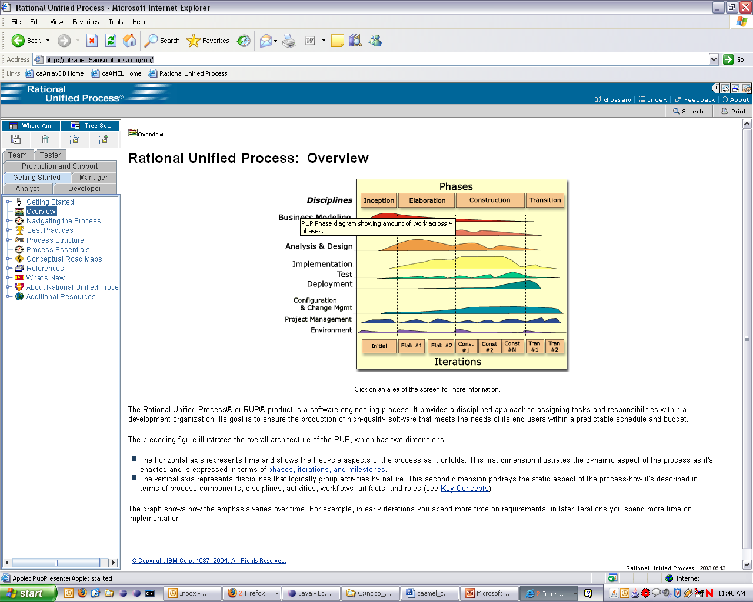
RUP Overview
Rational Unified Process
A process framework documented as a large web site
Process is defined/tailored for specific projects or organizations
Can be found online at http://intranet.5amsolutions.com/rup/
  Version is 2003.06.13

Slide 5
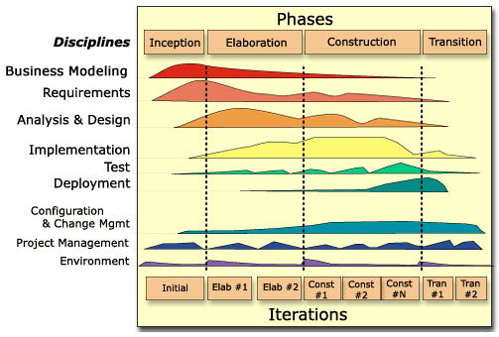
RUP Project Lifecycle – Phases, Iterations, and Disciplines

Slide 6
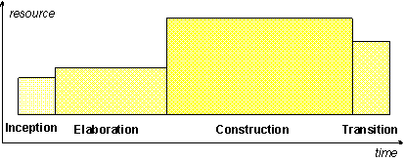
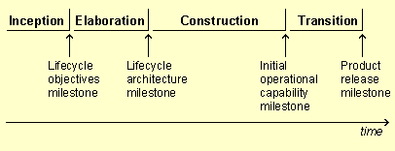
RUP Phases
Inception, Elaboration, Construction and Transition
Each Phase includes all Disciplines, but with different emphases (see previous slide)
Each Phase has a different specific objective (milestone)
Each Phase (typically) has different staffing and level of effort

Slide 7
RUP Iterations
Planned duration (between 4-8 weeks typically)
Culminate in either in internal or external release
Have defined objectives
  e.g. in first Elaboration iteration implement the persistence, authorization, and transaction handling mechanisms and implement the Login and Manage Account use cases
Culminate in a review
  Did we meet the objectives?
  What’s working in the process?
  What can we do better?

Slide 8
RUP Disciplines
Core Disciplines
  Business Modeling
  Requirements
  Analysis & Design
  Implementation
  Test
  Deployment
Supporting Disciplines
  Configuration & Change Management
  Project Management
  Environment
Describing how we implement these Disciplines will constitute the bulk of this overview

Slide 9
5AM Development Philosophy
“Just enough” process
A smaller team of effective developers is more productive than a large team of inexperienced or non-communicative developers
No broken windows
Prefer automation to manual tasks
No death marches
Keep learning
Collaborate
Have fun!

Slide 10
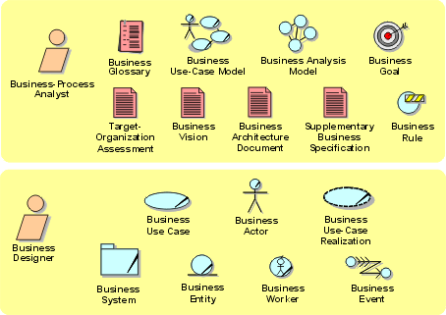
Business Modeling
Currently not performed with the exception of some domain modeling
May be useful to understand complex domains

Slide 11
Requirements
Major Artifacts
  Vision
  Use-Case Model
  Use-Case Documents
  Supplementary Specification
  Storyboards / Wireframes
  Requirements Management Plan
  Software Requirement (in GForge)

Slide 12
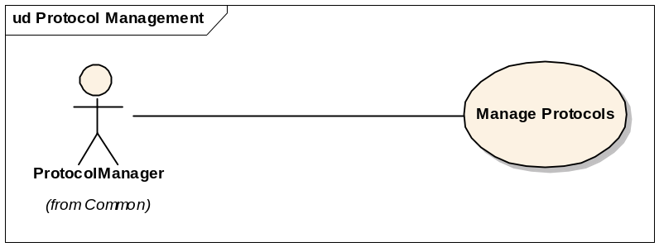
Requirements: Use-Case Model
Top level view in project Enterprise Architect UML model
Use Cases organized in packages of related functionality
Shows users and external systems that interact with the system

Slide 13
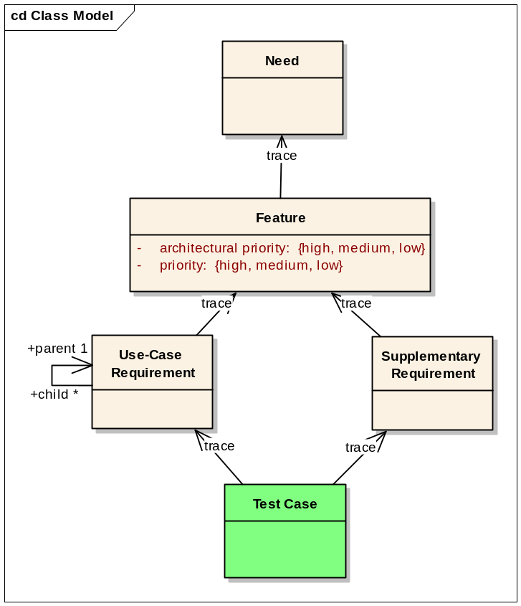
Requirements: Software Requirement
Classified as either:
  Need (high level, real world)
  Feature (high level requirements)
  Use-Case Requirement (low level functional requirements)
  Supplementary Requirement (non-functional requirements)

Slide 14
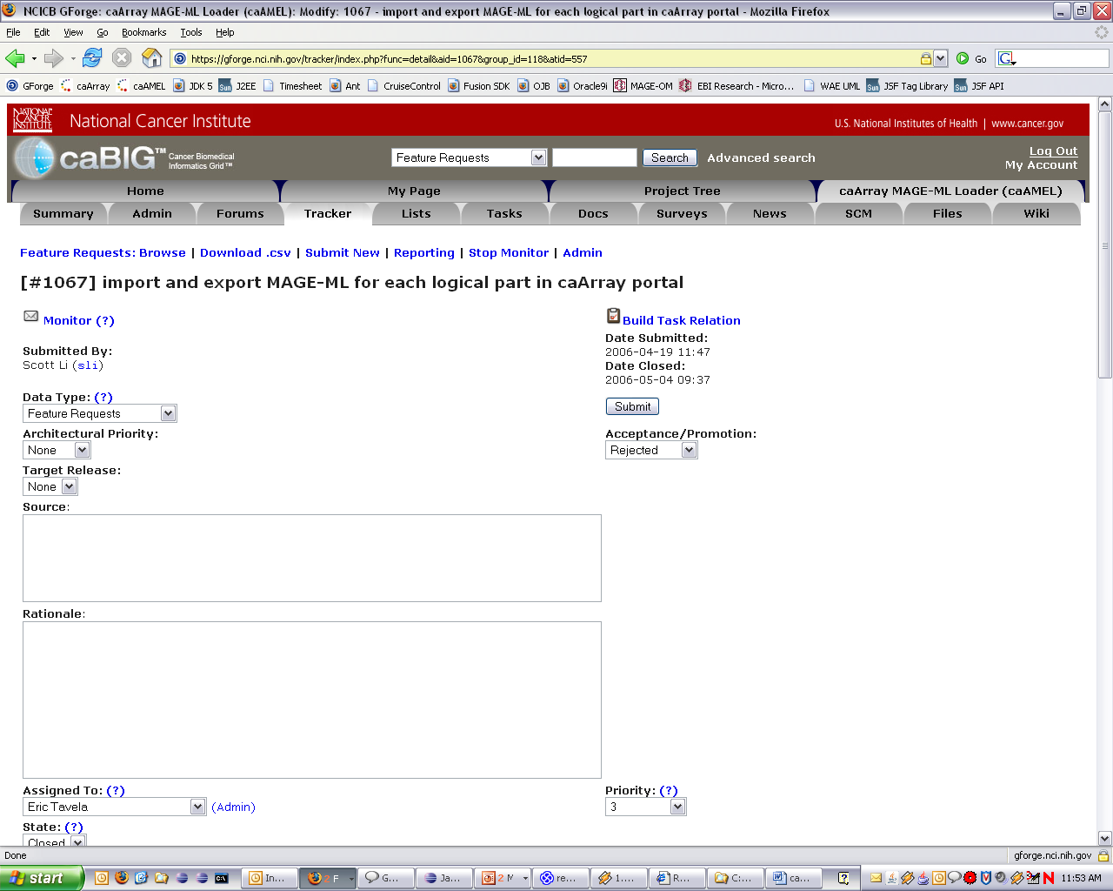
Requirements: Software Requirement (continued)
Implemented in GForge as modeled

Slide 15
Analysis & Design
Analysis modeling
Design modeling
  Architectural static view
  Use-case realizations
  Interface definitions
  Subsystem composite structure
  Subsystem design

Slide 16
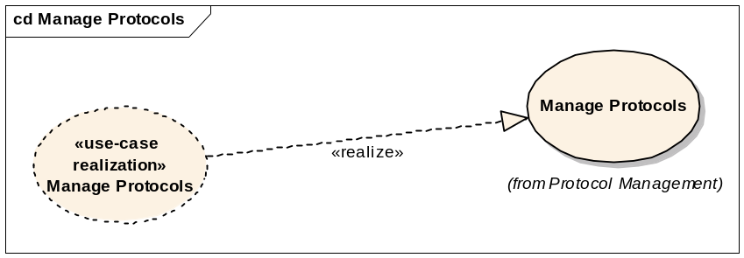
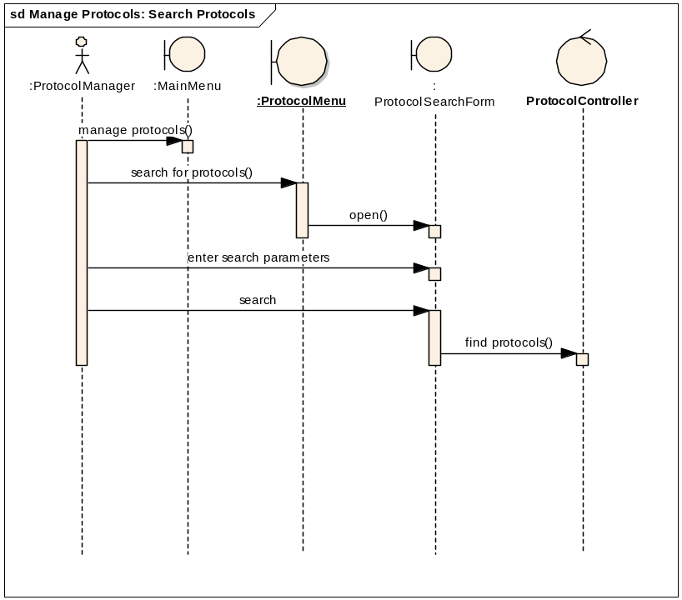
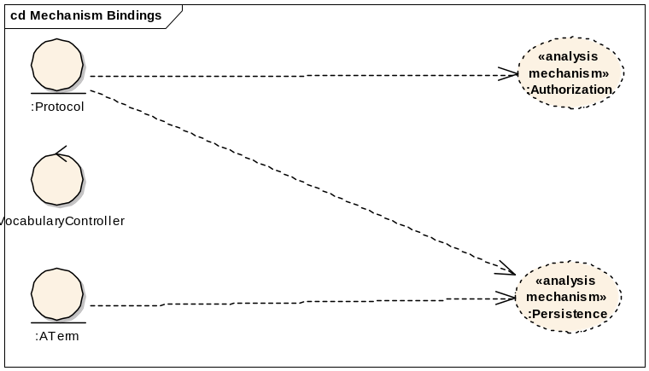
Analysis & Design: Analysis Model (optional)
Documents use case functionality in terms of Boundary, Control, and Entity classes
Documents necessary mechanisms and bindings to analysis classes

Slide 17
Analysis & Design: Design Model
Documents static and dynamic aspects of the system
Generally detailed to the architectural level only, though design level modeling can be included when necessary
Includes the following key elements
  Architectural Views
  Use-Case Realizations
  Mechanism Descriptions
  Subsystem Composite Structure

Slide 18
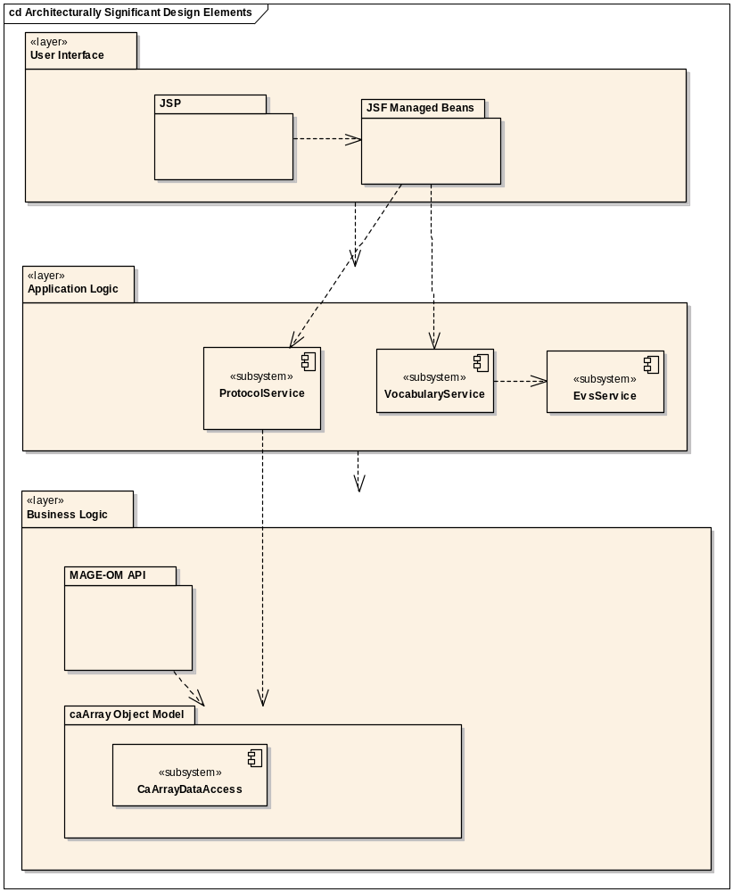
Analysis & Design: Architectural Views

Slide 19
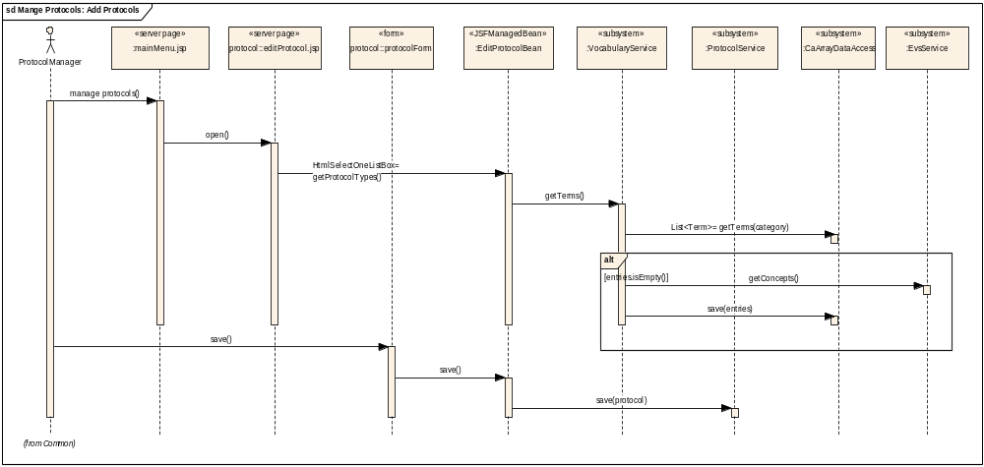
Analysis & Design: Use-Case Realizations
Show the interactions between Subsystems (and some other elements)

Slide 20
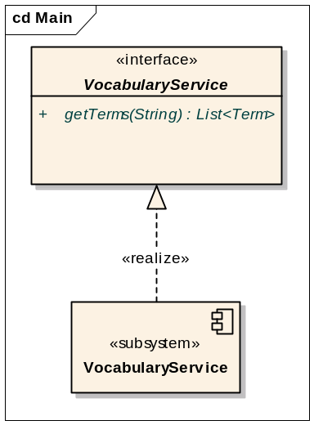
Analysis & Design: Interface Definitions

Slide 21
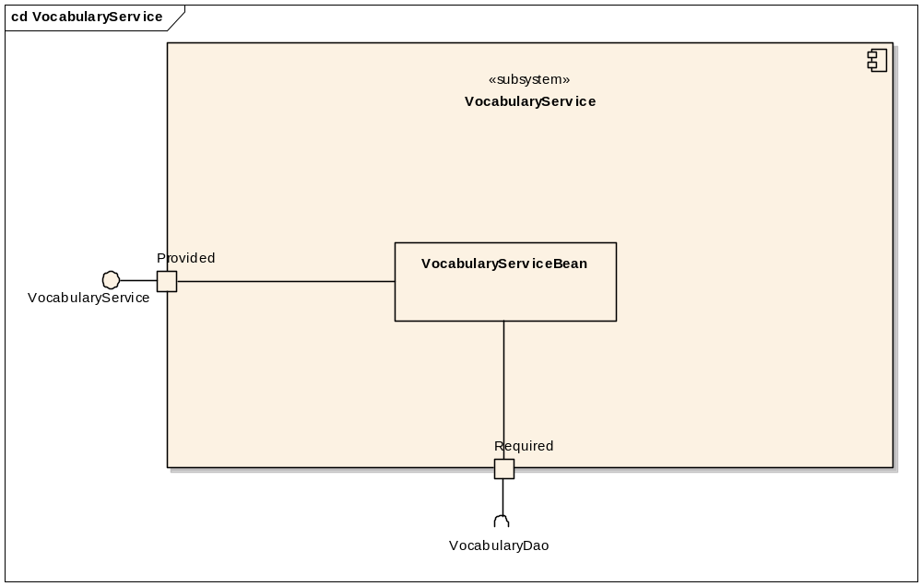
Analysis & Design: Subsystem Composite Structure
Required for all subsystems
Documents the provided and required interfaces

Slide 22
Analysis & Design: Subsystem Design
For complex or key subsystems

Slide 23
Implementation
Workflow
Code Style and Conventions
Eclipse
Unit Tests
Continuous Integration

Slide 24
Implementation: Workflow
Tasks assigned in MS Project, GForge Tasks (controversial), or GForge Tracker
If GForge, mark item as “in process”
Implement code and unit tests
Check in code

Slide 25
Implementation: Code Style and Conventions
Small classes (about 300 lines max)
Short methods (prefer about 4-5 lines, about 20 max)
Javadoc for protected and public methods
Few, if any inline comments (code should be self-documenting)
Refactor mercilessly
Automated tools are set up to enforce conventions and good coding practices
  Checkstyle
  PMD

Slide 26
Implementation: Eclipse
Configuration steps documented in Development Environment portion of 5AM Wiki
Problems View (Errors and Warnings) must be clear prior to committing code
  Most issues here will cause the continuous integration build to fail
  No broken windows

Slide 27
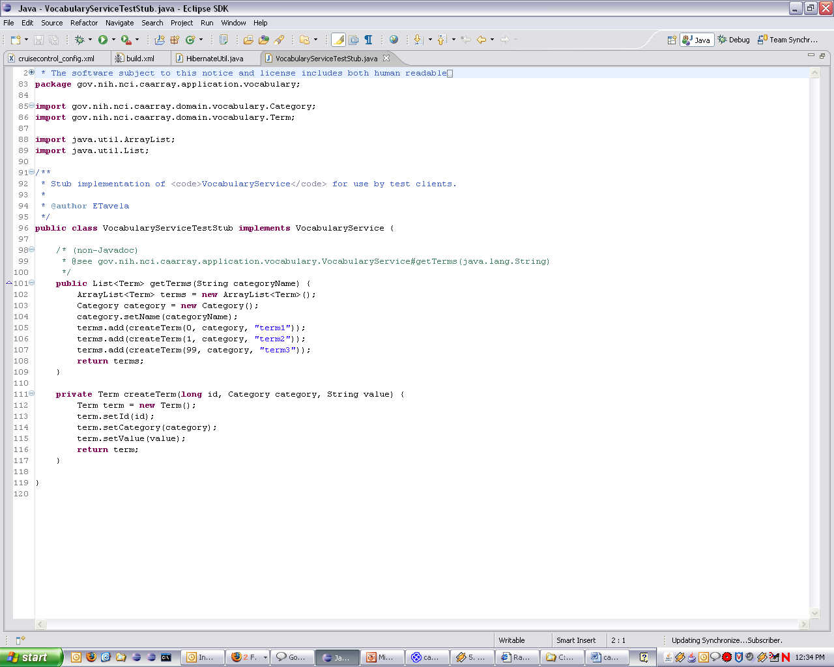
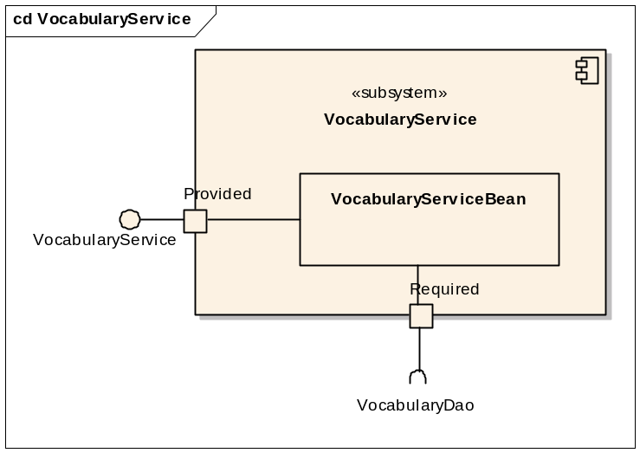
Implementation: Unit Tests
Use JUnit 4 for unit testing
Unit tests should ideally only test code in a single class
  Realistically, other classes in the subsystem will be involved
  Subsystem dependencies on required interfaces should be implemented with test stubs

Slide 28
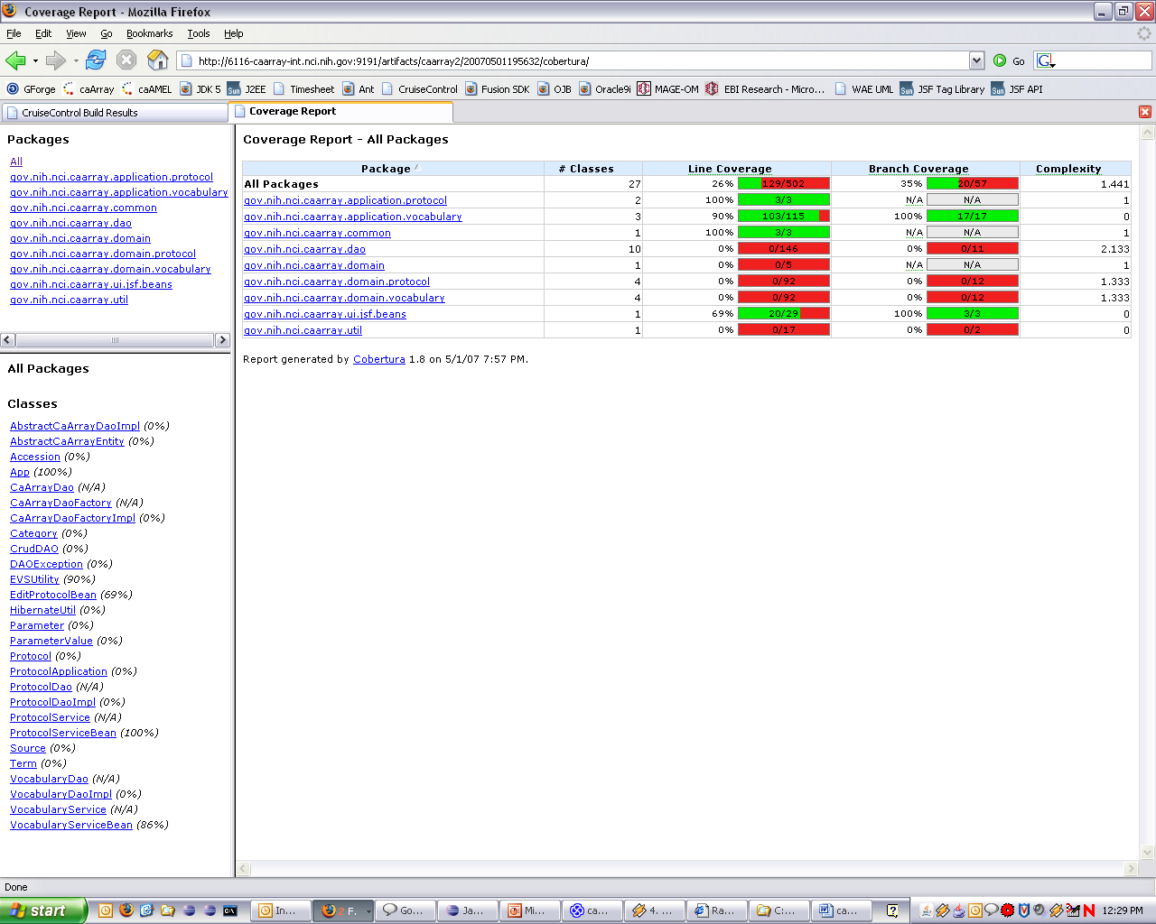
Implementation: Unit Test Coverage
Checked with Cobertura in continuous integration build
  Insufficient coverage will cause build to fail

Slide 29
Implementation: Continuous Integration
Uses CruiseControl
When code is checked in automatically triggers a build within a minute
Builds artifacts, runs code checks, runs unit tests and publishes results
  For this reason, it’s important that unit tests run quickly (i.e. no dependencies on external resources)
Run “ant continuous-integration” locally in order to check if build will be successful, if in question
If build fails, team must immediately drop current work and work to resolve.

Slide 30
Test
Descriptions here are for development side testing (not independent QA testing)
  Test Cases
  Test Traceability
  Test Automation

