Slide 1

5AM NCICB Development Process
An Overview
Notes:
Post mortem title

Slide 2
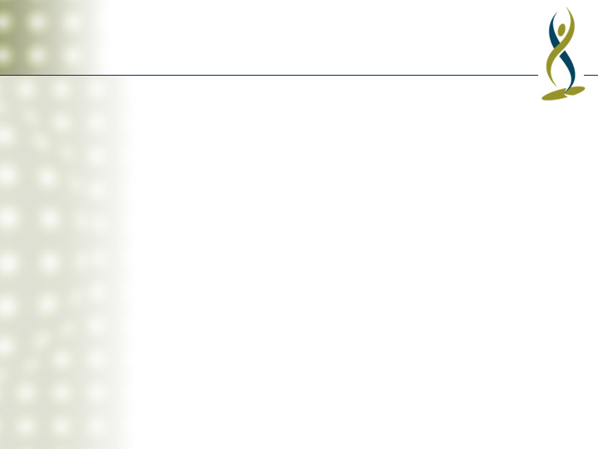
Introduction
Overview of the development process we use at NCICB
Very closely based on Unified Process at 5AM (UP@5) with some NCICB specific twists
This overview should give the essential information necessary to get stuff done.
  See the Development Process Quick Start
  For the gory details, see the project artifacts (under construction)

Slide 3
Outline
RUP Refresher/Overview
Process description categorized by RUP Discipline
Phase-based considerations

Slide 4
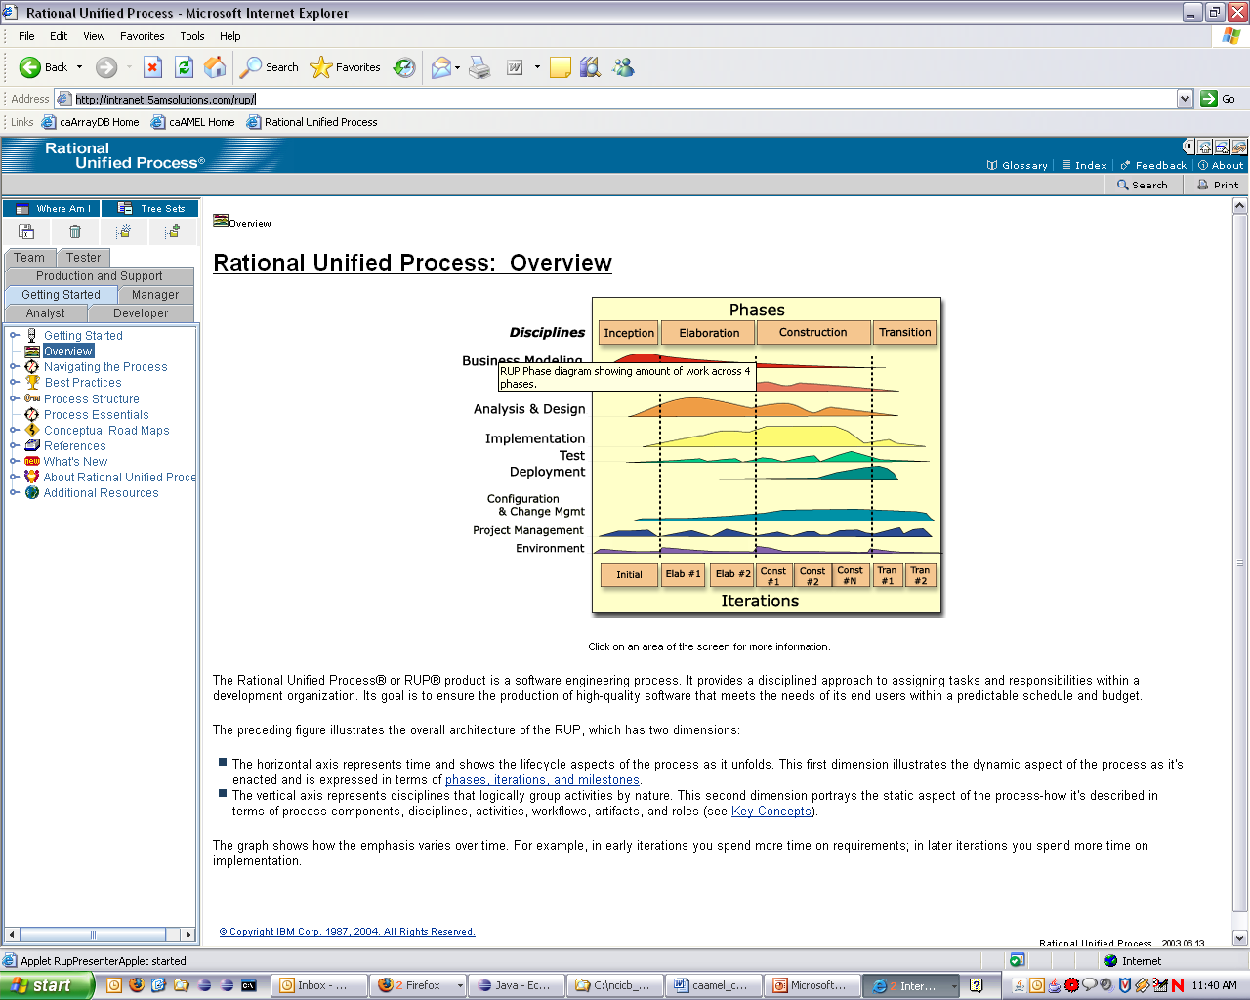
RUP Overview
Rational Unified Process
A process framework documented as a large web site
Process is defined/tailored for specific projects or organizations
Can be found online at http://intranet.5amsolutions.com/rup/
  Version is 2003.06.13

Slide 5
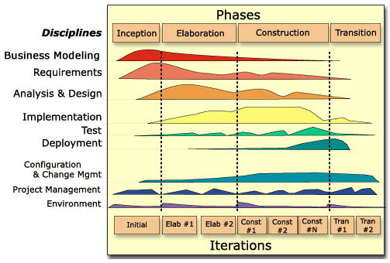
RUP Project Lifecycle – Phases, Iterations, and Disciplines

Slide 6
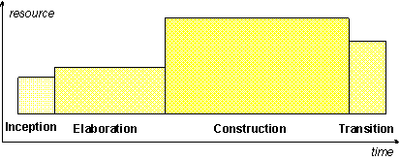
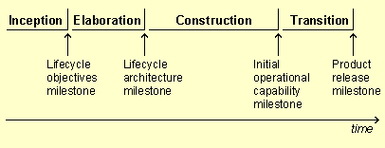
RUP Phases
Inception, Elaboration, Construction and Transition
Each Phase includes all Disciplines, but with different emphases (see previous slide)
Each Phase has a different specific objective (milestone)
Each Phase (typically) has different staffing and level of effort

Slide 7
RUP Iterations
Planned duration (between 4-8 weeks typically)
Culminate in either in internal or external release
Have defined objectives
  e.g. in first Elaboration iteration implement the persistence, authorization, and transaction handling mechanisms and implement the Login and Manage Account use cases
Culminate in a review
  Did we meet the objectives?
  What’s working in the process?
  What can we do better?

Slide 8
RUP Disciplines
Core Disciplines
  Business Modeling
  Requirements
  Analysis & Design
  Implementation
  Test
  Deployment
Supporting Disciplines
  Configuration & Change Management
  Project Management
  Environment
Describing how we implement these Disciplines constitues the majority of this overview

Slide 9
5AM Development Philosophy
“Just enough” process
A smaller team of effective developers is more productive than a large team of inexperienced or non-communicative developers
No broken windows
Prefer automation to manual tasks
No code ownership
No death marches
Keep learning
Collaborate
Have fun!
Notes:
- Get feedback / review

Slide 10
Project Roles
Roles here are specified in the RUP (mostly)
Expected that many roles fulfilled by the same person
Roles
  Project Manager (1)
  System Analyst (1)
  Requirements Specifier (*)
  Software Architect (1)
  Designer (*)
  Implementer (*)
  Process Engineer (1)
Notes:
- Should we also have a Tech Lead role?

Slide 11
Iteration Workflow: Project Management (Before Start of Iteration)
Project Manager: Develop the Iteration Plan
  Select targeted use cases and supplementary requirements
  Determine evaluation criteria
  Schedule iteration activities (in MS Project, copy into Iteration Plan)
  Send Iteration Plan to all project members for feedback
  Meet with project members to revise according to feedback
Scheduling notes
  Many tasks will initially be high-level and then refined
    E.g. 120 hours for Subsystem Design refined into 20 hours for PermissionsManagement subsystem, 40 hours for FileAccessSubsystem, etc. (refined as subsystems are identified during design process)

Slide 12
Iteration Workflow: Requirements (Start of Iteration)
System Analyst: Find Actors and Use Cases
  Add to Use-Case Model
  Add requirements to GForge
Requirements Specifier: Detail a Use Case
  Complete use cases in enough detail to be implemented
  Send use case to entire team for feedback
  Meet with entire team to discuss use case, incorporate feedback
System Analyst: Develop User-Experience Storyboard
  Document use-case realizations in terms of UI elements
  Forces explicit decisions on any ambiguous use case requirements
  Send to entire team for feedback
  Meet with entire team to discuss, incorporate feedback
UI Designer: Create Wireframes (non-RUP)

Slide 13
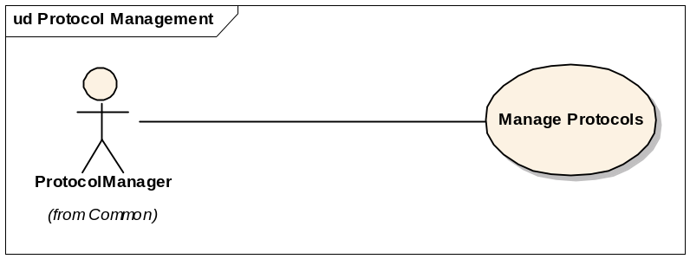
Requirements: Use-Case Model
Top level view in project Enterprise Architect UML model
Use Cases organized in packages of related functionality
Shows users and external systems that interact with the system

Slide 14
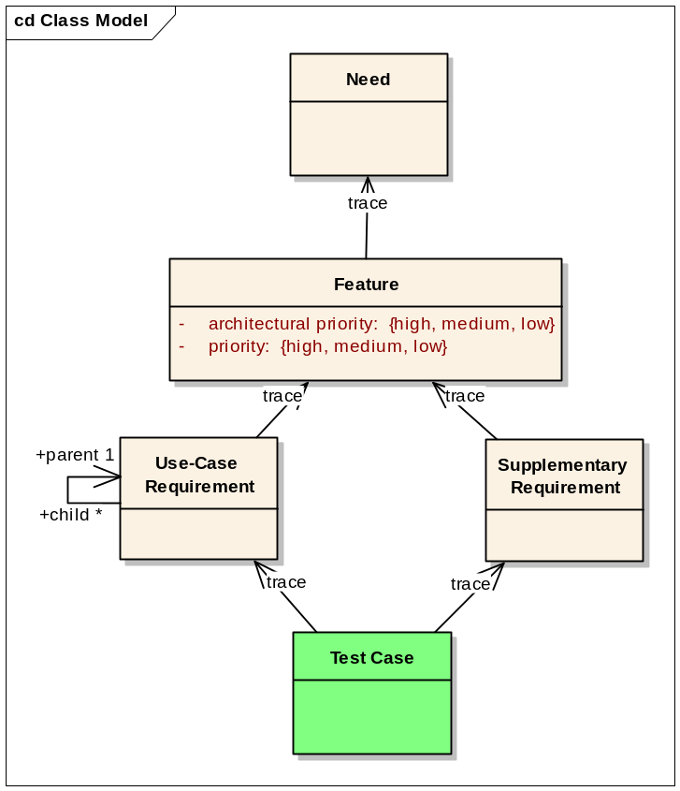
Requirements: Software Requirement
Classified as either:
  Need (high level, real world)
  Feature (high level requirements)
  Use-Case Requirement (low level functional requirements)
  Supplementary Requirement (non-functional requirements)

Slide 15
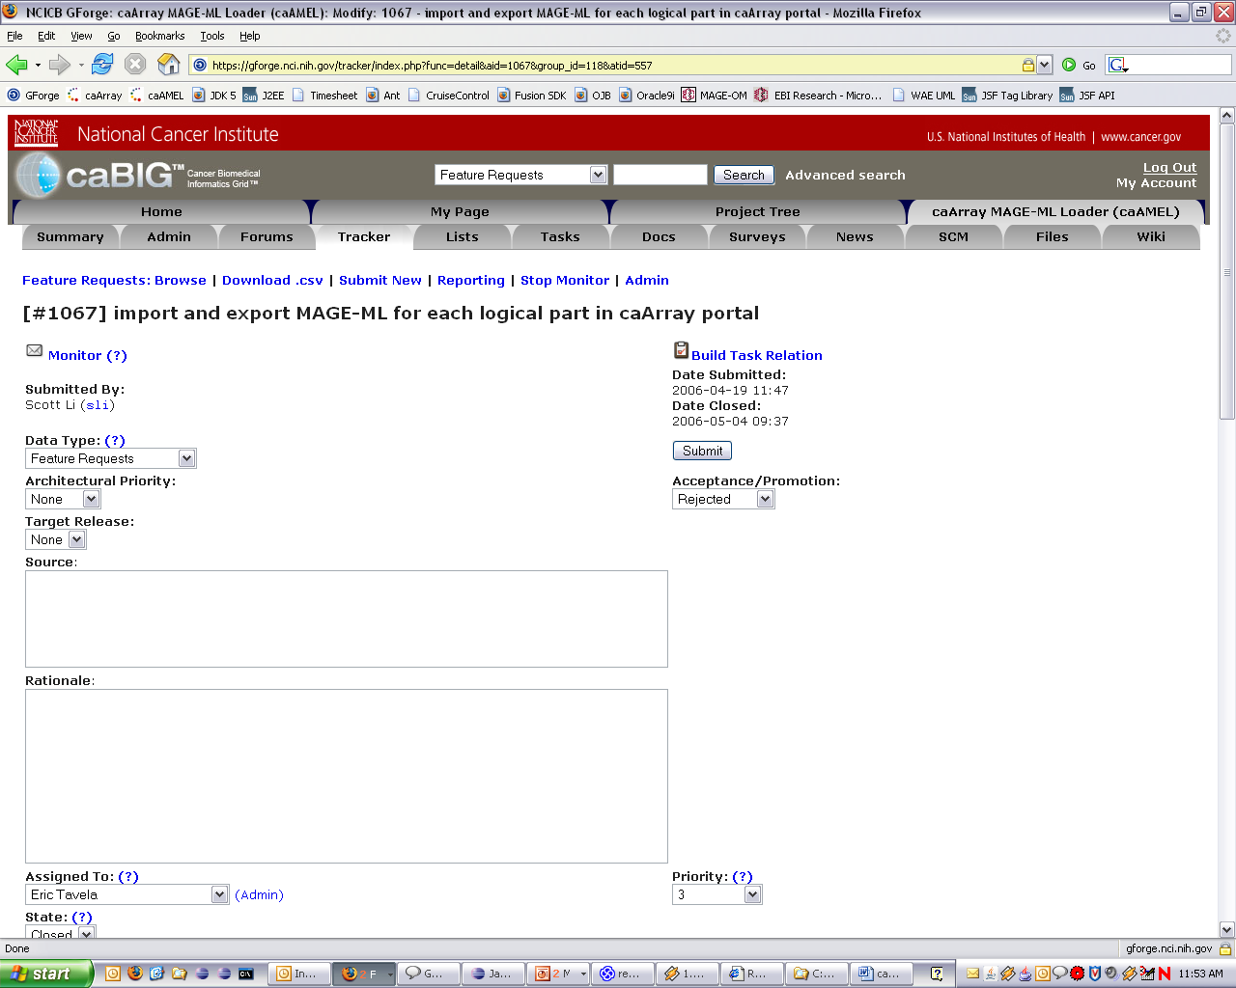
Requirements: Software Requirement (continued)
Implemented in GForge as modeled

Slide 16
Iteration Workflow: Use-Case Design
Use-Case Design
  Create <<use-case realization>> collaboration with sequence diagram per flow to be modeled
  Create Realization class diagram showing realization relationship of collaboration to subsystem
  Demonstrate use case behavior as messages between actor, subsystems and any necessary supporting classes
  Allocate use case flow text to corresponding messages
  Ensure all participants and relationships are shown on Participants class diagram
Notes:
Use-Case Design
The design workflow starts with Use-Case Design. In this task, the objective is to define the messages that must pass between subsystems (and other supporting system elements) to provide the functionality described in the use case.
Create a package with the same name as the use case to be designed in the Use-Case Realizations package of the Design Model. The use-case realization packages should be organized in the same way that the corresponding use-case packages are organized in the Use-Case Model.
Create the following elements in the new package:
a class diagram named Realization (default diagram),
a class diagram named participants,
and a <<use-case realization>> stereotyped Collaboration with the same name as the use case to design in the new package.
Add the <<use-case realization>> to the Realization diagram and create a realization relationship to the corresponding use case.
For each flow (Basic Flow and Alternate Flows) create a sequence diagram nested within the <<use-case realization>>. Right-click on the diagram, choose Properties… and check the option “Show Sequence Notes”.
Design the use-case functionality in terms of messages between subsystems (and any other necessary support classes) within the sequence diagram, defining the necessary subsystem interface operations. Add the literal use-case step text as the “Notes” field in the diagram (this will cause the text to show up on the left had side of the diagram as a script).
Add the classes and subsystems referenced in all of the sequence diagrams to the Participants diagram and ensure that sufficient relationships exist between the elements to support the messages defined in the sequence diagrams.

Slide 17
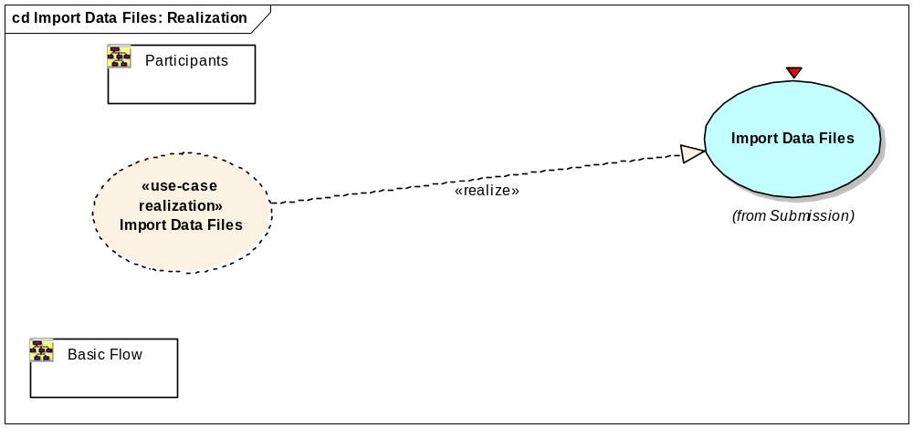
Use-Case Realization: Realization Diagram

Slide 18
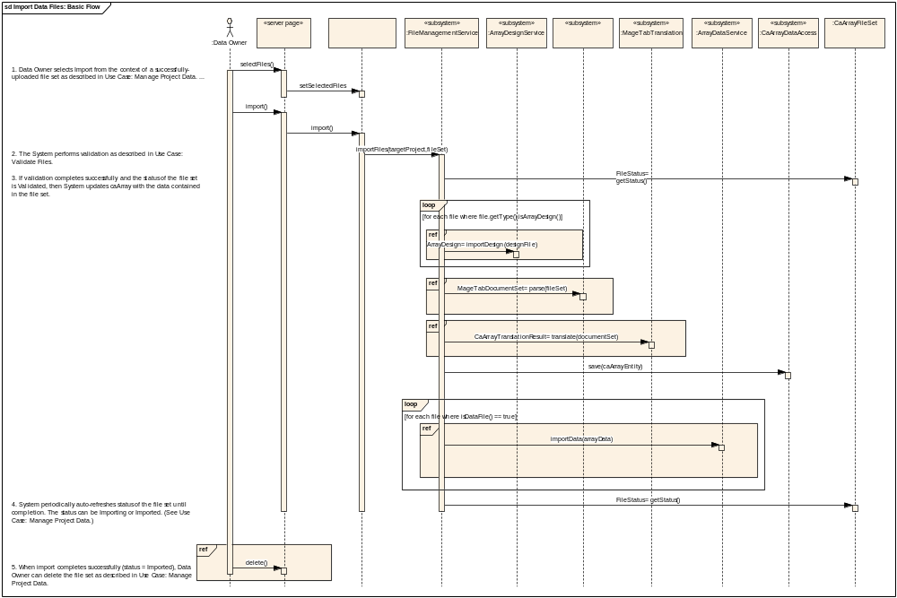
Use-Case Realization: Sequence Diagrams

Slide 19
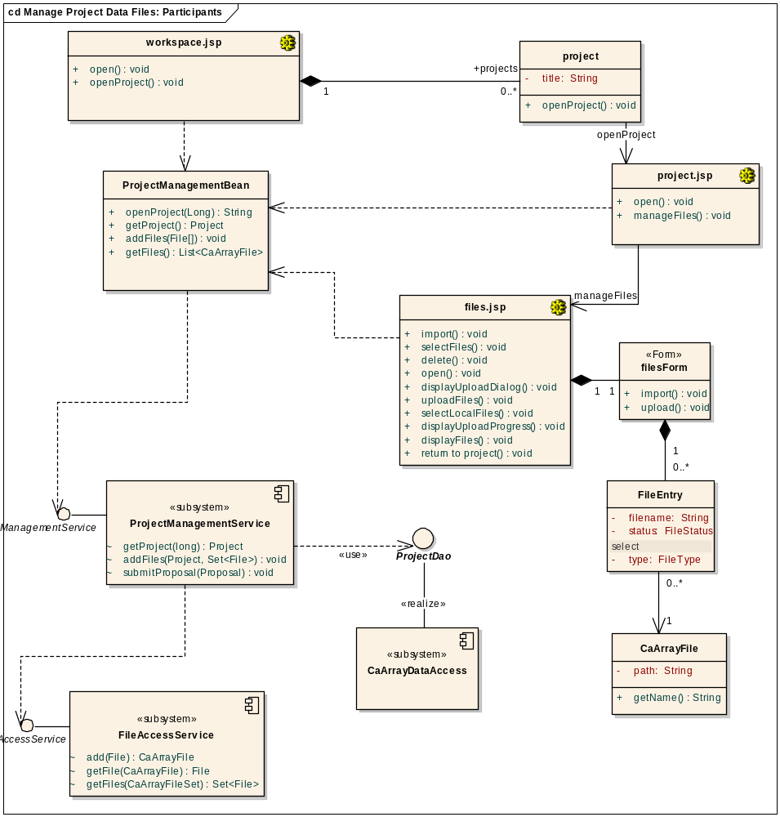
Use-Case Realization: Participants

Slide 20
Subsystem Design
Create a class diagram to show the subsystem interfaces and implementation classes
Create a composite structure diagram to show the subsystem’s realized and required interfaces (and any other dependencies)
  Documenting internal parts in this diagram not required (but encouraged if helpful)
Create <<interface realization>> collaboration with sequence diagram per operation to be modeled
Generate or write Java code for subsystem interface

Slide 21
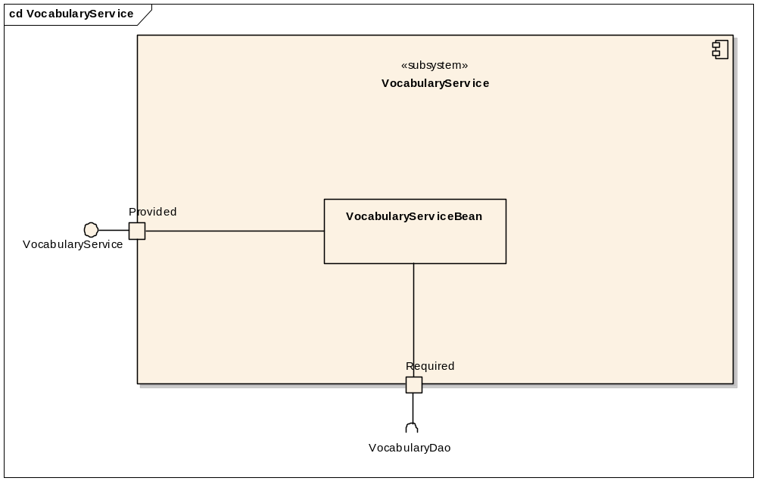
Subsystem Composite Structure

Slide 22
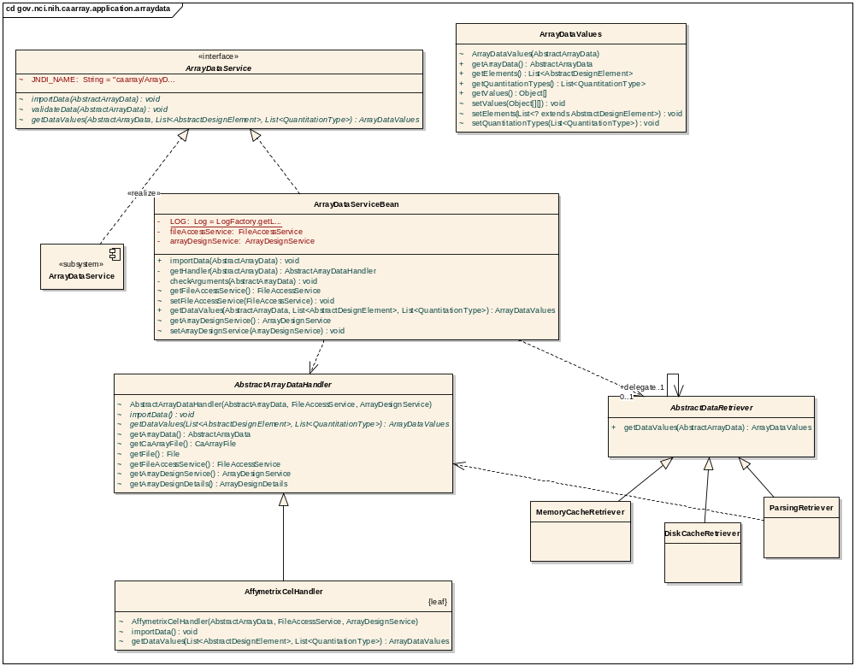
Subsystem Contents

Slide 23
Iteration Workflow: Implementation
Tasks are assigned

Slide 24
Implementation: Workflow
Tasks assigned in GForge Tracker
If GForge, mark item as “in process”
Implement code and unit tests
Check in code

Slide 25
Implementation: Code Style and Conventions
Small classes (about 300 lines max)
Short methods (prefer about 4-5 lines, about 20 max)
Javadoc for protected and public methods
Few, if any inline comments (code should be self-documenting)
Refactor mercilessly
Automated tools are set up to enforce conventions and good coding practices
  Checkstyle
  PMD

Slide 26
Implementation: IDE
The supported 5AM IDE is Eclipse
  Configuration steps documented in Development Environment portion of 5AM Wiki
Problems View (Errors and Warnings) must be clear prior to committing code
  Most issues here will cause the continuous integration build to fail
  No broken windows

Slide 27
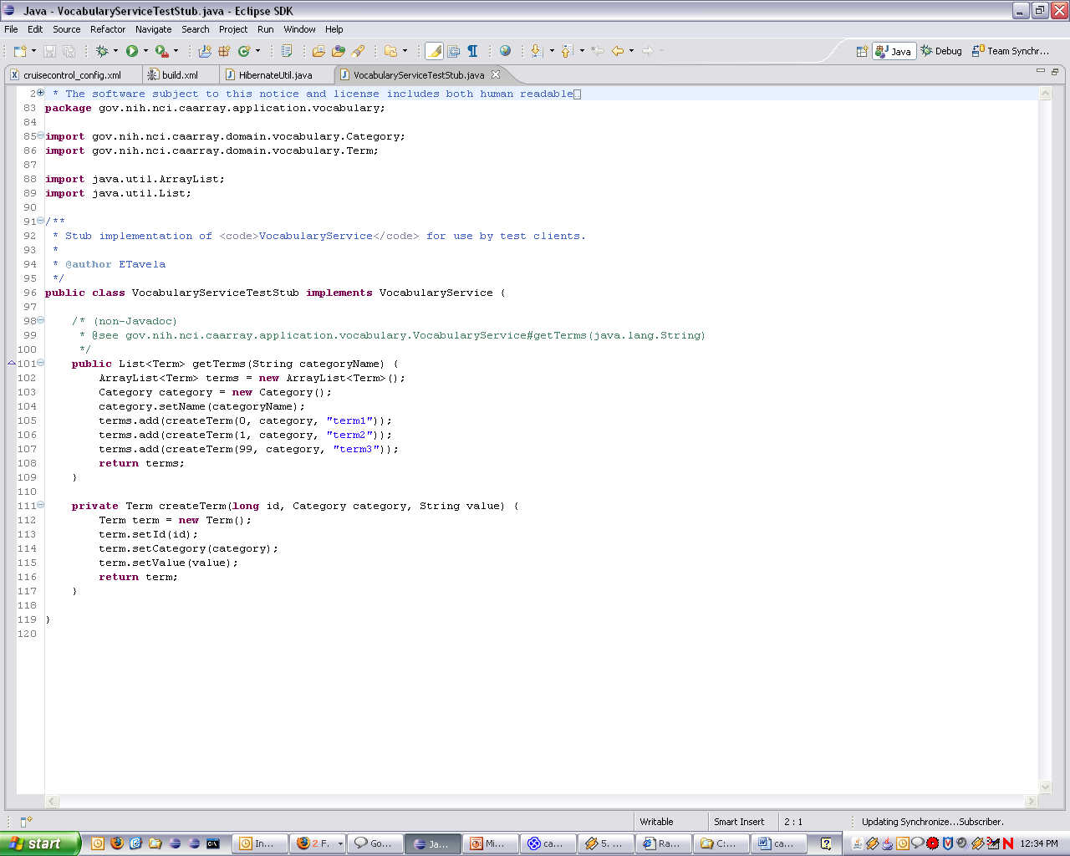
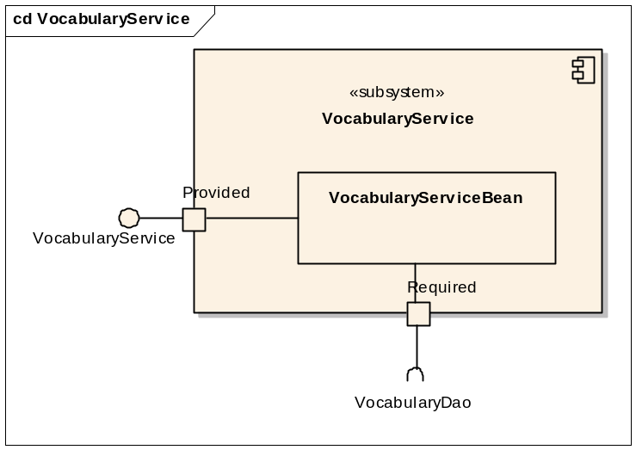
Implementation: Unit Tests
Use JUnit 4 for unit testing
Unit tests should ideally only test code in a single class
  Realistically, other classes in the subsystem will be involved
  Subsystem dependencies on required interfaces should be implemented with test stubs

Slide 28
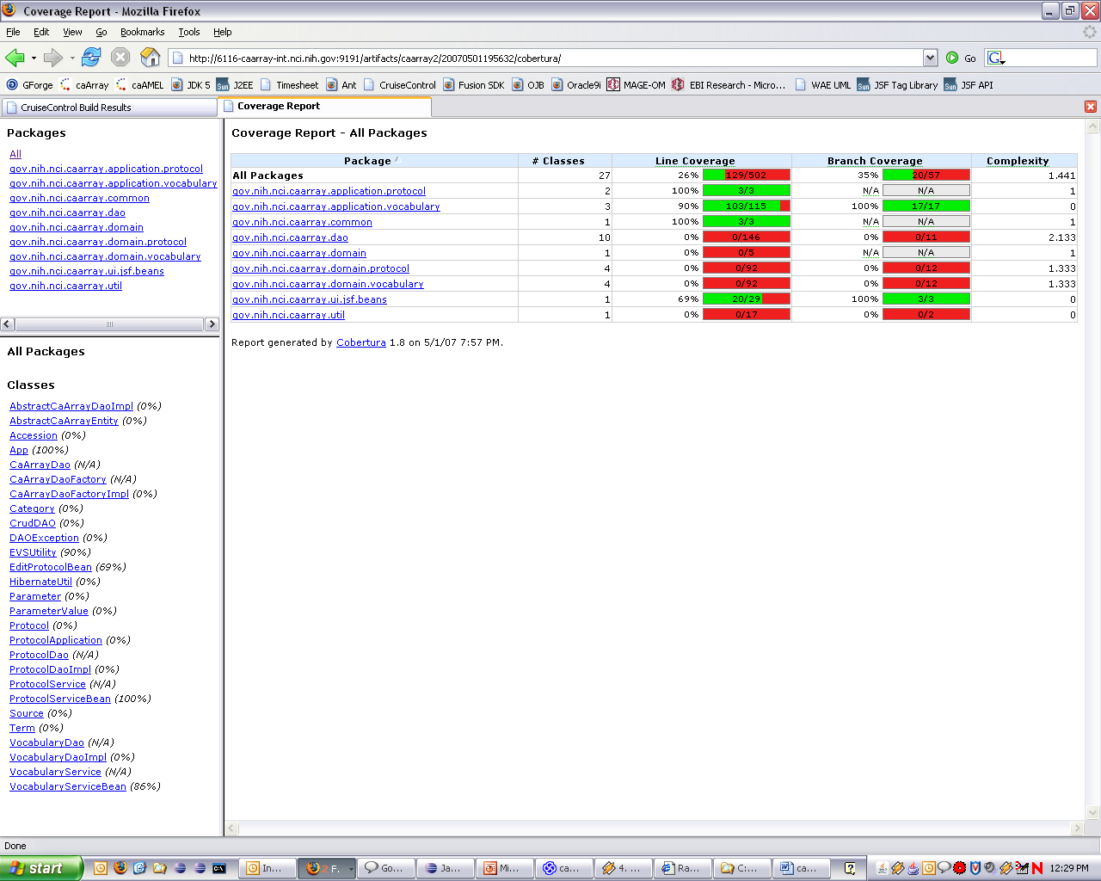
Implementation: Unit Test Coverage
Checked with Cobertura in continuous integration build
  Insufficient coverage will cause build to fail

Slide 29
Implementation: Continuous Integration
Uses CruiseControl
When code is checked in automatically triggers a build within a minute
Builds artifacts, runs code checks, runs unit tests and publishes results
  For this reason, it’s important that unit tests run quickly (i.e. no dependencies on external resources)
Run “ant continuous-integration” locally in order to check if build will be successful, if in question
If build fails, team must immediately drop current work and work to resolve.

Slide 30
Test
Descriptions here are for development side testing (not independent QA testing)
  Test Cases
  Test Traceability
  Test Automation
Delivery to QA

Slide 31
Responsibilities
Project Manager
  Get approval of scope of iteration from the client at the start of the iteration
  Monitor tasks
  Monitor risks
  Monitor all responsibilities listed here are met
  Revise schedule
Software Architect
  Define or approve subsystem interfaces
  Approve use-case realizations and subsystem designs
Implementer
  Review partner’s code and unit tests within 24 hours
  Adhere to design in model
All
  If any scheduled task will be late, let Project Manager and Software Architect know at least one day before deadline
Notes:
What are Software Architects responsiblities for code quality / productivity issues?

Slide 32
Consequences
Project Manager monitors

