Slide 1
The cancer Biomedical Informatics Grid (caBIG):
Large Scale Harmonization

Slide 2
Outline
Background
Process & Products
Findings
Recommendations
Next Steps

Slide 3
Background
Strategic Planning Workspace Meeting
  April 2006
  Create a workgroup in VCDE
  Address model harmonization across caBIG workspaces

Slide 4
Background
Problem Statement
Application teams re-creating same or similar domain objects
  Within and between workspaces
Creates rework, reinterpretation, and potential interoperability issues
Gold Level Compliance requires harmonization

Slide 5
Background
Objectives
Align the characteristics of the information objects across workspaces, i.e., semantic interoperability
  Data elements
  Domain models (e.g. BRIDG)
Define overarching model (Übermodel)
Define process for harmonizing existing applications, models, and data elements

Slide 6
Process & Products
Review bottom-up vs. top-down approaches
Review tooling and resources
Review existing application models
Gathered information from other sources,
e.g., BRIDG
Prototype based on a boundary objects,
e.g., biospecimen

Slide 7
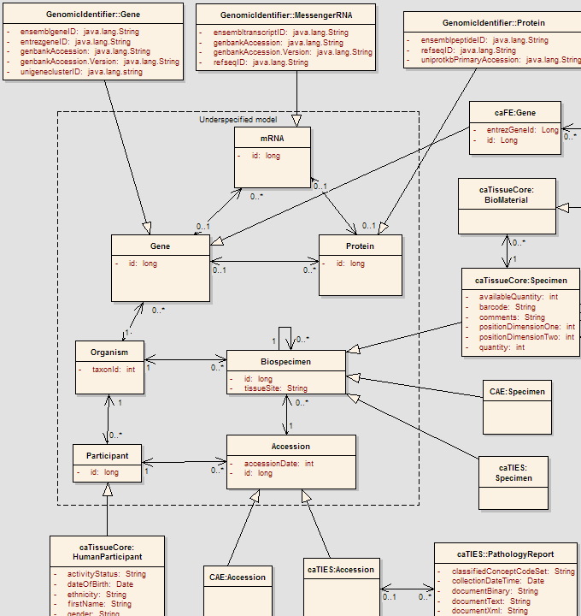
Core Objects
Application Objects

Slide 8
Findings
Consensus on Value
  To achieve the maximum value the Übermodel must balance the needs of the application developers with the need to remain independent of any one implementation.
Magnitude of Effort
  Significant participation from
    Domain experts
    Harmonizers
    Application modelers

Slide 9
Findings
Issue | Resolution
Level of Abstraction | Concretely interpretable
Model Ownership | next step
Globalization | caGrid Identifier Services Framework
Static vs. Dynamic Modeling | Dynamic is next step
Semantic Interoperability | Sub-classing, associations, reuse
Data Types | caDSR Datatype small workgroup
Naming Conventions | caCORE SDK Programmers Guide
Tooling | next step
Resources for Alignment | next step
Scalability | next step

Slide 10
Recommendations
Model Recommendations
  Implementations independent
  Not abstract
  Focus on boundary objects
  Underspecified
Process Recommendations
  Review BRIDG processes
  Pre-Harmonization
  Post Harmonization

Slide 11
Next Steps
Engage Community
Create Review Entity
Review Processes from BRIDG project
Develop Pre-harmonization Process
Create UML Repository
Write Whitepaper

Slide 12
Team
Participants:
Christopher Chute, Mayo
James Buntrock, Mayo
Brian Davis, 3rdMill
Lewis Frey, Utah
Mike Keller, BAH
George Komatsoulis, NCICB
Paul Mandel, BAH
Frank Manion, Fox Chase
Patrick McConnell, Duke
Rakesh Nagarajan, Washington University
Vito Perrone, NCRI
Steve Sandberg, Mayo
Contributors:
Doug Fridsma, University of Pittsburgh
Meg Gronvall, BAH
Charlie Mead, BAH

Slide 13
Resources
Gforge site
http://gforge.nci.nih.gov/projects/model-harmony
List Serve
https://list.nih.gov/archives/cabig_lrg_mod_harm-l.html
Final Report
http://gforge.nci.nih.gov/docman/view.php/135/3203/caBIG_Model_Harmonization_Report.doc
Übermodel
http://gforge.nci.nih.gov/frs/download.php/792/ICR_and_TBPT_Model_Harmonization_Final.EAP

Slide 14

Questions and Comments

