Slide 1

caArray 2.0
Elaboration 1 Design Review
Notes:
Post mortem title

Slide 2
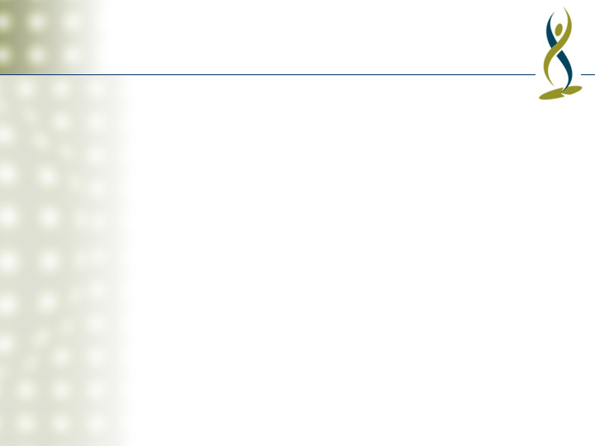
Agenda
Describe Model Organization
Logical View
  High-Level (Components and Dependencies)
  Use-Case Realizations
  Subsystem Design
Implementation View (Packaging)
Deployment View

Slide 3
Model Relationships
Model organized according to 4+1 Views of Architecture
  Logical, Implementation, Process, Deployment + Use Case
  85% in Logical Model, 10% in Use-Case Model, rest in others
Logical Model to be registered in caDSR is a shared package referenced in the Design Model

Slide 4
Logical Model Organization
Design Elements
Use-Case Realizations

Slide 5
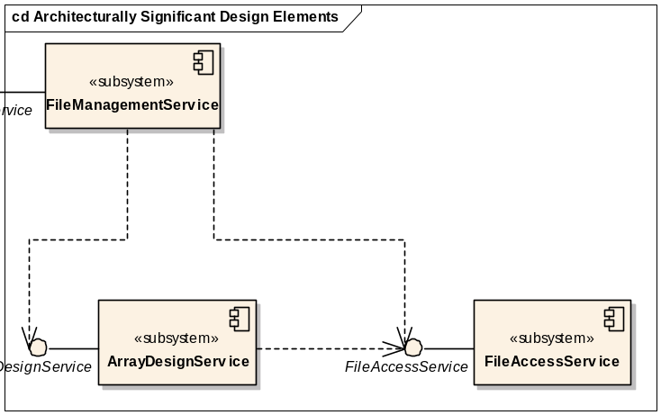
Logical Model: Component Architecture
Organize system into small number of subsystems accessed through interfaces
  Subsystems completely encapsulated behind interfaces
  Manages complexity: 10 subsystems vs. 300 classes
  Allows parallel development, unit-testing using stubbed dependencies
Most subsystems implemented with EJB session bean, others with POJOs
  Note that RUP best practice “Use Component Architectures” means use subsystem approach, not specific component technology

Slide 6
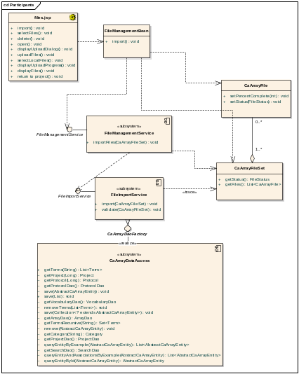
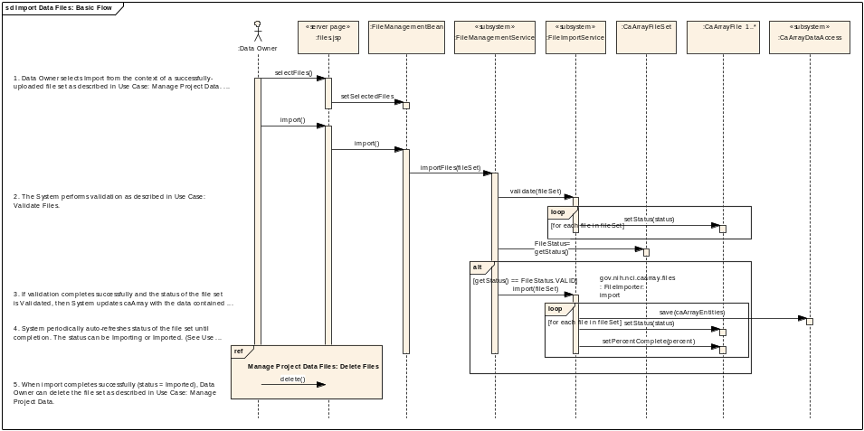
Logical Model: Use-Case Realizations
Use-case driven design
  Map use-case flows to messages between actor and system and between subsystems (and other design elements)
  Contains references to mechanisms
  Provides direct traceability from requirements to implementation
Used to identify and define subsystem interfaces
Sequence diagrams document behavior, class diagram (Participants) documents structure

Slide 7
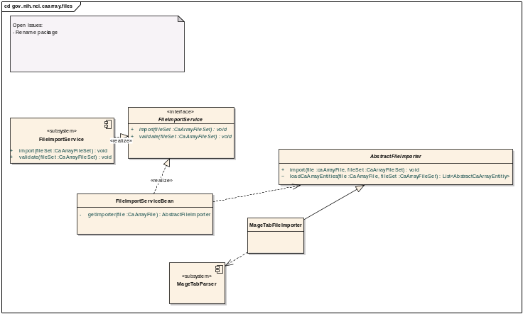
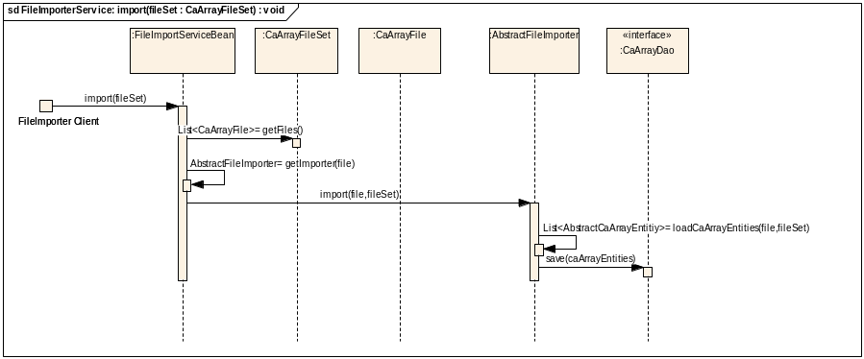
Logical Model: Subsystem Design
Specifies implementation of subsystem
  Usually one class that implements subsystem interface and delegates to other subsystem classes.
Shows both behavioral and structural aspects
  Structure shown in subsystem class diagrams
  Behavior shown in <<interface realization>> collaboration sequence diagrams

Slide 8
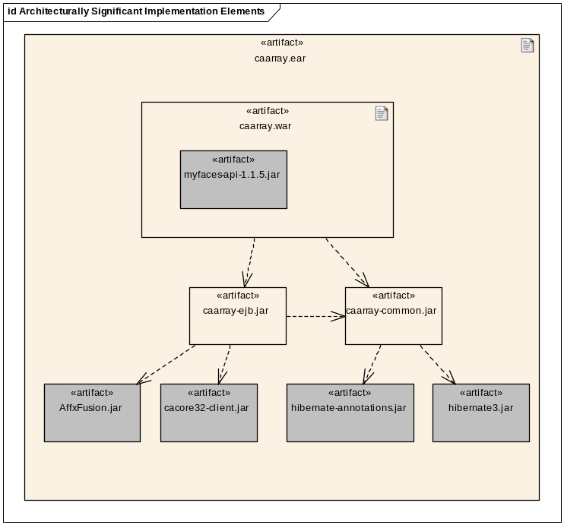
Implementation Model
Defines software packaging and software component dependencies.
Artifacts are realizations of elements from the Logical View

Slide 9
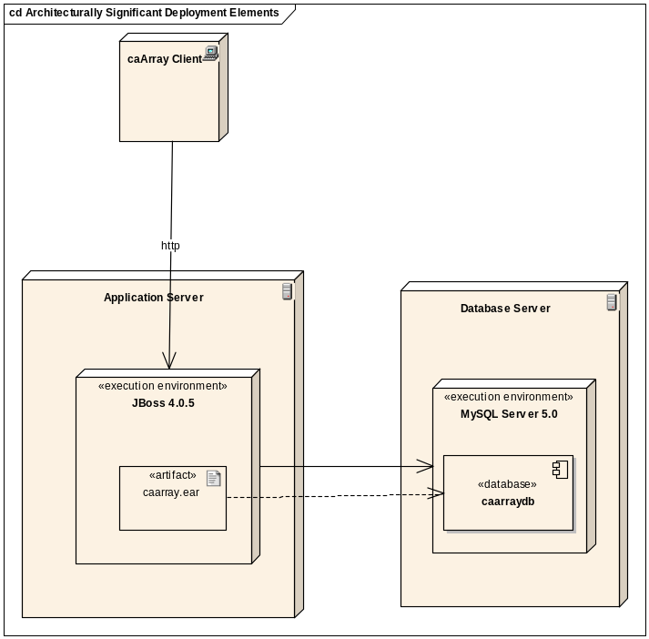
Deployment Model
Defines hardware nodes and allocation of Implementation Model artifacts to nodes
Defines communication between nodes
Defines execution environments required for implementation artifacts

Slide 10
caArray 2.0 E1 Design
Layering and Subsystems
Use-Case Realizations
  Submit Project Proposal
  Manage Project Data Files
  Import Data Files
  Acquire Project Data via API
Subsystems
  MageTabParser
  MageTabTranslation
  ArrayDataService
  ArrayDesignService
  RemoteAccessService
Implementation Model
Deployment Model

Slide 11
Changes Expected
Elaboration 2
  Authentication and Authorization design
    Including authorized access and filtering of entities based on permissions.
  Validation design
  Full Grid API design
  Revision of layering and allocation of components to layers
  Revision of physical packaging

