Slide 1
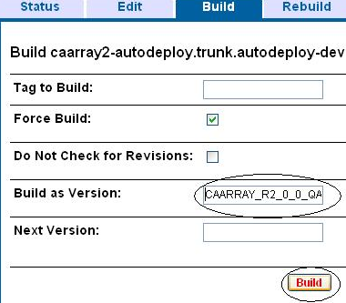
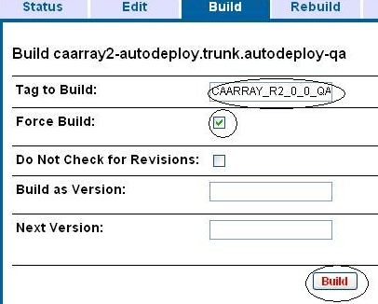
Build Promotion Checklist
Development tech lead informs build master that the build can be run
Build master notifies the development team he will be running a build in the
DEV environment
Build master ensures the DEV.properties file has been updated to match
the caarray2-property-template.properties file
Build master launches AntHill Pro administration console and selects the DEV track,
while passing the tag name to the Build as Version: text box in the Build tab
BUILD FROM TAG
CREATE TAG
Once the build is successfully complete, the build master notifies the development
team to perform testing in the DEV environment
Once testing in the DEV environment is complete, the tech lead notifies the build master
Build master requests permission from the QA team to run build in the QA environment.
Build master updates the QA.properties file and enters Tag to Build:
Build master runs smoke tests to ensure the build has been run correctly in the
QA environment
Build master notifies the QA team that the build is ready to test and provides the SVN
tag name and links to deployment request files

