Slide 1




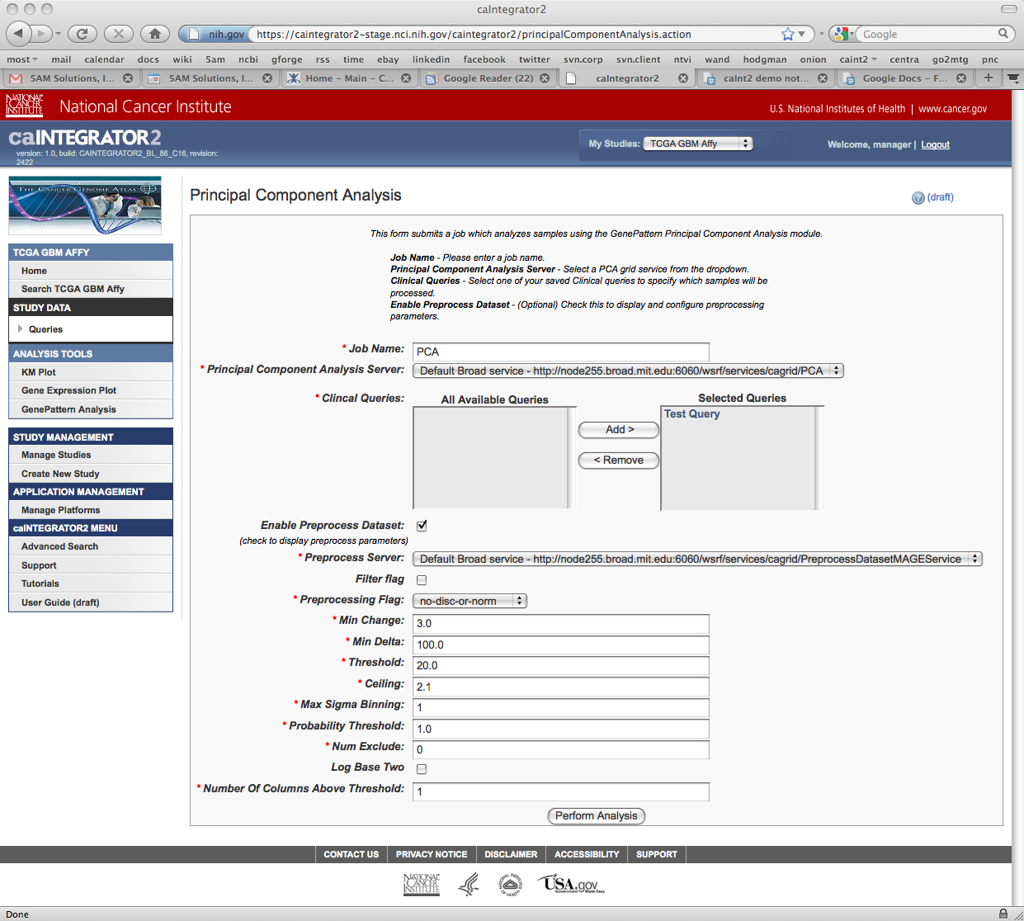
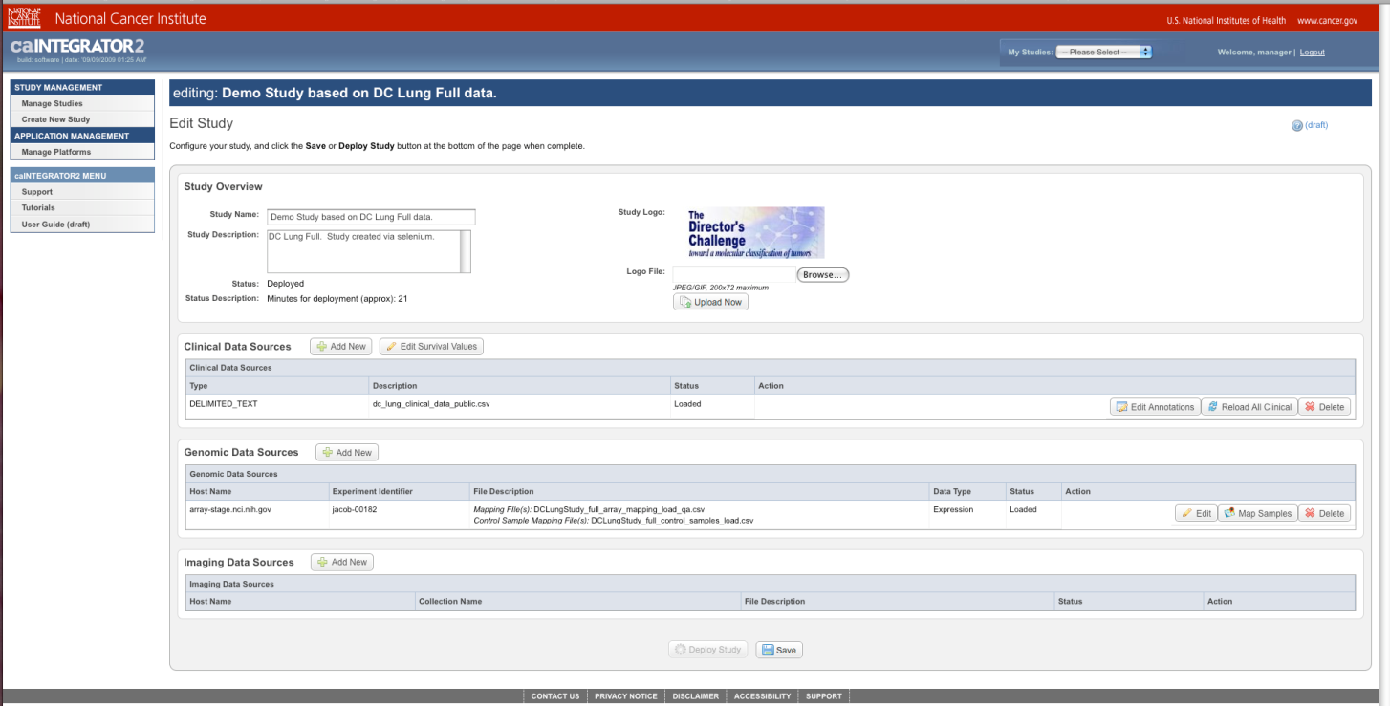
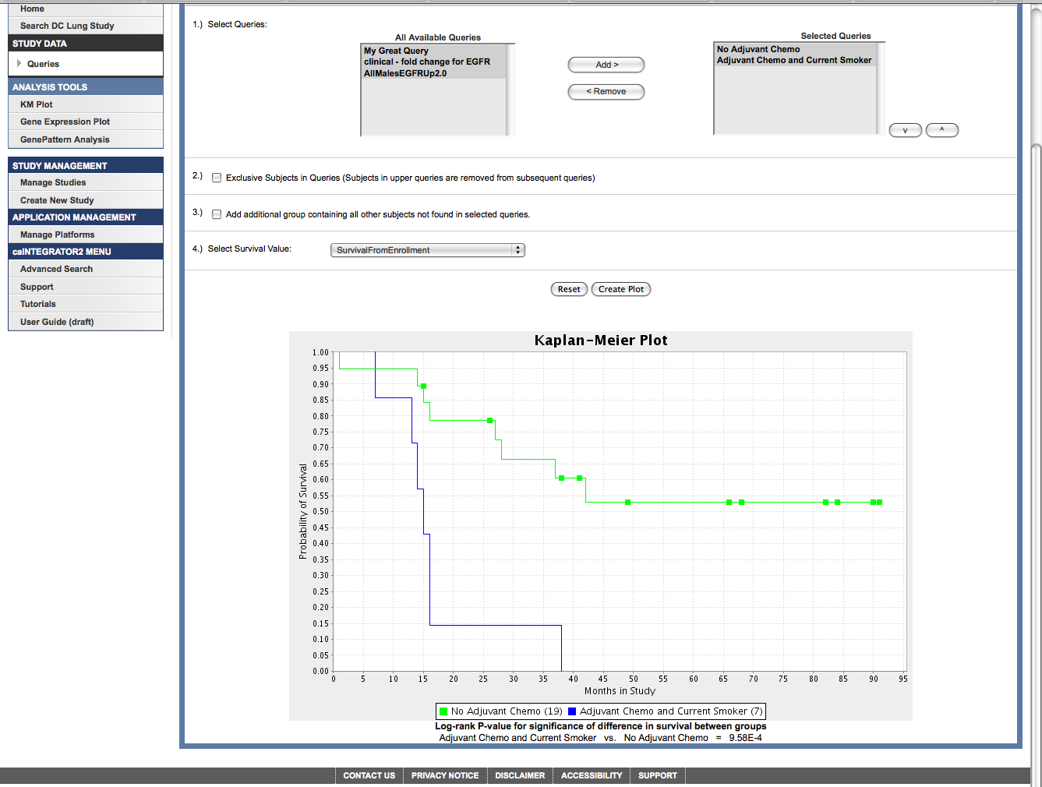

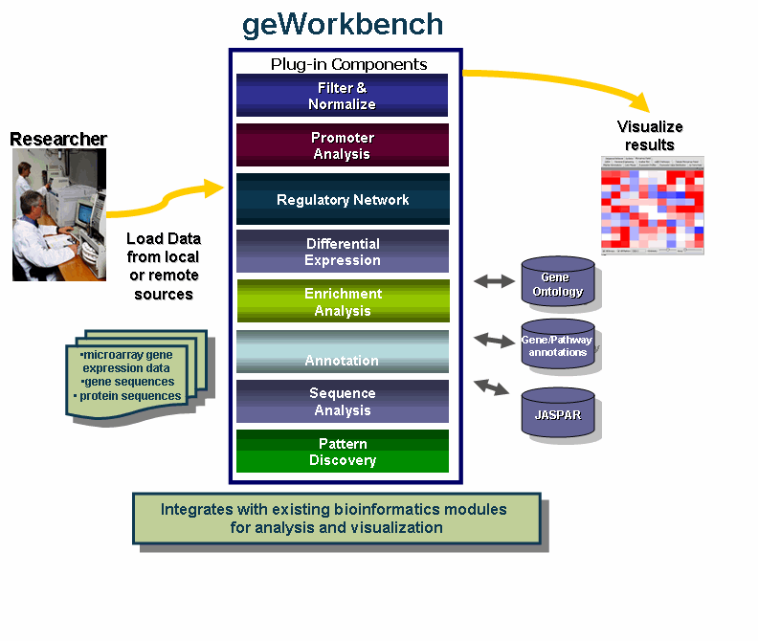



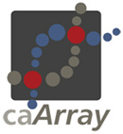
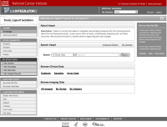
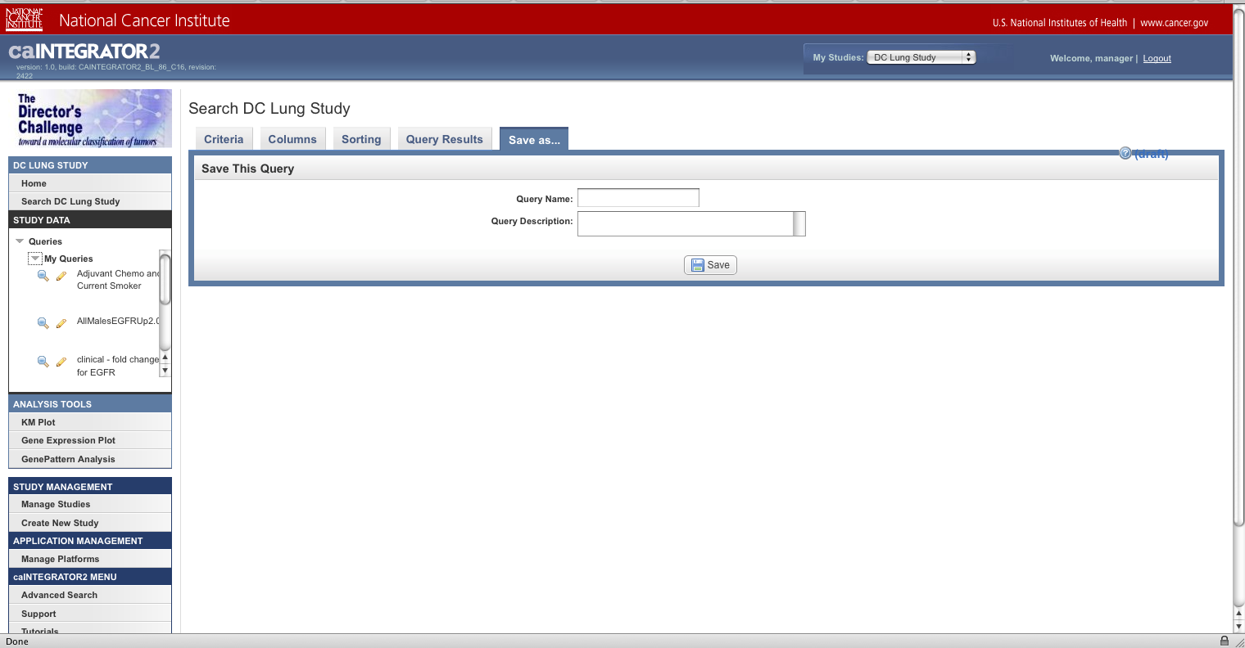

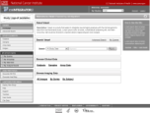



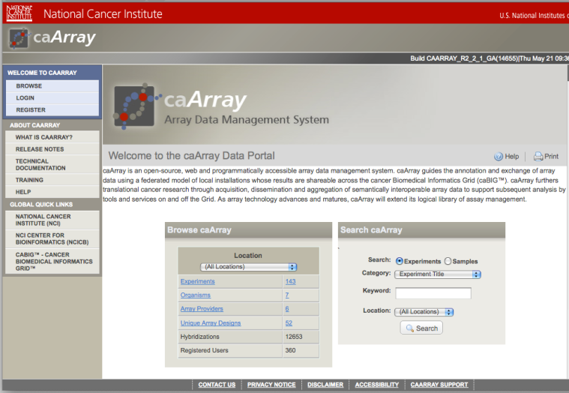
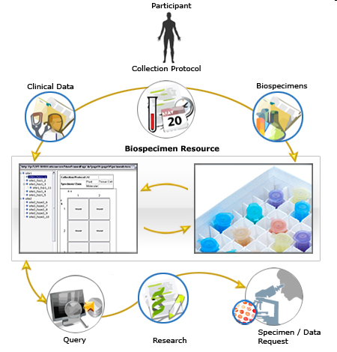
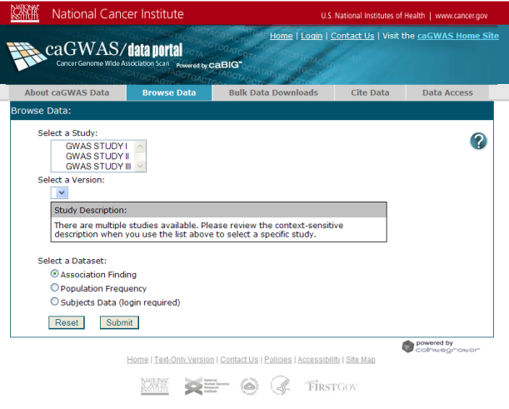
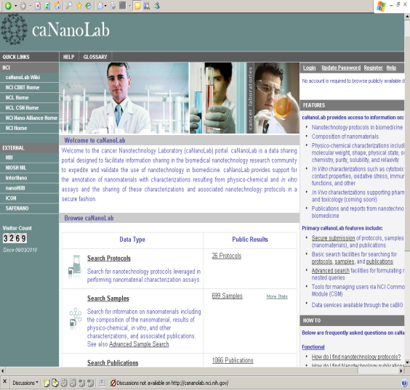

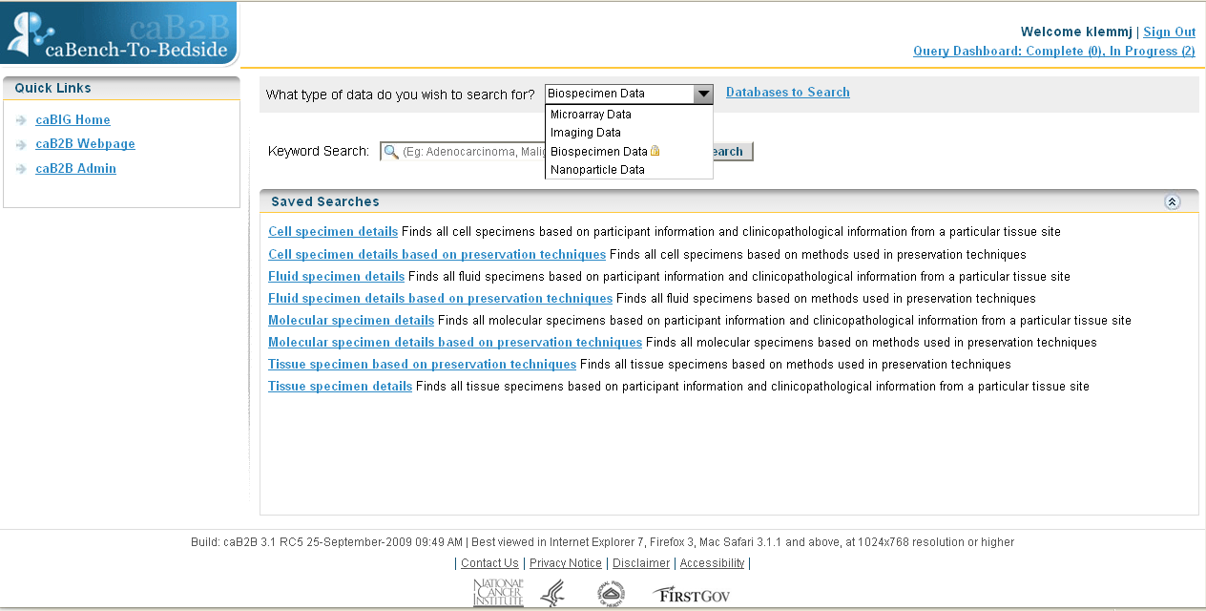
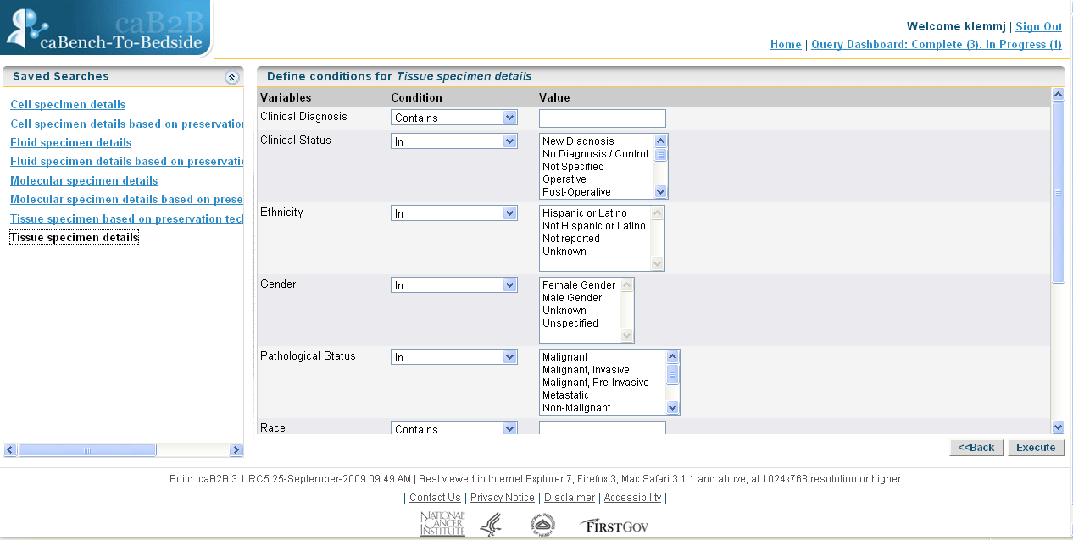
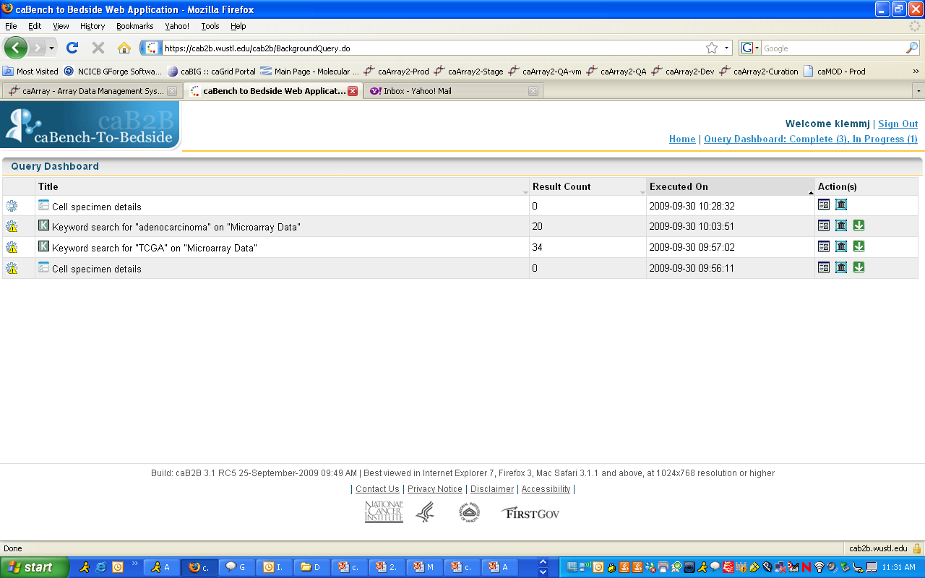
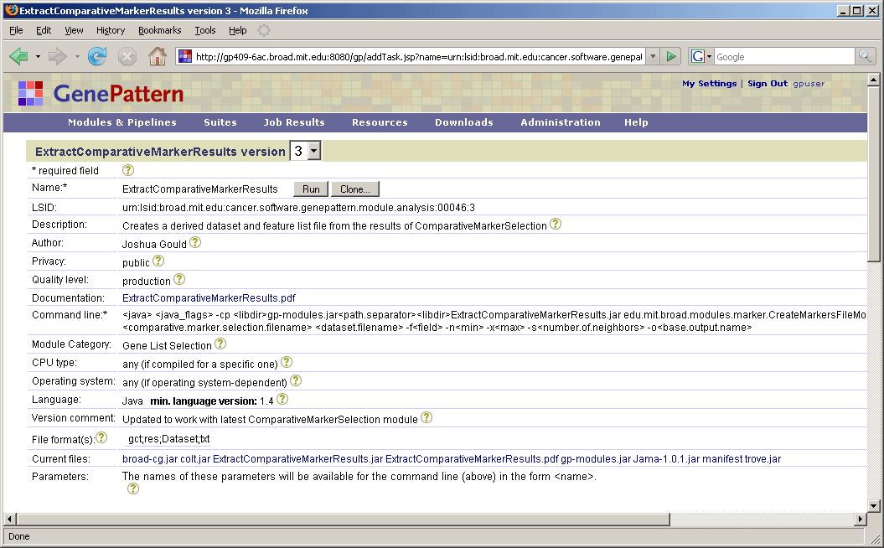
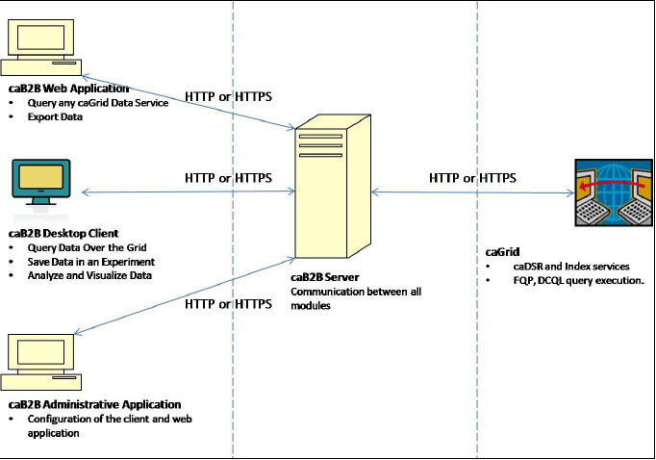
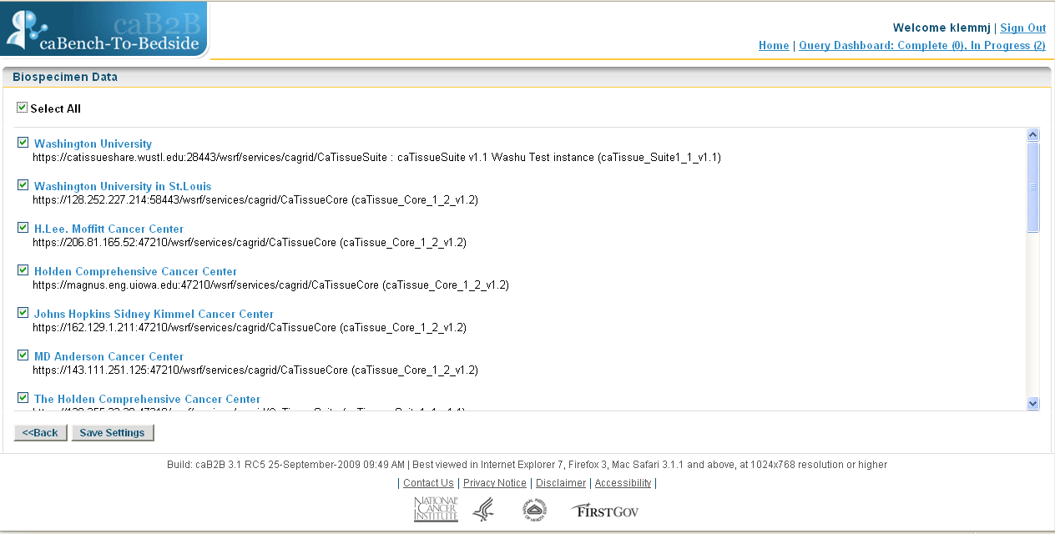
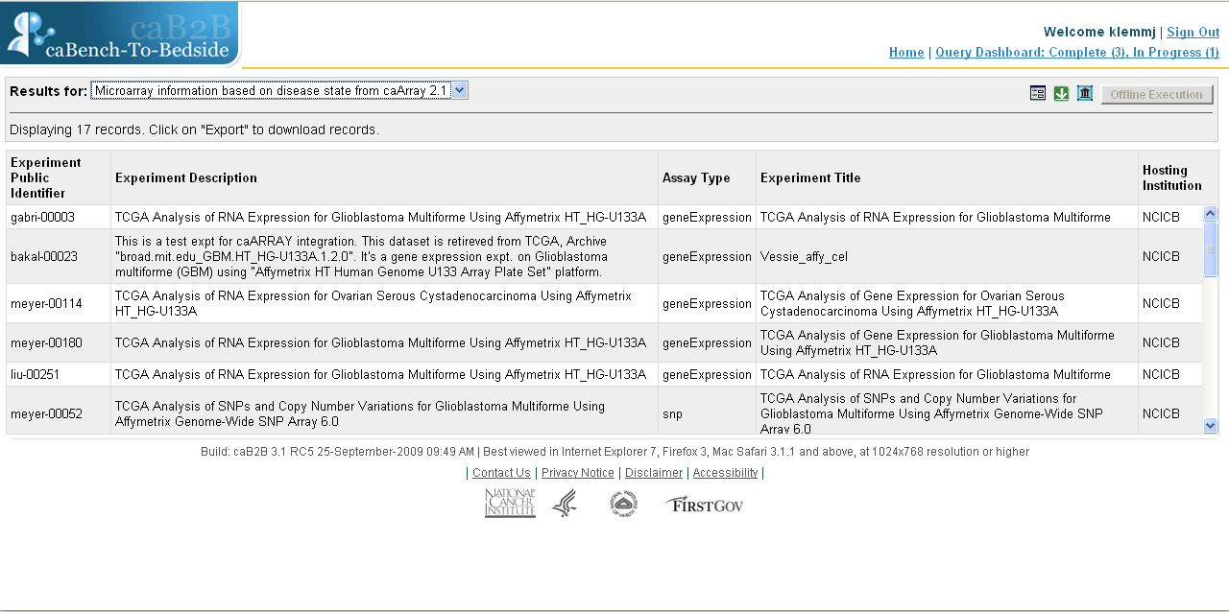
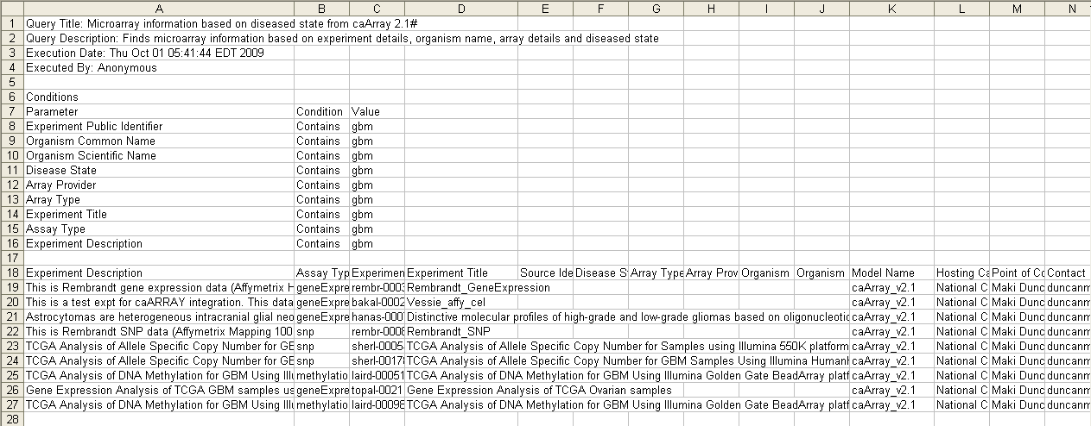
Life Sciences Research Enabled by caBIG® Tools for Data Integration, Discovery and Analysis
Rashmi Srinivasa¹, Mervi A. Heiskanen², John P. Marple¹, Dan Kokotov¹, Don Swan⁶, Shine Jacob³, Karen Ketchum³, Anand Basu², Aris Floratos⁴, Ian Fore², Michael Reich⁵, Juli Klemm².
¹5AM Solutions Inc., Rockville, MD; ²NCI-CBIIT, Rockville, MD; ³E-SAC Inc. , Rockville, MD; ⁴Columbia University, New York, NY; ⁵Broad Institute, Cambridge, MA, ⁶TerpSys, Inc.
The cancer Biomedical Informatics Grid® (caBIG®) is a collaborative network designed to accelerate the translation of discoveries from research to clinical care. This extensible informatics platform integrates diverse data types and supports interoperable software tools in clinical science, biospecimen management, imaging and discovery science. An institution can combine various caBIG® tools to form a comprehensive solution for data management as well as data integration, discovery and analysis. Data management solutions within the caBIG® Life Sciences domain include those for microarray data (caArray), biospecimens (caTissue Suite), nanoparticle data (caNanoLab) and Genome Wide Association Study data (caGWAS). To support the connection of data across these resources, there are integrative tools that allow the scientist to search data across different repositories connected to the grid, and analyze, integrate and visualize this data. caIntegrator2 allows users with no programming skills to set up a study-specific custom web portals that allow search and analysis across different data types. caBench-to-Bedside (caB2B) allows users to search array data, biospecimens, and nanoparticle data across instances of caArray, caTissue Suite, and caNanoLab, on the grid. In addition, both geWorkbench and GenePattern support integrative analysis and visualization of expression data, pathways and protein structures.
Several of these tools have had recent releases: caIntegrator2 v1.1 supports lists of genes/subjects for query and analysis, and caBIO integration for pathway search. caArray v2.4 parses array data from Affymetrix, Illumina, Agilent, Nimblegen, Genepix and MAGE-TAB files, and data can be annotated using controlled vocabularies like the MGED Ontology. The NCI CBIIT caArray instance includes data from key NCI initiatives like TCGA, TARGET, MMHCC and ICBP, loaded using MAGE-TAB. geWorkbench 2.0 includes a comparative modeling pipeline and database of homology models for protein structures.
caBIG®'s emphasis on a sSOA (semantic Service Oriented Architecture) ensures that a rich set of API methods is available to pass semantically meaningful data among applications. All caBIG® tools are open source, and community members are encouraged to contribute. More information is available at https://cabig.nci.nih.gov/.
caIntegrator2
caIntegrator2 is a platform for creating a study data warehouse
for performing correlative analyses and for sharing
a logical grouping of data with collaborators.
geWorkbench
caIntegrator2 allows researchers to set up custom web portals that bring together heterogeneous clinical, microarray and medical imaging data. The tool provides a graphical user interface to allow a study author to “point” to data of interest in systems on the grid and to then bring that data (or pointers to it, in the case of images) into the data warehouse. Once this information is in the caIntegrator2 environment, end user scientists can then run advanced queries, perform correlative outcomes analysis using Kaplan-Meier plots, and access analysis and visualization tools on and off the grid.
Enables integrated analysis of genomics data: gene expression, sequence, pathways - Genomic data integration with visualization tools, external databases, and computational services.
Clinical Data – Spreadsheet-style file
Array Data – caArray reference
Imaging Data – NBIA reference
Data Analysis in caIntegrator2
first production release
View Study
Study Team
Public
Configure study data sources
GenePattern Analysis
Pass genomic data to any appropriate GenePattern module, along with ‘class’ information derived from clinical annotations or saved queries
Once that module is run the results are saved in GenePattern and subsequent analyses can be performed
caGrid Analysis
Direct integration with caGrid analysis services for select modules:
Principal Component Analysis for exploration of gene expression data
GISTIC for copy number analysis across a number of samples
Comparative Marker Selection for finding significant markers between two classes of samples
Array Data
Spread-sheet
caIntegrator2
Kaplan-Meyer Plot using saved subsets
Study Team
Clinical Data
Deploy Study
Study Manager
Images
Spread-sheet
caIntegrator Public Server
https://caintegrator2.nci.nih.gov
General Information:
https://cabig-kc.nci.nih.gov/Molecular/KC/index.php/CaIntegrator2
Image Annotations
Saved Queries are good for:
Saving curated subsets of data
Sharing those subsets with other users
Storing subsets of data for use in other parts
of caIntegrator2
Image Annotations
AIM
Tissue Data
later production releases
Data aggregation in caIntegrator2
caArray
caTissue Suite
Cancer Genome Wide Association Studies
caNanoLab
Standards based data management system
for microarray data - MIAME compliant annotation
of experiments, connects to analytical tools -
Securely share data internally and over caGrid.
Tissue banking tool for biospecimen inventory, tracking and basic annotation - Track the collection, storage, annotation, quality assurance and distribution of specimens.
Supports the correlation of SNP genotype data, SNP association findings, population frequency data, and clinical phenotypes and provides tools for search and retrieval of GWAS findings in the context of genes or chromosomal regions of interest.
caNanoLab was engineered to facilitate the capture and exchange of information on the composition and synthesis of nanomaterials; physico-chemical, in vitro, and in vivo characterizations; nanotechnology protocols; and associated publications.
caBench-to-Bedside
caBench-to-Bedside (caB2B) allows translational research scientists
to search for and combine data from virtually any caGrid data source.
NCI Instance of caB2B:
https://cab2b.nci.nih.gov
Documentation and Software Download:
https://cabig.nci.nih.gov/tools/caB2B
The caB2B Web Application is a component of the caB2B Suite that allows users to search data services across the caGrid using preconfigured keyword and form-based queries, based on common use cases. These preconfigured queries have been created using the caB2B Suite components and local installers may also import the metadata for any other caGrid data service and create new queries for their instance of the caB2B Web Application. The caB2B Client Application enables advanced end users to create and execute queries across caGrid data services. The query component consists of a diagrammatic view that allows the user to create a directed acyclic graph connecting two or more classes of the query. Users can then save the query, execute the query, view the results using various graphical components, and save the results as a ‘virtual experiment’.
Designed to encourage rapid integration of new techniques
Pulls native data files directly from caArray’s API
Current library includes over 100 analysis modules
  Gene Expression Analysis
  SNP Analysis
  Data Conversion Modules
Supports sharing of analysis workflows through a pipeline engine
The caB2B Home Page
A caB2B form-based query
Queries may be executed in the background and the status
monitored on a query dashboard
User may search all databases on caGrid or only select ones
Search results
Query parameters and results may be exported to Excel

