Slide 1


Annotating Experiments with MAGE-TAB: Annotare Example files can be downloaded from here: https://gforge.nci.nih.gov/docman/view.php/305/23084/magetab_samples.zip
caArray User Community Meeting
2.2.0 Feature Overview and Review of MAGE-TAB Update and Export Specification
Notes:
1

Slide 2
Outline
Overview – MAGE-TAB and Annotare
Installation
Starting from Templates
Starting from the Design Wizard
Editing the IDF
Configuring and Editing the SDRF
Finding annotations from controlled vocabularies
Validating MAGE-TAB
Plan for Annotare v2.0

Slide 3
MAGE-TAB Overview
Spreadsheet-based format for annotating and exchanging assay data in a MIAME-compliant fashion.
MAGE-TAB components:
Investigation Description Format (IDF): General information about the investigation including its name, a brief description, the investigator’s contact details, bibliographic references, etc.
Sample and Data Relationship Format (SDRF): Describes the relationships between the samples, data, and other objects used or produced in the investigation.
A scientist can use MAGE-TAB to record an experiment’s data and annotations.
Annotations reference controlled vocabularies like the Experimental Factor Ontology and the NCI Thesaurus.

Slide 4
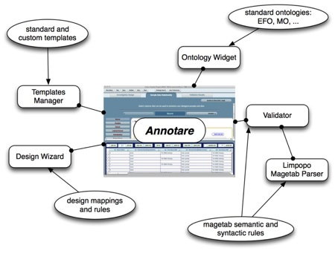
Annotare Overview
GUI tool to create MAGE-TAB IDF and SDRF files
Standard templates for common experiment types
A design wizard that guides the biologist step-by-step
Easy incorporation of annotations from relevant biomedical ontologies,
A MAGE-TAB validator that checks the annotations
Open source (MIT license), based on Adobe AIR and Java.

Slide 5
Installation
Requirements: 190M disk space for Mac OR 70M for Windows
Windows (XP, Vista, 7)
Uninstall any older version of Annotare via the Control Panel and then delete the Annotare folder under “Program Files”.
Download the Installer bundled with/without the JRE:
http://annotare.googlecode.com/files/Annotare-v1.1.1-jre.exe (Recommended)
http://annotare.googlecode.com/files/Annotare-v1.1.1.exe (First install JRE 1.5/1.6)
Double-click on the exe and follow the steps to install.
Go to Programs -> Annotare to start the application.
MAC OS X (10.5 or greater)
Uninstall any older version of Annotare by removing it from /Applications.
Get Java JRE 1.5 or higher.
Download the installer:
http://annotare.googlecode.com/files/Annotare-v1.1.1.pkg.zip
Double-click to unzip, then double-click on the .pkg to install.
Click on /Applications/Annotare to start the application.

Slide 6
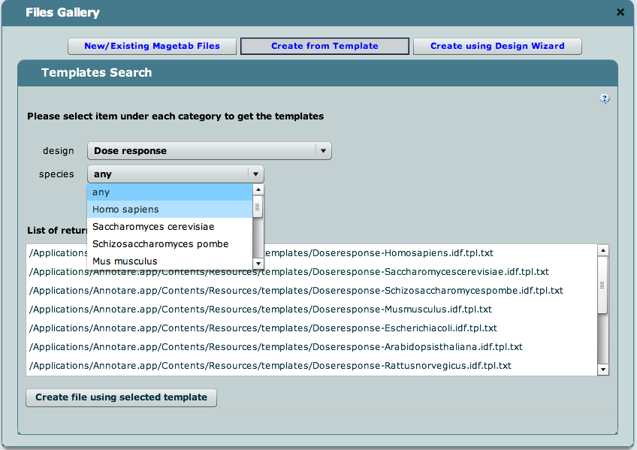
Templates
Don’t start from a blank slate; use a template.
A template gives you a partially populated MAGE-TAB document set that can then be completed with experiment-specific information.
From the Files Gallery, choose “Create from Template”.
Search for a template by experimental design and species.

Slide 7
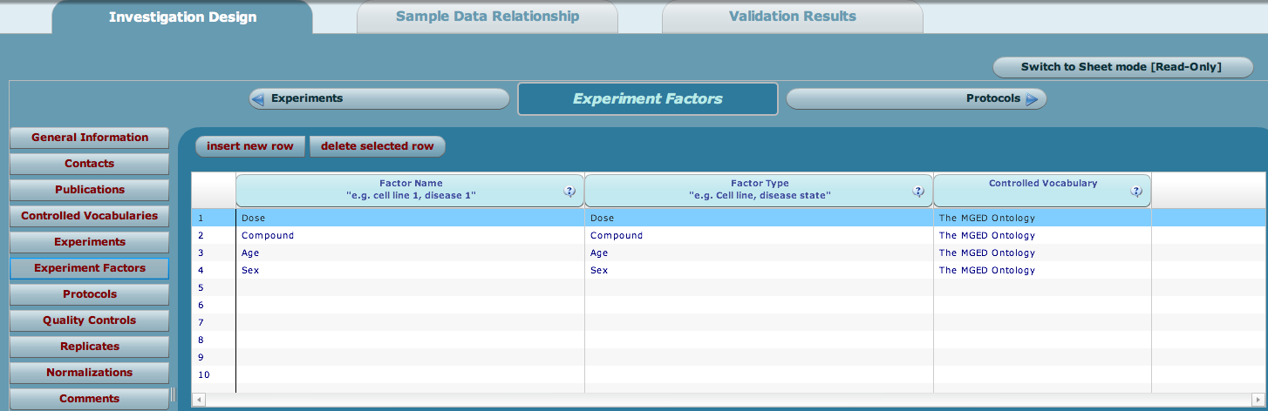
Templates
Generate MAGE-TAB files from the template
Choose “Create file using selected template” and start editing it.
Clicking on Save will save an <filename>.idf.txt and <filename>.sdrf.txt.

Slide 8
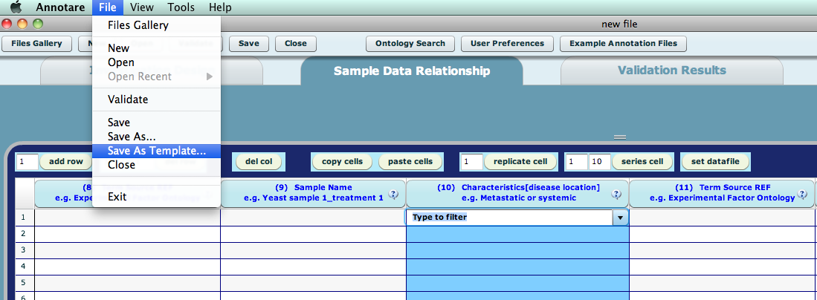
Templates
Custom Templates
Clicking on File -> Save as Template (in the Annotare menu) will save your edits as a new template in your files location (defined in user preferences). The files will be saved as <filename>.idf.tpl.txt and <filename>.sdrf.tpl txt.
Custom templates can be created with often-used annotations already filled in, and saved for use in future experiments.

Slide 9
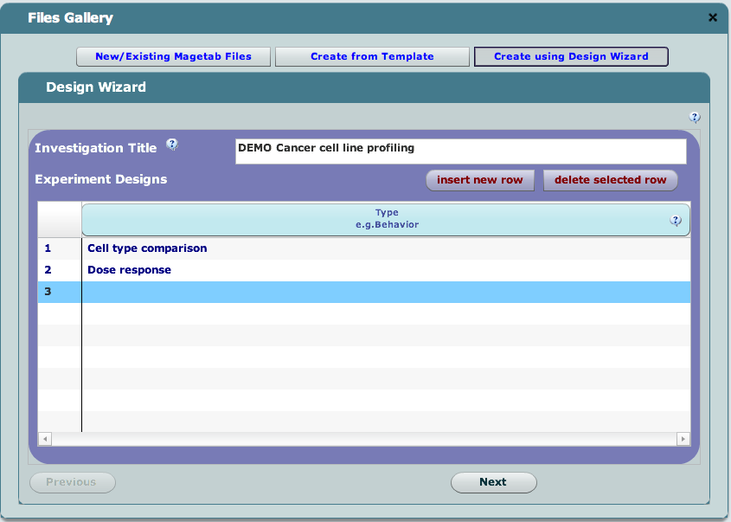
Design Wizard
Useful when no template is available
Guides a novice user with step-by-step questions
Experimental design, number of channels, labels
Platform and protocols

Slide 10
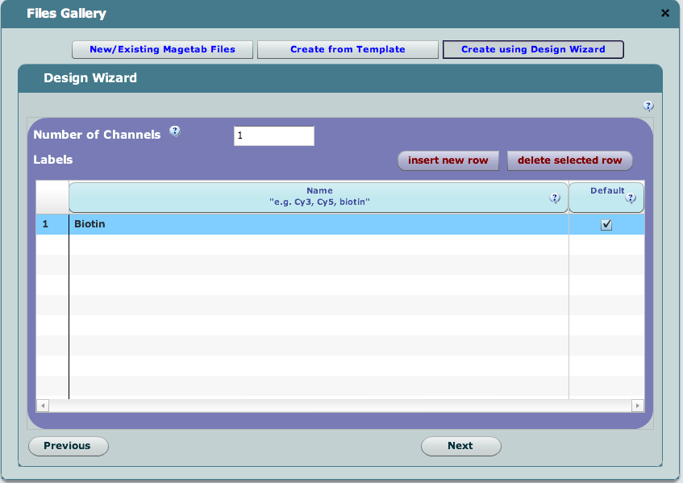
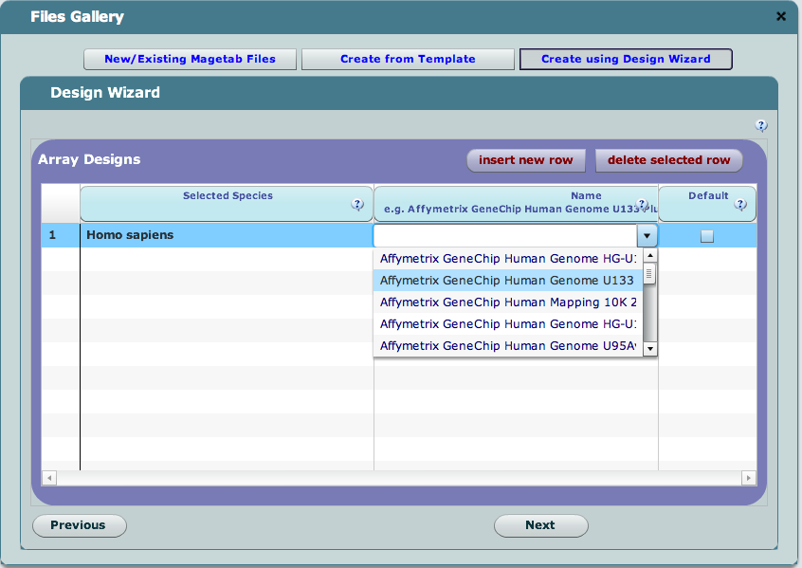
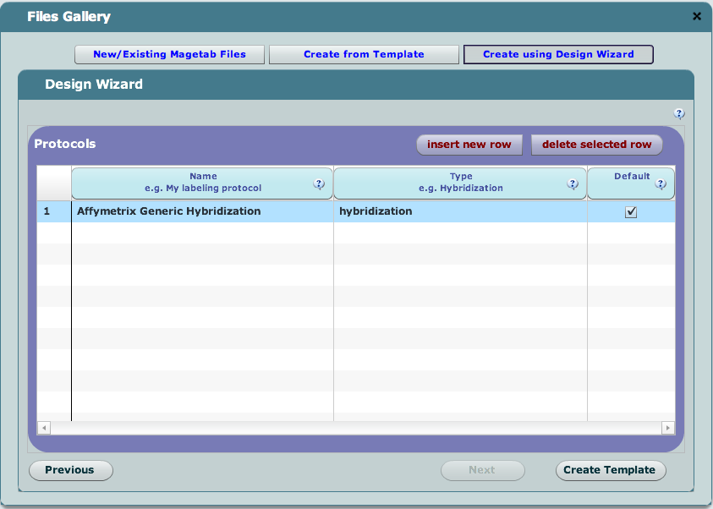
Design Wizard
Screenshots

Slide 11
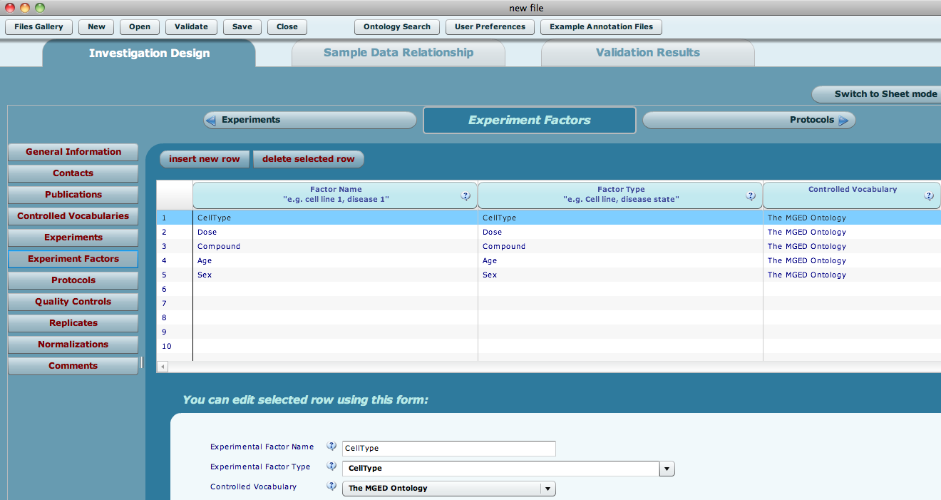
Design Wizard
Wizard generates partial annotations

Slide 12
IDF
GUI forms
hide the syntactic complexity of MAGE-TAB as much as possible
group related information together in an intuitive manner
Edit the IDF to
provide basic information about an experiment
list the people associated with the experiment and their roles
list any associated publications
describe the experimental design and factors being studied
describe the protocols that were employed at various stages in the investigation

Slide 13
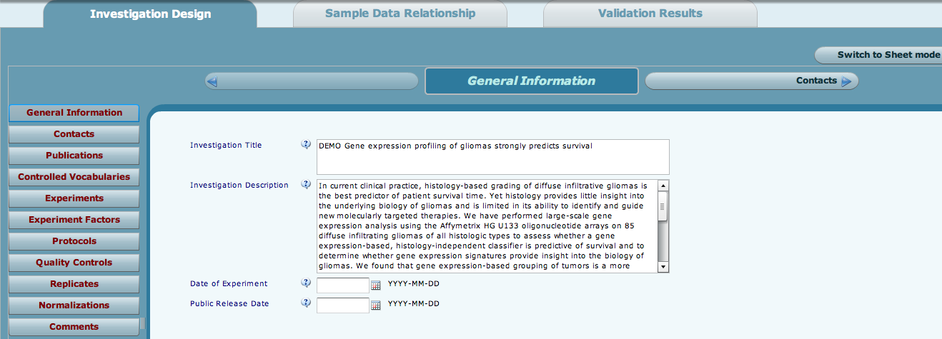
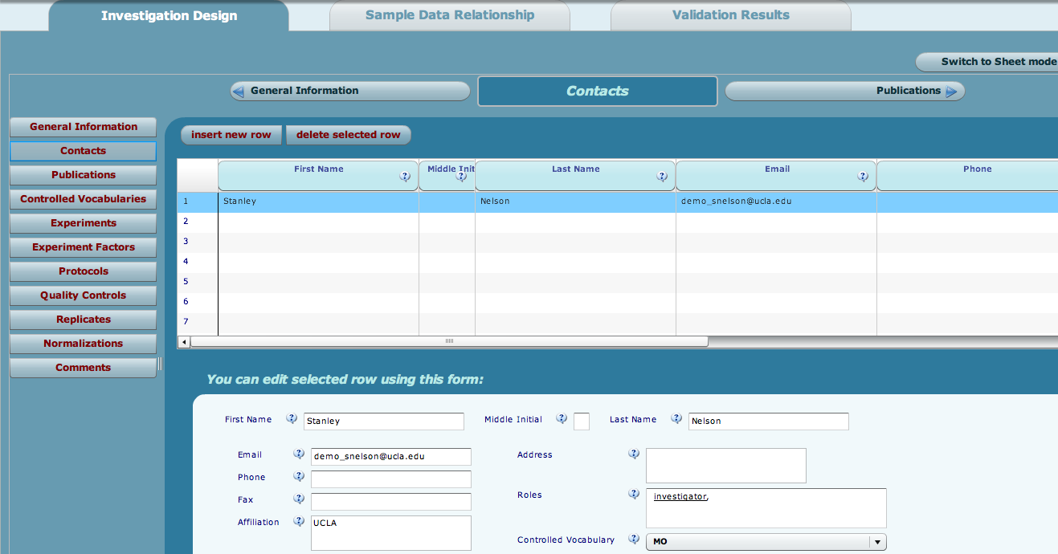
IDF Forms
IDF forms for general information and contacts

Slide 14
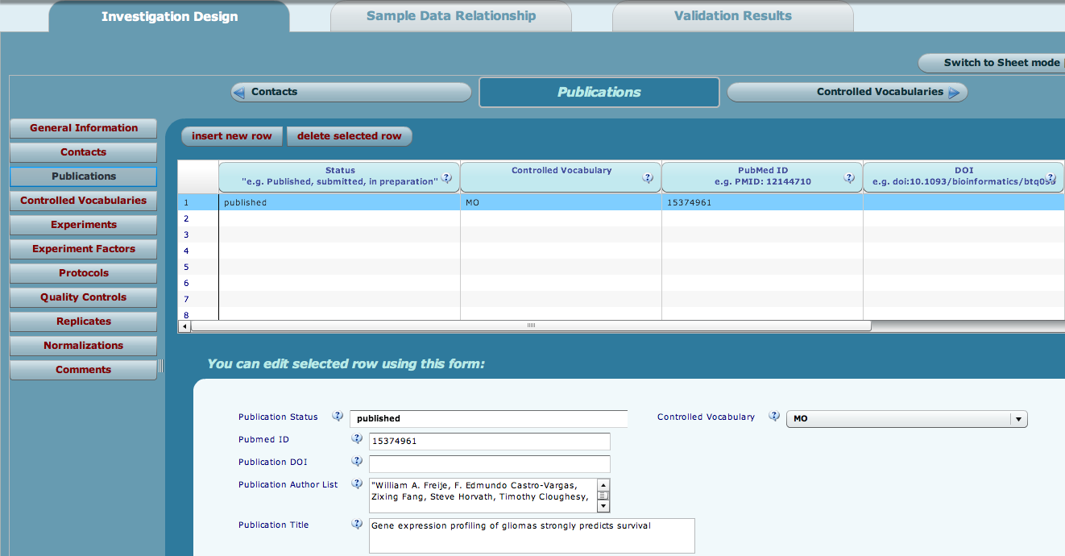
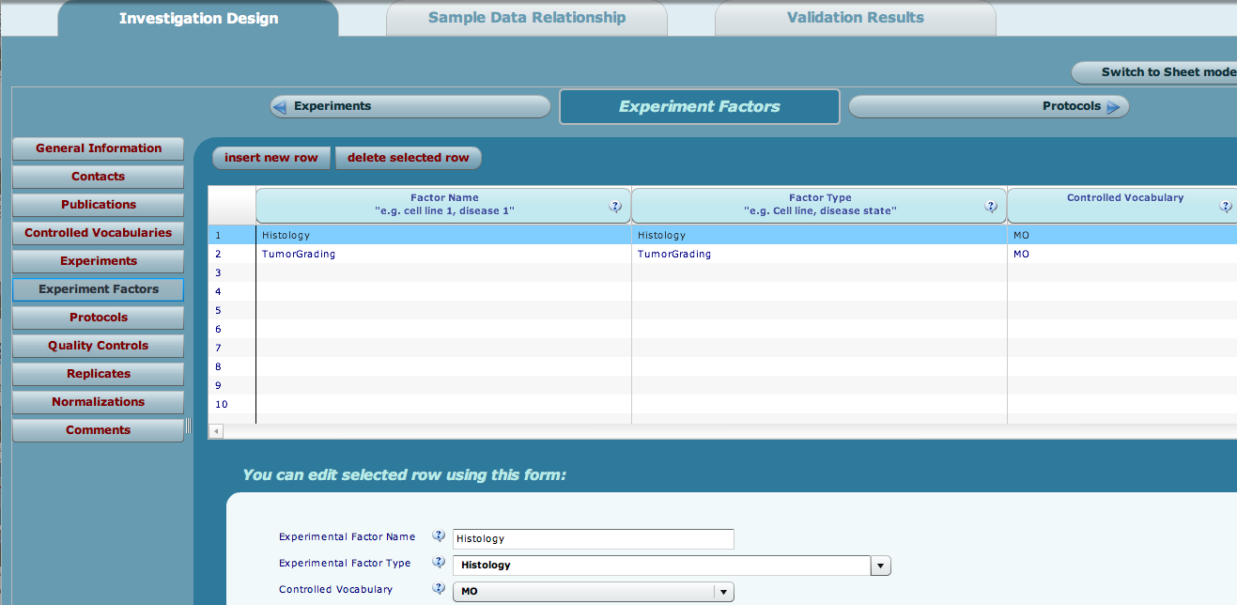
IDF Forms
IDF forms for publications and factors

Slide 15
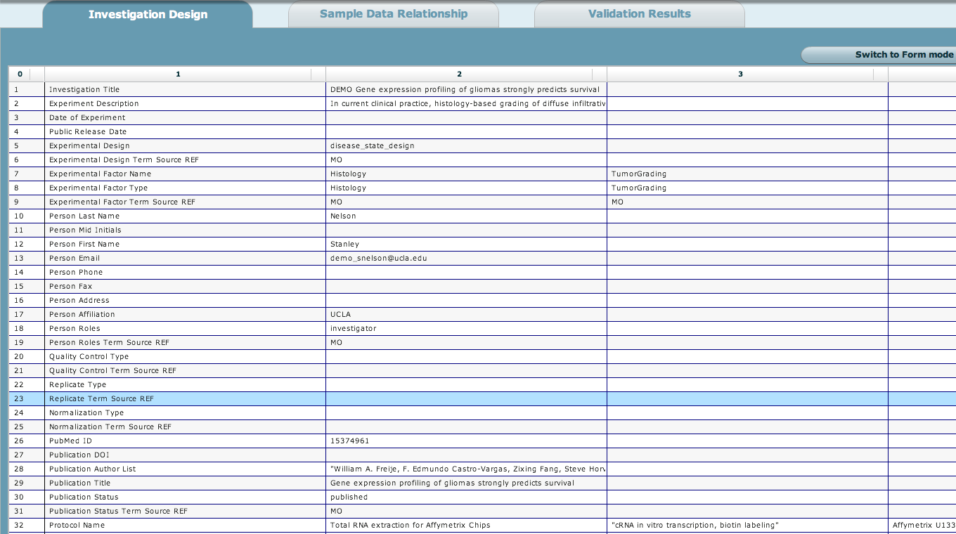
IDF Spreadsheet
Spreadsheet view of an example IDF

Slide 16
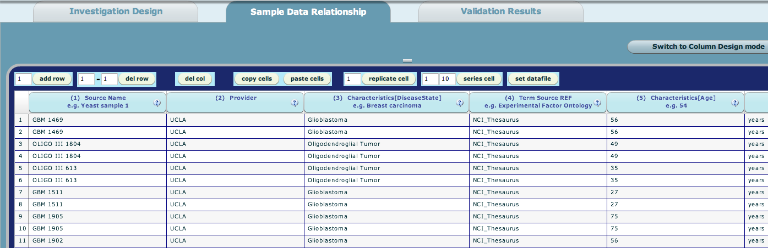
SDRF Editing
Edit the SDRF in spreadsheet mode
Excel-like cut and paste functionality
More sophisticated context-sensitive drop-downs coming in the next release

Slide 17
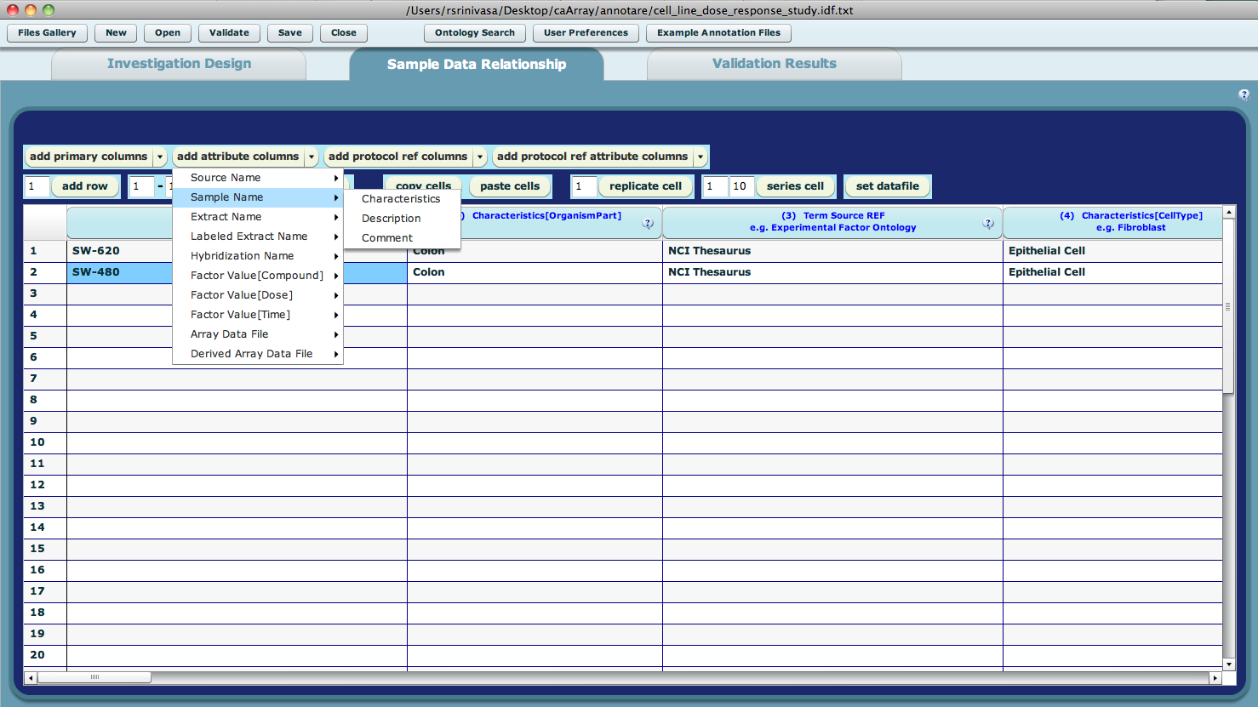
SDRF Configuration
Configure the columns in the SDRF
Columns for biomaterials, characteristics, factor values, protocols and files

Slide 18
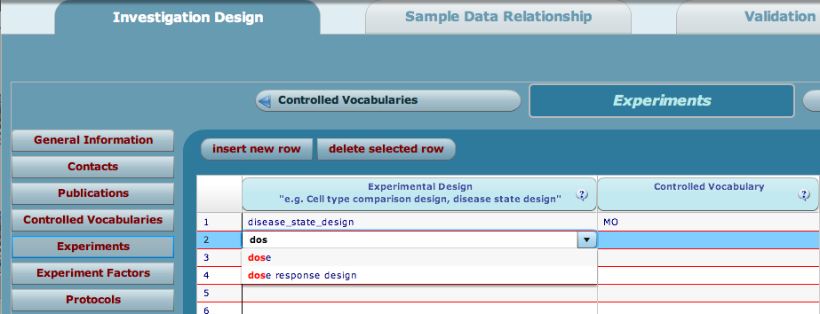
Using Controlled Vocabularies
Ontology-enabled fields with auto-complete
Experimental design & factor types, protocol types, sample characteristics
Annotare comes bundled with the Experiment Factor Ontology (EFO)

Slide 19
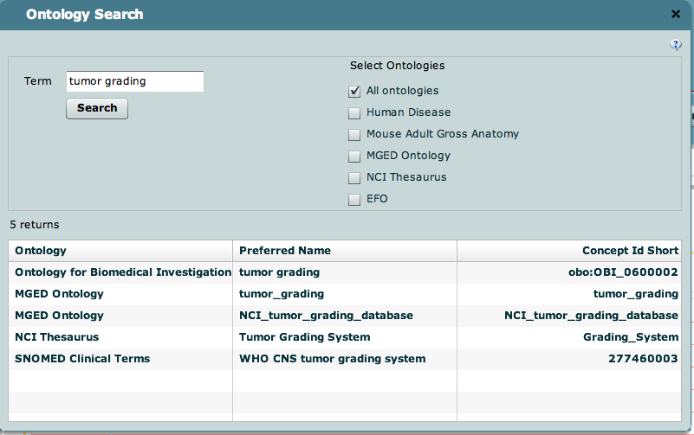
Using Controlled Vocabularies
Ontology widget
Use it to search the NCBO Bioportal (http://bioportal.bioontology.org/) for terms from other ontologies, e.g., NCI Thesaurus, MGED Ontology.

Slide 20
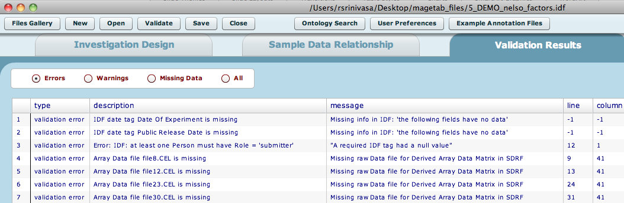
Validation
MAGE-TAB Validator
Checks syntactic and semantic rules on layout and content
Flags invalid headers, missing mandatory annotations, broken integrity of references, misordered columns and missing data files
Files and templates can be validated
An invalid file can still be saved

Slide 21
Plan for 2.0
Features being prioritized for Annotare 2.0
Web version
Context-sensitive ontology-enabled fields
Enhanced Design Wizard
Plug-in validators
“Undo” functionality
Graphical view of experiment design graph

Slide 22
Avenues for Feedback
Feedback on Annotare
Issue tracker: http://code.google.com/p/annotare/issues/list

