Slide 1


caArray User Community Meeting
caArray Roadmap
2.2.0 Feature Overview and Review of MAGE-TAB Update and Export Specification
ICR Workspace Meeting
Call in: 877-416-5524
Participant Passcode: 2627056
Centra: http://ncicb.centra.com
Meeting ID: ICR_meeting
November 5, 2008
August 2009

Slide 2
Agenda
caArray Roadmap
  Upcoming releases this year - 2.3.0 and 2.3.1
  High-priority features for future releases
  Features being prioritized for future releases

Slide 3
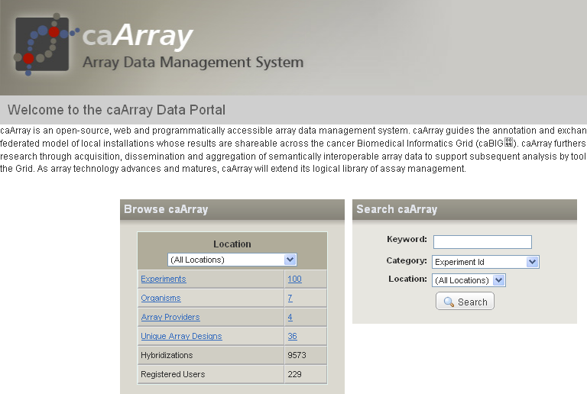
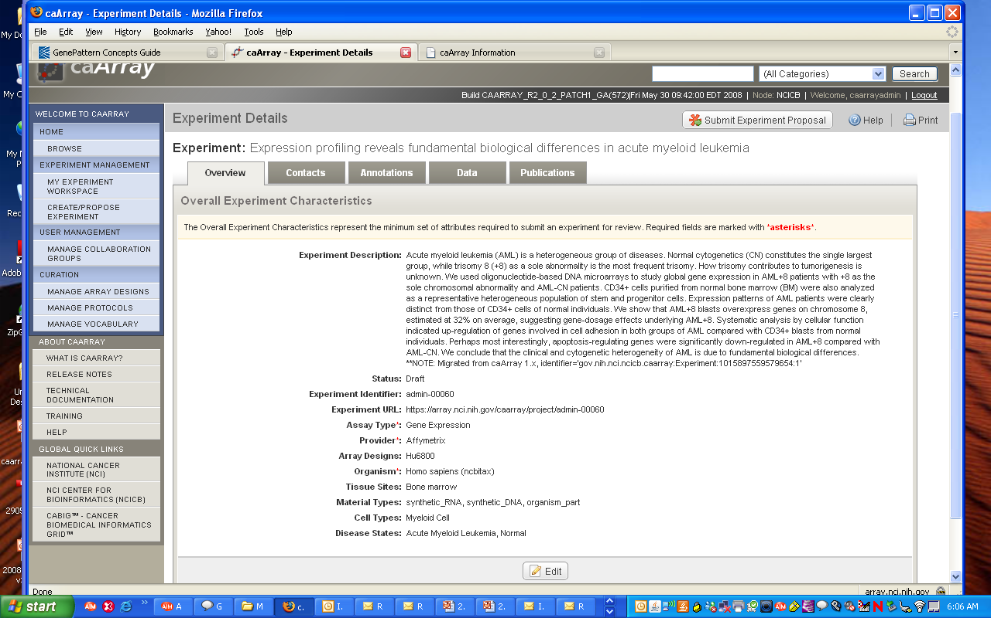
caArray Overview
Store array data associated with MIAME-compliant experiment and sample annotations
Data access control for Experiments and Samples
Manage protocols and controlled vocabularies
Browse and Search Experiments and Samples
Integration with data aggregation and analysis tools
All open source technologies, easy installation (including upgrade installers for new releases)

Slide 4
Upcoming Releases: 2.3.0
caArray 2.3.0
Release targeted for early October 2009.
  Aligns with LSD Bundle release.
Stage tier has Release Candidate RC3.
  Available outside the firewall for integration development
Highlighted features:
  New API: richer, faster, enables backwards compatibility.
  Audit trail of permissions changes.
  Separation of experiment locking from permissions control.
  Ability to download array designs.

Slide 5
Upcoming Releases: 2.3.1
caArray 2.3.1
Release targeted for later this year
Primary feature: Export to GEO
  Problem:
    Users store their data + annotations in caArray. When ready to publish, they have to repackage the same data in order to publish it in GEO.
  Solution:
    caArray will allow the user to export an experiment into GEO SOFT format. This SOFT package can then be submitted to GEO.
    The initial release will support single-channel experiments that have Affymetrix CHP data files, and that are based on array designs (platforms) already in GEO.
    Focussing on CHP files allows us to package the native data files in the SOFT package as opposed to having to derive data tables to include in the SOFT submission.

Slide 6
High-priority Features for Future Releases
Fix collaborator group access to unimported files.
  Problem:
    Files that are uploaded but not yet imported can be seen only by the experiment owner, and are invisible to collaborators who have read access to the experiment.
  Solution:
    Users with read or read-write access to the experiment will be allowed to see unimported files.
    A user with sample-selective access to the experiment will not be allowed to see unimported files, except if he/she uploaded the files.

Slide 7
High-priority Features for Future Releases
Add parsers for the latest Illumina data formats.
  Problem:
    caArray parses old Illumina data formats which are not prevalent now.
  Solution:
    Add a parser for Illumina BGX array designs.
    Add a parser for the Illumina Sample Probe Report data file generated by BeadStudio 3.

Slide 8
High-priority Features for Future Releases
Integrate caArray with biospecimen systems (caTissue).
  Problems:
    Various ad hoc systems (like email/paper) are used during the lab workflow in order to transfer specimen information from the biospecimen system to the assay system (caArray).
    Users need a way to look up data associated with a specimen they found in the biospecimen system.
    Users need a way to look up the specimens associated with data they found in caArray.
  Possible Solution:
    Use an "external ID" biomaterial characteristic in caArray to store the identifier for the specimen as defined by the biospecimen system.
    Provide a mechanism for transfer of specimens (with selected annotations) between caArray and the biospecimen system. This could be through a MAGE-TAB spreadsheet, and/or via programmatic services.
    Provide APIs that allow a Data Integration system (like caB2B) to search for biomaterials by external ID.

Slide 9
High-priority Features for Future Releases
Simplify the import of large data sets.
  Problem:
    Attempts to import more than about 1.5GB of data files fail because this requires more than 4GB of data to be stored in the database transaction, which exceeds the MySQL limit. This forces the user to import in multiple smaller batches.
  Possible Solutions:
    Programmatically break the import into multiple smaller transactions.
    Evaluate other databases (Postgres).

Slide 10
High-priority Features for Future Releases
Support Grid API access to protected data.
  Problem:
    The current version of the Grid API supports access to only publicly available data. This means that if programmatic access to protected data is desired, then the Java API must be used instead.
  Solution:
    Allow a programmatic client to log in using Grid credentials and retrieve protected data.
    Local installers will have the choice to keep old-style local accounts or migrate to Grid accounts.
    A mechanism must be provided for users to migrate their local accounts to Grid accounts.

Slide 11
High-priority Features for Future Releases
Enable development and distribution of plug-in parsers.
  Problem:
    If a parser for a new data type is to be introduced, it mandates a new release of caArray.
  Solution:
    Rework the architecture so that new parsers can be developed independently and distributed as plug-ins without the need for a full-fledged release.

Slide 12
Additional features being prioritized
Provide a writable API to allow programmatic loading of data into caArray as part of existing pipelines. [11][8]
Controlled vocabulary: [5][6]
  Suggest alternative terms already available.
  Allow curator to merge duplicate terms.
Enable easy upload of large data sets (>2GB). [5][4]
Collaboration group ownership should not be tied to experiment ownership. [3][8]
Numbers in green were added after the caArray User Meeting, and are the results of a quick poll of the 20 meeting attendees to gauge how many people are interested in the feature.
Numbers in blue were added after the ICR Meeting, and are the results of a quick poll of the meeting attendees.

Slide 13
Features being prioritized (continued)
Allow user to reset the status of files stuck in the Importing state. [3][4]
Add parsers for Agilent and Nimblegen data formats. [2][5]
Allow adding a new organism through the UI. [1][5]
Add ability to move Supplementary files back to the Manage Data tab. [0][1]
Support upload of files in the tar.gz format. [0][4]
Numbers in green were added after the caArray User Meeting, and are the results of a quick poll of the 20 meeting attendees to gauge how many people are interested in the feature.
Numbers in blue were added after the ICR Meeting, and are the results of a quick poll of the meeting attendees.

Slide 14
Avenues for Feedback
Molecular Analysis Tools Knowledge Center Forum
Gforge Community Change Request tracker:
  http://gforge.nci.nih.gov/tracker/?atid=1339&group_id=305&func=browse
The caArray monthly User Meeting:
  Next Meeting: Wednesday, September 2, 2:00 PM ET

