Slide 1
caArray 2.0
Architecture Review
Prepared by 5AM Solutions
October 9, 2007

Slide 2
Overview
Architecture defined
  The organizational structure of a system. An architecture can be recursively decomposed into parts that interact through interfaces, relationships that connect parts, and constraints for assembling parts. Parts that interact through interfaces include classes, components and subsystems.
4 + 1 Views of Architecture
  Logical View
  Implementation View
  Process View
  Deployment View
  Use Case View (the + 1)
Standard method for representing software architecture recommended by the Rational Unified Process
This review will focus principally on the Logical View

Slide 3
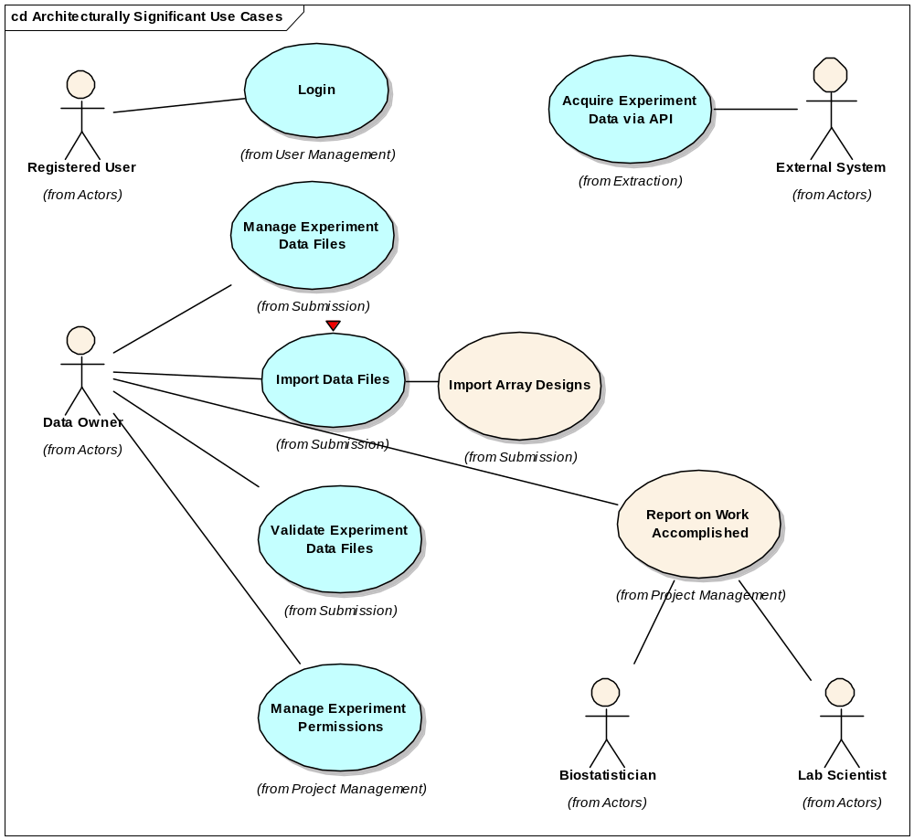
Use-Case View
System behavior with the most influence on the important design constructs
Logical View will describe components used to realize this behavior

Slide 4
Logical View
Architecturally Significant Design Elements
  High-level structural view of software layers and subsystems
Use-Case Realizations
  Show interactions between subsystems to provide behavior described in architecturally significant use cases
  Use-case realizations described:
    Login
    Manage Experiment Data Files
    Import Experiment Data
    Acquire Experiment Data via API
Subsystem Descriptions
  Show how major subsystems are implemented to provided necessary behavior invoked in use-case realizations
  In this review, subsystem implementation descriptions will be provided in the context of the use-case realizations they support.

Slide 5
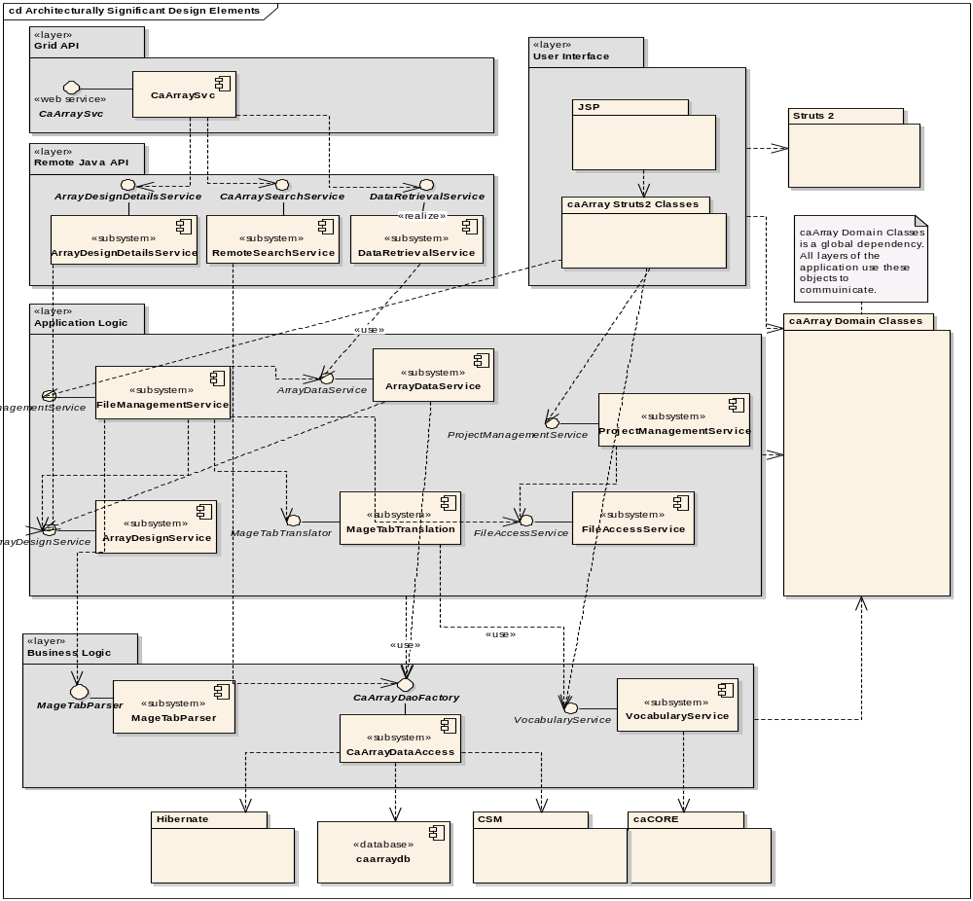
Architecturally Significant Design Elements
Logical model is decomposed into layers
Major areas of internal functionality decomposed into subsystems accessed through interfaces
caArray Domain Classes are used by all subsystems; they are the value objects that model microarray, experiment, and data entities.

Slide 6
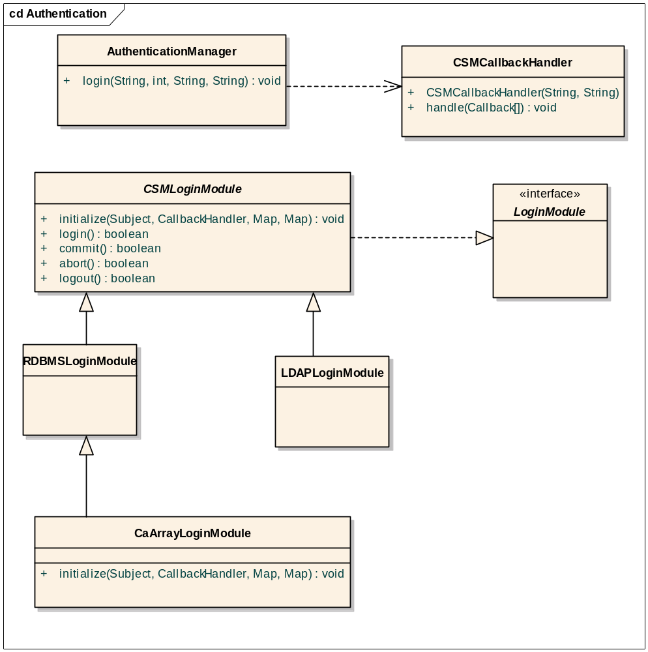
Authentication (Login)
Principal authentication is handled by the container.
caArray and CSM provide specialized authentication implementation classes invoked by the container at login
The caArray application is configured to use these specialized LoginModules to provide LDAP and RDBMS based authentication

Slide 7
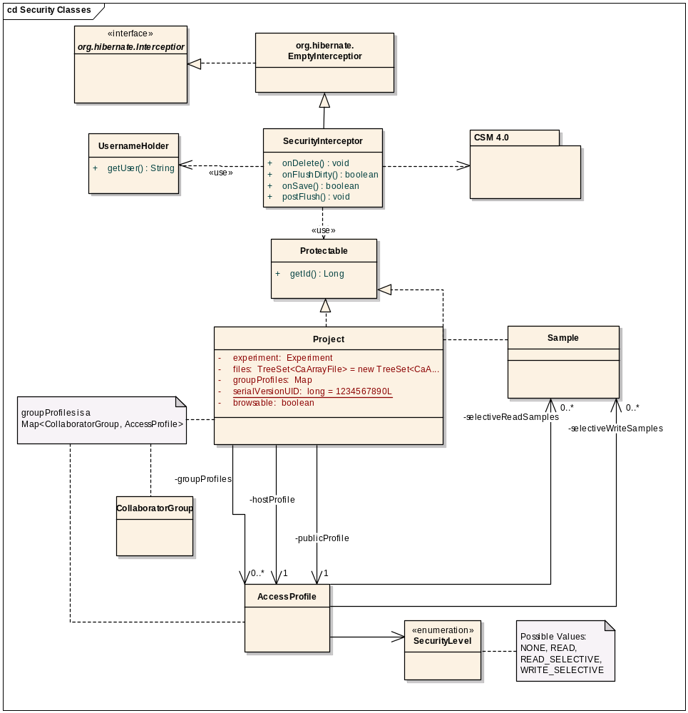
Authorization Mechanism
Authorized access to objects is handled transparently at the persistence layer using CSM 4.0 integrated into caArray.
When Protectable elements are created they are automatically registered with the necessary supporting access control metadata
When Protectable objects are retrieved, the security framework ensures that only objects visible to the current user are returned by using Hibernate filters.

Slide 8
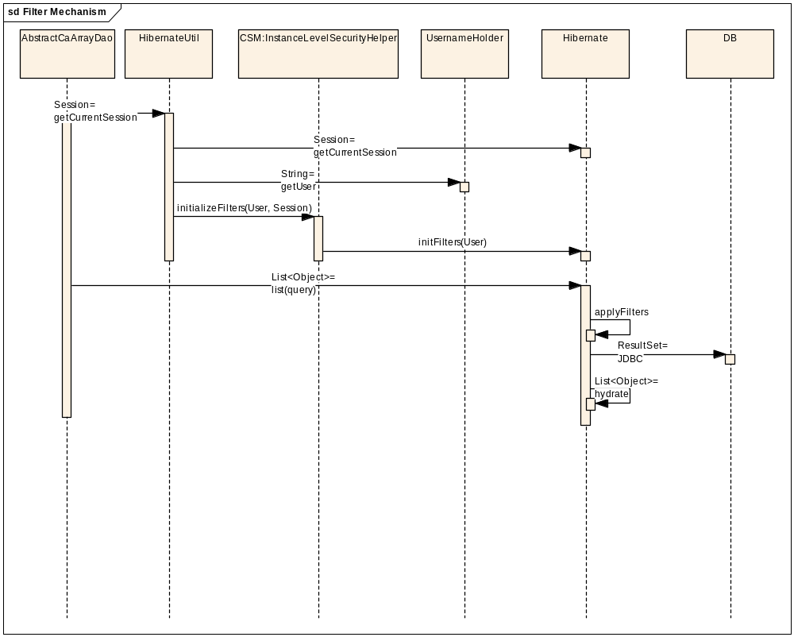
Authorization Filter Mechanism

Slide 9
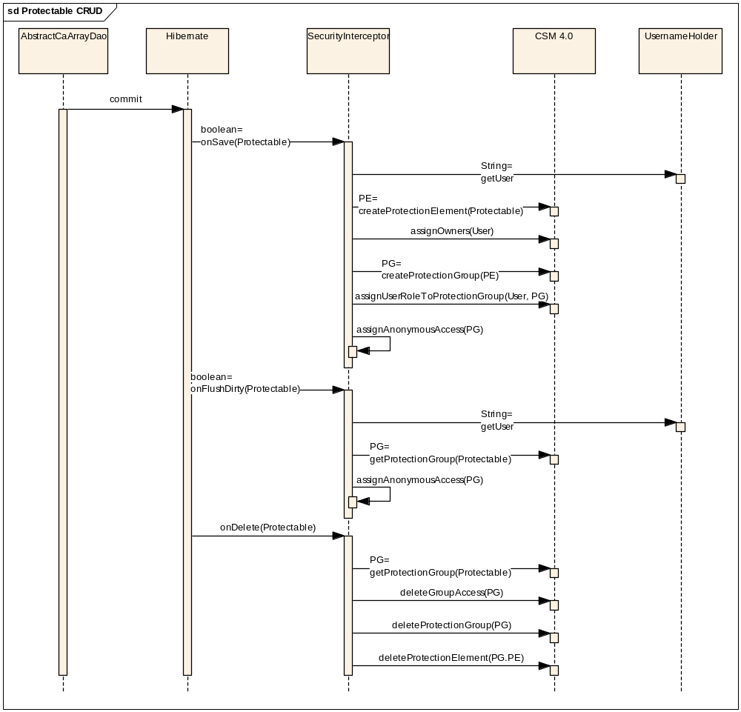
Save, Update and Delete on Protectable

Slide 10
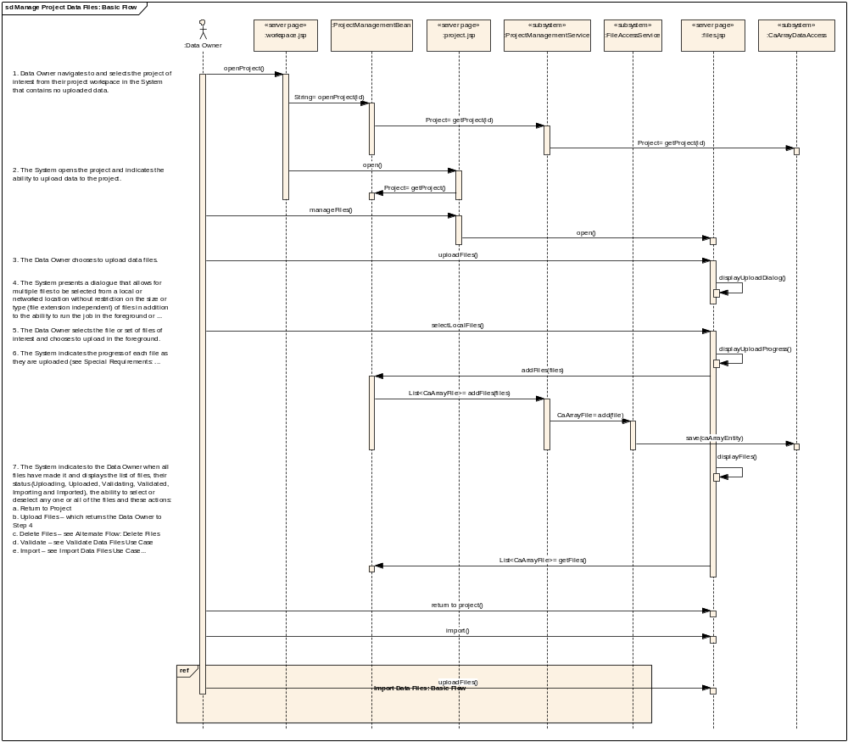
Manage Project Data Files – Basic Flow
File contents are stored compressed into MySQL by the FileAccessService subsystem (shown later)
Compression ratios range from 10% to 50% of original file size.

Slide 11
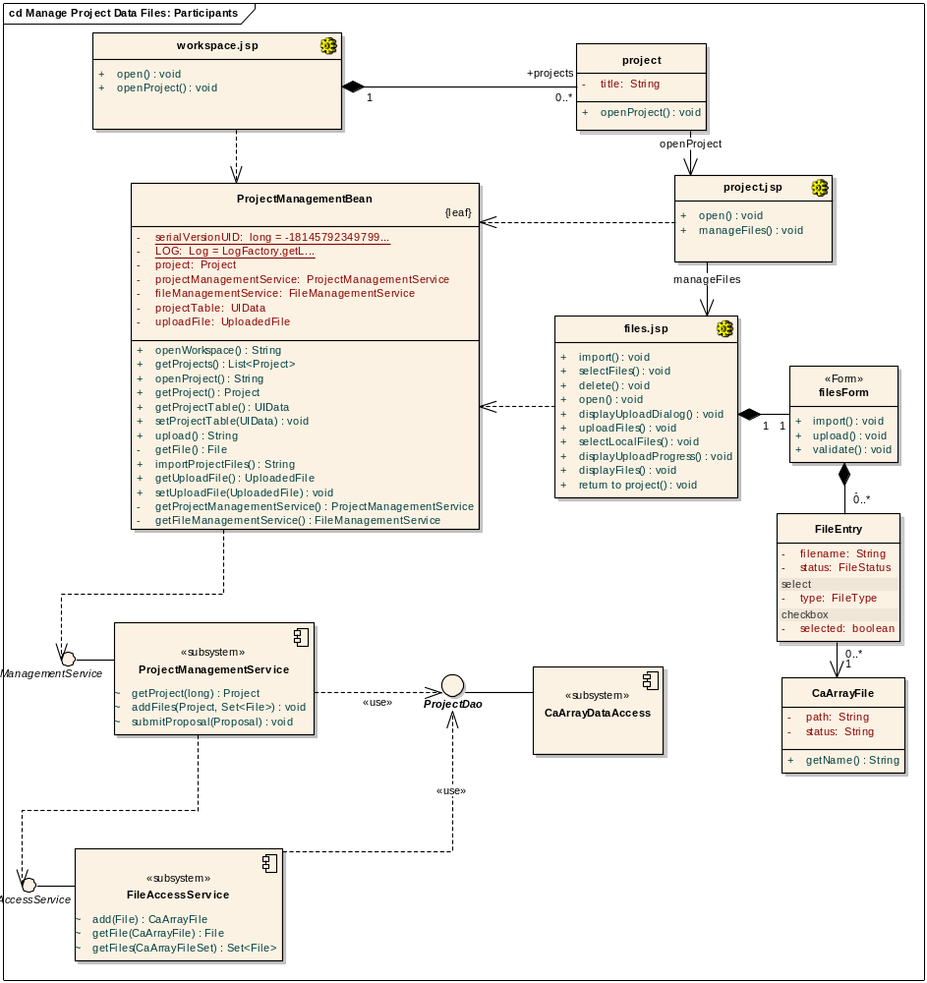
Manage Project Data Files – Participants

Slide 12
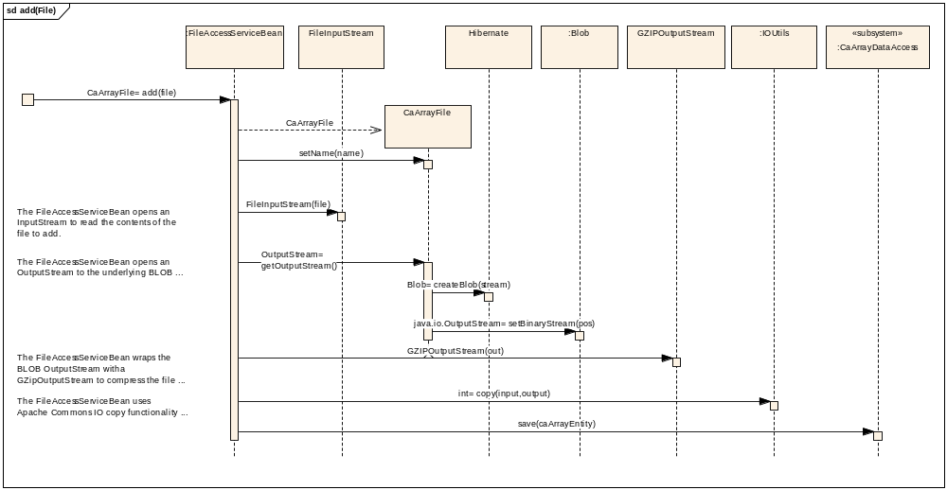
FileAccessService Subsystem Implementation

Slide 13
Import Project Data Use-Case Realization
FileManagementService subsystem provides overall flow-of-control
ArrayDataService, ArrayDesignService, MageTabParser and MageTabTranslation service provide data parsing and validation
After validation and parsing, entities are persisted using the CaArrayDataAccess DAO subsystem

Slide 14
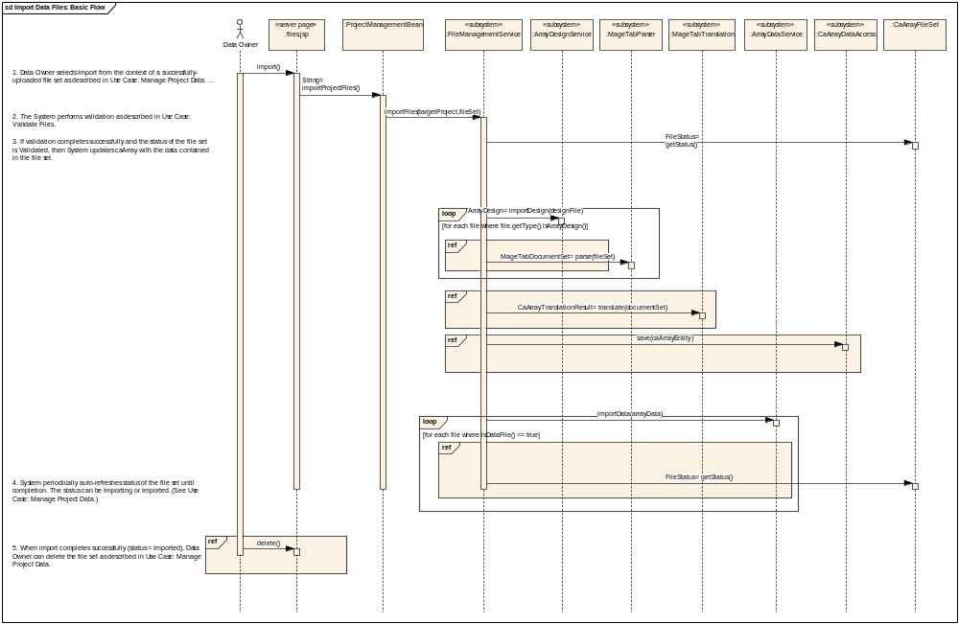
Import Project Data – Basic Flow

Slide 15
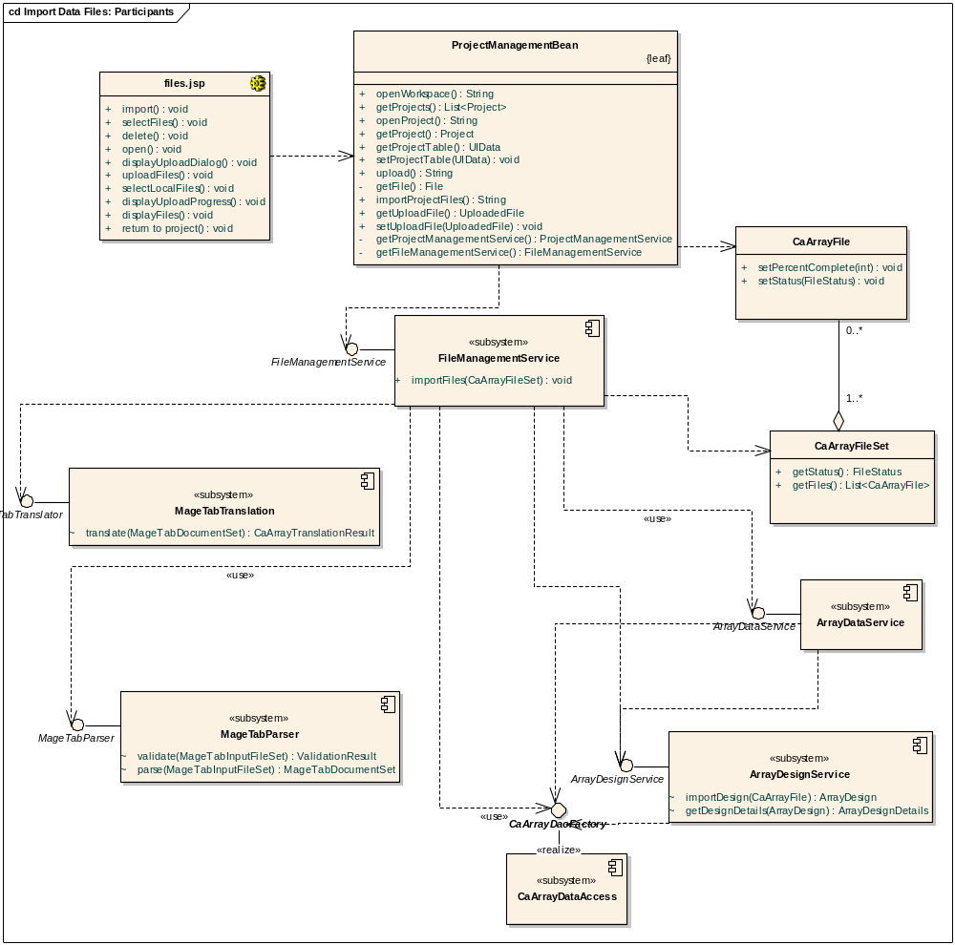
Import Project Data – Participants

Slide 16
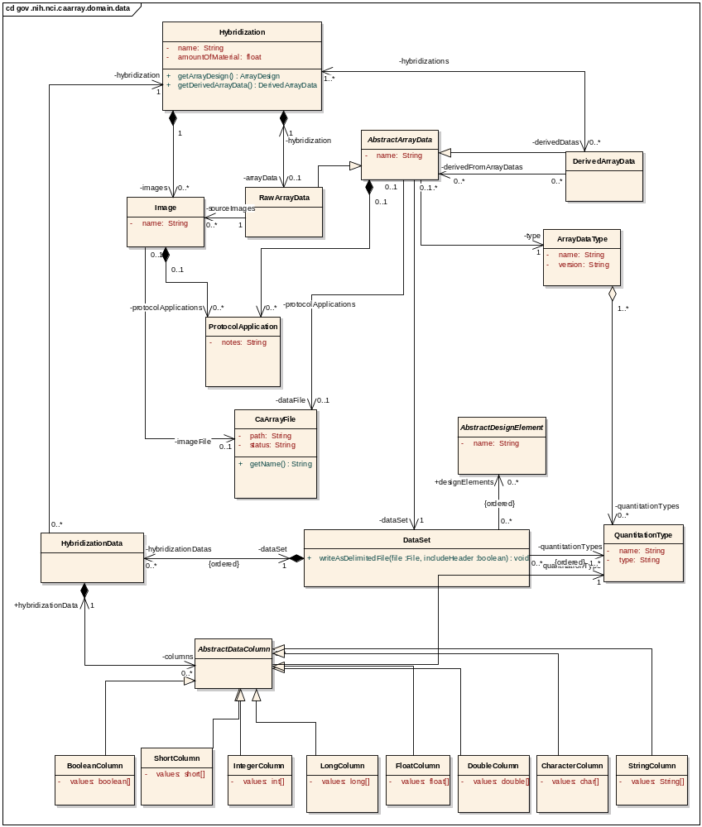
Array Data Classes
Fundamentally, a DataSet is composed of an ordered list of columns (organized by Hybridization) of data values corresponding to the QuantitationTypes in the DataSet.
There are persistent DataSets for data files uploaded to the system and transient custom DataSets that are composed of parts of persistent DataSets based on client requests (e.g. return all Signal values for all Hybridizations in an Experiment)

Slide 17
Array Data Value Compression and Storage
public abstract class AbstractDataColumn extends AbstractCaArrayObject {
…
@Basic(fetch = FetchType.LAZY)
@Column(columnDefinition = "LONGBLOB")
byte[] getSerializedValues() {
return valuesSerializer.getSerializedValues();
}
void setSerializedValues(byte[] serializedValues) {
valuesSerializer.setSerializedValue(serializedValues);
}
@Transient
Serializable getValuesAsSerializable() {
return valuesSerializer.getValue();
}
void setSerializableValues(Serializable values) {
valuesSerializer.setValue(values);
}
}

Slide 18
Array Data Value Compression and Storage
public class IntegerColumn extends AbstractDataColumn {
private static final long serialVersionUID = 1L;
/**
* @return the values
*/
@Transient
public int[] getValues() {
return (int[]) getValuesAsSerializable();
}
private void setValues(int[] values) {
setSerializableValues(values);
}
/**
* {@inheritDoc}
*/
@Override
public void initializeArray(int numberOfValues) {
setValues(new int[numberOfValues]);
}

Slide 19
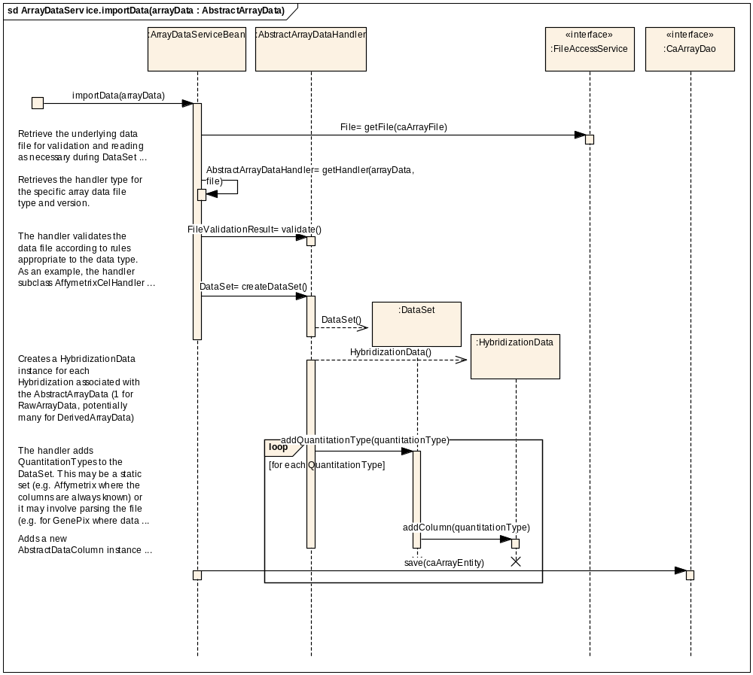
ArrayDataService: importData Implementation

Slide 20
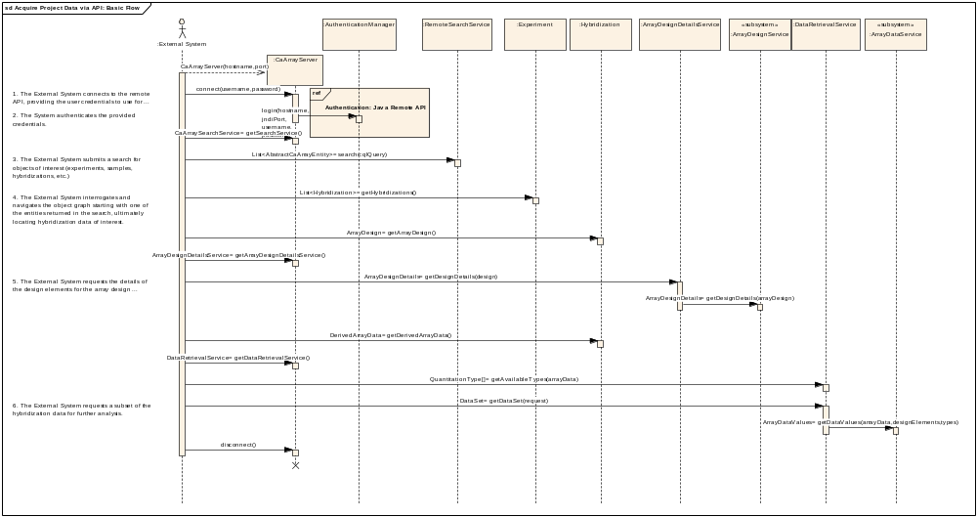
Acquire Experiment Data via API Use-Case Realization

Slide 21
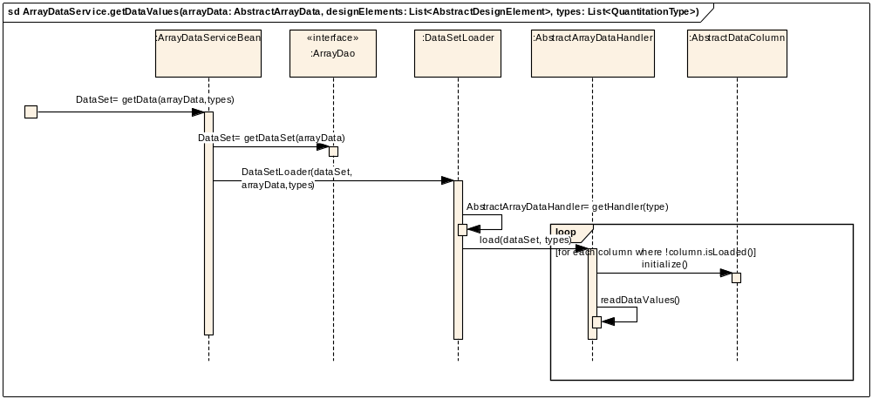
ArrayDataService: getData Implementation

Slide 22
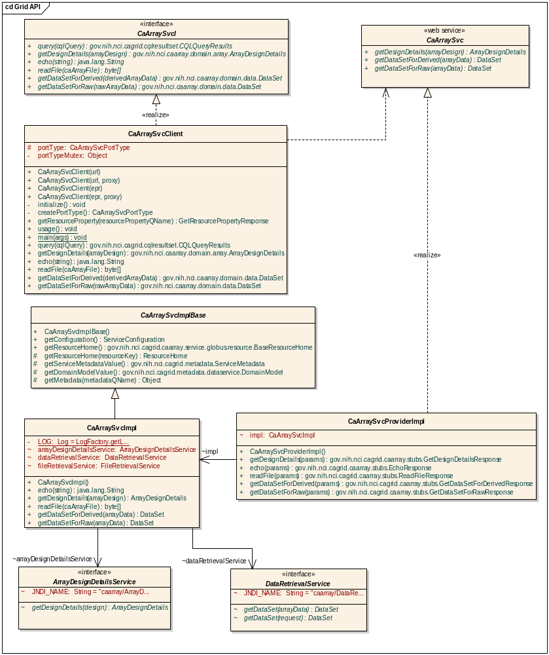
Grid API
The Grid API provides a wrapper around access to the services exposed by the Java Remote API
Acquire Experiment Data via API flow is similar to that shown earlier, except all service methods are exposed through CaArraySvc interface

Slide 23
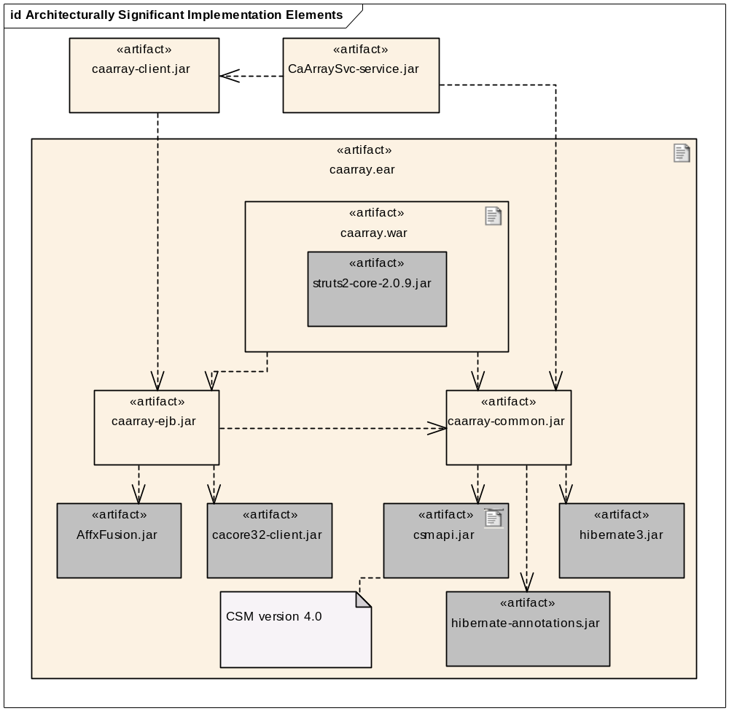
Implementation View

Slide 24
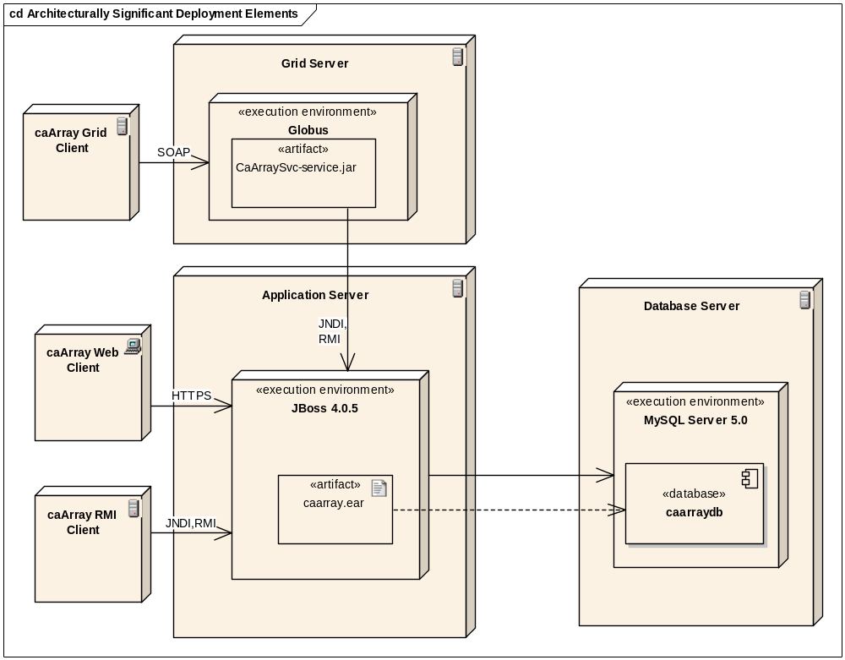
Deployment View

