Slide 1
caArray Grid Data Transfer
For the ICR WG HTP
February 20, 2008

Slide 2
Overview
Three sources of “large” data
  Parsed values from microarray data files (focus of presentation)
  Array design annotation
  File contents
Describe current approach to handling microarray data in caArray 2.0.0 with a focus on caGrid clients
  Advantages
  Flaws / Issues
  Other approaches considered
Describe future directions for data handling caArray 2.x.

Slide 3
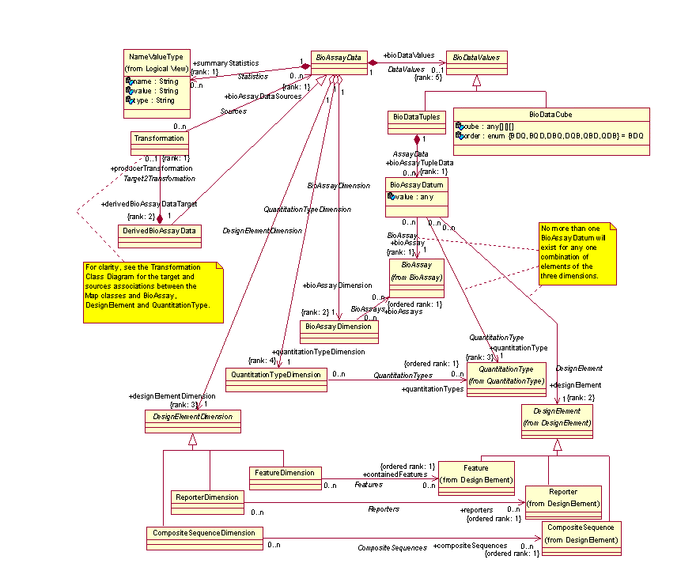
caArray 1.x Array Data

Slide 4
Array Data Handling Strategy
Don’t require special data de-serialization or unpacking on the client
  caArray 1.x requires custom de-serializer for BioDataCube content
  It was suggested that we BASE64 encode data structure, but we decided against this or any other sort of encoding approach
All transmitted data is registered
  Full semantics in caDSR
Represent data in most efficient way possible for management, marshalling and serialization
Transmit only data required by client
  Change from MAGE-OM BioDataCube approach in caArray 1.x

Slide 5
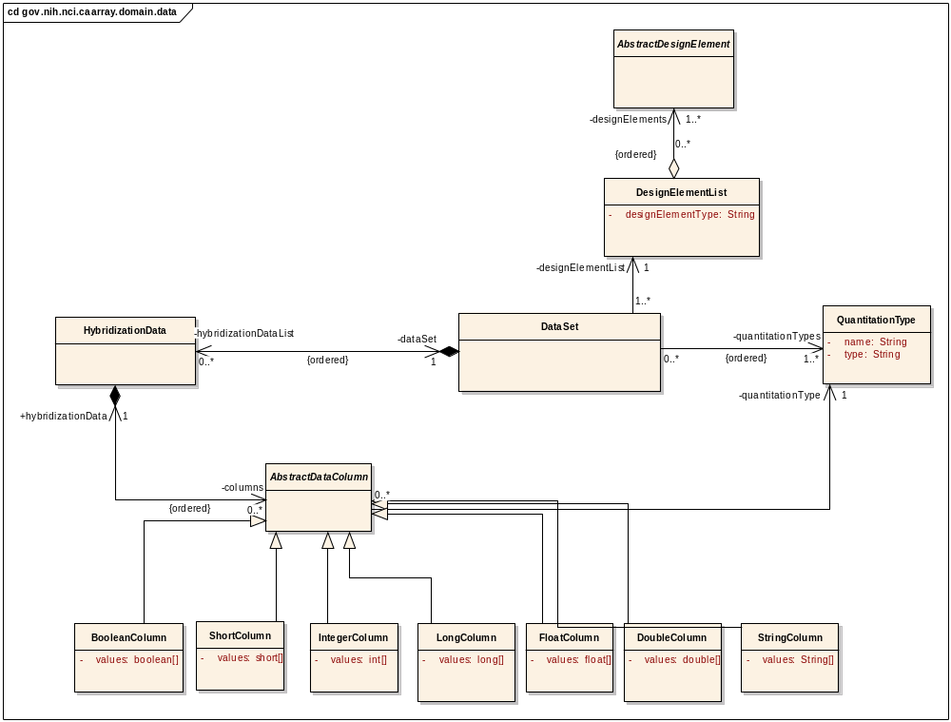
Array Data Domain Model

Slide 6
Array Data Domain Model
Array data can be conceptually represented as a spreadsheet
  QuantitationTypes are the columns (relatively few)
  AbstractDesignElements are the rows (up to 1.5M+)
Most efficient mechanism for storage and grid serialization is to store individual values as large, primitive arrays along the larger dimension.
  E.g. FloatColumn.values:float[]
  XML representation in marshalling is reasonably efficient: single XML element with space-separated numeric values
  <ns4:FloatColumn id="3" values="190.0 11263.3 164.0…” />

Slide 7
Array Data Schema and Mapping Excerpts
From XSD
<xs:element name="FloatColumn" type="FloatColumn" />
<xs:complexType name="FloatColumn">
<xs:complexContent>
<xs:extension base="AbstractDataColumn">
<xs:sequence>
<xs:element name="values" minOccurs="0" maxOccurs="unbounded" type="xs:float" />
</xs:sequence>
</xs:extension>
</xs:complexContent>
</xs:complexType>
From xml-mapping.xml
<class name="gov.nih.nci.caarray.domain.data.FloatColumn" identity="id" extends="gov.nih.nci.caarray.domain.data.AbstractDataColumn">
<map-to xml="FloatColumn" ns-uri="gme://caArray.caBIG/2.0/gov.nih.nci.caarray.domain.data" />
<field name="values" type="float" collection="array">
<bind-xml name="values" node="attribute" />
</field>
</class>

Slide 8
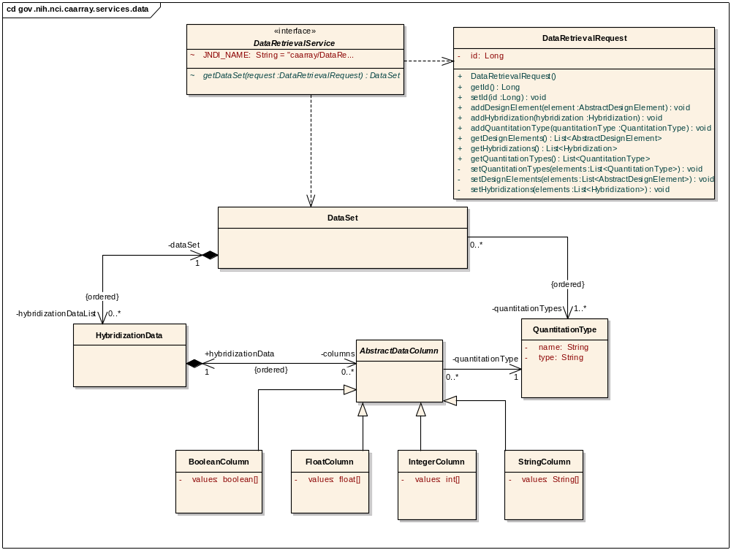
Array Data Retrieval API

Slide 9
Array Data Retrieval API
Allows clients to request specific data
Non-API aware clients can use standard CQL and class associations to navigate to and retrieve data.

Slide 10
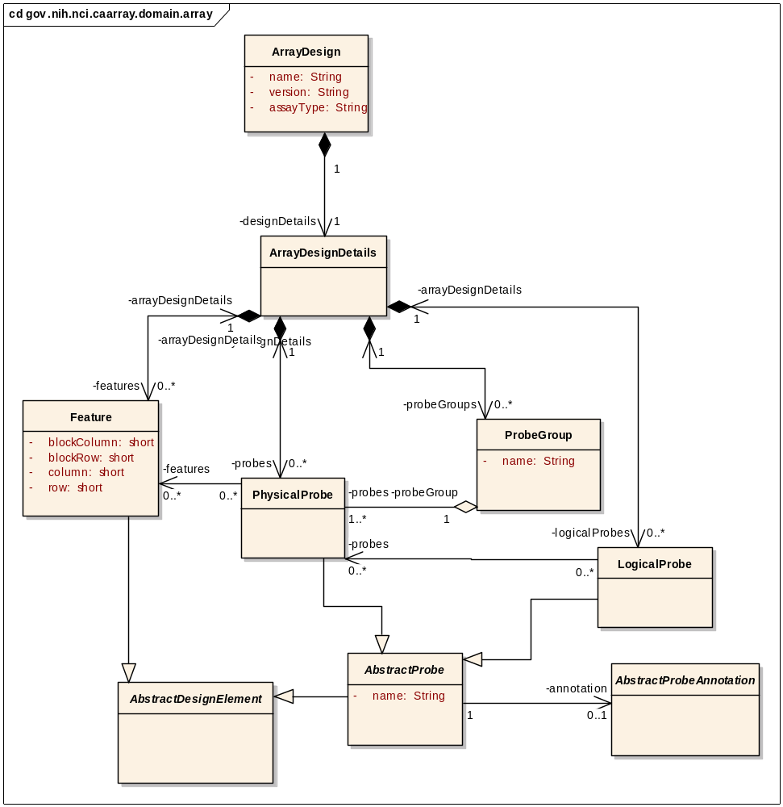
Array Design Classes

Slide 11
Issues
XML marshalling/unmarshalling is still slow and resource intensive
  Rudimentary profiling shows overhead is on the client side.
  Marshalling to text is inefficient by nature
Large DesignElementLists are problematic
  True of any API method or CQL search that returns a large object graph.
  Can easily exhaust memory on the client and even the server
File content retrieval returns byte[] – this marshals very poorly

Slide 12
Considerations for Future Releases
In addition to current data API, provide a mechanism based on caGrid Transfer (caGrid 1.2) to provide more efficient transport
  Use binary, compressed file format
  Provide reader/de-serialization classes for clients
Provide “paged” API for navigating large object graphs such as array design details
  List<?> search(CQLQuery cqlQuery, int limit, int offset)
  Also need to investigate, consider use of ws-enumeration
Provide flattened, report-like results for array design detail retrieval
  As contrasted with serialized object graph
Provide URL-based file content retrieval mechanism
  and/or caGrid Transfer based file retrieval

Slide 13
Questions / Comments?

