Slide 1
Mentor Guides
Silver Level Compatibility
XC WS Mentor Guides

Slide 2
Team Members
VCDE Guides to Mentors
  Robert Freimuth
  Lewis Frey
  Salvatore Mungal
Architecture Guides to Mentors
  Tahsin Kurc
  Patrick McConnell
XC WS Leadership
  Brian Davis
  Mike Keller
  George Komatsoulis
  Avinash Shanbhag

Slide 3
Agenda
VCDE Issues and Changes
  Revised checklist format
  Presentation of changes to the checklist
    Discussion and feedback
Architecture Issues and Changes
  Checklist Items
Revisions in Review Process
  Presentation, discussion, and feedback

Slide 4
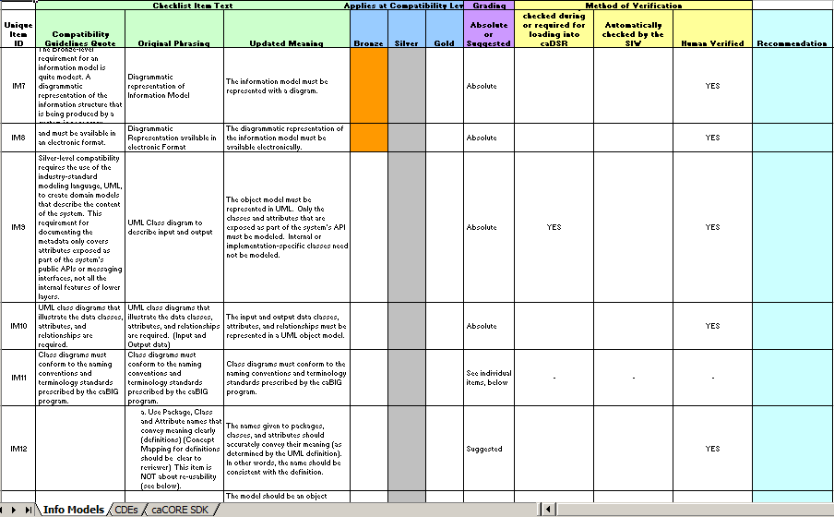
VCDE Silver Level Checklist
Revised Format

Slide 5
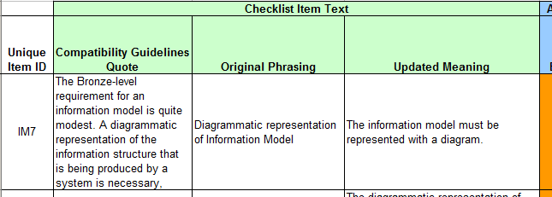
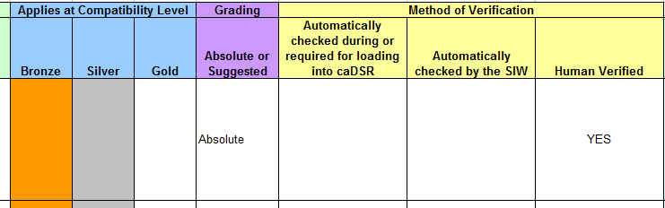
VCDE Silver Level Checklist
Revised Format

Slide 6
Update VCDE Silver Criteria
Remove caCORE SDK Dependencies
Issue: Remove caCORE SDK dependencies from the checklist criteria
  The compatibility criteria should be technology-independent
  Items will be maintained separately, e.g., for reference by mentors
  Items will not be graded during compatibility reviews
Proposal: Remove the following items from the checklist:
  If an association end has multiplicity >1, the association name must be appended with "Collection".
  The elements of the UML model must reside in a package named "Logical Model".
  Minimum versions for the XMI file: XMI 1.1, UML 1.3
  The XMI file must contain Unisys/Rose extensions.
  The XMI file must not contain editor-specific tagged values.
  The XMI file must include the "Logical Model" package.

Slide 7
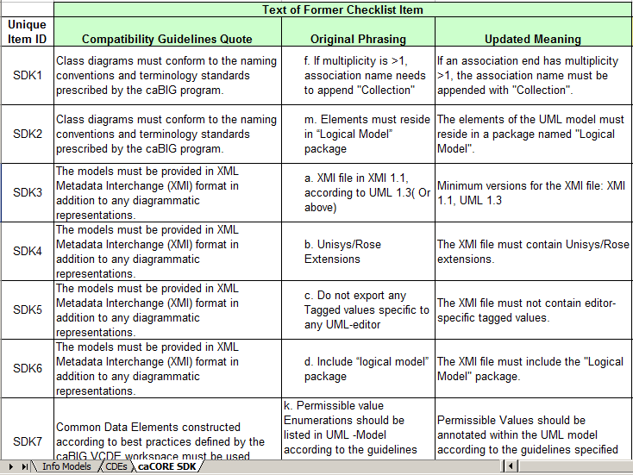
VCDE Silver Level Checklist
Revised Format

Slide 8
Update VCDE Silver Criteria
Remove Outdated Items
Issue: Remove outdated items from the checklist
Proposal: Remove the following items from the checklist:
  Association end names must be the associated class name.
    This is no longer a caCORE SDK requirement
  Models must be reviewed and validated by the VCDE mentor before they are loaded into the caDSR.
    This no longer reflects the workflow for mentoring and loading UML models
  Models must be submitted for registration and loading into the caDSR.
    This is redundant with other items on the checklist

Slide 9
Update VCDE Silver Criteria
Refine Criteria for Representation Terms
Issue: Revise a checklist item to provide finer granularity for grading
  All VDs must have a representation assigned from EVS.
Proposal: Revise the checklist item as follows:
  Create new item:
    All VDs must have a representation term.
  Create new item:
    One or more concept(s) from a VCDE-approved vocabulary must be assigned to each representation term.
  Delete the original item

Slide 10
Update VCDE Silver Criteria
Remove Limitation to EVS
Issue: Change the wording of several checklist items to reflect the possibility that not all VCDE-approved vocabularies will/may be registered in EVS.
Proposal: Use the following items to replace their EVS-centric equivalent.
  The concept terms assigned to the Data Element Concept (Object Class and Property) of each CDE must be from a controlled vocabulary approved by VCDE before they can be assigned a status of "released" in the caDSR.
  The concept terms assigned to the Permissible Values (in the Value Domain) of each CDE must be from a controlled vocabulary approved by VCDE before they can be assigned a status of "released" in the caDSR.
  All DECs have Object Class and Property definitions assigned from a controlled vocabulary approved by VCDE.
  All VDs must have a representation assigned from a controlled vocabulary approved by VCDE.
  If permissible values are specified, each permissible value should have a concept code from a VCDE approved controlled vocabulary assigned to the value meaning. Institution-specific values are exempt.

Slide 11
Update VCDE Silver Criteria
Plurality of UML Names
Issue: The checklist item regarding the plurality of UML names no longer reflects the consensus of the workspace
Proposal: Revise the checklist item as specified below:
  Original item: Class and attribute names should be singular.
  Updated item: The plurality of UML class and attribute names should reflect the semantics of the respective class or attribute.

Slide 12
Silver Compatibility Checklist
Grading Scheme
Red
Infringement of Absolutely Required criteria
Issues must be corrected
Orange
Infringement of Strictly Enforced criteria
Issues should be corrected
Yellow
Infringement of Suggested criteria
Violations of best practices/recommendations
Green
No issues found, or issues have already been addressed during the review
Gray
Not reviewed or not applicable

Slide 13
Update VCDE Silver Criteria
Grading Changes – Best Practices
Issue: Improve the level of quantitation in VCDE Silver level reviews by changing Strictly Enforced (orange) criteria to either Absolutely Required (red) or Suggested (yellow)
Proposal: Change the grading on the following items related to best practices to Suggested (yellow)
  The model should be an object model (not a data model) that follows generally accepted OO design practices and caBIG UML best practices.
  The names given to packages, classes, and attributes should accurately convey their meaning.
  The UML Class name must be in UpperCamelCase format.
  The UML attribute name must be in lowerCamelCase format.
  Attribute names should not contain the class name.
  Permissible Values should be annotated within the UML model according to the guidelines specified in the caCORE SDK User's Guide.

Slide 14
Update VCDE Silver Criteria
Grading Changes – SIW Error Log
Issue: Improve the level of quantitation in VCDE Silver level reviews by changing Strictly Enforced (orange) criteria to either Absolutely Required (red) or Suggested (yellow)
Proposal: Change the item related to the SIW error log to Absolutely Required (red)
  The annotated XMI file should load error-free into the SIW (some errors may be acceptable with explanation).

Slide 15
Update VCDE Silver Criteria
Grading Changes – CDE Reuse
Issue: Improve the level of quantitation in VCDE Silver level reviews by changing Strictly Enforced (orange) criteria to either Absolutely Required (red) or Suggested (yellow)
Proposal: Change the item related to CDE reuse to Absolutely Required (red)
  Existing CDEs are reused wherever possible before new CDEs are created.

Slide 16
Update VCDE Silver Criteria
Grading Changes – Semantics
Issue: Improve the level of quantitation in VCDE Silver level reviews by changing Strictly Enforced (orange) criteria to either Absolutely Required (red) or Suggested (yellow)
Proposal: Change the grading on the following items related to semantics to Absolutely Required (red)
  The UML definitions for the classes and attributes accurately describe what they represent and are sufficiently clear to enable accurate semantic annotation.
  The concepts assigned to each class and attribute must be synonymous (consistent) with the developer-derived UML definition.
  All CDEs have names, definitions, datatypes, and permissible values that have unambiguous meanings.

Slide 17
Agenda
VCDE Issues and Changes
  Revised checklist format
  Presentation of changes to the checklist
    Discussion and feedback
Architecture Issues and Changes
  Checklist Items
Revisions in Review Process
  Presentation, discussion, and feedback

Slide 18
Architecture Silver Level Compatibility
Significantly reduce barrier to interoperability among caBIG applications
A reviewer should determine whether a system
  has sufficiently reduced its barrier to interoperability
  can be considered a caBIG silver level interoperable application/system.
Ideally and ultimately, every caBIG compliant system meet 100% of the criteria
  Applications under review may deviate from criteria in some cases
  Gray areas when performing reviews because some deviations from checklist items impede interoperability more than others

Slide 19
Architecture Review Process
Main issues
  How to make the review process more consistent
  How to make the review process more efficient
Updated Checklist Items
  Three level grading scheme
  New items and more details
Review Process Changes
  Reporting and timeline for developers to fix issues
  Resolving disputes
    Involvement of the Guides
    Effect of previously reviewed cases

Slide 20
Updated Checklist Items
Three level grading scheme
  Absolutely Required
    Without meeting “absolutely required” criteria, a system will not be interoperable.
    A deviation from an “Absolutely Required” checklist item warrants failure of the system.
    Example: The API provides access to input and output data in the form of data objects that are instances of classes represented by an object-oriented domain model in UML
  Strictly Enforced
    Criteria critical to interoperability.
    System may still have reduced its barriers to interoperability significantly, even if the system fails to meet some of the “strictly enforced” items.
    Some deviation from the checklist items may be acceptable.
    Example: Data formats must conform to standards set by the caBIG workspace with which the resource is aligned.

Slide 21
Updated Checklist Items
Three level grading scheme
  Suggested
    Criteria enhancing interoperability and employing best practices.
    Not critical to interoperability and should not be used as a basis for failing the review.
    Example: The XML schema should be registered in the GME.
 | Red | Infringement of an absolute criteria – issues must be corrected in order for the system to pass the silver compatibility review
 | Orange | Infringement of a strictly enforced criteria – issues should be corrected and may warrant the system failing the silver compatibility review
 | Yellow | Infringement of a suggested criteria – issues should be corrected in order to enhance usability and/or interoperability
 | Green | No issues found for the criteria
 | Gray | The criteria was not reviewed or not applicable

Slide 22
Updated Checklist Items
Compliance Details | Bronze | Silver | Gold | Requirement | Outcome
General Criteria
a. Programmatic access through public API and/or a messaging interface. | X | X | X | Absolute
c. Detailed documentation of public API and messaging interface | X | X | X | Absolute
d. In the case of data-oriented systems, basic query retrieval of objects in the information model must be available through the API. | X | X | X | Absolute

Slide 23
Updated Checklist Items
Criteria Specific to Public API
b-1. Independent of whether the system is an analytical system or a data oriented system, each exposed object type should be accessible by the API. |  | X | X | Strictly Enforced
b-2. Object structures in the API and UML must conform to each other. This includes the names of classes and attributes, as well as which attributes are included in which classes. |  | X | X | Strictly Enforced
c. Functions exposed by The API must be strongly-typed. |  | X | X | Strictly Enforced
c-1. For programming languages, this means that methods should not take generic primitive types, such as pointers to bytes or array of bytes, integers, and Strings, as input and should not return generic primitive types as output. |  | X | X | Strictly Enforced
c-2. For messaging systems, the interface should not accept or return messages containing generic primitive types, such as an array of bytes or strings. |  | X | X | Strictly Enforced
e-5. The information model should be highly connected. That is, all objects in the information model should be connected in some fashion through one or more other objects. There should not be “floating classes”. However, if the problem scenario and use cases require such disconnected classes, disjoint portions of the model should still be queriable through a query method. The model should not be so disjoint that the number of query methods begins to approach the number of classes. |  | X | X | Strictly Enforced

Slide 24
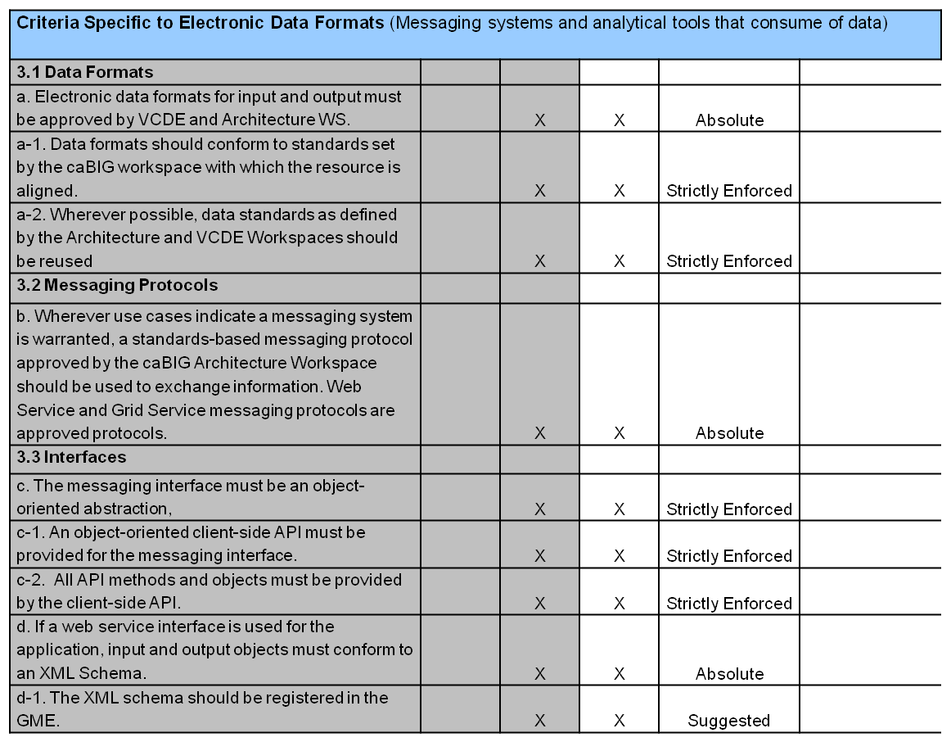
Updated Checklist Items

Slide 25
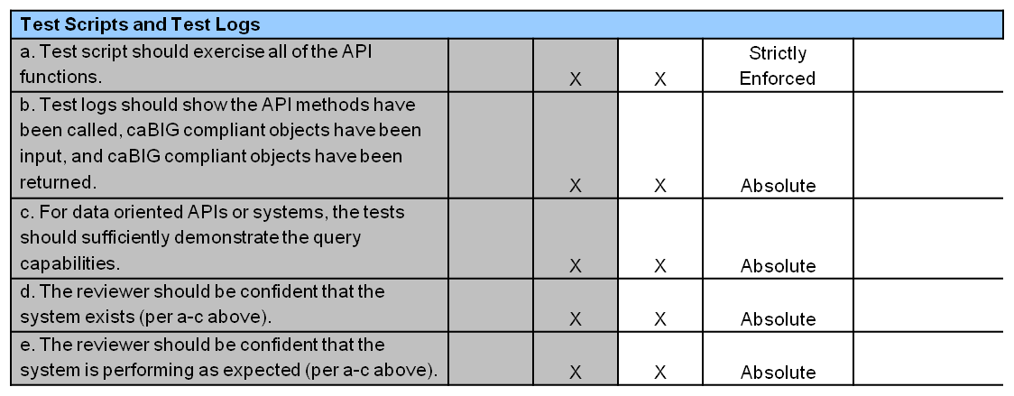
Updated Checklist Items

Slide 26
Agenda
VCDE Issues and Changes
  Revised checklist format
  Presentation of changes to the checklist
    Discussion and feedback
Architecture Issues and Changes
  Checklist Items
Revisions in Review Process
  Presentation, discussion, and feedback

Slide 27
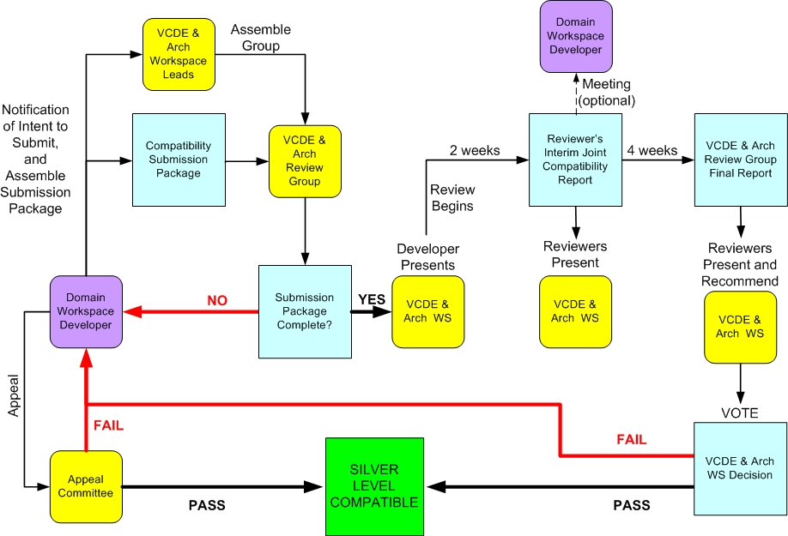
Silver Level Reviews
Existing Workspace Process

Slide 28
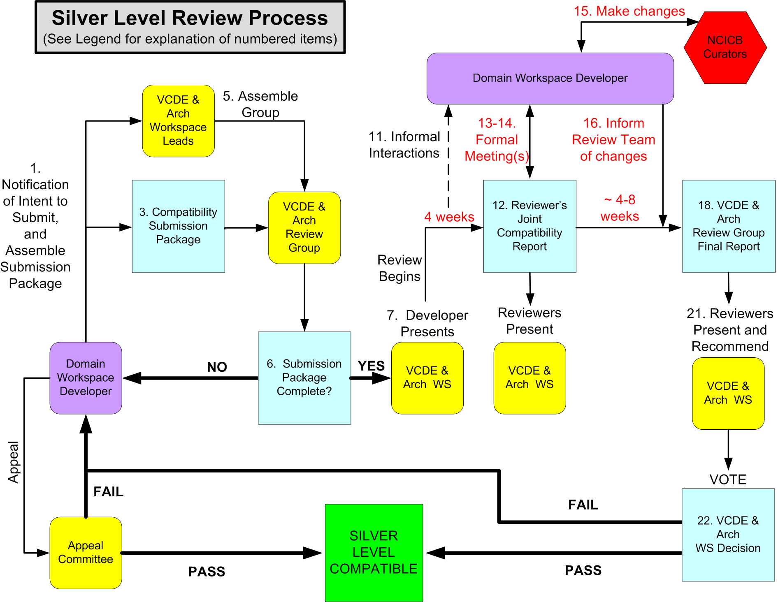
Silver Level Reviews
Revised Workspace Process
Notes:
Don't discuss – mention we will be proposing changes to the process and will discuss during the Guides talk

Slide 29
Silver Level Reviews
Revised Workspace Process
Lead Reviewer may schedule meetings with the Developer to answer questions that arise during the review (optional).
Lead Reviewer receives and collates the individual reviewer reports into the draft Joint Compatibility Report and sends it to the Developer, sponsoring WS lead and NCI Lead no later than 4 weeks from the start of the review. In the formal meeting between the Review team and the Developer, discuss issues found by the review team and clearly define what changes are necessary for passage.
Notes:
Don't discuss – mention we will be proposing changes to the process and will discuss during the Guides talk

Slide 30
Silver Level Reviews
Revised Workspace Process
Developer, NCI curation team and Lead Reviewer sets an appropriate and agreed upon deadline for addressing issues that prevent passage. The deadline should be approximately 4-8 weeks after the meeting between the review team and the developer.
Lead Reviewer updates the draft Joint Compatibility Report to reflect the results of the meeting(s) with the Developer, specifying the changes that will be made and those that are not practical at that time. Lead Reviewer uploads the report to the gForge site and presents the findings to the XC WS.
Notes:
Don't discuss – mention we will be proposing changes to the process and will discuss during the Guides talk

Slide 31
Silver Level Reviews
Revised Workspace Process
Developer makes changes to the UML model and the API. Developer and NCI curation team work together to make the necessary changes to the metadata registered in the caDSR.
Developer informs Lead Reviewer of the changes that were made (or not made, with explanation). This should occur by the agreed upon deadline.
Review team reviews the changes and agrees upon a pass/fail recommendation to the XC WS.
Review Lead assembles the final report.
Notes:
Don't discuss – mention we will be proposing changes to the process and will discuss during the Guides talk

Slide 32
Silver Level Reviews
Revised Workspace Process – Summary
The Draft Joint Compatibility Report (presented 4 weeks after the start of the review) needs to be complete so developers know all the issues that need to be fixed
Increased requirement for active discussion between the review team and the developer after the Draft Joint Compatibility Report is complete
  Identify and explain all issues found
  Clearly state what changes are necessary for passage
Allow approximately 4-8 weeks for the developer to fix issues

