Slide 1
EVS 4.0 Feature Overview
EVS API and User Interface pBIO Meeting
March 20, 2007
Frank Hartel
NCICB
frankh@mail.nih.gov
Gilberto Fragoso
NCICB
fragosog@mail.nih.gov
Doug Mason
SAIC
masondo@mail.nih.gov

Slide 2
Outline
Overview
Current LexBIG psuedoproduction server
Integration
  System Overview
4.0 Deployment / Timelines
Application Programming Interface to NCI Vocabularies
User Interfaces
Next Steps

Slide 3
What is LexBIG?
Successor to LexGRID 1.0
  Open terminology server
  Developed by Mayo
  Reference implementation HL7 CTS 1.0 spec
LexBIG is a caBIG project
  vCDE contract to Mayo for development
    Delivery of LexBIG 1.0 (March 2006)
    Ongoing bug and feature enhancements
  vCDE contract to Mayo for deployment support
  Future vCDE support possible for LexBIG 2.0
Deployed at NCICB in caCORE 3.2 “quasi-production” release

Slide 4
Why Incorporate LexBIG in caCORE?
Current terminology components are proprietary, Metaphrase is frozen, requires complex caCORE architecture, many severs
LexBIG is open, simplifies caCORE architecture, operations
  Superior performance
  Supports existing capabilities and provides new ones
    Search, sub-setting, and Boolean operations across multiple terminologies simultaneously
    Superior lexical search capabilities
    Superior graph construction
  Adoption by National Center for Biomedical Ontology, CDC, inherent support of HL7 CTS and pending HL7 CTS2 spec
  caBIG product, support

Slide 5
Current LexBIG psuedo-productions Server
Supports caCORE 3.2 API with LexBIG serving terminologies
  http://cabio-lexbig.nci.nih.gov/cacore32/remoteService
  http://cabio-lexbig.nci.nih.gov/cacore32/Happy.jsp
May use for deprecated 3.2 support after caCORE 4.0 release
  Questions – Our app developers/users need to answer – NOW!
    Does it return the same search results as the production server?
    If not are the results acceptable?
Answer will influence how we support EVS access using 3.2 API after caCORE 4.0 release. Important because:
  In caCORE 4.0 LexBIG model will be exposed at caCORE API
    Faster, more capable but
    Not backward compatible with 3.2 EVS API
  So …
  Approach for 3.2 EVS API support in 4.0 is important!

Slide 6
Integration

Slide 7



System Overview – caCORE / Proprietary System Integration
Current System (3.2)
  Proprietary Servers
  Four servers
NCI Metathesaurus Server
Oracle Database Server
caCORE
User
Request
NCI DTS Server

Slide 8
System Overview – caCORE / LexBIG System Integration
Proposed System (4.0)
  Open Source Servers (DB)
  Two servers
MySQL Database
caCORE
LexBIG
User
Request

Slide 9
System Overview - Interfaces / Services
Query-by-example (QBE) system
  Java
  Web Services
  REST (HTTP / XML)
Distributed LexBIG
caCORE Server
Web Services
Cache
XML / HTML
Service Layer
DAO
Java QBE
Distributed
LexBIG Interface
LexBIG API

Slide 10
System Overview - Benefits
Reduces the complexity of System deployment
Reduces the System cost / maintenance overhead
Complete Open Source solution
Flexible Query API
  Extension points (Sort, Match Algorithms)
Performance
  Index common terms
  Direct access to API
  “lazy” loading (deferred loading)
  Iterator (results paged from server)
Not tied to data particular format

Slide 11
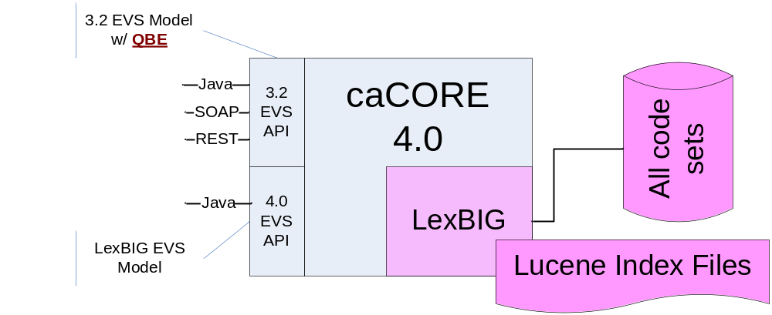
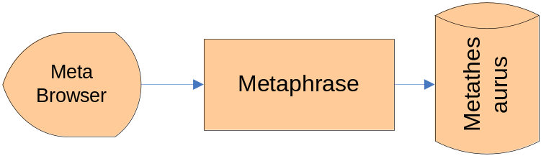
Production 4.0 Tier
Use LexBIG
Support only one terminology
transformation and load
process
And maybe…
Use Metaphrase
For browser support
Only…
Notes:
In 4.0 the Java API against the 3.2 model will be QBE, making it consistent with SOAP and RESTful APIs, but requiring changes to Java API- dependent apps.
Meta data available in LexBIG and in Metaphrase.
Given current human resources, this is the greatest degree of production reliance on LexBIG we can achieve in caCORE 4.0
Metaphrase supports only browser. Data consistency issues may arise between browser results and API results due to very different models, schemas and APIs. How big a problem would inconsistency be for caDSR, other users?

Slide 12
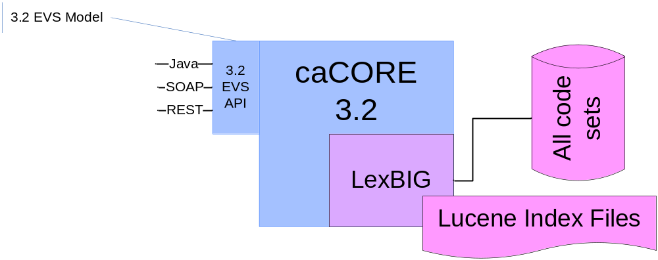
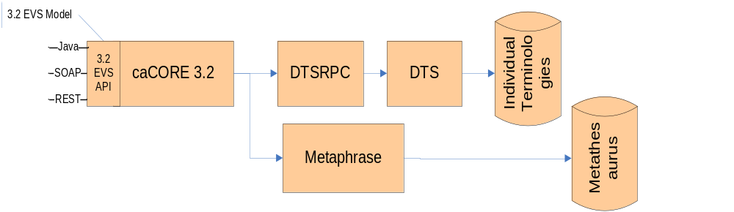
Deprecated 3.2 Tier
Use Only LexBIG
Support only one terminology
transformation and load
process
Or...
Retain Legacy Infrastructure
More servers and a
second, incompatible
terminology data
transformation and load
process required
Notes:
Operational Costs Lower If We Use quasi-production caCORE 3.2 as deprecated EVS 3.2 service in 4.0 than if we retain current caCORE 3.2 Production EVS Infrastructure
-- This approach requires that users find 3.2 quasi production results to be acceptable substitute for 3.2 production results for EVS searches
Else we will need to 3.2 production environment in 4.0 as deprecated 3.2 EVS resource
-- greatly higher monthly operation costs due to each terminology update requiring hosting on incompatible server infrastructure

Slide 13
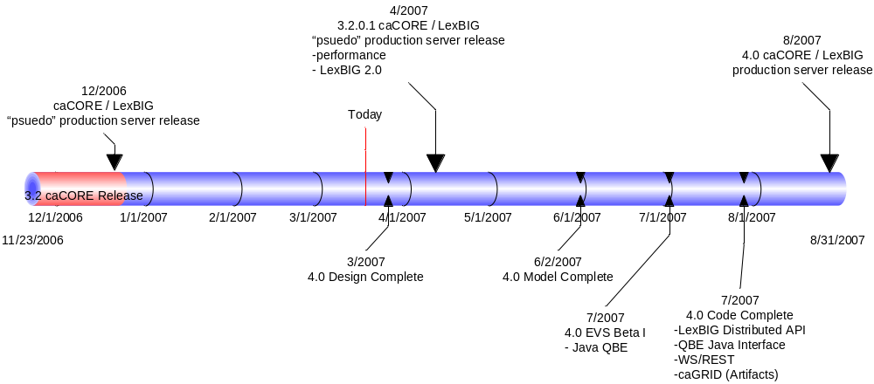
4.0 Deployment / Timelines
Notes:
Current resources adequate to deliver Production Tier as shown in slide 10
Due to significance of changes to EVS in 4.0 we wil produce two betas for dependent al testing during 4.0 development cycle.
Add’l resources possible. Depending on amount of add’l resources and timing of availability
-- unified terminology browser supporting both Meta and individual terminology data may be made part of 4.0 delivery. Would eliminate need for Metaphrase support in 4.0.
Worst case scenario is that current production caCORE 3.2 EVS stays in production as 4.0 EVS systems and that current 3.2 quasi is replaced by caCORE 4.0 EVS as the quasi production implementation.

Slide 14
Application Programming Interface to NCI Vocabularies

Slide 15
caCORE / LexBIG 4.0 API Benefits
Does not use “proprietary-looking” terminology
  codedEntry rather than DescLogicConcept, MetaThesaurusConcept
No need to wrap API, can be exposed with minor changes (if any), and distributed with caCORE
  No performance lost on conversions from one model to another (e.g. Apelon Concept -> DTSRPC Concept -> caCORE DescLogicConcept)
Same API utilized for the Metathesaurus as well as stand-alone vocabularies
Utilizes Lucene for searching, allows user to select matching algorithms (contains, exact, “sounds like”).
Upside/Downside – very granular API, learning curve

Slide 16
caCORE / LexBIG 4.0 API Examples – Current caCORE
Search a vocabulary for concepts containing a specific synonym
From a standalone DTS vocabulary; for description logic concepts
EVSQuery evsQuery = new EVSQueryImpl();
List evsResults = new ArrayList();
evsQuery.getConceptWithPropertyMatching("NCI_Thesaurus", "Synonym", "protocol", 10);
evsResults = (List)appService.evsSearch(evsQuery);
for(int i=0; i<evsResults.size(); i++){
DescLogicConcept dlc = (DescLogicConcept) evsResults.get(i);
// do something with the returned concepts
}
From a source vocabulary in the Metathesaurus
EVSQuery metaQuery = new EVSQueryImpl();
List metaResults = new ArrayList();
metaQuery.searchMetaThesaurus("protocol", 10, "NCI2006_10D", false, false, false);
metaResults = (List)appService.evsSearch(metaQuery);
for(int m=0; m<metaResults.size(); m++){
MetaThesaurusConcept mtc = (MetaThesaurusConcept)metaResults.get(m);
// do something with the returned concepts
}

Slide 17
caCORE / LexBIG 4.0 API Examples – LexBIG-based caCORE
Search a vocabulary for concepts containing a specific synonym…
From a LexBig-hosted vocabulary
CodingSchemeVersionOrTag tagOrVersion = new CodingSchemeVersionOrTag();
tagOrVersion.setVersion("06.12d");
org.LexGrid.LexBIG.LexBIGService.LexBIGService lbSvc = new LexBIGServiceImpl();
CodingScheme scheme = lbSvc.resolveCodingScheme("NCI_Thesaurus", tagOrVersion);
CodedNodeSet cns = new CodedNodeSetImpl(codingScheme, tagOrVersion, true);
LocalNameList propertyList = new LocalNameList();
propertyList.addEntry("Synonym");
String matchAlgorithm = "contains"; // exactMatch, luceneQuery
cns = cns.restrictToMatchingProperties(propertyList, null, "protocol", matchAlgorithm, language);
LocalNameList restrictToProperties = new LocalNameList();
restrictToProperties.addEntry("Preferred_Name");
restrictToProperties.addEntry(“Synonym");
SortOptionList sortCriteria =
Constructors.createSortOptionList(new String[]{"matchToQuery", "code"});
ResolvedConceptReferenceList rcrl = cns.resolveToList(sortCriteria, restrictToProperties, null, 10);
ResolvedConceptReference[] rcrs = rcrl.getResolvedConceptReference();
ResolvedConceptReference rcr = null;
for (int i=0; i<rcrs.length; i++) {
rcr = rcrs[i];
CodedEntry ce = rcr.getReferencedEntry();
// do something with the returned coded entries
}

Slide 18
caCORE / LexBIG 4.0 API Examples – LexBIG-based caCORE
Retrieve a coded entry by its code/identifier
org.LexGrid.LexBIG.LexBIGService.LexBIGService lbSvc = null;
lbSvc = new LexBIGServiceImpl();
ResolvedConceptReferenceList matches = null;
ConceptReferenceList crefs =
ConvenienceMethods.createConceptReferenceList( new String[] {"C12345"}, "NCI_Thesaurus");
CodingSchemeVersionOrTag tagOrVersion = new CodingSchemeVersionOrTag();
tagOrVersion.setVersion("06.12d");
LocalNameList propertyList = null;
SortOptionList sortOrder = null;
matches = lbSvc.getCodingSchemeConcepts("NCI_Thesaurus", tagOrVersion, false)
.restrictToCodes(crefs)
.resolveToList(sortOrder, propertyList, 1);
ResolvedConceptReference ref =
(ResolvedConceptReference)matches.enumerateResolvedConceptReference().nextElement();
CodedEntry entry = ref.getReferencedEntry();

Slide 19
User Interface

Slide 20
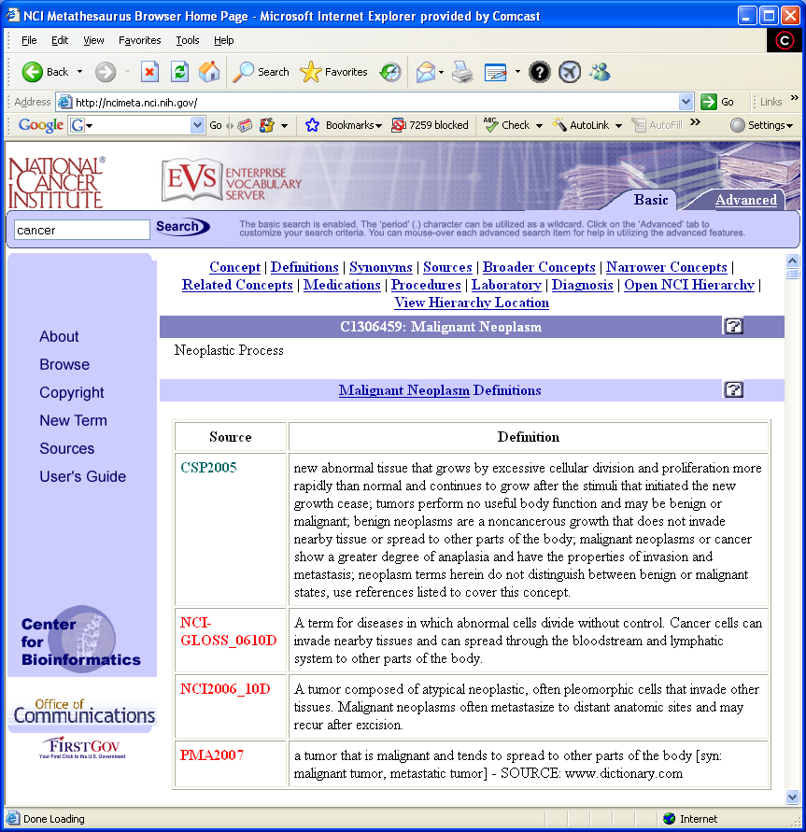
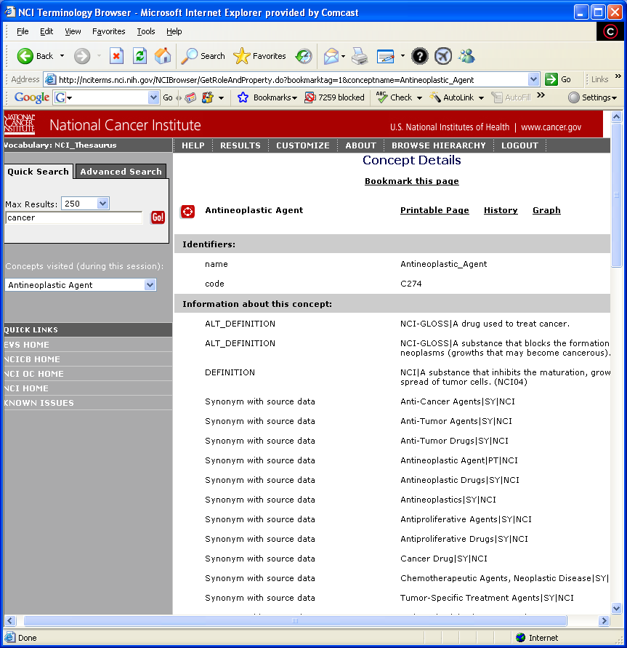
NCI Terminology Browser & Meta Browser in caCORE 4.0
Notes:
Till now separate Browsers for Metathesaurus and for individual terminologies
Ideally fro 4.0 create a new, unified NCI Terminology Browser for both Meta and individual terminologies
Proprietary components interfere with optimization for NCI needs; Metaphrase development frozen so browser frozen
Different lexical search capabilities on each; Meta browser more lexically capable than NCI Terminology Browser
Tree display in NCI Terminology Browser grafted on. Tree to detail screen communication a challenge
In NCI Terminology Browser you can search for term in only one terminology at a time
Resource constraints may push new browser out past 4.0 release
Fall back is to continue to use current browsers in 4.0
NCI Terminology Browser runs off caCORE API. Little effort to use it in 4.0
Would require us to continue to operate NCI Metaphrase server even though the same data will be in LexBIG

Slide 21
Next Steps
Obtain user feedback about the quality and acceptability of EVS search results from 3.2 quasi-production server
Complete schedule for EVS caCORE 4.0
  Offer one or two beta releases of caCORE 4.0 to enable users to test and comment on EVS API, performance, etc.

Slide 22
STOP STOP STOP
STOP

Slide 23
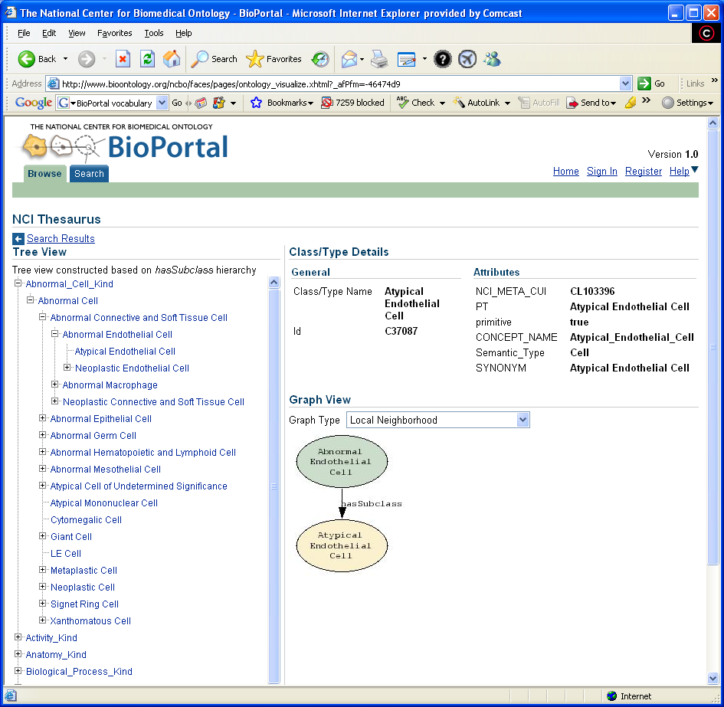
BioPortal – LexBIG powered User Interface
Benefits
  Browser for both NCI Metathesaurus and individual terminologies
  Supports
    Terminology metadata
    Terminology download
    Multiple graph types
  Open, extensible, developed by NCBO
    Will support fine grained user-terminology publisher dialog
Notes:
Shared development with NCBO
New capabilities – can search simultaneously for term across many terminologies
But
Still evolving
Not enterprise architecture implementation currently (2 tier)
Needs to be extended to display Meta data
Will require re-architecting, probably after caCORE 4.0 release. Will go on own release cycle

