Slide 1


Annotating Microarray Experiments with MAGE-TAB Hands-on Session caBIG Annual Meeting September 14, 2010 If you don’t have the preloaded example files, download them from here: https://gforge.nci.nih.gov/docman/view.php/305/23084/magetab_samples.zip
caArray User Community Meeting
2.2.0 Feature Overview and Review of MAGE-TAB Update and Export Specification
Notes:
1

Slide 2
Theme of this session
Two ways of creating MAGE-TAB files

Slide 3
Outline
Associating samples to data
Annotating samples
Annotating the experiment
Describing protocols
Calling out experimental factors
Modeling different experiment design graphs
MAGE-TAB v1.1

Slide 4

Associating samples to data
SDRF
IDF

Slide 5
Associating samples to data
SDRF

Slide 6
Annotating samples
SDRF
IDF

Slide 7
Annotating samples
Characteristics treated as 1st class attributes in caArray
Material Type
(e.g., whole_organism, total_RNA)
Provider
(organization that provided the source biomaterial)
Label
(e.g., biotin, Cy5)
Characteristics[OrganismPart]
(tissue site, e.g., Brain)
Characteristics[DiseaseState]
(e.g., Glioblastoma, Acute Myeloid Leukemia)
Characteristics[CellType]
(e.g., Epithelial Cell)
Characteristics[ExternalID]

Slide 8
Annotating samples
Try it yourself
Augment 2_DEMO_nelso_annotate_samples.sdrf to annotate the samples with gender/sex (male/female).
Augment 2_DEMO_nelso_annotate_samples.sdrf to annotate the samples with dose (e.g., 10 nmol/L)
Hint: Use one of the following ontology browsers to look up the characteristic category and values
NCI Term Browser: http://nciterms.nci.nih.gov
NCBO Bioportal: http://bioportal.bioontology.org/

Slide 9
Annotating the experiment
Experimental factors and Protocols discussed later

Slide 10
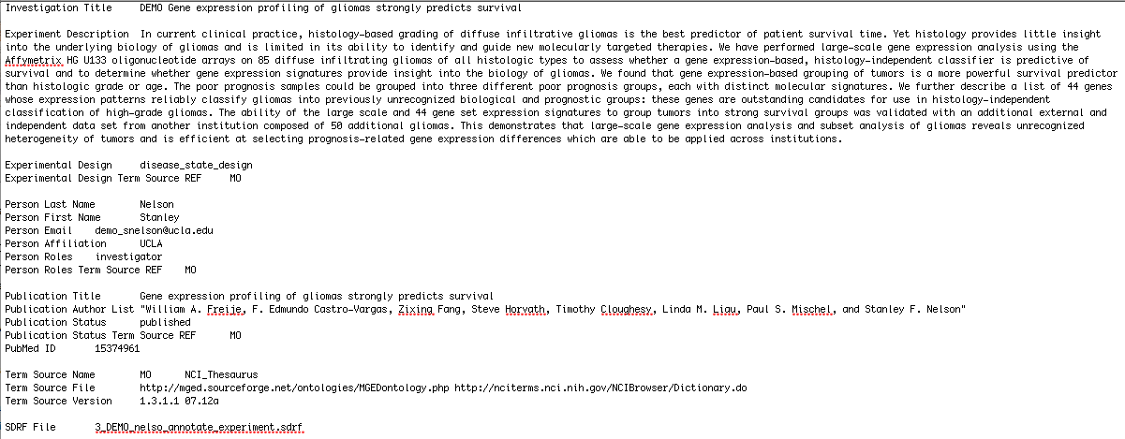
Annotating the experiment
Example IDF: 3_DEMO_nelso_annotate_experiment.idf

Slide 11
Annotating the experiment
Try it yourself
Add to 3_DEMO_nelso_annotate_experiment.idf to annotate the experiment with replicate type (technical replicate) and normalization type (Lowess).
Add to 3_DEMO_nelso_annotate_experiment.idf to add another contact who is the submitter of the experiment.
Add to 3_DEMO_nelso_annotate_experiment.idf to annotate the experiment as a dose response study (in addition to a disease state study).
Hint: Use one of the following ontology browsers to look up the terms you need
NCI Term Browser: http://nciterms.nci.nih.gov
NCBO Bioportal: http://bioportal.bioontology.org/

Slide 12
Describing protocols
Biomaterial chains
Protocols
Procedures used for extraction, labeling, hybridization
Procedures used for feature extraction, data processing

Slide 13
Describing protocols
IDF
SDRF

Slide 14
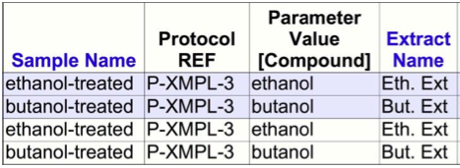
Describing protocols
Examples of protocol usage
4_DEMO_nelso_protocols
6_DEMO_acgh
Protocol Parameters

Slide 15

Describing experimental factors
Call out factors (independent variables) in your study (Special Characteristics)
IDF
SDRF

Slide 16
Describing experimental factors
Try it yourself
Augment 5_DEMO_nelso_factors to make Age an experimental factor too.

Slide 17
Modeling experiment design graphs
2-channel with reference sample
(See 6_DEMO_acgh.sdrf)

Slide 18
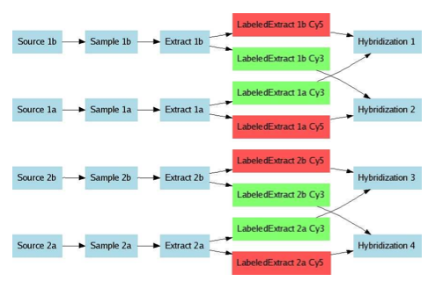
Modeling experiment design graphs
Refer to the MAGE-TAB spec for other graphs
http://www.mged.org/mage-tab/spec1.0.html
E.g., Dual channel with dye swap

Slide 19
Modeling experiment design graphs
Try it yourself
Create a MAGE-TAB SDRF for the 2-channel dye swap design
… or any other design of interest to you.

Slide 20
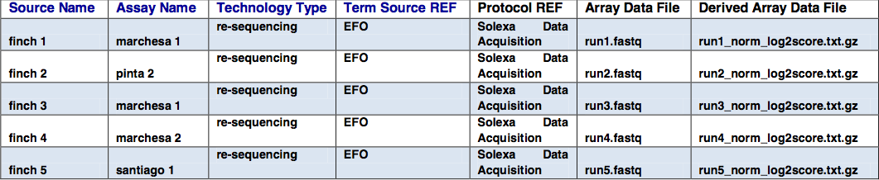
MAGE-TAB v1.1
Highlights of MAGE-TAB specification v1.1 (Draft)
Supports technology types other than microarray, e.g., next gen seq.
Term Accession Numbers
More explicit rules on ordering and cardinality of SDRF elements

Slide 21
Outline
Overview
Installation
Starting from Templates
Starting from the Design Wizard
Editing the IDF
Configuring and Editing the SDRF
Finding annotations from controlled vocabularies
Validating MAGE-TAB
Plan for Annotare v2.0

Slide 22
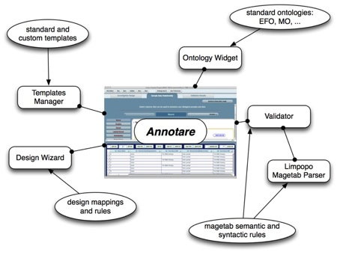
Overview
GUI tool to create MAGE-TAB IDF and SDRF files
Standard templates for common experiment types
A design wizard that guides the biologist step-by-step
Easy incorporation of annotations from relevant biomedical ontologies,
A MAGE-TAB validator that checks the annotations
Open source (MIT license), based on Adobe AIR and Java.

Slide 23
Installation
Requirements: 190M disk space for Mac OR 70M for Windows
Windows (XP, Vista, 7)
Uninstall any older version of Annotare via the Control Panel and then delete the Annotare folder under “Program Files”.
Download the Installer bundled with/without the JRE:
http://annotare.googlecode.com/files/Annotare-v1.1.1-jre.exe (Recommended)
http://annotare.googlecode.com/files/Annotare-v1.1.1.exe (First install JRE 1.5/1.6)
Double-click on the exe and follow the steps to install.
Go to Programs -> Annotare to start the application.
MAC OS X (10.5 or greater)
Uninstall any older version of Annotare by removing it from /Applications.
Get Java JRE 1.5 or higher.
Download the installer:
http://annotare.googlecode.com/files/Annotare-v1.1.1.pkg.zip
Double-click to unzip, then double-click on the .pkg to install.
Click on /Applications/Annotare to start the application.

Slide 24
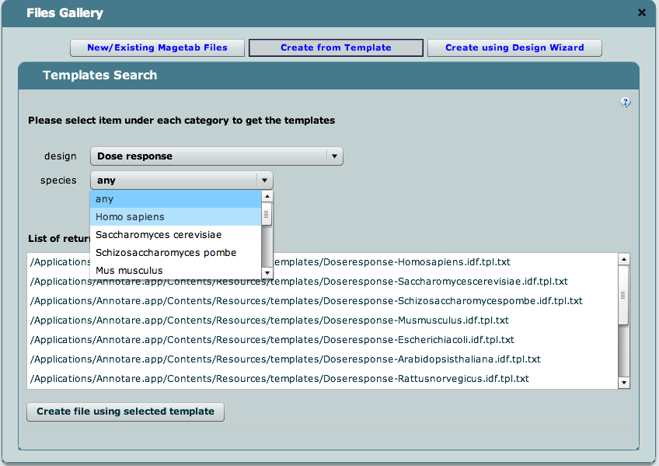
Templates
Don’t start from a blank slate; use a template.
A template gives you a partially populated MAGE-TAB document set that can then be completed with experiment-specific information.
From the Files Gallery, choose “Create from Template”.
Search for a template by experimental design and species.

Slide 25
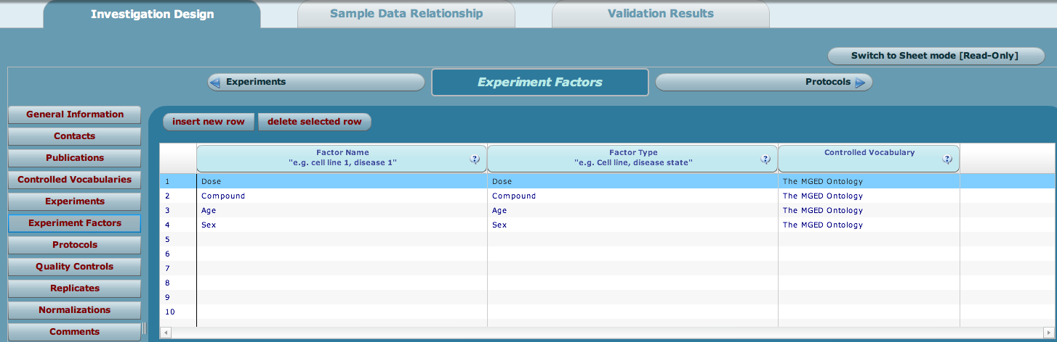
Templates
Generate MAGE-TAB files from the template
Choose “Create file using selected template” and start editing it.
Clicking on Save will save an <filename>.idf.txt and <filename>.sdrf.txt.

Slide 26
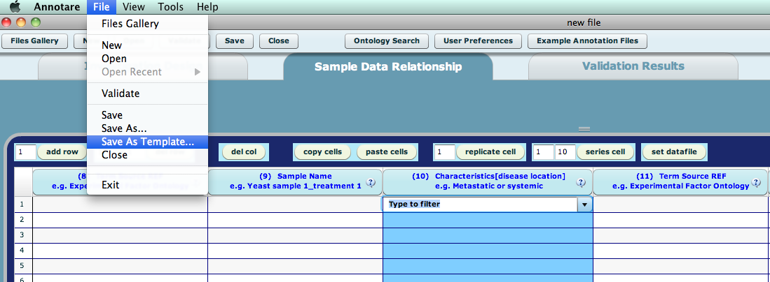
Templates
Custom Templates
Clicking on File -> Save as Template (in the Annotare menu) will save your edits as a new template in your files location (defined in user preferences). The files will be saved as <filename>.idf.tpl.txt and <filename>.sdrf.tpl txt.
Custom templates can be created with often-used annotations already filled in, and saved for use in future experiments.

Slide 27
Templates
Try it yourself
Use templates based on other designs, e.g., time series
Create custom templates with characteristics, protocols or factors of your choice

Slide 28
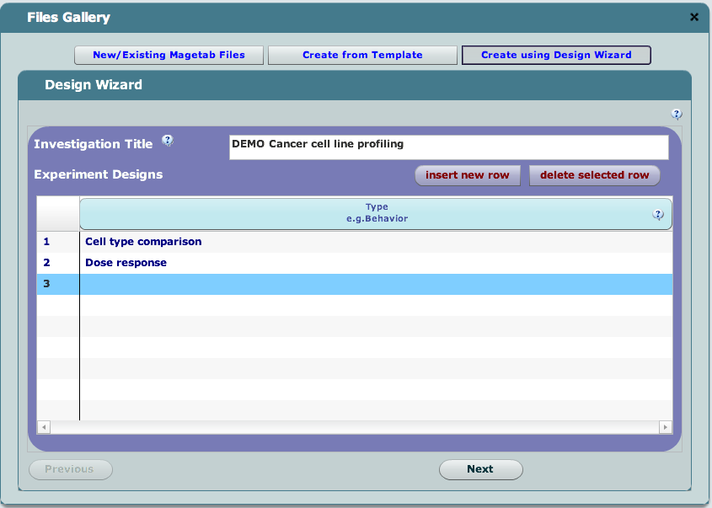
Design Wizard
Useful when no template is available
Guides a novice user with step-by-step questions
Experimental design, number of channels, labels
Platform and protocols

Slide 29
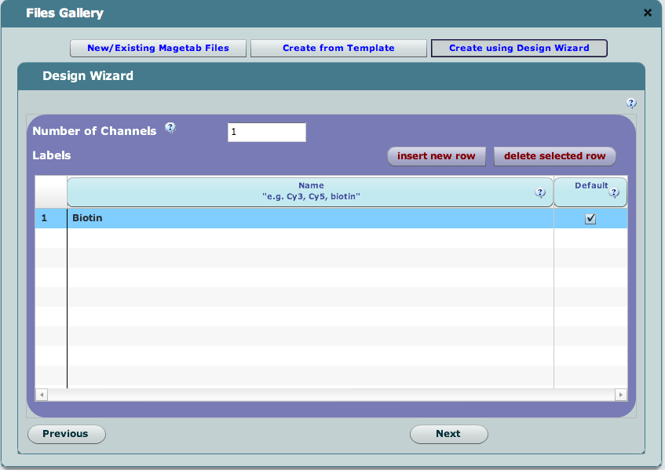
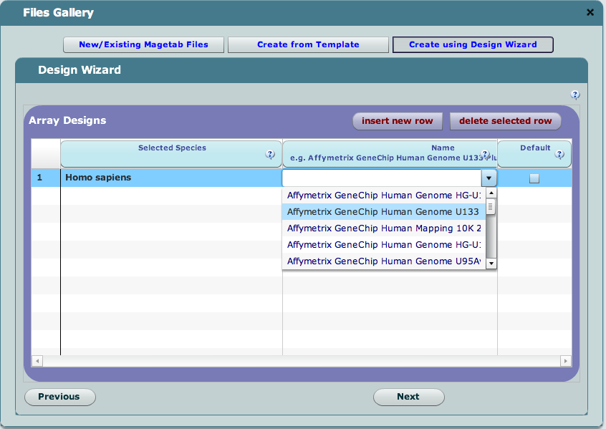
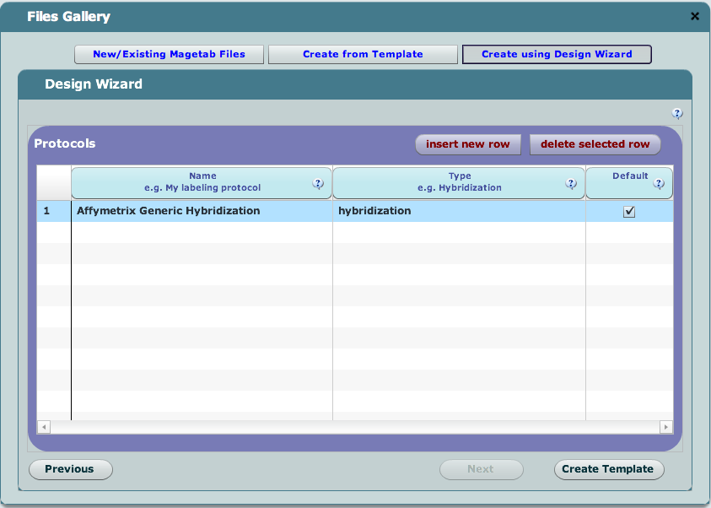
Design Wizard
Screenshots

Slide 30
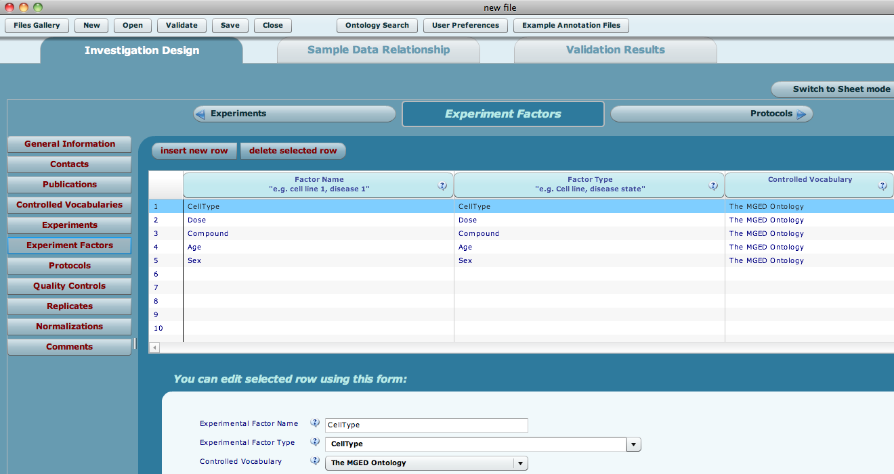
Design Wizard
Wizard generates partial annotations

Slide 31
IDF
GUI forms
hide the syntactic complexity of MAGE-TAB as much as possible
group related information together in an intuitive manner
Edit the IDF to
provide basic information about an experiment
list the people associated with the experiment and their roles
list any associated publications
describe the experimental design and factors being studied
describe the protocols that were employed at various stages in the investigation

Slide 32
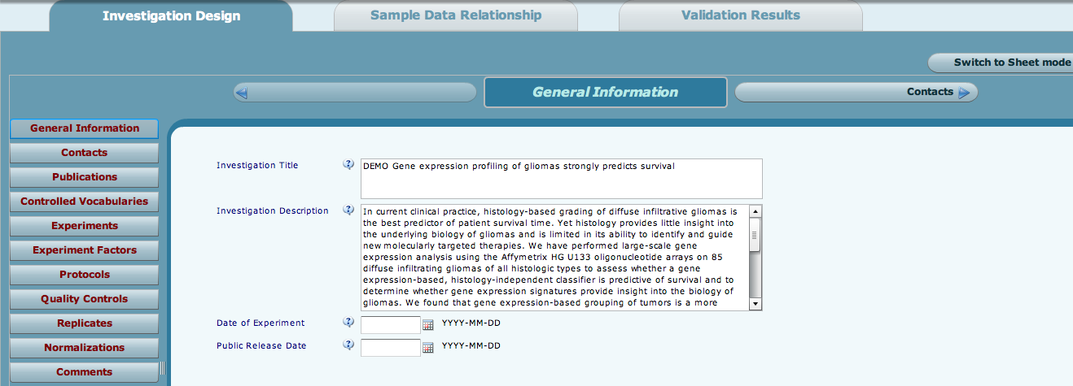
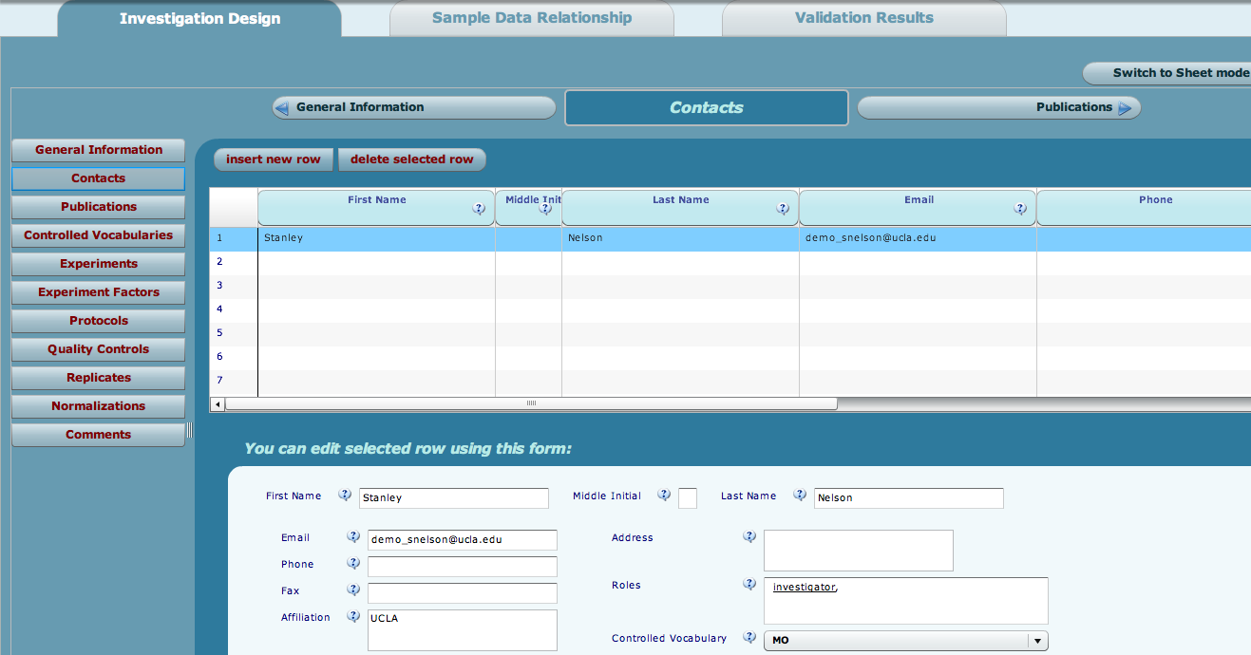
IDF Forms
IDF forms for general information and contacts

Slide 33
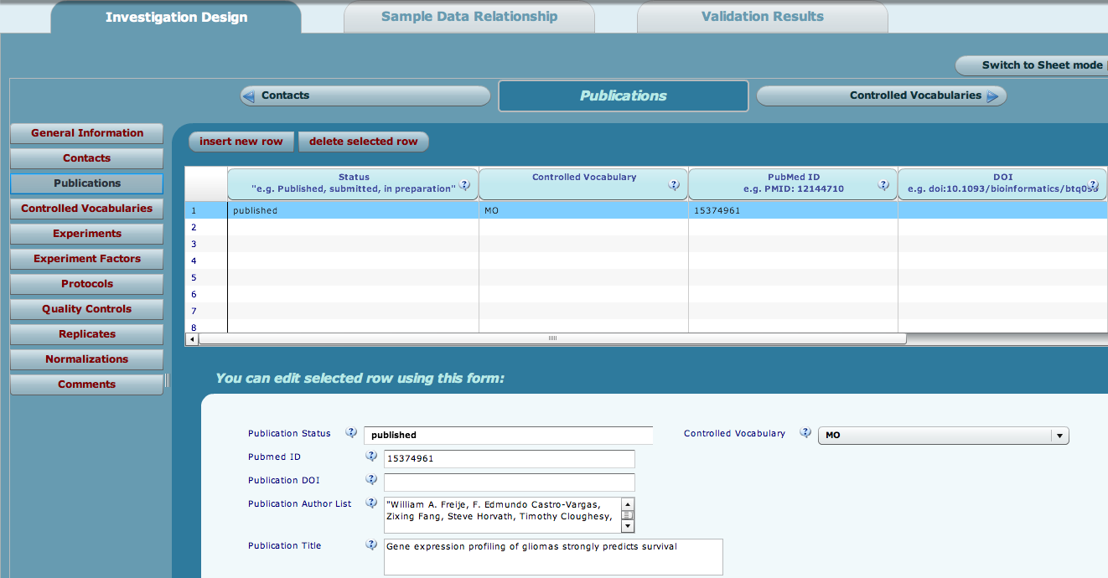
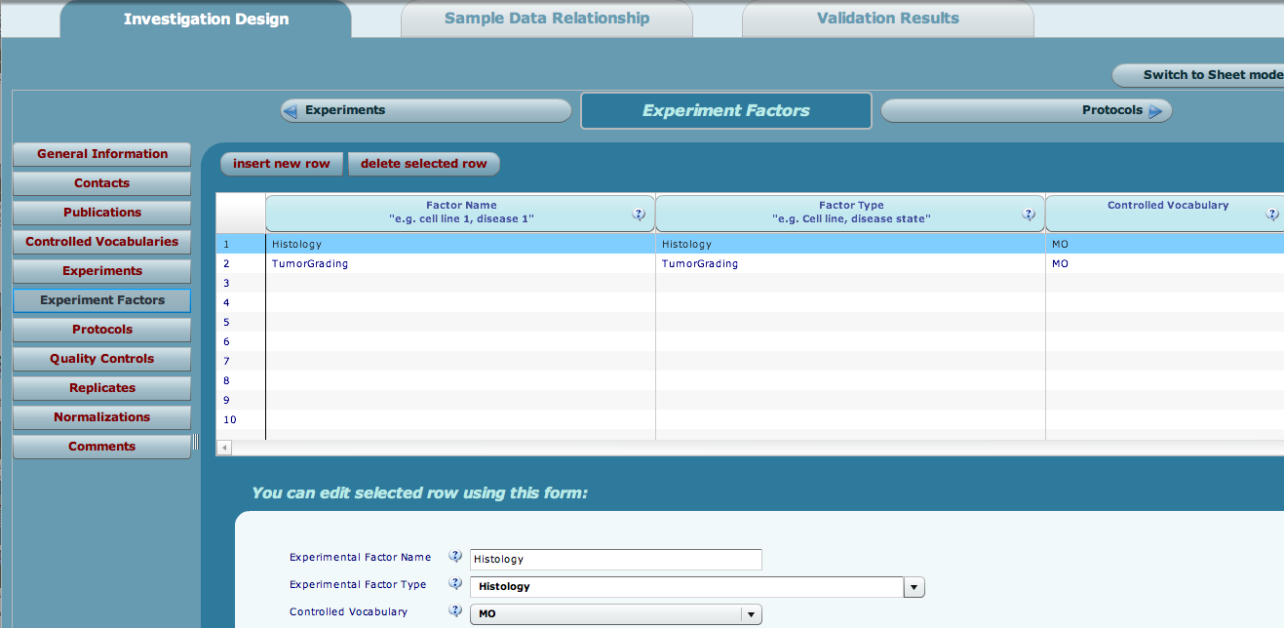
IDF Forms
IDF forms for publications and factors

Slide 34
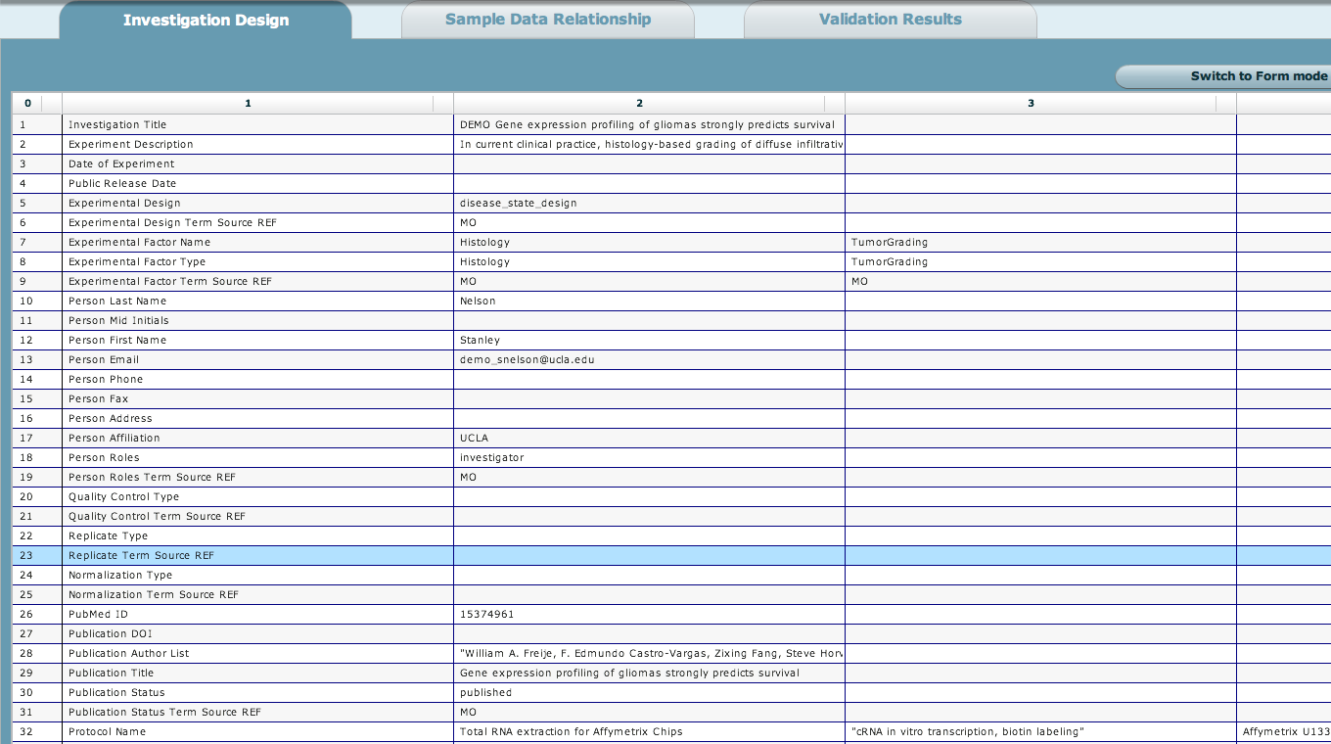
IDF Spreadsheet
Spreadsheet view of an example IDF

Slide 35
IDF
Try it yourself
Open any of the DEMO files in Annotare and add contacts, publications, factors etc. to the IDF

Slide 36
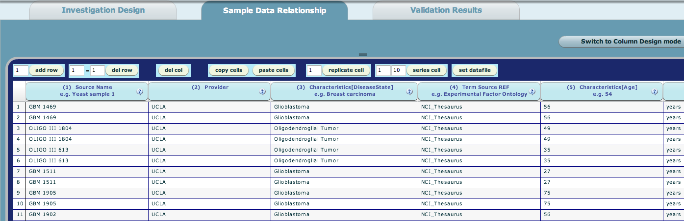
SDRF Editing
Edit the SDRF in spreadsheet mode
Excel-like cut and paste functionality
More sophisticated context-sensitive drop-downs coming in the next release

Slide 37
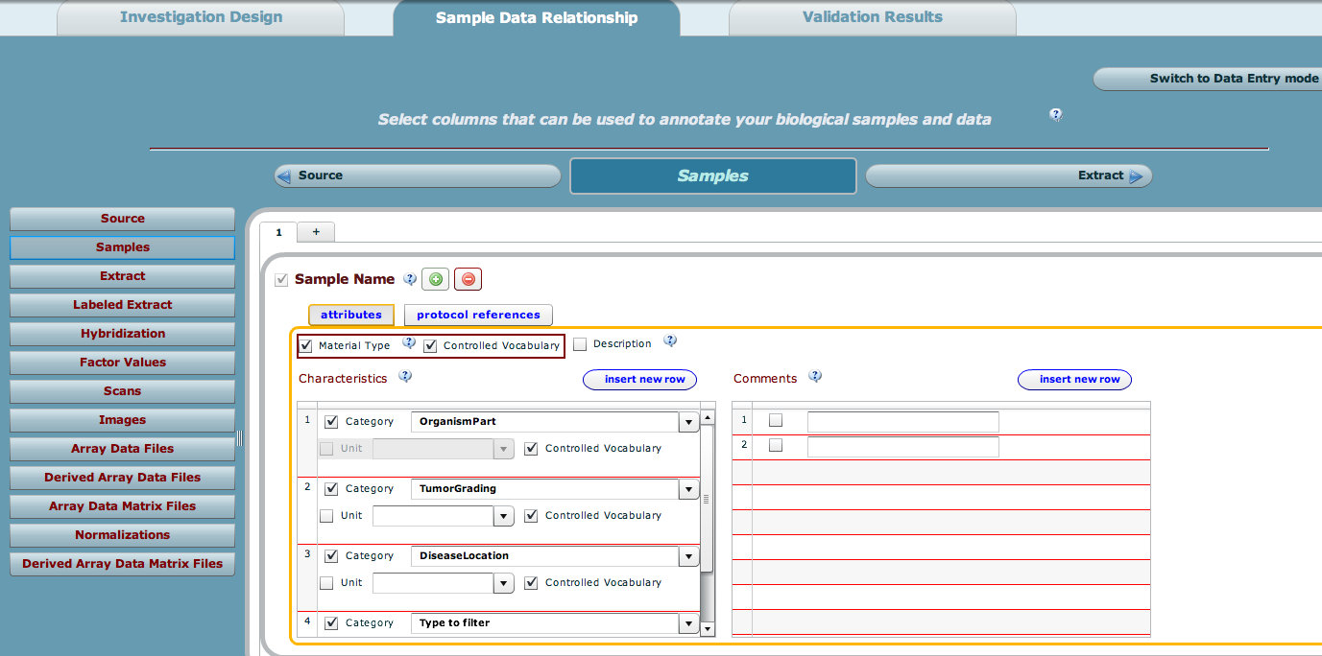
SDRF Configuration
Configure the columns in the SDRF
Add columns to describe biomaterials, their characteristics, factor values, protocols and files

Slide 38
SDRF
Try it yourself
Open any of the DEMO files in Annotare and add biomaterial characteristics, protocols, files etc. to the SDRF

Slide 39
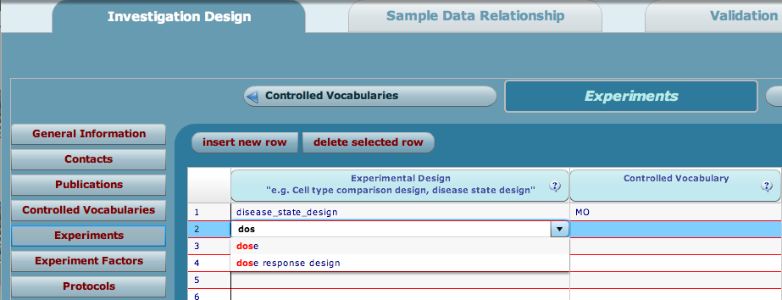
Using Controlled Vocabularies
Ontology-enabled fields with auto-complete
Experimental design & factor types, protocol types, sample characteristics
Annotare comes bundled with the Experiment Factor Ontology (EFO)

Slide 40
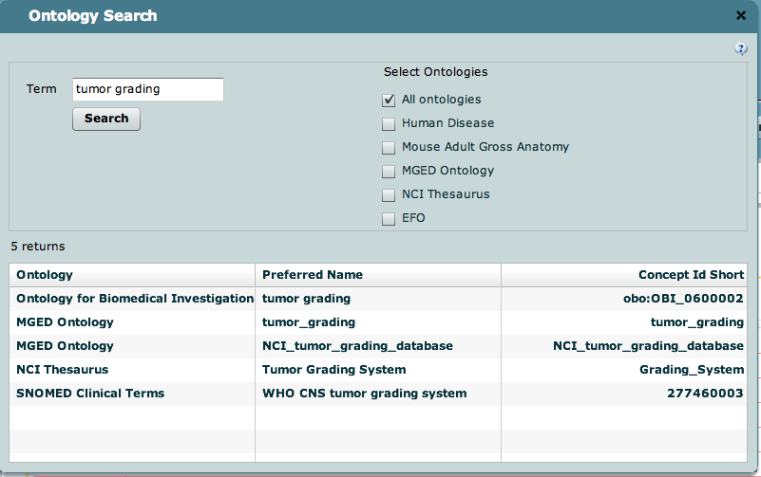
Using Controlled Vocabularies
Ontology widget
Use it to search the NCBO Bioportal (http://bioportal.bioontology.org/) for terms from other ontologies, e.g., NCI Thesaurus, MGED Ontology.

Slide 41
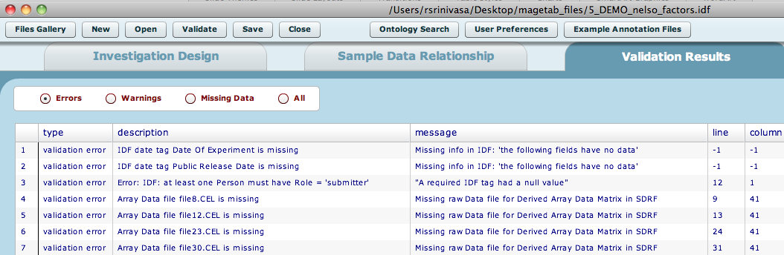
Validation
MAGE-TAB Validator
Checks syntactic and semantic rules on layout and content
Flags invalid headers, missing mandatory annotations, broken integrity of references, misordered columns and missing data files
Files and templates can be validated
An invalid file can still be saved

Slide 42
Plan for 2.0
Features being prioritized for Annotare 2.0
Plug-in validators
Web version; open MAGE-TAB from a caArray experiment accession
Context-sensitive ontology-enabled fields
Redesign SDRF Column Designer
Enhanced Design Wizard
“Undo” functionality
Graphical view of experiment design graph

Slide 43
Avenues for Feedback
Feedback on Annotare
Issue tracker: http://code.google.com/p/annotare/issues/list
Feedback on caArray
Molecular Analysis Tools Knowledge Center Forum: https://cabig-kc.nci.nih.gov/Molecular/forums/

