Slide 1


caArray User Community Meeting
ICR-WS Meeting
2.2.0 Feature Overview and Review of MAGE-TAB Update and Export Specification
caArray 2.4.0 and 2.5.0
Call in: 877-416-5524
Participant Passcode: 2627056
Centra: http://ncicb.centra.com
Meeting ID: ICR_meeting
November 5, 2008
Call in: 800-593-0616
Participant Passcode: 2927756
Centra: http://ncicb.centra.com
Meeting ID: ICR_WS
August 11, 2010

Slide 2
Outline
Overview of caArray
caArray 2.4.0 – upcoming release
  New data parsers
caArray 2.5.0 – next major release
  Improve import of very large datasets and include support for next gen sequencing experiments
Avenues for Feedback

Slide 3
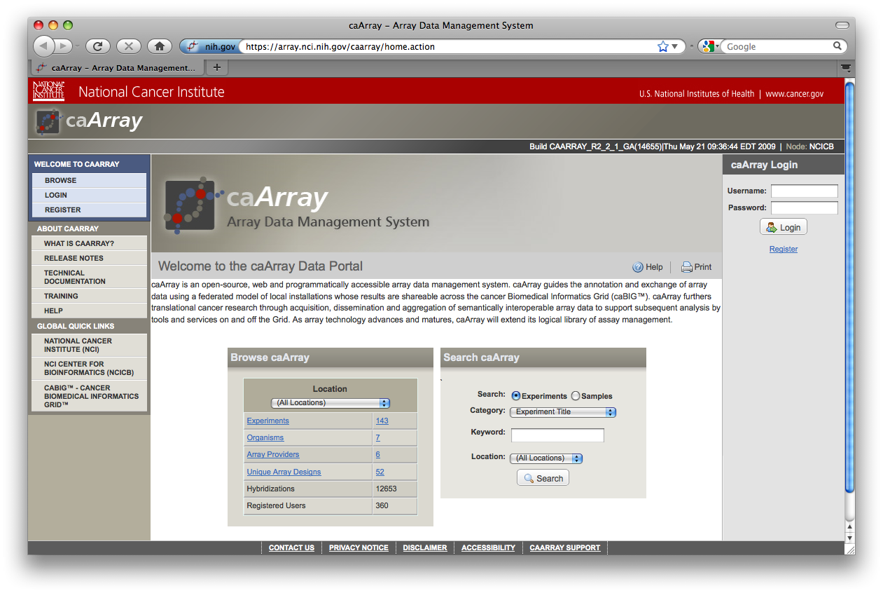
caArray Overview
Manage data/annotations throughout the life of an experiment
Collaborate & share pre-publication data with partners
Control access at the experiment or sample level
Install locally or use the central NCI instance

Slide 4
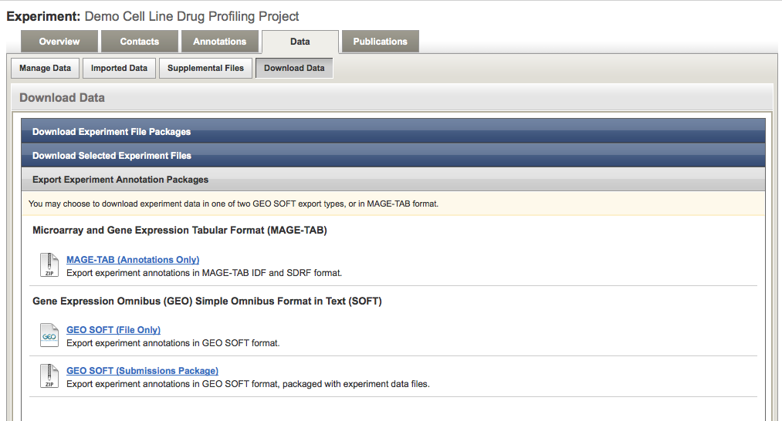
Import and Export in caArray
Import data and annotations using MAGE-TAB
  Associate data files to samples
  Annotate the experiment and samples using controlled vocabularies
  Specify protocols used to process samples and data
Export data and annotations
  Export into MAGE-TAB
  Export into SOFT format for subsequent GEO submission

Slide 5
Data in caArray
Native data
  Native files from various platforms and providers can be stored and associated to samples. E.g., Affymetrix, Agilent, Illumina, Nimblegen, Genepix, ImaGene
Parsed data
  In addition, caArray parses a subset of file types so that the data can be pulled by analytical clients using programmatic APIs. E.g., retrieve signal values from Affymetrix CHP file.

Slide 6
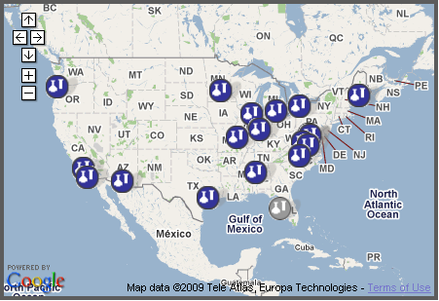
Programmatic APIs and the Grid
Programmatic APIs allow…
  search and retrieval of annotations and native data files
  retrieval of parsed data that can be passed on to analysis applications
Grid API and Java-only API
  Grid API: Retrieve public data across caArray installations on caGrid
  Java API: Retrieve public or private data

Slide 7
Clients of caArray
  Clients consuming caArray data via APIs include…
  GenePattern
  geWorkbench
  caIntegrator2
  caB2B
  Taverna workflows

Slide 8
caArray 2.4.0 – upcoming release
  Timeline: expected release this month (August)
Scope: New Data Parsers
  Agilent:
    GEML/xml array designs (aCGH, gene expression and miRNA)
    Raw TXT data files (aCGH, gene expression and miRNA)
  Nimblegen – Community Code Contribution:
    NDF array designs
    Pair Report (raw and normalized) data files
  Illumina:
    BGX/TXT array designs
    Gene expression: Sample Probe Profile TXT files with unique Probe_Id
    Genotyping: Processed matrix TXT files with unique IlmnID values
  Affymetrix:
    AGCC/Command Console formats for CDF, CEL and CHP files.
    CNCHP files with copy number and LOH data.
  Copy number data in MAGE-TAB Data Matrix format

Slide 9
caArray 2.5.0
  Plan for caArray 2.5.0
  Focus on upload/import/download of large data sets
  Plan for Grid security
  Plan for caTissue integration
  Fix collaborator view of uploaded files
  Curate organisms, material types and protocol types
  Plug-in architecture prototype
  Support search for experiments by publication
  Find & download samples within an experiment
  Upgrade Java (6), Jboss (5.1) and MySQL (5.1)

Slide 10
Upload/import/download of large data sets
  Current functionality
  The current approach of storing data files in a MySQL database does not scale to the large volumes of data expected from experiments like next gen sequencing.
  Individual imports are limited to about 1.5GB each, forcing the user to import in multiple smaller batches.
  There is room to improve in the upload/import/download user experience.
  2.5.0 Plans
  Support storage of large volumes of data, possibly on a distributed file system
  Support large data set imports without the need for chunking. Possible approaches are to store parsed data on the file system, to use Postgres, or to break the import into multiple smaller transactions.
  Support import of next gen sequencing files like FASTQ and BAM.
  Add queue management to ease the import process
  Support resumable downloads and transparent compression

Slide 11
Plan for Grid security
  Current functionality
  The current version of the Grid API supports access to only publicly available data. This means that if programmatic access to protected data is desired, then the Java API must be used instead
  2.5.0 Plans
  Perform design work for implementing Grid security, including items such as:
    Allow a programmatic client to log in using Grid credentials and retrieve protected data.
    Local installers will have the choice to keep old-style local accounts or migrate to Grid accounts.
    A mechanism must be provided for users to migrate their local accounts to Grid accounts.
    Use Grid Grouper to manage groups.

Slide 12
Plan for caTissue integration
  Current functionality
  Various ad hoc systems (like email/paper) are used during the lab workflow in order to transfer specimen information from the biospecimen system to the assay system.
  Users need a way to look up data associated with a specimen they found in the biospecimen system, or to look up the specimens associated with data they found in caArray.
  2.5.0 Plans
  Agree upon requirements with the caTissueSuite team for how biospecimens/biomaterials will be mapped between the two systems, and what services are needed to enable integration.

Slide 13
Fix collaborator view of uploaded files
  Current functionality
  Files that are uploaded but not yet imported can be seen only by the experiment owner, and are invisible to collaborators who have read access to the experiment.
  2.5.0 Plans
  Users with read/write access to the experiment will be allowed to see uploaded files.
  A user with sample-selective access will not be allowed to see uploaded files, except if (s)he uploaded the files.
  Significant work on the security filters in 2.4.0 makes this fix now possible.

Slide 14
Curate organisms, material types and protocol types
  Current functionality
  Duplicate terms are readily created, especially on MAGE-TAB import
  2.5.0 Plans
  Limit organisms to the NCBI taxonomy term source, and clean up duplicates
  Limit material types and protocol types to the MGED ontology and clean up duplicates
  Longer-term Plans
  Suggest alternative terms during import
  Let curators merge duplicate terms

Slide 15
Plug-in Architecture Prototype
  Prototype demonstrating the benefits of a plug-in architecture
  Refactoring caArray to introduce a plug-in framework based on OSGi
  Gives the ability to deploy plug-ins without the need for a full-fledged release
  Plug-ins would be allowed at defined integration points – e.g., parsers for new data types, new visualizations, additional APIs that can be exposed
  Prototype will demonstrate a heatmap visualization of gene expression data as a plug-in.

Slide 16
Avenues for Feedback
  Molecular Analysis Tools Knowledge Center Forum:
  https://cabig-kc.nci.nih.gov/Molecular/forums/
  GForge Community Change Request tracker
  http://gforge.nci.nih.gov/tracker/?atid=1339&group_id=305&func=browse
  This meeting. The next caArray session on the ICR-WS will be on:
  Wednesday, October 13, 2:00 PM ET

