Slide 1


caArray Update: Next Releases ICR-WS Meeting October 13, 2010
caArray User Community Meeting
2.2.0 Feature Overview and Review of MAGE-TAB Update and Export Specification
Notes:
1

Slide 2
Next Releases
2.4.0.1
Fixes memory problem with imports of large array designs (>100,000 design elements)
Fixes problem where Illumina data values are not associated to probes
Supports N/A values in copy number data
2.5.0 scope is being driven by…
a user community need to support new assay types especially next gen sequencing
the need to scale to higher volumes of data
current limitations of the upload/import process
the user community’s desire to better-manage user roles and collaboration groups
the NCI CBIIT infrastructure requirements for Grid security; and
the need to update the technologies used by caArray

Slide 3
Next generation sequencing assays
Priority: High
Needs
Technologies like next generation sequencing are becoming widely used in the user community that caArray seeks to serve, as investigators move from microarray experiments to newer assay types.
Features
Support the new MAGE-TAB v1.1 SDRF columns (Assay Name and Technology Type) that allow specification of non-microarray assay types.
Support specification of fastq and BAM/SAM files, possibly as links to accessioned files in an external repository like the NCBI Short Read Archive (SRA).

Slide 4
Storing large volumes of data
Priority: High
Needs
As the number of experiments in caArray grows, there is a critical need for the application to be able to scale to support large volumes of data. E.g., the TCGA project is now generating next generation sequencing data at the rate of 10 TeraBytes per month. Not all of this will be stored in caArray, but the storage architecture must be updated nevertheless.
Features
Allow storage of data files on the file system instead of the database.
Support cloud storage of data files, allowing a local installer to configure this.
Prototype storage of parsed data on the file system (using NetCDF or similar). Also prototype storage of parsed data in a Postgres database. Compare the two options on performance and transaction limits. A migration strategy for existing data will be needed.

Slide 5
Upload/Import/Download of large data sets
Priority: High
Needs
Current limitations in the user experience during upload, import and download create a need for an easy way to perform these tasks without a lot of manual effort to “chunk” large data sets.
Features
Implement an Upload/Download manager that eliminates the 2GB upload limit and allows resumable downloads and transparent compression.
[See parsed data storage options on the previous slide, for ways to eliminate the current 4GB import limit imposed by MySQL.]
Add better Import Queue management, including the ability to see the position of your import in the queue and the ability to cancel an import.

Slide 6
User roles/privileges, collaboration groups
Priority: Medium
Needs
User community feedback has revealed that they would like to be able to provision different user roles in order to control access to subsets of data and/or features in the application.
There are known problems with visibility of files to collaboration groups.
Features
Gather requirements around what user roles and privileges are needed, and what portions of the application/data need to be restricted based on role.
The fix to Gforge #14630 would ensure that collaborators with the appropriate privileges would have access to uploaded-but-not-yet-imported files.

Slide 7
Grid security
Priority: Medium
Needs
Invokers of the caArray programmatic Grid APIs (e.g., analysis applications like geWorkbench and GenePattern) are restricted to public data, because the Grid APIs do not support Grid security. Supporting Grid user login is essential to meet the NCI CBIIT infrastructure requirements.
Features
Design a Grid security enabled application and API. Components would include migration of current user accounts to Grid accounts using CGMM, allowing local installers to configure their preference for Grid security versus local security, and implementing Grid authentication in the remote Java (EJB) API.

Slide 8
Tech stack upgrades
Priority: High
Needs
Several of the technologies used by caArray are becoming dated, and there is an urgent need to upgrade them.
Features
Upgrade the application server to Jboss 5.1
Upgrade to Java 6
Upgrade to MySQL 5.1
Upgrade to BDA 1.7

Slide 9
2.5.0 on the wiki
caArray 2.5.0 on the NCI wiki
https://wiki.nci.nih.gov/display/caArray2project/2.5.0+Project+Plan

Slide 10
Annotating Experiments with MAGE-TAB: Annotare Example files can be downloaded from here: https://gforge.nci.nih.gov/docman/view.php/305/23084/magetab_samples.zip
caArray User Community Meeting
2.2.0 Feature Overview and Review of MAGE-TAB Update and Export Specification
Notes:
10

Slide 11
Outline
Overview
Installation
Starting from Templates
Starting from the Design Wizard
Editing the IDF
Configuring and Editing the SDRF
Finding annotations from controlled vocabularies
Validating MAGE-TAB
Plan for Annotare v2.0

Slide 12
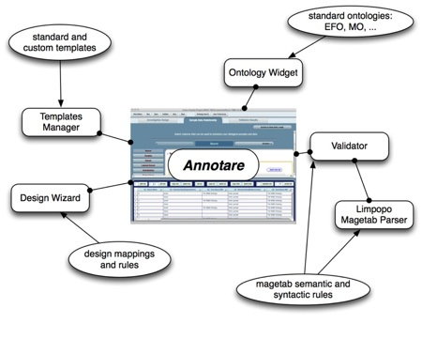
Overview
GUI tool to create MAGE-TAB IDF and SDRF files
Standard templates for common experiment types
A design wizard that guides the biologist step-by-step
Easy incorporation of annotations from relevant biomedical ontologies,
A MAGE-TAB validator that checks the annotations
Open source (MIT license), based on Adobe AIR and Java.

Slide 13
Installation
Requirements: 190M disk space for Mac OR 70M for Windows
Windows (XP, Vista, 7)
Uninstall any older version of Annotare via the Control Panel and then delete the Annotare folder under “Program Files”.
Download the Installer bundled with/without the JRE:
http://annotare.googlecode.com/files/Annotare-v1.1.1-jre.exe (Recommended)
http://annotare.googlecode.com/files/Annotare-v1.1.1.exe (First install JRE 1.5/1.6)
Double-click on the exe and follow the steps to install.
Go to Programs -> Annotare to start the application.
MAC OS X (10.5 or greater)
Uninstall any older version of Annotare by removing it from /Applications.
Get Java JRE 1.5 or higher.
Download the installer:
http://annotare.googlecode.com/files/Annotare-v1.1.1.pkg.zip
Double-click to unzip, then double-click on the .pkg to install.
Click on /Applications/Annotare to start the application.

Slide 14
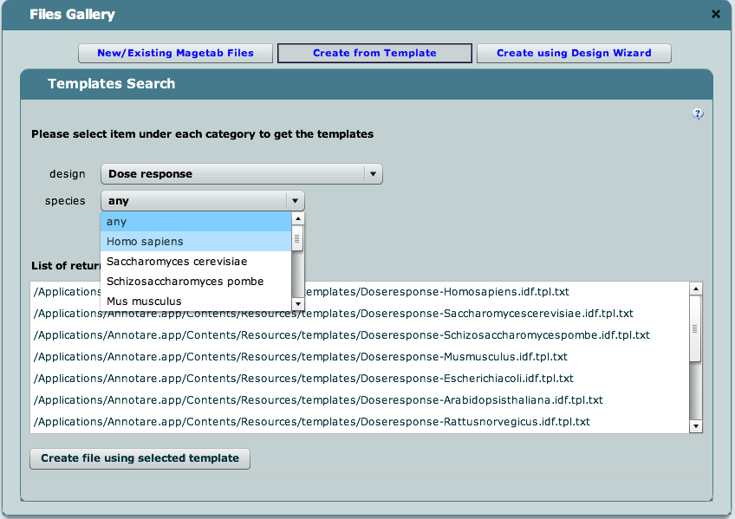
Templates
Don’t start from a blank slate; use a template.
A template gives you a partially populated MAGE-TAB document set that can then be completed with experiment-specific information.
From the Files Gallery, choose “Create from Template”.
Search for a template by experimental design and species.

Slide 15
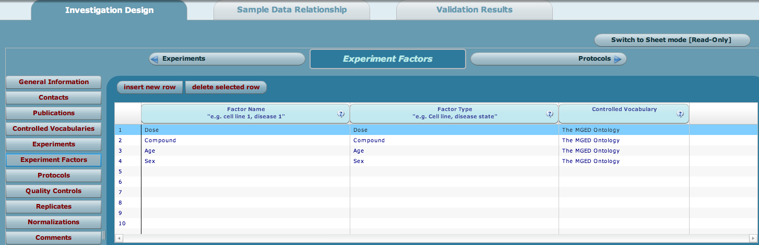
Templates
Generate MAGE-TAB files from the template
Choose “Create file using selected template” and start editing it.
Clicking on Save will save an <filename>.idf.txt and <filename>.sdrf.txt.

Slide 16
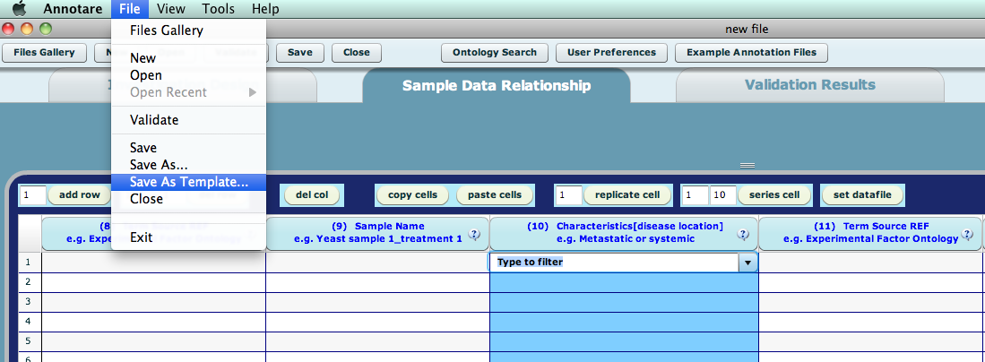
Templates
Custom Templates
Clicking on File -> Save as Template (in the Annotare menu) will save your edits as a new template in your files location (defined in user preferences). The files will be saved as <filename>.idf.tpl.txt and <filename>.sdrf.tpl txt.
Custom templates can be created with often-used annotations already filled in, and saved for use in future experiments.

Slide 17
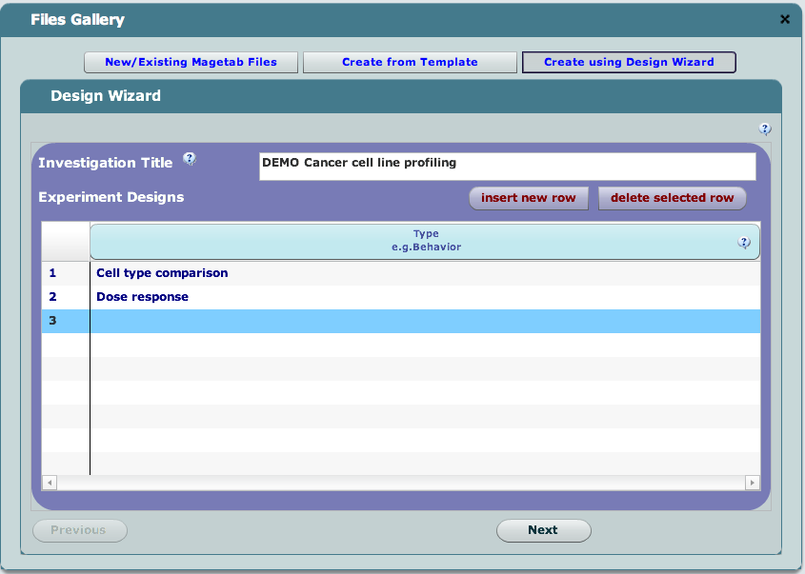
Design Wizard
Useful when no template is available
Guides a novice user with step-by-step questions
Experimental design, number of channels, labels
Platform and protocols

Slide 18
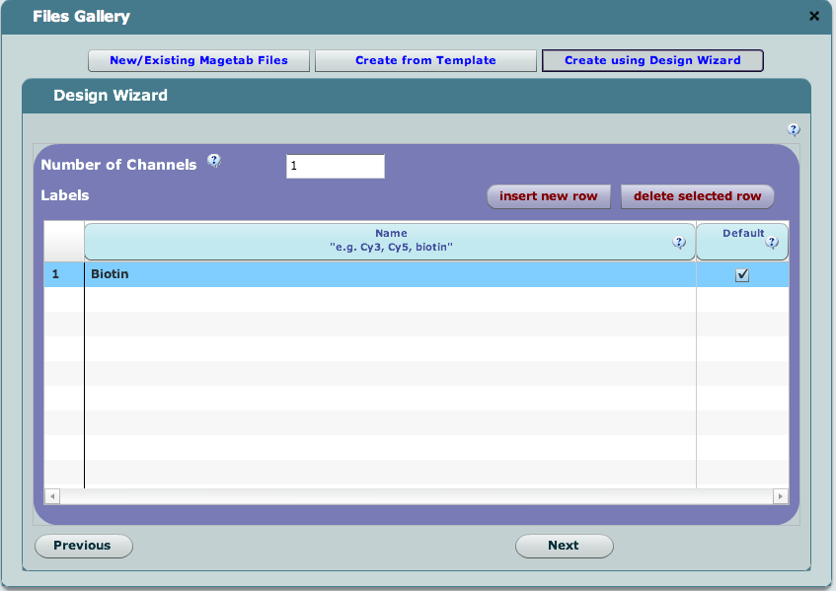
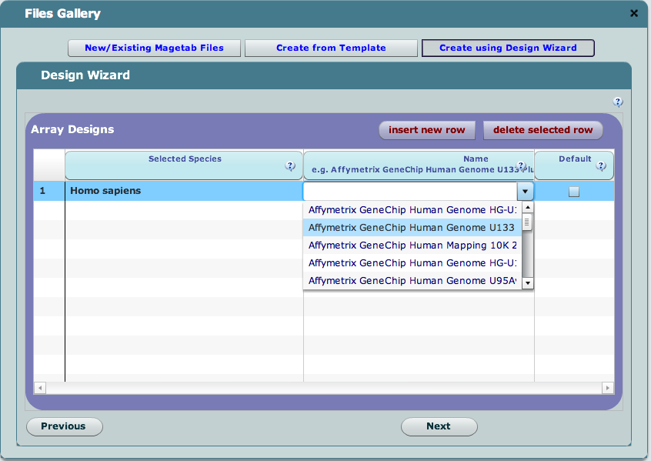
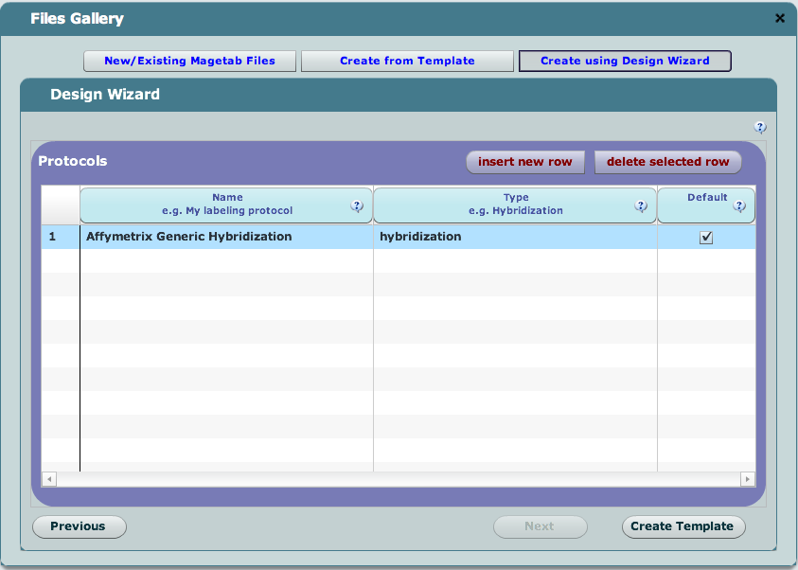
Design Wizard
Screenshots

Slide 19
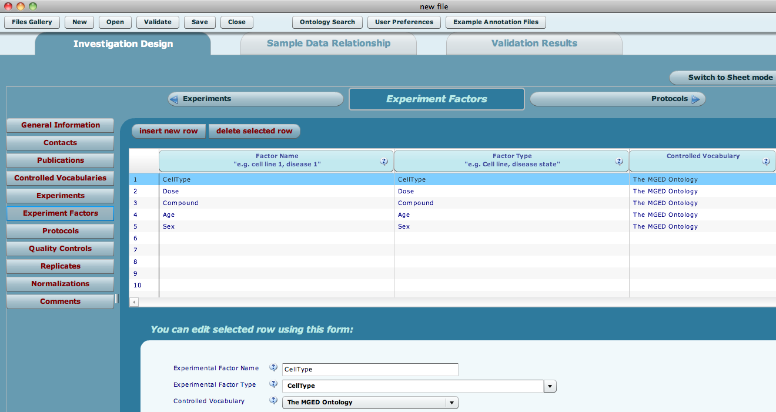
Design Wizard
Wizard generates partial annotations

Slide 20
IDF
GUI forms
hide the syntactic complexity of MAGE-TAB as much as possible
group related information together in an intuitive manner
Edit the IDF to
provide basic information about an experiment
list the people associated with the experiment and their roles
list any associated publications
describe the experimental design and factors being studied
describe the protocols that were employed at various stages in the investigation

Slide 21
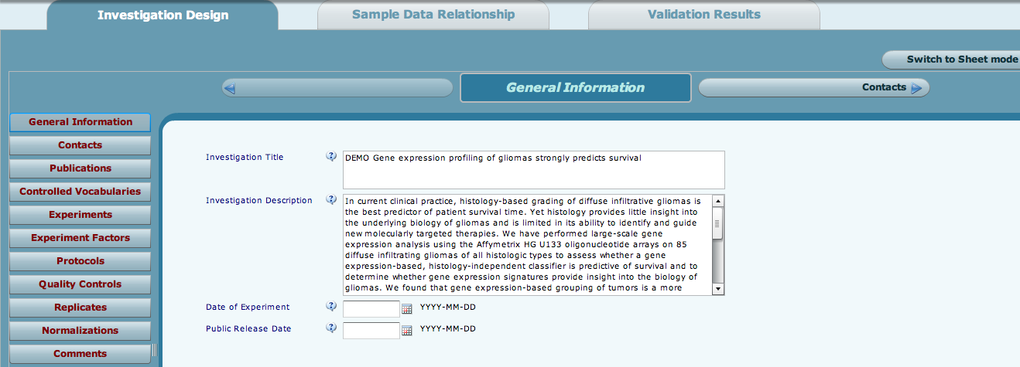
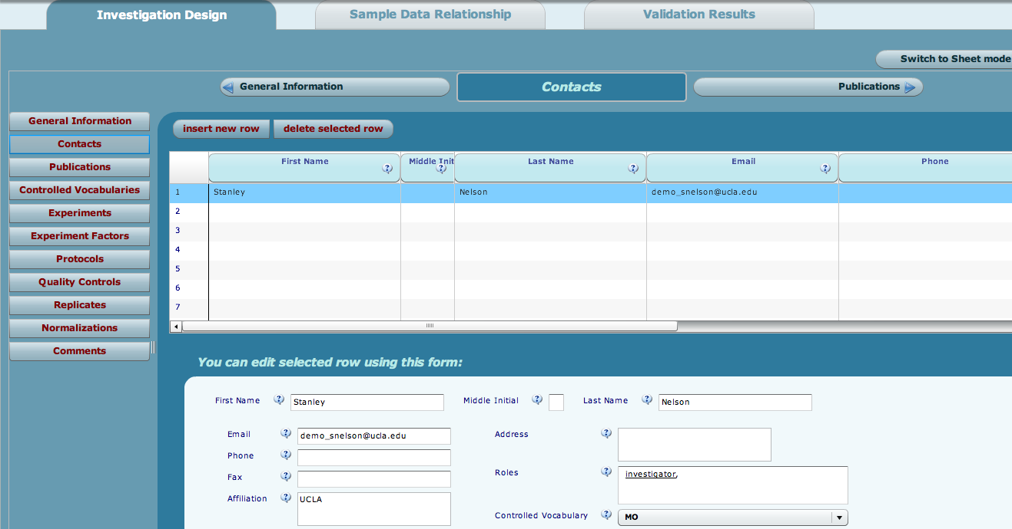
IDF Forms
IDF forms for general information and contacts

Slide 22
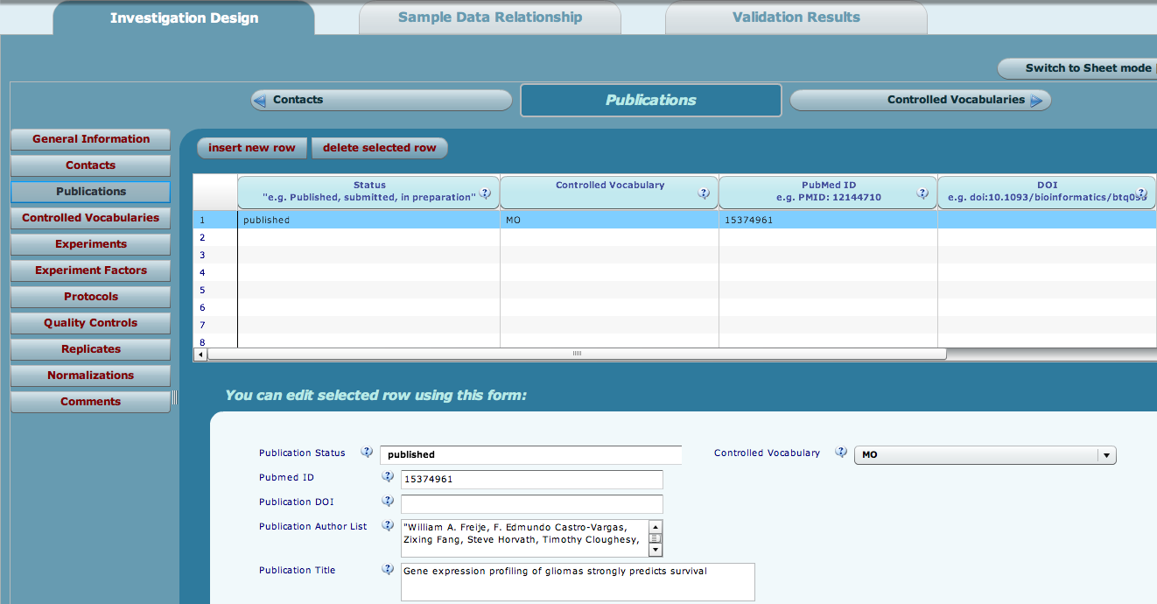
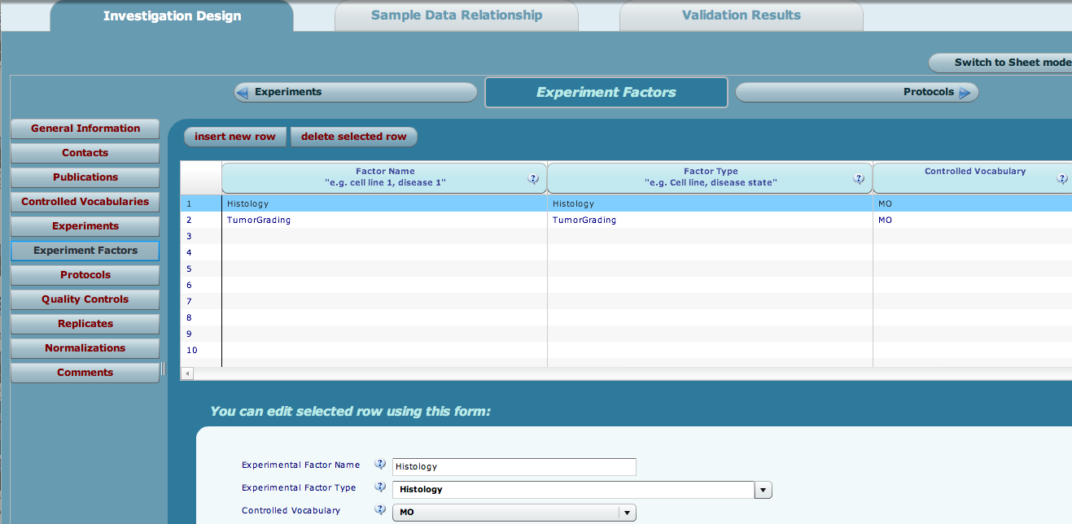
IDF Forms
IDF forms for publications and factors

Slide 23
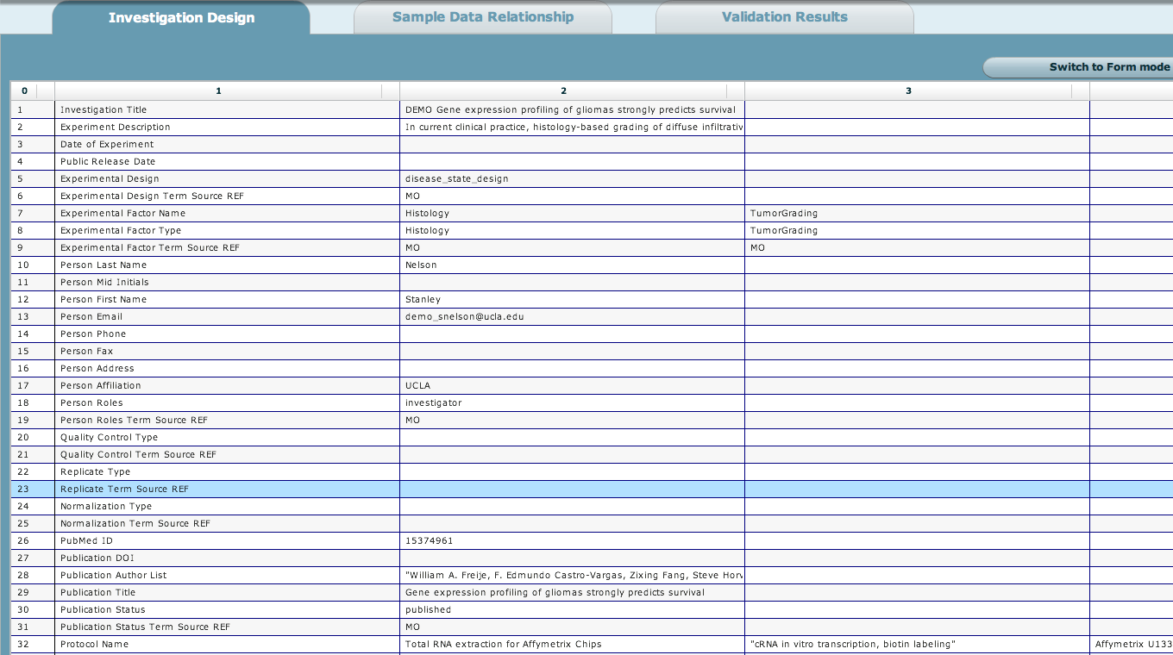
IDF Spreadsheet
Spreadsheet view of an example IDF

Slide 24
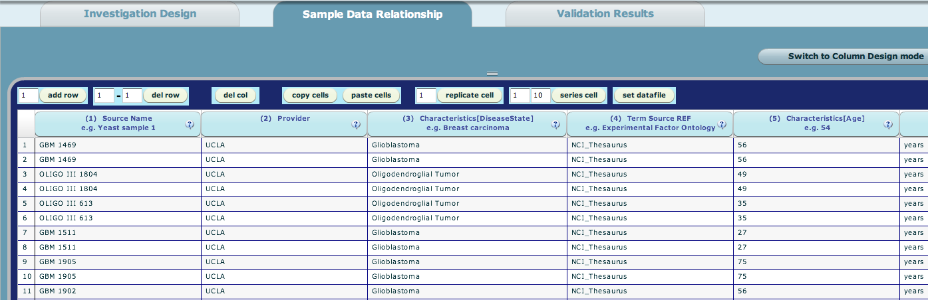
SDRF Editing
Edit the SDRF in spreadsheet mode
Excel-like cut and paste functionality
More sophisticated context-sensitive drop-downs coming in the next release

Slide 25
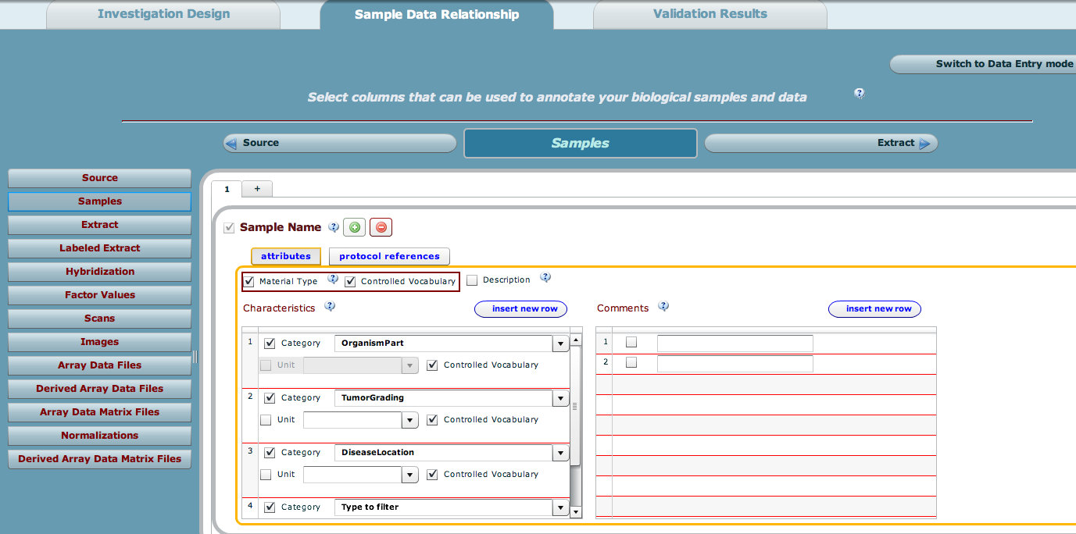
SDRF Configuration
Configure the columns in the SDRF
Add columns to describe biomaterials, their characteristics, factor values, protocols and files

Slide 26
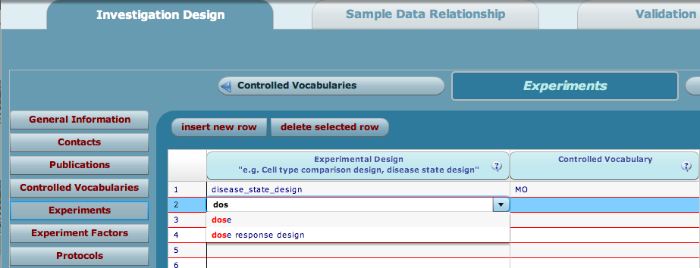
Using Controlled Vocabularies
Ontology-enabled fields with auto-complete
Experimental design & factor types, protocol types, sample characteristics
Annotare comes bundled with the Experiment Factor Ontology (EFO)

Slide 27
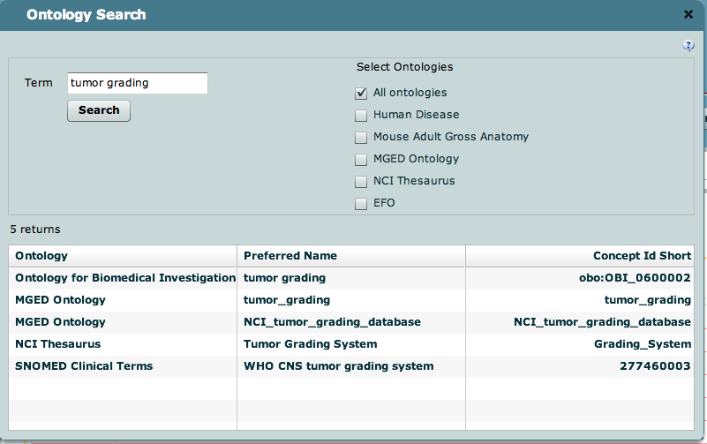
Using Controlled Vocabularies
Ontology widget
Use it to search the NCBO Bioportal (http://bioportal.bioontology.org/) for terms from other ontologies, e.g., NCI Thesaurus, MGED Ontology.

Slide 28
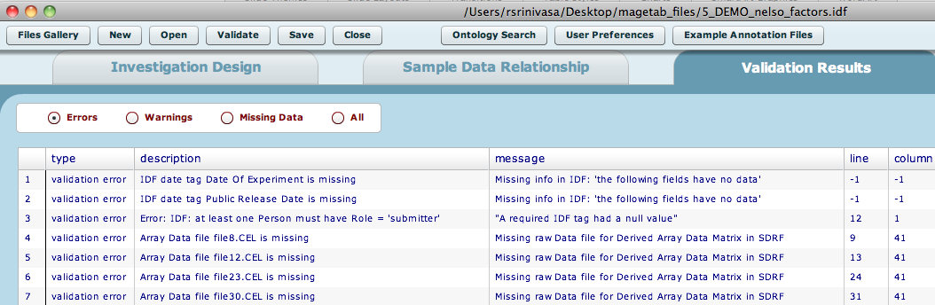
Validation
MAGE-TAB Validator
Checks syntactic and semantic rules on layout and content
Flags invalid headers, missing mandatory annotations, broken integrity of references, misordered columns and missing data files
Files and templates can be validated
An invalid file can still be saved

Slide 29
Plan for 2.0
Features being prioritized for Annotare 2.0
Plug-in validators
Web version; open MAGE-TAB from a caArray experiment accession
Context-sensitive ontology-enabled fields
Redesign SDRF Column Designer
Enhanced Design Wizard
“Undo” functionality
Graphical view of experiment design graph

Slide 30
Avenues for Feedback
Feedback on Annotare
Issue tracker: http://code.google.com/p/annotare/issues/list
Feedback on caArray
Molecular Analysis Tools Knowledge Center Forum: https://cabig-kc.nci.nih.gov/Molecular/forums/

