Slide 1


caArray Update: Release 2.4.1 ICR-WS Meeting May 11, 2011
caArray User Community Meeting
2.2.0 Feature Overview and Review of MAGE-TAB Update and Export Specification
Notes:
1

Slide 2
Next Release: 2.4.1
Schedule
Testing started this week.
Release at the end of May.
Scope
Feature: Visibility into the queue of import and validation jobs. Ability to cancel a queued job.
Feature: Search for experiments by publication author or PubMed ID.
Enhancement: Organisms are now restricted to terms from the NCBI Taxonomy.
Enhancement: The installer no longer depends on an internet connection.
Bug Fix: Allow proper import of Agilent array design files where the chromosome name is not in a strictly numeric or X/Y format.
Bug Fix: Experiments with multiple array designs may cause copy number data to get imported as "Imported (Not Parsed)”.

Slide 3
Demonstration of 2.4.1 Features
DEMO

Slide 4
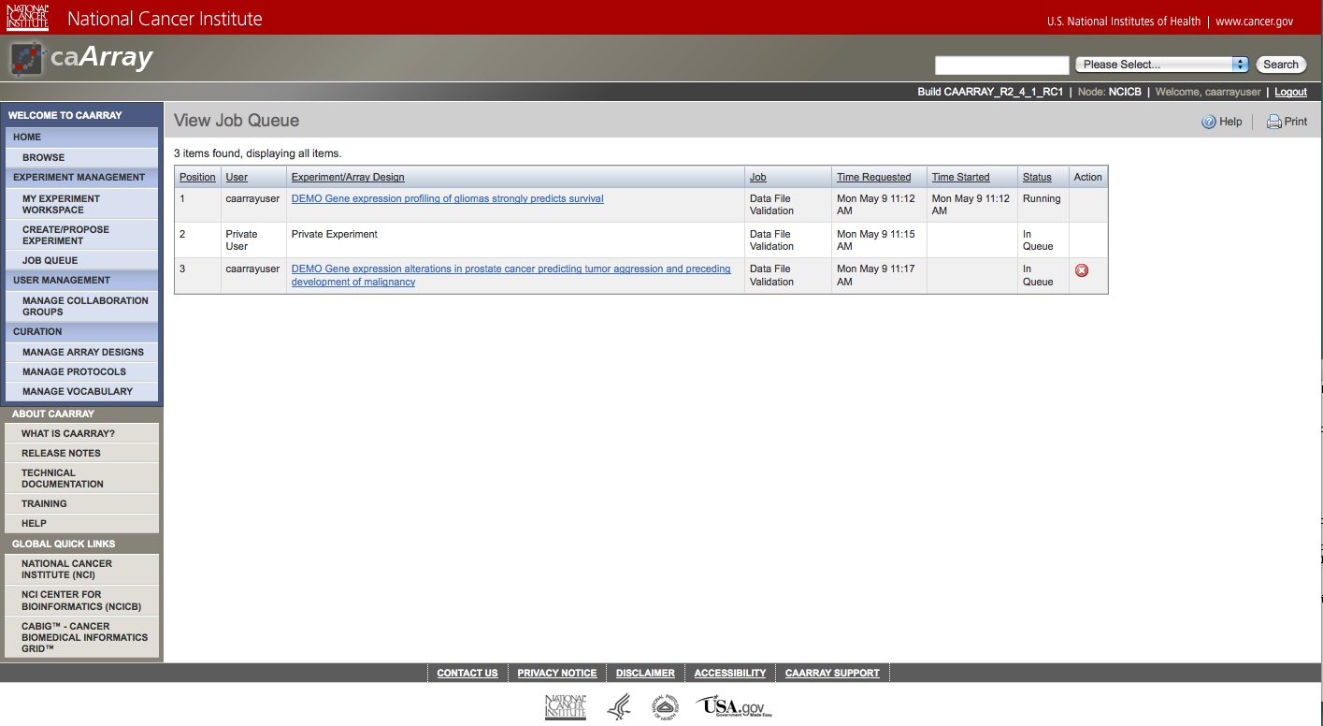
Screenshot: Job Queue

Slide 5
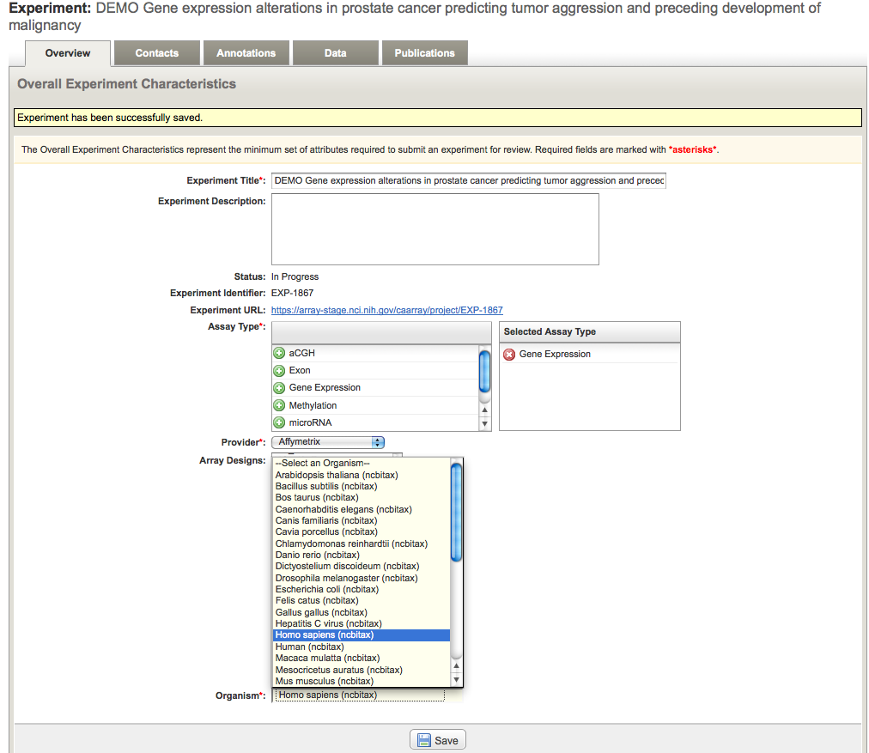
Screenshot: Organisms from the NCBI Taxonomy

Slide 6
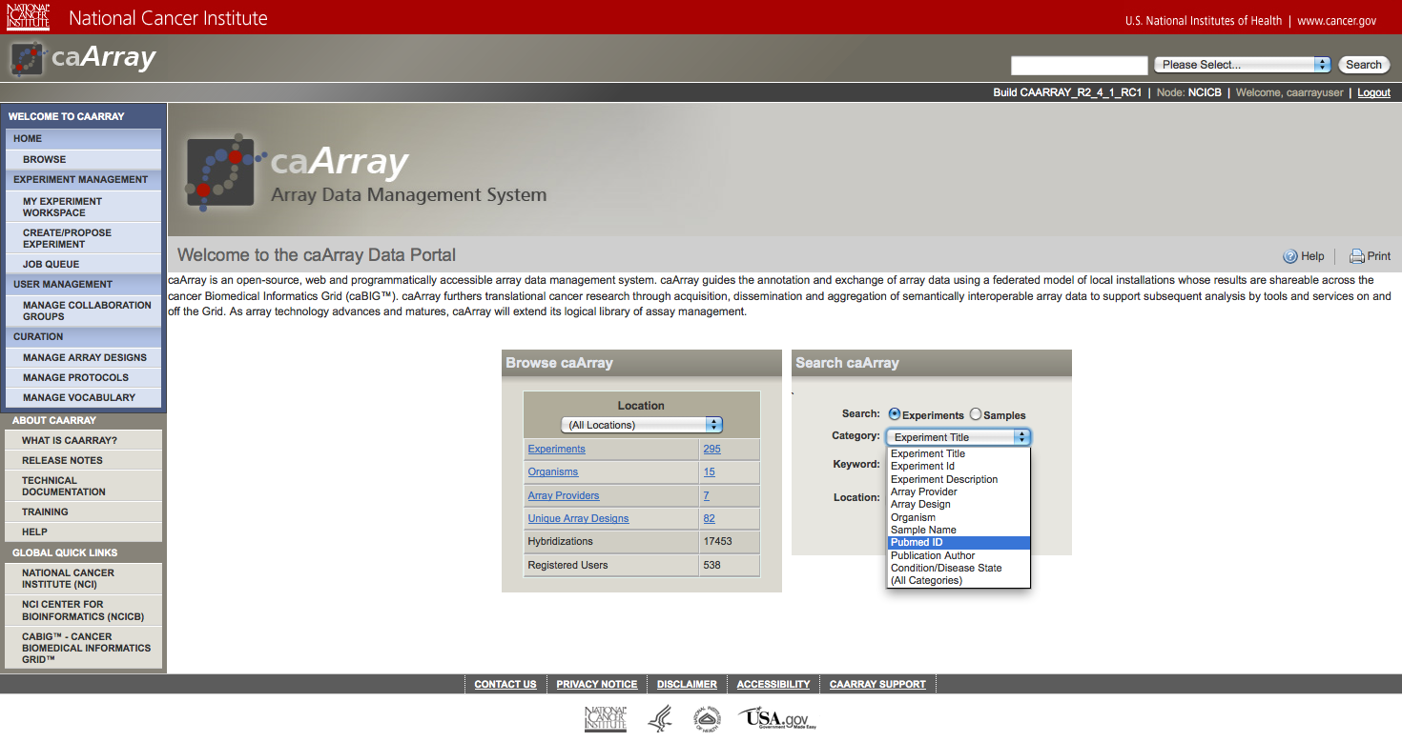
Screenshots: Search by Publication

Slide 7
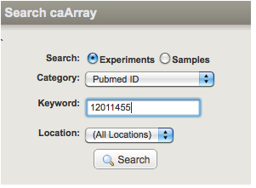
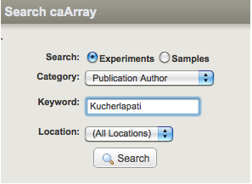
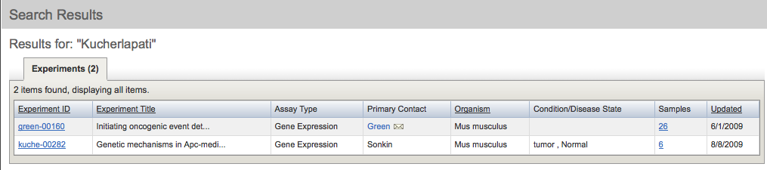
Screenshots: Search by Publication

Slide 8
Next Major Release
2.5.0 main themes
Easier upload and import of large data sets without having to break them into batches. Files can be stored on the file system rather than in the database. An Upload/Download manager eliminates the 2GB upload limit and allows resumable uploads.
A plug-in architecture that supports the easy addition of parsers for new data types without requiring a new application release. Plug-ins can be hot-deployed into a running caArray instance and are instantly picked up and incorporated into the application.
An updated technology stack (Jboss 5.1, MySQL 5.1, BDA 1.7, Java 6)

Slide 9
What’s New on caArray Support
New Knowledgebase Articles
Caarray075 UPT user group/caArray collaboration group clarification
Caarray071 How to check whether my caArray data is published on caGrid?
Caarray067 Zip file uncompression failed. Why?
Caarray065 Can we amend the ownership for a deleted user's experiment?
Caarray077 How to increase time-out period when running CQL queries?
Community Code Contribution Update
Support RPLA in caArray by Leandro Hermida’s team at PMI
caarray080 A step-by-step guide to Create MAGE-TAB template specific to RPLA Project
Upgraded caArray Importer to work with caArray 2.4.0.2 by Talha at UAMS
https://cabig-kc.nci.nih.gov/Molecular/forums/viewtopic.php?f=6&t=497

Slide 10
Avenues for Feedback
We welcome feedback on caArray
Molecular Analysis Tools Knowledge Center Forum: https://cabig-kc.nci.nih.gov/Molecular/forums/

