Slide 1
caArray Update 2.4.1 October 12, 2011

Slide 2
caArray 2.4.1
Released on October 3, 2011
Scope
Feature: Visibility into the queue of import and validation jobs. Ability to cancel a queued job.
Feature: Search for experiments by publication author or PubMed ID.
Enhancement: Organisms are now restricted to terms from the NCBI Taxonomy.
Enhancement: The installer no longer depends on an internet connection.
Bug Fix: Allow proper import of Agilent array design files where the chromosome name is not in a strictly numeric or X/Y format.
Bug Fix: Experiments with multiple array designs may cause copy number data to get imported as "Imported (Not Parsed)”.
Maintenance: Updates to raise Section 508 compliance score.

Slide 3
Demo of caArray 2.4.1
DEMO

Slide 4
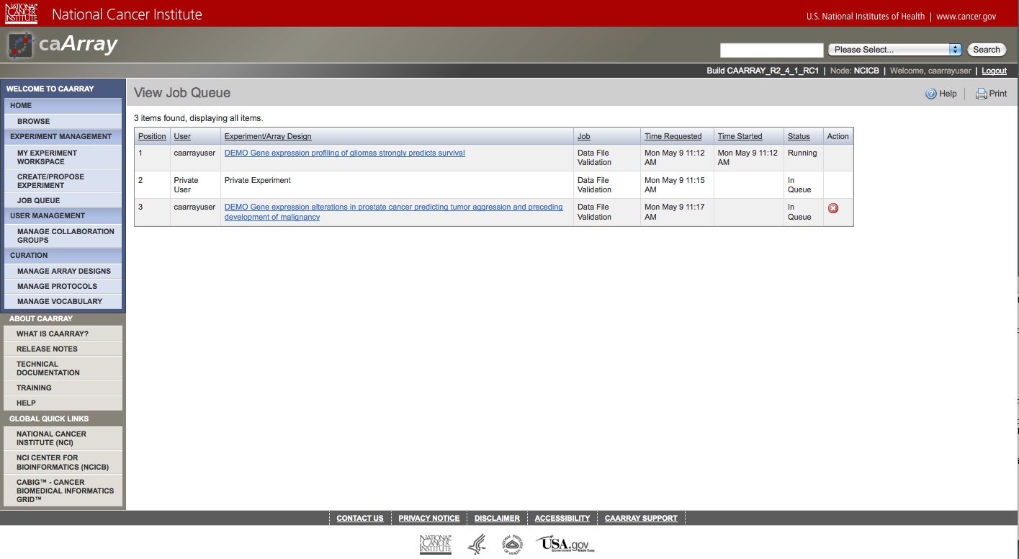
Job Queue

Slide 5
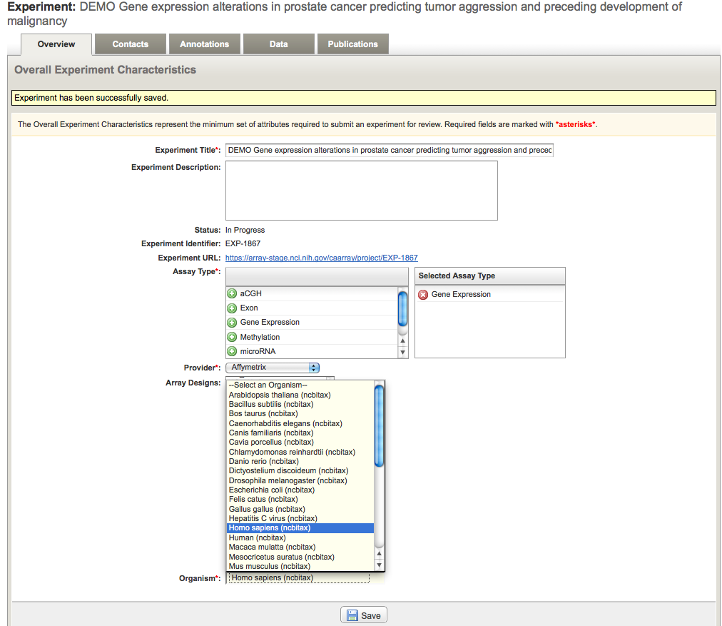
Organisms from the NCBI Taxonomy

Slide 6
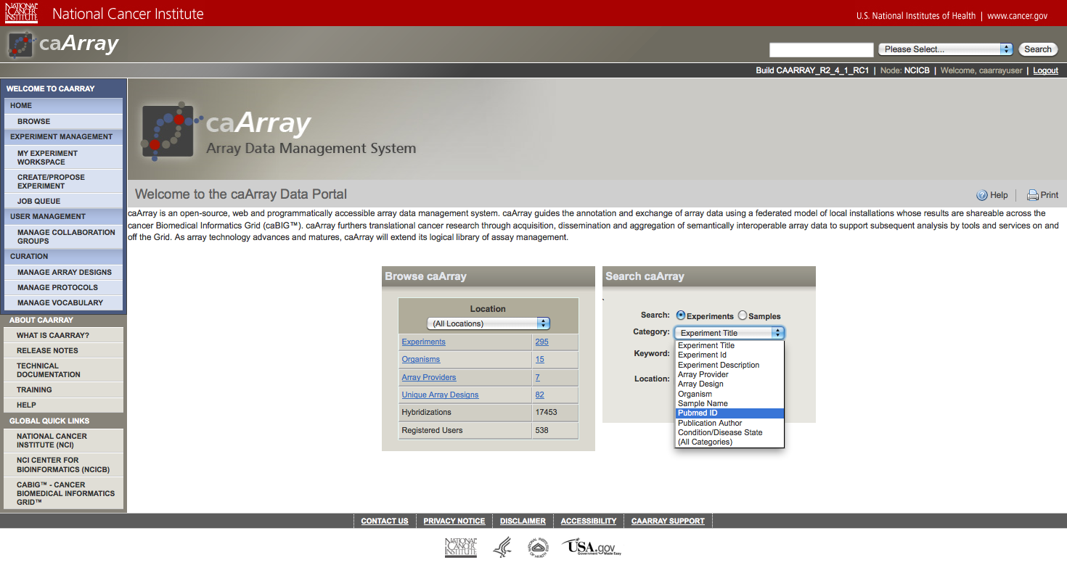
Search by Publication

Slide 7
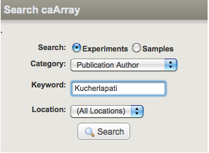
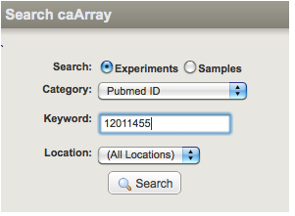
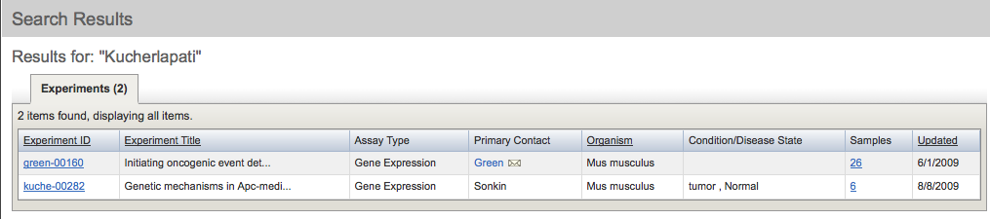
Search by Publication - Results

Slide 8
Next Major Release
2.5.0 main themes
Easier upload and import of large data sets without having to break them into batches. Files can be stored on the file system rather than in the database.
A plug-in architecture that supports the easy addition of parsers for new data types without requiring a new application release. Plug-ins can be hot-deployed into a running caArray instance and are instantly picked up and incorporated into the application.
An updated technology stack (Jboss 5.1, MySQL 5.1, Java 6, BDA-Lite)

Slide 9
Data Parsing in 2.5.0
Disable Affymetrix CEL file parsing and store files as-is?
Pros: Faster import; less database space usage.
Cons: Client applications needing raw signal values will have to download the CEL file from caArray and parse it themselves.
Note: Affymetrix CHP files will continue to be parsed.

Slide 10
What’s New on caArray Support
New Knowledgebase Articles
caArray080 A Step-by-Step Guide to Create a MAGE-TAB Template Specific to RPLA Project
caArray081 Can caArray and caIntegrator2 share the same version of the UPT application?
caArray085 Which columns are required for an Illumina csv datafile and caArray?
caArray086 UPT was installed successfully but I could not log in as the super user. Why?
caArray087 Why Do I Get an Error Message When Attempting to Validate an Illumina SNP Data File in caArray?
Important Notice on Using UPT to Create Groups for caArray
Do NOT use protection elements or protection groups directly within UPT
Do NOT create caArray collaboration groups within UPT.
Doing so may result in irreversible changes to the data in caArray database, and will require reinstallation of caArray

Slide 11
Avenue for Feedback
We welcome feedback on caArray
Molecular Analysis Tools Knowledge Center Forum: https://cabig-kc.nci.nih.gov/Molecular/forums/

