Slide 1
caArray:
An open source microarray data management system in caBIG™
Juli Klemm, Ph.D.
National Cancer Institute
Center for Biomedical Informatics and Information Technology
MGED-10 / AMATA-7 Conference
Brisbane, Australia
September 3-7, 2007

Slide 2
Agenda
NCI CBIIT and caBIG™
caArray today
caArray into the future

Slide 3
The NCI Center for Biomedical Informatics and Information Technology
Who are we?
The Center for Biomedical Informatics and Information Technology (CBIIT) is the NCI’s strategic and tactical arm for research information management
We collaborate with both intramural and extramural groups
Production, service-oriented organization
Mission to integrate and harmonize disparate research data

Slide 4
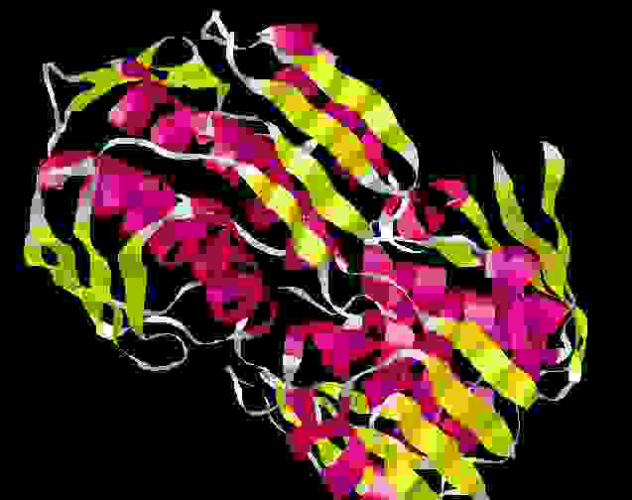
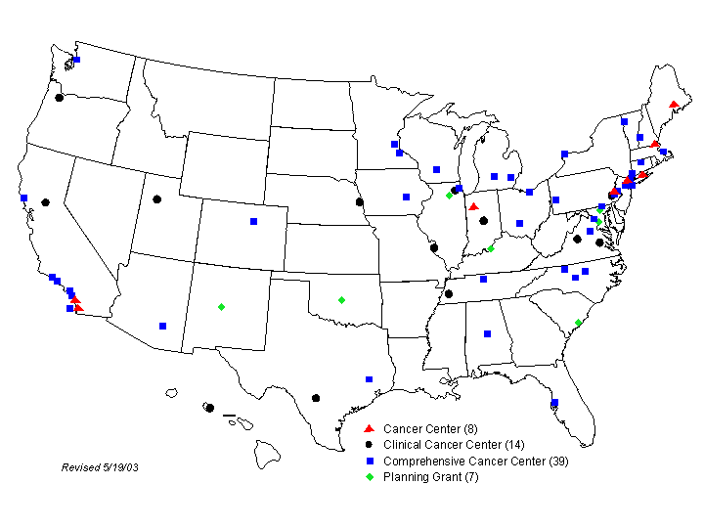


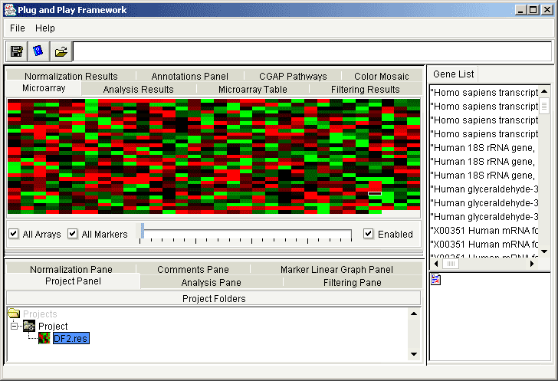
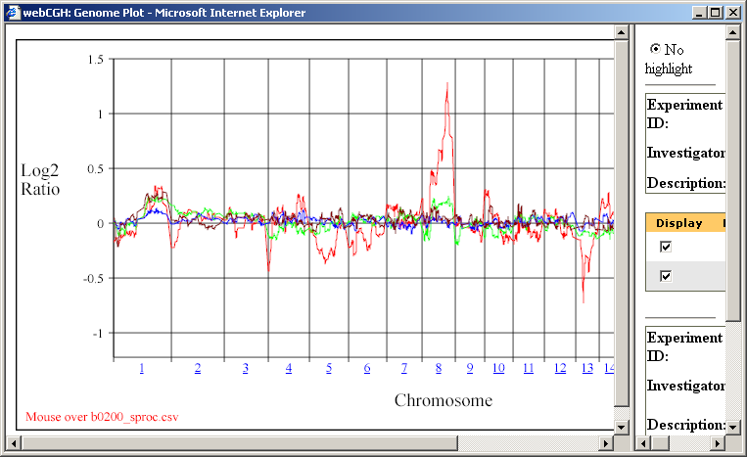
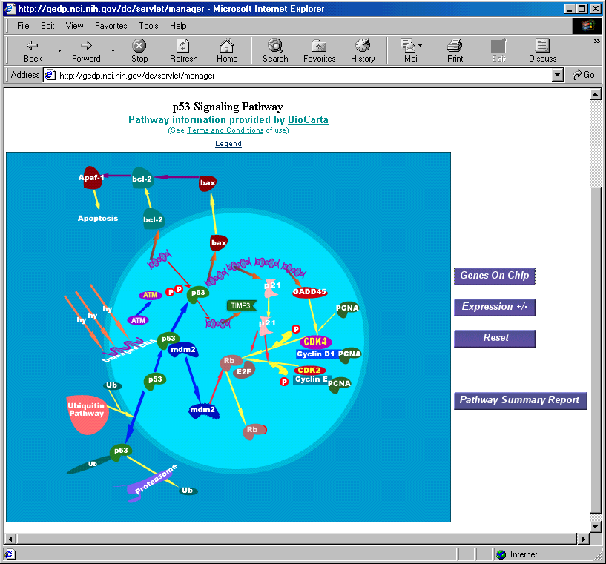
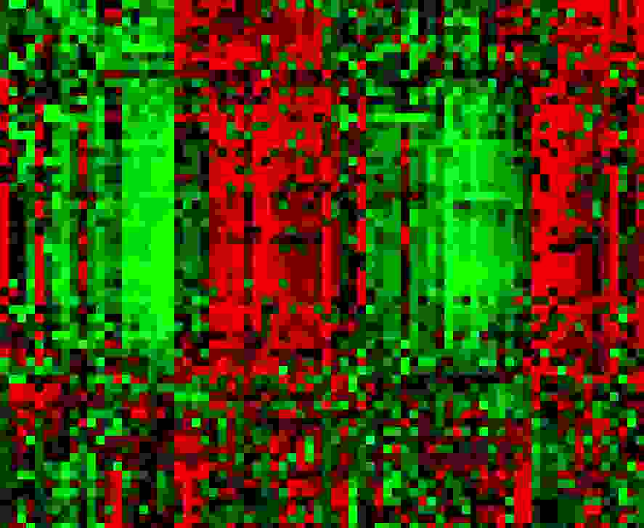
caBIG™ is an innovative bioinformatics program at the NIH’s National Cancer Institute
Common, widely distributed
infrastructure permits
research community
to focus on innovation
Shared vocabulary, data
elements, data models
facilitate information exchange
Collection of interoperable applications
developed to common standards
Biomedical research data will be available for mining and integration
The principles driving caBIG™ are:
  Open Source
  Open Access
  Open Development
  Federation

Slide 5

caBIGTM Compatibility Guidelines
The caBIG™ compatibility guidelines are the program’s guiding principles of interoperability.
The caBIGTM compatibility guidelines are designed to ensure that systems can both access and use information from other such systems.
Since achieving interoperability is a process, caBIGTM recognizes three levels of compatibility
  Bronze
  Silver and
  Gold (fully interoperable)
https://cabig.nci.nih.gov/guidelines_documentation/

Slide 6
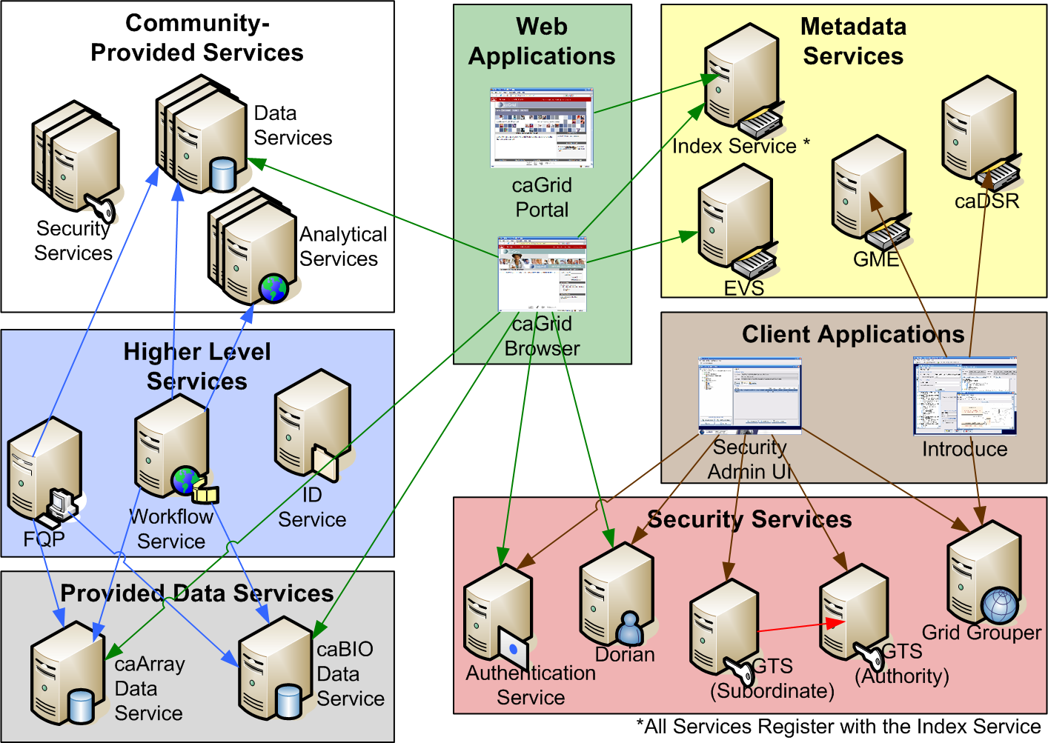
caGrid – “The grid”

Slide 7
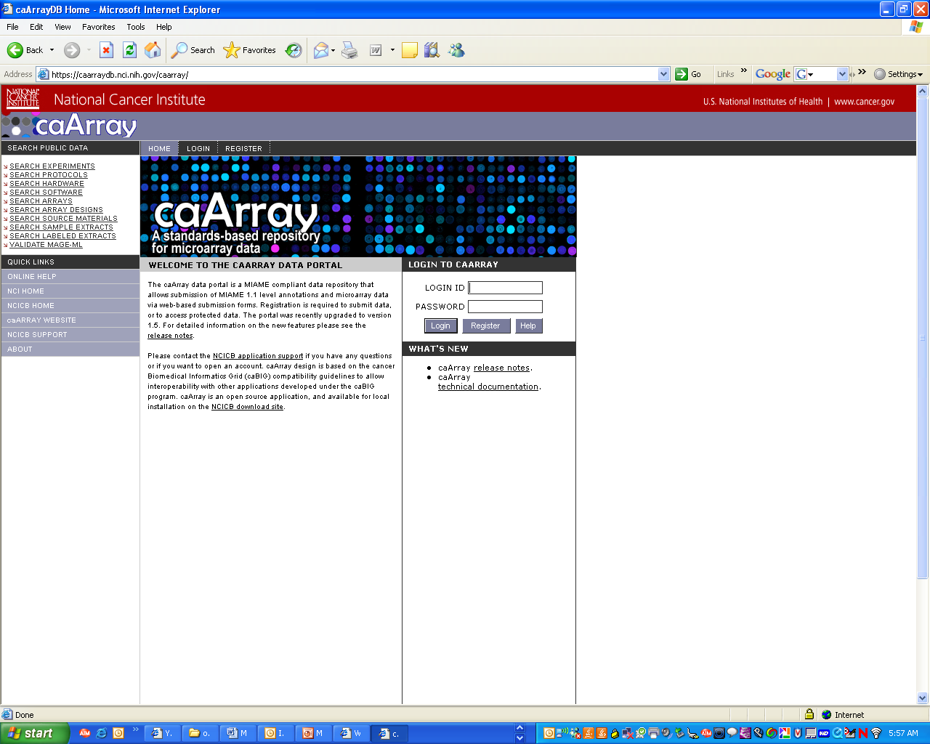
Overview of caArray
caArray is a caBIG™-compliant microarray data repository at the NCI CBIIT
First released in January, 2003; currently v1.5
Supports MIAME compliant experiment annotation
Structure of the repository based on MAGE; vocabularies from MGED Ontology
Developed to support a federated model of microarray data sharing

Slide 8
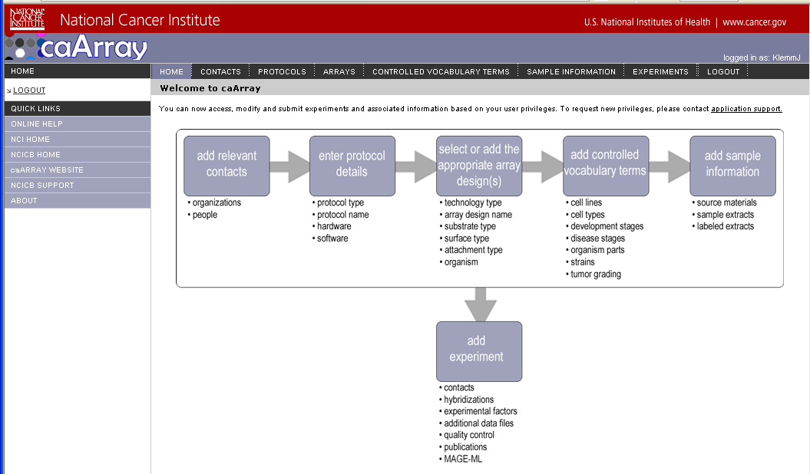
Key Features of caArray 1.5
Data entry via
  Web interface for experiment annotations
  Upload applet for native hyb files
  MAGE-ML import (caAMEL)
Supported file formats
  Affymetrix
  GenePix
  ImaGene
  Illumina
  Agilent
Data query and download via
  Web interface to query for experiments; download native files
  MAGE-OM API to acquire hyb data as a BioDataCube
  MAGE-OM-based grid service on caGrid 1.0

Slide 9




Selected analytical applications compatible with caArray
 | Brings together analysis and visualization tools for gene expression, sequences and pathways
 | A platform for integrated access to 65+ data analysis and visualization modules
 | An open-source collection of software packages for high throughput genome analysis
Cytoscape | Overlay gene expression data on pathways and visualize the results
VIsual Statistical Data Analyzer (VISDA) | An analytical tool for cluster modeling, visualization, and discovery
Distance-Weighted Discrimination | Performs statistical corrections to reduce systematic biases

Slide 10



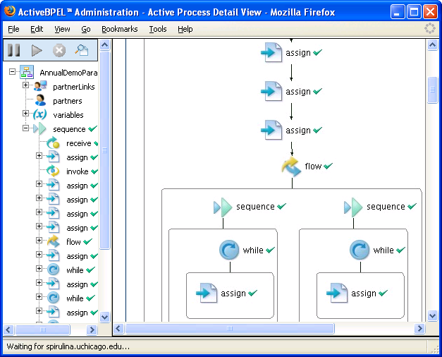
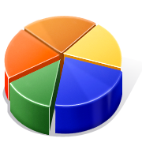
caGrid Workflow Engine
Workflow
Results
caGrid Data
Services
caGrid
Application
BPEL
Engine
caGrid Analytical
Services

Slide 11
Next generation of caArray – 2.0
Address Adopter feedback gained from our 1.x experience
  Improve the user experience for storing and retrieving data produced
  Simplify and improve the performance of data access through the API and grid service, for analytical applications
  Integrate with caBIG™ tissue repository (caTissue) and annotation repository (caBIO)
  Support additional array platforms, including SNP arrays
  Organize the application around workflow between investigators and the labs that serve them
Use an agile software development approach that will allow more frequent feature additions and better responsiveness to the user community

Slide 12
Key changes for caArray 2.0
 | caArray 2.x | caArray 1.x
Bulk data import | MAGE-TAB | MAGE-ML
API | Objects to support MAGE-TAB; harmonized with other caBIG™ models | MAGE-OM
Supported platforms | Expression arrays, SNP arrays | Expression arrays
Workflow | Capture information over the lifetime of the experiment | Capture information at the end of the experiment

Slide 13
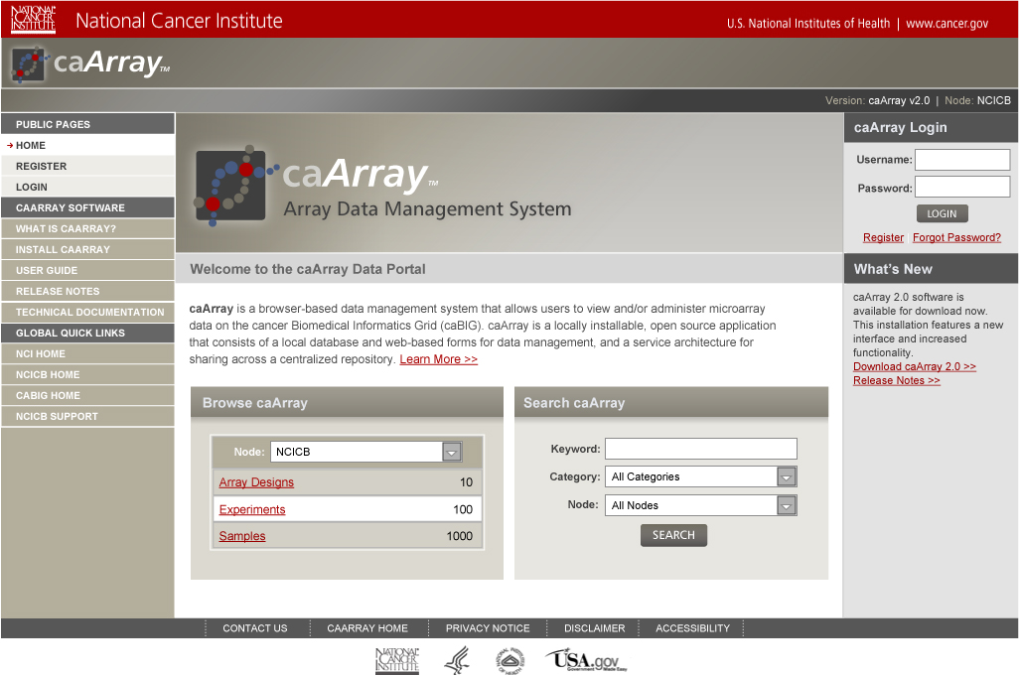
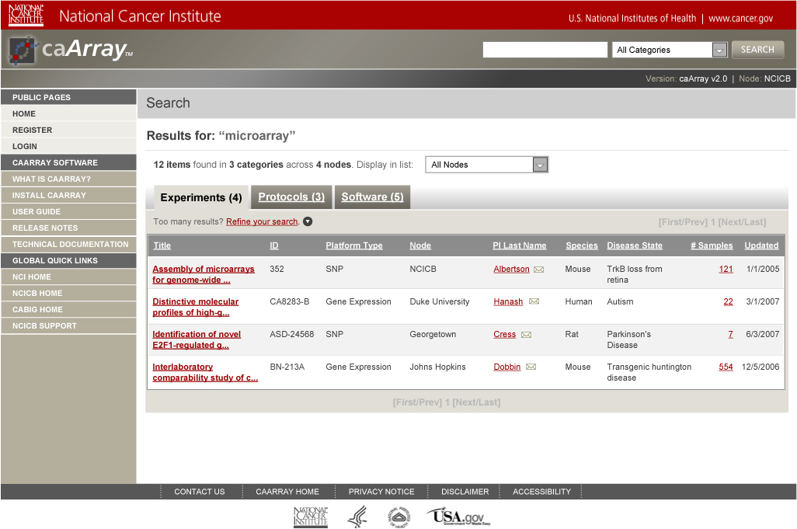
Sneak peek at wireframes…

Slide 14
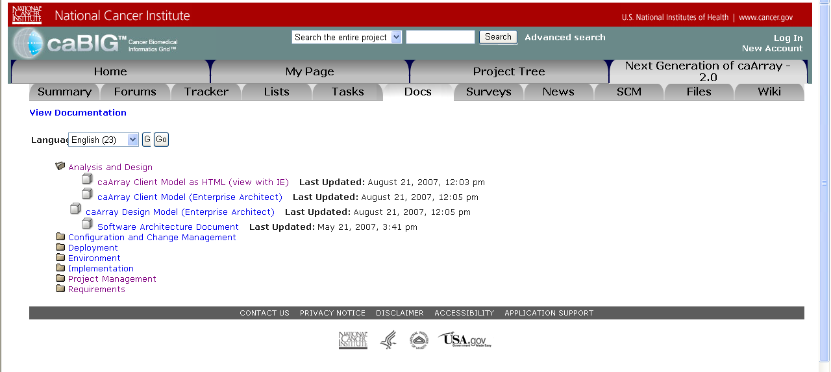
Get involved!
caArray Users mailing list – subscribe at:
https://list.nih.gov/archives/caarray_users-l.html
  Regular updates about releases
Monthly teleconferences to provide status and collect feedback
All caArray 2.0 development artifacts are available at:
  https://gforge.nci.nih.gov/projects/caarray2/

Slide 15





Grid Federation
caArray
caArray
caTissue
Data Mart
caCORE
- caBIO
- caDSR
- EVS
NCICB
Research
Center
Researcher
Data Mart
Clinical Data
Patient
Physician
Bioconductor
Clinical Data
caArray
Research
Center
Proteomics
Data
geWorkbench,
GenePattern
Research
Center
Genomics
Data
caArray and caGrid 1.0
Open, multi-institutional data sharing, annotation and
analysis environment
caArray: data service, NCICB
GenePattern: analytical service, Broad Institute
GeneConnect: data service, Washington University
GridIMAGE: analytical service, Ohio State University
geWorkbench: analytical service, Columbia University
caTRIP: data service, Duke Comprehensive Cancer Center
Bioconductor: analytical service, Fred Hutchinson Cancer Center

Slide 16

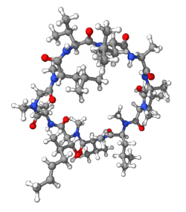
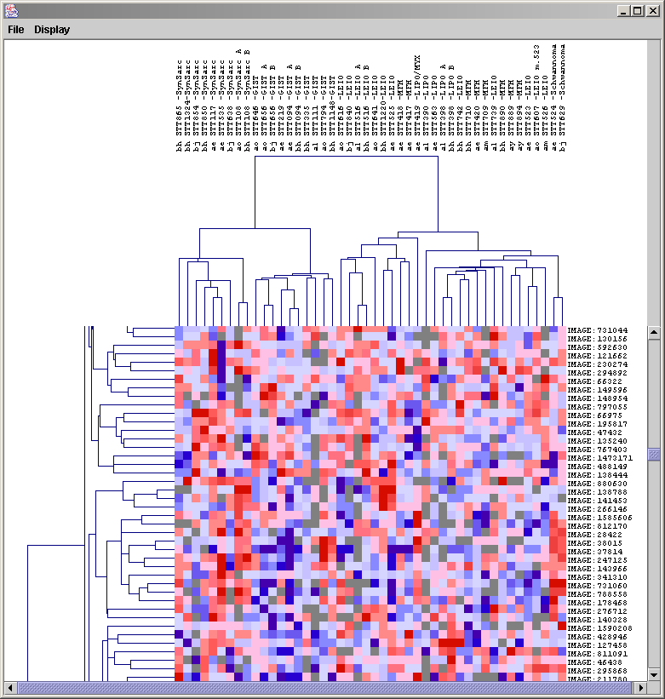
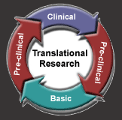
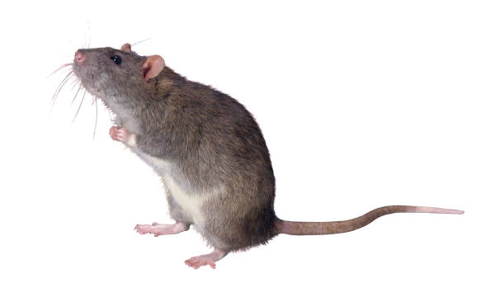
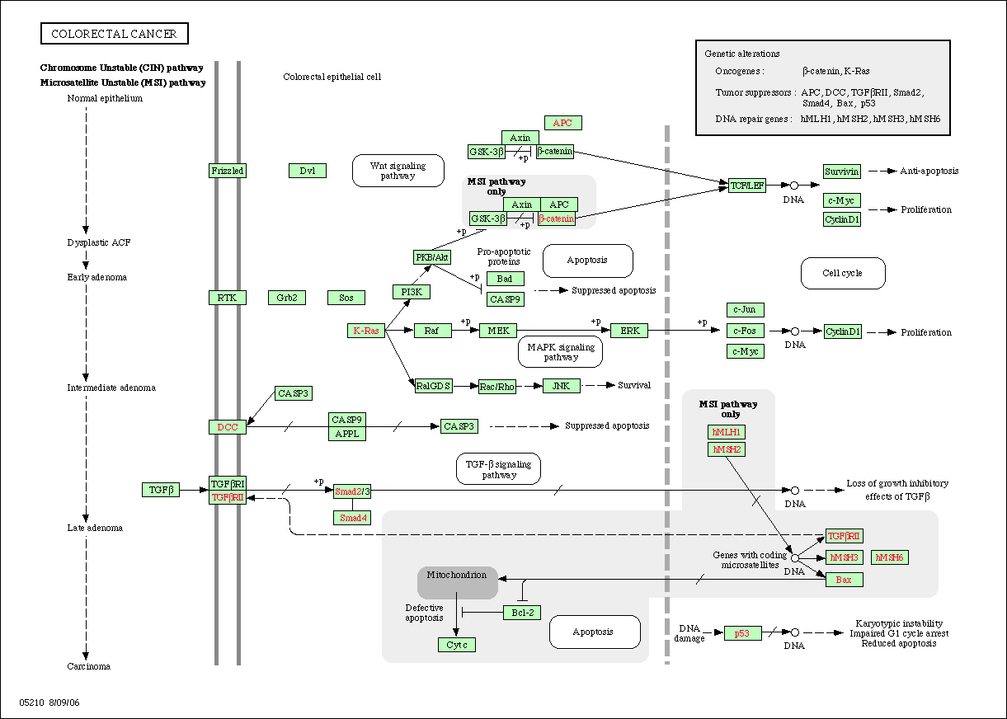

Enabling translational research

Slide 17
Acknowledgments
Software Engineering
  Anand Basu (NCI)
  Brent Gendleman (5AM)
  Steve Matyas (5AM)
  Eric Tavela (5AM)
  Todd Parnell (5AM)
  Bill Mason (5AM)
  Rashmi Srinivasa (5AM)
Quality Assurance
  George Komatsoulis (NCI)
  Jenny Glenn (NARTec)
  Ron Keene (NARTec)
  Tom Boal (NARTec)
  Ye Wu (SAIC)
Project Management
  Jerry Eads (NTVI)
Community Alliance
  Mervi Heiskanen (NCI)
Application Training and Support
  Don Swan (TerpSys)
Data Curation
  Xiaopeng Bian (NCI)
Documentation
  Jill Hadfield (NCI)
Systems Support
  Chris Crowley (TerpSys)
  Keith Ober (TerpSys)
EVS
  Gilberto Fragoso (NCI)
CBIIT Leadership
  Ken Buetow (NCI)
  Peter Covitz (NCI)

