Slide 1


The caArray Models Rashmi Srinivasa September 29, 2010
caArray User Community Meeting
2.2.0 Feature Overview and Review of MAGE-TAB Update and Export Specification
Notes:
1

Slide 2
Two models
Internal domain model
External model exposed via the service API

Slide 3
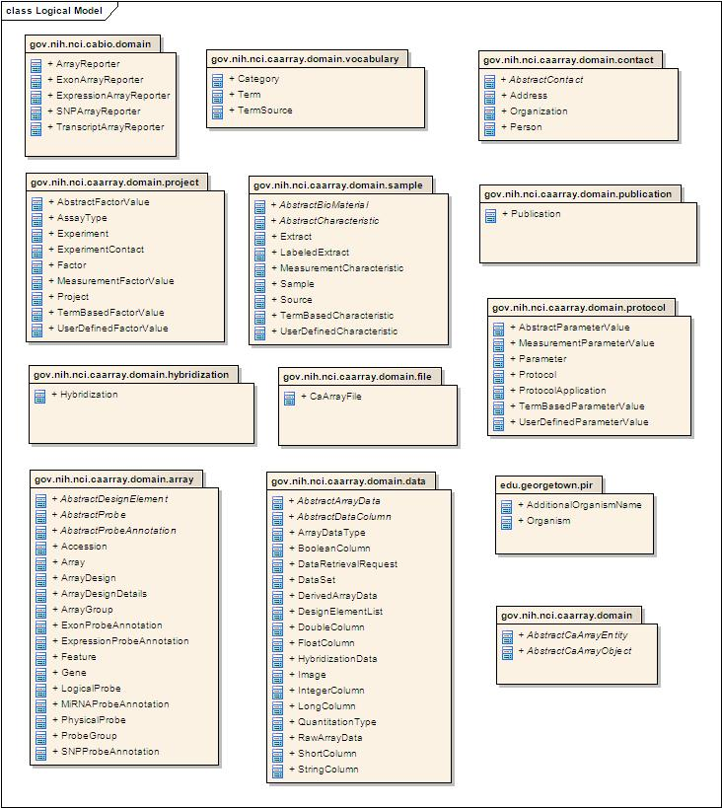
Internal Domain Model

Slide 4
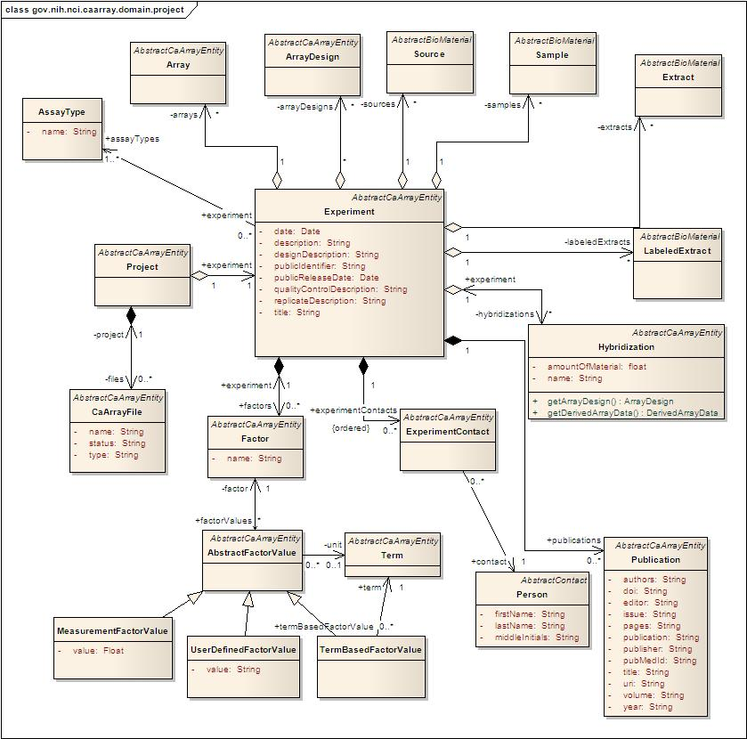
Experiment

Slide 5
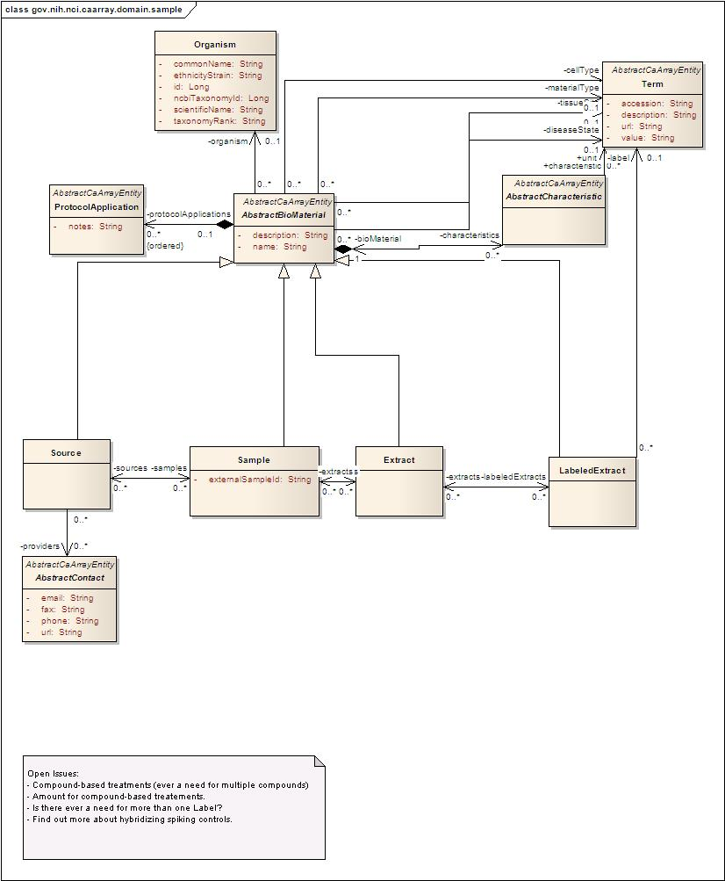
Sample

Slide 6
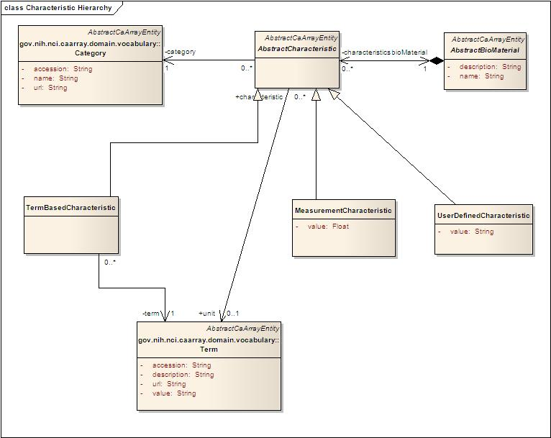
Characteristics

Slide 7
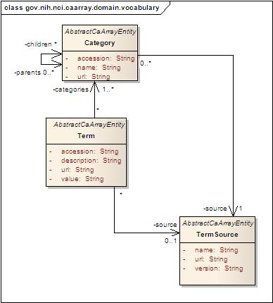
Controlled vocabulary

Slide 8
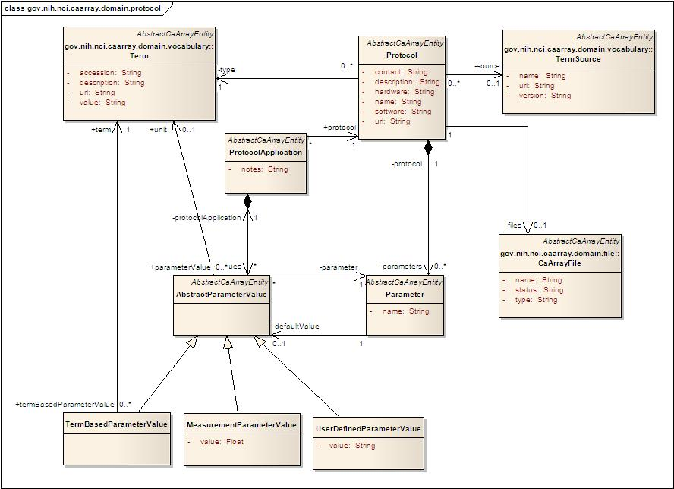
Protocols

Slide 9
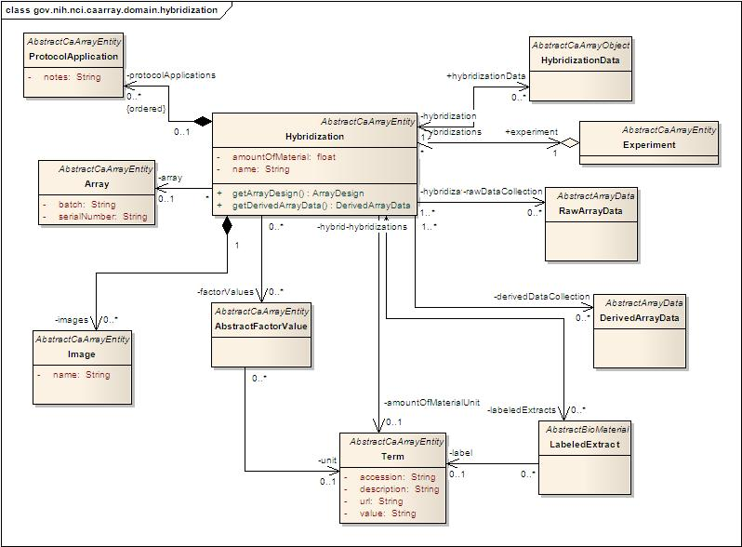
Hybridization

Slide 10
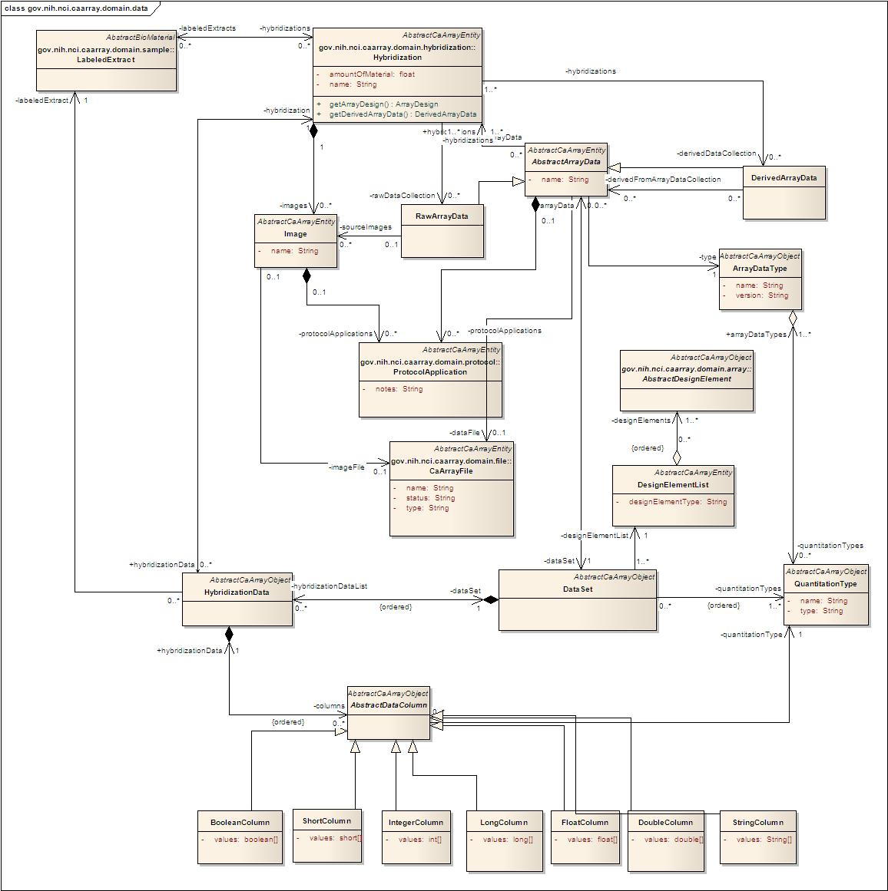
Data

Slide 11
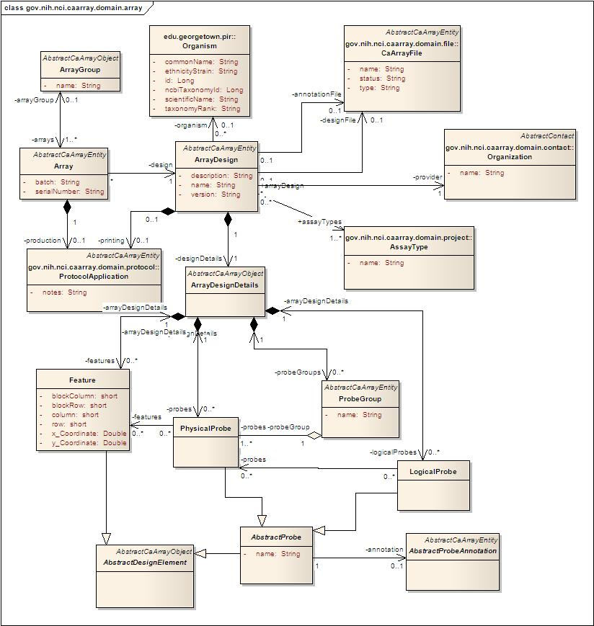
Array

Slide 12
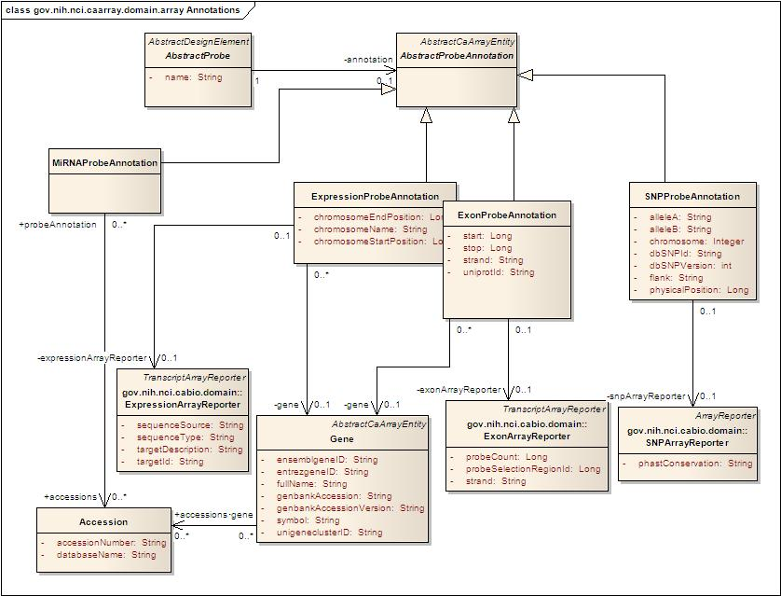
Array Annotations

Slide 13
External Model
Exposes a subset of elements
Optimized for API queries

Slide 14
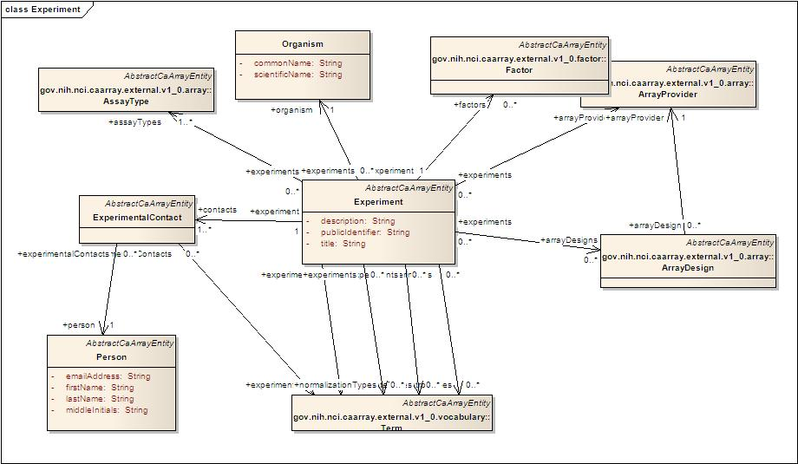
Experiment (external)

Slide 15
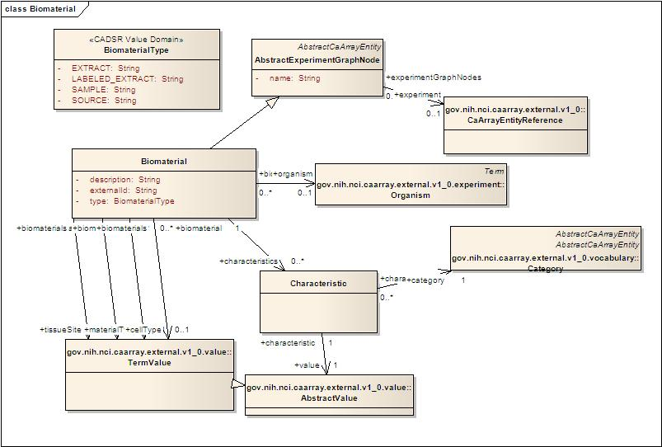
Biomaterial (external)

Slide 16
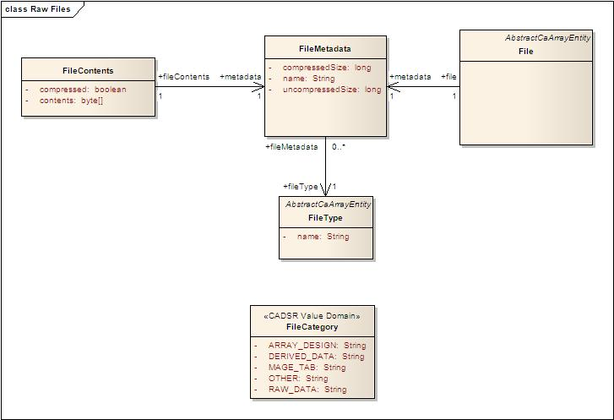
Native files (external)

Slide 17
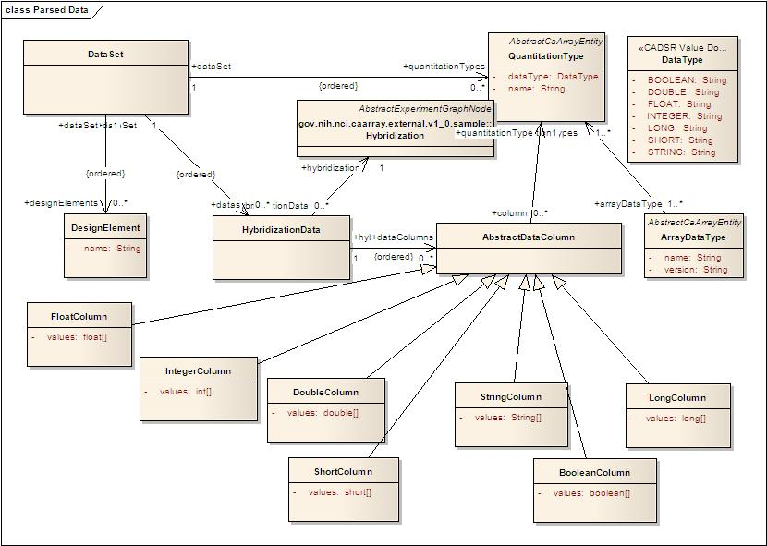
Parsed data (external)

Slide 18
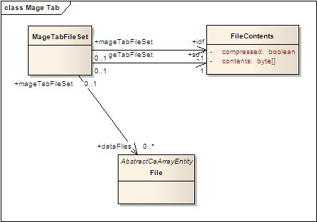
MAGE-TAB (external)

Slide 19
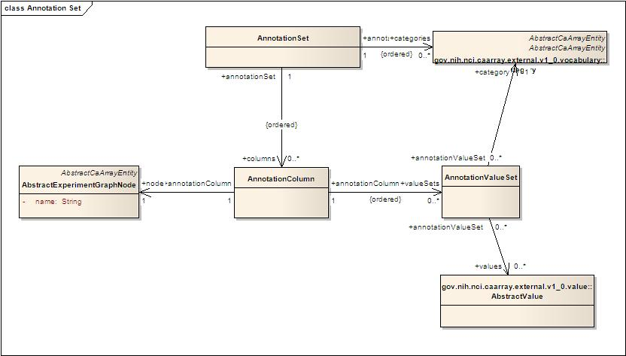
Annotation set (external)

Slide 20
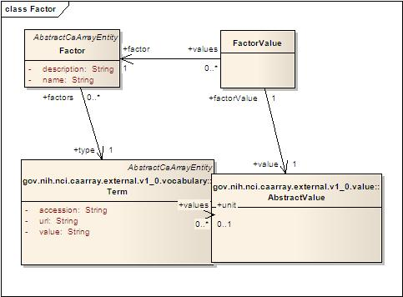
Factors (external)

Slide 21
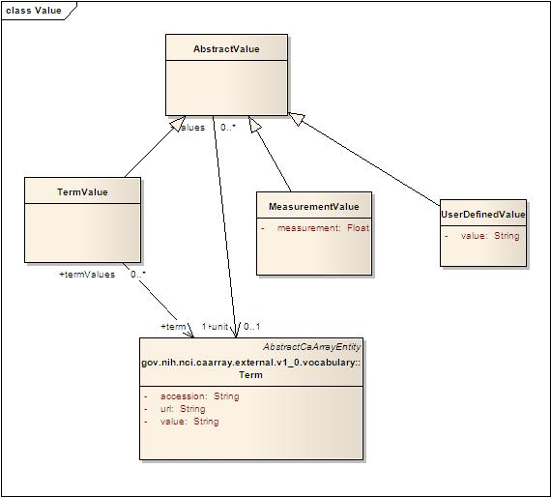
Values (external)
Used for factor values, characteristics and protocol parameter values

Slide 22
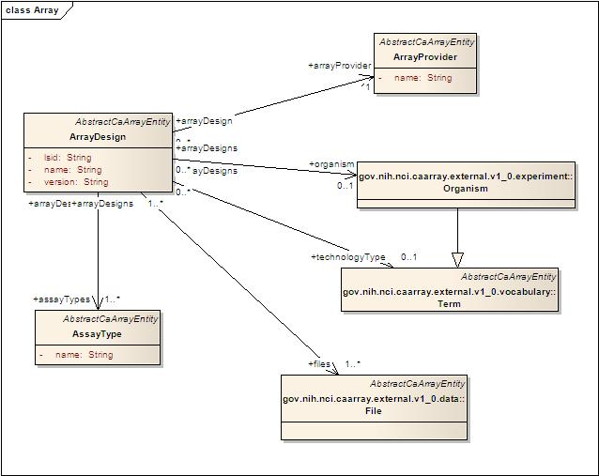
Array (external)

Slide 23
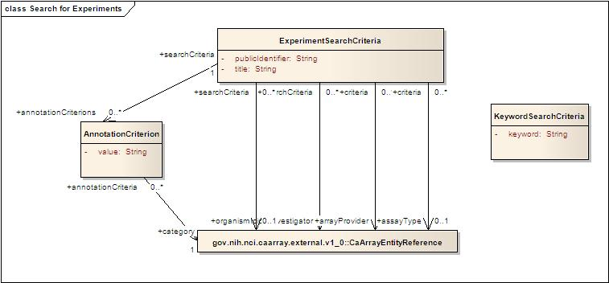
Query (external)
Search for experiments

Slide 24
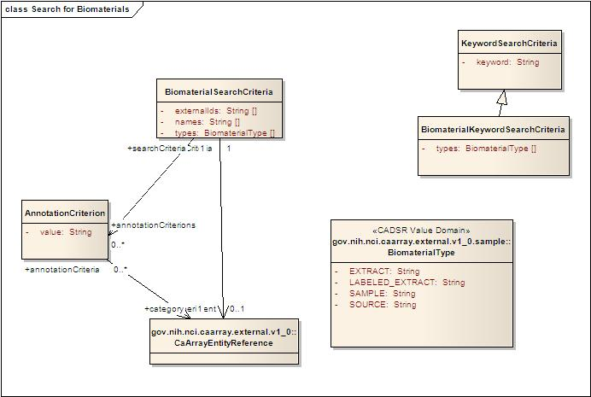
Query (external)
Search for biomaterials

Slide 25
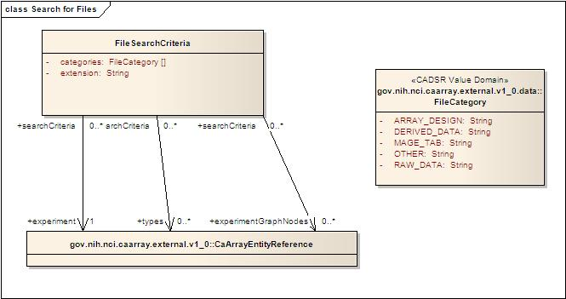
Query (external)
Search for files

Slide 26
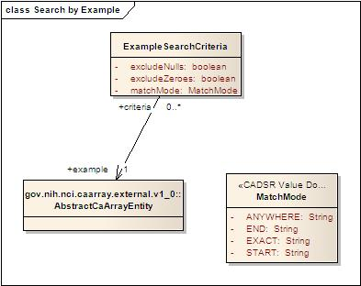
Query (external)
Search by example

Slide 27
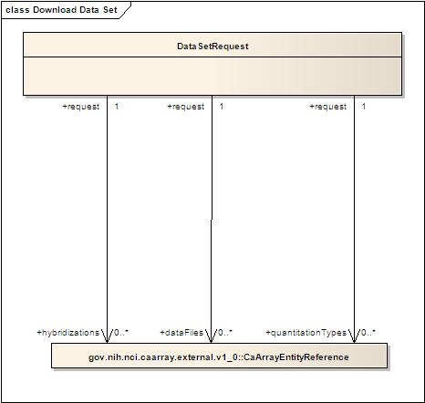
Query (external)
Download data sets

Slide 28
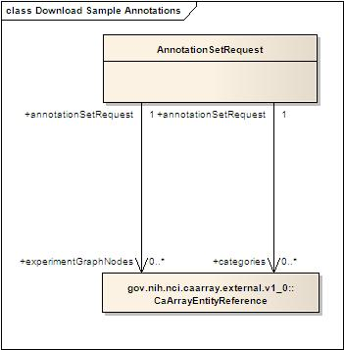
Query (external)
Download annotation sets

Slide 29
References
Internal domain model
http://gforge.nci.nih.gov/caarray2/trunk/docs/analysis_and_design/models/caarray_internal_model.eap
External model exposed via service API
http://gforge.nci.nih.gov/caarray2/trunk/docs/analysis_and_design/models/caarray_service_model_v1_0.eap

