Slide 1

caArray 2.0
Inception Review
Notes:
Post mortem title

Slide 2

Before we begin
In Case Anyone Feels Intimidated…
  The caArray Development team uses Iteration Postmortems/Reviews as a means to improve – Our Process, Our Products, and Ourselves
  “Regardless of what we discover, we must understand and truly believe that everyone did the best job he or she could, given what was known at the time, his or her skills and abilities, and the situation at hand.”
    Norman Kerth, from Project Retrospectives, a Handbook for Team Reviews

Slide 3
Goals of Any Postmortem
Reveal and Share the Gold:
  What worked well that we don’t want to forget
  What we learned
  What we should do differently next time
  What still puzzles us
  What we need to discuss in greater detail
Notes:
Note: Kerth recommends tracking each of these on a flipchart/whiteboard as the postmortem progresses.

Slide 4
Iteration Characteristics
Project Name | caArray 2.0
Customer | NCICB
Iteration Name | Inception 1
Started | 04/02/2007
Finished | 05/16/2007
Binary Result | In progress
Team Size | 4
Notes:
Feel free to add any externally consumable metrics as needed. Also, be sure to reference the Project Metrics.xls that should be up to date at this point with metrics you are collecting for this project.

Slide 5
Players
Development Team – Brent, Eric, John, Rashmi
Product Management – Juli,
Community Relations - Mervi
Engineering Management – Anand
External Stakeholders – see Vision section Stakeholders
Internal Stakeholders to be involved more
  QA, App Support, Suba and Xiaopeng
Notes:
Put org charts, people and roles, and other stuff like that here. Be sure to include BLS/PPI Staff, Important Stakeholders (e.g.,Business Users) and Contractors. Only list those that participated in this iteration.

Slide 6
Goals of Iteration
Establish the Vision of the Product
Elicit and Prioritize the Requirements
Establish a representative and maintainable Use Case Model
Review and Update the Architecture
  Against the current application
  Supporting caBIG-wide elements and tools
Build out an initial prototype of the to be architecture
Create a maintainable environment
Coordinate with QA a use case oriented approach for traceability and testing
Notes:
Author: Put Goals from Iteration Plan here.

Slide 7
Risks to Be Mitigated
caArray perception in the community and internally is laced with failure to meet expectations
Procedural and organizational change
Lack of detailed awareness of who and what is using caArray as a data source
Balance current user needs and requests for 1.5 against the desire to release a new version
Timing of the 2.0 release and pressure to get it
Notes:
Author: Put Risks to Be Mitigated from Iteration Plan here.

Slide 8
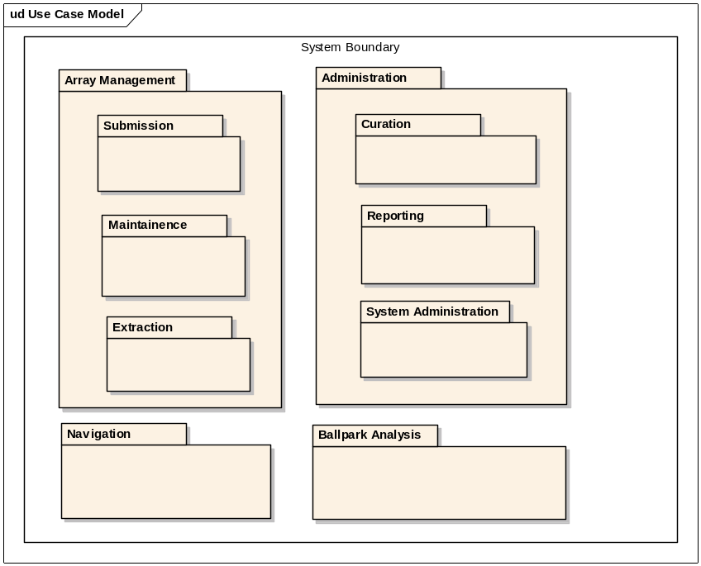
Use-Case Fill Levels
This will be completed at the end of Inception
Current packaging is displayed
Likely to be refined based on Stakeholder input
Notes:
Author: Put a use-case diagram (hopefully in iteration plan as well) that is color coded or fill patterned to show use-cases that were:
Previously implemented
Implemented Partially during this iteration
Implemented Fully during this iteration
Leave all TBD and Wish List use-cases in their subtle form

Slide 9
Success Criteria
Clearly articulated requirements that have been prioritized by the user community and the Product Manager and validated by independent QA for testability
A supporting architectural design that can meet the requirements stated
A running prototype that tests the proposed design
A stable development environment that can support the automation of deployment requests and testing
A reasonable plan for the next iteration and version 2.0 as a whole with a 5-month lifecycle.
Notes:
Author: Put success criteria from Iteration Plan here.

Slide 10
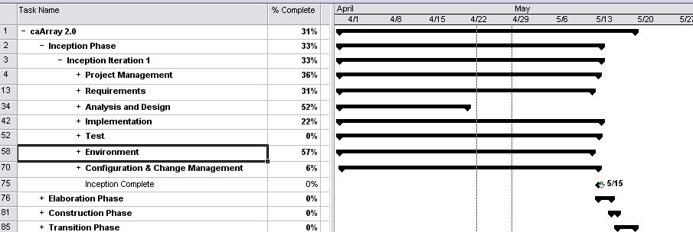
Project Manager’s View of the Iteration
Overall progress is solid
  Vision and use case documentation is behind, but… stakeholder meetings are confirming our direction
  Analysis and Design activities are on schedule
  Implementation – unusual for Inception – is also on schedule
Notes:
Author: Put Project Manager’s Assessment here.
Feel free to use multiple slides.
Bear in mind our overall goals of the postmortem. Focus on project management issues and:
What worked well that we don’t want to forget
What we learned
What we should do differently next time
What still puzzles us
What we need to discuss in greater detail
This will conclude the manager’s portion of the presentation.
They should hand off to the Lead Architect.

Slide 11
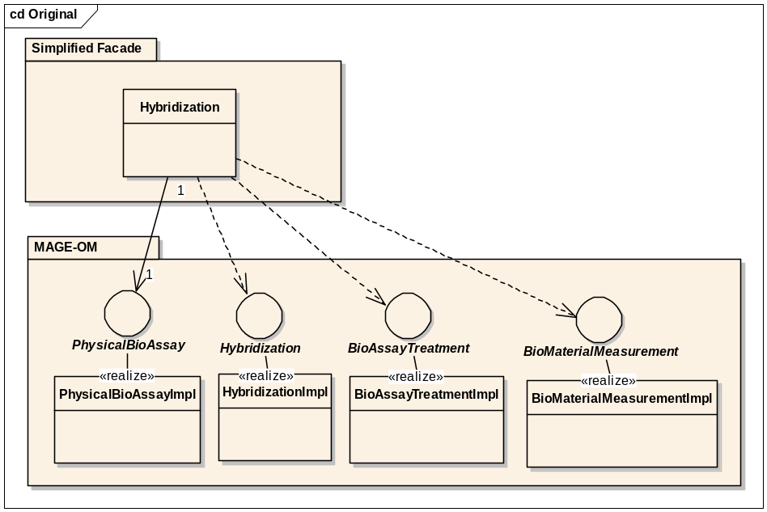
Architecture Review - Simplified Façade
Approach
  Underlying data stored as MAGE-OM objects with front-end façade classes hiding the complexity
Pros
  Simpler data migration
  Easier to implement MAGE-OM API and MAGE-ML Import
Cons
  Façade objects often require complex logic to manage underlying MAGE objects
  Difficulties getting caCORE generated classes to match existing interfaces.
  Cyclic relationships and size of MAGE model makes remote navigation of MAGE objects problematic

Slide 12
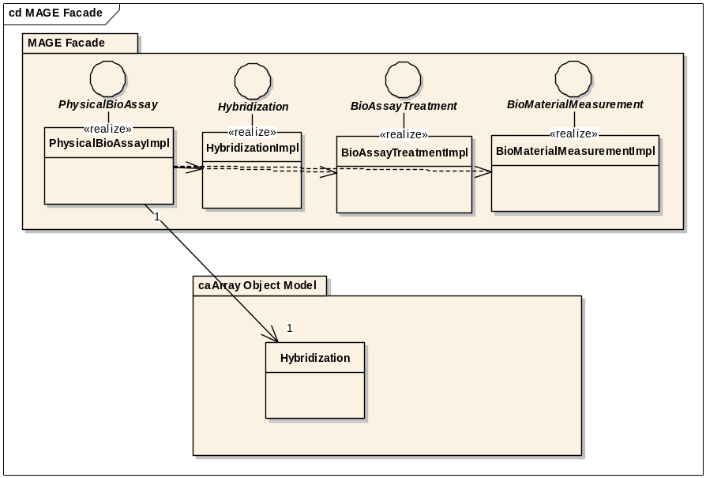
Architecture: MAGE-OM Façade
Approach
  Data managed and stored as simplified object model. MAGE-OM clients use façade objects that provide a MAGE-based view of the underlying data.
Pros
  MAGE view of simplified model relatively easy to implement
  RMI clients receive performance advantages of simplified model
Cons
  Data migration more difficult
  Can’t take advantage of code generation for MAGE-OM classes
  MAGE-ML import and grid implementation would likely need different MAGE implementation classes

Slide 13
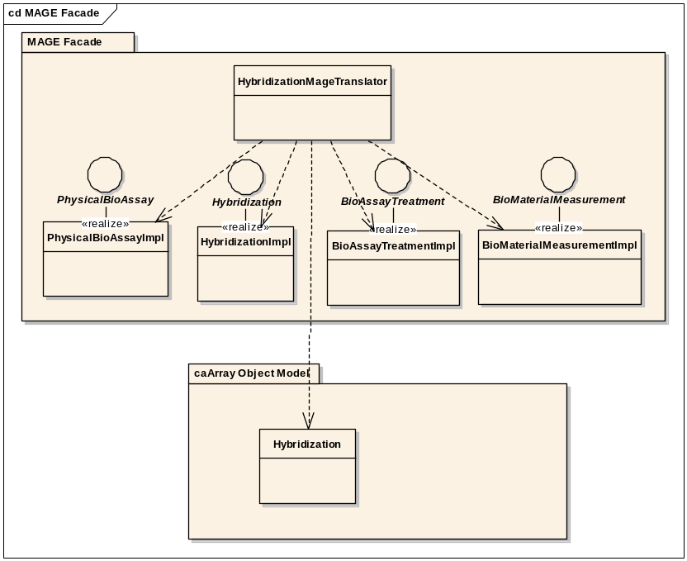
Architecture: MAGE-OM Translation
Approach
  Data managed and stored as simplified object model. Translation classes instantiate a MAGE-OM based view for clients that require it.
Pros
  Better separation of concerns
  Can use code generation tools for both simplified and MAGE-OM classes.
  MAGE classes can be used for MAGE-ML import and remote clients.
Cons
  Data migration and MAGE-ML import still more difficult to implement than if data represented in MAGE

Slide 14
Closing Topics
Unexpected Topics and Questions
Review what needs to be discussed in more detail
Any issues/questions resolved today
What’s next
Notes:
This one goes back to the project manager to put it all together.

