Slide 1
caB2B features
Rakesh Nagarajan

Slide 2

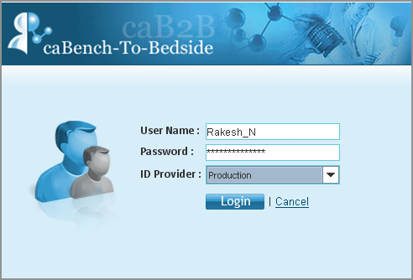

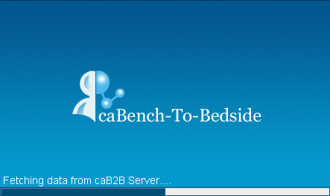
Login using grid identity
username-password
SAML Assertion
Authentication Service / Identity provider (IdP)
SAML Assertion
Proxy Certificate
Lauch caB2B
Dorian
caB2B launch screen

Slide 3
User friendly spread sheet
Add user defined column to data
Advanced filtering (Range, Pattern, List)
Save subset of data as data category
Export selected data in CVS format
Copy paste and column movements
Dynamic menu bar
Allows selecting specific rows
Can hide/unhide columns, get more details

Slide 4
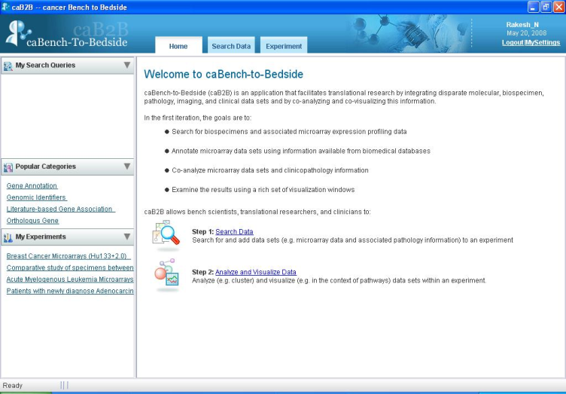
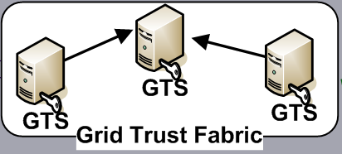
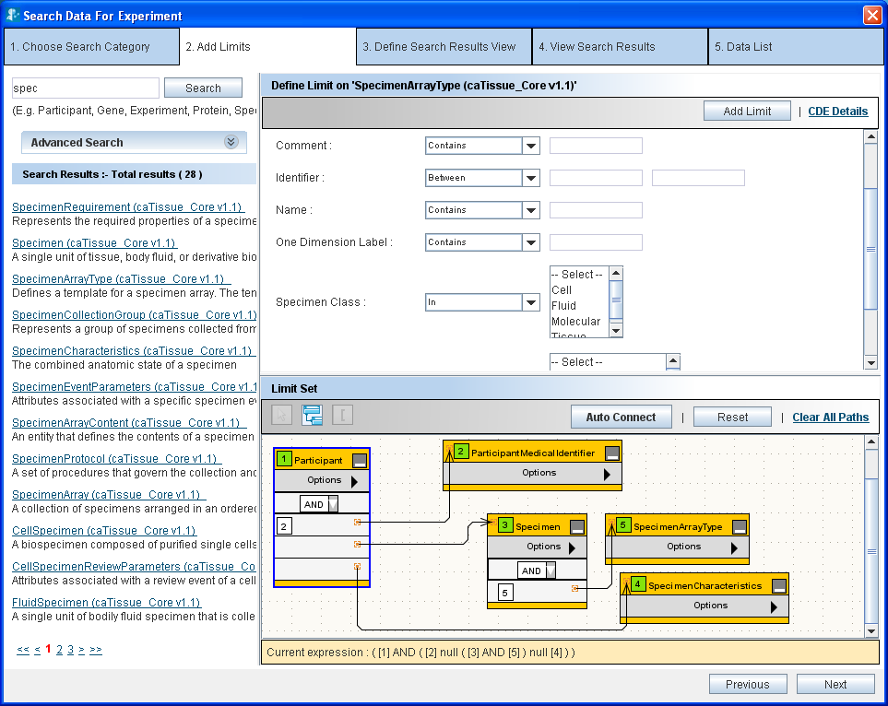
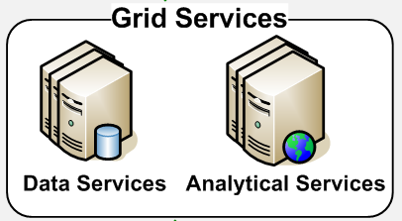
Access secure data
caB2B user interface
Trust validate / authenticate
Invoke
data
Metadata based query

Slide 5
Web base administration

Slide 6
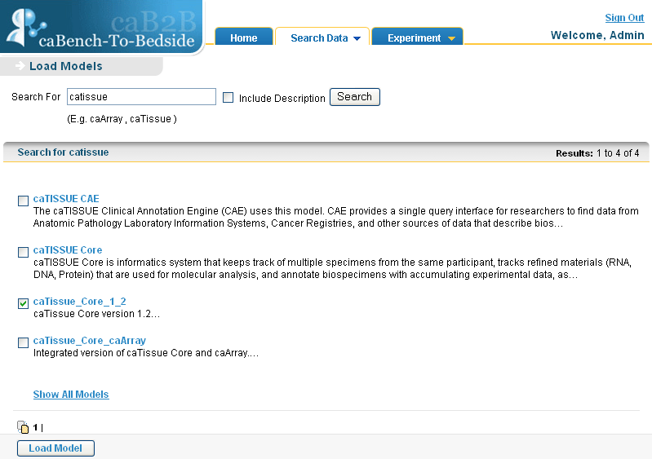

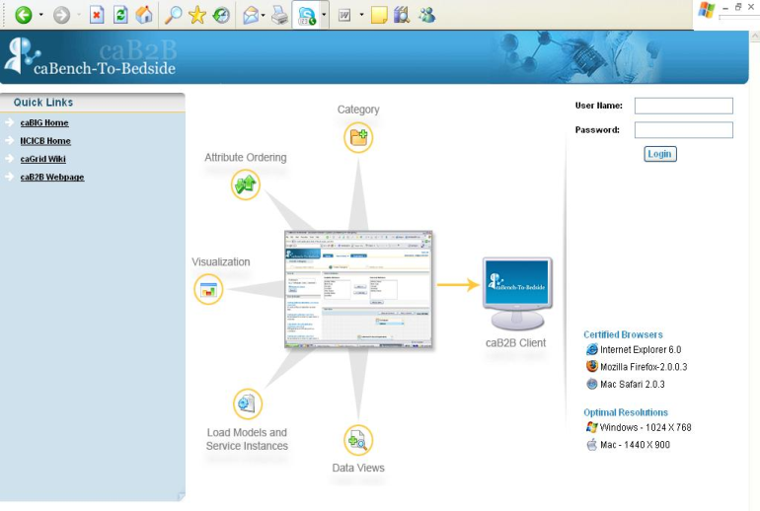

Load models from caDSR
caB2B
MDR
Select models to load
Fetch selected model
Get all Model names
Administrative interface

Slide 7
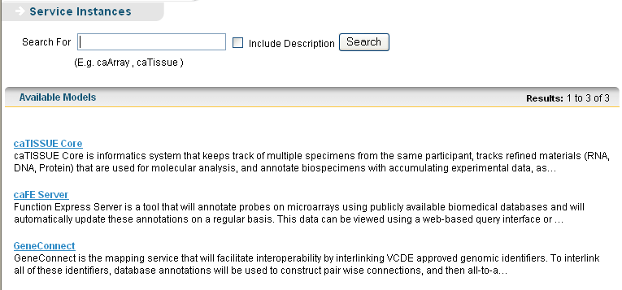
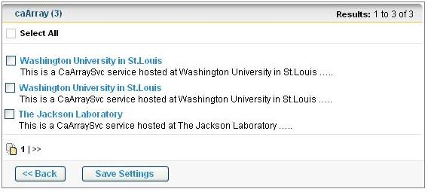



Discover services dynamically
Select models to discover services
Select service instances
Discover data services by domain model
caB2B
MDR
Get already loaded Models

Slide 8
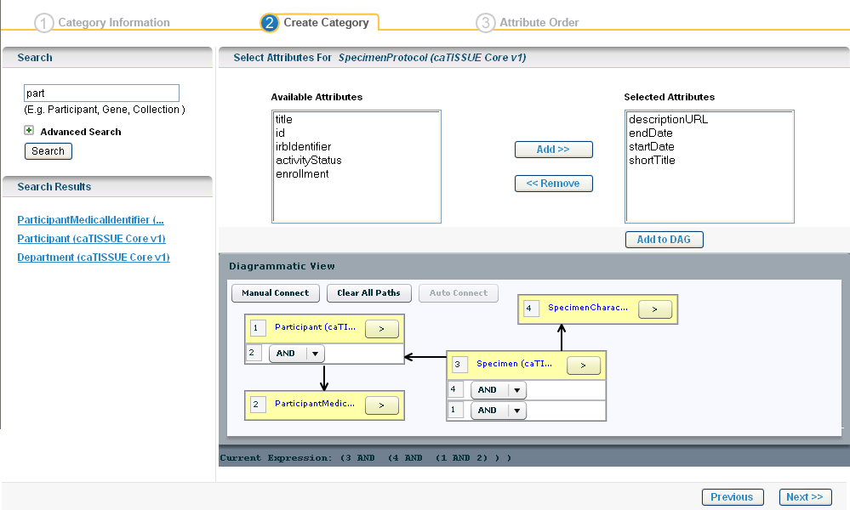
Create Category

