Slide 1
caCIS Security Architecture
caCIS Team
Aug. 24th, 2011

Slide 2
Agenda
caCIS Security Architecture – Overview
Security for each architectural component
  Source System to Semantic Adapter
  Semantic Adapter to Integration Platform
  Integration Platform to Clinical Data Warehouse
  Clinical Data Warehouse to End User Query Interface
  Document Router to Recipient via XDS
  Document Router to Recipient via Secure Email
  Document Router to Recipient via Secure File Transfer

Slide 3

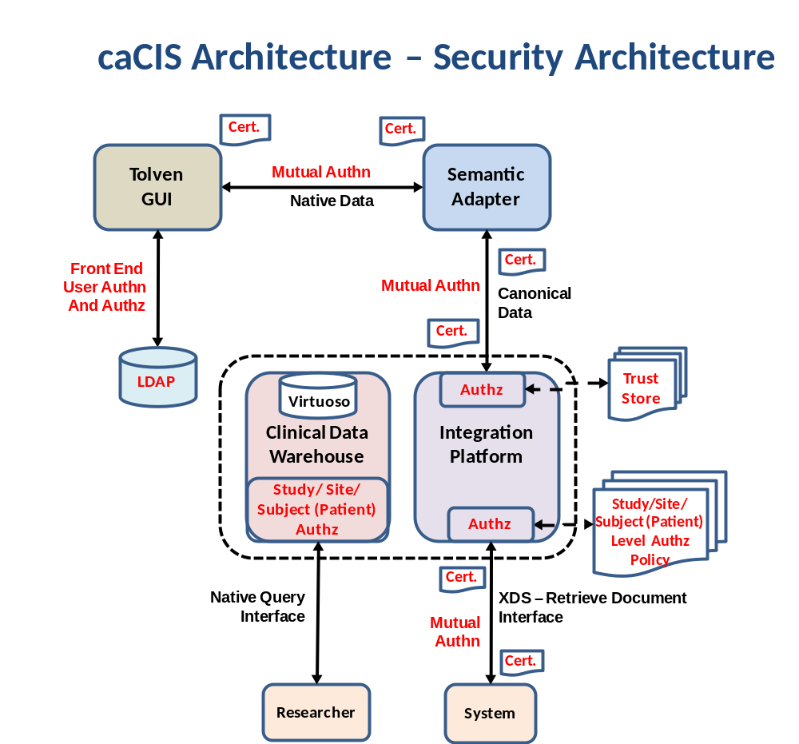

Slide 4
caCIS Security Architecture - Overview
Supports system level security using digital certificates (X.509)
All communication channels in the solution will be secured and encrypted (as required by HIPAA)
  Clinical systems to semantic adapter
  Semantic adapter to integration platform
  Document interface (XDS) to recipient system
Authorization is enforced using
  Digital Certificate Identities for the Document Interface
  User Ids for CDW Query Interface
Inbound interface of the integration platform will accept data only from authorized source system’s SA
  Enforced by trusting only authorized digital certificates

Slide 5
caCIS Security Architecture - Overview
All clinical data is stored on an encrypted file system within the entire solution (For FISMA, HIPAA etc.)
XDS Document Interface and CDW Query Interface enforce the authorization policies at the following levels:
  Study Level – Access to all data for a particular study
  Study Site Level – Access to a particular site data for a study
  Subject (Patient) Level – Access to a particular subject data on a specific study at a site
Additionally, XDS Document interface implements a mandatory recipient-level authorization check
  This ensures that only the intended recipients can retrieve the documents
NOTE: The diagram on the next slide depicts the authorization work flow for XDS Document Interface - Recipient-level authorization check is mandatory whereas Study/Site/Patient level granular security is optional

Slide 6
caCIS Integration Platform
4. Retrieve
Document
(DocId)
3. Username /
Password
End User 1
Document Router
1. Publish
Document
OpenXDS
UPenn
System
(Recipient )
End User 2
UPenn
Cert.
End User N
6. Validate
Doc Id And Cert Ids.
Against Sec. Metadata
2. Store Doc Id
And Associated
Metadata
7. Retrieve Certificate’s
Study, Site and Patient Access
Study = “iSPY2”
Site = “UPenn”
Patient = “ABC123”
<ExchangeDoc>
<RIMITS>
</RIMITS>
</ExchangeDoc>
Exchange Metadata Master
Security Authorization Master
Doc Id
Study Id
Site Id
Patient Id
Cert Ids
Study | User ID
iSPY2 | UPenn
: | :
: | :
Site | User ID
UPenn | UPenn
: | :
: | :
Pt. | User ID
ABC123 | UPenn
: | :
: | :
Doc Id
Study Id
Site Id
Patient Id
Cert Ids
Doc Id
Study Id
Site Id
Patient Id
Cert Ids
5. Administrator manually provisions
Study, Site and Patient for the
Certificate id.
Optional Security Component
Security Provisioning
Document Router generates Exchange Document and Metadata and stores it within XDS
Store the Document Id and associated Certificate Ids as well as Study Id, Site Id and Patient Id as Security Metadata
End users log into the UPenn’s System with their local username and passwords and request the document
UPenn’s system connects to the OpenXDS Repository with its certificate and queries the document on user’s behalf passing the document id
This Certificate Id is granted access to appropriate study, site and patient in the security system by the administrator manually
OpenXDS Server validates if the Certificate Id is allowed access on the document
It then proceeds to perform secondary check to ensure that the user UPenn has access to the study, site and patient associated with the document by retrieving them from the Security Authorization Master

Slide 7
Security design for caCIS components
Source System to Semantic Adapter Interface
Authentication
  Mutual Authentication as dictated by ATNA using X.509 Digital Certificates
Authorization
  Only trusted certificates are configured in semantic adapter’s trust store thereby restricting access only to the trusted source systems
Security Features
  The same certificates used for authenticating a source system are leveraged for access control as well
  Requires only a single configuration step for both authentication and authorization
  Uses standard X.509 certificates which can be obtained from any reliable Certificate Authority (including caGrid)

Slide 8
Security design for caCIS components
Semantic Adapter to Integration Platform Interface
Authentication
  Mutual Authentication as dictated by ATNA using X.509 Digital Certificates
Authorization
  Only trusted certificates are allowed access thereby restricting access only to the trusted semantic adapters
Security Features
  The same certificates used for authenticating a source system are leveraged for access control as well
  Requires only a single configuration step for both authentication and authorization
  Uses standard X.509 certificates which can be obtained from any reliable Certificate Authority (including caGrid)
  Allows leveraging HTTP Server to provide SSL security as there is no subsequent custom authorization checks which rely on certificate ids

Slide 9
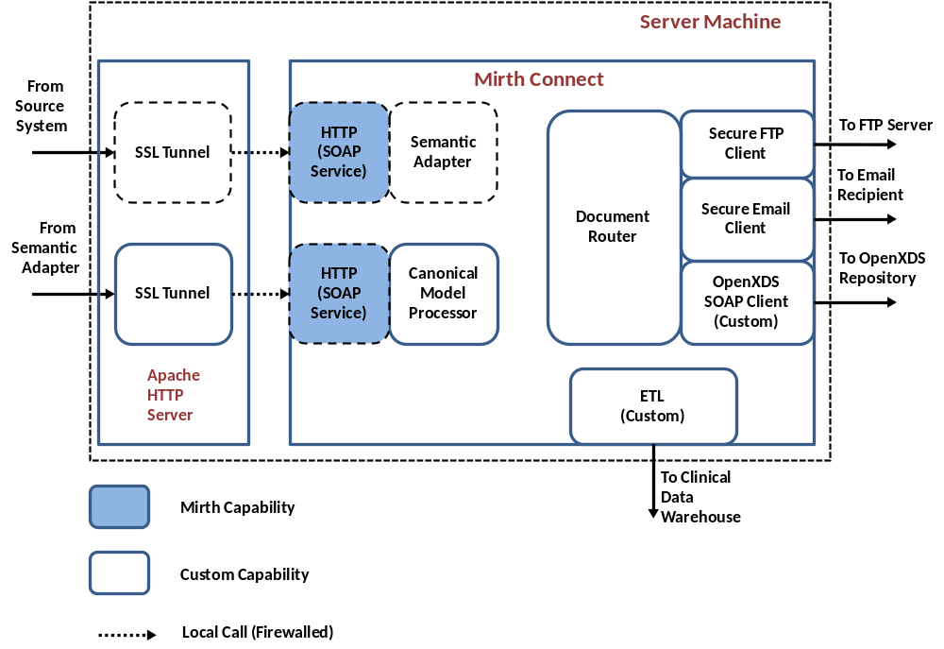
MirthConnect Deployment Alternatives – Option 1
  SSL Tunneling using http server
  No additional development required
  Requires deployment and configuration of the HTTP server to create SSL tunnels

Slide 10
Security design for caCIS components
Integration Platform to CDW Interface
Authentication
  Username and Password to identify the IP as required by Virtuoso’s DB Interface / APIs
Authorization
  Access granted to the IP user to be able to create RDF triples, graphs, graph groups and provision access to existing users
Security Features
  Leverages out of the box security features provided by Virtuoso

Slide 11
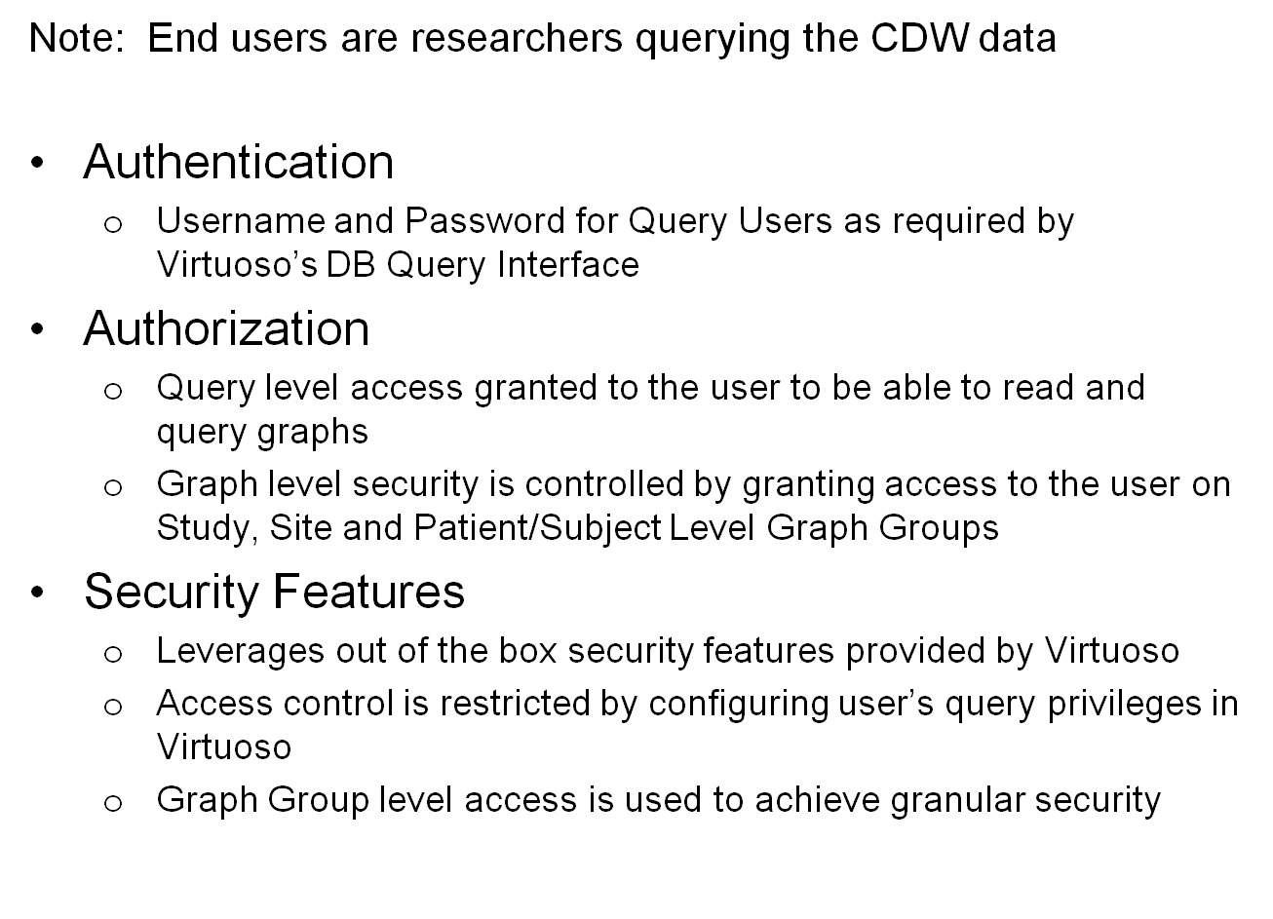
Security design for caCIS components
CDW to End User Query Interface

Slide 12
Security design for caCIS components
Document Router to Recipient via XDS
Note: In case of OpenXDS, document recipient will be a system or a custom client
Authentication
  Mutual Authentication as dictated by ATNA using X.509 Digital Certificates
Authorization
  Recipient level checks performed to ensure intended recipient
  Additional Group level security to enforce Study, Site and Patient/Subject Level checks
Security Features
  Leverages X.509 certificates for Authentication and Authorization
  Group / Role based security employed using database tables
  Extensible to support future / existing group solutions (e.g. Grid Grouper, CSM etc. can be configured as PDPs)

Slide 13
Security Design for caCIS components
Document Router to Recipient via Secure Email
Note: In case of Secure Email, document recipient will be an individual user
Authentication – Not Applicable
Authorization – Not Applicable
Security Features
  Uses S/MIME features to transmit email securely
    Encrypts the message using recipient’s public certificate – This way only the intended recipient can decrypt the message
    Signs the message with sender’s private key – This way recipient can ensure that the message originated from sender (by being able to decrypt with sender’s public key) and is un-tampered during transmission
    Database/Trust store will be leveraged to store recipients public keys

Slide 14
Security Design for caCIS components
Document Router to Recipient via Secure File Transfer
Note: In case of Secure FTP, document recipient will be a system
Authentication
  Mutual Authentication established over SSL using SSL proxy capabilities provided by HTTP Server (Design to be finalized)
Authorization
  Not Applicable
Security Features
  Leverages same HTTP Server used on the inbound side for securing outbound channel

