Slide 1
caCIS Solution Architecture
caCIS Team
June 9th

Slide 2
Agenda
Action Items from Previous Meeting
caCIS Revised Scope
caCIS Proposed Architecture
caCIS Security Architecture
Risks
Assumptions
Recommended Options
Questions

Slide 3
Action Items from Previous Meeting
Assess NCBO Annotation tool for Semantic Mapping - Complete
Revise proposed scope and architectural solution – This presentation
Revise plan to reflect the new scope and resource constraints – This presentation
Circulate TRANSCEND clinical notes - Complete

Slide 4
caCIS: Revised Scope
Security
  Node or user based authentication and authorization using X.509 certificates.
Semantic Adapter
  Support for push/pull from multiple clinical systems
  Designed to support vocabulary mapping and identifier resolution
Integration Platform
  Open Source XDS based implementation – support for XDS Get and NAV.
  Supports generation and transfer of documents (clinical notes) in CDA (Canonical), HL7v2 and RIM ITS formats
  Secure Email and FTP support

Slide 5
caCIS: Revised Scope
  Data Warehouse
  Supports ad-hoc queries and report generation on Clinical Data Warehouse
  Stores all data from TRANSCEND TRIM messages
Canonical Model and Mapping
  Develop a standards based canonical model
  Map TRANSCEND TRIM to canonical model (Clinical Notes and PCO data elements will be mapped)
  Implementation guide for the canonical model
TRANSCEND Deployment
  Deployment of the caCIS integration platform
  Integration and configuration of software at TRANSCEND

Slide 6
caCIS: Out of Scope Items
ECCF Specifications
CQL Support
User initiated document requests that are propagated to the source system
Aggregation and integration of document sections – delegated to source system or semantic adapter (through custom code)
Mapping scope is limited to TRANSCEND clinical notes and NCI defined PCO data elements
  Harmonization of canonical model with NCI’s standardized CRF

Slide 7

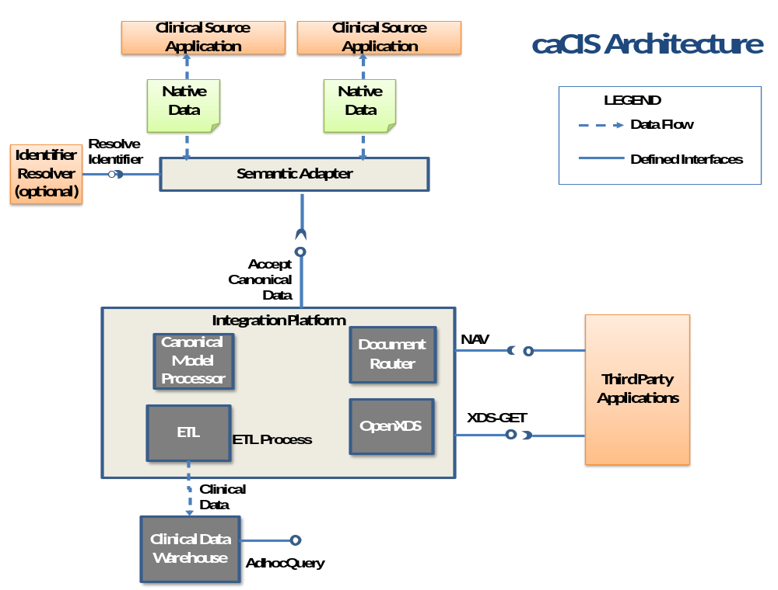

Slide 8
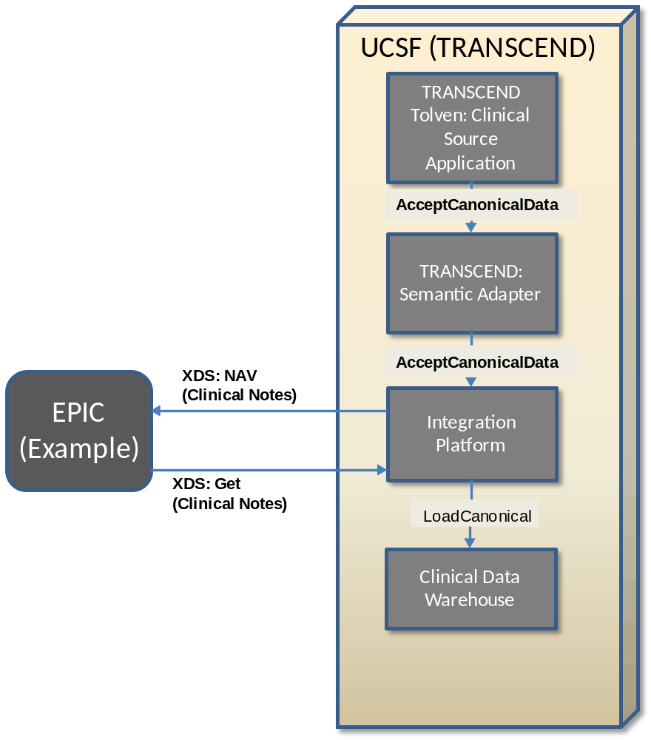
caCIS Architecture – TRANSCEND Deployment

Slide 9
Proposed Architecture - Components
Source System
  Can be a clinical care or clinical research application
  Publishes the data to be shared
  Provides all the data required for generating the exchange documents (no document generation from multiple sources in this implementation)
Semantic Adapter
  Accepts the data in native format from the source system and converts into canonical model
  Provides capability to resolve identities from local to standardized identifiers (e.g. call out to CTRP services) – design only
  Provides capabilities to map from native vocabulary to canonical model vocabulary (e.g. call out to EVS api) – design only

Slide 10
Proposed Architecture - Components
Integration Platform: Canonical Model Processor
  Accepts data from one or more semantic adapters
  Validates the incoming data against the canonical model format
  Persists the data into the warehouse via the ETL process
  Document transfer requests are sent to the document router for exchange
  Provides restricted access to trusted clinical sources only

Slide 11
Proposed Architecture - Components
Integration Platform: Document Router
  Determines the list of recipients from the request or pre-defined configuration (based on document type)
  Creates document metadata for the data (completed canonical model)
  Creates an entry in OpenXDS repository for the document
  Based on the recipient list, generates a XDS-NAV notification
Integration Platform: OpenXDS
  Based on open source implementation of XDS - openXDS
  Supports XDS-GET request from the recipients
  OpenXDS will be extended to enforce authorization on the XDS-GET interface.

Slide 12
Proposed Architecture - Components
Integration Platform: ETL
  Transforms and loads data in canonical model format into the Clinical Data Warehouse (local or remote)
Clinical Data Warehouse
  Supports multiple deployment configuration, centrally at NCI, and local to IP.
  Based on open source implementations (TBD)
    Pentaho, TrialDB, i2B2
    XML database or other RESTful implementation
  Designed to be extensible
CDW: Query
  Interface natively supported by the warehouse (no customizations)
  Will be secured using the same authorization scheme as the document interface

Slide 13
Proposed Architecture – Data Formats
Canonical Model & Document Transfer
  When possible, model will be based on the C-32/CCD standard and contain sections as described in the C-83 standard
  Will be backed by vocabularies specified by C-80
Warehouse Design (TBD)
  If using XML DB approach, will be the same as Canonical
  If using off-the-shelf solution, will map Canonical to off-the-shelf persistence schema (e.g. star schema, EAV)

Slide 14
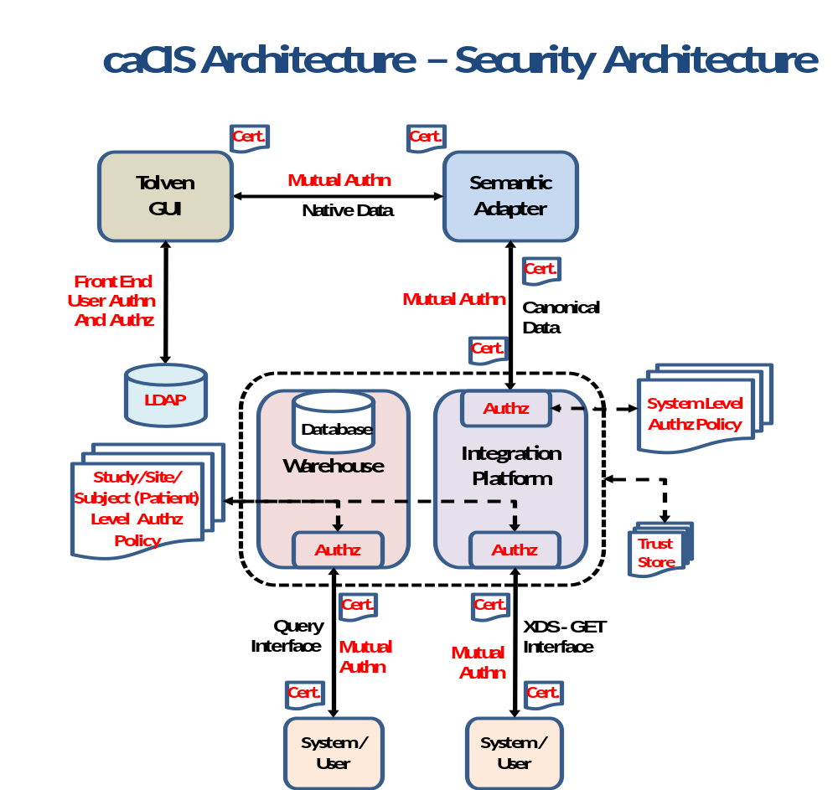

Slide 15
caCIS Security Architecture
Supports both system and user level security using digital certificates (X.509)
All communication channels in the solution will be secured and encrypted (as required by HIPAA)
  Clinical systems to semantic adapter
  Semantic adapter to integration platform
  Document interface (XDS) to recipient system or user
  Query interface to recipient system or user
Authorization is enforced using the identity of the user obtained from the digital certificates
Inbound interface of the integration platform will accept data only from authorized source systems
All clinical data is stored in an encrypted form within the integration platform

Slide 16
caCIS Security Architecture
Document interface allows systems/users to access documents based on defined authorization policies
Query Interface enforces the authorization policies at the following levels:
  Study Level – Access only to particular study data
  Site Level – Access to a particular site data
  Subject (Patient) Level – Access to a particular subject data
Authorization components can leverage existing authorization stores

Slide 17
caCIS Security Architecture – Benefits
Solution uses digital certificates (X.509)
  Can be obtained from multiple sources
    Commercial Certificate Authorities (CA)
    NCI’s current caGrid CA (Dorian) with enhanced LOA
    Future caGrid STS Service issuing X.509 tokens*
  Provides flexibility as well as backward compatibility
  Can be issued for both users as well as systems
  Identity obtained from certificates is used to identify the system or user for authorization purposes

Slide 18
caCIS Solution – Risks
TRANSCEND integration and deployment:
  TRANSCEND data elements are not coded – might not get the necessary support from TRANSCEND
  TRANSCEND may not be able to make the required changes to integrate with the proposed solution – before Sep 30th, no resource will be available for deployment
Timeline
  Timeline is extremely aggressive with external dependencies
  Estimates do not include time for addressing any unanticipated issues.

Slide 19
Assumptions
Proposed solution includes time for coding the TRANSCEND data elements (PCO + Clinical Notes)
Audit logs are not shared across the enterprise
The TRANSCEND Tolven instance will be modified to allow the user to initiate the export of data and invoke the service call on the Semantic Adapter. This will be done by TRANSCEND.
The minimal granularity of data will be at a section level, support for lower granularity will be handled by custom code in the semantic adapter

Slide 20
Assumptions
Integration of data from multiple versions of the same sections is the responsibility of the source system (or a customized adapter)
The data warehouse will not be tuned/optimized for particular query types.
Source systems data will be mapped to appropriate attributes of the canonical model
De-identified/anonymized access is out of scope and will be handled by a separate data mart loaded from data warehouse.

Slide 21
caCIS – Recommended Options
Solution Sign-Off
  With plan and approach for TRANSCEND deployment
Project closeout – expectations cannot be met because of the current constraints

Slide 22
caCIS: Level Of Effort Analysis (man-months)
 | Design | Implementation | Quality Assurance | TRANSCEND Deployment
CQL | 1 | 1 | 0.5 | 0.5
Semantic Mapping of Remaining TRANSCEND Elements | 6
Note: The LOE is the additional (incremental) effort for realizing the proposed solution beyond what’s already included in scope.

Slide 23
Questions ?

