Slide 1
NCI caBIG Project Update as of Friday August 27, 2010
Project Sponsor Caterina E.M. Lasome, PhD, MBA, RN, CPHIMS Chief Operating Officer National Cancer Institute

Slide 2
Agenda
CBIIT caBIG Strategy
CBIIT caBIG strategic direction
Project Introduction
caBIG Clinical Information Suite
Business Opportunity
Purpose
Overview
Project Goals & Objectives
Business Capabilities
Focused List
Currently active
Project and Services Development Methodology
Project
Services Delivery
Key Milestones/Activities
Themes
Project Documentation, References & Artifacts

Slide 3
NCI sSOA Development: Architecture for the Translational Medicine Continuum
Standards Development Organizations
Center for Biomedical Informatics & Information Technology
Software Development Companies and Open Source Community
Consume/Contribute
Validate
Inform

Slide 4
Project Introduction
Project Introduction and Goals

Slide 5
Oncology-Extended EHR (caEHR)
The National Cancer Institute (NCI), through its Cancer Biomedical Informatics Grid (caBIG®) program, is leveraging the nation’s $44 billion investment in Healthcare Information Technology to fuel research in the following way:
NCI has collaborated with the American Society of Clinical Oncology (ASCO) and other professional societies to develop specifications for an “oncology-extended Electronic Health Record” to fill a gap in existing Electronic Health Record (EHR) functionality for practicing ambulatory oncologists
This NCI/ASCO project is called Clinical Oncology Requirements for the Electronic Health Record (CORE)

Slide 6
caBIG® Clinical Information Suite
NCI is developing a series of software modules (service and application modules, also referred to as “capabilities”) collectively known as the caBIG® Clinical Information Suite:
This Suite is based on the CORE specifications, and the expressed needs of the NCI community
This Suite will support the specific oncology-related data collection needs of practicing oncologists, and build the “bridge” between clinical care and research

Slide 7
caBIG® Clinical Information Suite
The caBIG® Clinical Information Suite can be used in conjunction with any EHR platform (proprietary or open source) to furnish an end-to-end EHR suitable for ambulatory oncology
NCI will select an open-source EHR platform with which to integrate the caBIG® Clinical Information Suite and thus deliver an end-to-end, deployable EHR as a Reference Implementation
Selected National Community Cancer Center Program (NCCCP) sites intend to deploy the caBIG® Clinical Information Suite, either as a series of modules in conjunction with their existing EHR, or as the full open source reference implementation, beginning in the fall of 2010

Slide 8
caBIG® Clinical Information Suite: A collaborative national effort
American Society of Clinical Oncology (ASCO)
Began evaluating issue, involving end users
Engaged the vendor community through its EHR lab, utilizing unique case scenarios
Developed high level requirements document/white paper outlining the issue
cancer Biomedical Informatics Grid (caBIG®)
Vendor technology evaluation
Problem assessment
Technical Specification
NCI Community Cancer Centers Program (NCCCP)
Oncology EHR Laboratory
Other domain experts
Notes:
8

Slide 9
caBIG® Clinical Information Suite
Provides support for the workflow of practicing oncologists, and for their collection and management of data specific to the treatment of cancer
Supports the oncology clinical care community by accelerating “knowledge turns” – the speed by which hypotheses can be validated in the clinical environment
Supports NCI’s research community by delivering much needed clinical outcomes data to the research community for rapid validation of hypotheses
Connects with, and expands, existing caBIG® clinical resources and leverages NCI’s investment in a scalable services-based infrastructure (developed by NCI to support the caBIG® program) to finally deliver a flexible, agile, comprehensive bidirectional link between research and care

Slide 10
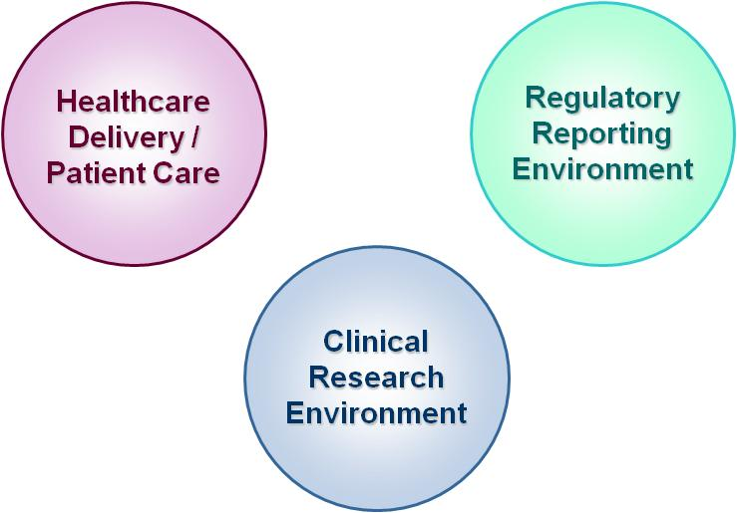
Business Problem & Opportunity
System Wide Challenges
Isolated information “islands”
Siloed health information infrastructure
Significant expectations for increased use of health record technology through HITECH Act stage 1, 2, and 3 targets and ensuing standards
A need for more modular, interoperable software solutions to meet the needs of diverse clinical settings
Ambulatory Oncology Sector Challenges
Limited availability of EHR solutions focused on the unique needs of the ambulatory oncology sector and ready for the emerging demands of 21st century biomedicine
Go-Forward Opportunities
Significant progress from ASCO & NCI collaborative efforts to document clear ambulatory oncology EHR functional requirements
ARRA funding to address technology gaps
A willing array of NCI Community Cancer Centers Program (NCCCP) implementation partners

Slide 11
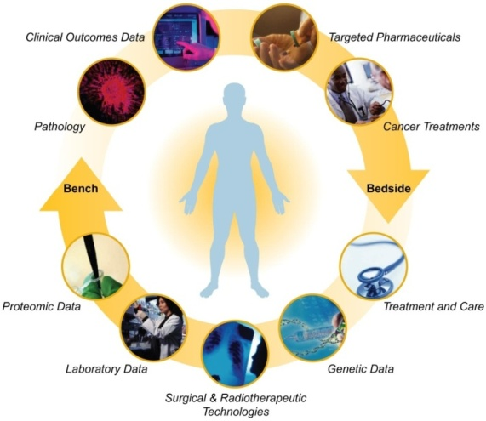
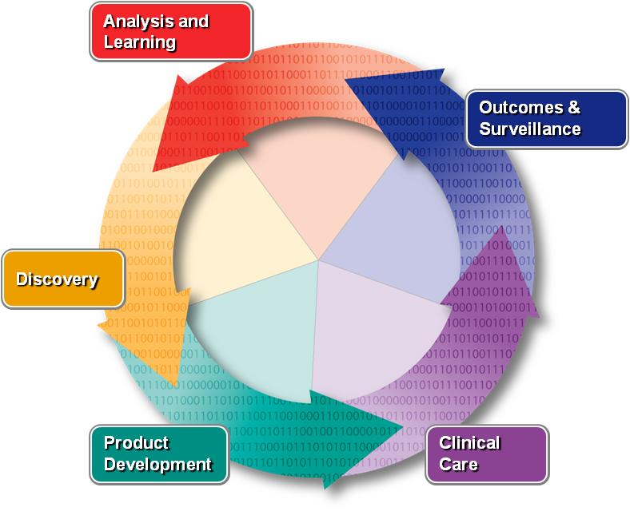
Clinical Information Suite Project Purpose
To support the ambulatory oncology clinical care and engage software vendor communities (open source and commercial) by delivering a series of business capability services that address the unique needs of the ambulatory oncology sector while meeting the ARRA/HITECH meaningful use requirements.
These capabilities will:
Be highly modular and configurable to address a wide range of clinical settings;
Position users for effective integration with other clinical, administrative and research systems;
Leverage existing HIT standards and extend these standards from an oncology perspective where appropriate; and
Be released with a full set of specifications that can be used by vendors and implementers to leverage all or portions of the caEHR deliverables.
Notes:
Key Points:
The project is intended to support the ambulatory oncology clinical care community through the delivery of key business capabilities;
The vendor community (both open source and commercial) is a key part of this support;
The business capabilities are intended to address ARRA/HITECH meaningful use requirements;
The deliverables will NOT be in the form of a monolithic software product but rather a series capabilities in a modular and configurable fashion;
Enabling integration is a key outcome sought through the delivery of specifications and software modules that can be used as follows - Vendors and implementers can:
Use the specifications to built compliant modules;
Use the software components to integrate these with existing software;
Potential Presentation Text:
The caEHR project is primarily intended to support the ambulatory oncology clinical care environment both directly as well as through the vendors – both open source and commercial – that serve this community. Rather than delivering a single monolithic software solution the project aims to deliver a series of key business capabilities that not only address the unique needs in the oncology sector but that also meet meaningful use requirements. Specifically, the capabilities will,
Be highly modular and configurable to address a wide range of clinical settings;
Position users for effective integration with other clinical, administrative and research systems;
Leverage existing HIT standards and extend these standards from an oncology perspective where appropriate; and
Be released with a full set of specifications that can be used by vendors and implementers to leverage all or portions of the caEHR deliverables.
This modular delivery of capabilities is intended to address three pragmatic project goals …
11

Slide 12
caEHR Goals
Target Goals
(One or more of these goals by close of project)
Architectural Adoption by Industry: Software solution vendor(s) consumption of platform independent caEHR specifications in the development / extension of their product suite.
Measure of success: At least 1 service specification being utilized by industry to develop production viable functionality within their product.
Solution Adoption through the Open Health Tools (OHT) Community: Business Capabilities and/or Reference Implementation consumption by the OHT (open health tools) community to integrate and/or repackage for the health IT market.
Measure of success: At least 1 fully specified and developed business capability consumed by the open source community and/or being implemented as a production implementation by the open source community vendors
Clinical Community Adoption: One or more Business Capabilities and/or the full Reference Implementation (RI) being used in a daily production manner at ‘in scope’ early adopter site(s).
Measure of success: One or more fully specified and developed business capabilities in production use within a clinical care setting within one or more National Community Cancer Center Program sites.
Notes:
Key Points:
The project is intended to deliver three measurable goals by October 1, 2011 as outlined in this slide; (N.B. These goals are focused on the concrete adoption of the solution while the solution itself is intended to achieve various business goals that are documented in the full briefing deck and presently being elaborated in the Scope and Vision materials – these range from meaningful use support and other capabilities to meet core health record automation needs through to enabling substantially more integration of systems both within adopter sites as well as across the entire health system – subject, of course, to applicable policy and privacy constraints)
Potential Presentation Text:
The caEHR project is of course trying to achieve a number of business outcomes that revolve around improving cancer care through the deployment of appropriate eHealth solutions. In concrete terms this has been expressed as a series of progressive adoption targets, including:
Adoption by industry. The specifications and software being devised clearly have to help the broader market meet the needs of the ambulatory oncology market. A key measure of this fit will be the adoption of at least one – but obviously ideally many more – of the capabilities being delivered by at least one solution vendor into a production offering.
Solution Adoption through the Open Health Tools (OHT) Community. In order to enable wide adoption by the broadest community of vendors, the NCI intends to distribute the services and associated specifications not only directly but also through distribution mechanisms such as those offered by the Open Health Tools community. In its own words, “Open Health Tools is an open source community with a vision of enabling a ubiquitous ecosystem where members of the Health and IT professions can collaborate to build interoperable systems that enable patients and their care providers to have access to vital and reliable medical information at the time and place it is needed.” As such it enables the caEHR components to find a broad audience; one which ideally will consume one or more of the services targeted for delivery.
Clinical Community Adoption. The ultimate and obviously most important measure of success will be true clinical adoption – in other words, production use and, ideally, improved care. This is perhaps the most important aspect particularly in the context of our NCCCP early adopter partners who, we hope, will not only help us ensure that the caEHR solution components are clinically relevant but who will also demonstrate that in their deployments by October 1, 2011.

Slide 13
caBIG® Clinical Information Suite Deliverables
caBIG®-developed deliverables will include:
A detailed, industry-validated requirements document (CORE, developed with ASCO)
A set of structured use cases and application/service specifications documents, usable to guide development
A number of capabilities, i.e., software modules including both clinical (collecting data) and administrative (managing the trial) functionality, all available under a non-viral license for use by vendors and others in the community
A fully functional reference implementation of the EHR based on an existing open-source EHR platform that may be deployed to sites as needed
An HL7 (Health Level 7) validated functional profile for ambulatory oncology based on the ASCO/NCI CORE requirements document and the HL7 EHR functional model

Slide 14
caBIG® Clinical Information Suite Integration and Usage
Updated versions of the reference implementation with increased functionality will be released, iteratively and incrementally, over the lifecycle of the project
NCI expects there will be a wide variety of approaches to integration including, but not limited to:
Collaboration with EHR vendors and providers to implement the specifications
Incorporation of NCI’s source code and/or specification adaptation by open-source and/or commercial vendors
Deployment of the full reference implementation by healthcare providers

Slide 15
caBIG Clinical Information Suite
Business Capabilities

Slide 16
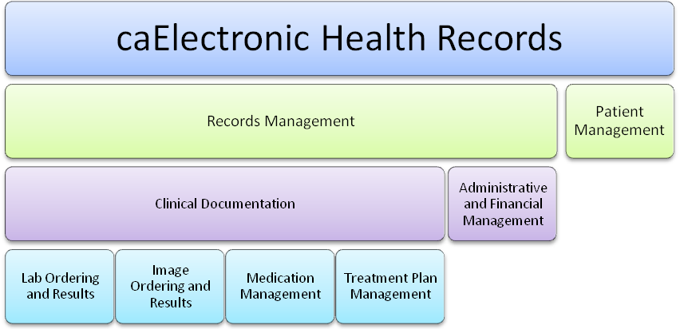

Clinical Information Suite Business Capabilities

Slide 17
Clinical Information Suite
Diagnostic Clinical Information
Tumor Staging
Laboratory Ordering and Result Management
Clinical Documentation (including Pathology and Surgical Reports)
Image Ordering and Results Management
Therapeutic Clinical Information
Medication Management
Treatment Plan Management
Patient Functional Information
Patient Management
Records Management
Financial Information
Administrative and Financial Management
Decision Support
Generate Reports
Clinical Decision Support

Slide 18
Business Capability Roadmap
Multi-dimensional Outcomes Category | Release Cycle 1 – NLT June 2010 (PODS SS1 and SS2) | Release Cycle 2 – NLT October 2010 (version 0.5) | Release Cycle 3 – NLT January 2011 (version 1.0) | Release Cycle 4 – NLT April 2011 (version 2.0) | Release Cycle 5 – NLT July 2011 (version 2.1) | Release Cycle 6 – NLT October 2011
Business Capabilities
Administrative | Short Suspense Releases of Patient Outcomes Data Services | Patient Demographics Information | Referral Management
Diagnostic |  | Diagnosis (e.g., Tumor Stage Capture) | Tumor Staging
Therapeutic |  | Treatment Regimen |  | Chemotherapy Management Patient Trial Finder | Treatment Planning
Disease Response to Treatment |  | Outcomes |  |  | Assessment Tool
Proposed NCCCP Deployments – Goals Supported
Proposed NCCCP Deployments |  |  | Tolven Deployed to Adoption Site (1 NCCCP) | Platform + Oncology Ext Deployed to (2 NCCCP ‘s) |  | Platform + Oncology Ext Deployed to (2 NCCCP’s)
caEHR Goals Supported |  | Architecture Adoption | Architectural Adoption | Architectural Adoption Solution Adopt. Clin Community Adoption | Architectural Adoption Solution Adopt. Clin Community Adoption | Architectural Adoption Solution Adopt. Clin Community Adoption
Complete

Slide 19
Project Methodology & Trajectory

Slide 20
Design Objectives
Semantic Services-Oriented Architecture (sSOA) approach enabling release of:
Technology-independent PIM-level specifications
Incremental/Iterative deployment of prioritized Business Capabilities
Maximum localization capabilities including
Workflow
Semantics (e.g. term lists, vocabularies, etc.)
User Interface (UI)
Contribute to/align with CBIIT SAIF Implementation Guide
ECCF-compliant specifications with demonstrated traceability
Leveraging of, and contribution to, CBIIT Enterprise Service Specifications
Standards-aware, Standards-involved
RIM- / BRIDG-based information model
ANSI HL7 EHR Functional Model
Submit an Oncology Functional Profile for ballot

Slide 21
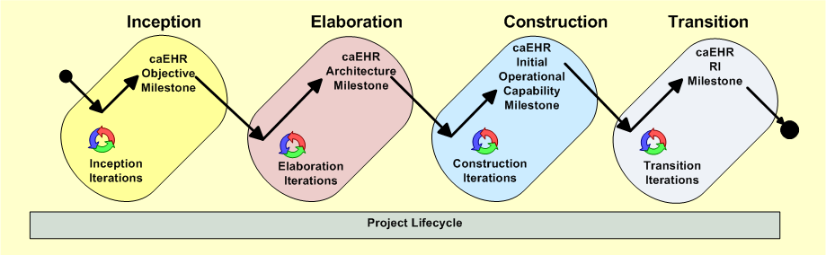
Overall Project Methodology
Traditional Unified Process Approach
Agile-Like Iterative and Incremental
Project Planning Release and Iteration Focused

Slide 22
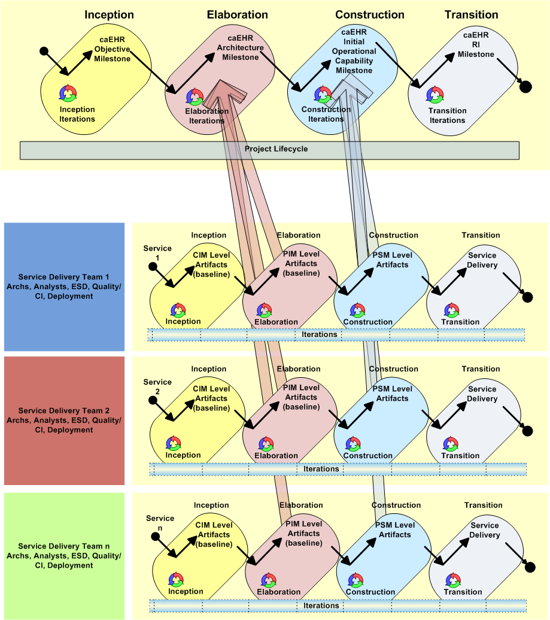
Services Development Methodology
sSOA Development Methodology
Overall Scope and Vision
Topic scope per release cycles
Parallel focused service delivery teams supporting overall project goals
Effectively breaking large complex interdependent project deliverables into focused service delivery
Iterative and Incremental ensuring fail often, fail early, course corrections.
Provides early progress against larger project goals
Allows for stakeholder engagement early and often
Supports ability to integrate 3rd party other agency involvement in services delivery

Slide 23
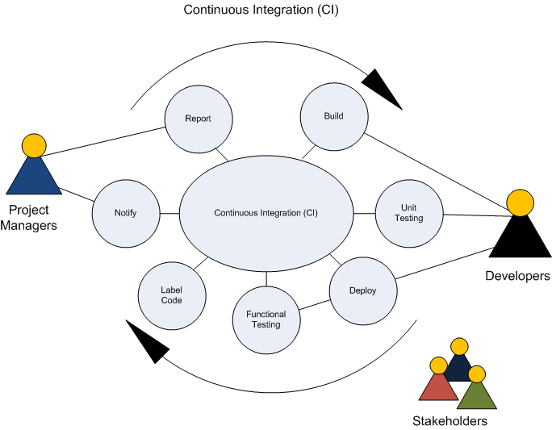
Continuous Integration Project Approach (Elaboration through Transition Phases)

Slide 24
Key Milestones & Activities

Slide 25
Project Milestones
Release 2 Objective | Iteration 1 | Iteration 2 | Iteration 3 | Outcome
Project Roadmap/ Scope & Vision | Long Term Roadmap Planning Initiation | Roadmap Final Planning | Roadmap for remaining release cycles approved | Approved Roadmap
Services Development | Referral, Outcomes
PODS Refactor | Decouple ensure model aligned to Clinical Information Suite
HL7 Training | Team training to support HL7 | N/A | N/A | Team trained on HL7 standard/artifacts
Project Reporting | Project Health Refinement
Tooling/Infrastructure | Finalize support for team
Vertical Slice of SAIF Stack
Platform Gap Analysis | Ensure platform team understands all technological modifications needed to support clinical information suite deployment

Slide 26
Project Documentation, References & Artifacts

Slide 27
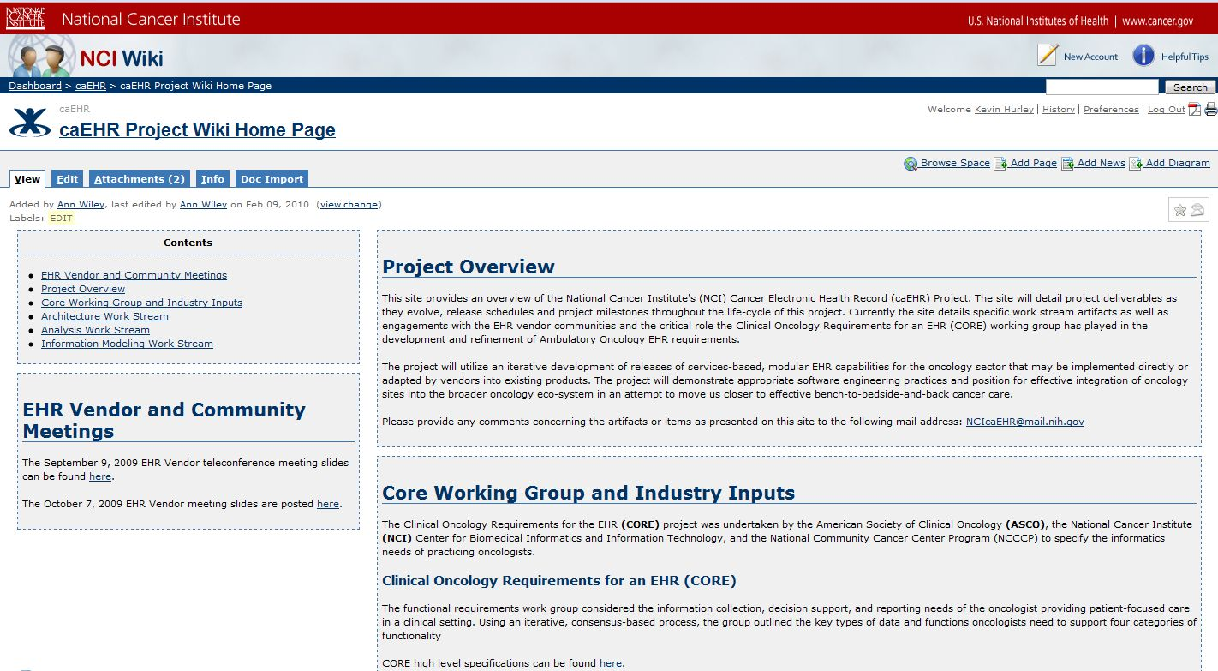
caEHR Wiki
Artifacts Posted Regularly for Stakeholder and Interested Parties Consumption and Comments
https://wiki.nci.nih.gov/x/zSJyAQ

Slide 28
Acronym List
Acronym | Meaning
caEHR | Cancer Electronic Health Record (*the scope of this project is limited specifically to the ambulatory oncology community)
CBIIT | Center for Biomedical Informatics and Information Technology
CI | Continuous Integration
CORE | Clinical Oncology Requirements for EHRs
DSL | Discipline Specific Lead
FFRDC | Federally Funded Research and Development Center
HL7 | Health Level 7 Standards Development Organization
NCCCP | National Cancer Center Community Program
NCI | National Cancer Institute
PODS | Patient Outcomes Data Service
SAIF | Services Aware Interoperability Framework

