Slide 1
caBIG® Clinical Information Suite Revised Solution Presentation Rockville MD Thursday May 5, 2011 Where: 2115 E Jefferson, Suite 5001 and Tcon 800-366-7242 Part code: 6801959

Slide 2
Agenda
Feedback from Previous Solution Presentation
Canonical CCD cannot be the constraint for message on the wire and storage
Security is not an after-thought but needs to be built in from the beginning
Recommended Solution
Key Functional Requirements
Solution: PCO Application
Solution: caCIS Integration Platform
Architecture Design
Security Requirements
Security Solution
Solution Benefits
Project Assumptions, Risks and Constraints
2

Slide 3
Recommended Solution

Slide 4
Key Functional Requirements
Create a Patient Centric Outcomes application capable of receiving, sharing, and creating/editing PCO data
Goal is to develop a platform that can be extended.
Create a data-sharing solution that can be leveraged by many clinical applications to share data securely via pre-defined standardized formats
Solution has to be reusable, and cannot be scoped to TRANSCEND alone
Support for multiple standardized formats with the flexibility to extend/accommodate new formats in the future.
Support data-sharing between applications as well as applications and providers/patients
Support both “push” via e-mail and “pull” of data through standard interfaces.
Security will be covered extensively in the security section of this presentation

Slide 5
Solution: PCO application
Uses Tolven as a platform for persistence & user interface
Leverages data elements previously identified in PODs/Demo Pilot projects
Will seek confirmation from NCI that the selected data elements are appropriate for intended analysis
Initial source data will come from TRANSCEND using the data-sharing solution (caCIS Integration platform)

Slide 6
Solution: caCIS Integration Platform
Two-phase conversion process
Native to Canonical via Semantic Adapter component
Canonical to Exchange syntax
Initially: Full CCD, PCO CCD, Clinical Note CCD, XML ITS, HL7 v2
CDA subsumed into CCD (CCD allows all CDA sections)
Canonical will be a RIM structure using CDA organization
Leverage CCD-defined sections where possible
Leverage CDA-defined templates for additional sections where possible
Use RIM-based extensions where content does not fit

Slide 7
Solution: caCIS Integration Platform (cont’d)
Uses XDS and NAV as system-to-system transfer mechanism
ATNA as security (dual-end authentication and TLS)
Canonical stored in encrypted XDS repository for retrieval at the convenience of receiving app and (in the future) for query
Uses secure e-mail for system to provider/patient delivery
Usable by any clinical application that configures a semantic adapter to support their native format
Transcend will be an implementation of this platform.

Slide 8
High-level Design
Clinical App 1 (e.g. TRANSCEND Tolven)
Clinical App 2
(e.g. PCO Tolven)
Other
Systems & People
Native
(e.g. TRIM)
Native
(e.g. TRIM)
Semantic
Adapter
Semantic
Adapter
Secure e-mail
Secure e-mail
Canonical
Canonical
XDS /
NAV over ATNA
Integration Platform
Integration Platform
CCD, v2,
RIM ITS XML,
etc.
XDS
XDS

Slide 9
Security Requirements
Ensure data can be exchanged between two systems in a secure manner
encrypted, non-changeable, with verified identify of sender & receiver
Ensure data can be passed from a system to a specific user or patient in a secure manner
encrypted, non-changeable, with verified identify of sender & receiver
Ensure that users and systems are authenticated and authorized prior to initiating the transfer or retrieval of data
For PCO, this will extend to having privileges to view or update patient data as well
Ensure that data is encrypted when stored
All data exchanges must be logged

Slide 10
Security solution – Authentication & authorization
Local user authorization & authentication
Users will authenticate to their local clinical applications
Authorization to access data sharing (send/receive) and any other functions will be managed by the application
Encrypted data store
Provided using the database level encryption feature of Postgres
All the data that is stored within the database layer of the integration solution will be encrypted
This provides protection against unauthorized access by system administrators and database administrators
Data logging via IHE’s Audit Trail and Node Authentication
Will identify requesting user (if any) as passed from local system, date, and what exchange was requested or performed

Slide 11
Security solution - Transmission
Will support secure transmission in two ways
Secure email following the S/MIME protocol for direct to patient/provider
Both sender and receiver need digital certificates for signature and encryption
Transmitted documents encrypted using receiver’s certificate so only the receiver can open the document
Documents are signed using the sender’s certificate to allow identity verification
Provides “message-level” security
Node to node web services using IHE’s ATNA standard
Data encrypted over a TLS pipe
Each node authenticated with a digital certificate
Transmitter as well as receiver must be a secured node – Must have appropriate policies for authentication, authorization, etc.

Slide 12
Security solution - caGrid Review
The Team assessed the feasibility of using both caGrid 1.0 and caGrid 2.0 for the proposed solution
Current requirements and use-cases can be satisfied without using any caGrid security components
The solution provides the flexibility to leverage caGrid components in the future – as use-cases are identified

Slide 13
Solution Benefits
Based on widely used industry standards
Reduced implementation costs
Likelihood of enhanced uptake by clinical community
Minimizes expectations on participating clinical applications
Reduces barriers to participation
Easily extensible
New exchange transforms can be easily introduced
Canonical can be extended to support additional data elements
as CDA sections, and when required as RIM extensions
Leverages off-the-shelf open-source components
Open XDS (XDS, NAV and ATNA implementation)
Open e-Health (orchestration)
Mirth Connect (transformation)

Slide 14
Project Assumptions, Risks and Constraints

Slide 15
Assumptions
Assumptions
Any patient-specific consent-based constraints on what data may be shared with other systems or imported from other systems will be enforced by the EHR systems being integrated (in this case the Tolven instances). The Semantic Adaptor and Integration Platform will have no responsibility in this area. Any changes needed to the Tolven instance to support consent policies fall outside the scope of this project.
The creation of the business associate agreements required by legislation (e.g. HIPPA) to allow for the exchange and storage of personally identifiable healthcare information is outside the scope of this project.
Automated configuration of communication paths between EHR applications via publish/subscribe or similar mechanism is out of scope.
HL7 v2 exchanges will be treated as “documents” that just happen to be expressed in v2 syntax. I.e. There will be no HL7 workflow functionality required in terms of real-time transmission in response to trigger events or to deal with acknowledgement messages.
While audit log sharing is supported by the underlying technology, audit logs will be stored locally by each Integration Platform instance and will not be shared.

Slide 16
Assumptions (Cont.)
Assumptions
User authentication and permissions, including permissions related to the sharing and/or importing of data, will remain the responsibility of the communicating applications and will not be part of the functionality of the Semantic Adaptor or Integration Platform components.
The TRANSCEND Tolven instance will be modified as necessary to allow the user to initiate the export of data and invoke the service call on the Semantic Adaptor. The making of these modifications is out of scope for the project team.
All exports will be treated as “snapshot”, conveying the complete set of data needed to populate the Canonical format. There will be no support for “partial” exports.
The XDS persistent store and the ATNA log files will be stored within the linked clinical application’s “trusted” data area. Similarly, communication between the clinical applications, the Semantic Adaptor and the local Integration Platform will occur within a secure network environment.
PCO stakeholders will define requirements (e.g., business rules for entering, viewing and amending PCO data, data-sharing triggers, etc.) on a timely basis.
The HL7 v2 exchange format will be treated as a “proof of concept” and will not be designed to satisfy the particular v2 interface requirements of any particular consumer.
PCO will be deployed into a stage environment within the Amazon EC2 cloud and have the capability to be deployed into a production environment, however the caCIS team will not deploy the PCO instance to a production environment during the life cycle of this project.
16

Slide 17
Excluded Functionality
Excluded Functionality
The solution will not support integrating data from multiple sources before generating an exchange instance.
The solution will not provide decision support for the applications contributing data.
When communicating system-to-system, the solution will not encrypt instances directly, but will instead share them across an encrypted point-to-point tunnel.
The solution will not provide centralized user authentication or authorization.
The solution will not expose registry services (e.g. patient, provider, organization, location, etc.).
The solution will not expose a terminology services interface.
The system will not pull data from client sources, but will instead rely on each source to “push” data to be shared in a timely and appropriate fashion.
The solution will not allow client applications to “query” for what data might be available for retrieval.
The solution will not allow manipulation of data at a level of granularity smaller than a single patient’s record. I.e. There will not be distinct service interfaces for different clinical topics such as medications, allergies, etc.

Slide 18
Risks
Risks
The initial set of data elements expressed in the Canonical Data Format and the transforms mapping to and from the canonical format will be driven by the data available from TRANSCEND. Revision will be required for future integrated applications and could be substantial if TRANSCEND is not a representative application in terms of data requirements and capabilities.
There is only one client and one target system to test mapping and data exchange. This is not very rigorous for a system that is intended to support a wide variety of source and client applications. Integration issues are therefore likely to surface when introducing new clinical applications.
The proposed solution is based on our current understanding of requirements that may be dated or incomplete.
The solution relies on the use of several external off-the-shelf components. This may complicate maintenance due to version management issues as new releases of the off-the-shelf components are produced.
TRANSCEND may not be able to make the required changes to integrate with the proposed solution.

Slide 19
Dependencies
Dependency
Determination of the final Canonical Exchange Format is dependent on NCI sign-off on the list of proposed PCO data elements, the determination of the TRANSCEND data elements to be shared with EPIC and the determination of the list of additional TRANSCEND data elements to be exposed for sharing.

Slide 20
Conclusion
Solution Architecture and Approach
Approval to move forward
Approval with considerations
Next Steps
20

Slide 21
BackUps

Slide 22
Architecture

Slide 23
Deployment Architecture

Slide 24
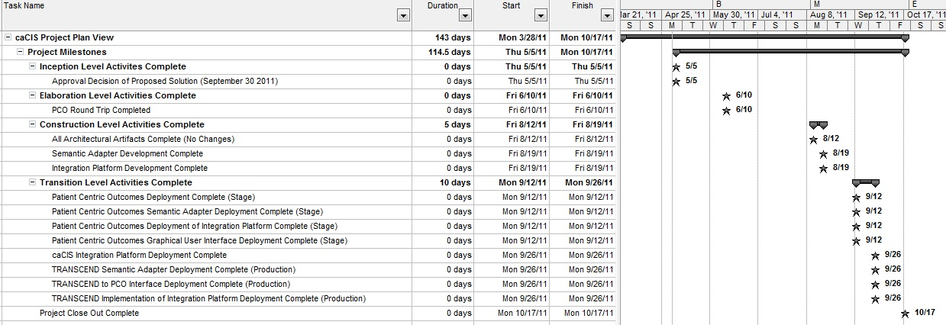
Milestones Supporting Project
The following list of milestones will be dated and updated after proposed solution approval expected by 5/5.

