Slide 1


caCORE Infrastructure
- Next generation tooling
A top-down view
Prasad Konka
caCORE SDK Team
July 20, 2010

Slide 2
Outline
Motivation
  BIG 3
Not a gap Analysis
Enterprise-level Interoperability - sSOA, SAIF/ECCF
caCORE Infrastructure
  Service Infrastructure
  Semantic Infrastructure
  Security Infrastructure
  Integration Infrastructure
  Deployment Infrastructure
caCORE Infrastructure – Next Generation Tools
  Semantic Tools
  Syntactic Tools

Slide 3
CBIIT “BIG 3” Priorities for 2010-2011*
Enterprise-Level Interoperability
  Our applications, data, and analytic services need the capacity to connect and meaningfully exchange information and coordinate behavior.
Enterprise Security
  Develop and implement a clear, integrated enterprise strategy and operational tactics that unify and integrate our approach to security.
Deployment Support
  Comprehensively support the requirements of the 21st-century healthcare community, including
    On-going stakeholder identification and management; and
    Development of technology-independent specifications and reference implementations of software that provides clear benefit to that community.
* From Avinash Shanbhag, Director at CBIIT presentation at caBIG XC WS F2F meeting in June 2010

Slide 4
Enterprise-level Interoperability - sSOA, SAIF/ECCF
Working Interoperability (WI)
Semantically-Aware Services-Oriented Architecture (sSOA)
SOA-Aware Interoperability Framework (SAIF )
Enterprise Compliance and Conformance Framework (ECCF)

Slide 5
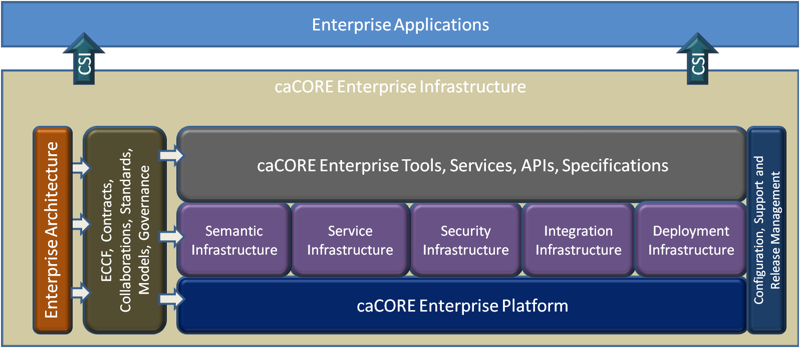
caCORE Infrastructure

Slide 6
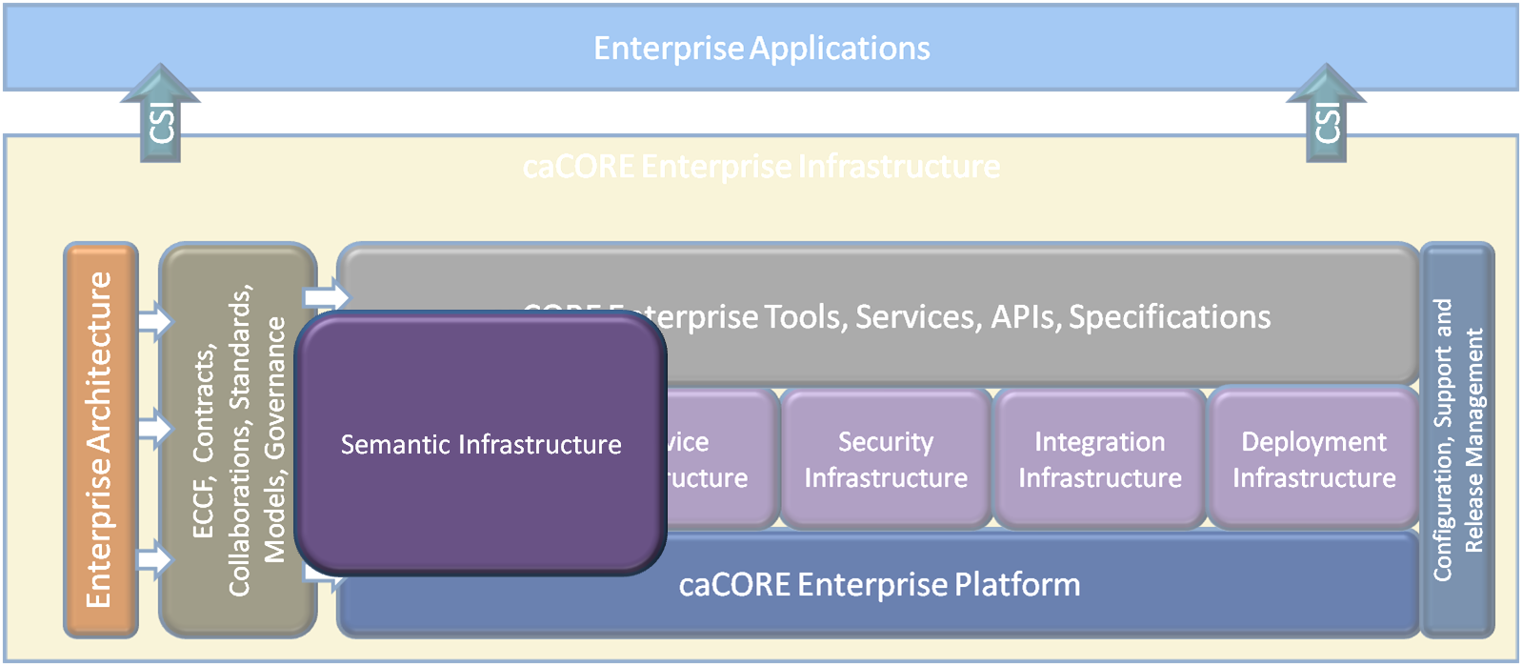
caCORE Infrastructure

Slide 7
Semantic Infrastructure
Basis of semantic interoperability is to provide common vocabulary and terminology between two interoperable systems
Derive the same inferences from the same information
Standard terminology
Controlled vocabulary
Structured data
Shared annotated models
Metadata
Shared, distributed repositories

Slide 8
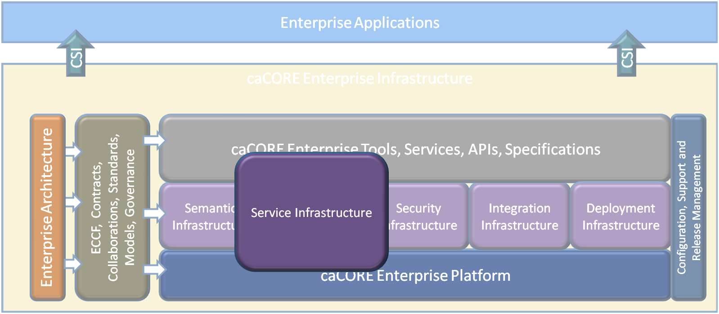
caCORE Infrastructure

Slide 9
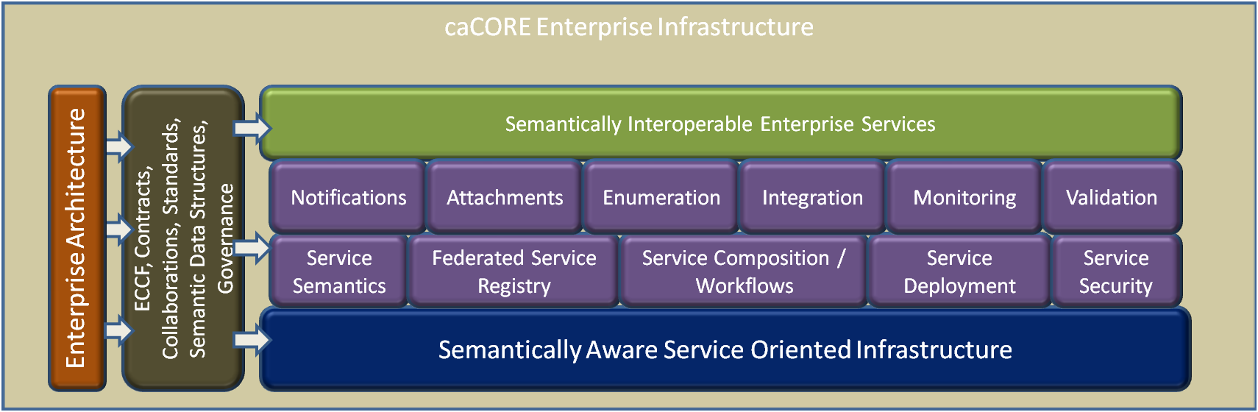
Service Infrastructure

Slide 10
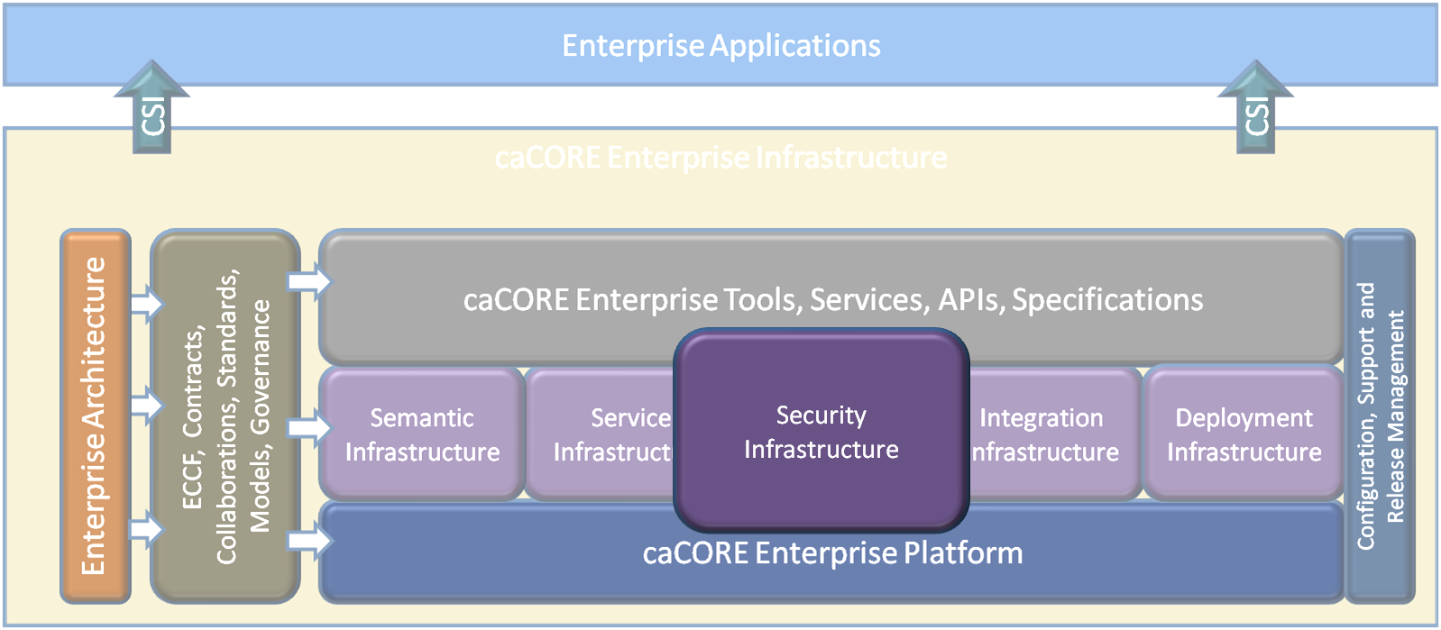
caCORE Infrastructure

Slide 11
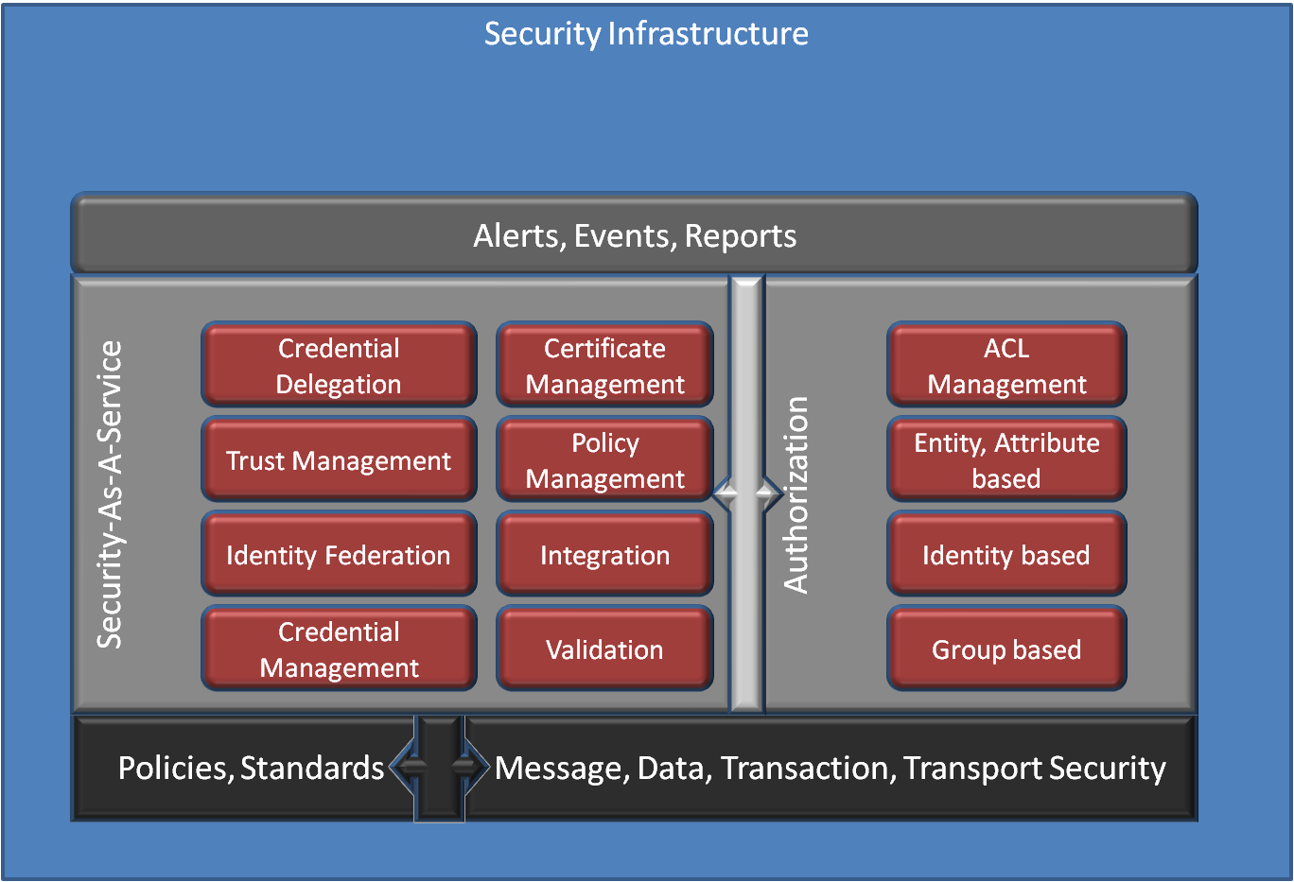
Security Infrastructure

Slide 12
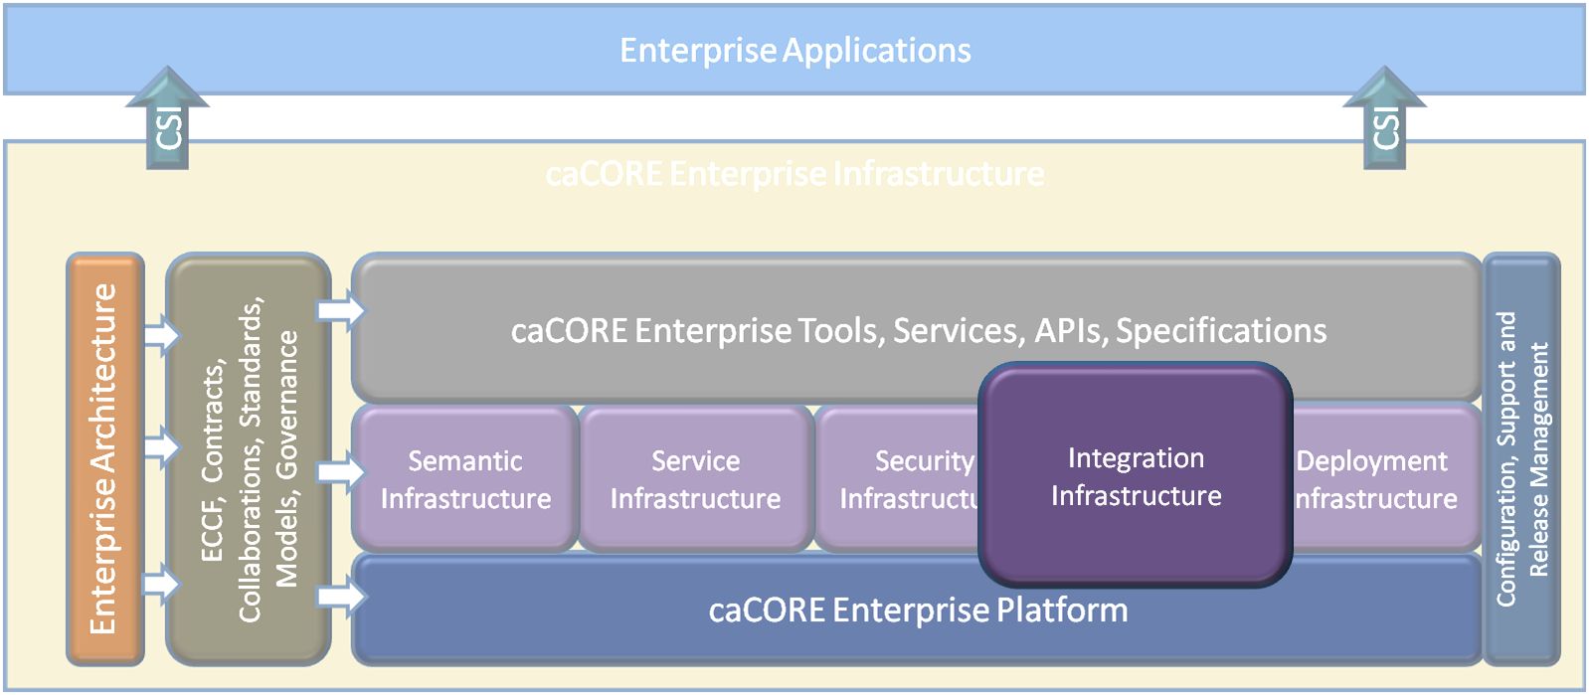
caCORE Infrastructure

Slide 13
Integration Infrastructure
An approach to bring together different standards, frameworks, technologies and terminologies.
Integration with external domains, trading partners or government agencies
Data transformations
Semantic Adapters / connectors
Security

Slide 14
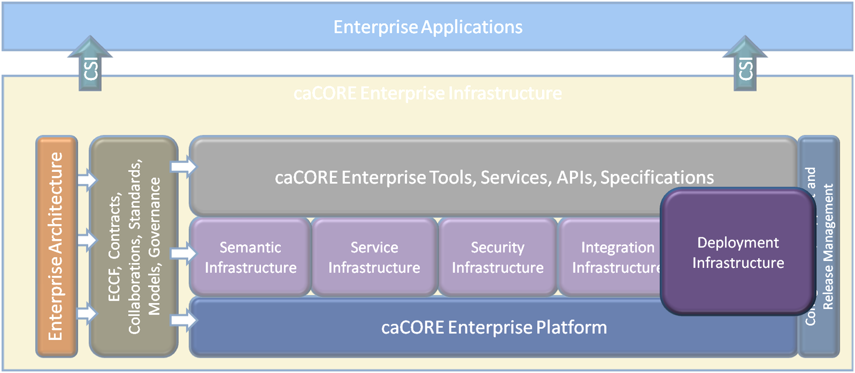
caCORE Infrastructure

Slide 15
Deployment Infrastructure
A standardized, easy and unified Deployment
Dependency management
Flexible and elastic
Deployment support
Cloud deployment
Saas, IaaS
Configuration & Release Management

Slide 16
caCORE Infrastructure - Next Generation Tools
Four pillars of Computable Semantic Interoperability*
  Common model across all domains-of-interest
  Robust data type specifications mapped to common models
  Methodology for binding terms from concept-based terminologies to build Structures
  A formally-defined process for specifying the static and behavioral semantics of the interoperability

Slide 17
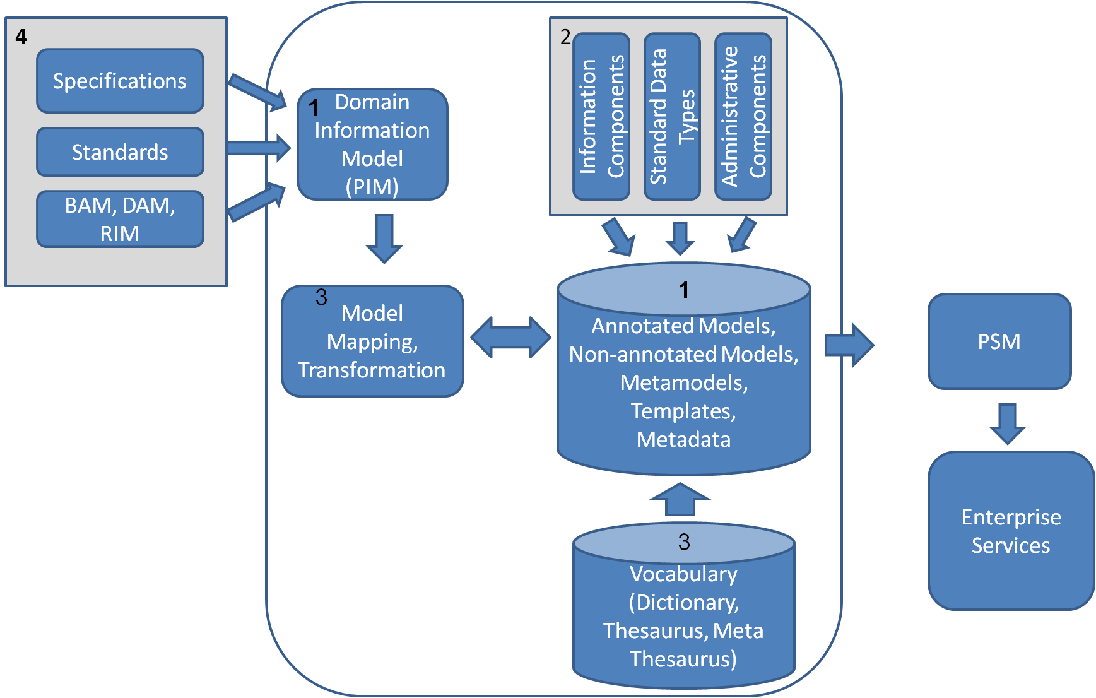
caCORE Infrastructure - Next Generation Tools

Slide 18
caCORE Enterprise Tools
Characteristics
Process and Standards driven
Modular
Loosely coupled
Extensible
Pluggable
Developer friendly
Open source
Model Driven
Framework
Platform & Technology Independent

Slide 19
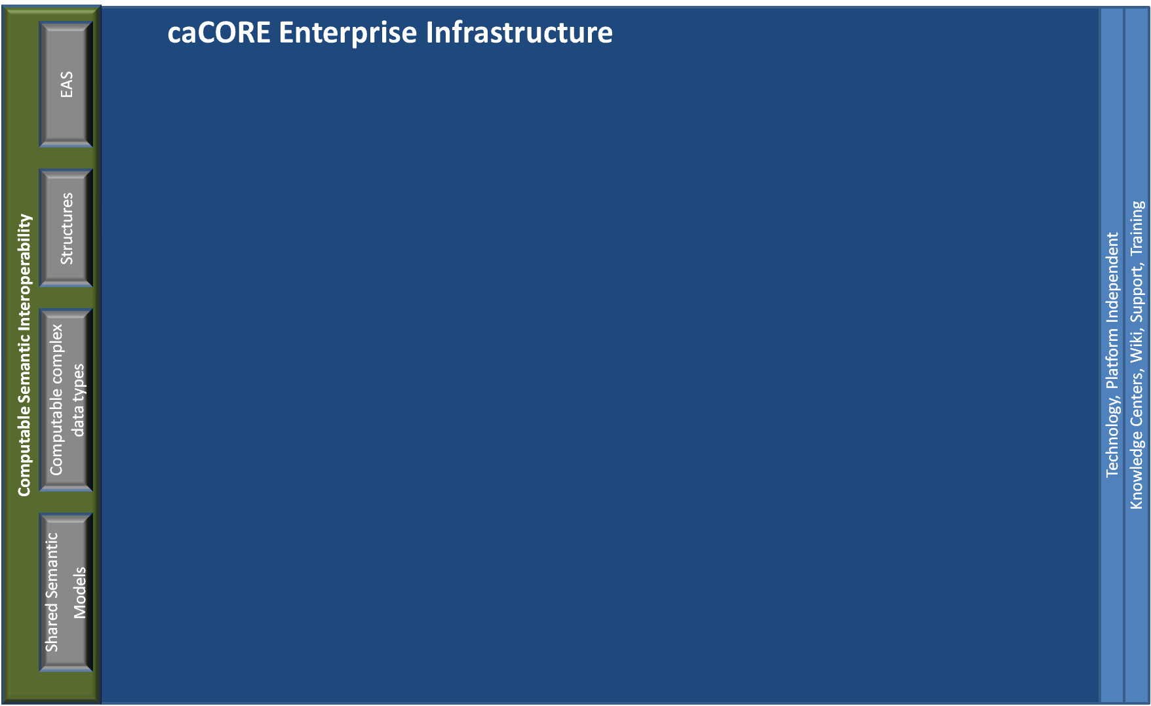
caCORE Infrastructure - Next Generation Tools

Slide 20
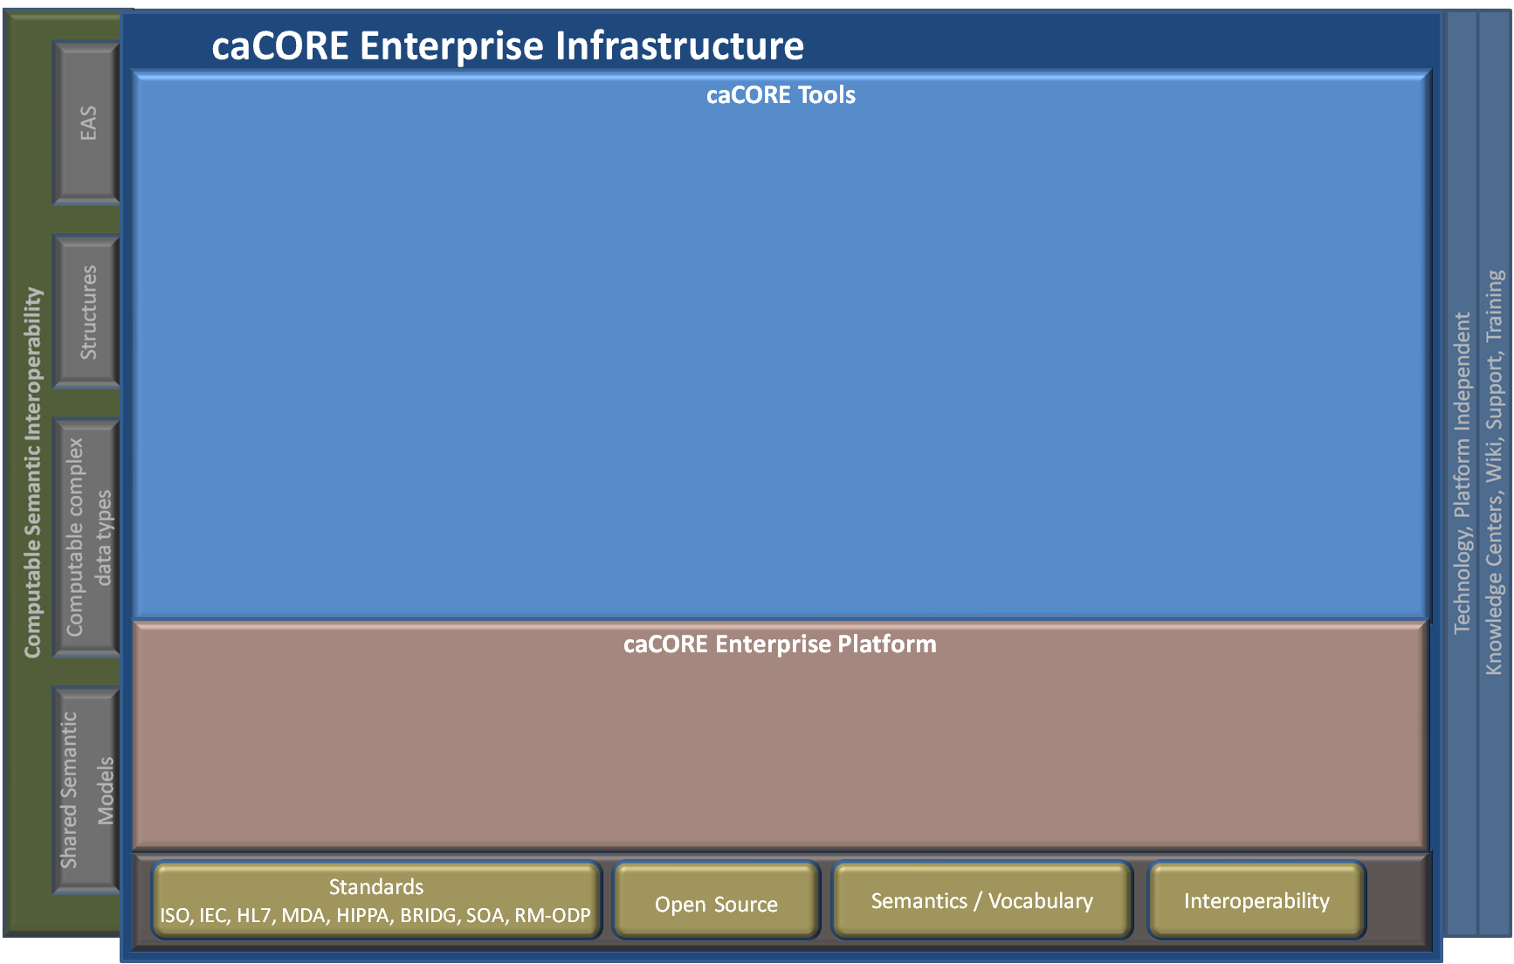
caCORE Infrastructure - Next Generation Tools

Slide 21
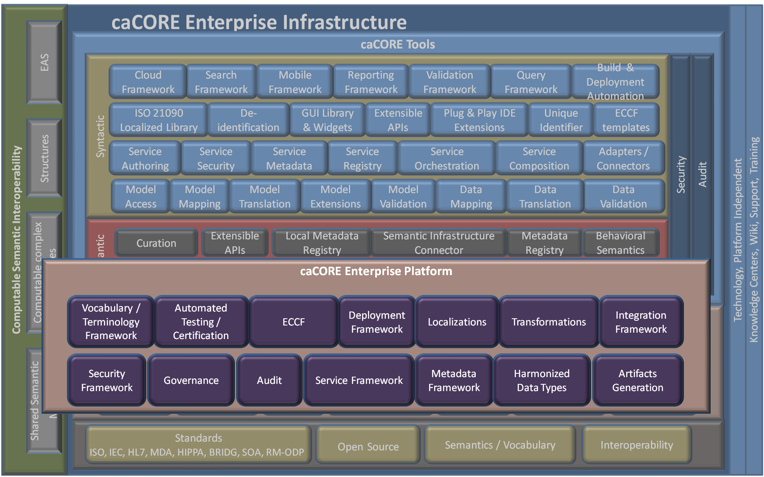
caCORE Infrastructure - Next Generation Tools

Slide 22
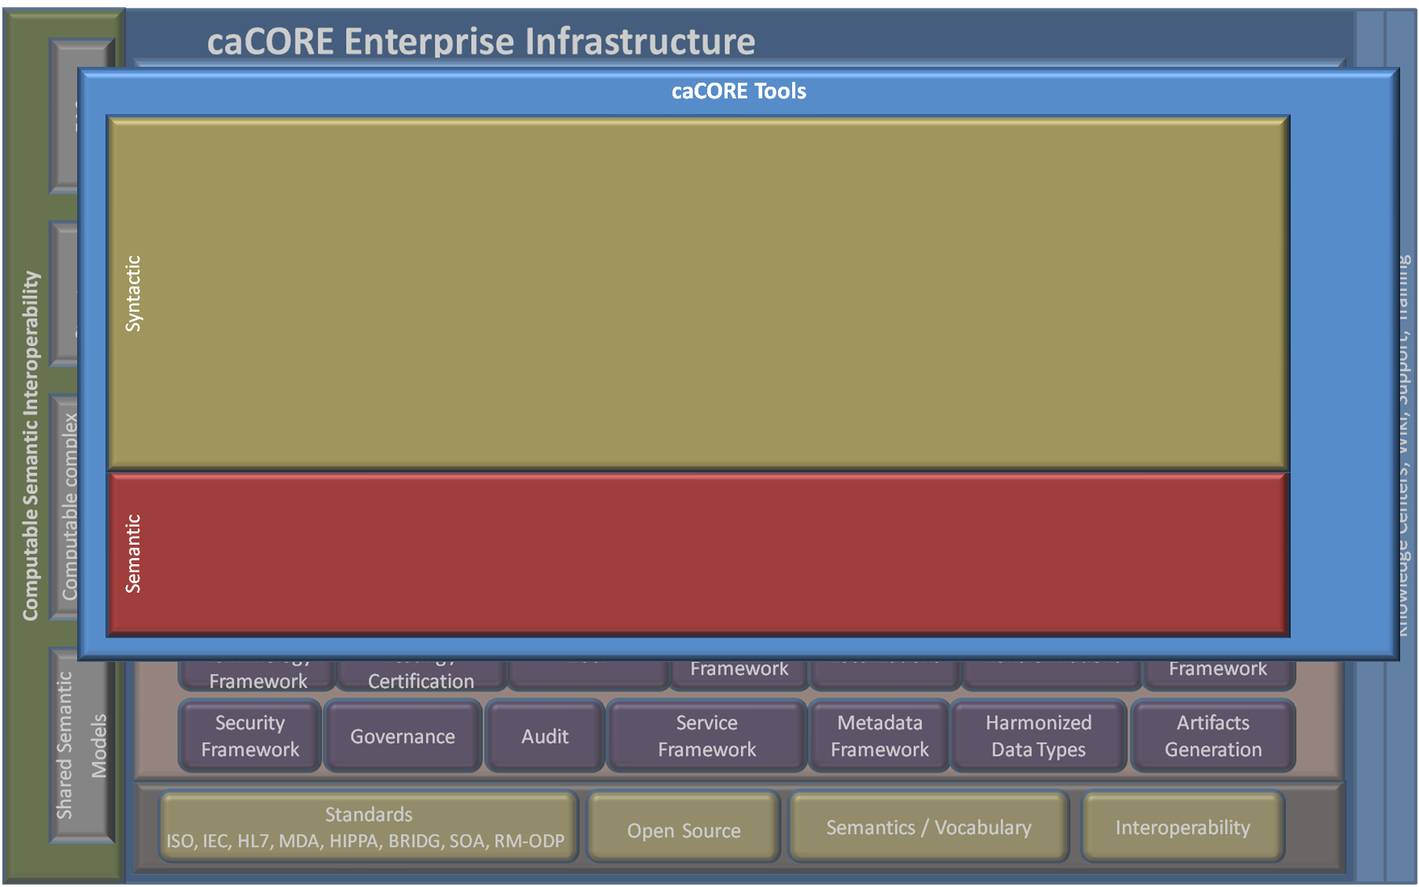
caCORE Infrastructure - Next Generation Tools

Slide 23
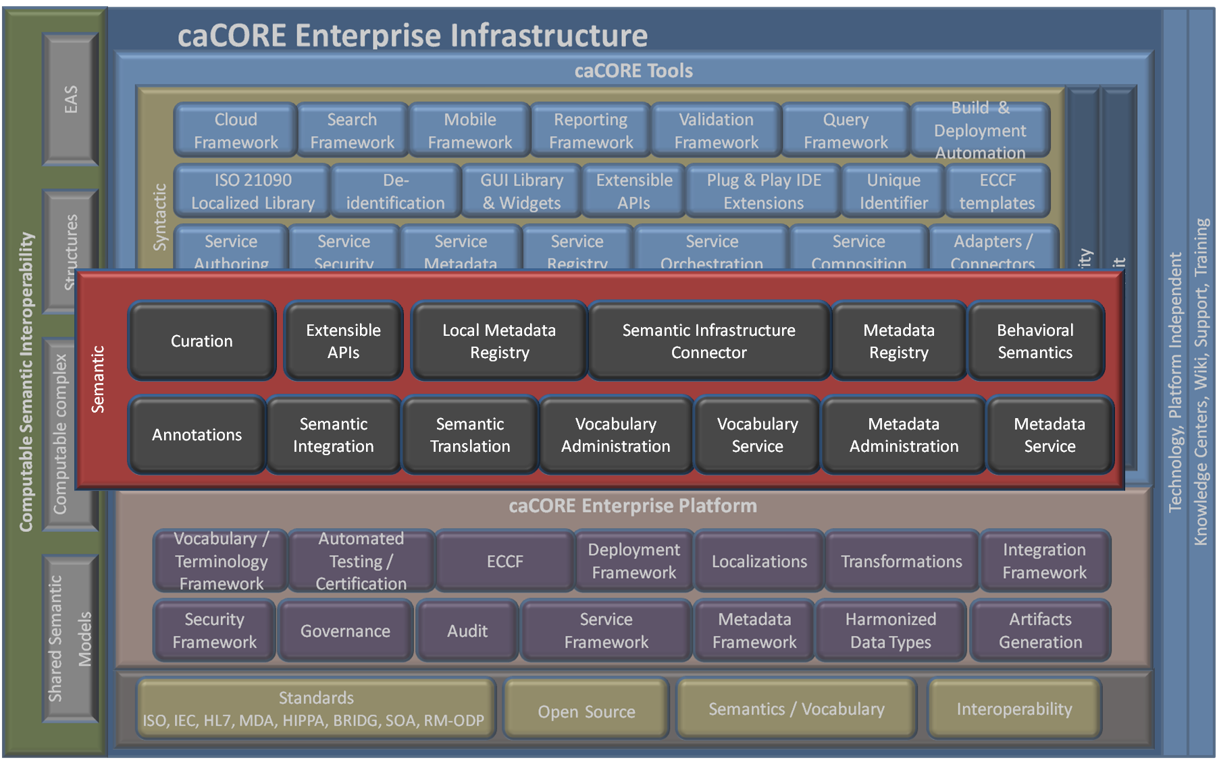
caCORE Infrastructure - Next Generation Tools

Slide 24
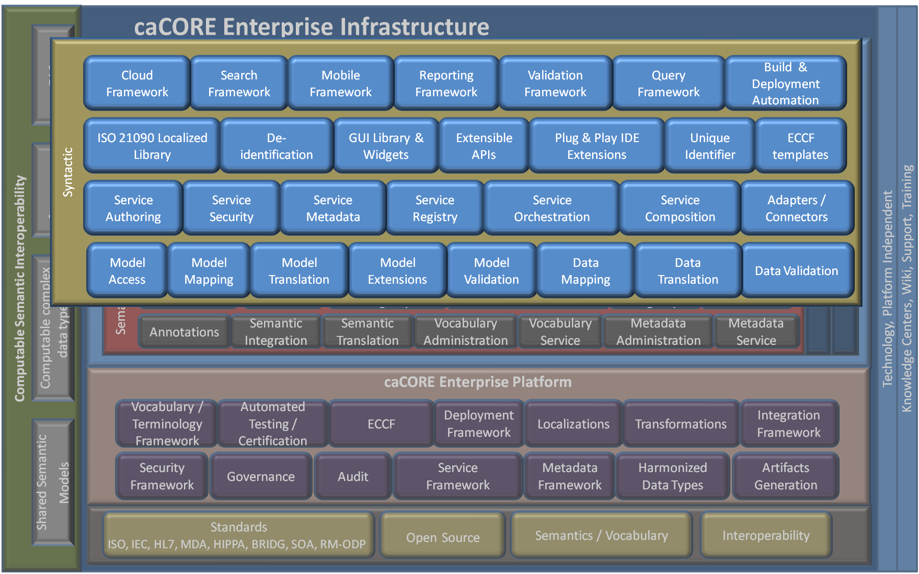
caCORE Infrastructure - Next Generation Tools

Slide 25
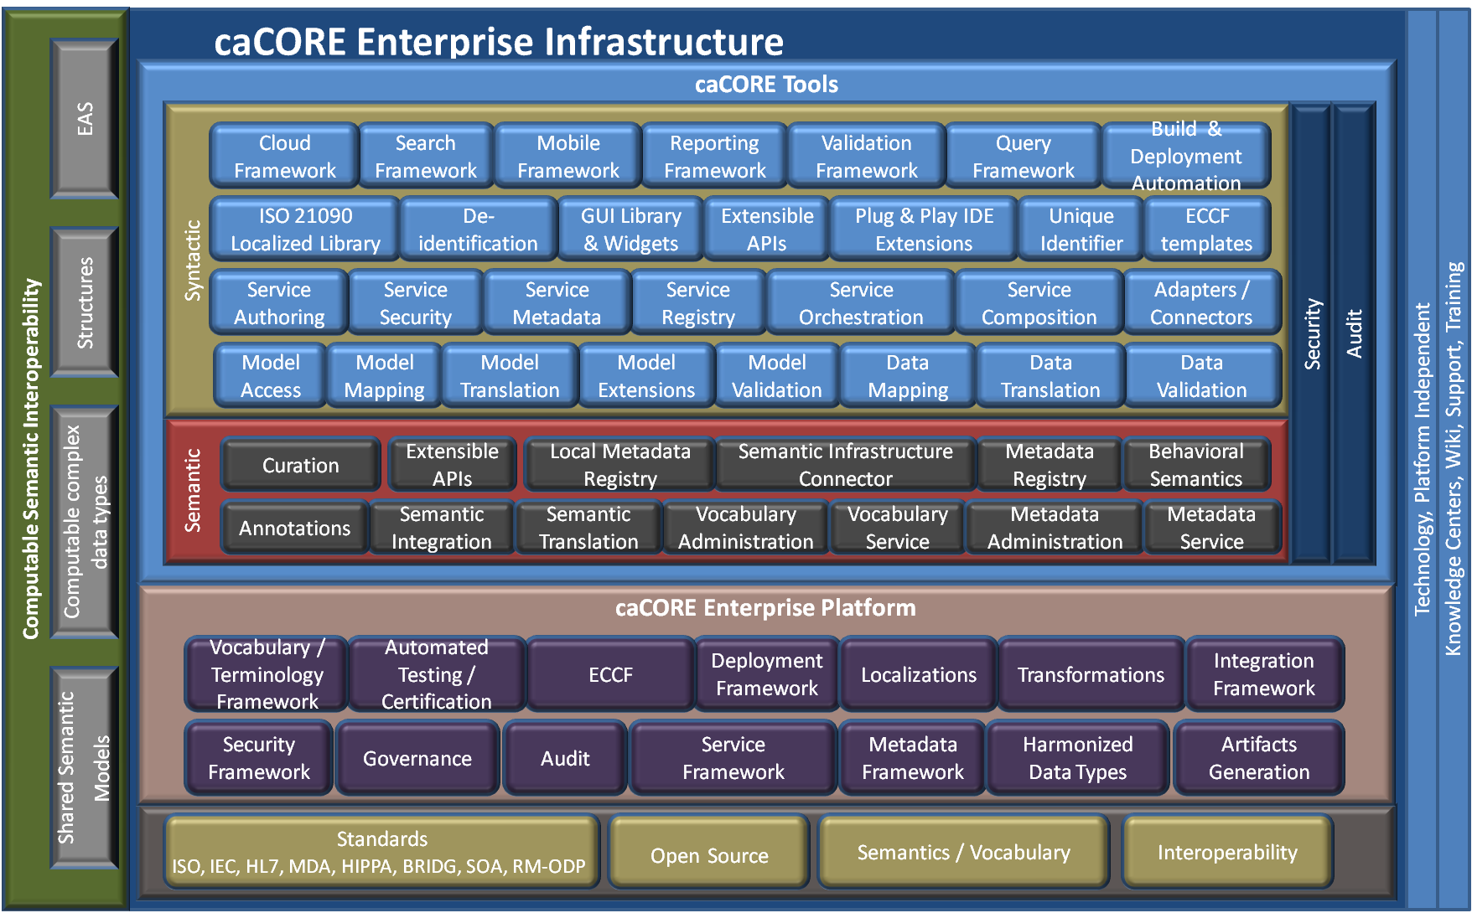
caCORE Infrastructure - Next Generation Tools

Slide 26

Questions

