Slide 1


Service Generation Framework
Prasad Konka
caCORE SDK Team
August 10, 2010

Slide 2
Scope
  Generate various service artifacts
  Provide pluggable business interface implementation to facilitate loose coupling between service and business implementation
  Assemble service artifacts and business implementation to generate deployable enterprise service.

Slide 3
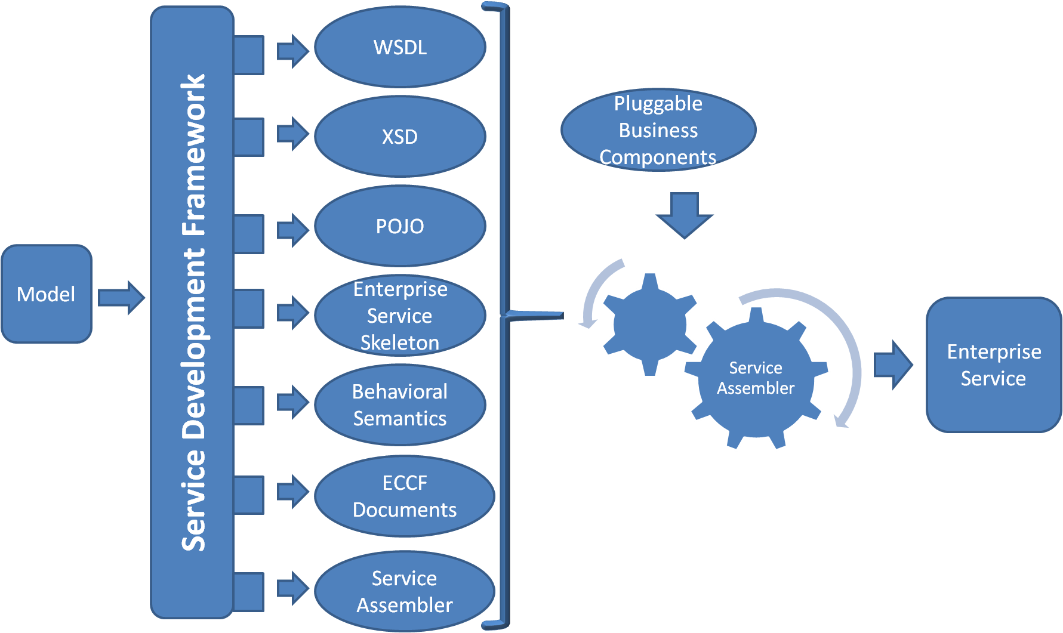
Service Generation Framework

Slide 4
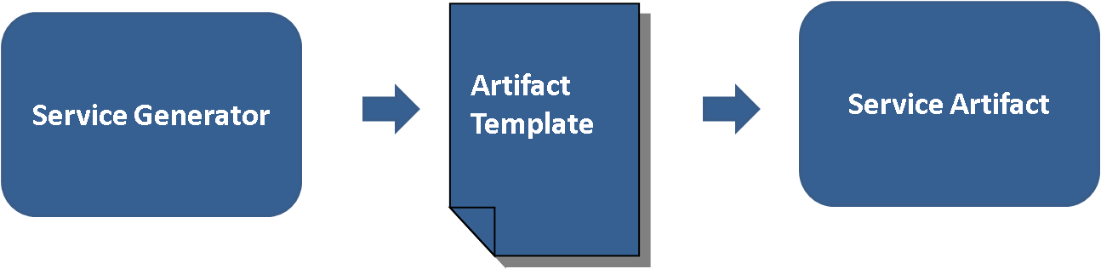
Templates

Slide 5
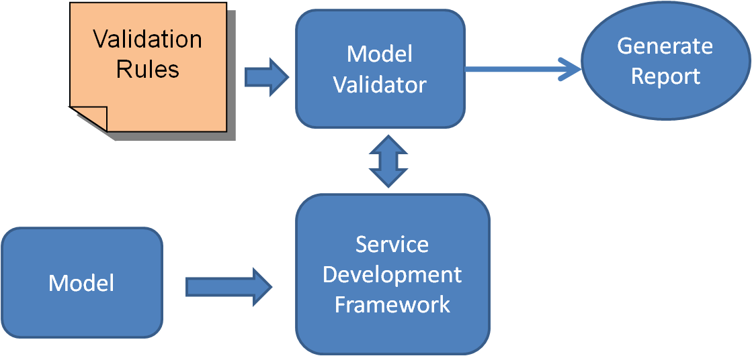
Validation

Slide 6
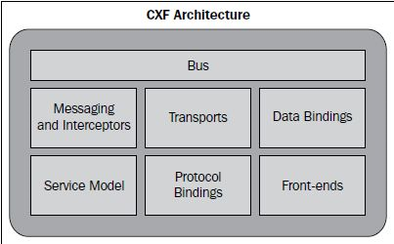
CXF
CXF code generation tools
Java to WSDL
WSDL to Java
XSD to WSDL
WSDL to XML
WSDL to SOAP
WSDL to service
WSDL to JavaScript
WSDL validator
Eclipse webtools

Slide 7
Annotations
  package com.nih.nci.sdk.demo;
  @WebService
  public interface HelloWorld {
  String sayHi(@WebParam(name="text") String text);
  }

Slide 8
Annotations
  package com.nih.nci.sdk.demo;
  import javax.jws.WebService;
  @WebService(endpointInterface = " com.nih.nci.sdk.demo.HelloWorld",
  serviceName = "HelloWorld")
@SOAPBinding(style=SOAPBinding.Style.DOCUMENT,use=SOAPBinding.Use.LITERAL,parameterStyle=SOAPBinding.ParameterStyle.WRAPPED)
  public class HelloWorldImpl implements HelloWorld {
  @WebMethod
  public String sayHi(String text) {
  System.out.println("sayHi called");
  return "Hello " + text;
  }
  }

Slide 9
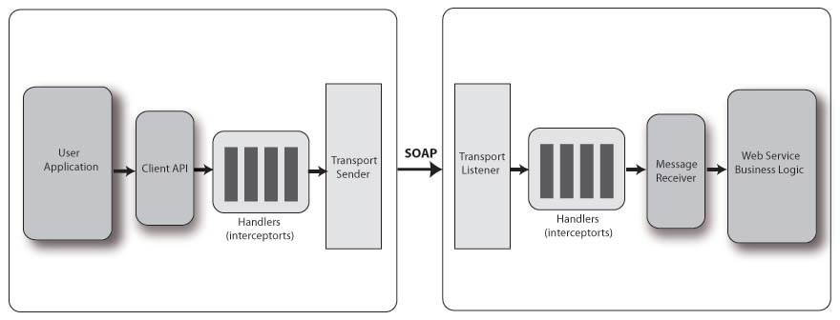
Interceptors

Slide 10
Interceptors
  public class MyInterceptor extends AbstractSoapInterceptor {
  public MyInterceptor() {
  super(Phase.USER_PROTOCOL);
  // MyInterceptor needs to run after SomeOtherInterceptor
  getAfter().add(SomeOtherInterceptor.class.getName());
  // MyInterceptor needs to run before YetAnotherInterceptor
  getBefore().add(YetAnotherInterceptor.class.getName());
  }
  ...
  }

Slide 11
Interceptors
  @org.apache.cxf.interceptor.InInterceptors (interceptors = {"com.example.Test1Interceptor" })
  @org.apache.cxf.interceptor.InFaultInterceptors (interceptors = {"com.example.Test2Interceptor" })
  @org.apache.cxf.interceptor.OutInterceptors (interceptors = {"com.example.Test1Interceptor" })
  @org.apache.cxf.interceptor.InFaultInterceptors (interceptors = {"com.example.Test2Interceptor","com.example.Test3Intercetpor" })
  @WebService(endpointInterface = "org.apache.cxf.javascript.fortest.SimpleDocLitBare",
  targetNamespace = "uri:org.apache.cxf.javascript.fortest")
  public class HelloWorldImpl implements HelloWorld {
  public long sayHi(long arg) {
  return arg;
  }
  ...
  }

Slide 12
Error Handling
  package com.example.customerservice;
  @WebFault(name="NoSuchCustomer")
  @XmlAccessorType( XmlAccessType.FIELD )
  public class NoSuchCustomerException extends RuntimeException {
  /**
  * We only define the fault details here. Additionally each fault has a message
  * that should not be defined separately
  */
  String customerName;
  }

Slide 13
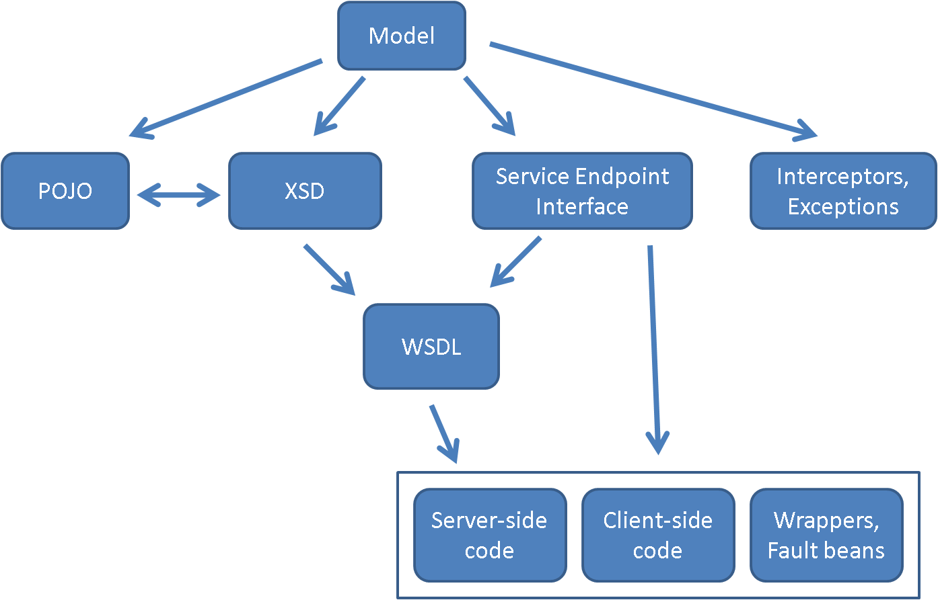
The approach

Slide 14
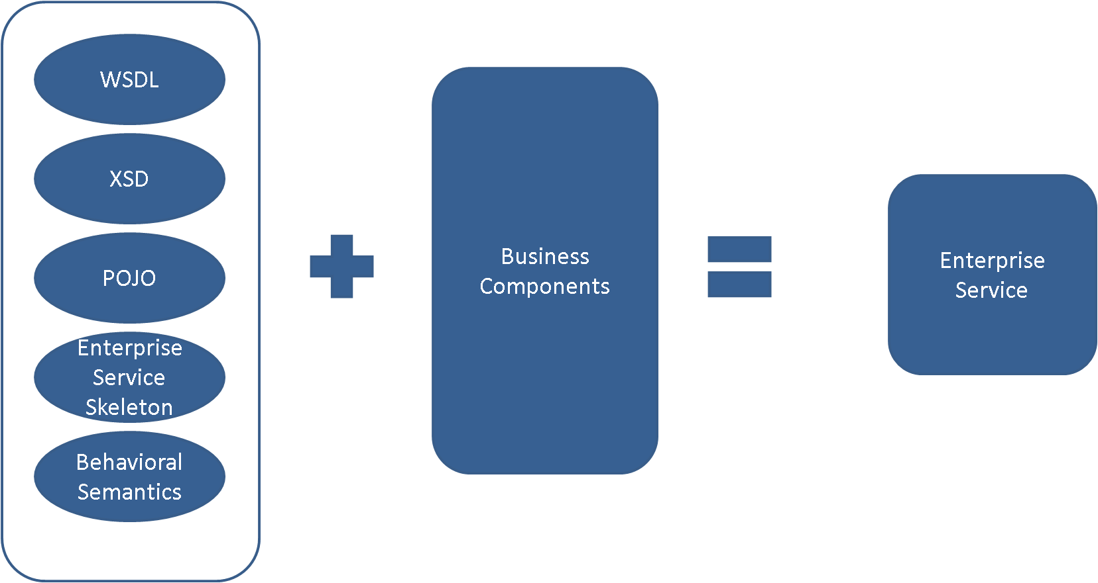
Service Assembler

Slide 15
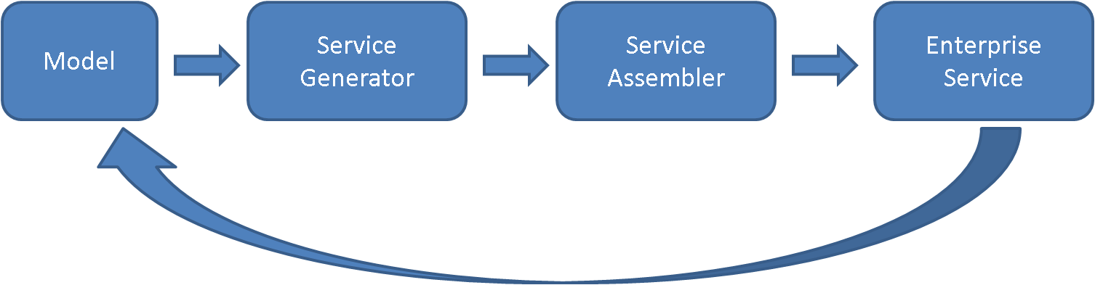
Service Synchronization
Operations
Relationships
Properties
Domain object annotations

Slide 16
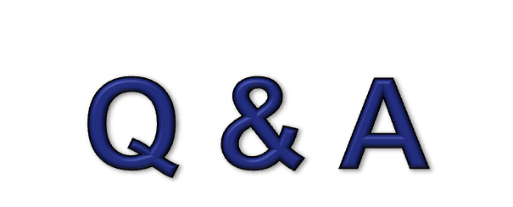
Questions

