Slide 1
Design Review
Requirement Phase for caCORE Release 3.1
Skip Pattern
Formbuilder
October , 2005
Prepared by Oracle Corporation
(Shaji Kakkodi)

Slide 2
Skip Pattern
Skip pattern stores the metadata about the navigation from one location on the form(Source) to another location on the form(Target).
Source location can be valid value of a question or end of a module/form.
Target location can be a form, module or a Question on the same form or a different form.
Skip pattern can also have an instruction.
Skip Patterns can be associated with a Classification/Protocol

Slide 3
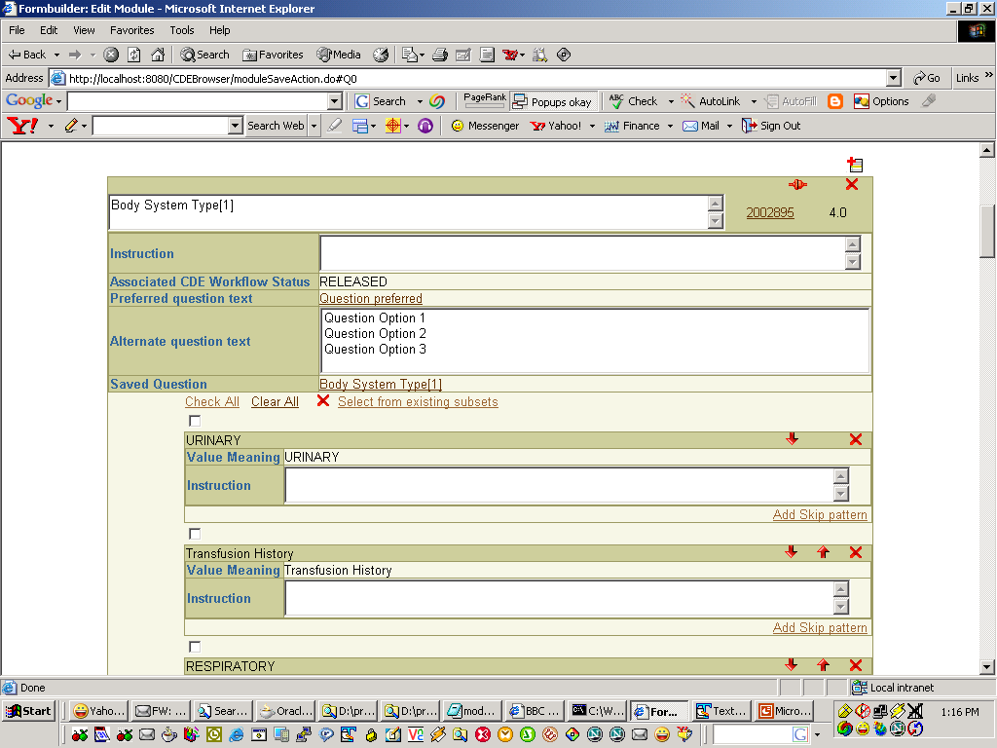

Slide 4
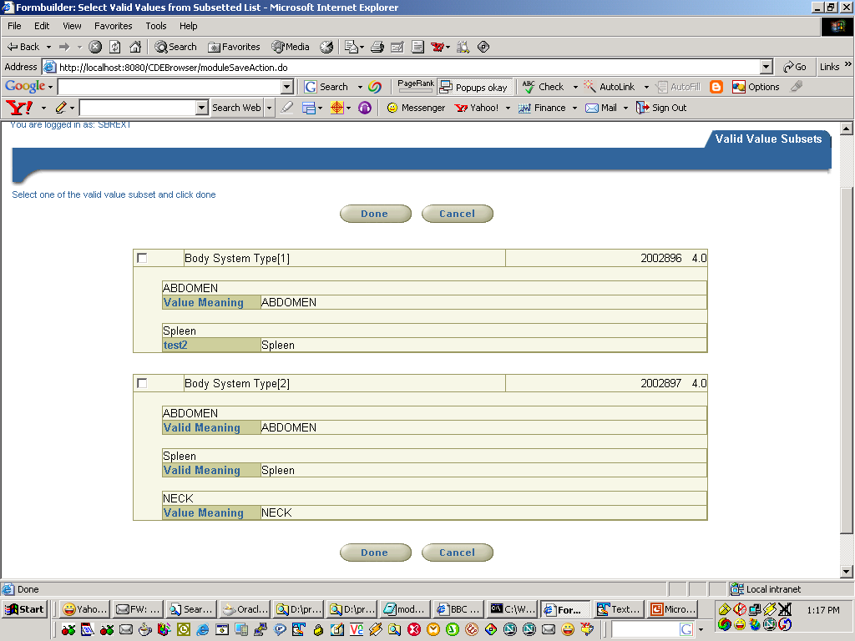
v

Slide 5
