Slide 1
Design Review
Design and Prototyping Phase for caCORE Release 3.1
Value Domain Subsetting
Wenesday, October 12, 2005
Prepared by Oracle Corporation November 2004
Revised by Denise Warzel

Slide 2
Presentation Outline
Recap
Creating new subsetted VDs.
Review Form Builder screens for creating subsets of valid values.
Issues that need to be addressed when new VDs are created for Subsets

Slide 3
The Goal
To list all the CDEs used for a particular protocol and also the subsetted Valid Values used on the form.
To be able to re-use subsets.
To be able to view subsetted VDs as an extension of the VD itself. (more visibility into relationships.)
Access metadata relationships through UI

Slide 4

Recap
ISO Compliant
Create new VD and new CDE – at time subsetted VD is added to CRF/Template
Create new VD and new CDE – only when CRF/Template’s workflow status gets changed to “Released.”

Slide 5
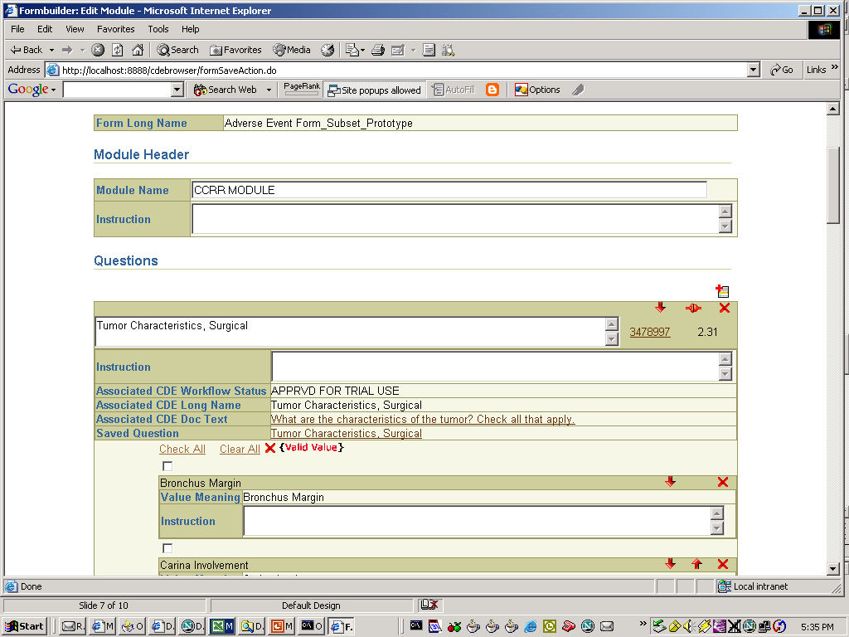
Review screens
Reuse subsetted VDs(View existing subsets)
Select from existing VD subsets
Select from existing VD subsets

Slide 6
Issues that need to be addressed when new VDs are created for Subsets
Naming convention
  All fields could remain the same except
    Long name -> Long name + [ + index + ]
    Preferred name -> parent publicId ID + parent version + [ + index + ]
Version
  When a VD is versioned related VD relationships are not copied (Unless user opts to do so)
  User could create a new version of a VD, which could have the same list of Permissible values as a child related VD, Curators are expected to check the related VDs before creating a new version of the VD
3. Relationship
  Bidirectional relation with different relationship types (parent, child)

Slide 7
Issues that need to be addressed when new VDs are created for Subsets
4. Hidden VDs
  Subsetted VDs that are hidden will not be visible in other tools “Will have deleted indicator=”LAT”
  Subsetted VDs that are hidden cannot be reused for creating new CDEs
Workflow Status
  Workflow status of the new subsetted VD will be same as its parent at the time of creation.
  What should be the WS of of hidden VDs?
6. Subsetting subsetted VDs
Who will be the parent when a subsetted VD is subsetted again?

Slide 8
Issues that need to be addressed when new VDs are created for Subsets
7. Context
  In which context will the new subsetted VD be created?
8. Duplicate subsets
  Can user create duplicate subsets (apart from Latent duplicate)?

Slide 9
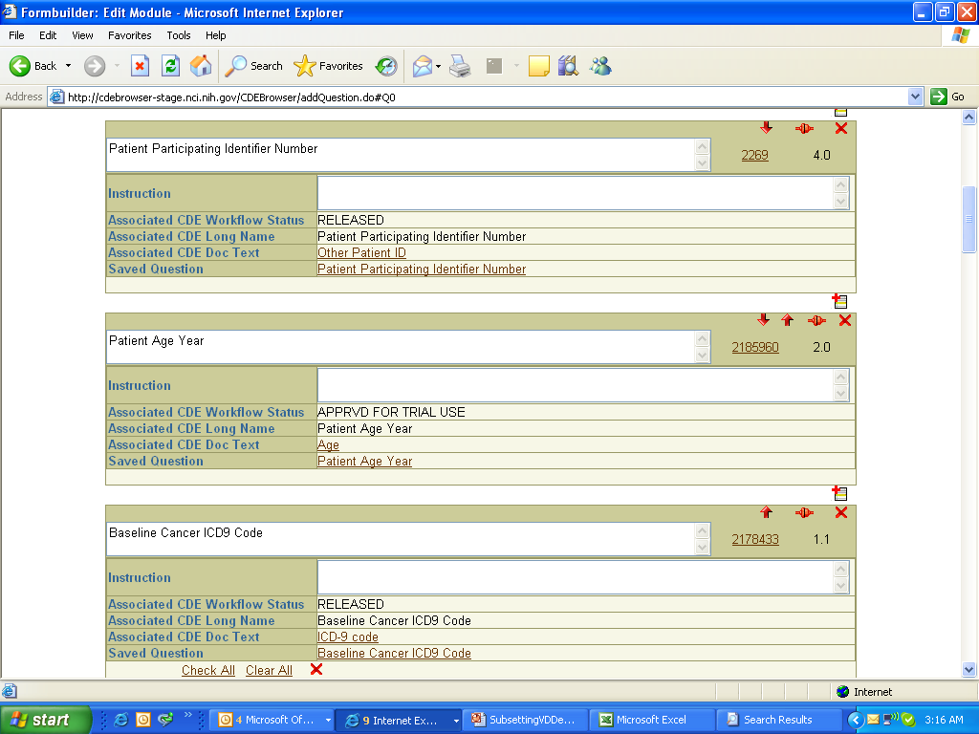

Slide 10
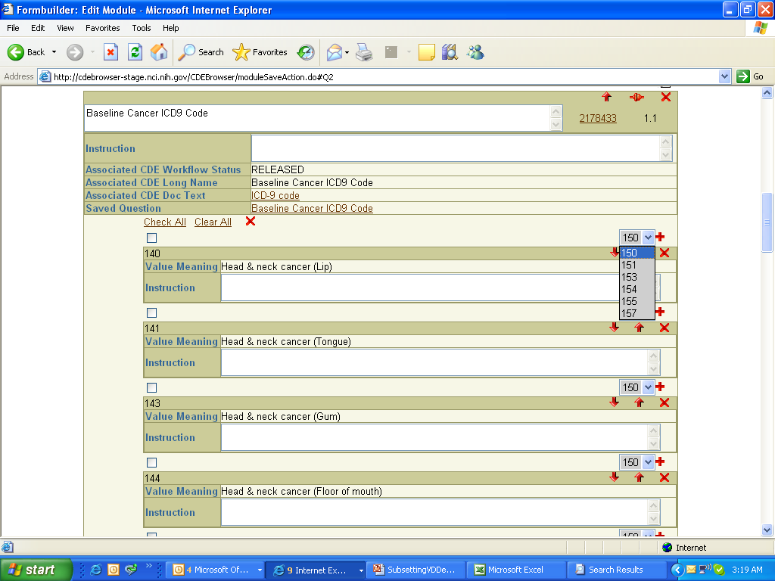
“SAVE Form with “Released”

Slide 11
Duplicate found based on Values

Slide 12
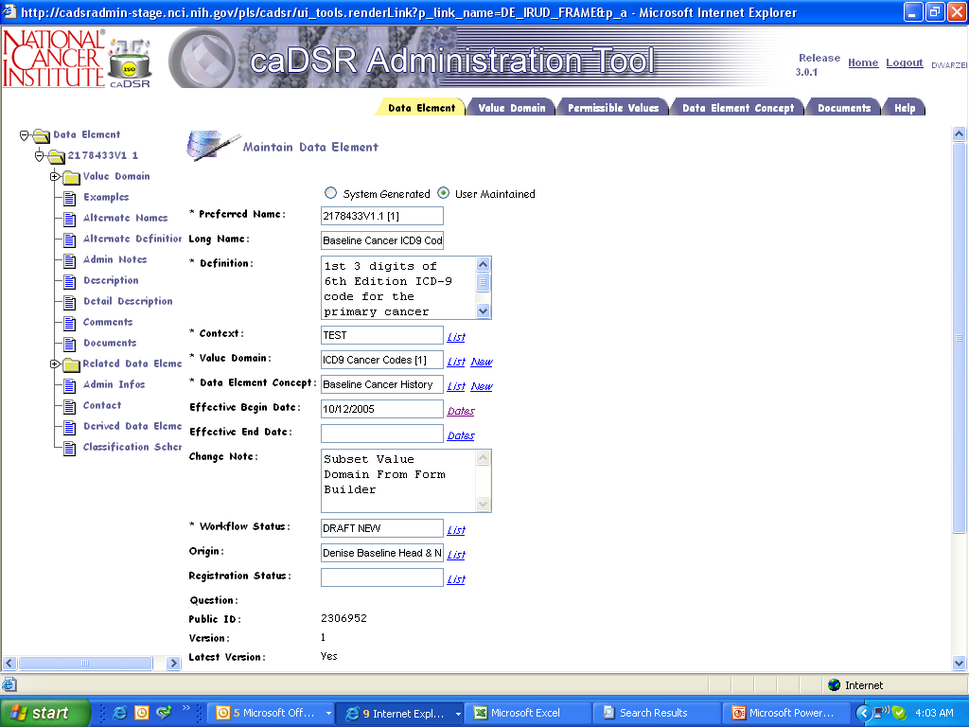
Child DE View
PublicId + V + [1] of Parent
Long Name + [1] of Parent
Context of Form
VD Long Name + [1] of Parent
Date Created
Subset Created/Form Builder
Draft New
Name of Form

Slide 13
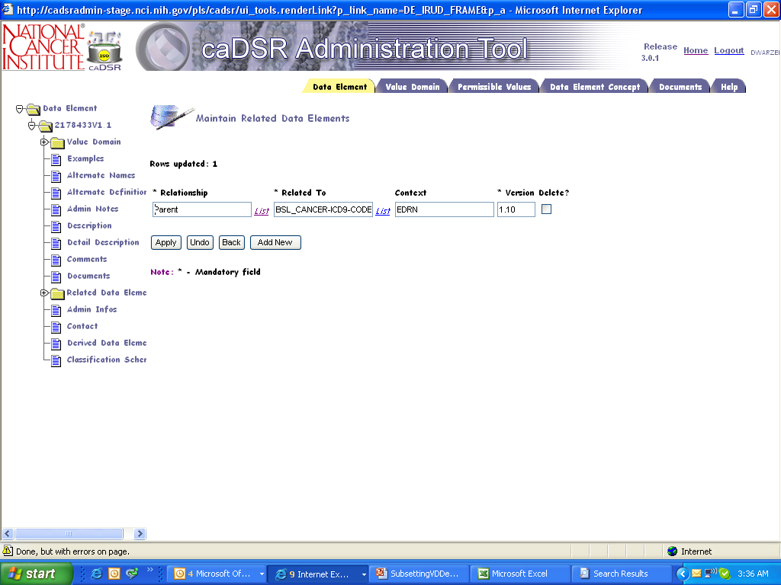
Child DE View
Parent
Baseline Cancer ICD9…

Slide 14
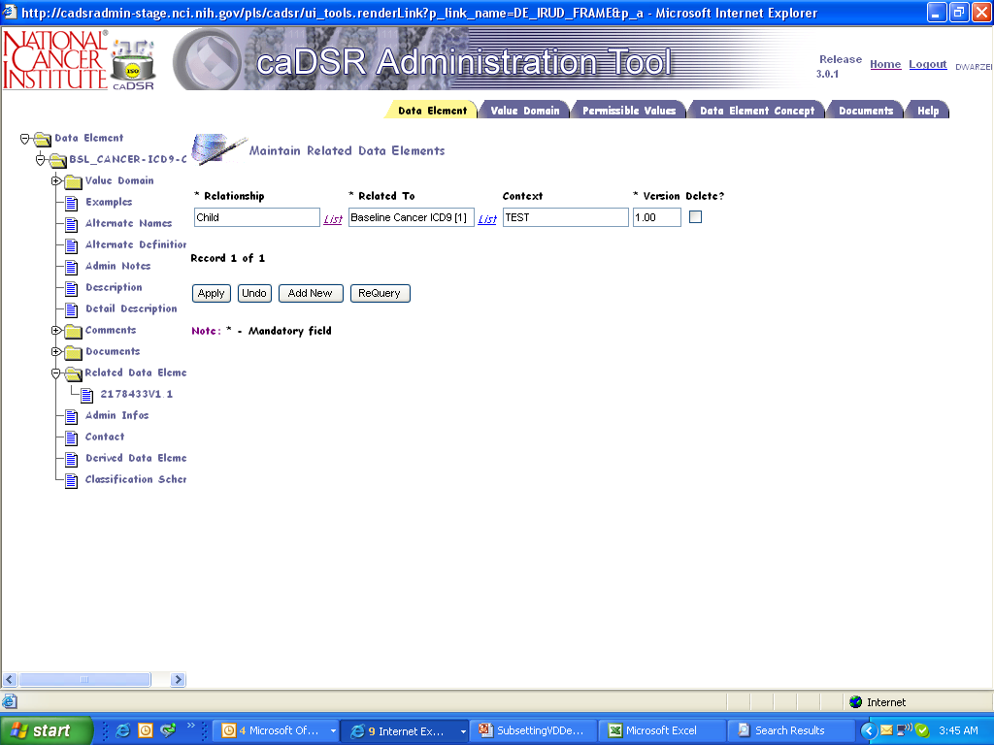
Parent DE View
Child
Baseline Cancer ICD9 [1]

Slide 15
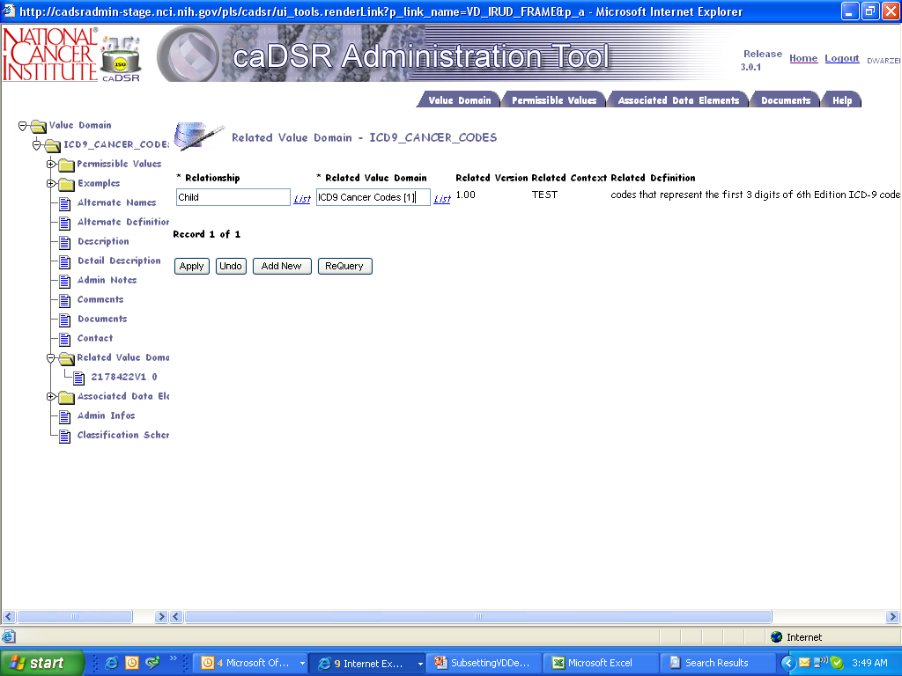
Parent Value Domain
Child
Baseline Cancer ICD9 [1]

Slide 16
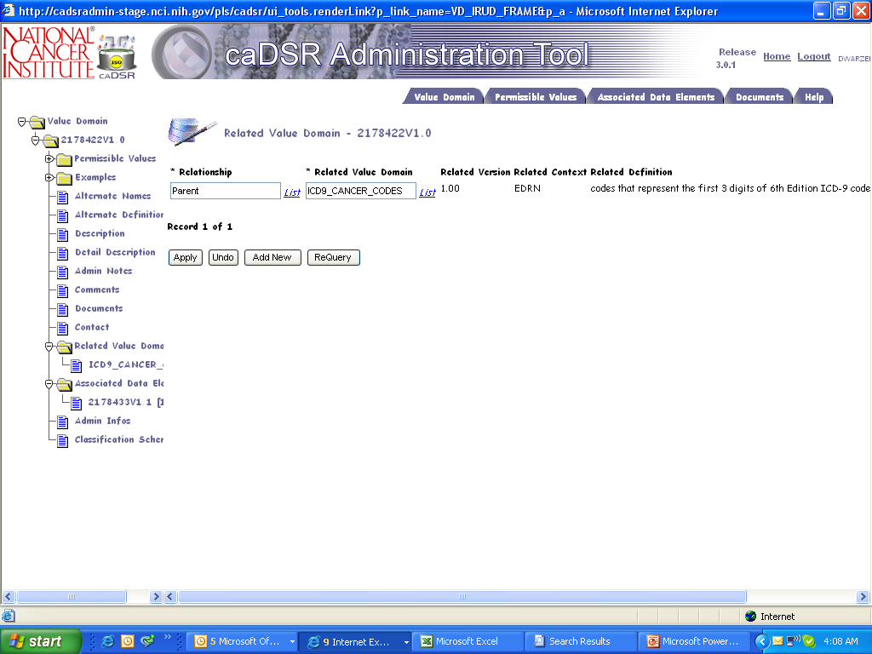
Child Value Domain
Parent
ICD9 Cancer Codes [1]

Slide 17
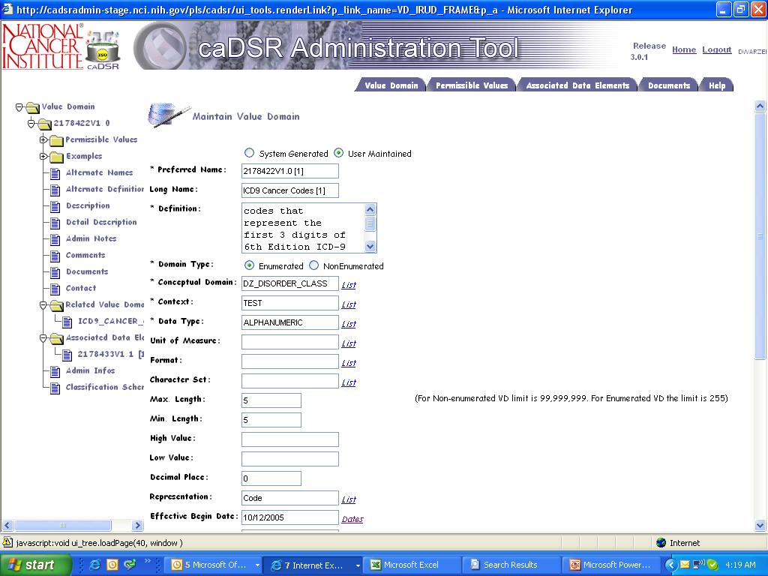
Child Value Domain
PublicId + V + [1] of Parent
Long Name + [1] of Parent
Context of Form

Slide 18
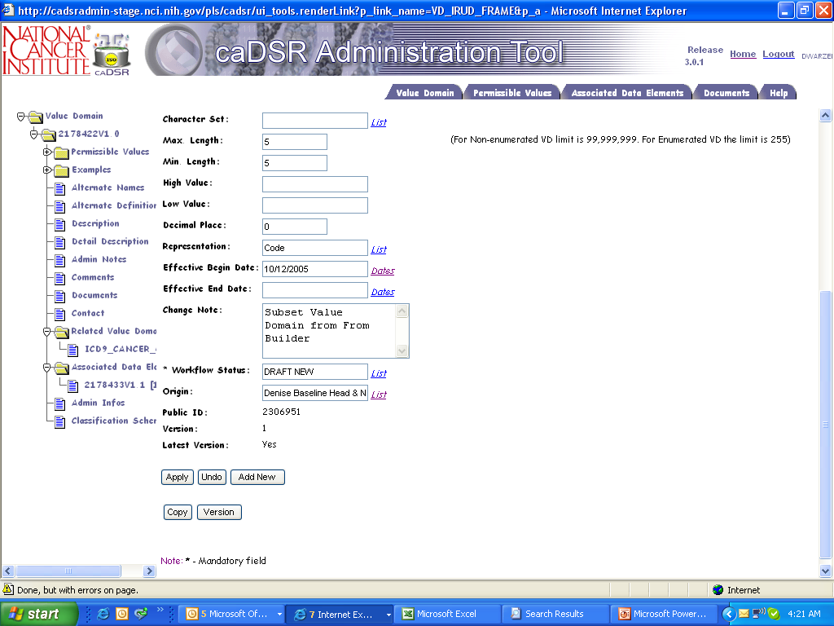
Child Value Domain
Date Created
Change Note
Form Name

Slide 19
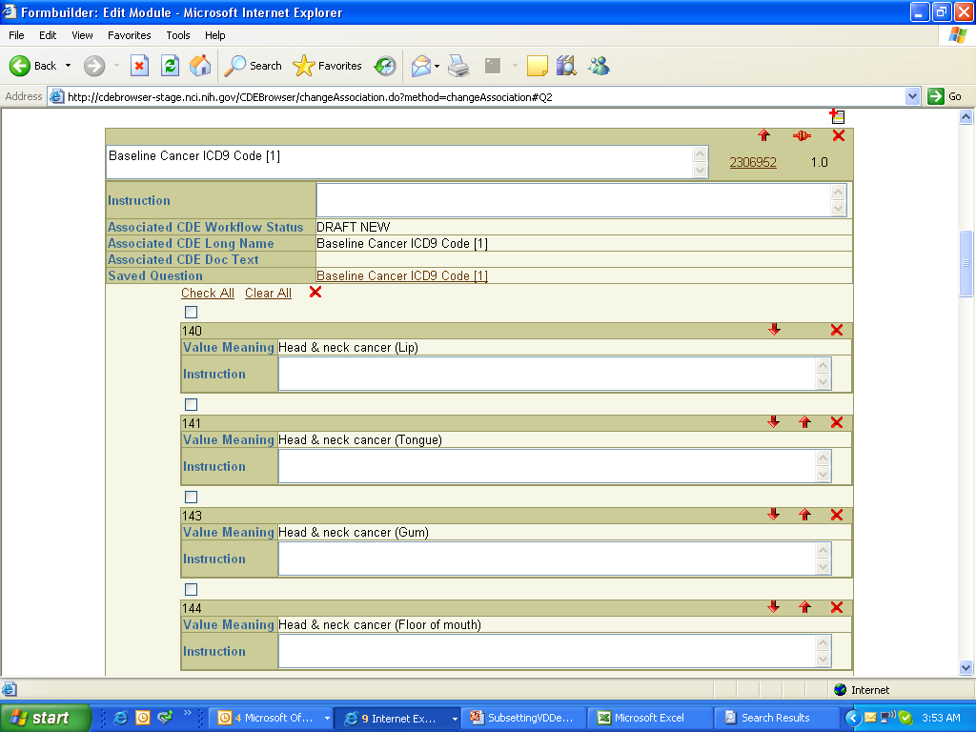
CDE Replaced with Child
2178433V1.1
Child
2178433V1.1 Parent
Default Question Text

