Slide 1
Design Review
Requirement Phase for caCORE Release 3.1
Praposed new features
Formbuilder
October , 2005
Prepared by Oracle Corporation
(Shaji Kakkodi)

Slide 2
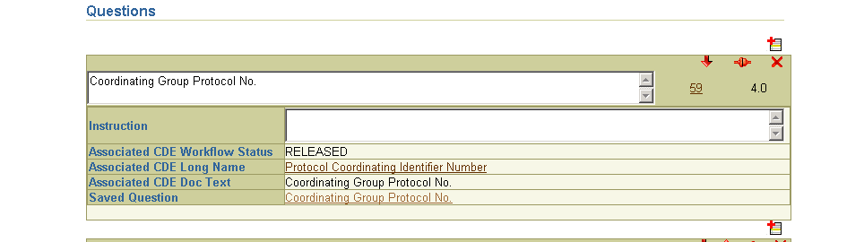
Specifying a Question
Current Implementation

Slide 3
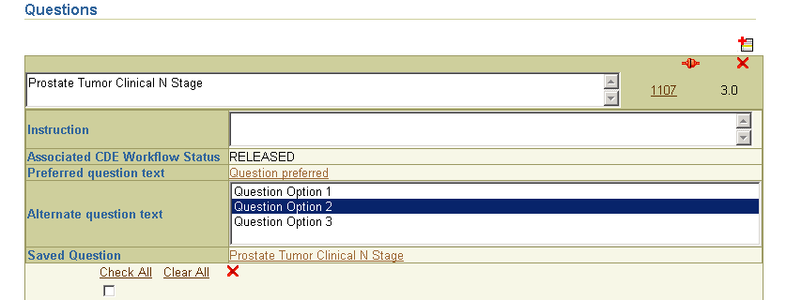
Specifying a Question
Question text: Use of Reference Document of type “Preferred Question Text” and “Alternate Question Text” of the associated CDE as the question text

Slide 4
Specifying a Question
Text field will not be editable
Defaults to “Preferred Question text” when cde is added to the form.
What if there is no “Preferred Question text” exit?

Slide 5
Skip Pattern
Skip pattern stores the metadata about the navigation from one location(Source) to another location(Target).
Source location can be valid value of a question or end of a form.
Target location can be a form, module or a Question on the same form or a different form.
Skip pattern can also have an instruction.
Validate skip patterns on a form
  Skip pattern is invalid if its target does not exit

Slide 6
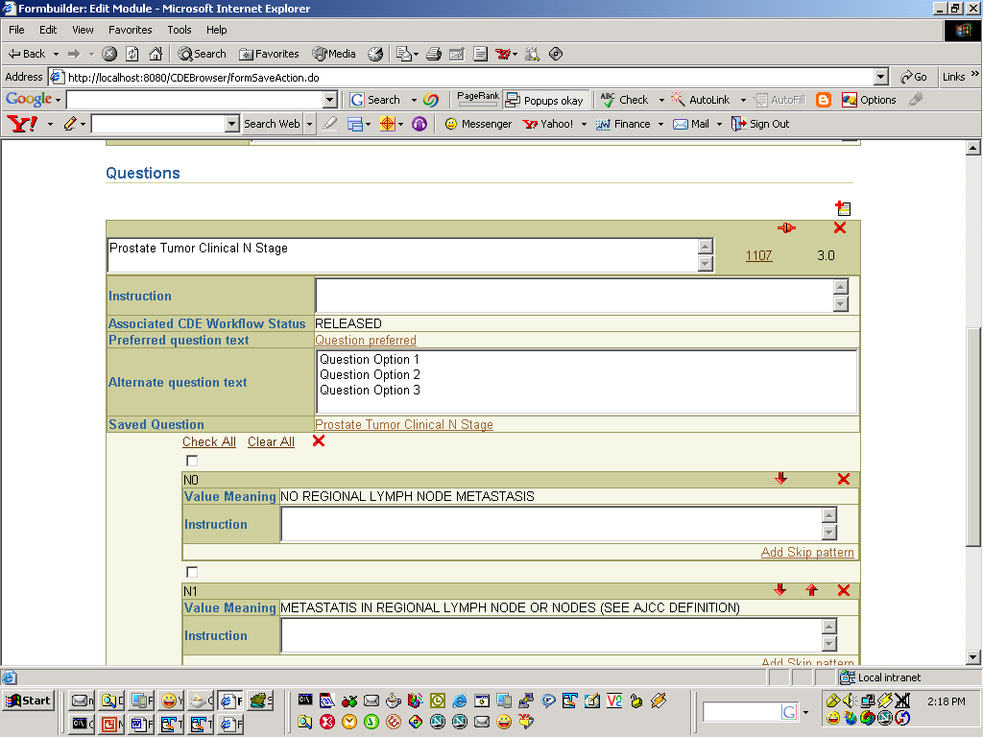
Module Edit Screen
Add skip pattern

Slide 7
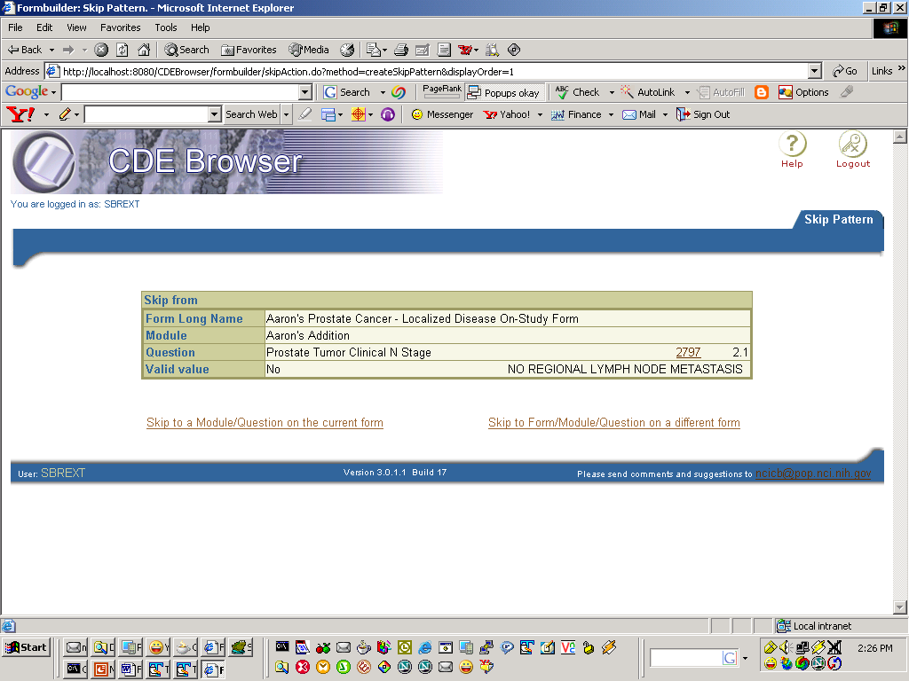
Skip where?

Slide 8
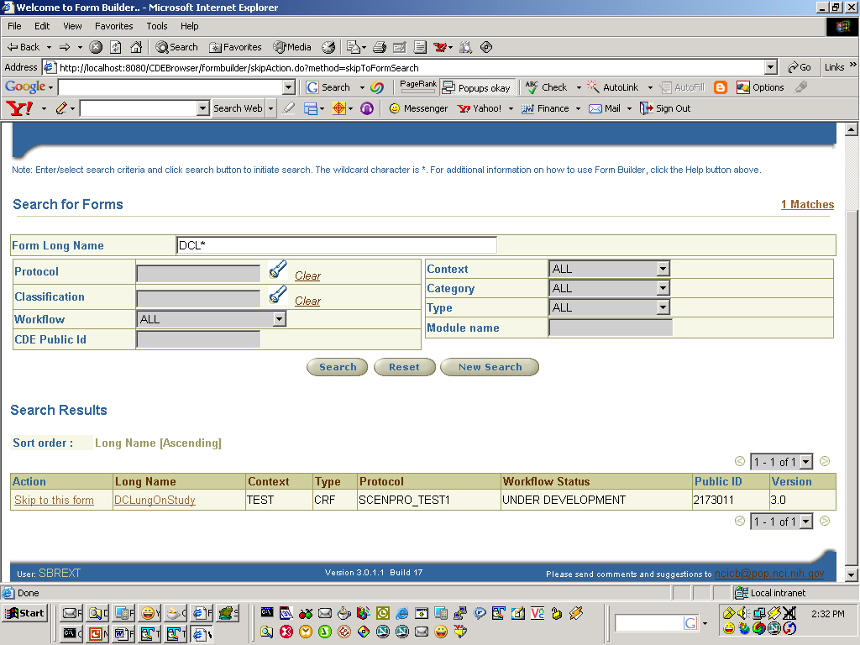

Slide 9
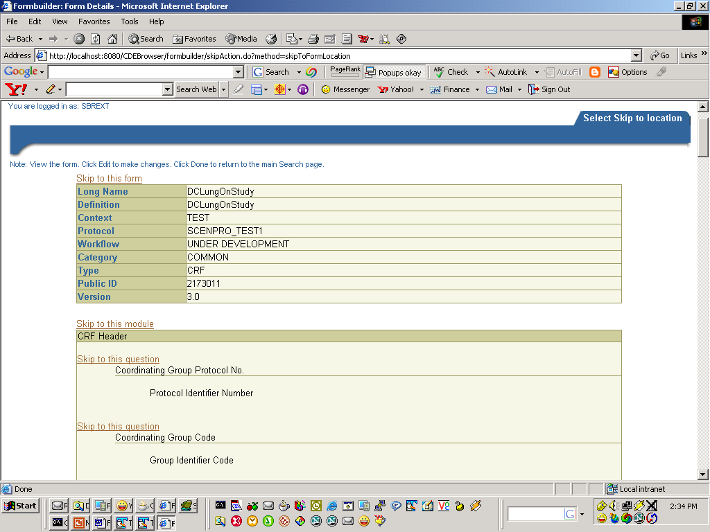
Skip to top of this form
Skip to this module
Skip to this Question

Slide 10
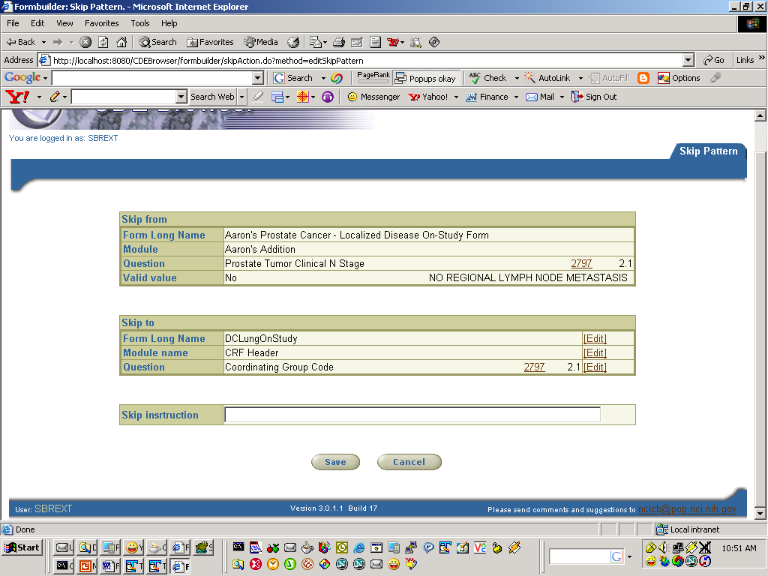

Slide 11
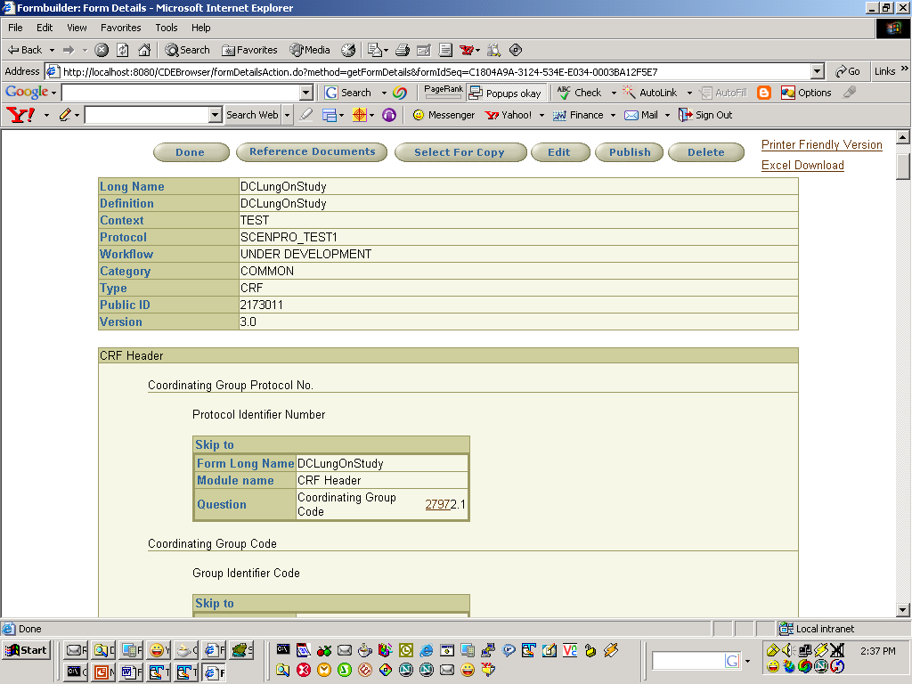
Adding a Skip Pattern to a Valid value

Slide 12
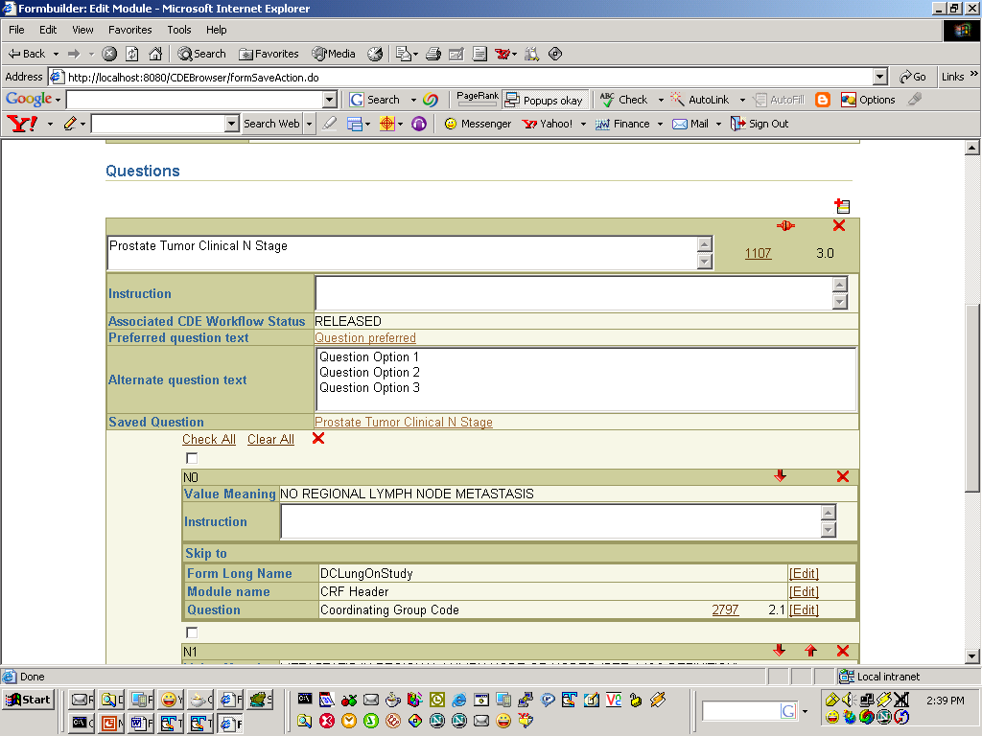
Adding a Skip Pattern to a Valid value

Slide 13
Copy Module
During form edit/create process
  Search for a module on the same/different form
  Copy and paste the module into the form
  Will have the ability to add multiple copies of the same module

Slide 14
Subset Value Domains: Create subsetted Value Domains/CDEs
  Create a subsetted VD if one does not exits
  Create Parent child relationship
  Create new CDE
  Create Parent child relationship
  Question associated with new CDE
  New VD/CDE to created in the same context
  Question associated with the new CDE

Slide 15
UI Metadata: Add/Display UI Metadata attributes
Value Domain: Display VD attributes for non-enumerated
  Data type
  Format
  Max length, Min length
Classification
  Ability to Classify all CDEs on Form when classifying a form.
  Enhance classification LOV
    Add search criteria “type”
    Change Column ordering to
      CS Long Name, CS Context, WS, CSI Long Name, CSI Long Name
Label Change: Change Preferred Name to Short Name and Long Name to Preferred Name

Slide 16
Derived DataElements: Display derived data element information.
Form version: User can version a form
  All attributes are copied.
  Workflow status?
Context Search: Allow users to search more than one context at a time.
Integration: Curation tool and Setinal tool
  If no matching CDE exit create new CDE
  Set alerts

Slide 17
HL7 Message: Generate HL7 message for a form.

