Slide 1
Application architecture
CDEBrowser/Formbuilder
November , 2005

Slide 2
Technology Stack
Struts
  JSP and Struts tags for presentation
Jakarta POI
EJB
  Wraps business logic/Transaction
Spring
  Dependency Injection
  Gives a abstraction layer over JDBC/Hibernate
Hibernate
  OR Mapping layer
JDBC
  Persistence
Securtiy
  JAAS
JBOSS

Slide 3
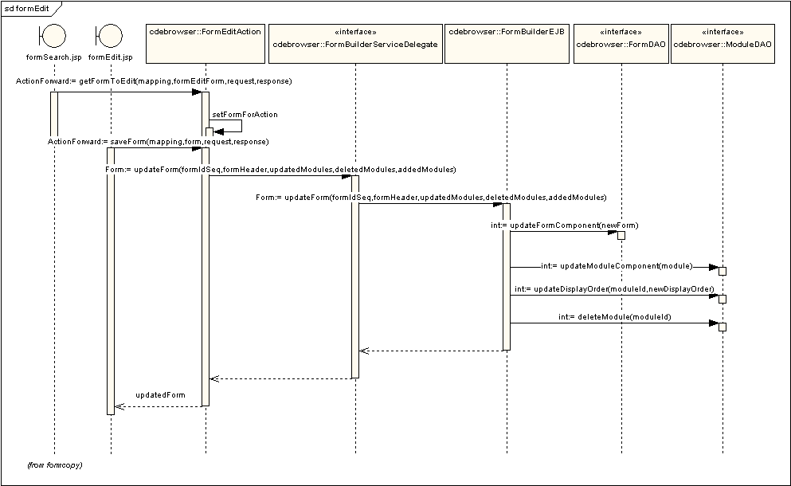
Formbuilder

Slide 4
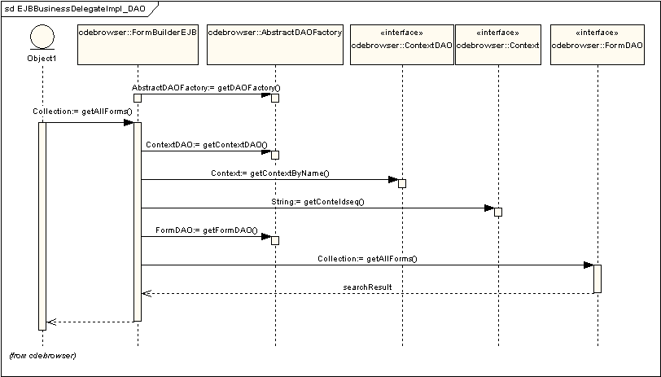
Formbuilder

Slide 5
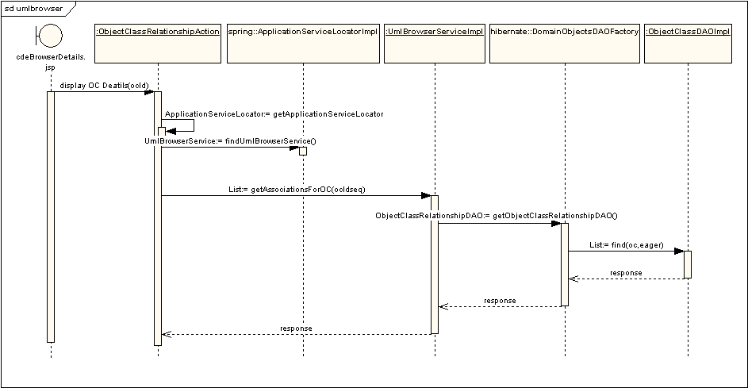
ObjectClass Browser

Slide 6
Spring
<beans>
<bean id="OCBrowserService" class="gov.nih.nci.ncicb.cadsr.ocbrowser.service.impl.OCBrowserServiceImpl">
<property name="domainObjectsDaoFactory"><ref local="domainObjectsDaoFactory"/></property>
</bean>
<bean id="domainObjectsDaoFactory" class="gov.nih.nci.ncicb.cadsr.persistence.dao.domain.hibernate.DomainObjectsDAOFactory">
<property name="adminComponentDAO"><ref bean="adminComponentDAO"/></property>
<property name="dataElementDAO"><ref bean="dataElementDAO"/></property>
<property name="conceptualDomainDAO"><ref bean="conceptualDomainDAO"/></property>
</bean>
</beans>

Slide 7
Spring
Web.xml
<context-param>
<param-name>contextConfigLocation</param-name>
<param-value>/WEB-INF/spring/applicationContext-ocbrowser.xml</param-value>
<description> Spring application context xml files</description>
</context-param>
<listener>
<listener-class>oracle.clex.util.ServletEventListener</listener-class>
<listener-class>org.springframework.web.context.ContextLoaderListener</listener-class>
</listener>
WebApplicationContextUtils.getRequiredWebApplicationContext(servletContext).findObject("OCBrowserService");

