Slide 1
Design Review
Requirement Phase for caCORE Release 3.1
Formbuilder/CDEBrowser
December 4 , 2005
Prepared by Oracle Corporation
(Shaji Kakkodi)

Slide 2
New features
Default value for a enumerated questions.
Copying modules
Module repetitions
Classification tree node by registration status

Slide 3
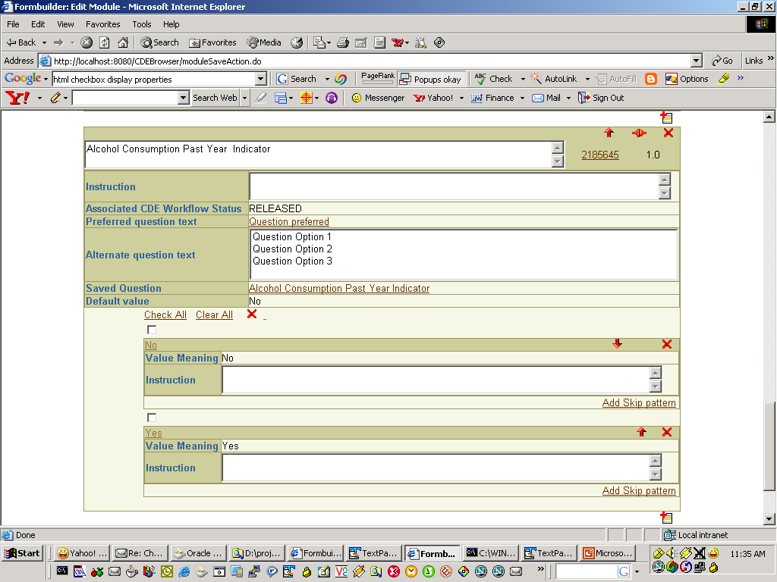
Module edit screen
Default Value

Slide 4
Copying Modules
Copy module from any form/template to any form/template.
Form edit
Click to Copy
module from
a form
Search for the form
select form
Copy module
from the selected
form

Slide 5
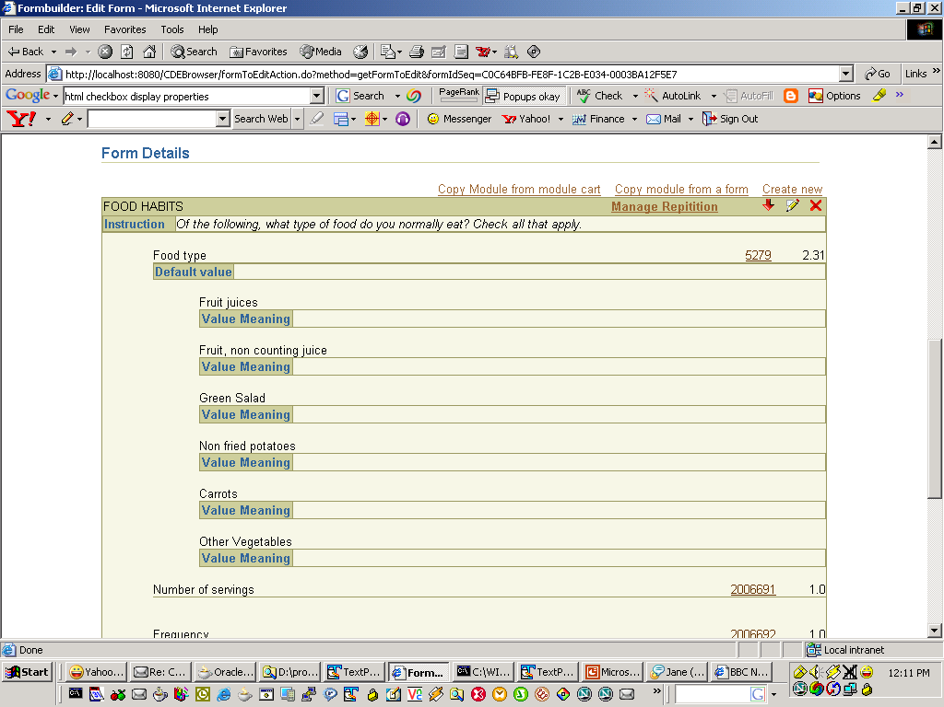
Form edit screen
Copy module from a form

Slide 6
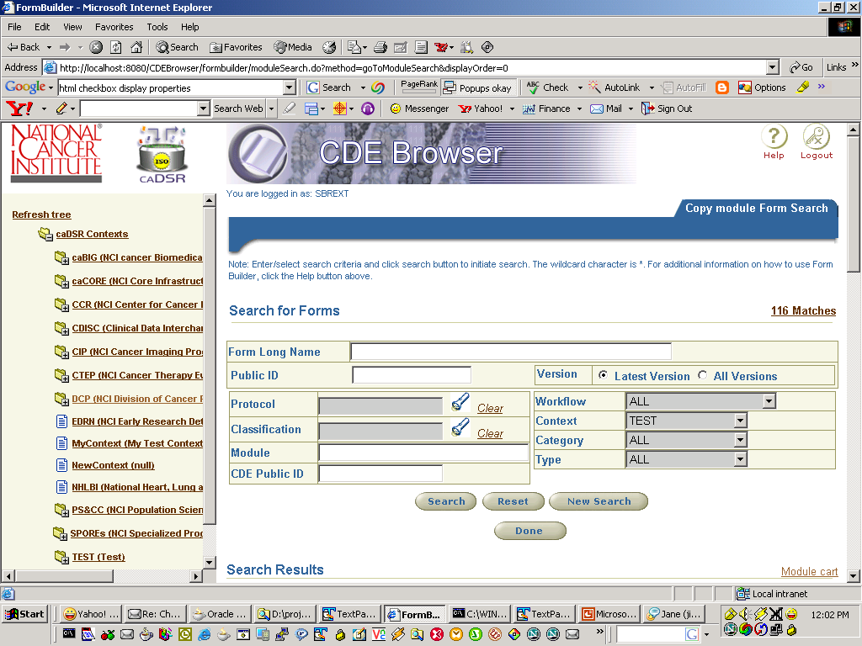

Slide 7
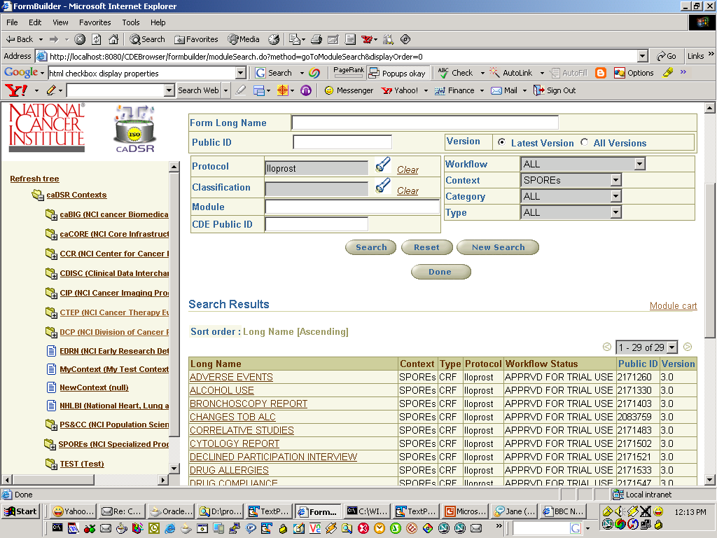

Slide 8
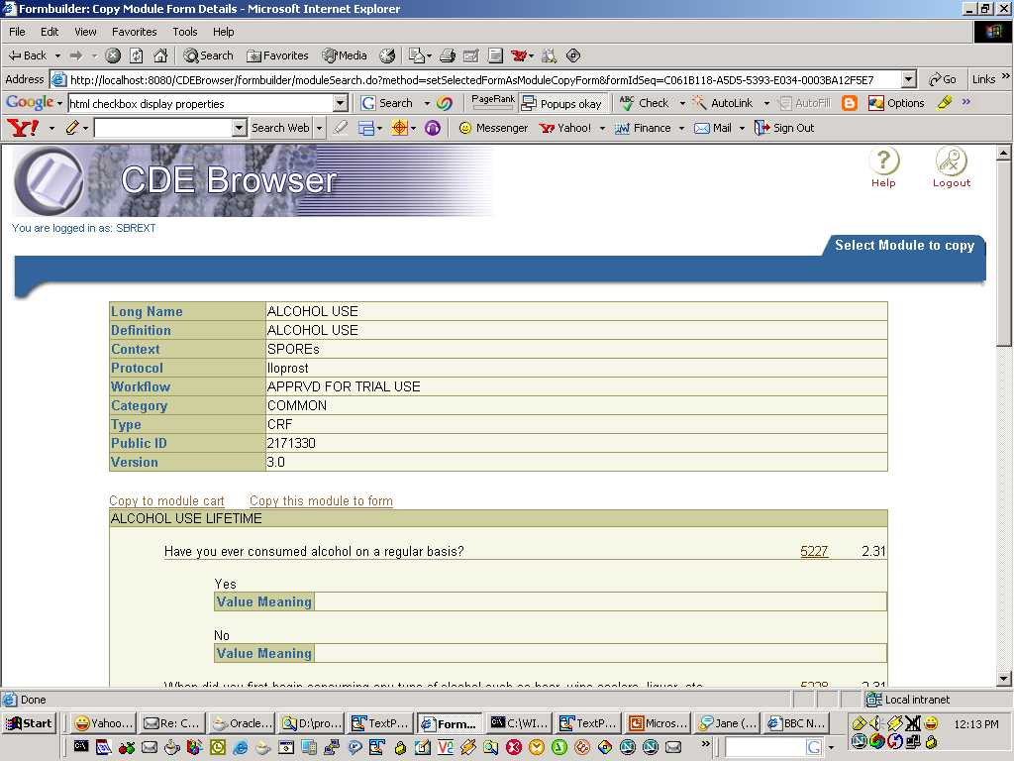
Copy module to from

Slide 9
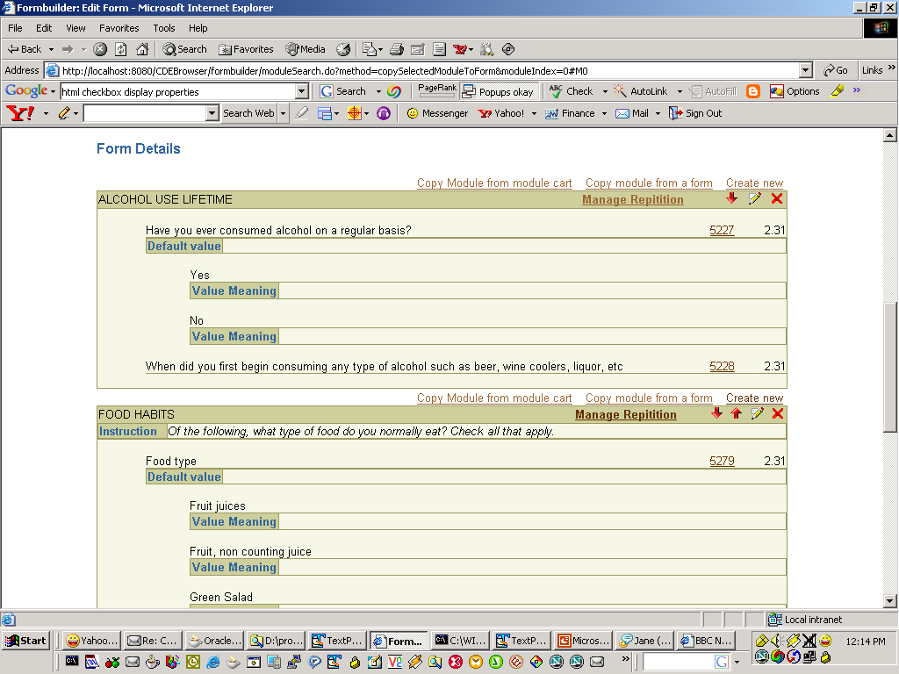
Form edit screen

Slide 10
Copying Modules
Using a Module Cart (Current Session)
  Copy module(s) from any form/template to this cart
  Copy module(s) from the cart to a form
Form view
Copy module to cart
Form edit
Select to copy
from cart
Select module(s)
from cart
Copy selected
module(s)
to form

Slide 11
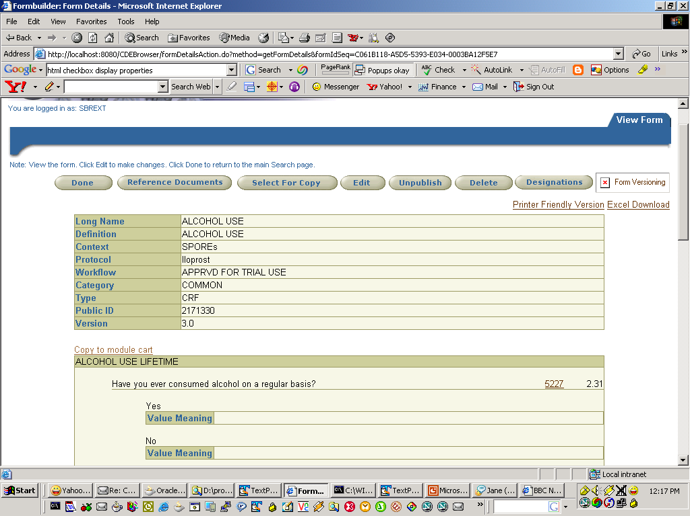
Form view screen
Copy to module cart

Slide 12
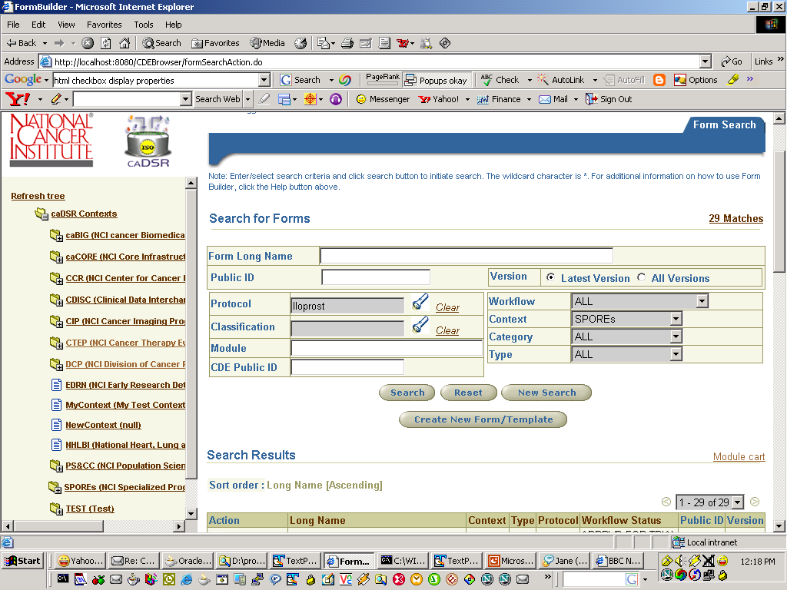
Module cart

Slide 13
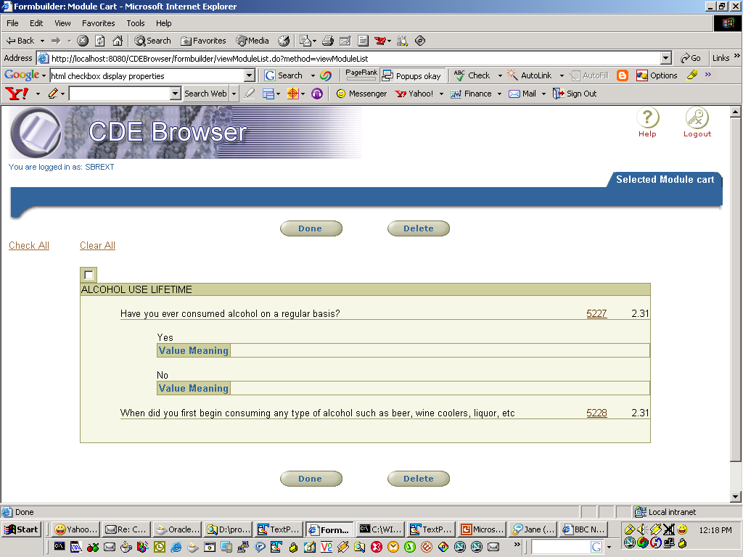

Slide 14
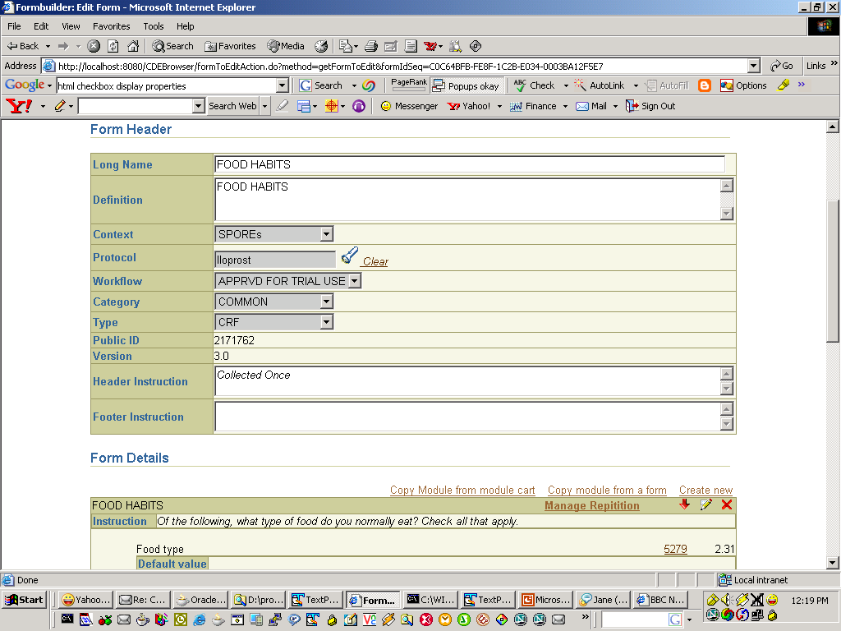
Form edit screen
Copy from module cart

Slide 15
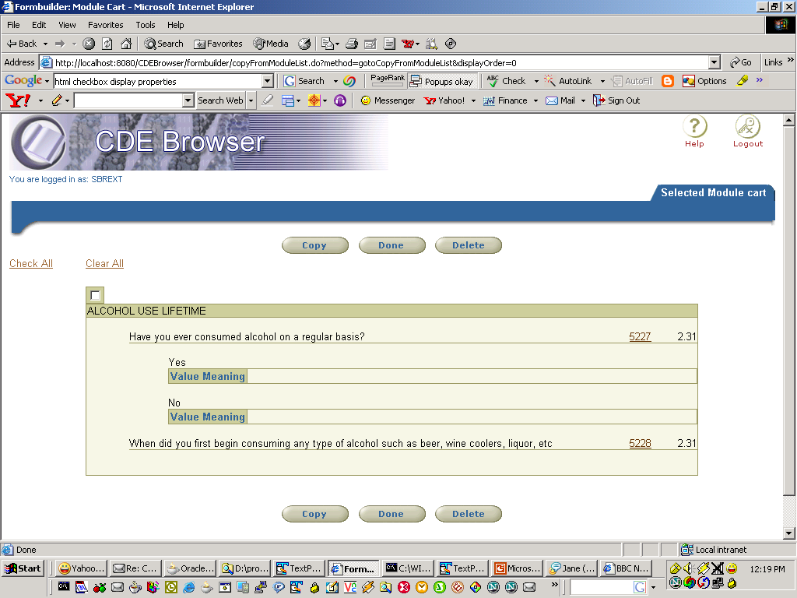

Slide 16
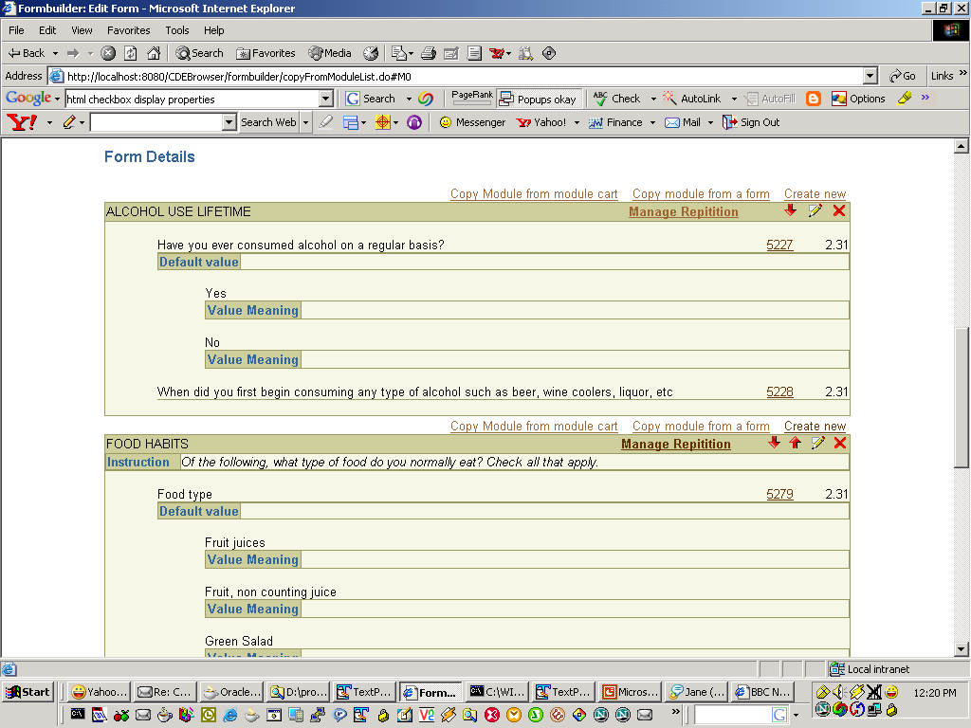

Slide 17
Repeating Modules
Modules can be repeated multiple times on a form
Repetitions can have different default values
Skip patterns not copied for repetitions
Form edit
Manage repetitions
: ADD
: Delete
: set defaults

Slide 18

Manage Repetitions

Slide 19
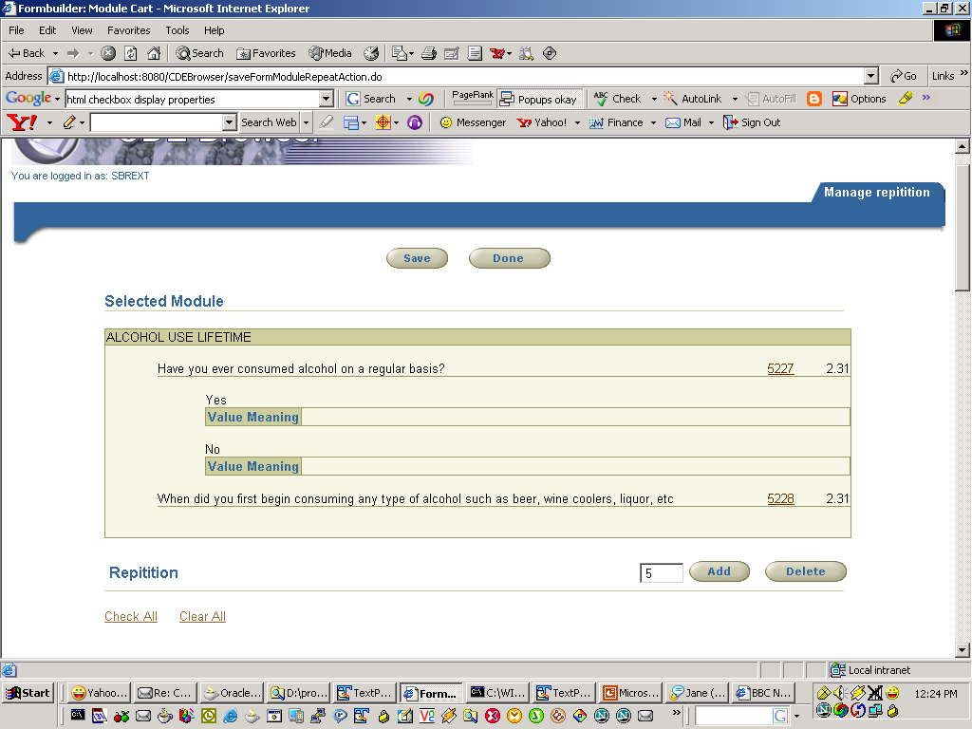

Slide 20
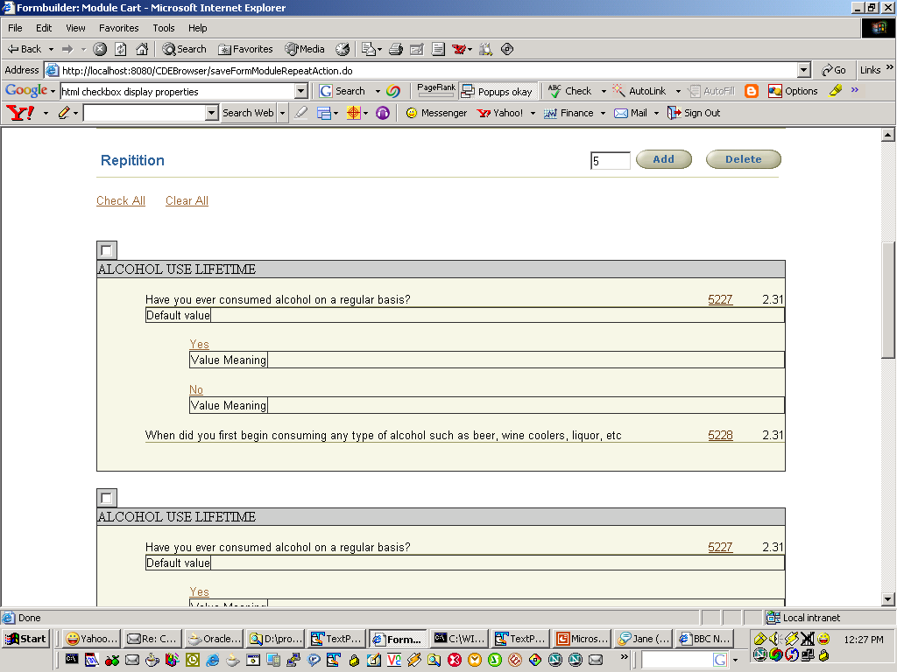

Slide 21
Tree node by Registration Status
Classification Scheme Items grouped by Registration status of the Classified CDEs
Current Strategy
  Include Registration status as CSI in CSI hierarchy
  Classify CDEs
  When Registration status of CDEs changes, unclassify and reclassify the CDE with a CSI hierarchy containing the new registration status

Slide 22
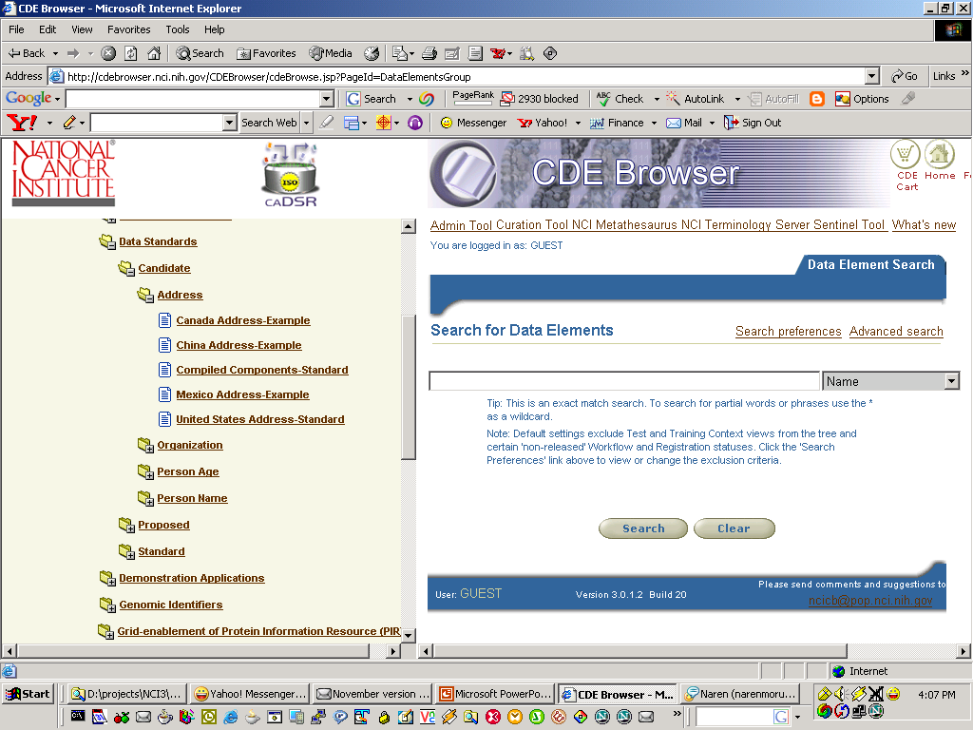
Tree node by registration Status
Problem

Slide 23
Proposed solution
New Classification type “Registration status”
All CSs of type “Registration status” will have Registration statuses as its sub nodes
  Example
  Classification hierarchy used to classify CDES
  Data Standards → Address →Canada address example(CSI)
  Tree View
  Data Standards(CS of type Registration Status)
  Candidate (Registration Status)
  Address(CSI)
  Canada address example(CSI)
  Organization(Registration Status)
The Registration statuses nodes would be configurable

