Slide 1
Design Review
Requirement Phase for caCORE Release 3.1
Skip Pattern
Formbuilder
October , 2005
Prepared by Oracle Corporation
(Shaji Kakkodi)

Slide 2
Skip Pattern
Skip pattern stores the metadata about the navigation from one location on the form(Source) to another location on the form(Target).
Source location can be valid value of a question or end of a module/form.
Target location can be a form, module or a Question on the same form or a different form.
Skip pattern can also have an instruction.
Skip Patterns can be associated with a Classification/Protocol

Slide 3
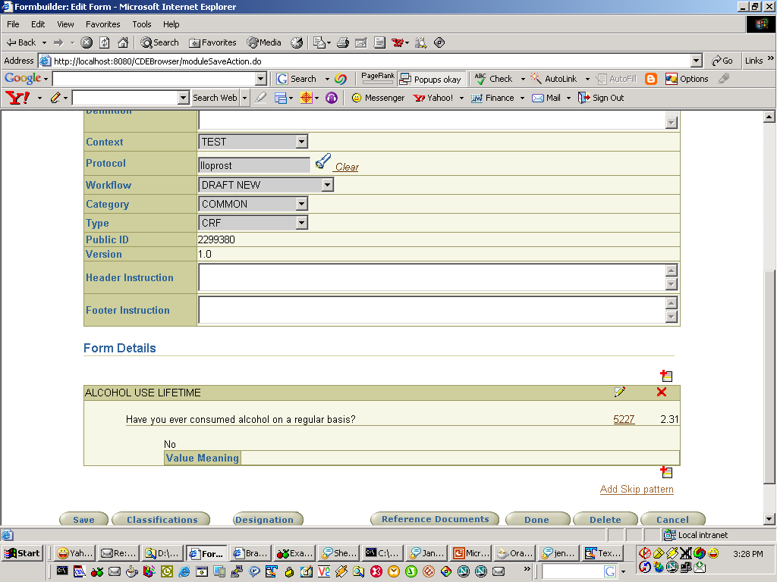

Slide 4
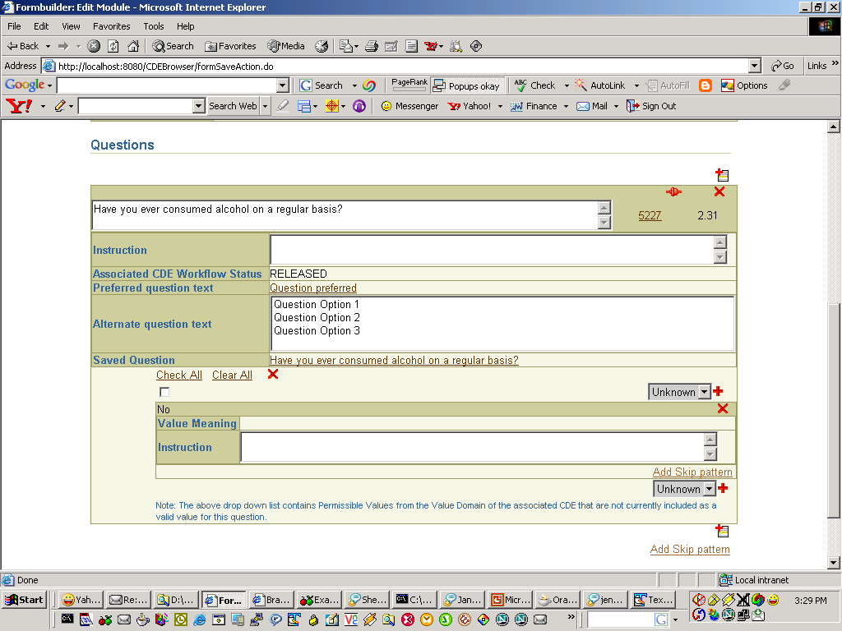
Skip where?

Slide 5
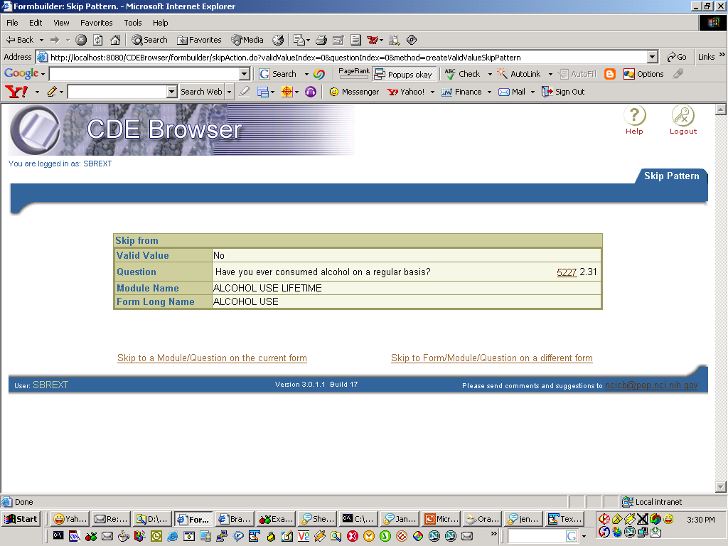

Slide 6
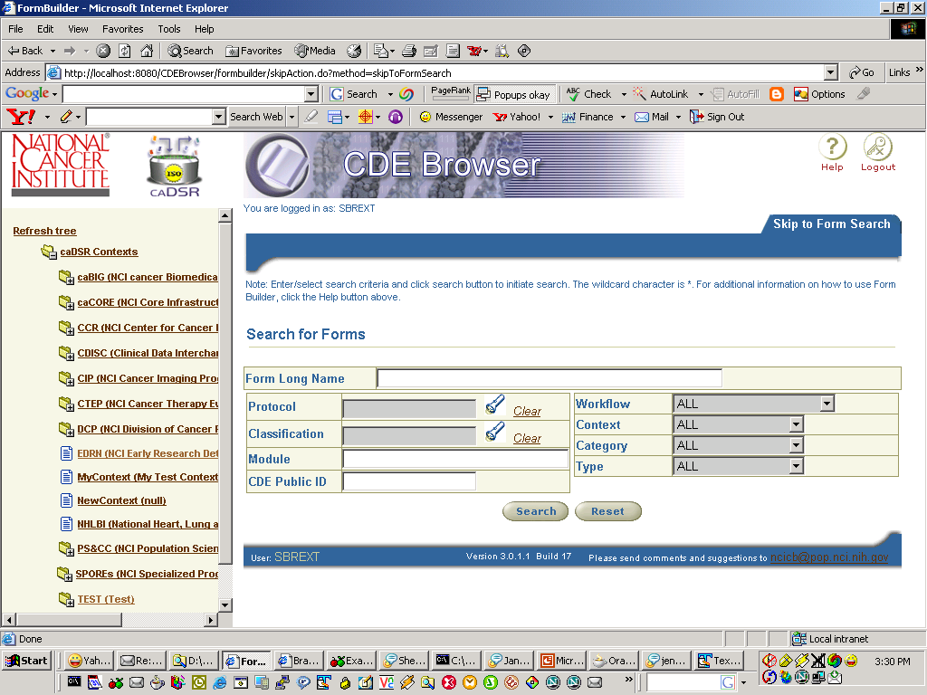

Slide 7
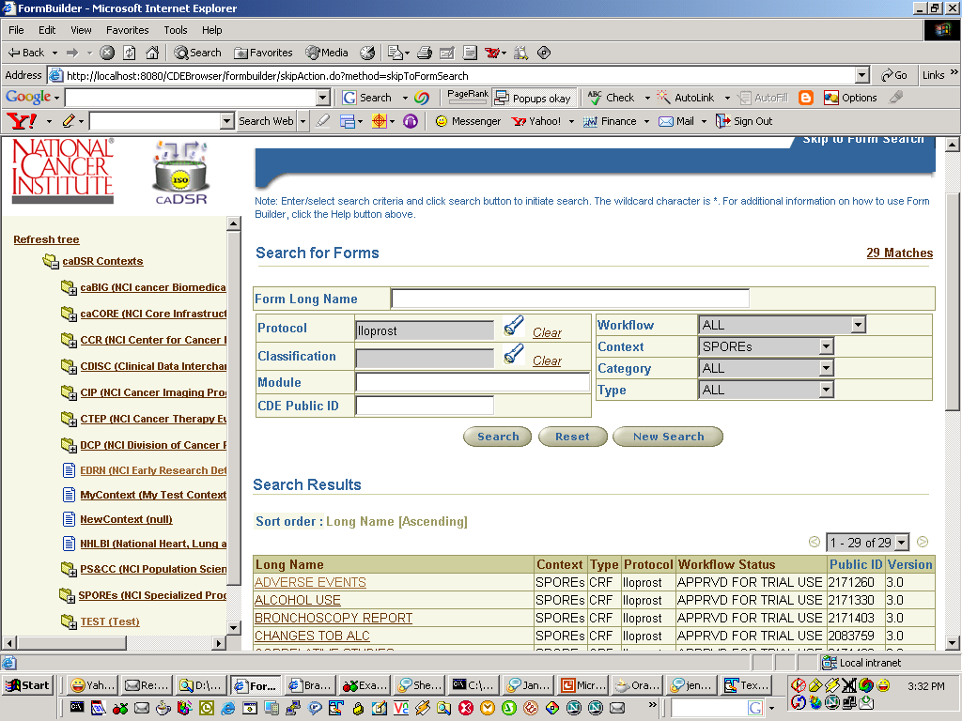

Slide 8
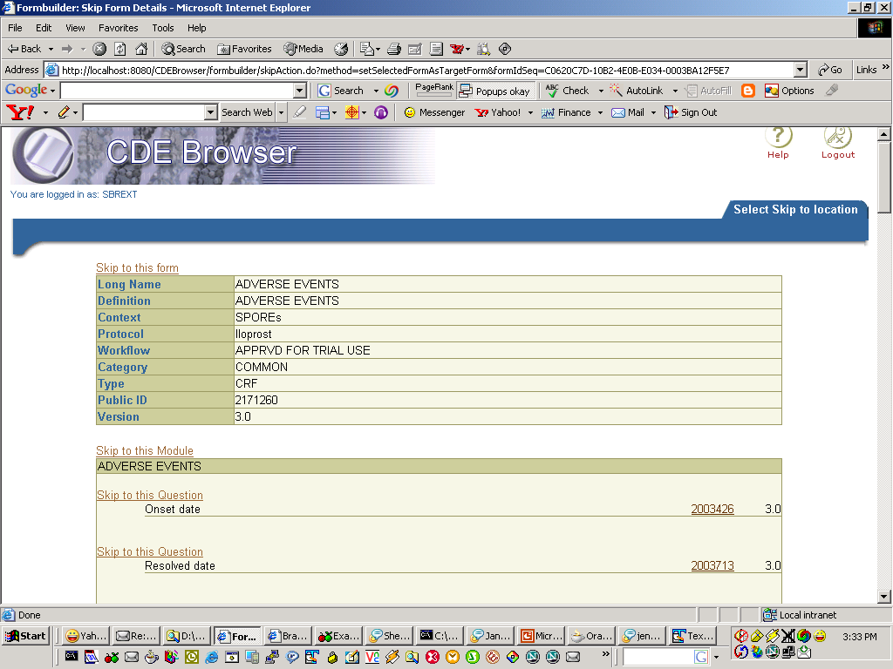
Adding a Skip Pattern to a Valid value

Slide 9
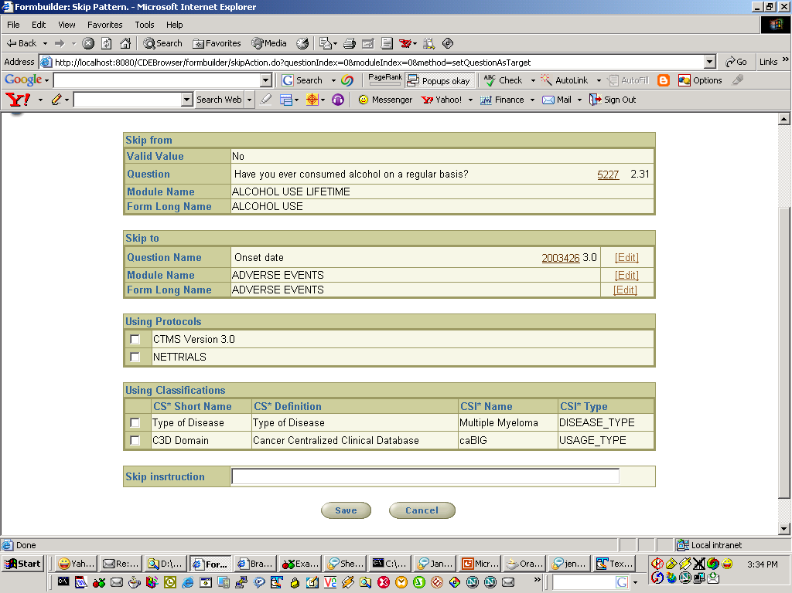
Adding a Skip Pattern to a Valid value

Slide 10
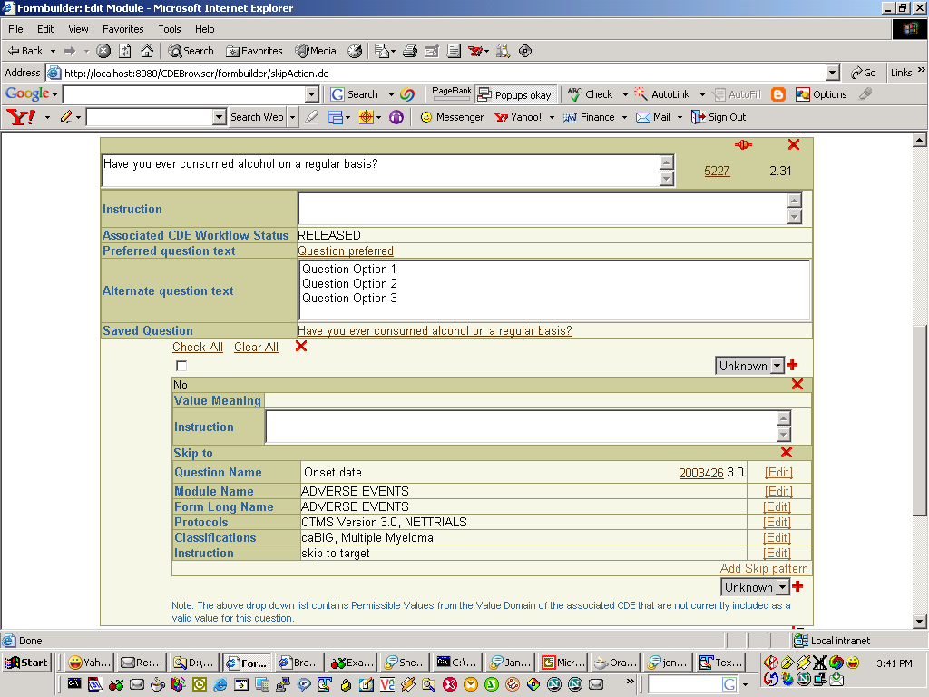

Slide 11
Business Rules
There can multiple skip patterns for a form
There can only be one skip pattern between a source and Target within a protocol or Classifications.
  Example Form A is associated with Nettrials and Protocol2
    Skip pattern 1 → Form A to Form B (Protocol: Nettrials)
    Skip pattern 2 → Form A to Form C (Protocol:Protocol2)
    Skip pattern 3 → Form A to Form D
    Not Valid Skip pattern
    Skip pattern 4 → Form A to Form E(Protocol: Nettrials)
    (Protocol: Nettrials already used in skip pattern 1)

Slide 12
Business Rules
If a Target is deleted all the skip patterns that use the target will be deleted.
  When user views the Source form, they could review skip patterns that has been deleted due to deleted targets
If the Source is deleted all skip patterns will be deleted.
If Form’s protocols/Classifications is deleted associated skip patterns will be updated accordingly.
Target forms must be have the same protocol/Classifications used for the skip pattern, If not user will have the ability to assign protocol/classification to target form while creating the skip pattern

