Slide 1
Design Review
Requirement Phase for caCORE Release 3.1
UMLBrowser
October , 2005
Prepared by Oracle Corporation

Slide 2
Motivation
UML Model
SIW
UML Loader
UML Browser
caDSR
Current CDEBrowser only provides
  ISO 11179 Component view of the
  UML elements loaded into caDSR
  Is not very intuitive to UML Model user/owner

Slide 3
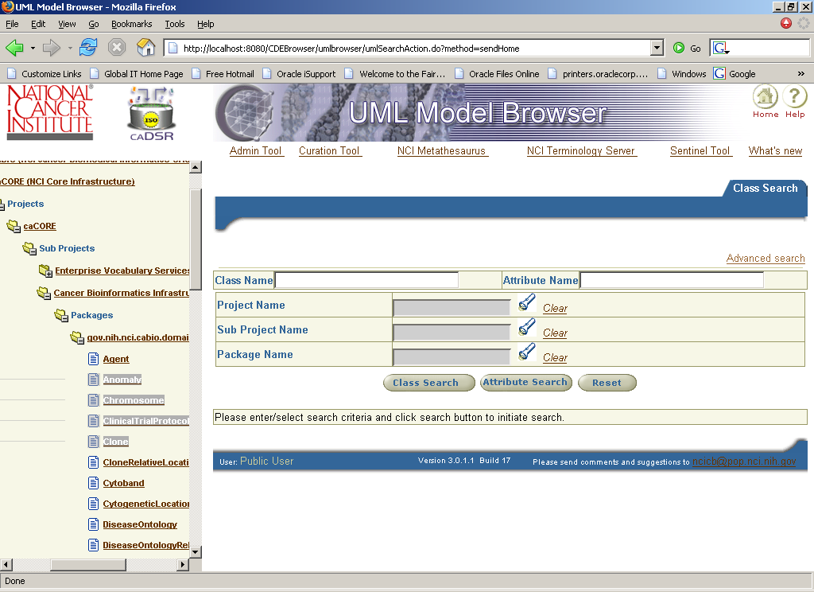

Slide 4
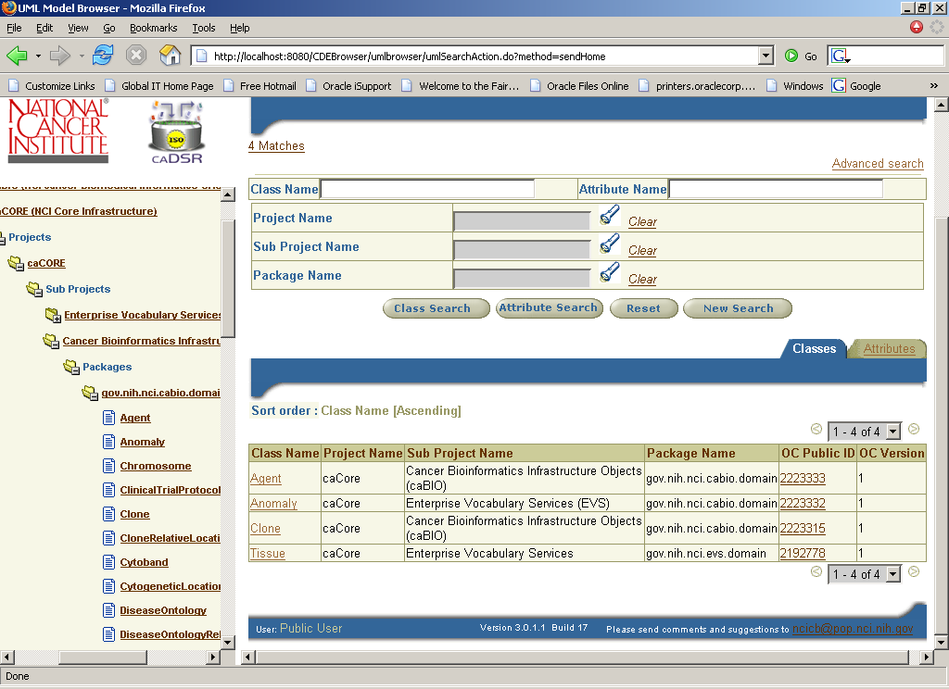

Slide 5
UML Browser Tree view example
caDSR Context
caCore
Projects
  caCore
    Sub Projects
      caDSR
      Packages
      gov.nih.nci.cabio.domain
      Agent
      Clone

Slide 6
Search Criteria
  Attribute name
  Class name
  Package name
  Sub Project
  Project
  Object Class Public Id
  Class Concept code
  Property Public Id
  Property Concept Code
  CDE Public Id
Advanced Search

Slide 7
Class Search results screen
  Class name
  Package name
  Sub Project
  Project
  Object Class Public Id
  Object Class version
Links to Attribute list
Links to OC Details

Slide 8
Attribute search results screen
  Name
  Type
  Class
  Package
  Sub Project
  Project
  CDE Public Id
  CDE version
CDE Details screen

Slide 9

Questions
Should the context node that do not have any projects be displayed in the tree

