Slide 1
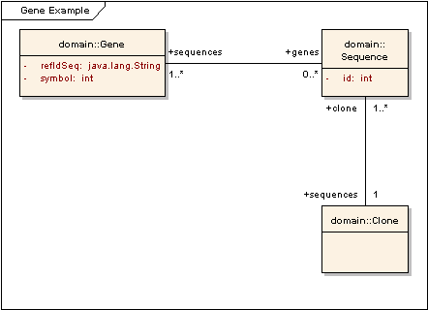
Original UML Model

Slide 2
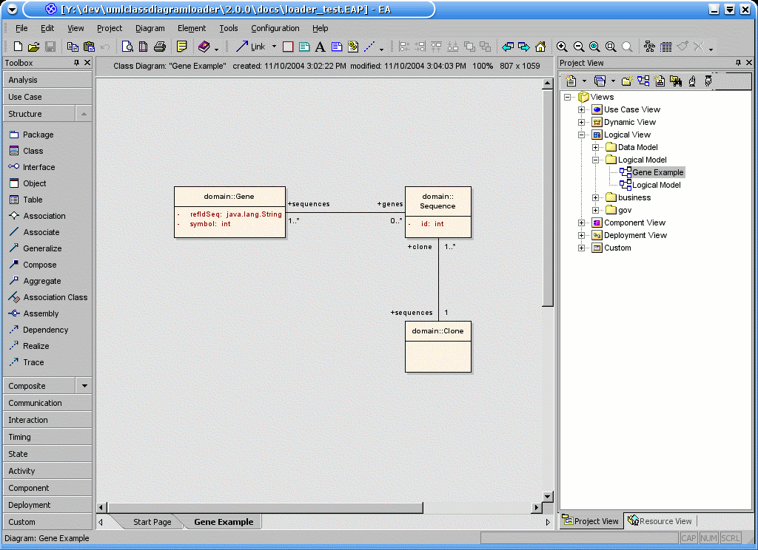
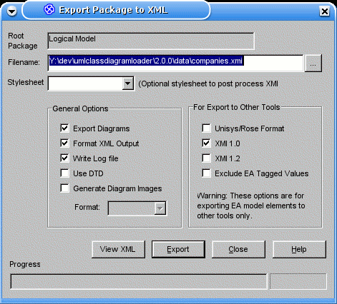
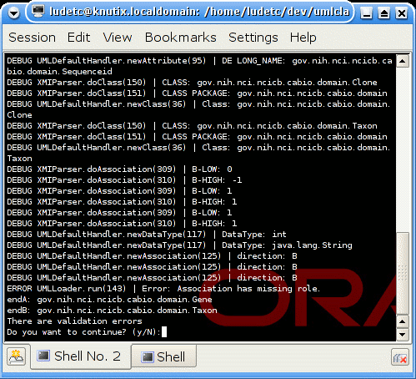
Process Flow
Semantic Integrator
1. Create / Update Diagram with EA or Rational Rose
2. Export to XMI
3. Run Semantic integrator
4. Run UML Loader

Slide 3
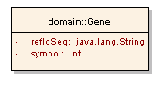
Gene Class in details
Package Name
Class Name
Attributes
Data Type

Slide 4
Gene Class in details
Package Name
Class Name
Class Concept Tagged Values:
ConceptCode = C16612
ConceptPreferredName = Gene
ConceptDefinition = The functional and ...
ConceptDefinitionSource = NCI-GLOSS
Attributes
Data Type

Slide 5
Gene Class in details
Package Name
Class Name
Class Concept Tagged Values:
ConceptCode = C16612
ConceptPreferredName = Gene
ConceptDefinition = The functional and ...
ConceptDefinitionSource = NCI-GLOSS
Attribute Concept Tagged Values
ConceptCode = CC_ID
ConceptPreferredName = ID
ConceptDefinition = Identifier
ConceptDefinitionSource = NCI-GLOSS
Attributes
Attribute Concept Tagged Values:
ConceptCode = CC_SYMB
ConceptPreferredName = Symbol
ConceptDefinition = An arbitrary sign...
ConceptDefinitionSource = NCI-GLOSS
Data Type

Slide 6

ISO/IEC 11179 Model
ISO/IEC 11179 Model
ISO/IEC 11179 Model
ISO/IEC 11179 Model
ISO/IEC 11179 Model
ISO/IEC 11179 Model
ISO/IEC 11179 Model
ISO/IEC 11179 Model
EVS
Object
Gene
EVS
Concept
Gene (C16612)
Symbol
Data Element Concept
GeneSymbol
Value Domain
java.lang.String
EVS
Property
Symbol
Data Element
GeneSymbolString

Slide 7
Mapping UML Models to ISO11179/caDSR
UML Model
caDSR ISO 11179
UML Class
Attribute Datatype
Value
Domain
UML Class
Attribute
Data
Element
DEC = UML Class:Class
Attribute
Data
Element
Concept
UML Class
Object Class =
EVS Concept
UML Class
Attribute
Property =
EVS Concept

Slide 8
Concept Mapping
Concepts are created if they do not already exist
  Mapping is:
  Long Name to ConceptPreferredName ( Gene )
  Preferred Name to ConceptCode ( C16612 )
  Definition Source to ConceptDefinitionSource ( NCI-GLOSS )
  PreferredDefinition to ConceptDefinition ( The functional and ... )
If a Concept exists but with a different definition source, an alternate definition is created for that concept.

Slide 9
UML Class Mapping
UML Classes are mapped to Object Classes.
Object Classes are uniquely identified by their Concepts
If the Object Class does not already exist, it is created with the following mapping:
  Long and Preferred Name from Concept Preferred Name (Gene)
  Preferred Definition from Concept Preferred Definition
  Definition Source from Concept Definition Source
If the Class Name is different from the Concept Name, i.e the Class Name may be “Genes”, then an Alternate Name is created for that Object Class.
If the Class Definition is different from the Concept Definition, then an Alternate Definition is created for that Object Class.

Slide 10
Classifications
All Objects created by UML Loader (except for Concepts) get assigned classifications and classifications.
A Project Classification Scheme links Objects to a project. Here, a “CaCORE 3.0” Classification Scheme will be created and used with the “Gene” Object Class.
Object Classes are also linked to a Package Classification Scheme Item.
Example of Classification for the “Gene” Object Class:
  CaCORE 3.0 ( CS )
    gov.nih.nci.ncicb.cabio.domain (CSI )

Slide 11
Attribute Mapping
Attributes are mapped to cadsr Properties
Properties are uniquely identified by their Concepts
If the Property does not already exist, it is created with the following mapping:
  Long and Preferred Name from Concept Preferred Name ( symbol )
  Preferred Definition from Concept Preferred Definition
  Definition Source from Concept Definition Source
If the Attribute Name is different from the Concept Name, i.e the Attribute Name may be “refIdSeq” while the Concept Name is “ID”, then an Alternate Name is created for that Property.
  The refIdSeq attribute of Gene is mapped to the “ID” concept, and an alternate name is created for the ID Property.

Slide 12
Attribute Mapping (cont'd)
Properties are reusable across multiple Object Classes
The relation between an Attribute and its class is mapped as a Data Element Concept, where Long Name is the concatenation of Class Name and Property Name.
Because DECs are classified, one can identify what project associates what attribute to what class.

Slide 13
Attribute Mapping (cont'd)
Data Types already exist in caDSR as value domains. UML Loader does not create Value Domains.
UML Loader creates a Data Element to store the data type of an attribute.
      DEC.LONG_NAME = = DE.LONG_NAME
The DE's Value Domain is set accordingly to the data type.
Because DEs are classified, one can identify what project associates what data type to what attribute

