Slide 1
caGrid Security
GAARDS Security Infrastructure
Stephen Langella
langella@bmi.osu.edu
January 2008

Slide 2
Agenda
GAARDS Overview (10 min)
CTMS Requirements (15 min)
  CCTS
  caExchange
GAARDS 1.2 (30 min)
  Overview
  Web Single Sign On (WebSSO)
  Credential Delegation Service (CDS)
Additional Information (5 min)

Slide 3
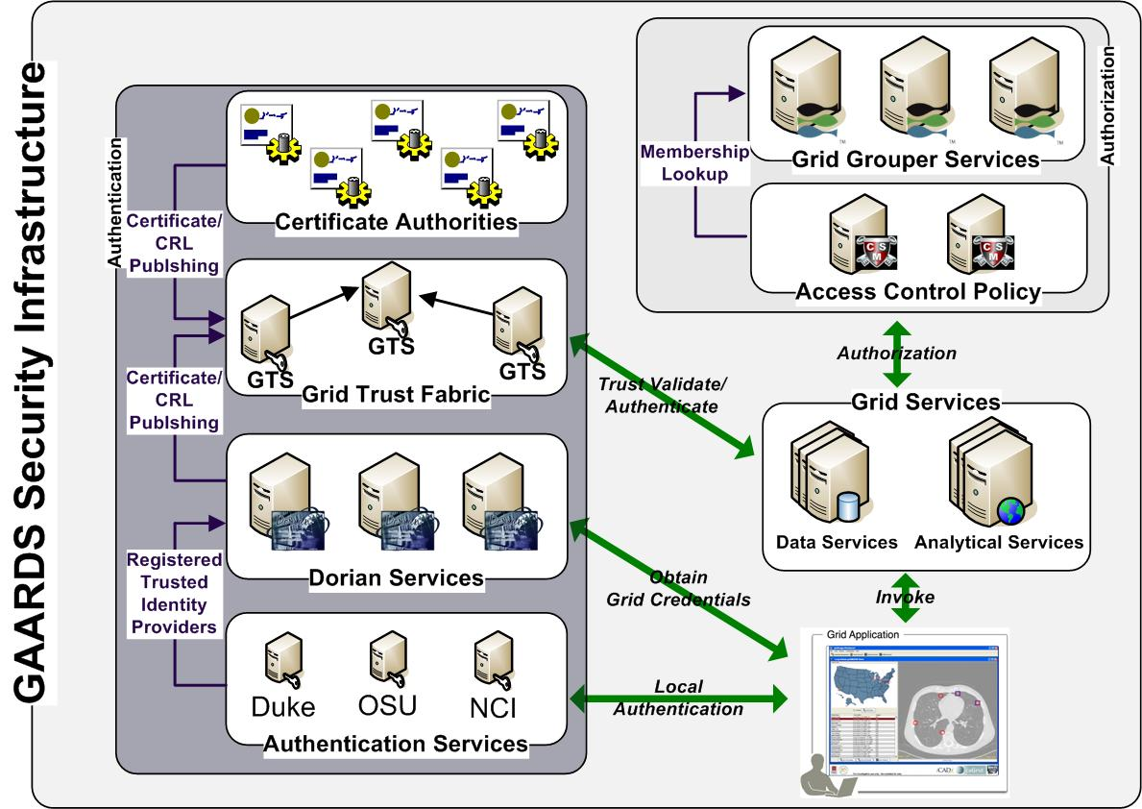
GAARDS Security Infrastructure
GAARDS provides services and tools for the administration and enforcement of security policy in an enterprise Grid.
GAARDS is the security infrastructure for caGrid.

Slide 4
GAARDS (Authentication)
Dorian
  Grid Account Management
  Allows accounts managed in external domains to be federated and managed in the grid.
  Dorian allows users to use their existing credentials (external to the grid) to authenticate to the grid
  Issues Host Credentials.
Authentication Service
  Integrates existing credentials providers into the grid.
  Provides a uniform grid interface for authenticating to existing credential providers.
  Applications can communicate with any credential provider.

Slide 5
GAARDS (Authentication)
Grid Trust Service (GTS)
  Creation and Management of a federated trust fabric.
  Supports applications and services in deciding whether or not signers of digital credentials can be trusted.
  Supports the provisioning of trusted certificate authorities and corresponding CRLS.

Slide 6
GAARDS (Authorization)
caGrid/GAARDS gives service providers complete control of enforcing access control policy.
Service providers may integrate any authorization/access control system(s).
caGrid provides tools/services for enforcing access control.
Grid Grouper
  Group management service for the grid
  Provides a group-based authorization solution for the Grid
  Enforce authorization policy based on membership to groups
Common Security Module (CSM)
  Centralize approach to managing and enforcing access control policy authorization.

Slide 7
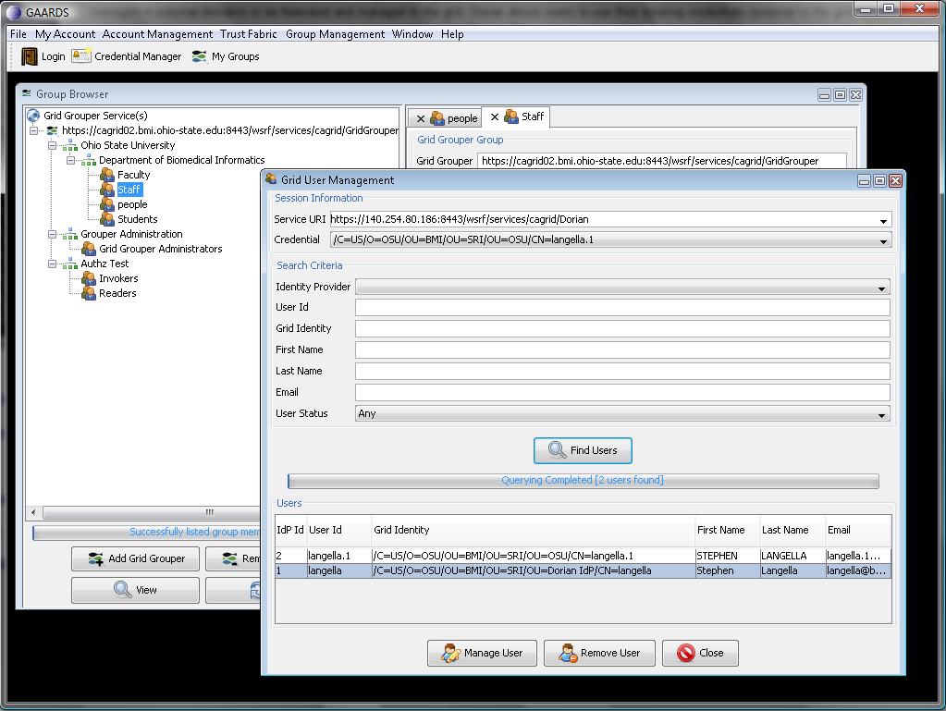
GAARDS Admin UI
GAARDS provides a comprehensive UI for using and administrating GAARDS

Slide 8
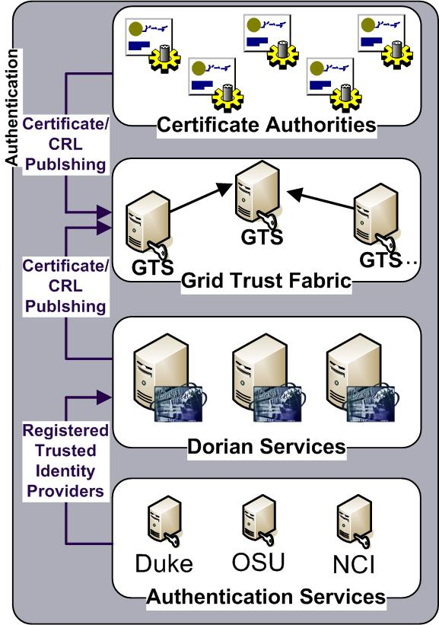
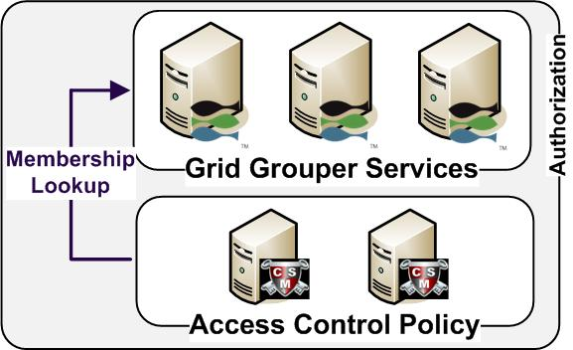
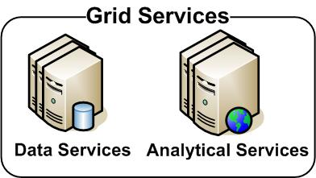
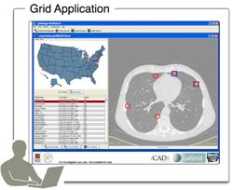
GAARDS in Action

Slide 9
GAARDS in Action
GAARDS in Action
Authenticate with
Local Credential Provider
User authenticates to local credential provider using your everyday user credentials
SAML Assertion

Slide 10
GAARDS in Action
SAML Assertion
Application obtains grid credentials from Dorian using SAML provided by the local provider.
Grid
Credentials

Slide 11
GAARDS in Action
GAARDS in Action
Application uses grid credentials to invoke secure grid services.
Grid
Credentials

Slide 12
GAARDS in Action
Should I trust the
credential signer?
Grid Service authenticates the user by asking the GTS whether or not the signer of the credential should be trusted.

Slide 13
GAARDS in Action
Authorization
Grid Service asks CSM or their access control policy enforcer whether or not the user can perform X and resource Y.
Is
Authorized?

Slide 14
GAARDS in Action
Is member of?
Authorization
Alternative
Grid Service can enforce local policy based on user membership to groups maintained in Grid Grouper.

Slide 15
GAARDS History and Future
GAARDS 1.0 (December 2006)
  Released inline with caGrid 1.0
GAARDS 1.1 (September 2007)
  Released inline with caGrid 1.1
  Individual Components Released
    GAARDS UI
    Dorian
    Authentication Service
    Grid Trust Service (GTS)
    SyncGTS
    GridGrouper
GAARDS 1.2 (March 2008)

Slide 16
CTMS Requirements
Driving use cases for caGrid/GAARDS 1.2
Edmund Mulaire
Kalpesh Patel
January 2008

Slide 17
GAARDS 1.2
Overview of WebSSO and Credential Delegation Service
Stephen Langella
Kunal Modik
January 2008

Slide 18
GAARDS 1.2 Overview
Credential Delegation Service (CDS)
  Enables users/services (delegator) to delegate their Grid credentials to other users/services (delegatee).
Web Single Sign On (WebSSO)
  Framework for integrating GAARDS into web applications.
GAARDS UI Enhancements
Bug Fixes

Slide 19
caGrid
WebSSO
caGrid Web Single Sign On
Kunal Modi
January 2008

Slide 20
What is Single Sign On
  Ability for a user to login into single application and then navigate to another application within the same realm without being challenged for credentials during that browser session
  Traditionally, SSO solutions deal with maintaining a single logged in session amongst web applications only
  In Grid domain, this signed-in session should be extended allowing the users to invoke grid services without providing their credentials again.

Slide 21
Web Single Sign On (WebSSO) Project
  The Web Single Sign On (WebSSO) Project is effort to provide the Single Sign On capabilities for the web applications as well the grid services using a single solution
  Uses the caGrid’s GAARDS framework in back end to authenticate and validate the user
  Allows users to use single set of local credentials to both navigate amongst different web applications and also invoke various grid services
  Provides an automated mechanism for delegation and retrieval of user’s grid credentials there by avoiding transfer of grid credentials around
  Built on top of JA-SIG’s Central Authentication Service (CAS) which provides the core Single Sign On capability

Slide 22
Components of WebSSO Solution
WebSSO Server
  Installed centrally in a separate web container
  Responsible for establishing the Single Sign On Session
  Interacts with Authentication Service (IdP) to validate user’s local credentials
  Interacts with Dorian (IFS) to obtain user’s grid credentials
  Prepares a delegation policy describing which host identities can obtain user’s grid credentials and publish it in the Central Delegation Service (CDS)
WebSSO Client
  Integrated with each target web application in the SSO realm
  Responsible for checking if a Single Sign On session has been established or not. If not, then route the user to WebSSO Server for authentication
  Once authenticated and Single Sign On session established, the WebSSO client connects and retrieves user’s attributes as well grid credential

Slide 23


Establish the SSO Session Workflow
CLIENT
WEB
GRID
1. User Request
Grid Service A
WebSSO
Client
Target
WebApp
15. User Attribute
+ Grid Proxy
16. Grid Proxy
14. Grid Proxy
Delegation Service
11. Single Sign
On Ticket
13. Delegation EPR
9. Delegation
EPR
8. Delegation Policy (Grid Proxy)
12. User
Attributes
Assertion
Dorian
10. Single Sign
On Ticket
6. Grid Proxy
WebSSO Server
2. Credentials
5. SAML
Authentication Service
7. Validate
4. SAML
GTS
3. Credentials

Slide 24
Installation/Configuration of WebSSO Server
Obtain the WebSSO Server Release from caGrid Download Center
Configure the WebSSO Properties
  Configure the Authentication Service Information (IdP)
  Configure the Dorian Information (IFS)
  Provide list of Host Identities to which the User’s Grid Credentials are to be delegated
  Configure the Delegation Service (CDS) which would hold the delegation policy
Build the WebSSO Project
Deploy the Server Web Application into a web container
Secure the Web Container for SSL

Slide 25
Integration of WebSSO Client
Obtain the WebSSO Client Release from the caGrid Download Center
Copy all the jar files in your web application’s lib directory
Configure WebSSO Filters into your web application’s web.xml file
  Provide the path to Host’s cert and key file (used for connecting to delegation service)
Configure WebSSO Client to talk to the WebSSO Server via the cas.properties file
Copy & Install the Server certificates to facilitate SSL
Deploy your web application with WebSSO Client embedded inside into the web container

Slide 26
Accessing WebSSO Attributes
WebSSO Client retrieves User’s Attributes from the WebSSO Server
It also retrieves User’s Grid Credentials from the Central Delegation Service (CDS)
All these attributes and grid credentials are stored in the HTTP Session of the user as session attributes
Following is list of attributes which are available to the application for retrieval from the HTTP Session
  User’s First Name
  User’s Last Name
  User’s Email Id
  User’s Grid Identity
  User’s Grid Credential
  End Point Reference to the published Delegation Policy in CDS

Slide 27
Information
Wiki
  http://www.cagrid.org/mwiki/index.php?title=WebSSO:Web_Single_Sign_On
Documentation
  http://gforge.nci.nih.gov/plugins/scmcvs/cvsweb.php/cagrid-1-0/Documentation/docs/security/sso/?cvsroot=cagrid-1-0
Download
  <<TBD>>
    - Thank You

Slide 28
Credential Delegation Service (CDS)
Stephen Langella
January 2008

Slide 29
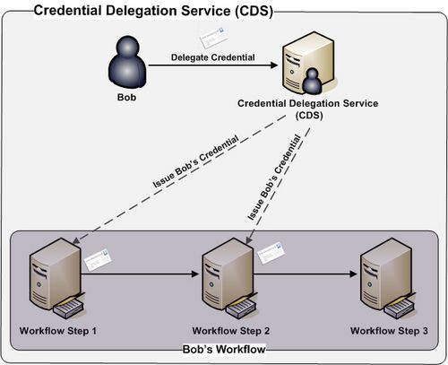
Credential Delegation Service (CDS)
Credential Delegation Service (CDS) - A WSRF-compliant Grid service that enables users/services (delegator) to delegate their Grid credentials to other users/services (delegatee) such that the delegatee(s) may act on the delegator's behalf.

Slide 30
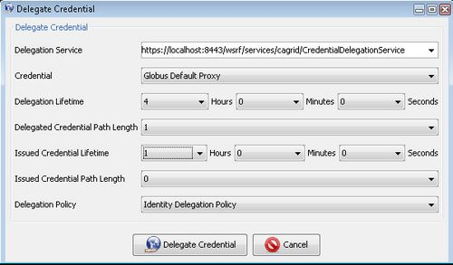
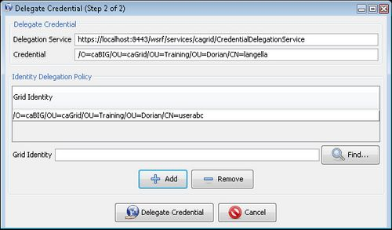
Delegating a Credential
Delegation Service
  URI of the CDS to delegate to.
Credential
  The credential to delegate.
Delegation Lifetime
  The amount of time the CDS may delegate the credential for.
Delegated Credential Path Length
  The path length of the credential issued to the CDS.
Issued Credential Lifetime
  The lifetime of credentials issued by the CDS to permitted clients.
Issued Credential Path Length
  The path length of credentials issued by the CDS to permitted clients.
Delegation Policy
  Policy specifying which client may request a delegate credential.

Slide 31
Delegation Policy
Delegation Policy – Allows a client to express to the CDS which entities may obtain their credential.
The CDS was architected to allow Delegation Policies to be plugged in.
Developers may easily implement and integrate their own Delegation polices.
Delegation Policies
  Identity Delegation Policy – A list of grid identities each whom are allowed to request a delegated credential. (CDS 1.2)
  Group Delegation Policy – Allows members of a specified Grid Grouper Group to request a delegated credential (POST CDS 1.2)

Slide 32
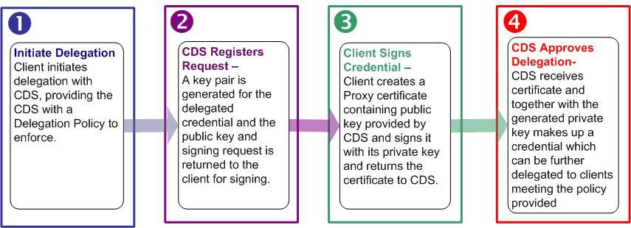
Delegating a Credential
Delegating a Credential

Slide 33
Delegating a Credential
Delegating a Credential

Slide 34
Delegating a Credential
Delegating a Credential

Slide 35
Delegating a Credential
Delegating a Credential

Slide 36
Delegating a Credential
Delegating a Credential

Slide 37
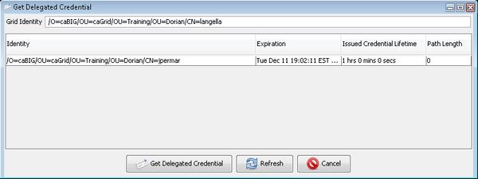
Obtaining a Delegated Credential
Delegated Credential Reference
  Reference to the credential that the client wishes to obtain
Credential
  The client’s credential, used to authenticate with the CDS and obtain the desired delegated credential.

Slide 38
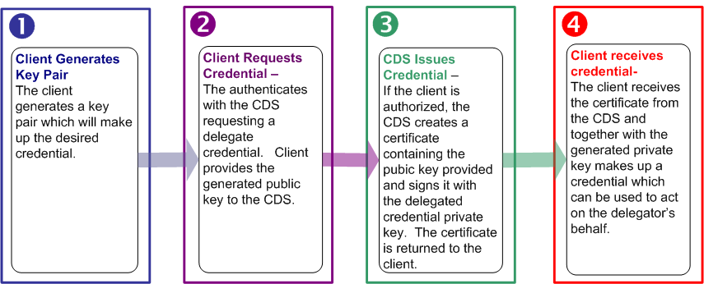
Obtaining a Delegated Credential
Obtaining a Delegated a Credential

Slide 39
Obtaining a Delegated Credential
Obtaining a Delegated a Credential

Slide 40
Obtaining a Delegated Credential
Obtaining a Delegated a Credential

Slide 41
Obtaining a Delegated Credential
Obtaining a Delegated a Credential

Slide 42
Obtaining a Delegated Credential
Obtaining a Delegated a Credential

Slide 43
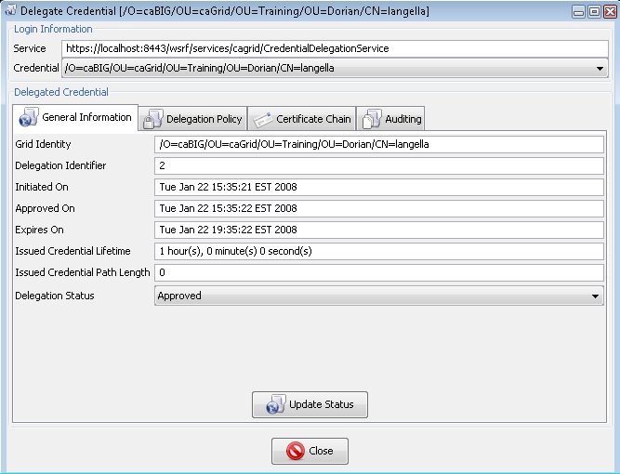
Monitoring Delegated Credentials
The CDS allows clients to monitor credentials they delegated.
General Information
  Grid Identity
  Delegation Id
  Initiated On
  Approved On
  Expires On
  Issued Credential Lifetime
  Issued Credential Path Length
  Delegation Status
    Client’s may suspend access to their credentials.
Delegation Policy
  Specifies who may obtain a delegated credential.
Certificate Chain

Slide 44
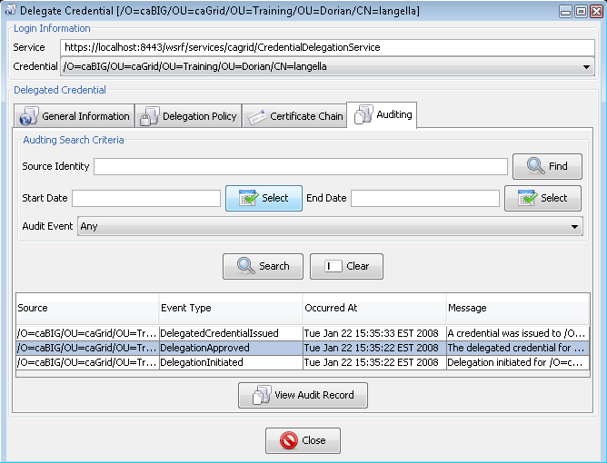
Monitoring Delegated Credentials
The CDS captures auditing information for the following events:
  Delegation Initiation
  Delegation Approval
  Delegation Status Update
  Credential Issued
  Access Denied to Credential
The CDS allows clients to search and access the auditing information captured for a delegated credentials.

Slide 45
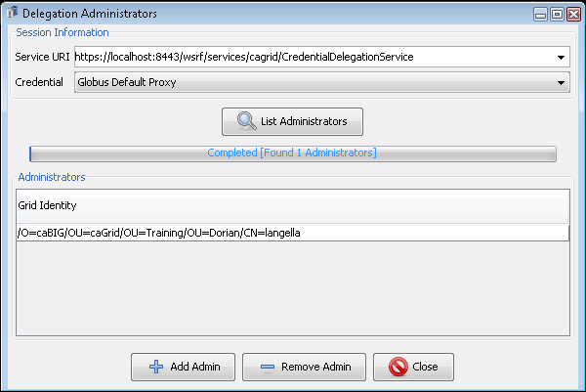
Administering the CDS
The CDS maintains a list of administrator(s).
CDS administrators may monitor all delegated credentials.
CDS administrators can be managed (added, removed) through the CDS web service interface.

Slide 46
GAARDS Additional Information
Stephen Langella
January 2008

Slide 47
Project Resources and Communication
www.cagrid.org
  Download Software
  Documentation
  Tutorials
  Technical Paper and Presentations
caGrid GForge Home
  Feature Requests
  Bug Reports
  Downloads / Source Repository
  http://gforge.nci.nih.gov/projects/cagrid-1-0/
caGrid Users Mailing List
  https://list.nih.gov/archives/cagrid_users-l.html
  cagrid_users-l@list.nih.gov

Slide 48
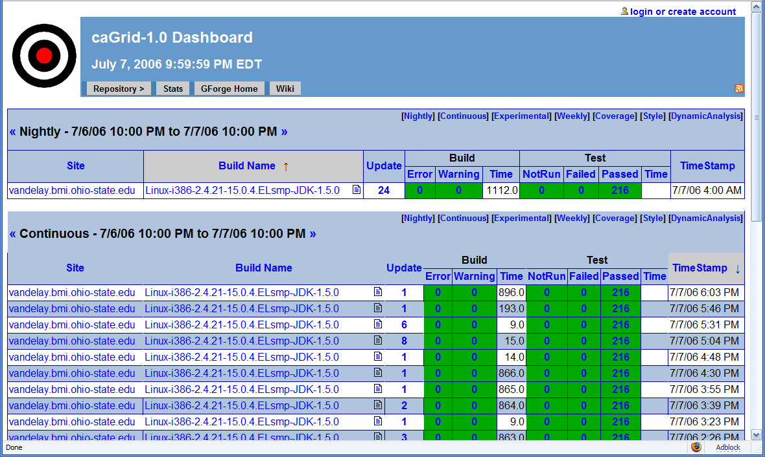
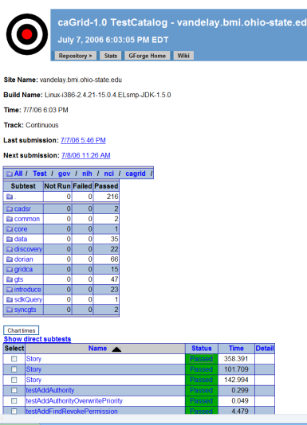
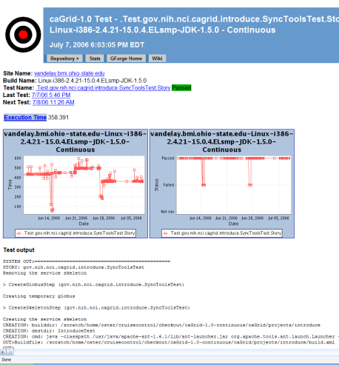
Software Quality
Unit and System Testing
  26 Tests for core security libraries
  138 Tests for Dorian
  48 Tests for the GTS
  19 Tests for Grid Grouper
  45 Tests for the CDS
Automated Builds/Tests on multiple nodes
  Nightly (on a schedule)
  Continuous (every CVS check in)
Quality Dashboards
  DART (multi-site, historical archive of quality)
  CruiseControl
Code Test Coverage
http://quality.cagrid.org

Slide 49
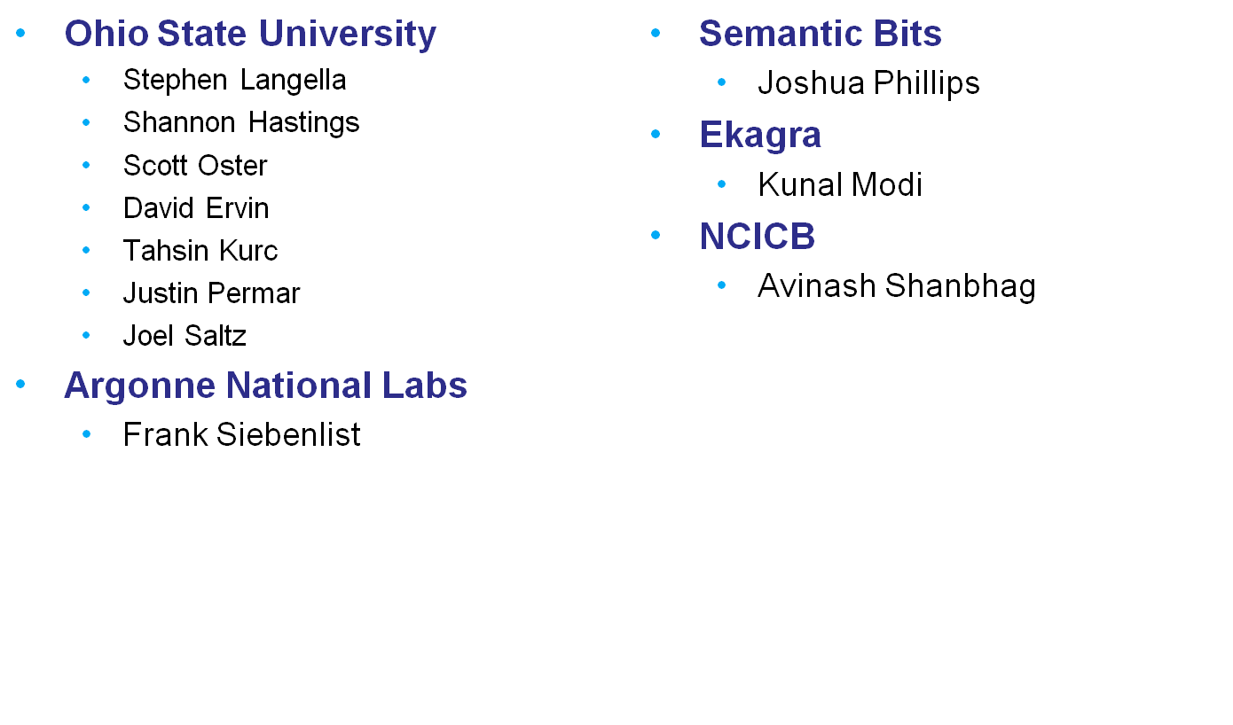
GAARDS Team

