Slide 1

Perl to CQL
(caGRID::CQL1)
A Perl toolkit to access caGRiD
Presented by BioTeam
April 15 2010
1

Slide 2

About BioTeam
A virtual consulting company, specializing in High Performance Computing and software development for Life Sciences.
  MIT, NASA, Harvard Medical School, EPA, the Navy, CDC, U. Connecticut, NCI, pharma...
  Sell Inquiry, a Web application to run >50 bioinformatics application on SGE or in the AWS Cloud
  Sell WikiLIMS, a custom Semantic MediaWiki for research data
  Maintain the infrastructure supporting the Open Bioinformatics Foundation (BioJava, BioPerl, BioPython, BioRuby)
  BioTeam employees are core contributors to BioPerl
2

Slide 3
Perl to CQL Rationale
Create a toolkit that Perl programmers can use to query caGRID
  Many researchers know about caGRID but do not know what it contains
  Many researchers know about caGRID but do not know how to access it
  Perl is the most popular language in the bioinformatics world that is centered on sequence and genomes
  Toolkits like BioPerl make it easy for scientists to write their own useful code
  There is a critical mass of Perl developers doing bioinformatics and the Perl to CQL project will capture their attention
3

Slide 4
Perl to CQL Objectives
Provide a client library for users of Perl so that they can access public caGRID data services
  Perl code constructs CQL, dispatches CQL as SOAP, gets response
  Perl code to build “easy to use” Perl modules
  caGRID data can be returned as familiar Perl data structures (object, Perl hash, XML)
  The modules use the strict pragma
  The modules can validate the CQL against the the CQL 1.0 XSD
  The library is fully tested using Perl’s Test::More
  In GForge:https://gforge.nci.nih.gov/plugins/scmsvn/viewcvs.php/projects/PerlToCQL/?root=net
  The package is available through CPAN - caGRID::CQL1
4

Slide 5
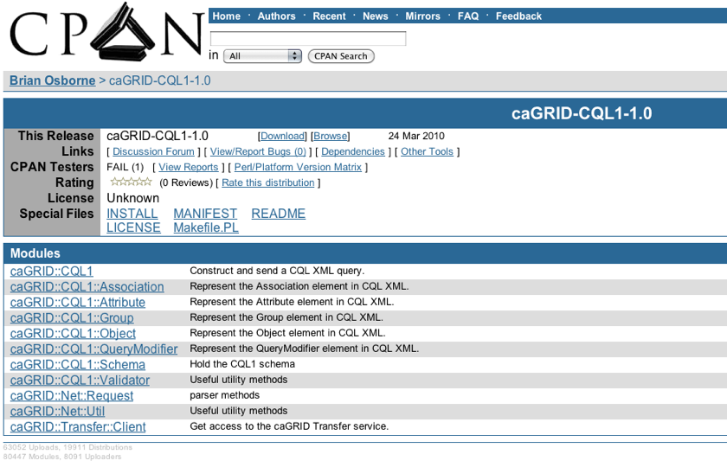
Perl to CQL - caGRID::CQL1
4

Slide 6
Perl to CQL - caGRID::CQL1
Available at http://search.cpan.org/~bosborne/caGRID-CQL1-1.0/
Or search at http://search.cpan.org with the term caGRID
Easy to install using the standard CPAN commands at the command line:
perl Makefile.PL
make
make test
make install
Easy to update through GForge
4

Slide 7
Perl to CQL - caGRID::CQL1
How to upload a new caGRID-CQL1 package to CPAN:1. Get a PAUSE Account2. Prepare the New Version3. Create a File to Upload4. Upload1. Get a PAUSE Accounthttps://pause.perl.org/pause/authenquery?ACTION=request_id2. Prepare the New Version- Edit lib/caGRID/CQL1.pm to add the new version number- If you have added, removed, or renamed a file make sure to edit MANIFEST- If you added or removed a Perl module dependency make sure to edit Makefile.PL- If you have added, removed, or renamed a top-level file then edit make-tar.sh3. Create a File to Upload >cd CPAN-uploads >./make-tar.sh 1.0.1Where "1.0.1" is the new version number.4. UploadLog in to PAUSE and upload the file. Wait a few hours.
4

Slide 8
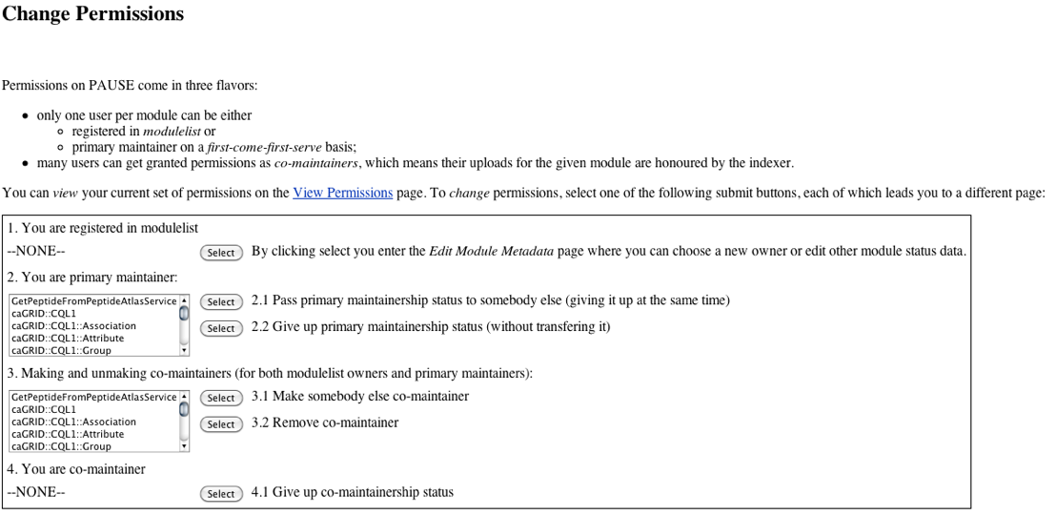
Perl to CQL - caGRID::CQL1
4

Slide 9
Perl to CQL Documentation
Create documentation in a Knowledge Center Wiki
  Overview and rationale
  Installation
  Example code that demonstrates how to query existing services using CQL and caGRID Transfer (caBIO, NBIA, and PIR)
  Example code that creates a query module without using CQL syntax (e.g. GetPeptideFromPeptideAtlasService)
  https://cabig-kc.nci.nih.gov/Molecular/KC/index.php/Perl-based_caGrid_Data_Access
  https://cabig-kc.nci.nih.gov/CaGrid/KC/index.php/Perl-based_caGrid_Data_Access
5

Slide 10
Perl to CQL Next Steps
  Announce at BioPerl
  Document at caGRID
  Enlist
5

