Slide 1
Hands on training
Building Services and creating workflow
Scott Oster and Ravi Madduri
Integrative Cancer Research Workspace Face to Face
September 23-24, 2008

Slide 2
Agenda
Building a Service with Introduce
  Introduce service creation process
  Feature Overview
Using Taverna to Realize caBIG Workflows
  overview
  lessons learned
  next steps

Slide 3

BUILDING A SERVICE WITH INTRODUCE

Slide 4
Introduce Vision
The one stop shop for grid service development
  Provide a simple, yet powerful, graphical user interface (GUI) to encapsulate complexities of grid service development
  Provide an extensible toolkit with which grid services can be created and modified graphically and programmatically

Slide 5
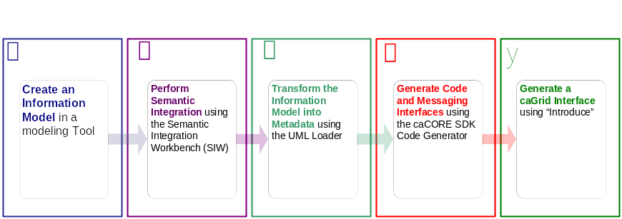




An example service development process (0 lines of developer code)
Create Semantically Harmonized Data Model
Generate
Data Resource
Grid-ify

Slide 6
Pre-grid
A caCORE SDK generated data resource which is not connected to the grid.
Grid
caBIO

Slide 7

Exposing the Resource:
We will use the Introduce data service wizard to describe our data resource and generate a grid service.
Grid
caBIO

Slide 8


Exposing the Resource:
Introduce will enable the user to browse data model in the caDSR and chose the ones which they are going to be exposing.
GME
Grid
CQL query
processor
caBIO

Slide 9

Exposing the Resource:
Then they will locate the schemas which describe the data models and will provide the wire protocol for transferring data instances.
GME
Grid
CQL query
processor
caBIO

Slide 10

Exposing the Resource:
Lastly the user will have to provide a CQL query processor to enable CQL query to be executed against the data resource.
GME
Grid
CQL query
processor
caBIO

Slide 11


Exposing the Resource:
Introduce will create a grid service which can expose the data resource we described to the grid
Grid
caGrid
Data
Service
caBIO
caCORE CQL query
processor

Slide 12
Data now available.
Now that our service is generated we can deploy it so that the resource can be used.
Grid
GridService
caBIO
Grid
Service
caGrid
Data
Service
caBIO
caCore CQL query
processor

Slide 13
How will users find me
We need to expose metadata to a registry so that a user/service can locate and use our service
Grid
GridService
caBIO
Grid
Service
caGrid
Data
Service
caBIO
caCore CQL query
processor

Slide 14

How will users find me
We will send our metadata to an index service that can be queried by grid users.
Grid
GridService
caBIO
Grid
Service
caGrid
Data
Service
caBIO
caCore CQL query
processor
Index Service

Slide 15
Introduce Summary
A framework which enables fast and easy creation of Globus and Standards based grid services.
Provide easy to use graphical service authoring tool.
Hide all “grid-ness” from the developer.
Utilize best practice layered grid service architecture.
Handle all core service architecture requirements for strongly typed and highly interoperable grid services.
Toolkit for creating and manipulating strongly typed grid services
  Command line and GUI tools for service skeleton generation and automatic service/client code generation
Utilizes other core grid services and architecture components
  caDSR and GME for schemas of registered data types
  Security service architecture (Dorian, GridGrouper, CSM)
  Advertisement and Registration configuration and
  Index Service for discovery

Slide 16
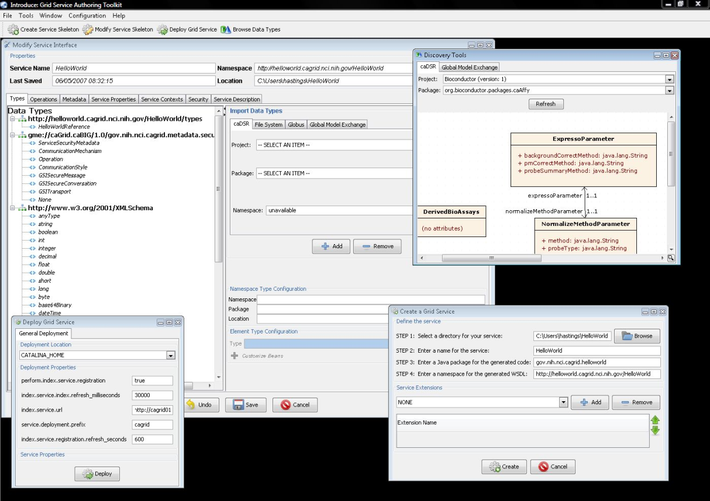
Introduce Graphical Development Environment (GDE)
GUI for creating and manipulating a grid service
  Provides means of simple creation of service skeleton that a developer can then implement, build, and deploy
  Automatic code generation of complete WSRF compliant grid service which is configured to provide:
    Security
    Advertisement
    Complete OO Client API
  Provides a set of tools which enable the developer to add/remove/modify/import methods of the service as well create sub-services/resources.
    Automatic code generation of all the required code, Globus grid service code/configuration, service configuration, implementation of the client, and stubbed implementation of the service

Slide 17
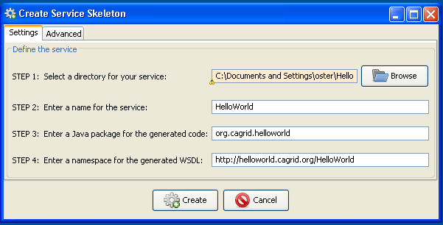
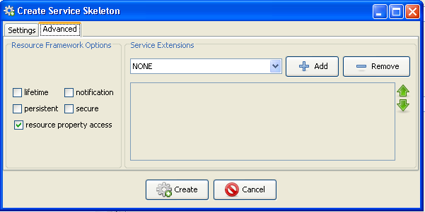
Service Creation
Populate required variables for service creation
  Creation Direction = directory to create the service
  Name = published service name
  Package = the java package you wish to use for your service
  WSDL Namespace = the namespace to be used to define the service interface and types
(Optional) Choose Extensions

Slide 18
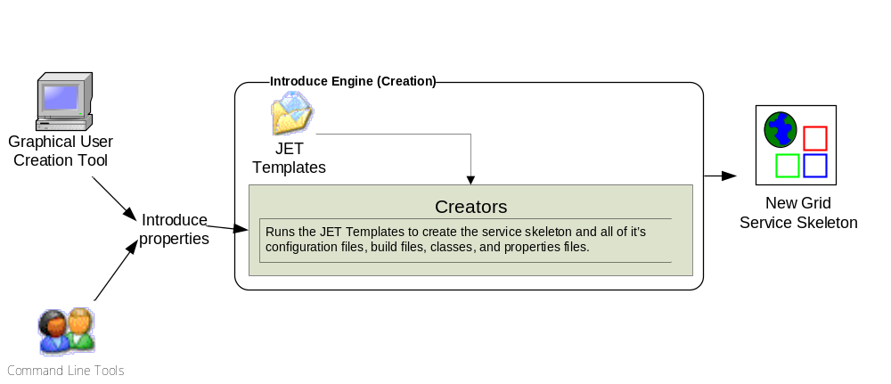
Introduce Service Creation Architecture
The Introduce Service Properties are a set if base properties
required for creating this service such as desired location to
create the service, namespace to use, package name to use,
and service name.

Slide 19
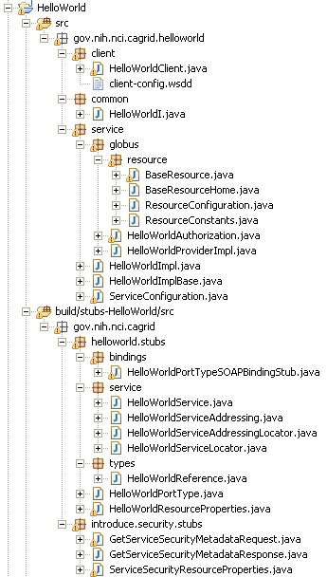
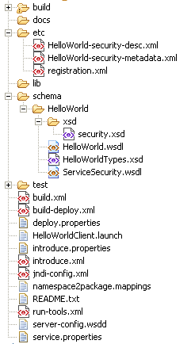
Created Skeleton Layout
= introduce managed
= globus/axis managed
= developer implements

Slide 20
Created Skeleton Layout (cont)
= implements the developer
defined interface and calls into
the generated client port type
stub.
= the developer defined grid
service interface
= manages the resources
of this grid service
= implements the port type
and calls into the actual
clean unboxed interface
the developer defined.
= developers implementation
of the defined interface.

Slide 21
Created Skeleton Layout (cont)
= service metadata registration configuration
= describes the services security configuration
= services WSDL file for axis
= introduce properties for this service
= ant build files
= client configuration file for axis
= deployment time service properties
= introduce representation of service
= JNDI service resources configuration
= namespace mappings for axis
= server configuration file for axis

Slide 22

Inside the Introduce created service
Services have many moving and configurable parts which support features such as:
  Advertisement
  Invocation
  Security (Authentication/Authorization)
  Stateful Resources
The Introduce Toolkit can keep all these features in sync as the developer creates and modifies the grid service

Slide 23
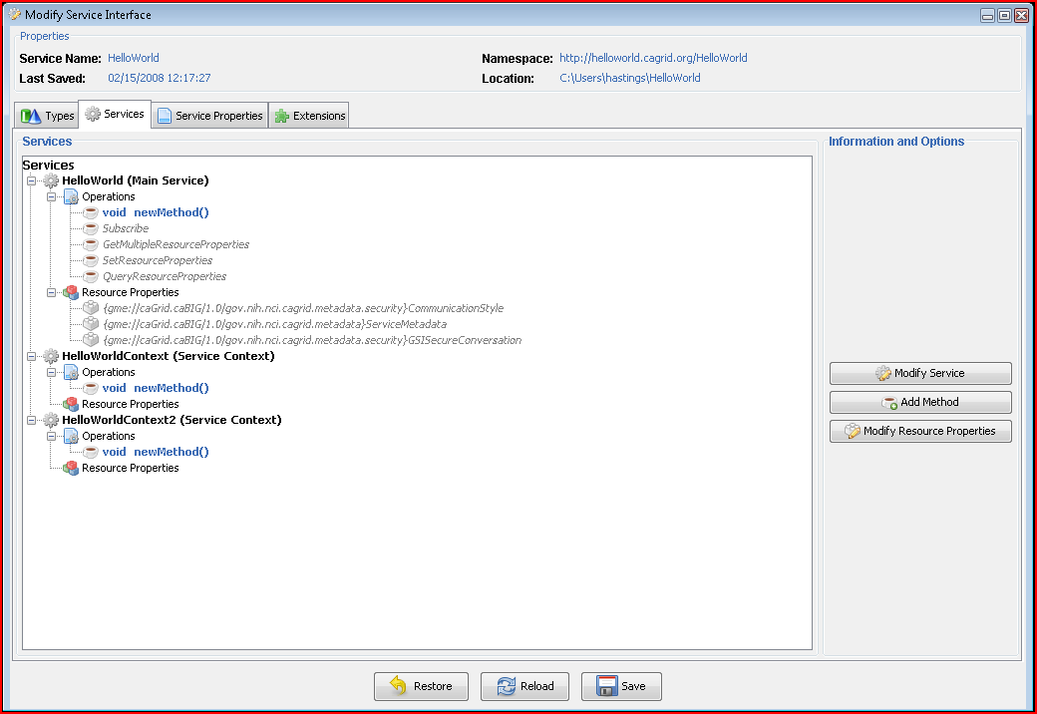
Modification
Add/Remove/Modify:
Operations
Resource properties
Service properties
Service contexts (services and resources)
Service, method, and resource level security settings

Slide 24
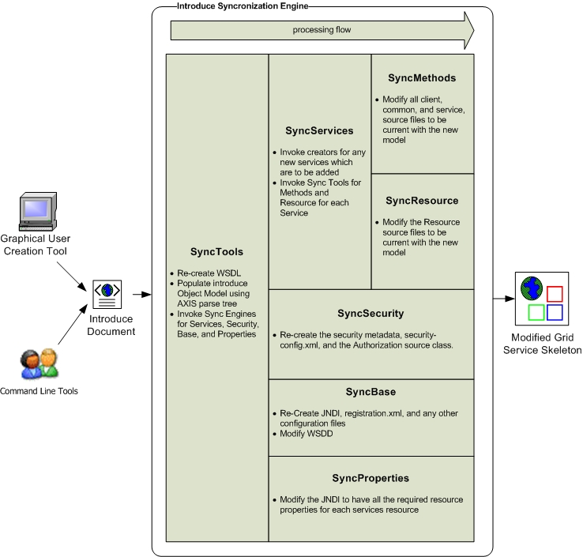
Introduce Service Modification Architecture
The Introduce Service Description document is the input to the introduce engine. The user can hand craft this document and call the engine via command line or API or can use the Introduce GDE to create and modify this document and execute the synchronization engine

Slide 25
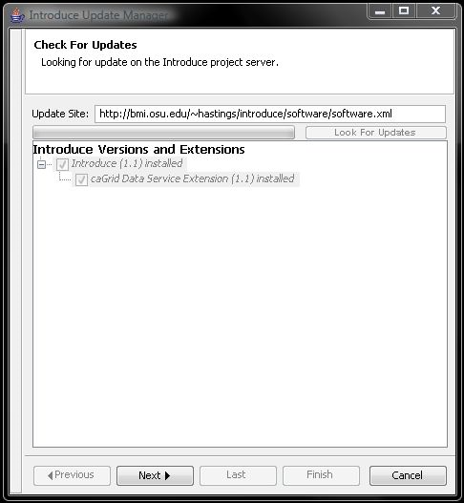
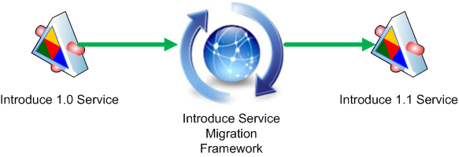
Introduce Service Migration
Introduce Service Migration Framework enables introduce and it’s extensions to provide upgraders which can run against services built with older versions of introduce and/or it’s extensions and migrate the services forward.

Slide 26
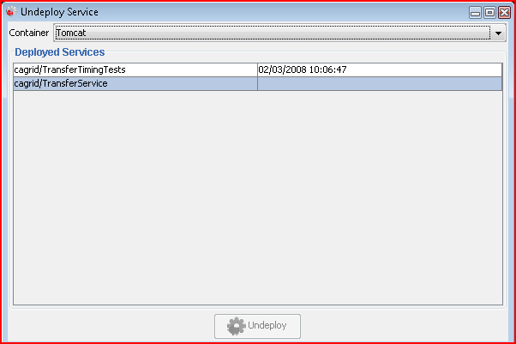
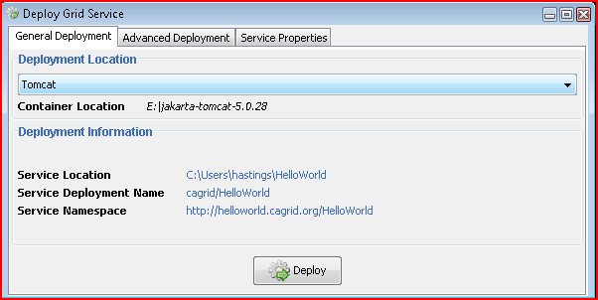
Service Deployment and Undeployment
Introduce provides support for graphically (and from the command line) deploying and undeploying services

Slide 27
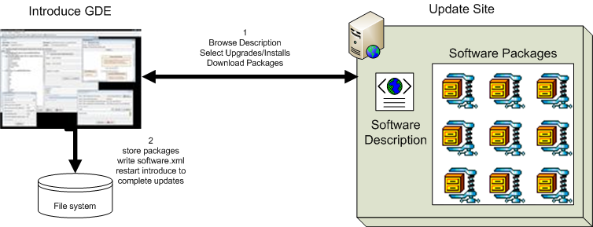
Introduce Software Updater
Update support enables introduce to role updates out and move to newer versions of itself and it’s extensions.

Slide 28
More Information
http://cagrid.org
  Tutorials
  Documentation
  Software Downloads
  Support Mailing Lists
  Much Much More

Slide 29

USING TAVERNA TO REALIZE CABIG WORKFLOWS

Slide 30
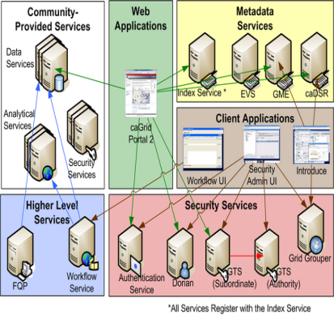
Why Taverna?
+
= ?
A primary goal of caBIG is to integrate a wide variety of distributed, cancer-related data and analytic resources virtualized as grid services.
Inevitably, users then want to interconnect multiple such services to perform more complex data collection and analysis tasks.
This type of workflow is data-flow oriented, and the need to support data-flow-oriented workflows was especially relevant when deciding on a solution for orchestrating workflows in caGrid.

Slide 31
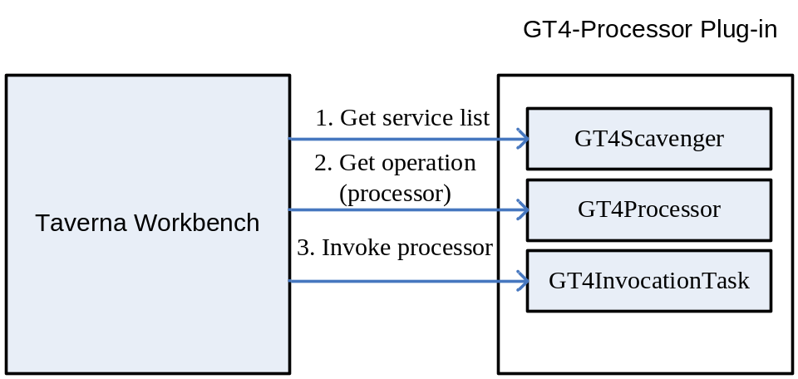
caGrid/GT4 Plug-in for Taverna
Processor: The concept of processor in a Taverna workflow is the same as the concept of task in a common workflow.
ProcessorTaskWorker: Each processor interface corresponds to a ProcessorTaskWorker interface. ProcessorTaskWorker interface defines the action that is to be performed at runtime when workflow execution reaches to that processor.
Scavenger: In Taverna, a scavenger is a logic collection of a set of processors. For example, a WSDL scavenger collects all the processors each of which corresponds to an operation defined inside that WSDL.

Slide 32
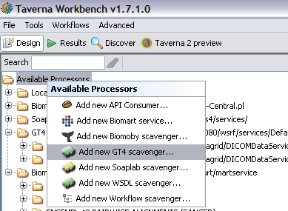
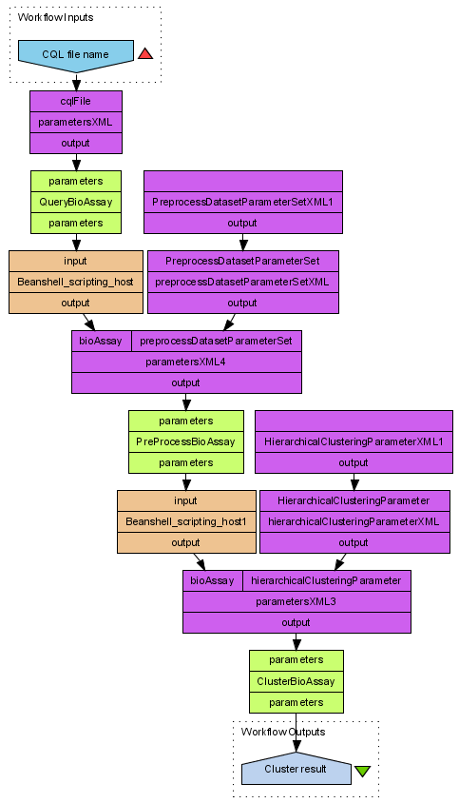
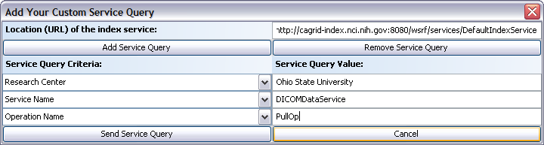
caGrid Plug-in for Taverna (cont’d)
A sample caGrid workflow
caGrid Scavenger with semantic/metadata
based caGrid service query
Notes:
The GT4 plug-in support semantic based service query. Users can input multiple (up to three, in current scenario three is enough. We can add more in our program upon request) service query criteria and input the corresponding value.
We can combine multiple criteria. The initial GUI only shows one query criteria, but more can be added by clicking “Add Service Query” button. For example, we can query the caGrid services whose “Research Center” name is “Ohio State University”, with Service Name “DICOMDataService”, and has operation “PullOp”.

Slide 33
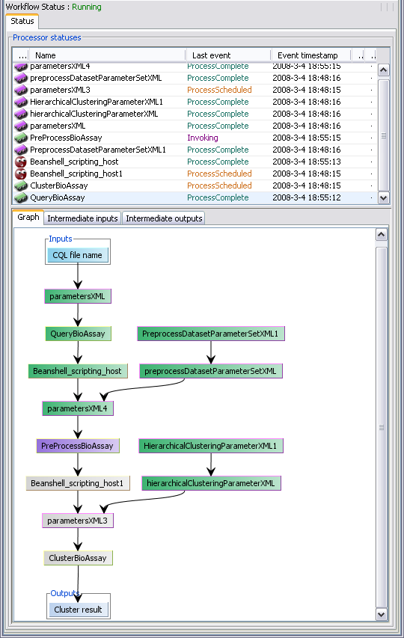
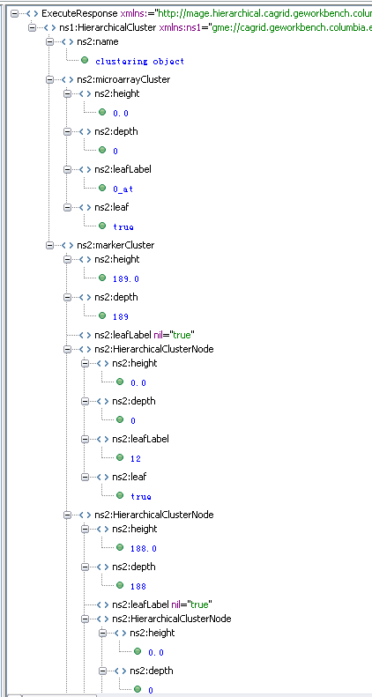
caGrid Plug-in for Taverna (cont’d)
Execution trace of the sample caGrid workflow

Slide 34
Lessons learned
Taverna has nice features in modeling data-intensive flows over other languages (like BPEL):
  Data does not need to be explicitly defined.
  Support for implicit iteration.
  A easy-to-extend invocation framework.
  A nice workbench integrates modeling/execution tooling.

Slide 35
Next Steps
Integrating WS-RF Resource Pattern in service invocation
Integrating Grid Security with Taverna
Semantic discovery of services
User acceptance.. We are going to try ☺
Remote Execution of the workflows

Slide 36
More Resources
An up-to-date online demo, showing the use of Taverna to model and execute caGrid workflows:
  https://webmeeting.nih.gov/p44387759/ (We STRONGLY recommend you to watch this first!!)
Taverna: http://taverna.sourceforge.net/
GT4 Plug-in download: http://www-unix.mcs.anl.gov/~madduri/taverna/
Create CaGrid Workflow Using Taverna http://www.cagrid.org/wiki/CaGrid:How-To:Create_CaGrid_Workflow_Using_Taverna

Slide 37
Discussion
Q & A
Contact us at Wei Tan wtan@mcs.anl.gov, Ravi Madduri madduri@mcs.anl.gov

