Slide 1
caGrid 1.3 Overview
John Eisenschmidt <eisenschmidtjw@mail.nih.gov>
caGrid Project Manager
April 2, 2009

Slide 2

caGrid Releases
caGrid 1.3 is a point release of the caGrid 1.x stream. Services and applications developed using caGrid {1.0, 1.1, 1.2}, will function against caGrid 1.3 versions of those services.
Version | Release Date
caGrid 0.5 | 31st August 2005
caGrid 0.5.1 | 7th October 2005
caGrid 0.5.2 | 15th November 2005
caGrid 0.5.3 | 25th January 2006
caGrid 0.5.4 | 12th May 2006
caGrid 1.0 Beta | 17th July 2006
caGrid 1.0 | 15th December 2006
caGrid 1.1 | 17th September 2007
caGrid 1.2 | 31st March 2008
caGrid 1.3 | 31st March 2009

Slide 3
caGrid 1.3 Core Services
All caGrid Core Services were redeployed on all caBIG® Grids
(OSU Training, QA, Stage, and Production) for this release.
The (12) caGrid 1.3 Core Services are:
* New for 1.3 ** Significantly Rewritten or Enhanced for 1.3
Metadata Services | Security Services | Business Activity Services
Global Model Exchange Service** | Authentication Service | Federated Query Processor Service**
Index Service** | Credential Delegation Service | BPEL Workflow Service
Metadata Model Service* | Dorian Service** | Taverna Workflow Service*
 | Grid Grouper Service
 | Grid Trust Service (Master & Slave)

Slide 4
Deprecated Services
During the development of caGrid 1.3, the caGrid Team issued a request for comments on, and adopted, a Deprecation Policy. For details, see:http://cagrid.org/display/caGrid13/Deprecated+Services+and+APIs
After adoption of that policy, the caGrid 1.2 caDSR, caGrid 1.2 EVS, and caGrid 1.2 GME were retired:
  caGrid 1.2 caDSR Service (based on caCORE 3.1)
    Replaced by the caDSR 4.0 Data Service and the new caGrid 1.3 Metadata Model Service (MMS)
  caGrid 1.2 EVS Service (based on caCORE 3.1)
    Superseded by EVS 4.1 Grid Service
  caGrid 1.2 GME Service
    Replaced by new GME service
These retired services will continue to operate until Q2 2009, when the caCORE 3.1 API is decommissioned.

Slide 5
Development Campaigns
The scope for this release came from requests entered into Gforge and feedback received from all the domain workspaces. Those tasks fell into one of seven development campaigns:
caBIG® Gold Compatibility
caCORE SDK Integration
Data Services
Introduce Toolkit
Security
Continuous Innovation
Bug Fixes

Slide 6
Gold Compatibility
Replacement of the Mobius Global Model Exchange (GME) with a new, refactored implementation.
  Supports schemas with cycles, includes, and redefines
Development of the new Metadata Model Service (MMS)
  Purpose: creation and semantic annotation of caGrid metadata models using caDSR-derived data
New Globus Index Service
  Embedded XML Database replaces in-memory persistence
  Design changes to improve performance and scalability
Registration of caGrid models in the caDSR (in process):
  CQL
  CQL Results
  Service and Security Metadata

Slide 7
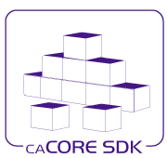
caCORE SDK Integration
Shared Libraries between SDK and caGrid:
  Common CQL for SDK and Data Services
  Common XMI reader in SDK and Introduce
Common Testing of caGrid and SDK
Data Service plug-in for SDK 4.1.1
Introduce upgrade to SDK 4.1.1

Slide 8


Data Services
CQL
  Added configurable query execution parameters, allowing only partial results to be returned
Significantly Enhanced Federated Query Processor (FQP)
  Support WS-Notification
  Support Credential Delegation (CDS)
  Out-of-band results (FQP + Transfer Service + WS-Enumeration)
  Performance enhancements, included multi-threaded queries

Slide 9

Introduce Toolkit
Security-related improvements
  More pluggable authorization
  Greater ability for client to control use of credentials
  Greater clarity of effect of options in GUI for security settings
Grid Grouper Introduce Authorization Extension
Service Upgrader
  1.1 -> 1.3
  1.2 -> 1.3
  No Updater for 1.0 -> 1.3

Slide 10
Security
Addition of Authentication Profiles, adding support for authentication beyond just “username/password”
  Support for one-time passwords profile included in this release
Ability to Discover Trusted Identity Providers
Move from issuing Proxy Certificates to Short-Term Certificates
Account Auditing to Dorian
WebSSO
Acegi client (CCTS)
Single sign-out
Author System Tests for WebSSO
Update the Sample Application, Build Process

Slide 11
Continuous Innovation
Support for CBIIT FY2008 Future Technology Stack
  http://www.cagrid.org/wiki/CBIIT:TechStack:FY2008
  Tomcat 5.5.27, JBoss 4.0.5
Refactored caGrid Installer
  Focused on desktop deployment (most common pattern)
  Installs: prerequisites, configures caGrid, and configures containers (current CBIIT technology stack)
  Does not deploy/configure services anymore
Expanded Independent Quality Assurance
  Significantly improved test coverage
  Most thoroughly tested version of caGrid ever
Complete redeployment of the NCI National Grid (all tiers)
  Ongoing work toward high-available deployment patterns for caGrid

Slide 12
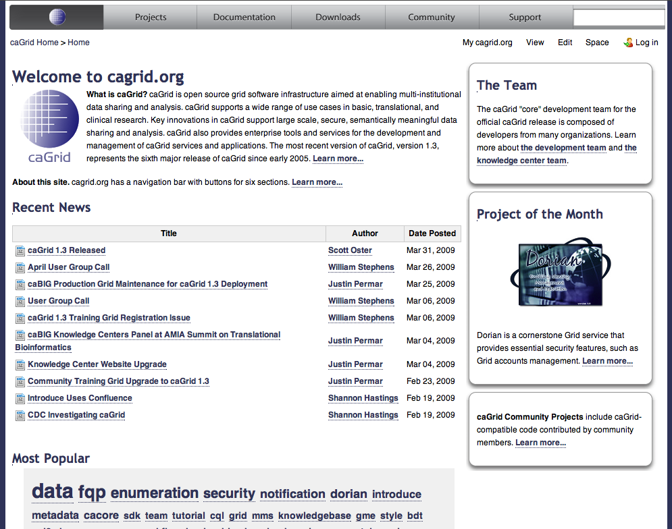
caGrid.org Wiki
caGrid 1.3 is first wiki-only release – no offline documents
caGrid.org wiki will continue to be the source of developer-written product documentation
caGrid KC Wiki will house higher level content supporting deployment, adoption, and integration scenarios
caGrid.org Wiki has been moved from Mediawiki to Conflence and content has been reorganized
Old content may still be accessed at http://mediawiki.cagrid.org

Slide 13
References
caGrid 1.3 Installation Instructions | http://cagrid.org/x/lyRM
caGrid 1.3 Installer | http://gforge.nci.nih.gov/frs/download.php/6357/caGrid-installer-1.3.zip
caGrid 1.3 Source Code | http://gforge.nci.nih.gov/frs/download.php/6354/caGrid-1.3.zip
caGrid 1.3 Documentation | http://cagrid.org/x/5YEX
caGrid 1.3 API Specifications | http://software.cagrid.org/caGrid-1.3-javadocs/
caGrid 1.3 Release Notes | https://gforge.nci.nih.gov/frs/shownotes.php?release_id=3288

Slide 14
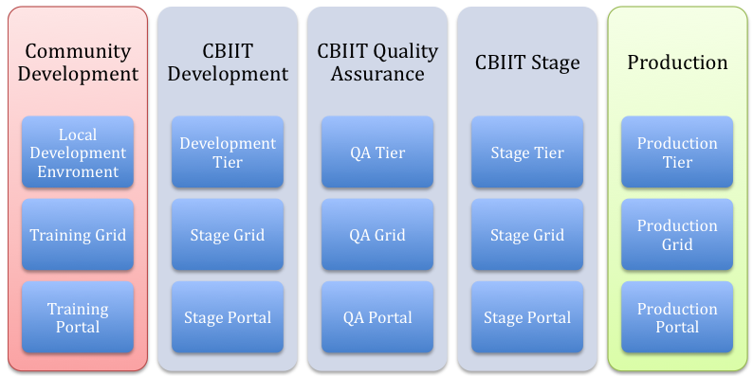
Tiers, Grids, and Portals

