Slide 1
caGrid Portal
2.0.2 Release
Architecture Workspace
July 11, 2008
John Eisenschmidt <eisenschmidtjw@mail.nih.gov>

Slide 2
Agenda
Portal Team Members
Release Notes
New Feature: EVS-based Discovery
New Feature: DCQL Query Builder
New Feature: caBIG™ Tools
  On caBIG™ Website
  In Portal
Coming Soon: Portal 2.0.2.1
Resources
Getting Support

Slide 3
caGrid Portal 2.0.2 Team Members
Product Management
Avinash Shanbhag
Development
Joshua Phillips
Manav Kher
Documentation
Carolyn Kelley Klinger
Quality Assurance
Aynur Abdurazik
Ye Wu
Project Management
Peter Yan
John Eisenschmidt

Slide 4
Release Notes
New Features and Updates
RFE Description
------------------------------------------------------------
11569 caGrid Portal Service Status Display on Home - Need Hosting Information
13232 Portal should delete services that are no longer advertising to the index
13600 Summary Portlet crashes if there is a service with invalid metadata
14508 Status Portlet should display timestamp of last aggregation
14930 Portal should display caBIG Tools and applications
14931 Portal query builder should support DCQL queries
14932 Portal should allow service discovery using concept codes from EVS
Bugs fixed Since Last Release
Bug Description
------------------------------------------------------------
14152 Icons are misaligned on the Portal map
13433 Scrolling of service list will lead to previously viewed service details
Known Issues Not Yet Fixed
* Some Portlets do not maintain strict screen width, and can get too wide and distort other portlets on the same page
* Service unbanning operation will sometimes fail for services that have been banned for a long time (greater than 4 days).
* Logged in users cannot see FQP results in Portal 2.0.2 (fixed in forthcoming 2.0.2.1)
https://gforge.nci.nih.gov/tracker/index.php?func=detail&aid=14997&group_id=25&atid=174
Reference: https://gforge.nci.nih.gov/frs/shownotes.php?release_id=2452

Slide 5
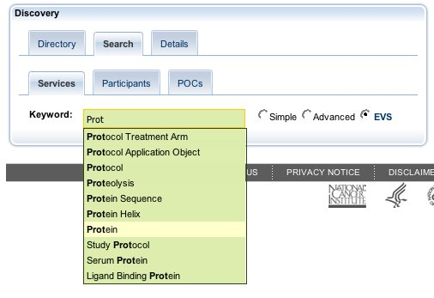
New Feature: EVS-based Discovery
Users can specify concept names from the NCI Thesaurus, then find services related to that concepts.
The concept-based discovery Portlet uses an intuitive autocompleter for looking up concepts.
  First loads concepts that are relevant to the services in the portal
  If a match isn’t found, it looks up concepts directly from the NCI Thesaurus.
Reference: http://gforge.nci.nih.gov/tracker/index.php?func=detail&aid=14932&group_id=25&atid=177

Slide 6
New Feature: DCQL Query Builder
The Data Service Query portlet allows users to:
  build and execute a query (CQL or DCQL)
  view the results in tabular form
  export your results to Microsoft Excel or XML form
If you are logged in, the portal maintains a complete history of your queries
Power users can start with the query builder, then refine their query in the Query XML view

Slide 7
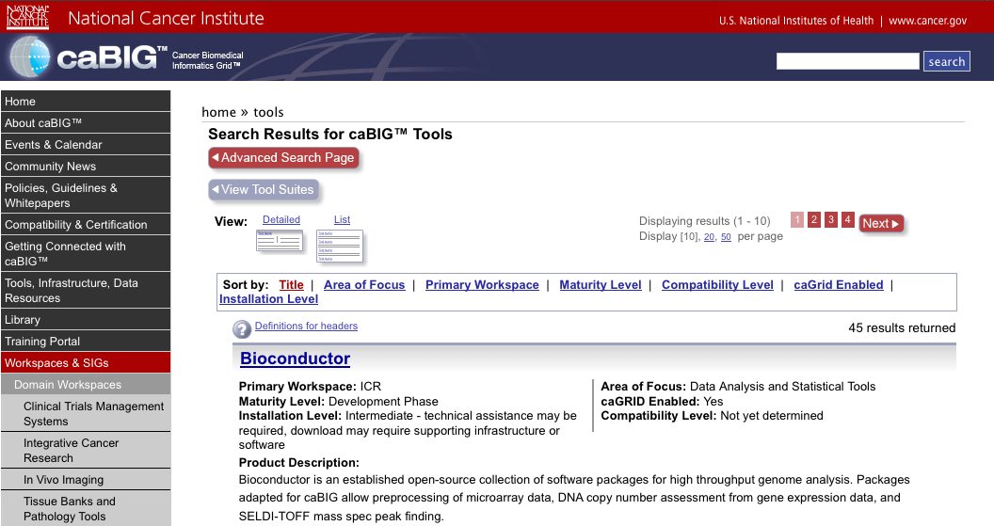
New Feature: caBIG™ Tools
Reference: https://cabig.nci.nih.gov/tools/toolfolder_view

Slide 8
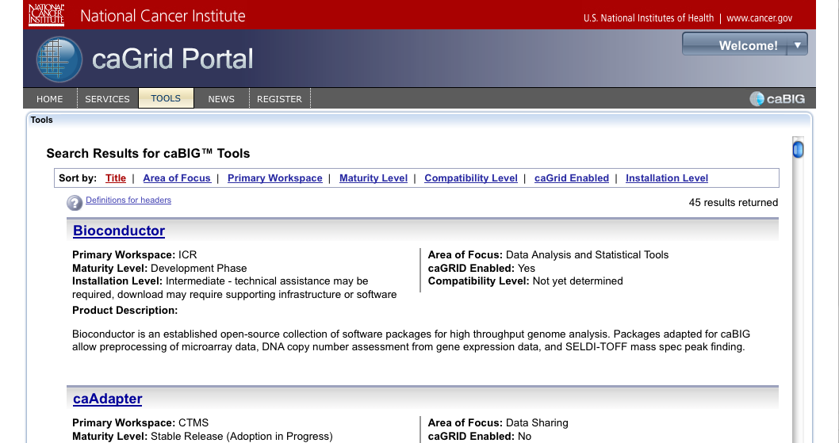
New Feature: caBIG™ Tools
Reference: http://cagrid-portal.nci.nih.gov/web/guest/tools

Slide 9
Coming Soon: Portal 2.0.2.1
Portal 2.0.2.1 will move into production any day to correct three small bugs discovered after Portal 2.0.2 was released:
Bug Description
------------------------------------------------------------
[15099] EVS search throws error in the browser
[14997] Logged in users cannot see FQP results in Portal 2.0.2
[14995] Share query button appears for DCQL queries
Reference: http://gforge.nci.nih.gov/frs/shownotes.php?release_id=2486

Slide 10
Resources
Documentation
Administrator Guide: http://gforge.nci.nih.gov/frs/download.php/4239/caGrid_Portal_2.0.2_AdminstratorsGuide.pdf
Installation Guide: http://gforge.nci.nih.gov/frs/download.php/4240/caGrid-Portal_2.0.2_InstallationGuide.pdf
User Guide: http://gforge.nci.nih.gov/frs/download.php/4274/caGrid-Portal_2.0.2_UsersGuide.pdf
caGrid.org Wiki: http://www.cagrid.org/wiki/Portal:Portal
Federated Queries using the portal (from Annual Meeting Hack-a-thon): http://www.cagrid.org/wiki/CaBIG:AnnualMeeting:2008:FederatedQueries:UsingPortal
Video
Demonstration of Portal 2.0.2 Functionality [QuickTime, 22.5MB, 16 min 41 sec]: http://gforge.nci.nih.gov/plugins/scmcvs/cvsweb.php/~checkout~/cagrid-1-0/Documentation/docs/portal/portal2/presentations/portal_movie_annual_meeting_2008.zip?rev=1.1;content-type=application%2Foctet-stream;cvsroot=cagrid-1-0

Slide 11
Getting Support
There are several ways to get assistance with, and provide feedback on, the caGrid Portal project:
Join the caGrid GForge Project at http://gforge.nci.nih.gov/projects/cagrid-1-0/ to view existing requests for enhancement and defects.
Post your questions to the caGrid_Users-L listserv (https://list.nih.gov/cgi-bin/wa?SUBED1=cagrid_users-l&A=1 )
Attend user group meetings: http://www.cagrid.org/wiki/CaGrid:FAQ#Is_there_a_user_community_for_caGrid.3F
Contact NCI CBIIT Application Support at ncicb@pop.nci.nih.gov
Get additional support information from the caGrid wiki: http://www.cagrid.org/mwiki/index.php?title=CaGrid:FAQ#How_can_I_get_support.3F

